Slide 1
PERINEAL POUCHES
Dr. k.c. shanthi
Assitant professor
Dept of anatomy ,vmkvmc

Slide 2
Superficial perineal pouch
It is an interfascial space
stretching between the pubic arch
situated below the perineal membrane.

Slide 3
boundaries
Above - perineal membrane
Below – fascia of colles
On each side - inner surface of ischio pubic ramus
Behind – is closed by fusion of perineal membrane with fascia of colles
Front – is open continuous with superficial inguinal space

Slide 4
Contents of the Superficial Perineal Pouch
Bulbospongiosus muscles - situated one on each side of the midline, cover the bulb of the penis and the posterior portion of the corpus spongiosum.

Slide 5
Their function is to compress the penile part of the urethra and empty it of residual urine or semen.
The anterior fibers also compress the deep dorsal vein of the penis, thus impeding the venous drainage of the erectile tissue and thereby assisting in the process of erection of the penis.

Slide 6
Ischiocavernosus Muscles
The ischiocavernosus muscles cover the crus penis on each side
The action of each muscle is to compress the crus penis and assist in the process of erection of the penis.

Slide 7
Superficial Transverse Perineal Muscles
The superficial transverse perineal muscles lie in the posterior part of the superficial perineal pouch
Each muscle arises from the ischial ramus and is inserted into the perineal body. The function of these muscles is to fix the perineal body in the center of the perineum

Slide 8
Vessels - two posterior scrotal vessels or labial vessels,
Transverse perineal vessels
Nerves - two posterior scrotal or labial branches of perineal nerve, perineal branch branch of posterior femoral cutaneous nerve

Slide 9
Other contents – crus penis or clitoridis
In male bulb of penis traversed by urethra
in female urethra and vagina in the middle, greater vestibular glands on each side of vagina.

Slide 10
Nerve Supply
All the muscles of the superficial perineal pouch are supplied by the perineal branch of the pudendal nerve

Slide 11
Perineal Body
This small mass of fibrous tissue is attached to the center of the posterior margin of the urogenital diaphragm.It serves as a point of attachment for the following muscles:
external anal sphincter
bulbospongiosus muscle
superficial transverse perineal muscles.

Slide 12
The perineal branch of the pudendal nerve on each side terminates in the superficial perineal pouch by supplying the muscles and skin

Slide 13
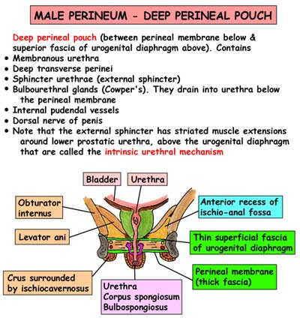

Slide 14
Contents of the Deep Perineal Pouch in the Male
the membranous part of the urethra
the sphincter urethrae
the bulbourethral glands
the deep transverse perineal muscles

Slide 15
the internal pudendal vessels and their branches,
the dorsal nerves of the penis.
Membranous Part of the Urethra
The membranous part of the urethra is about 0.5 in. (1.3 cm) long and lies within the urogenital diaphragm, surrounded by the sphincter urethrae muscle; it is continuous above with the prostatic urethra and below with the penile urethra

Slide 16
It is the shortest and least dilatable part of the urethra).
Sphincter Urethrae Muscle
The sphincter urethrae muscle surrounds the urethra in the deep perineal pouch. It arises from the pubic arch on the two sides and passes medially to encircle the urethra portion of the urethra.

Slide 17
Nerve Supply
The perineal branch of the pudendal nerve supplies the sphincter.
Action
The muscle compresses the membranous part of the urethra and relaxes during micturition. It is the means by which micturition can be voluntarily stopped.

Slide 18
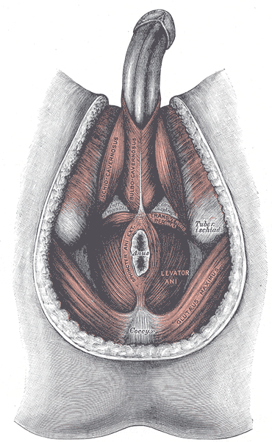

Slide 19
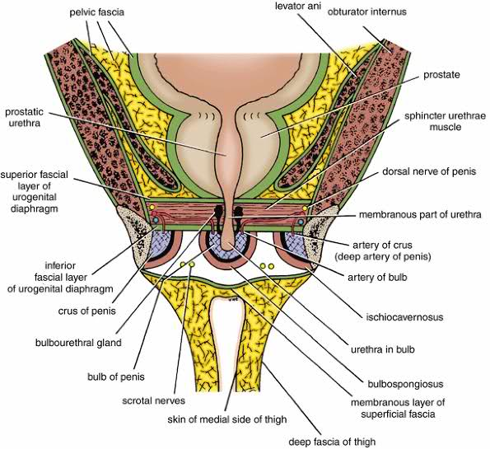

Slide 20
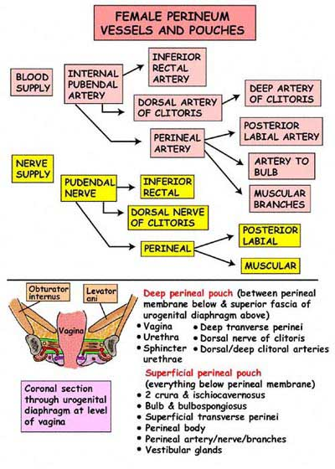

Slide 21
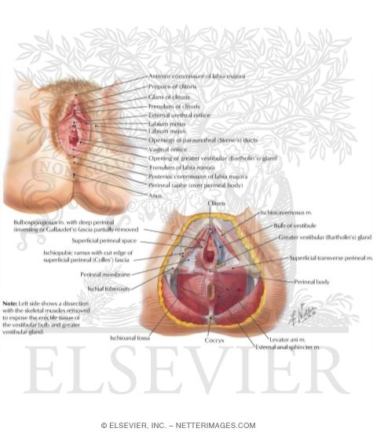

Slide 22
Thank you

