Slide 1
Anatomy of
BASAL GANGLIA
Dr. Deepti Shastri,
Professor & HOD,
Department of Anatomy,
VMKVMC, Salem

Slide 2
objectives
At the end of the session, you would be able to:
Name the basal ganglia and identify the ganglia in a cross section of brain
Mention the parts and location of the ganglia
Mention their blood supply
Explain their connections and functions

Slide 3
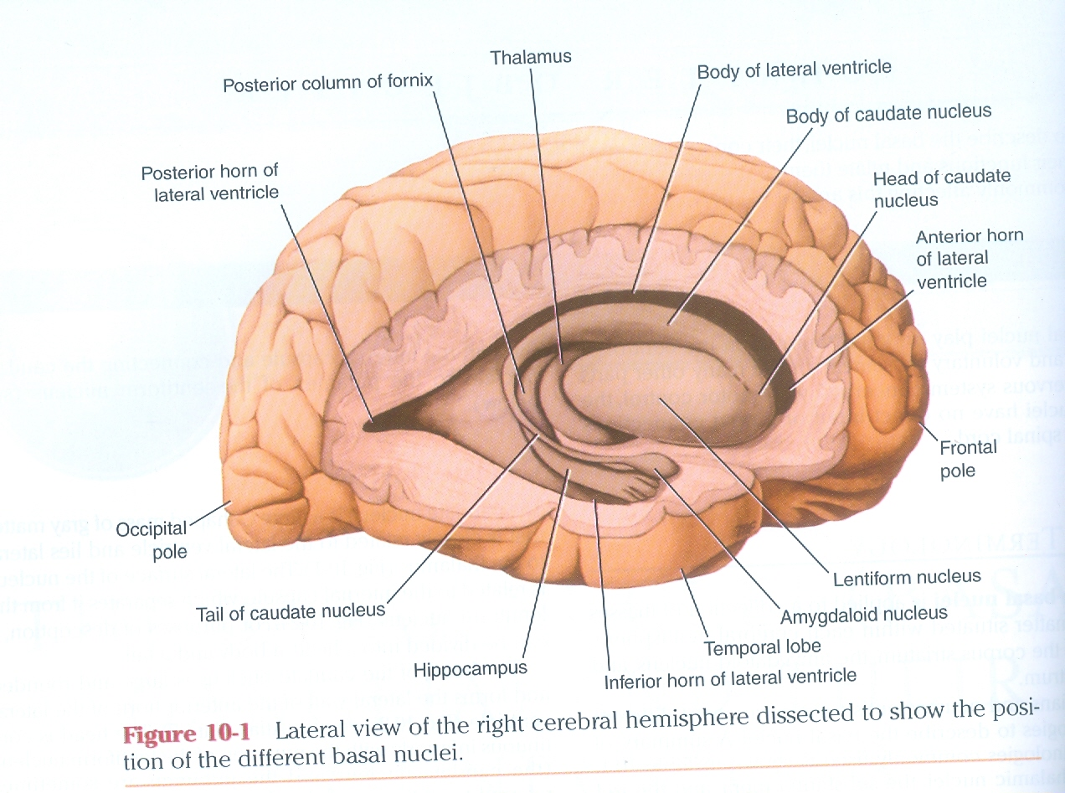

Slide 4
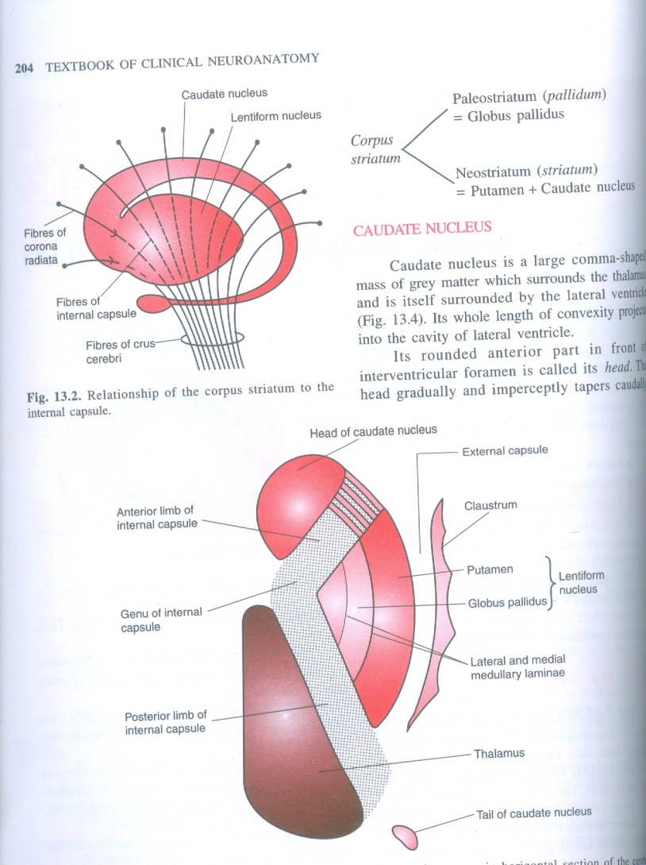
Amygdaloid body

Slide 5
Basal Ganglia
Introduction
Also called as Basal nuclei
The term is applied to a collection of subcortical masses of gray matter present within each cerebral hemisphere
Form important part of extrapyramidal pathway

Slide 6
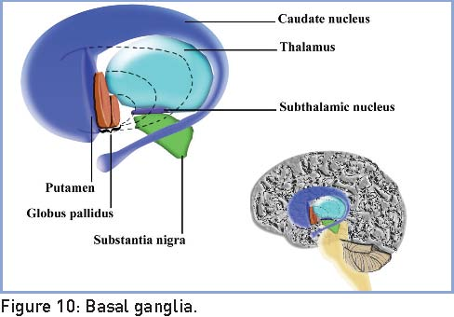
Basal Ganglia
They are :
Caudate nucleus
Lentiform nucleus
Claustrum
Amygdaloid body
Amygdaloid body

Slide 7
Basal Ganglia
Other closely related masses of gray matter:
Substantia nigra
Subthalamic nuclei
Ventral striatum
Ventral pallidum

Slide 8
BASAL GANGLIA
CLAUSTRUM
AMYGDALA
CORPUS STRIATUM
Archistriatum
NEO STRIATUM (STRIATUM)
PALEOSTRIATUM (PALLIDUM)
DORSAL STRIATUM
VENTRAL STRIATUM
DORSAL
PALLIDUM
VENTRAL PALLIDUM
CAUDATE NUCLEUS
NUCLEUS ACCUMBENS
GLOBUS PALLIDUS
ANTERIOR PERFORATED SUBSTANCE
PUTAMEN
LENTIFORM NUCLEUS

Slide 9
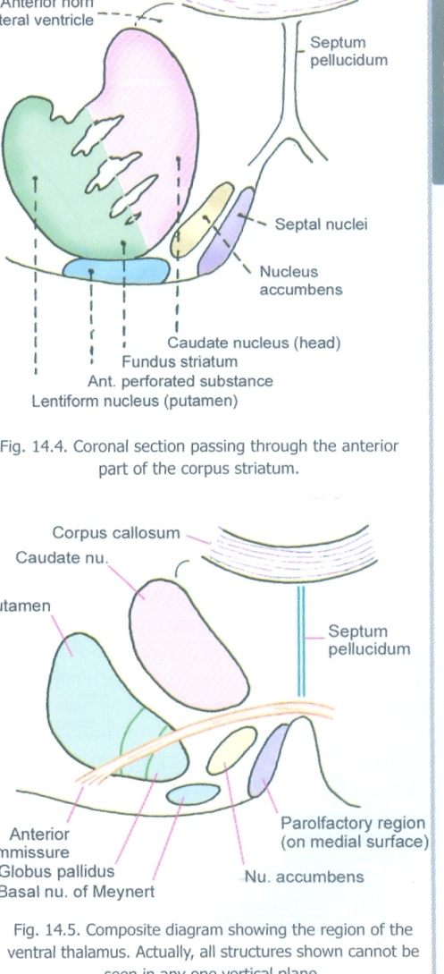

Slide 10
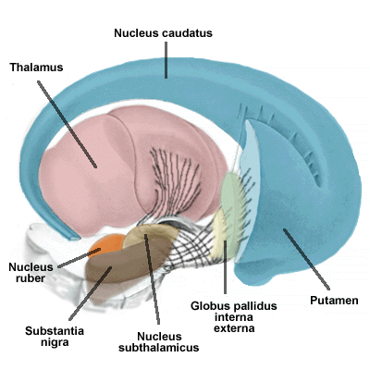

Slide 11
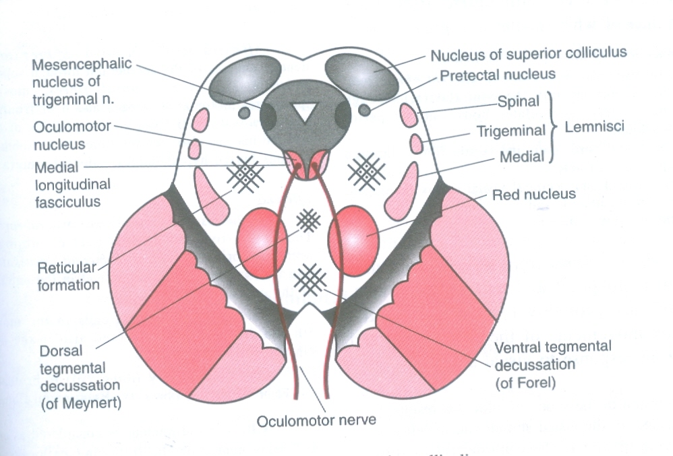

Slide 12
Basal Ganglia
Caudate nucleus
A large mass of gray matter
Lateral to thalamus
In the floor of lateral ventricle
Lateral to it is internal capsule & separates it from lentiform nucleus
Divided into head, body & tail

Slide 13
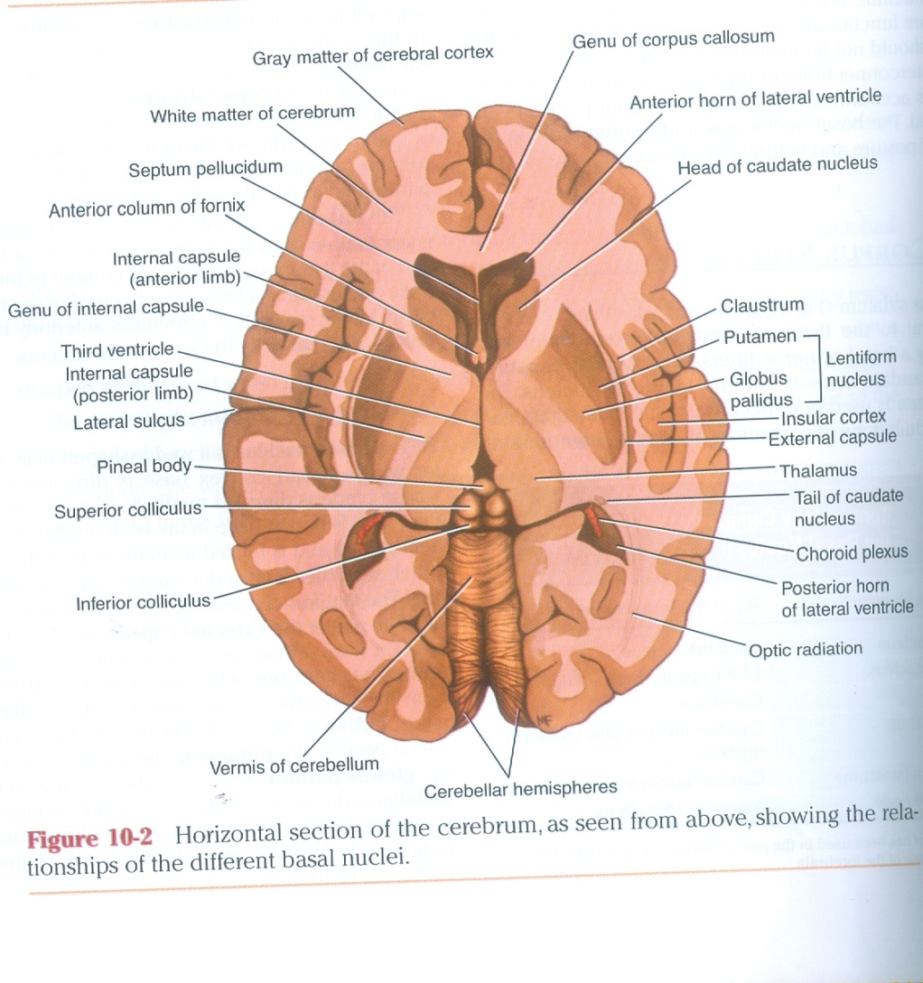

Slide 14
Basal Ganglia
Head of caudate nucleus
Large & rounded
Forms lateral wall of anterior horn of lateral ventricle
Continuous inferiorly with putamen of lentiform nucleus
Caudate nucleus & putamen together are called as Neostriatum
Strands of gray matter pass through internal capsule at the point of union of the two to give it a striated appearance hence called as corpus striatum

Slide 15
Basal Ganglia
Body of caudate nucleus
Long & narrow
Continuous with head at the level of interventricular foramen
Forms part of floor of body of lateral ventricle

Slide 16
Basal Ganglia
Tail of caudate nucleus
Long & slender
Continuous with body at the level of posterior end of thalamus
Follows lateral ventricle & lies in the roof of inferior horn of lateral ventricle
Terminates in amygdaloid body

Slide 17
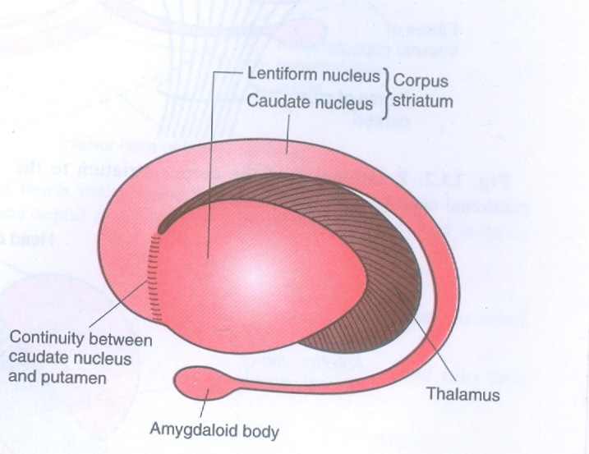

Slide 18
Basal Ganglia
Lentiform nucleus
Is a wedge shaped mass of gray matter
Base is directed laterally
Apex is medial
Related medially to internal capsule which separates it from caudate nucleus & thalamus
Related laterally to external capsule which separates it from claustrum
Divided by vertical plate of white matter into larger darker putamen & inner lighter part called globus pallidus
Putamen is continuous with head of caudate nucleus

Slide 19
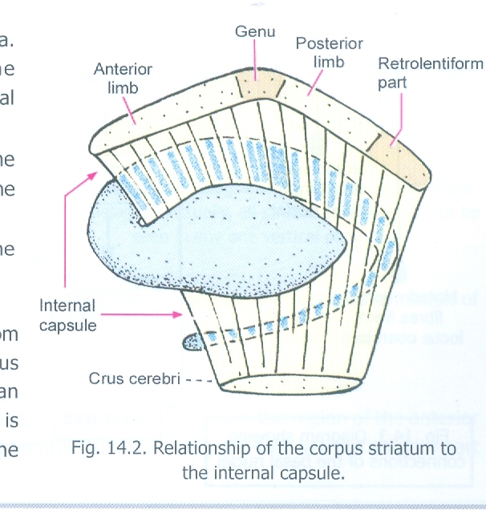

Slide 20
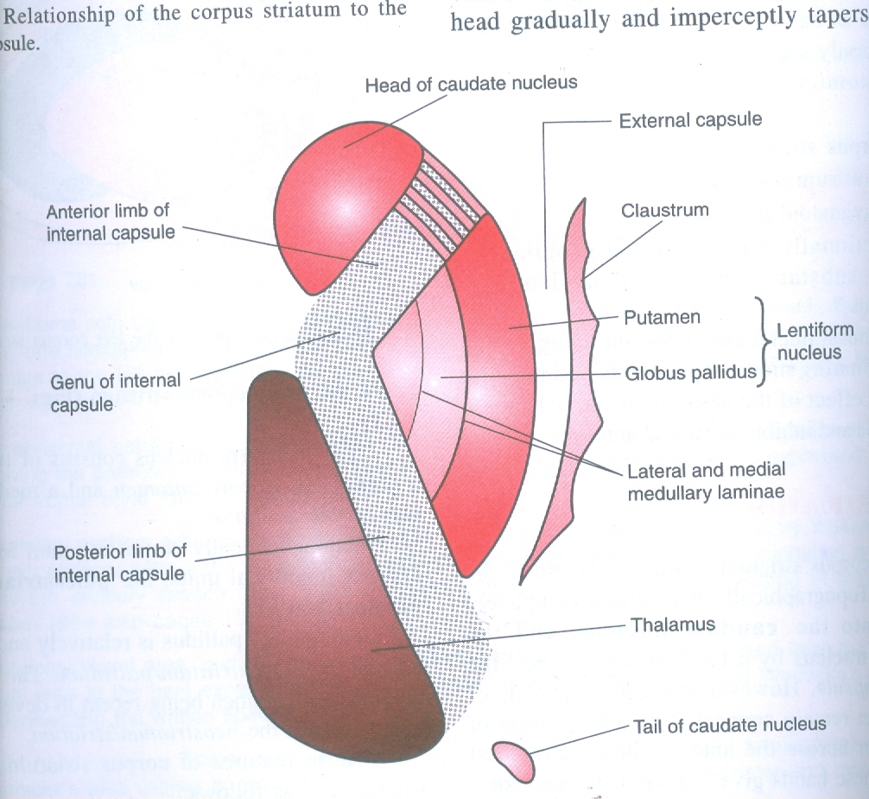

Slide 21
Basal Ganglia
Amygdaloid body
Present in temporal lobe of cerebrum close to uncus
Part of limbic system
Claustrum
Thin sheet of gray matter
Separated from lateral surface of lentiform nucleus by external capsule
Lateral to it is insula
Function not known

Slide 22
Basal Ganglia
Substantia nigra
In the midbrain
Part of cerebral peduncle
Consists of pars compacta & pars reticularis
Cells contain melanin & iron
Connected to corpus striatum

Slide 23
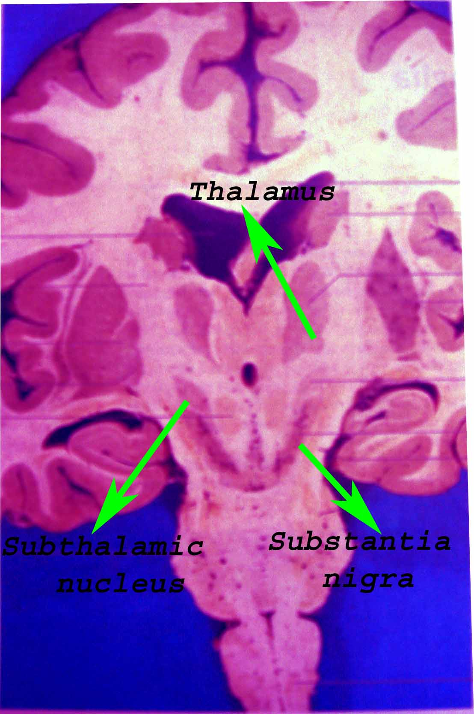
Basal Ganglia
Subthalamic nuclei
Connected to globus pallidus & substantia nigra
Ventral striatum
Nucleus accumbens
Ventral pallidum
Mass of gray matter near anterior perforated substance

Slide 24
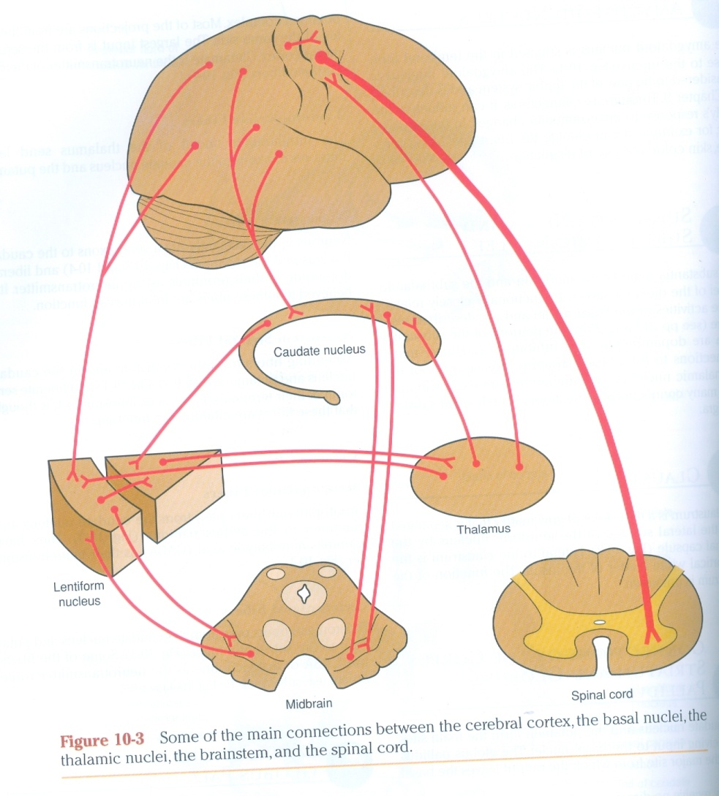

Slide 25
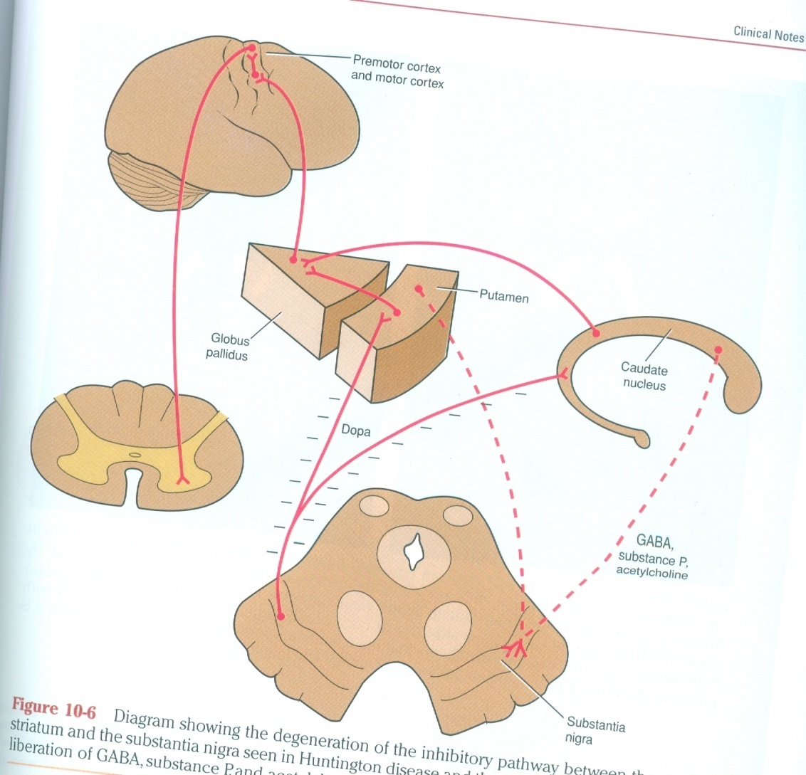

Slide 26

FUNCTIONS OF CORPUS STRIATUM
Controls muscle tone & helps to smoothen voluntary motor activities of the body

Slide 27
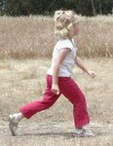
FUNCTIONS OF CORPUS STRIATUM
Controls automatic associated movements (swinging of arms during walking)

Slide 28
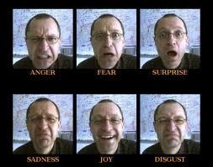
FUNCTIONS OF CORPUS STRIATUM
Controls group movements for emotional expressions

Slide 29
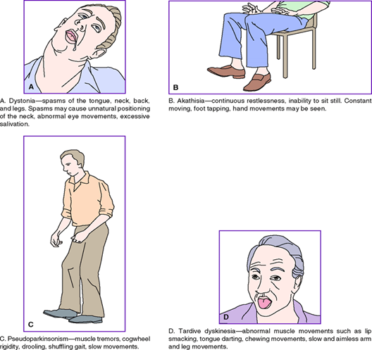
FUNCTIONS OF CORPUS STRIATUM
Influences premotor cortex which in turn controls extrapyramidal activities

Slide 30
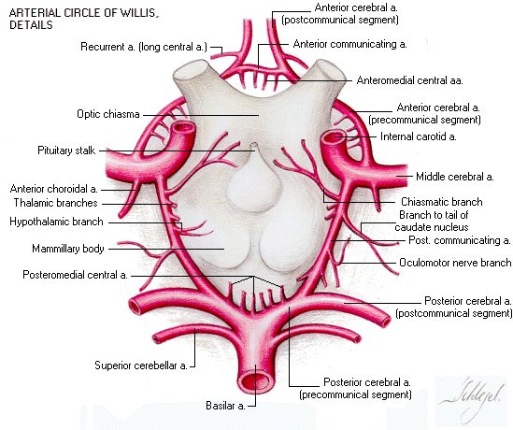

Slide 31
Blood supply
Central branches of Circle of Willis
Anterolateral branches of Middle cerebral artery
Medial striate & lateral striate arteries
Recurrent branch of anterior cerebral artery
Anterior choroid artery

Slide 32
THANK YOU

