Slide 1
INGUINAL CANAL

Slide 2
INGUINAL CANAL
It is a musculo aponeurotic tunnel about 4 cm in length.
It extends from the deep inguinal ring to the superficial inguinal ring.
The canal is directed downwards forwards and medially, above and parallel with the medial half of the inguinal ligament.

Slide 3
INGUINAL CANAL
The deep inguinal ring is an oval opening in the fascia transeversalis.
Situated 1.25 cm above the mid inguinal point.
Immediately lateral to the stem of inferior epigastric artery.

Slide 4
SUPERFICIAL INGUINAL RING
A triangular gap in the External Oblique Aponeurosis.
The base is formed by pubic crest.
The two sides of the triangle form the Lateral or Lower, Medial or upper margins of the opening.
It is 2.5 cm long and 1.2 cm broad at the base.
These margins are called crura.
At and beyond the apex of the triangle the two crura are united by inter crural fibres.

Slide 5
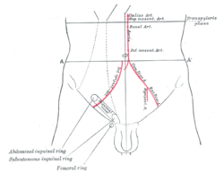
r

Slide 6
PECULIARITES
In the female the canal is narrow hence chances of inguinal hernia is less.
In the new born the canal is directed almost straight forwards, because muscles of the anterior abdominal wall are not properly differentiated.

Slide 7
CONTENTS
Spermatic cord in the males or Round ligament of uterus in the females (Entire content).
Ilio inguinal nerve (Partial content).
The nerve enters the canal by piercing the internal oblique muscle about 2.5 cm. below and medial to the anterior superior iliac spine.
It is superficial to the spermatic cord.
It leaves the canal through superficial ring.
It is a mixed nerve conveying fibres from the ventral ramus of L1 but after piercing the Internal oblique it conveys sensory fibres only

Slide 8
BOUNDARIES
Inguinal canal has
Anterior wall.
Posterior wall.
Roof.
Floor.

Slide 9
BOUNDERIES
Anterior wall-
Skin
Superficial fascia
Aponeurosis of external oblique muscle
Lateral 1/3 is formed by fleshy fibres of Internal oblique.(Inguinal Fibres).

Slide 10
POSTERIOR WALL
Formed wholly by Fascia Transeversalis.
Medial half of conjoint tendon.
Medial ¼ by reflected part of inguinal ligament.

Slide 11
ROOF
Arched fibres of Internal oblique.
Transeversus Abdominis.

Slide 12
FLOOR
GROOVED UPPER SURFACE OF Inguinal ligament.
Fascia Transeversalis.
At the medial end lacunar ligament.

Slide 13
DIRECTION OF THE CANAL
OBLIQUE- DIRECTED DOWNWARDS, FORWARDS AND MEDIALLY.

Slide 14
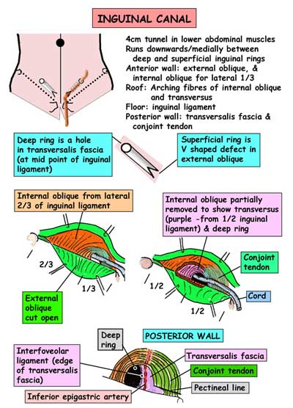

Slide 15
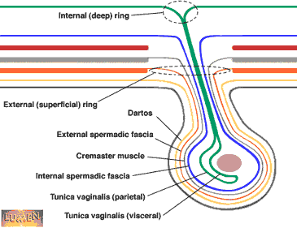
m

Slide 16
STRUCTURES ENTERING THROUGH THE CANAL
SPERMATIC CORD IN THE MALE.
ROUND LIGAMENT OF UTERUS IN THE FEMALES.

Slide 17
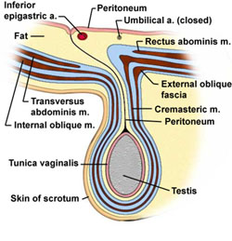
e

Slide 18
DEFENSIVE MECHANISM OF INGUINAL CANAL
(SHUTTER MECHANISM)
The Inguinal canal is oblique. the superficial and deep rings are situated at different places.
In increased intra abdominal pressure the posterior wall is pushed forwards and comes in contact with the anterior wall and the canal is obliterated.
This is known as flap valve mechanism.

Slide 19
DEFENSIVE MECHANISM
The arched fires of internal oblique and the transeversus act as demi sphincters in increased intra abdominal pressure .
The canal is obliterated by bringing the roof in contact with the floor of the canal.
This is known as Sir Arthur Keith’s shutter mechanism.

Slide 20
MECHANISM OF INGUINAL CANAL
Opposite the deep ring the anterior wall of the canal is strengthened by the fleshy fibres of the Internal oblique muscle.
Opposite the Superficial ring the posterior wall is strengthened by conjoint tendon and reflected part of inguinal ligament.

Slide 21
MECHANISM OF INGUINAL CANAL
Cremasteric plug-in increased intra abdominal pressure the cremasteric muscle in male contracts.
This will pull up the testes and spermatic cord.
This will plug or block the superficial inguinal ring.
Thus the outlet of the canal is closed like a plug.
This is known as ball valve mechanism

Slide 22
INGUINAL CANAL-MECHANISM
When abdominal muscles contract, the Deep inguinal ring moves upwards and laterally.
This will elongate the canal and lumen becomes narrow.
Hormones may play a role in maintaining the tone of inguinal musculature.

Slide 23
DEVELOPMENT OF INGUINAL CANAL.
The canal is formed by the descent of gubernaculum of testes or ovary.
The canal is formed before the descent of the testes.

Slide 24
APPLIED ANATOMY
INGUINAL HERNIA
When an abdominal content covered by a sac enters the inguinal canal abnormally it is known as Inguinal Hernia.
Contents of the hernial sac vary from a piece of omentum to small or large gut.
When meckel’s diverticulum enters the hernial sac it is known as LITTRE’S HERNIA.
The hernia is of two types-indirect (Oblique)and Direct.

Slide 25
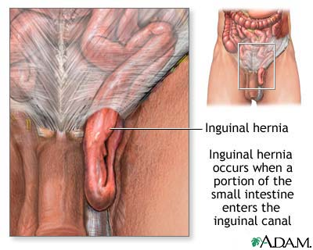
The test

Slide 26
INDIRECT HERNIA
Are of two types.
Complete and
Incomplete.
Indirect or oblique inguinal hernia—when hernia occurs through deep inguinal ring into the canal. It lies lateral to the inferior epigastric artery.

Slide 27
INGUINAL HERNIA
COMPLETE-When hernia passes through superficial inguinal ring and reaches the scrotal sac.
INCOMPLETE—When hernia does not pass through superficial inguinal ring but remains above the ring but within the canal.

Slide 28
COVERINGS OF INDIRECT HERNIA(COMPLETE)
FROM OUTSIDE INWARDS.
Skin.
Dartos muscle (absent when incomplete).
External spermatic fascia.
Cremasteric muscle and fascia.
Internal spermatic fascia.
Extra peritoneal tissue.
Peritoneal sac

Slide 29
TYPES OF OBLIQUE INGUINAL HERNIA
Vaginal—when processus vaginalis persists and contents of the hernia pass through it into the scrotum.
Funicular-processus vaginalis is obliterated above the testis and remains patent in proximal part. This is the most common type.
Infantile.
Interstitial.

Slide 30
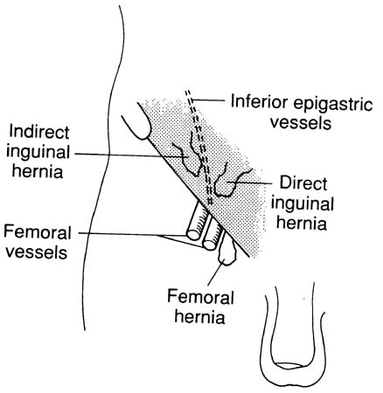

Slide 31
DIRECT INGUINAL HERNIA
When the hernia occurs in HESSELBACH’S triangle or Inguinal triangle and lies medial to Inferior epigastric artery.

Slide 32
HESSELBACH’S TRIANGLE
BOUNDARIES.
Medially—Lateral border of rectus abdominis.
Laterally-Inferior Epigastric artery.
Base—Inguinal ligament.
The triangle is subdivided into medial and lateral part by obliterated umbilical artery

Slide 33
DIRECT INGUINAL HERNIA
SUBDIVISIONS.
MEDIAL—Medial to obliterated umbilical artery.
LATERAL—Lateral to obliterated umbilical artery.
So direct inguinal hernia may be either medial or lateral.

Slide 34
COVERINGS
LATERAL TYPE-same as indirect hernia.
In place of cremasteric fascia --cremasteric fascia and muscle.
Fascia transeversalis in place of internal spermatic fascia.
MEDIAL TYPE-same as lateral type except cremasteric fascia and muscle.
Between external spermatic fascia and fascia transeversalis the following layers will be present.
Reflected part of Inguinal ligament.
Deep to above conjoint tendon,also known as falX Inguinalis.

Slide 35
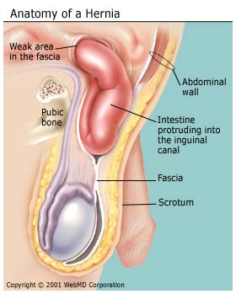

Slide 37
THANK YOU

