Slide 1
Histology of Salivary glands

Slide 2
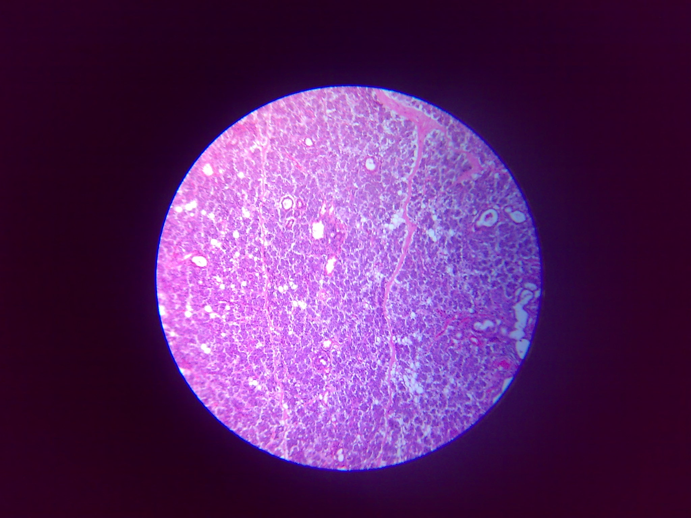
Serous salivary gland
Connective tissue stroma
Serous acini
Intralobular duct
Interlobular duct
10X10 magnification

Slide 3
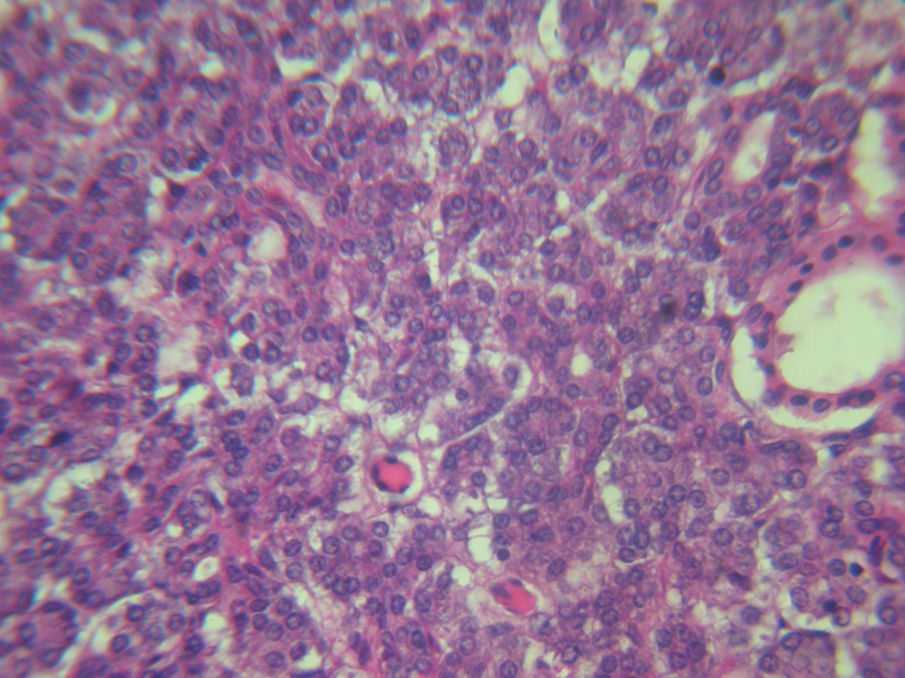
Intercalated duct
Striated duct
Serous acinus
10X40 magnification

Slide 4
Points for Identification
Serous acini lined by pyramidal shaped cells with round basal nuclei and strongly eosinophillic cytoplasm
Intralobular & interlobular ducts are present
E.g., Parotid gland

Slide 5
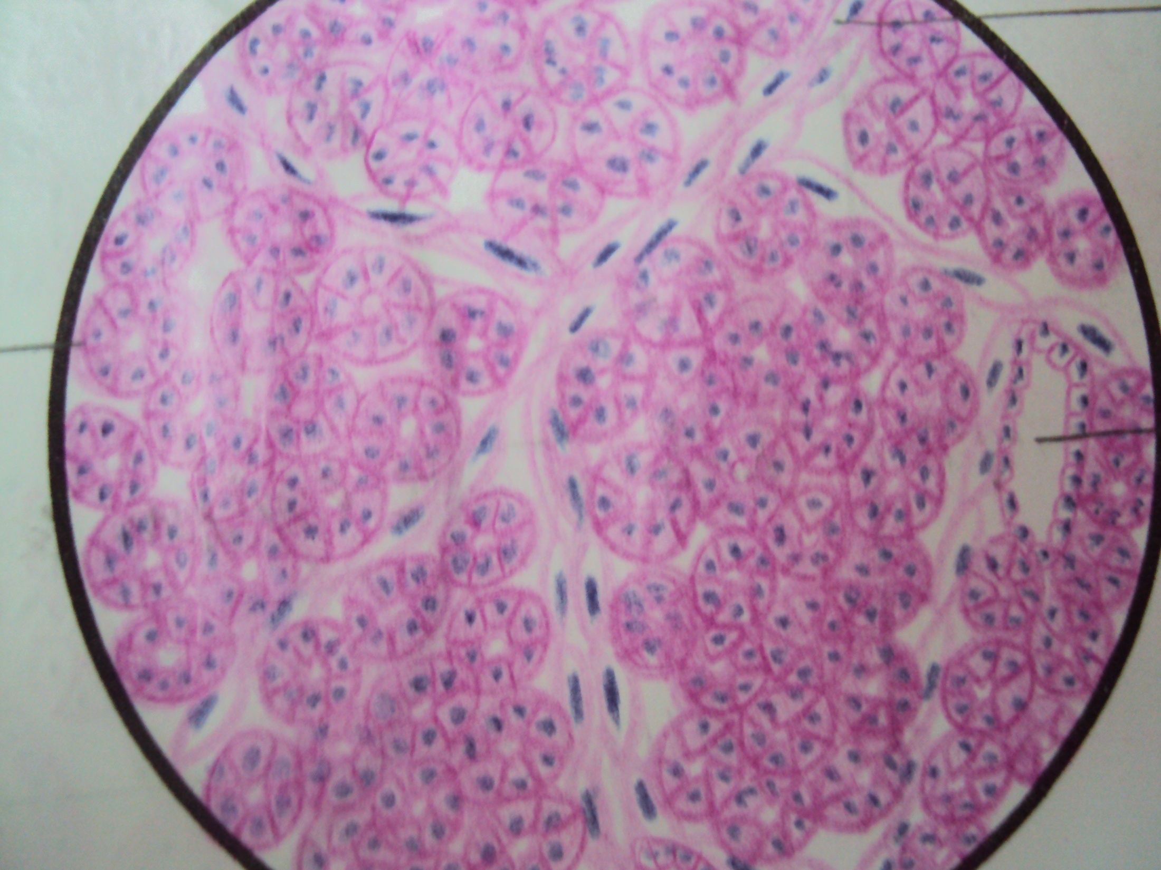
Serous salivary
gland
Serous acinus
Interlobular duct

Slide 6
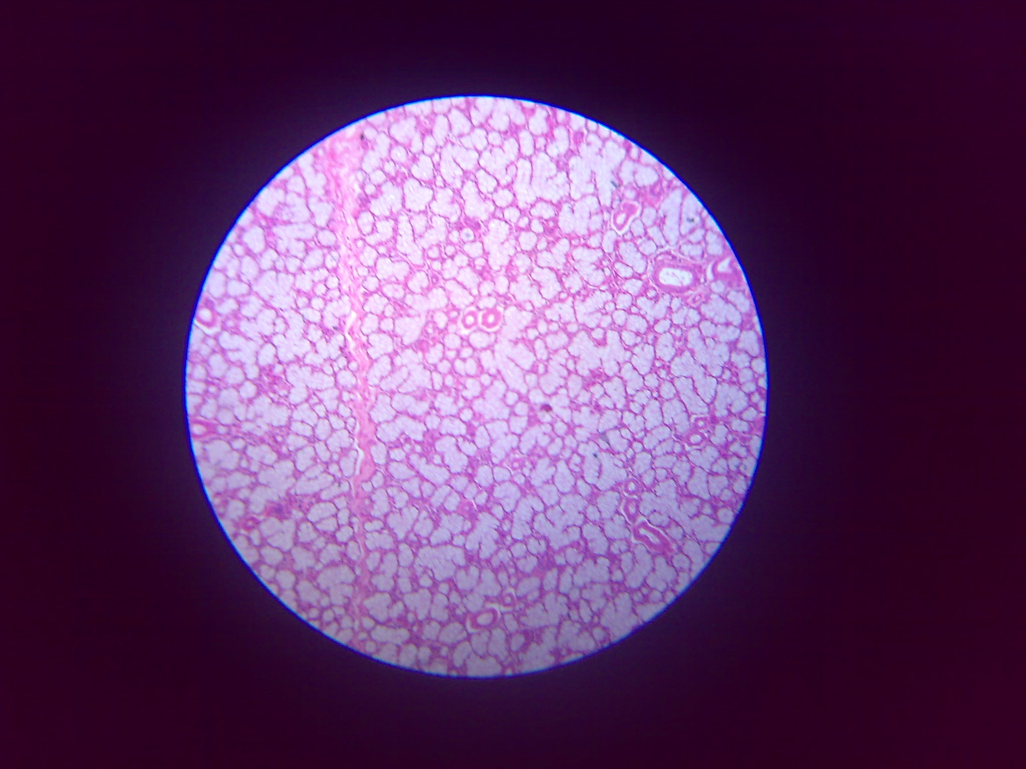
Mucous salivary gland
C.T. Septa
Intralobular duct
Mucous acinus
10X10 magnification

Slide 7
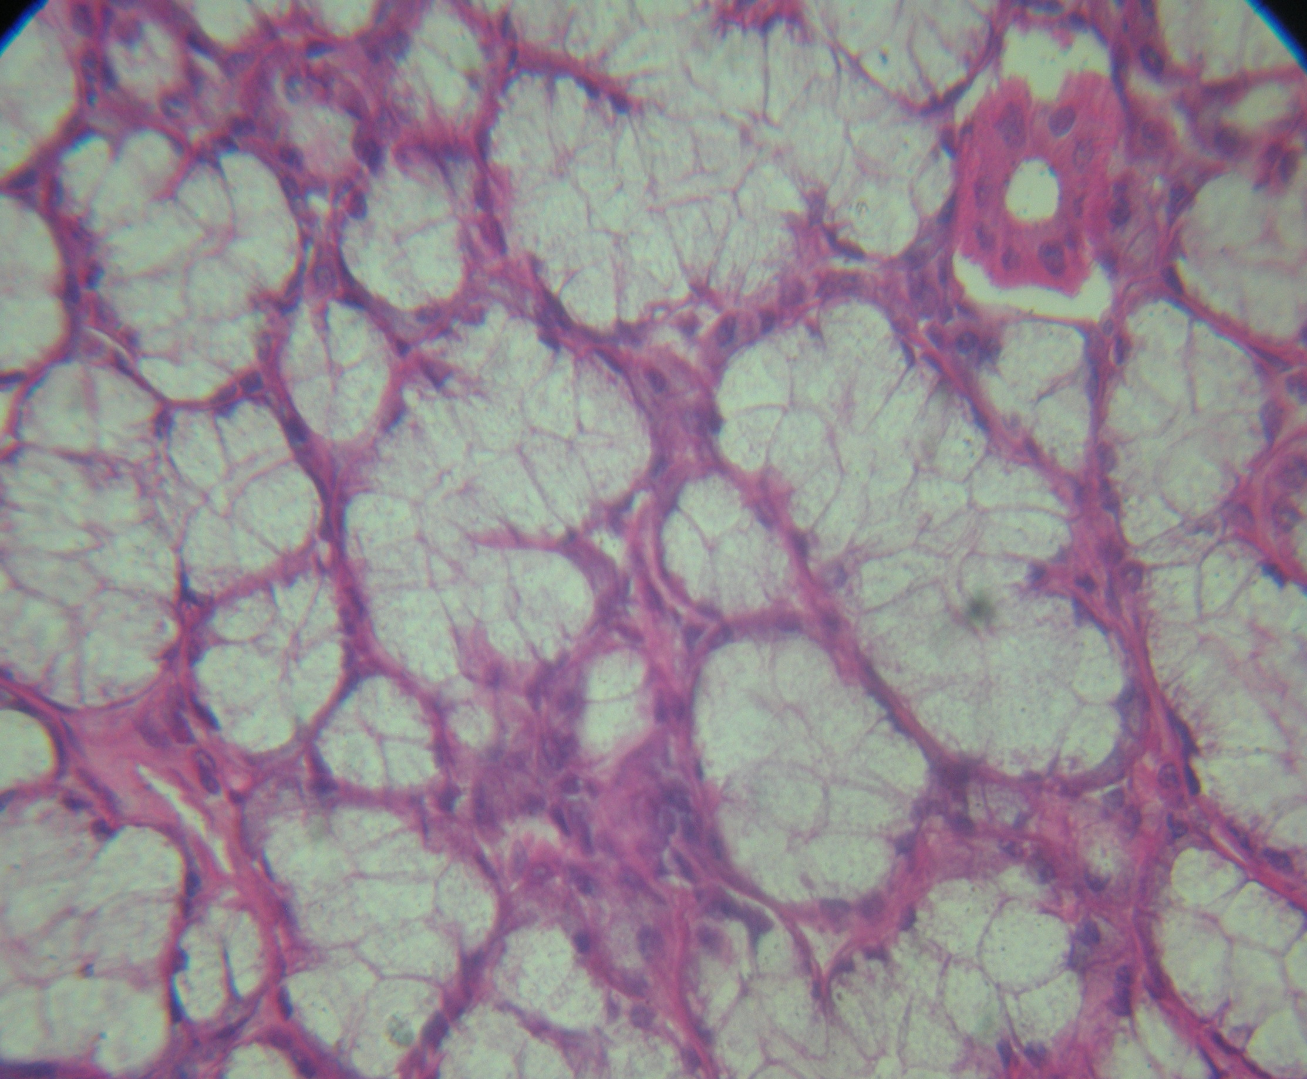
Intralobular duct
Mucous acinus
Serous demilune
10X40 magnification

Slide 8
Points for Identification
Mucous acini are lined by columnar cells
with pale staining cytoplasm
Intralobular and interlobular ducts are present
E.g., Sublingual salivary gland

Slide 9
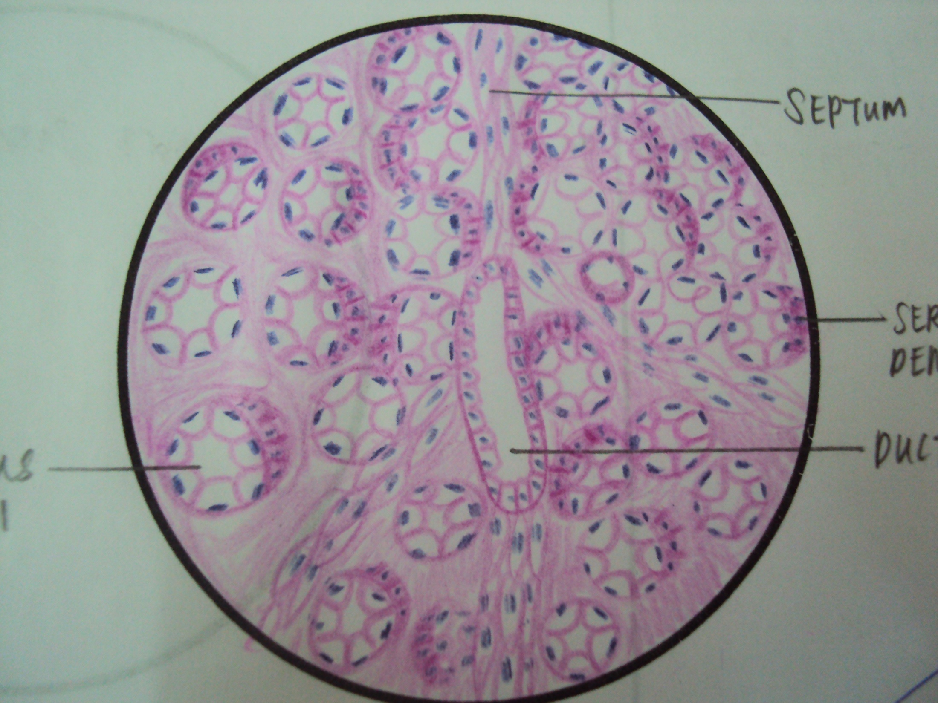
Mucous salivary gland
Mucous acinus with serous demilune
Serous demilune
Mucous acini
Inter-lobular duct

Slide 10
Thank You

