Slide 1
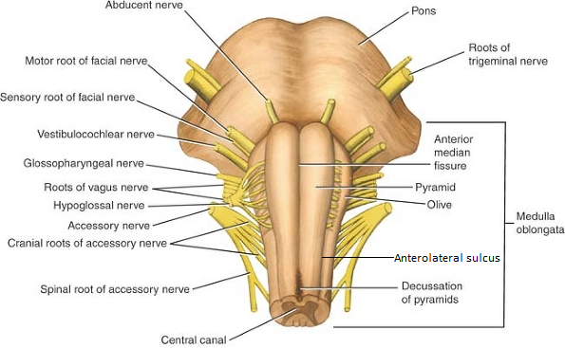
Basilar groove
Spotters - Pons
Pons
Pontomedullary junction
Middle cerebellar peducle

Slide 2
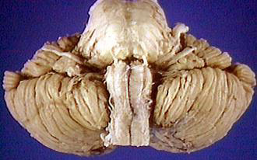
1. Identify the pinned structure.
Answer: Pons
Name the cranial nerve nuclei present in it.
V (Trigeminal nerve)
Principal sensory nucleus
Motor nucleus
Mesencephalic nucleus
Spinal nucleus
VI – Abducent nucleus (motor)
VII (Facial nerve)
Motor nucleus
Superior salivatory nucleus
Lacrimatory nucleus
Nucleus of tractus solitarius (in medulla)
VII – Vestibular & cochlear nuclei
Mention its blood supply.
Pontine branches of basilar artery
Superior cerebellar artery
Anterior inferior cerebellar artery
1

Slide 3
2. Identify the pinned groove.
Answer: Basilar sulcus
Name the structure which is related to it.
Answer: Basilar artery
Mention its branches
Pontine artery
Anterior inferior cerebellar artery
Labyrinthine artery
Superior cerebellar artery
Posterior cerebral artery
2
3
4
3. Identify the pinned structure.
Answer: Middle cerebellar peduncle
Mention the tract passing through it.
Corticopontocerebellar tract
4. Identify the pinned area.
Answer: Pontomedullary junction
What are the nerves related to it?
VI, VII & VIII cranial nerves

