Slide 1
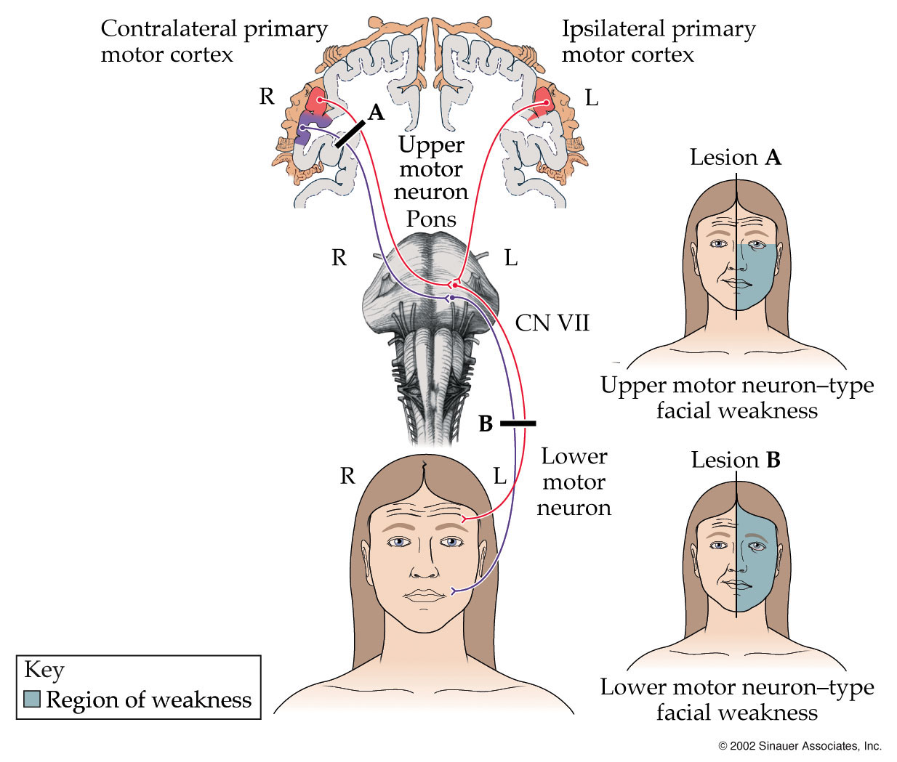

Slide 2
PONS
Dr. Deepti Shastri
Deputy Dean
Professor & Head
Department of Anatomy
Vinayaka Mission’s Kirupananda Variyar Medical College & Hospitals, Salem

Slide 3
Objectives
At the end of this session, you will be able to:
Describe the parts of pons
Mention the tracts & their location in the pons
Enumerate the cranial nerve nuclei in pons
Mention the accessory nuclei in pons
Identify & label transverse sections of lower & upper part of pons
Explain the anatomical basis of lesions in pons

Slide 4
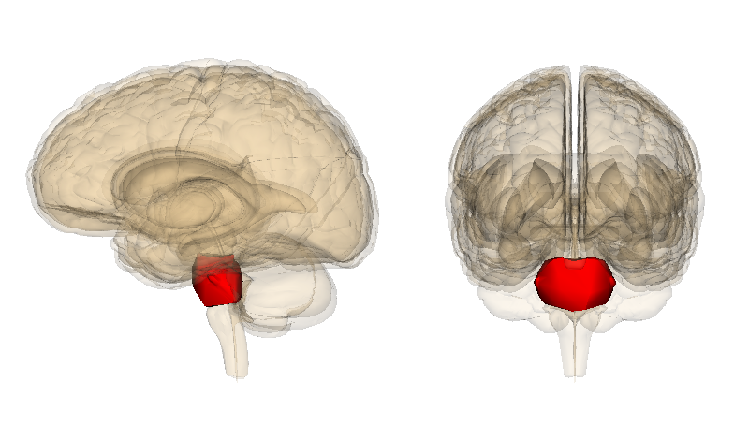
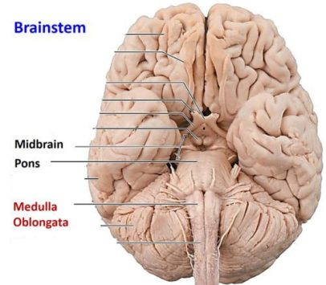
PONS
Introduction
Part of brainstem
Midbrain
Pons
PONS
Medulla Oblongata

Slide 5
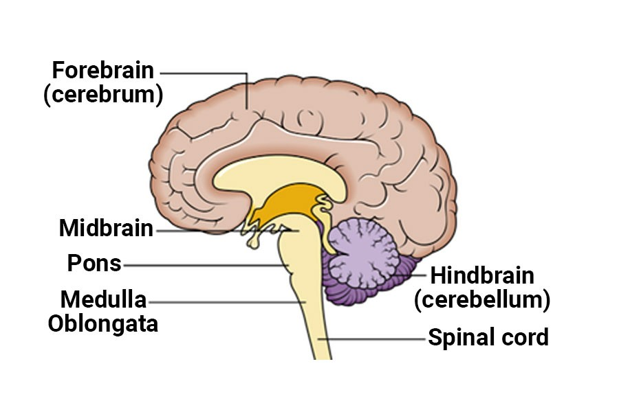
PONS
Introduction
Part of hindbrain
Cerebellum

Slide 6
PONS
Introduction
It’s a bridge between the two cerebellar hemispheres
Trivia:
Pons is called Pons Varolii after the Italian anatomist & surgeon Costanzo Varolio
Cerebellum

Slide 7
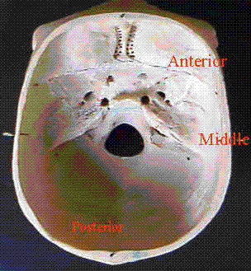
PONS
Introduction
Lies against clivus in the cranial cavity
Clivus

Slide 8
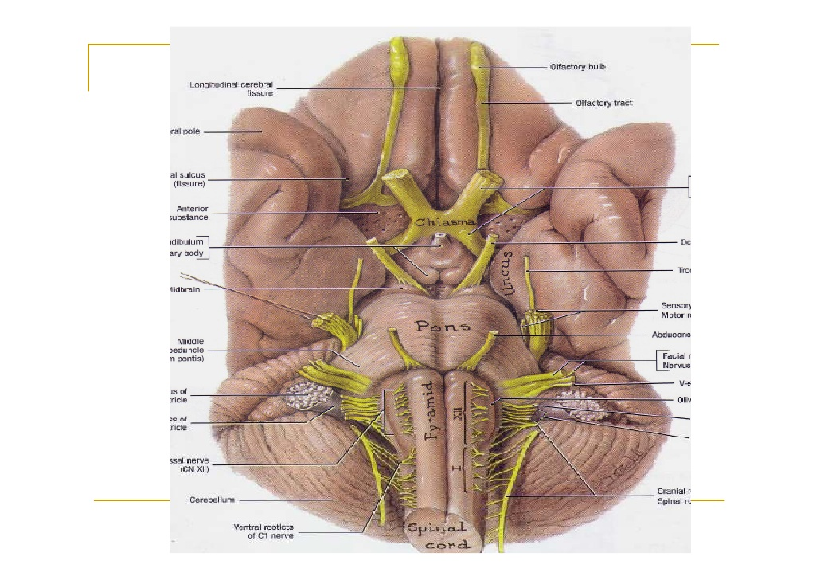
Anterior surface of base of brain
PONS
External features
Two surfaces
Ventral
Dorsal

Slide 9
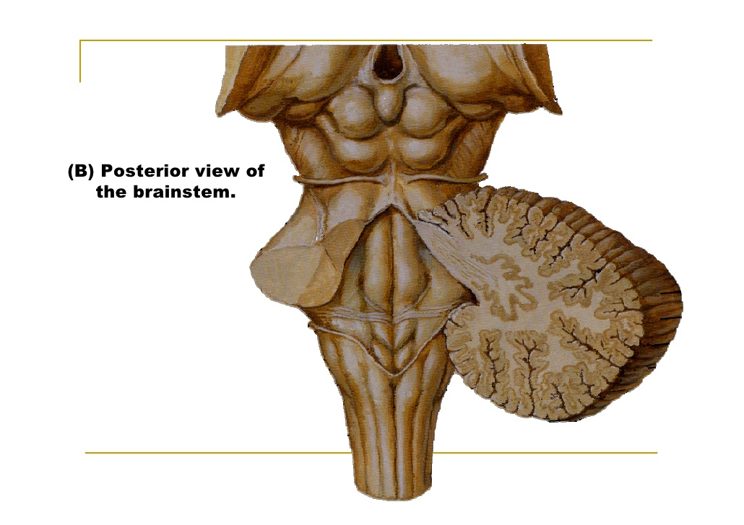
PONS
External features
Two surfaces
Ventral
Dorsal

Slide 10
PONS
Dorsal surface is covered by cerebellum
It is separated from it by IV ventricle
The surface is triangular
Forms upper part of floor of IV ventricle

Slide 11
PONS
Anterior view of base of brain
External features
Two borders
Superior
Inferior

Slide 12
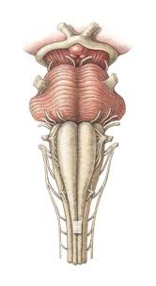
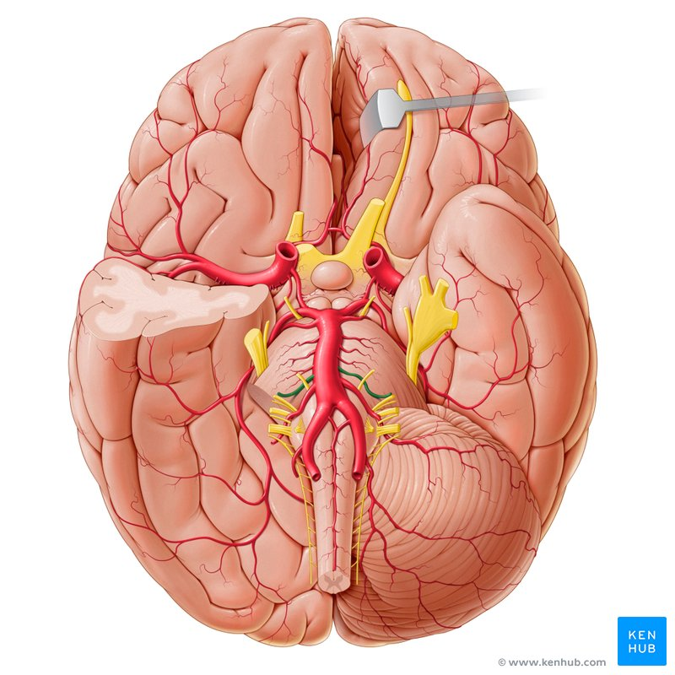
PONS
Ventral Surface
Convex
Transverse fibers on surface – pontocerebellar fibers
Vertical groove in midline – Basilar groove which lodges basilar artery
Pontocerebellar fibres
Basilar Artery

Slide 13
PONS
V nerve is attached to ventral surface at junction between it & middle cerebellar peduncle by a small medial motor & large lateral sensory root
V NERVE

Slide 14
PONS
VI, VII & VIII cranial nerves emerge through pontomedullary junction
VI NERVE
VII NERVE
VIII NERVE

Slide 15
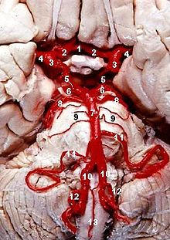
PONS
Superior cerebellar artery
Superior cerebellar artery curves along superior border
Anterior inferior cerebellar artery curves along inferior border
Anterior inferior cerebellar artery

Slide 16
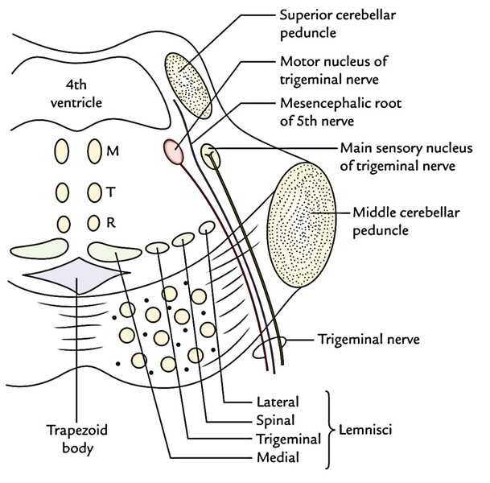
PONS
Internal features
Ventral basilar part
Dorsal tegmental part
Basilar part’s continuous with pyramids of medulla & middle cerebellar peduncle
Tegmentum’s continuous with medulla except pyramids
Tegmental part
Basilar part

Slide 17
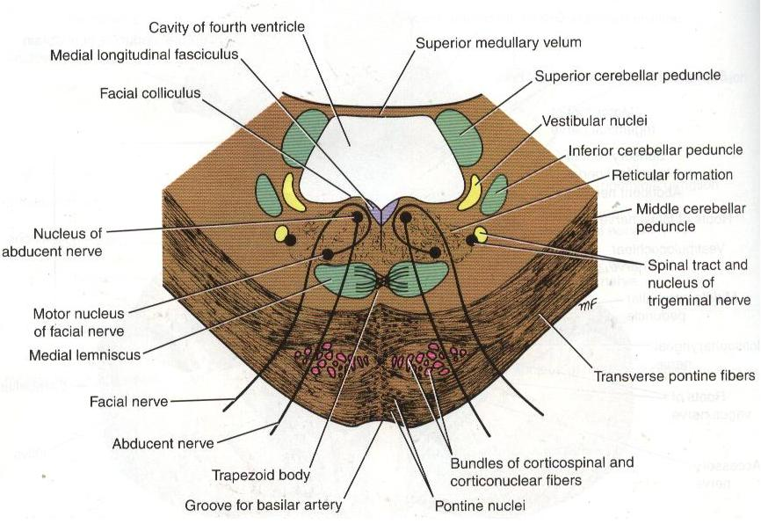
T.S of Lower Part of Pons

Slide 18
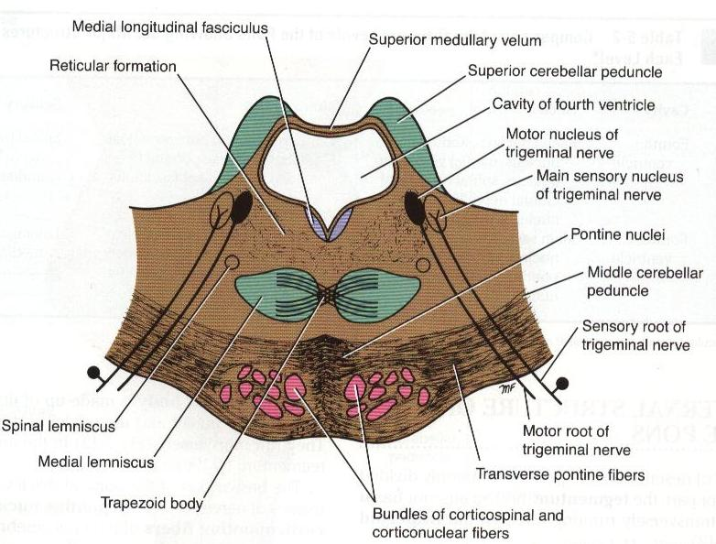
T.S of Upper Part of Pons

Slide 19
PONS
Internal features
Basilar part
(Same throughout)
White Matter
Longitudinal fibers:
Corticopontine fibers
Corticonuclear fibers
Corticospinal fibers
Transverse fibers
Pontocerebellar fibers
Internal features
Basilar part
(Same throughout)
Grey Matter
Pontine nuclei

Slide 20
PONS
Tegmental part
(Different in lower & upper parts of pons)
White matter
Ascending tracts
Decussating fibers
Grey matter
Cranial nerve nuclei

Slide 21
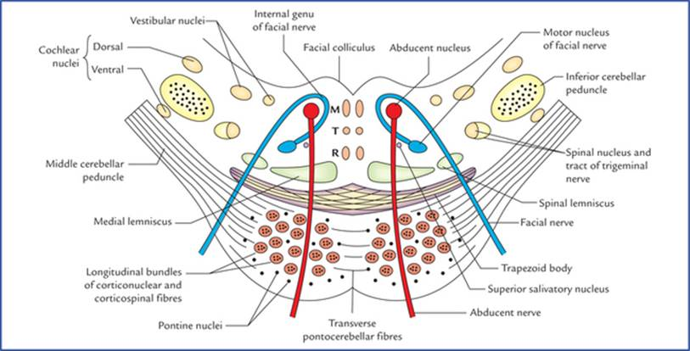
PONS
T.S Of Lower Part of Pons
Tegmentum
Lower part of pons
White matter
Trapezoid body
Medial lemniscus
Spinal lemniscus
Spinal tract of V nerve
Medial longitudinal fasciculus
Tectospinal tract
Rubrospinal tract

Slide 22
PONS
Lower part of pons
Grey matter
Abducent nucleus
Motor nucleus of VII N
Facial colliculus
Neurobiotaxis
Superior salivatory Nu
Lacrimatory Nucleus
Superior & lateral Vestibular Nuclei
Dorsal & ventral Cochlear Nuclei
Spinal Nu of V nerve
T.S Of Lower Part of Pons

Slide 23
PONS
Tegmental part
Basilar Part
Lacrimatory nucleus
Superior salivatory nucleus
T.S Of Lower Part of Pons

Slide 24
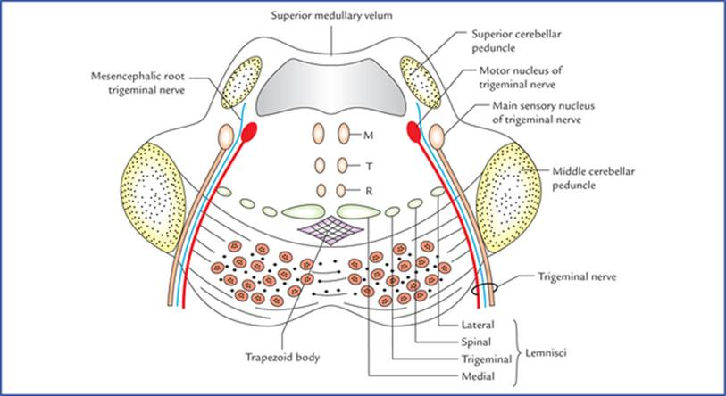
PONS
Mesencephalic nucleus
Spinal nucleus of V nerve
M - Medial longitudinal fasciculus
T – Tectospinal tract
R – Rubrospinal tract
T.S Of Upper Part of Pons

Slide 25
PONS
Tegmentum
Upper part of pons
White matter
Medial lemniscus
Trigeminal lemniscus
Spinal lemniscus
Lateral lemniscus
Trapezoid body
MLF, TST, RST
T.S Of Upper Part of Pons

Slide 26
PONS
Tegmentum
Upper part of pons
Grey matter
Motor nucleus of V nerve
Main sensory nucleus of V nerve
Mesencephalic nucleus of V nerve
Spinal Nucleus of V nerve

Slide 27
PONS
Superior cerebellar artery
Blood supply
Arterial supply
Pontine branches of basilar artery
Superior cerebellar artery
Anterior inferior cerebellar artery
Venous drainage
Inferior petrosal sinus
Basilar plexus of veins
Anterior inferior cerebellar artery
Pontine branches of basilar artery

Slide 28
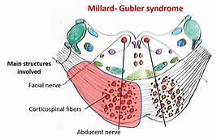
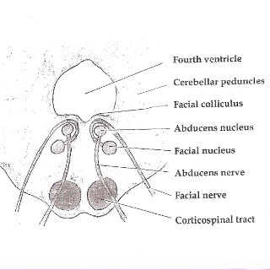
Applied Anatomy
Millard Gubler syndrome
Contralateral hemiplegia
Ipsilateral medial squint
Ipsilateral facial palsy
Ischaemia of ventral part of pons results in the syndrome

Slide 29

Millard Gubler Syndrome
Pons is a part of brainstem & hindbrain
Basilar part – Descending tracts & pontine nuclei
Tegmental part – Ascending tracts – ML, TL, SL, LL
& cranial nerve nuclei
Cranial nerve nuclei in lower part – VI, VII (motor fibres wind around VI nucleus & form facial colliculus – neurobiotaxis; superior salivatory, lacrimatory nuclei), VIII (superior & lateral vestibular; dorsal & ventral cochlear nuclei)
Cranial nerve nuclei in upper part – V (motor, mesencephalic, main sensory, spinal nuclei)
Decussations – Corticopontocerebellar fibres; Trapezoid body – cochlear fibres – lateral lemiscus
Blood supply

Slide 30
Thank you

