Slide 1
Vinayaka Missions Kirupananda Variyar Medical College & Hospitals, salem. Department of Anatomy I MBBS 2019-2020 Assignment

Slide 2
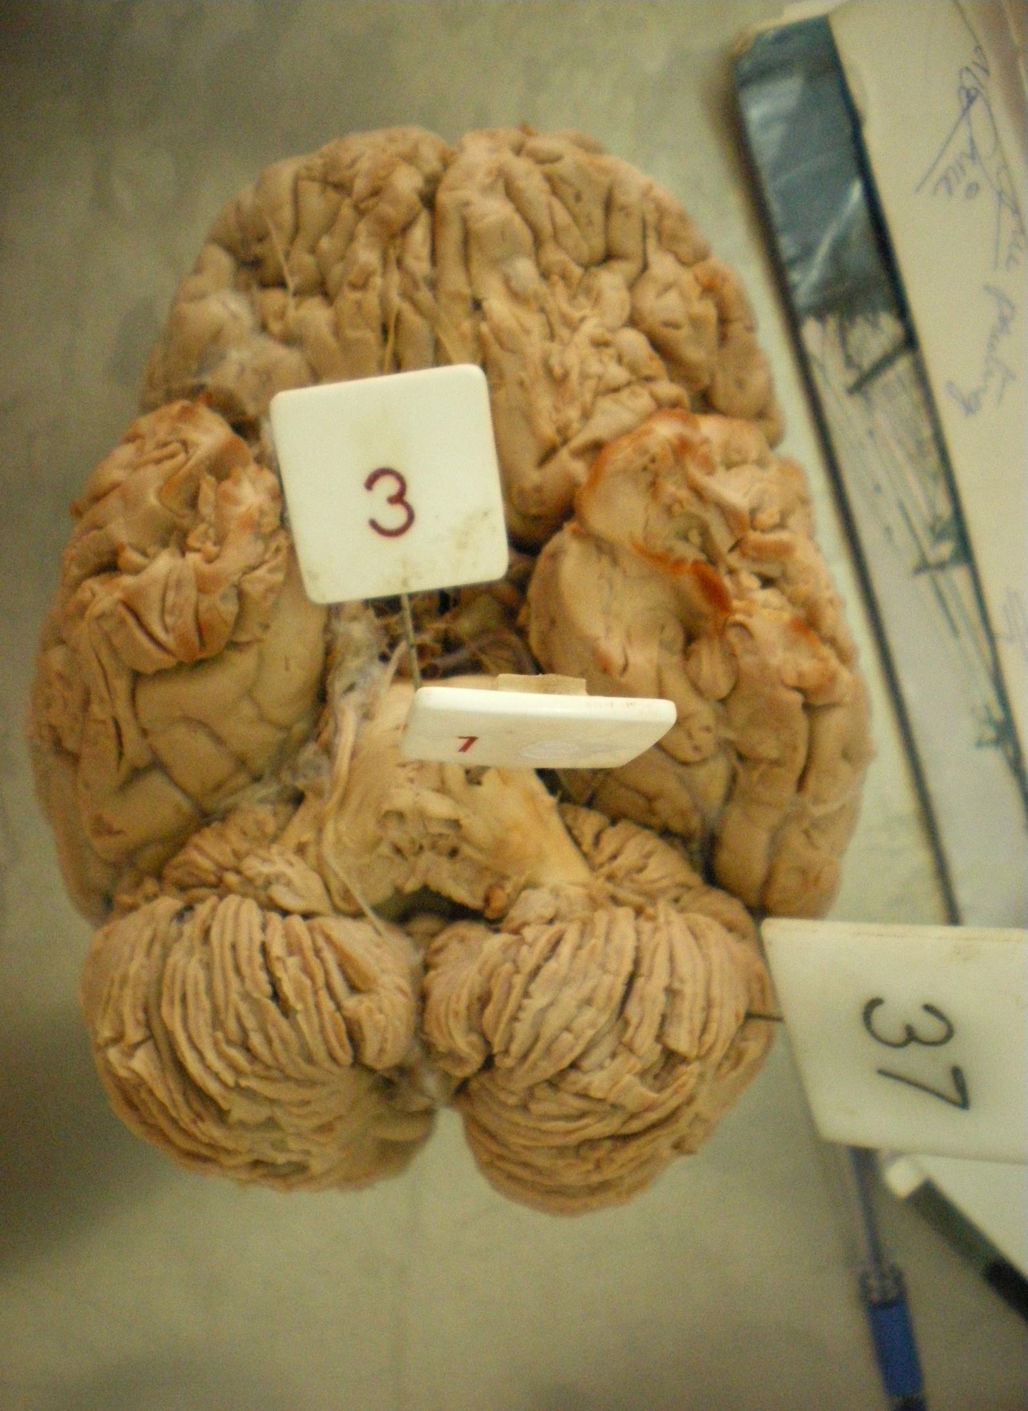
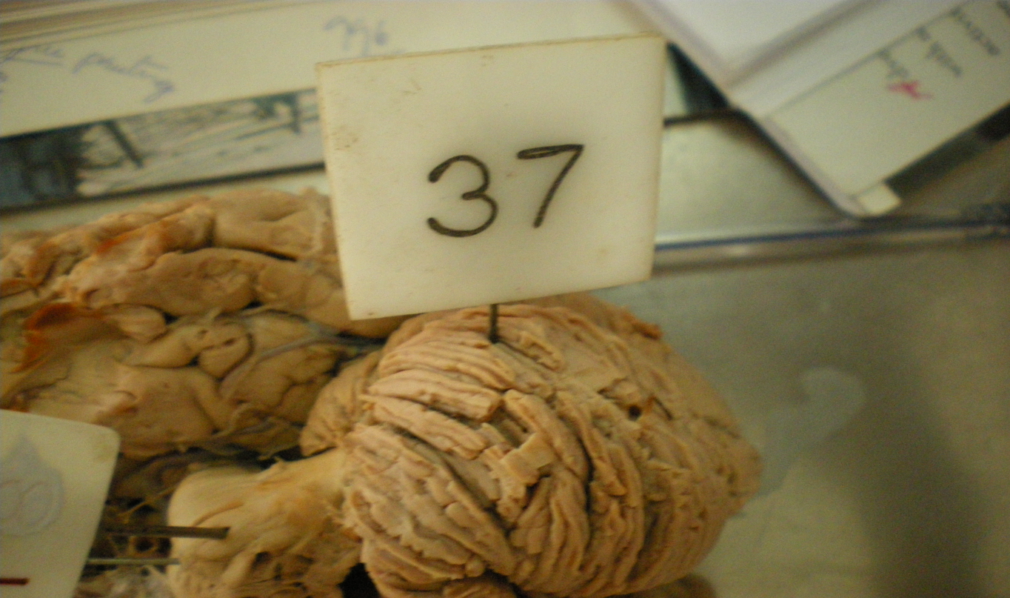
Topic: Cerebellum Date: 03/04/20
Answer the following spotter questions:
Mention the deep nuclei present in the pinned structure.
Mention the blood supply of the structure.
Name any four symptoms that are produced in case of lesion in the pinned structure.

Slide 3
Answer Briefly
Name the morphological classification of cerebellum.
Mention the relations of cerebellum.
Name the afferent and efferent fibres of superior cerebellar peduncles.
Discuss the anatomical basis of how cerebellum maintains tone & posture.
A 50 year old patient came to the OPD with abnormal gait & slurred speech. The patient was found to have a thrombosis in the posterior inferior cerebellar artery. Based on the given data answer the following questions.
Which part of the cerebellum would have been affected in the given case?
The occluded vessel is a branch of?

Slide 4
Write short notes on
Classification of cerebellum
Peduncles of cerebellum

