Slide 1
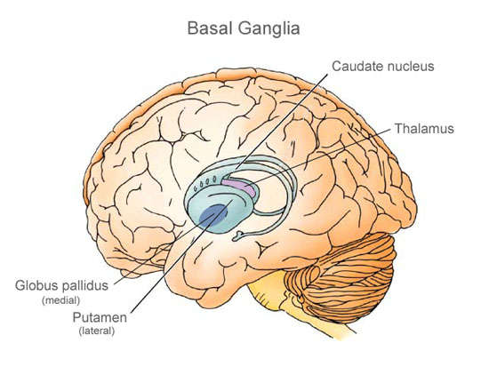
BASAL GANGLIA / NUCLEI
Dr. B. Senthil Kumar,
Assistant Professor,
Department of Anatomy.

Slide 2
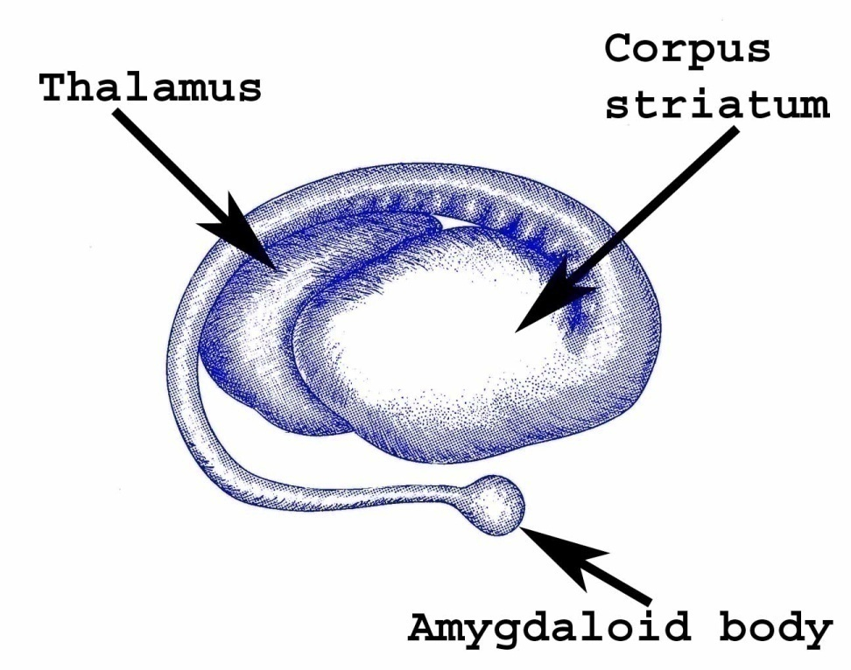
Basal ganglia / Basal nuclei.
These are large masses of grey matter, which is situated in the central white core of the each cerebral hemisphere.
All these telencephalic origin.
Comprises of :-
1.Corpus striatum.
2.Claustrum.
3.Amygdaloid body.

Slide 3
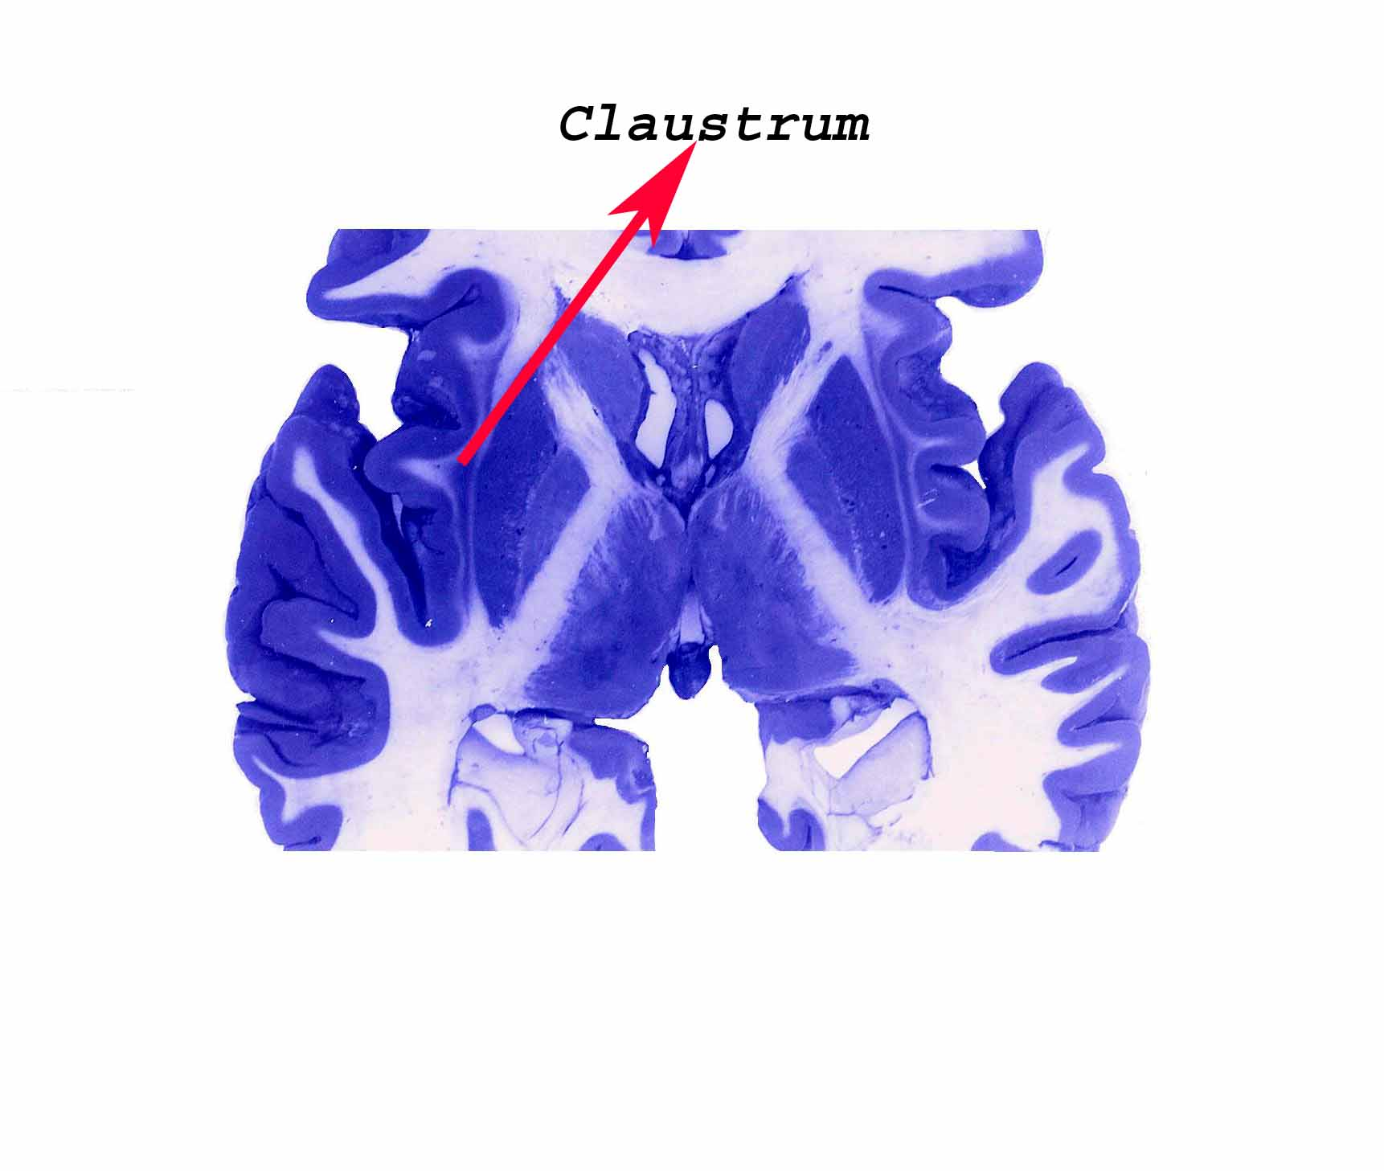
Caudate
Nucleus
Lentiform
Nucleus
Putamen + Globus Pallidus

Slide 4
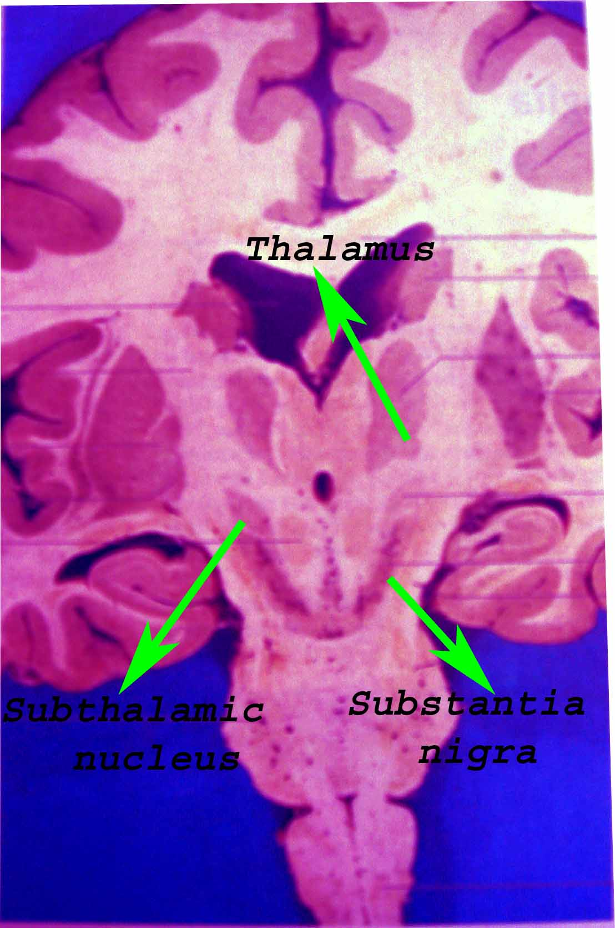
Basal Ganglia.
The masses of grey matter other than those mentioned previously are closely related functionally to the basal ganglia.
1.Subthalmic nucleus.
2.Substantia nigra.
3.Ventral striatum.
4.Ventral pallidum.

Slide 5
Basal ganglia
Carpus striatum amygdala claustrum
Neostriatum (striatum) paleostriatum (pallidum)
Dorsal striatum ventral striatum Dorsal pallidum ventral pallidum
Caudate n putamen Globus pallidus
Lentiform n

Slide 6
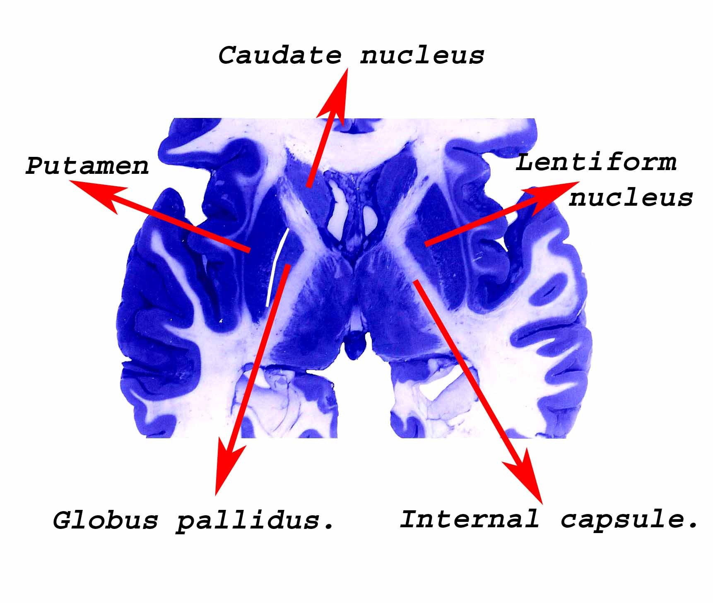
Corpus striatum.
The corpus striatum divided into -:
Medial part -: Caudate nucleus.
Lateral part -: Lentiform nucleus.

Slide 7
Lentiform nucleus.
The lentiform nucleus further subdivided into -:
Outer part -: Putamen nucleus.
Inner part -: Globus pallidus.

Slide 8
Basal ganglia.
In structures, connections & functions the caudate nucleus & putamen nucleus are similar & they are collectively called Neo-striatum / Striatum.
The globus pallidus provides chief efferent fibres of the basal ganglia is known as Paleo-striatum / Pallium.

Slide 9
Basal ganglia.
At present the striatum is subdivided into dorsal & ventral striatum; the pallidum subdivided into dorsal & ventral pallidum.
Dorsal striatum -: Caudate nucleus & putamen nucleus.
Dorsal pallidum -: Globus pallidus.

Slide 10
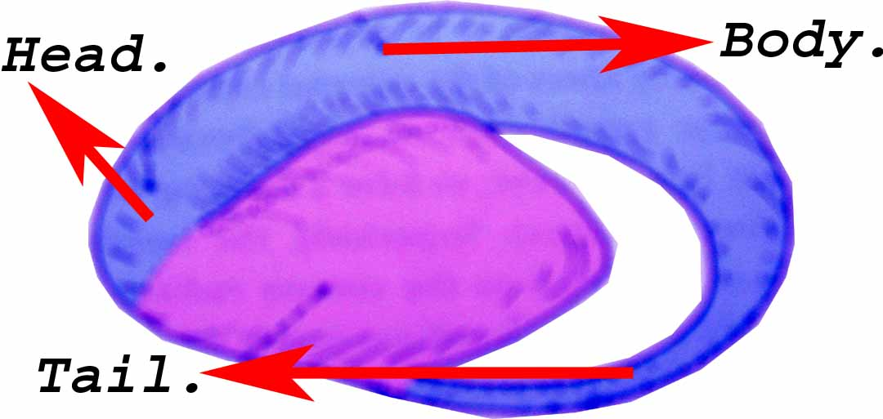
Caudate nucleus.
It is the `C` shaped mass of grey matter & consists of a large head, body & tail.

Slide 11
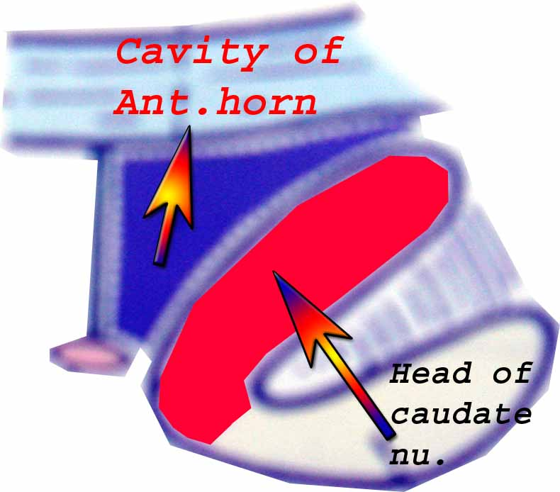
Caudate nucleus.
The head of the nucleus bulges into the anterior horn of the lateral ventricle & form the greater part of its floor.

Slide 12
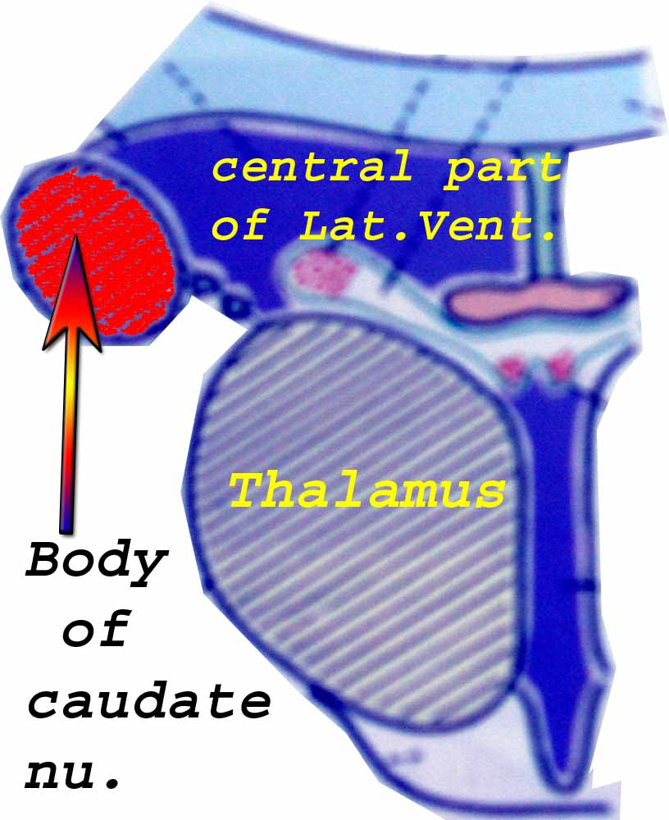
Caudate nucleus.
The body of the nucleus lies in the floor of the central part of the lateral ventricle.

Slide 13
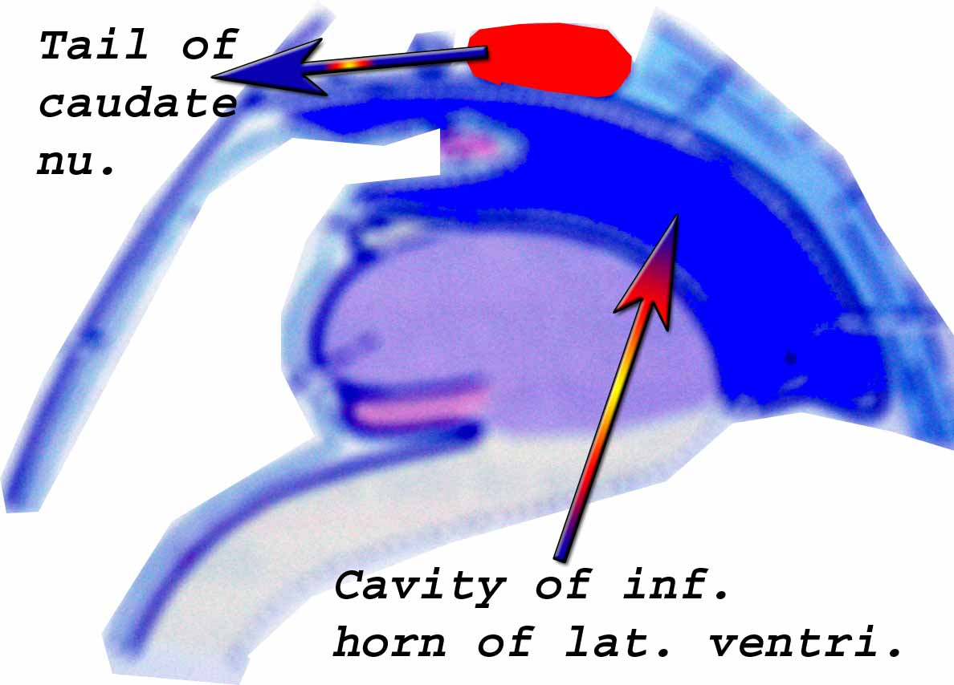
Caudate nucleus.
The tail lies in the roof of the inferior horn of the lateral ventricle.

Slide 14
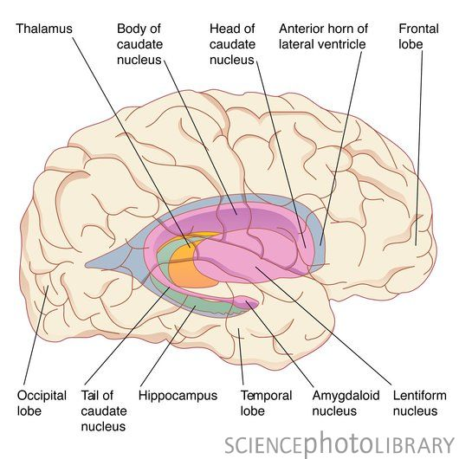

Slide 15
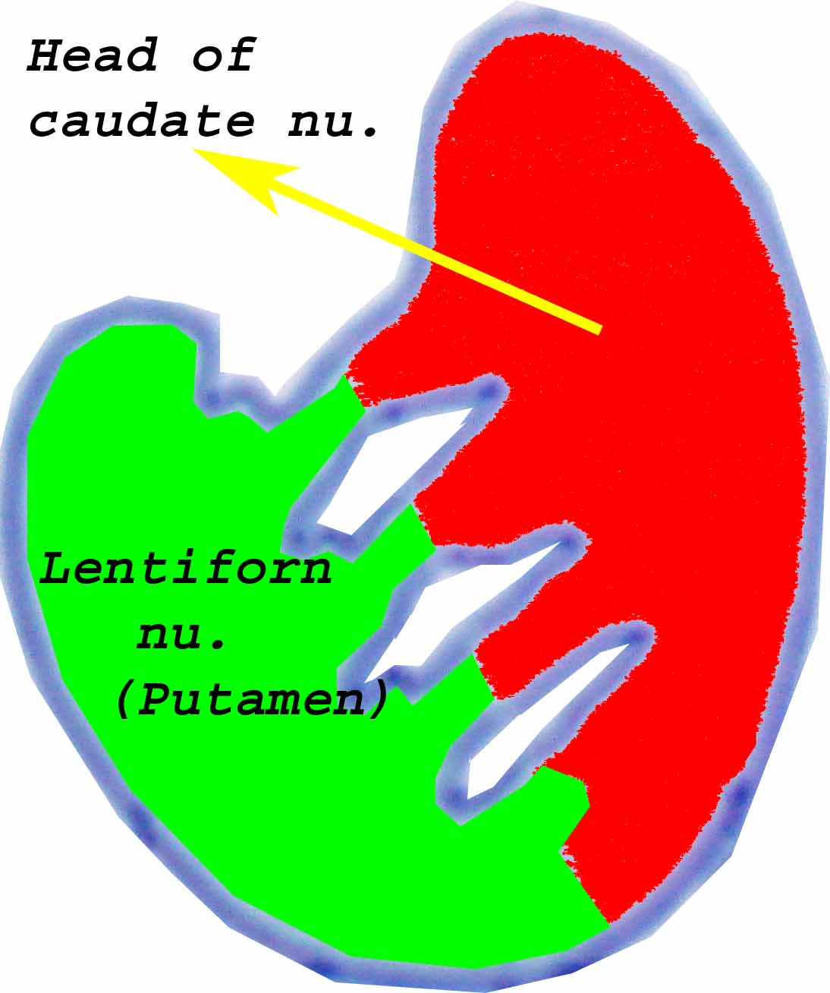
Caudate nucleus.
The anterior part of the head of the caudate nucleus is fused, inferiorly with the lentiform nucleus & known as fundus striati.

Slide 16
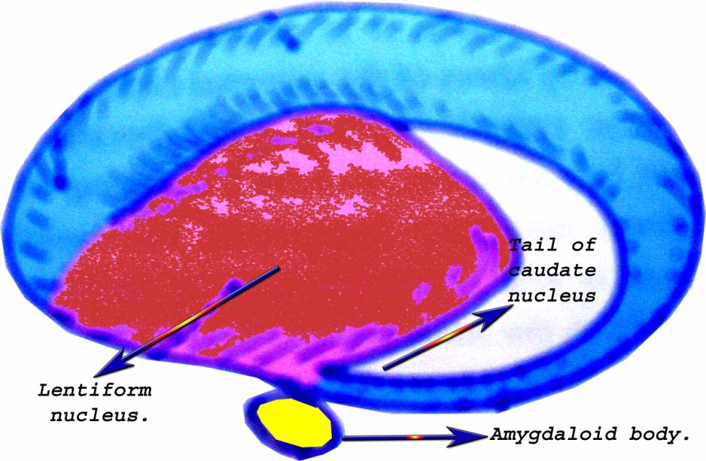
Caudate nucleus.
The anterior end of the tail of the caudate nucleus is continuous with the lentiform nucleus & lies close relation to the amygdaloid body.

Slide 17
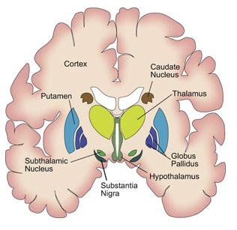
Caudate nucleus.
The body of the caudate nucleus related medially with the thalamus & laterally to the internal capsule which separates it from the lentiform nucleus.

Slide 18
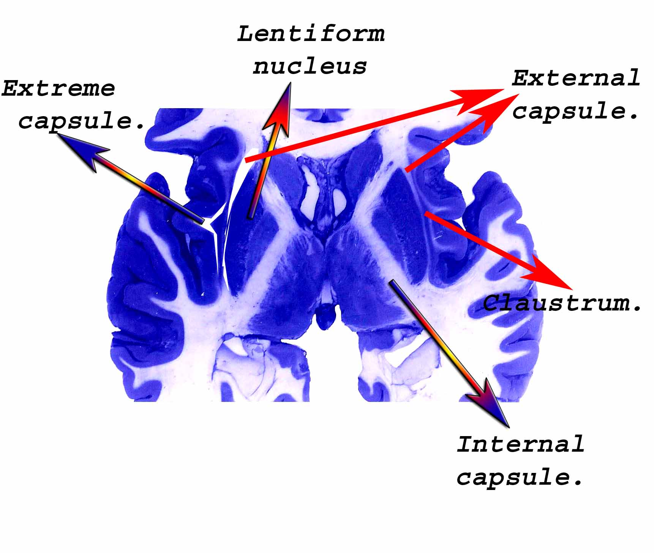
Lentiform nucleus.
It is the biconvex mass of the grey matter.
It lies lateral to the internal capsule.
Laterally it is separated from the claustrum by the fibres of the external capsule.

Slide 19
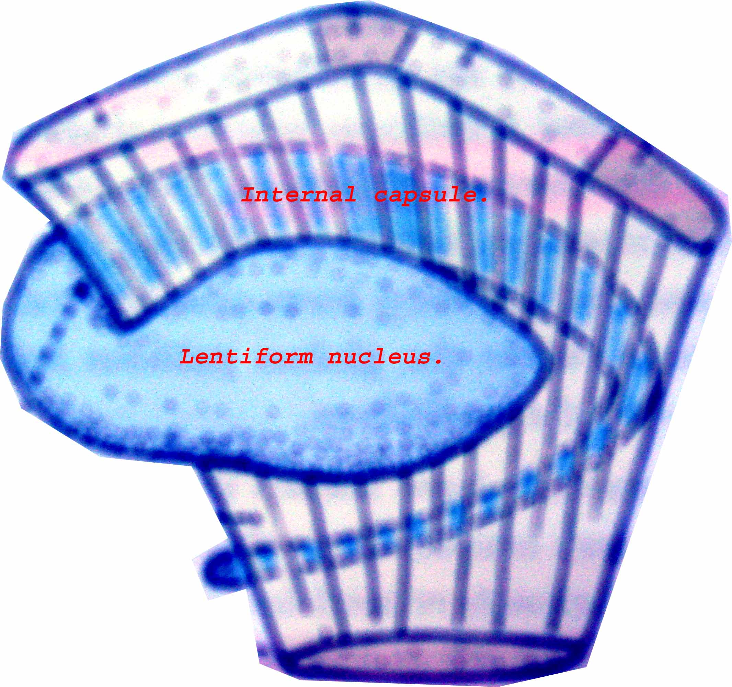
Lentiform nucleus.
Superiorly, it is related to the corona radiata & inferiorly to the sub-lentiform part of the internal capsule.

Slide 20
Lentiform nucleus.
It appears triangular in coronal section.
It is divided by external medullary lamina of the white matter into large lateral part, known as putamen nucleus & small medial part known as globus pallidus.
Globus pallidus further subdivided by an internal medullary lamina into medial & lateral parts

Slide 21
Claustrum.
It is a thin lamina of grey matter that lies lateral to the lentiform nucleus.
It lies between external capsule (medially) & extreme capsule (laterally).
If traces below & front, is continuous with the anterior perforated substance & amygdaloid body.

Slide 22
Claustrum.
The claustrum may be derived from detached part of the insular cortex / corpus striatum / from both.
It is connected with the wide area of neocortex, but its function not properly known.

Slide 23

Amygdaloid body / Archi-striatum.
It is apparently continuous with the tail of the caudate nucleus, but it is entirely a distinct structure & connected with the limbic system.
It lies in the temporal lobe of the cerebral hemisphere close to the temporal pole; deep to the uncus & is related with the anterior end of the inferior horn of lateral ventricle

Slide 24
Subthalamic nucleus / Ventral thalamus / Body of Luys
It is the diencephalic origin.
It is the biconvex mass of the grey matter which is lies lateral to hypothalamus.

Slide 25
Substantia nigra.
It is the sheet of the pigmented nerve cells, which extends along the entire length of the midbrain & its cranial end reaches close to the sub-thalamic nucleus.

Slide 26
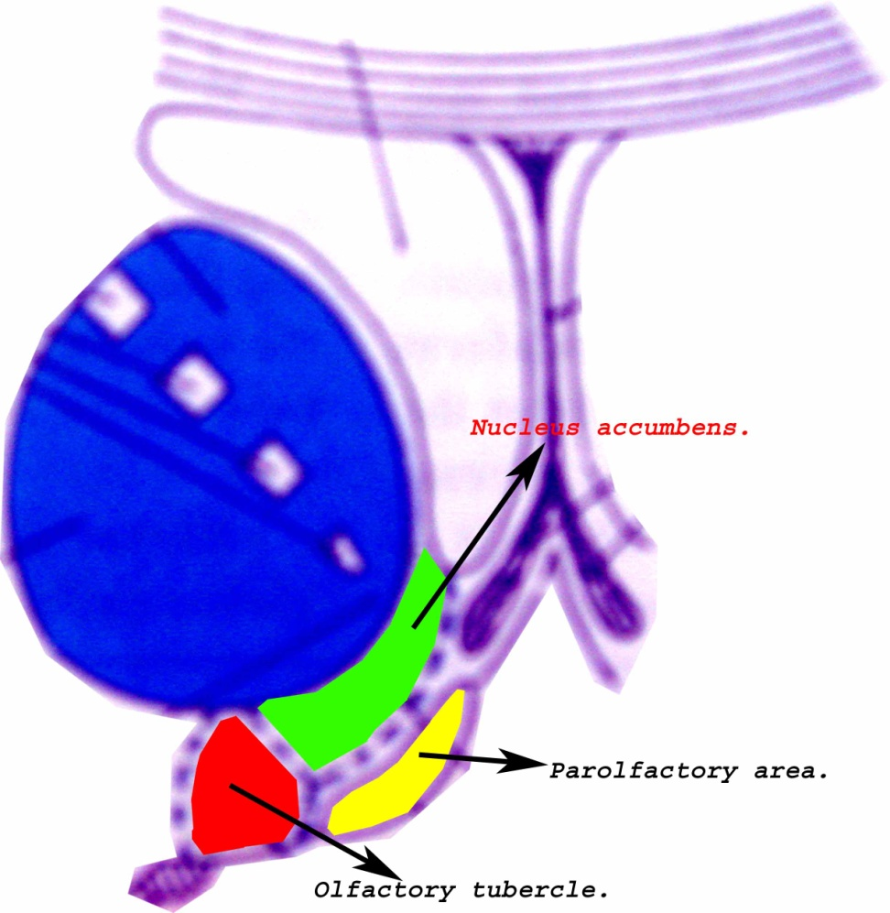
Ventral striatum.
It consists of nucleus accumbens & olfactory tubercle.
Nucleus accumbens intervenes between the fundus striati & par-olfactory areas.
It is closely related to the septal nuclei of the septum pellucidum.

Slide 27
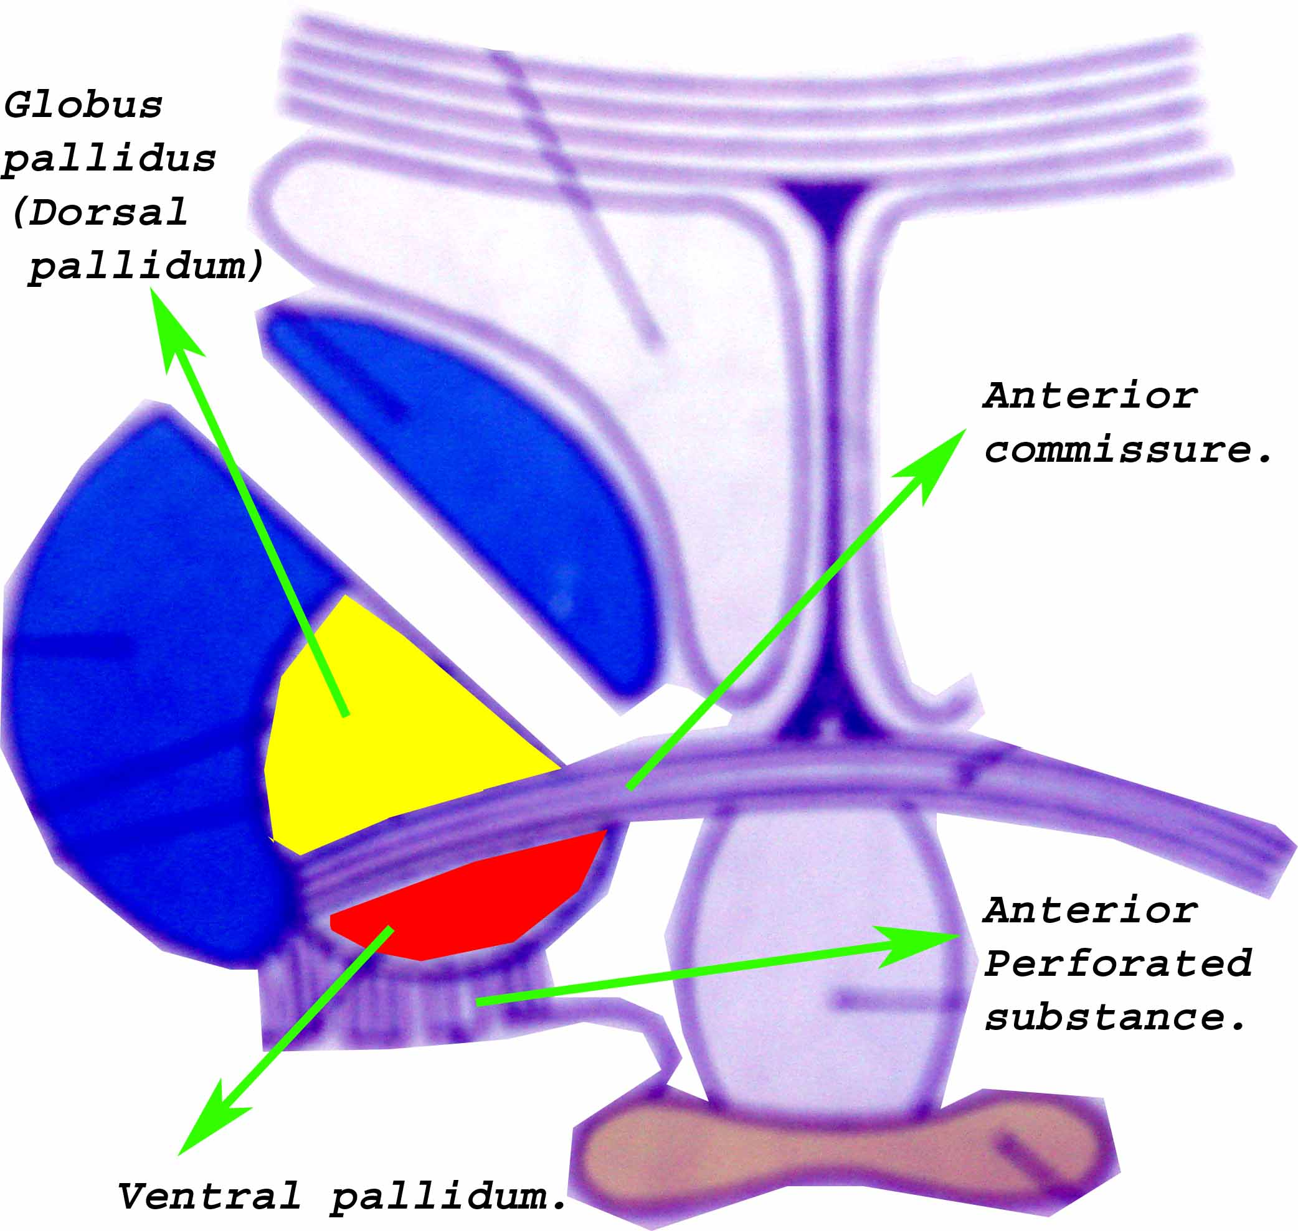
Ventral pallidum.
It lies in the anterior perforated substance below the anterior commissure.

Slide 28
Afferent connection of the basal nuclei.
Cerebral cortex
Intralaminar nuclei of thalamus
Striatum
Pars compacta of substantia nigra(Dopaminergic)
Raphe nuclei(noradrenergic)
Locus coeruleus (serotoninergic)

Slide 29
Efferent connection of the basal nuclei.
Intralaminar,Ventro-lateral nu.of thalamus
Striatum
Pars reticularis of substantia nigra
Pallidum
Subthalmic nu.
Sup. colliculus
Reticular formation
Pendunculo-pontine nu.

Slide 30
Functions of the basal ganglia.
The basal ganglia are considered to act as sub-cortical cell station for the extra-pyramidal motor pathway which influences the lower motor neurons of the brain stem & the spinal cord through the reticulo-spinal, rubro-spinal, olivospinal & vestibulo-spinal.

Slide 31
Clinical anatomy.
Parkinson`s disease -:
It is characterized by rigidity & tremor.
Cog –wheel rigidity - : when the force is applied passively on a limb during flexion / extension, the muscular resistance increases / decreases altenatively.
The patient. have masked face appearance with no emotional response.
It is due to degenerative changes in globus pallidus & substantia nigra with marked reduction of dopamine in the striatum & substantia nigra.

Slide 32
Clinical anatomy.
Athetosis - : this is characterized by slow, worm-like twisting movements of the extremities, due to the damage of putmen
Chorea -: this is characterized by brisk, jerky, purposeless & graceful movements of the distal part of the extremities.
Wilson`s disease. (hepato-lenticular degeneration.) -: it is genetically determined error of copper metabolism,c/f muscular rigidity, tremor,laughing / crying may be uncontrolled without apparent cause.

Slide 33

Thank you.

