Slide 1

Little Mermaid

Slide 2
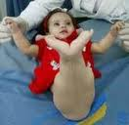
This baby was born with well developed upper part of the body but the lower part of the body was abnormal.
The lower limbs were fused
The left kidney was absent and right was small
There was a common lower opening for the digestive system, urinary system and genital system
Which process of development might have been disturbed to cause such defects?

Slide 3
Gastrulation and formation & fate of PRIMITIVE STREAK and intraembryonic mesoderm

Slide 4
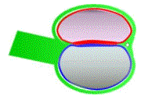
PRIMITIVE STREAK
Introduction
An elevation formed by proliferation of cells of epiblast
Location
Present at the caudal end of the germ disc
Epiblast
Primitive streak
Hypoblast

Slide 5
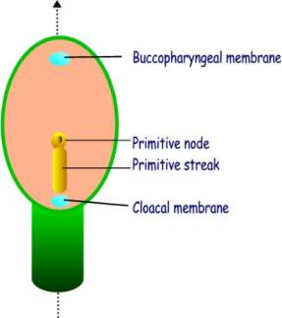
PRIMITIVE STREAK
Parts
Cranial expanded end – Primitive node/knot/ Hensen’s node
Depression in the node – Primitive pit
Depression in the rest of the streak – Primitive groove
(Prochordal plate)
GERM DISC

Slide 6
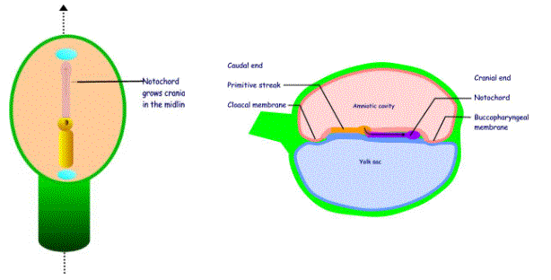
Structures developed from primitive streak
NOTOCHORD
Primitive pit
Primitive node
Primitive streak
Coronal section of GERM DISC
T.S of GERM DISC

Slide 7
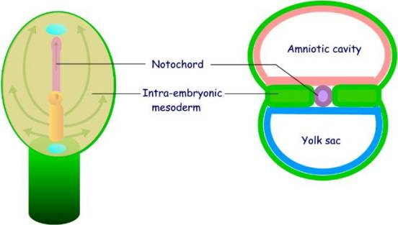
Structures developed from primitive streak
INTRAEMBRYONIC MESODERM
Coronal section of GERM DISC
T.S of GERM DISC

Slide 8
PRIMITIVE STREAK
Structures developed from primitive streak
Primitive streak gives rise to the notochord & intraembryonic mesoderm
Notochord is formed in the midline by proliferation of cells in the primitive node which invaginate through the primitive pit & extend between epiblast & hypoblast upto the prochordal plate

Slide 9
PRIMITIVE STREAK
Intraembryonic mesoderm is formed by proliferation of the cells in the primitive streak which invaginate through the primitive groove & extend between the epiblast & hypoblast except in the midline (occupied by notochord), prochordal plate (forms buccopharyngeal membrane), caudal to primitive streak (occupied by cloacal membrane)

Slide 10
PRIMITIVE STREAK
Before the intraembryonic mesoderm is formed, the initial cells which proliferate from the primitive streak & invaginate displace the hypoblast and form a new layer which is termed as the endoderm
After formation of the endoderm & mesoderm , the cells remaining in the epiblast are called as ectoderm

Slide 11
gastrulation
It is a term used for the process which establishes the three germ layers: Ectoderm, Endoderm & Mesoderm with the formation of the primitive streak
It occurs during the 3rd week of gestation

Slide 12
PRIMITIVE STREAK
Fate of Primitive streak
After formation of notochord & intraembryonic mesoderm, the primitive streak disappears

Slide 13
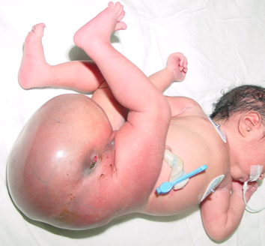
Applied aspects
Sacrococcygeal teratoma
Tumor formed from remnants of primitive streak
Consists of teeth/hair/cartilage/muscle tissue
As primitive streak consists of totipotent cells

Slide 14
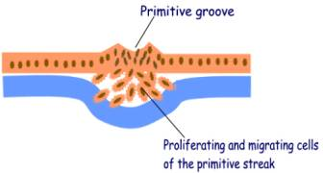
INTRAEMBRYONIC MESODERM

Slide 15
Intraembryonic mesoderm (IEM)
Introduction
Formed by proliferation of cells of primitive streak which invaginate & extend between ectoderm & endoderm
Location
IEM is present between ectoderm & endoderm but is absent in the midline, at the buccopharyngeal membrane & cloacal membrane

Slide 16
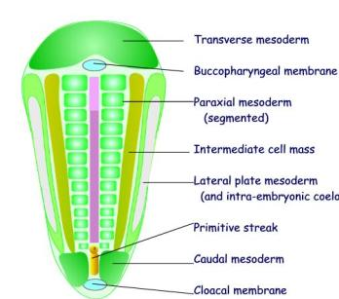
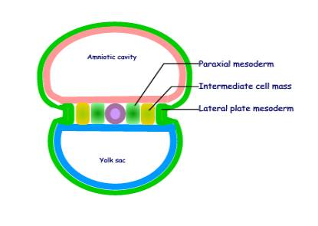
SUBDIVISIONS OF IEM
mesoderm

Slide 17
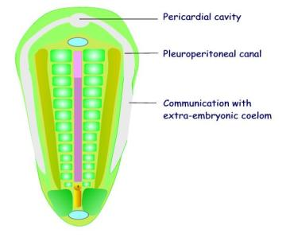
Intraembryonic mesoderm (IEM)
Subdivisions
Paraxial mesoderm
Intermediate mesoderm
Lateral plate mesoderm
SUBDIVISIONS OF IEM

Slide 18
Paraxial mesoderm
Features
Becomes segmented
Segments are called as somitomeres
44-45 somitomeres are formed
The cranial ones form the head mesoderm & help in formation of the skull
The remaining form condensed segments called as Somites

Slide 19
Paraxial mesoderm
Development of somites
Somites develop at the rate of 3 pairs per day. The first somites are formed on 15th day of gestation
Number of SOMITES
Occipital – 4
Cervical – 8
Thoracic – 12
Lumbar – 5
Sacral – 5
Coccygeal – 1-3

Slide 20
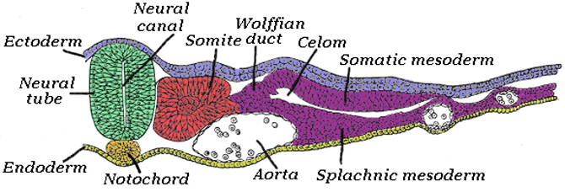

Slide 21
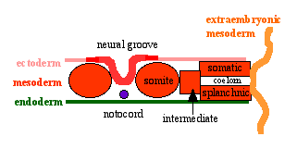
Somites are subdivided into:
Sclerotome
Myotome
Dermatome

Slide 22
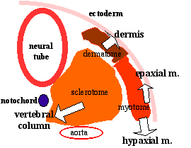

Slide 23
somites
Sclerotome
Ventromedial part of somite
Forms vertebrae & ribs
Myotome
Dorsomedial part of somite
Forms skeletal muscles of limbs & trunk
Dermotome
Dorsolateral part of somite
Forms dermis of skin & subcutaneous tissue

Slide 24
Intermediate mesoderm
Forms urogenital system
mesoderm

Slide 25
Septum transversum
Cardiogenic area
Intraembryonic coelom
LATERAL PLATE MESODERM

Slide 26
Lateral plate mesoderm
Small cavities appear in it which join together to form intraembryonic coelom (IEC)
IEC is horse shoe shaped
It divides IEM into Somatopleuric IEM(near ectoderm) & Splanchnopleuric IEM (near endoderm)
Somatopleuric IEM forms parietal layers of pleura, peritoneum & pericardium
Splanchnopleuric IEM forms visceral layers of pleura, peritoneum & pericardium, smooth muscles lining gut tube, respiratory system & blood vessels

Slide 27
Intraembryonic mesoderm (IEM)
IEC does not extend into IEM near cranial end of germ disc
This part of IEM is known as septum transversum – forms part of liver, diaphragm & fibrous pericardium
Cardiogenic area develops between prochordal plate & septum transversum & heart develops from it

Slide 28
Applied aspects
Sirenomelia
Improper development & migration of IEM

Slide 29
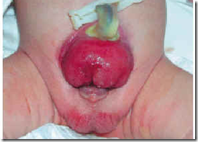
Applied aspects
Ectopia Vesicae
What is the defect?
What is the embryological basis of this condition?

Slide 30
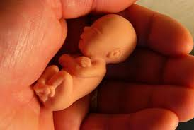
Thank you

