Slide 1
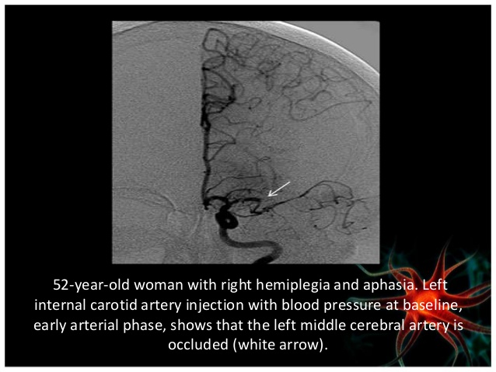

Slide 2
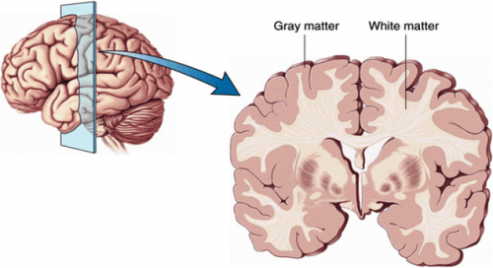
Classification of white matter of cerebrum & Internal Capsule

Slide 3
Objectives
Classify fibres of cerebrum
List out parts of internal capsule
Describe fibres of internal capsule
Enumerate blood supply of internal capsule
Correlate its clinical aspects

Slide 4
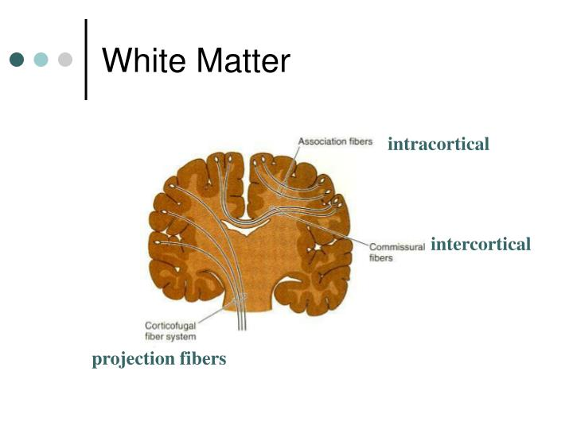
White Matter of Cerebrum
Association fibres
Commissural fibres
Projection fibres

Slide 5
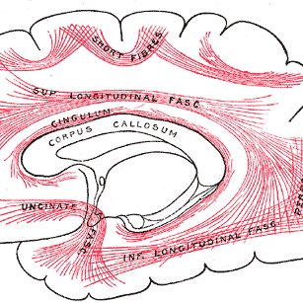
Association Fibres
Short association fibres
Long association fibres
Superior longitudinal fasciculus
Inferior longitudinal fasciculus
Uncinate fasciculus
Cingulum
Fronto occipital fasciculus

Slide 6
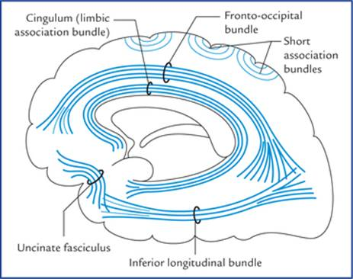

Slide 7
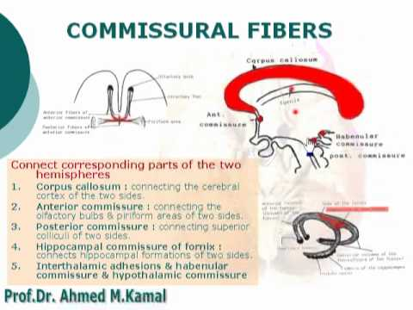
Commissural Fibres
Corpus callosum
Anterior commissure
Posterior commissure
Habenular commissure
Hippocampal commissure
Hypothalamic commissure

Slide 8
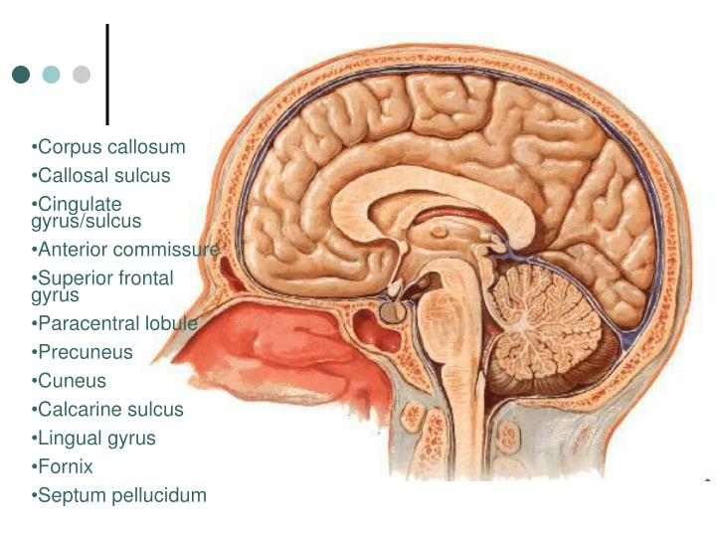
Inter hemispheric transfer of information which is essential for bilateral responses and learning
Applied anatomy Split brain syndrome
Anterior
commissure
Corpus callosum
Fornix
Habenular
commissure
Posterior
commissure

Slide 9
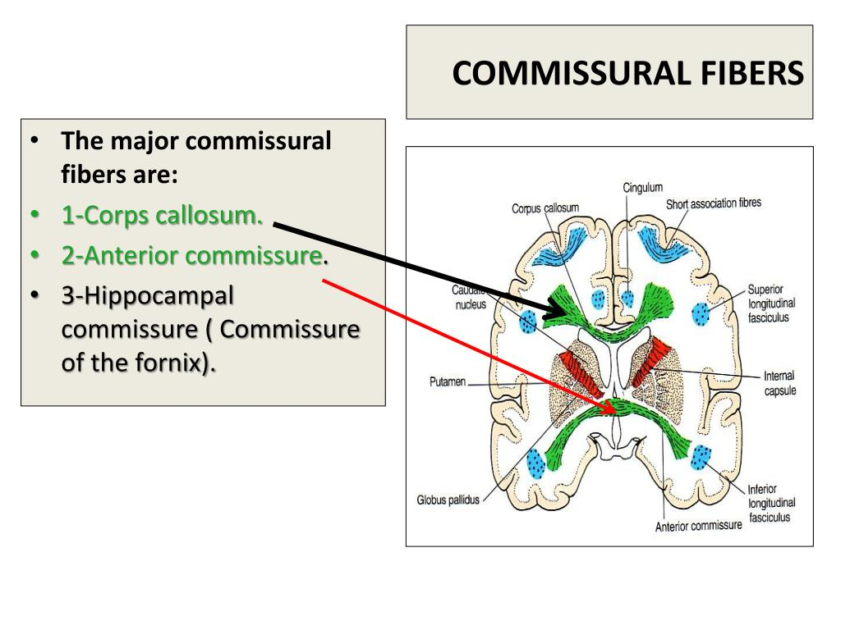
Commissural Fibres
Corpus Callosum
Anterior
commissure

Slide 10
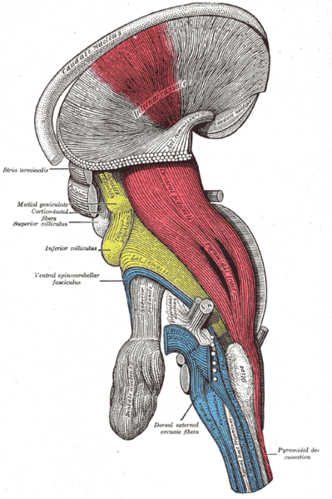
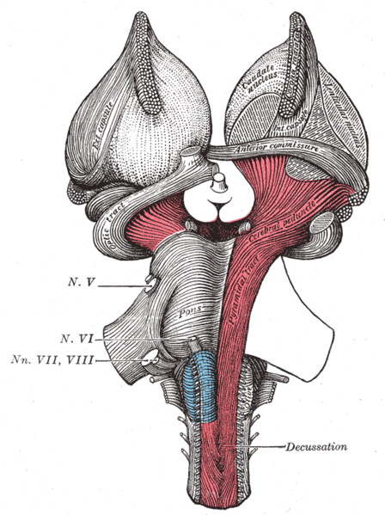
Projection Fibres

Slide 11
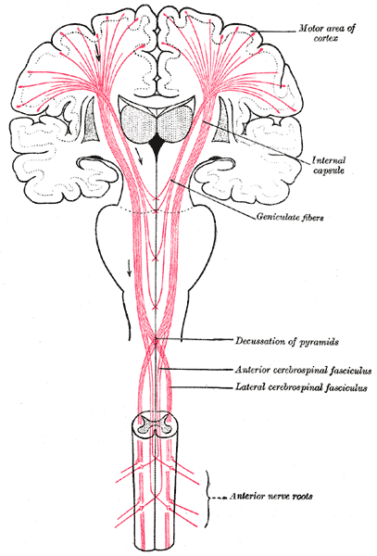

Slide 12
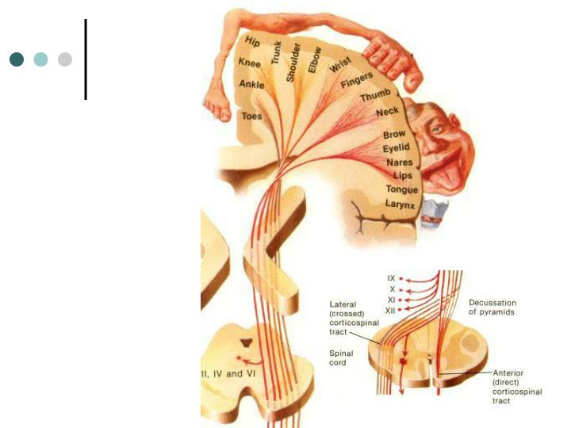
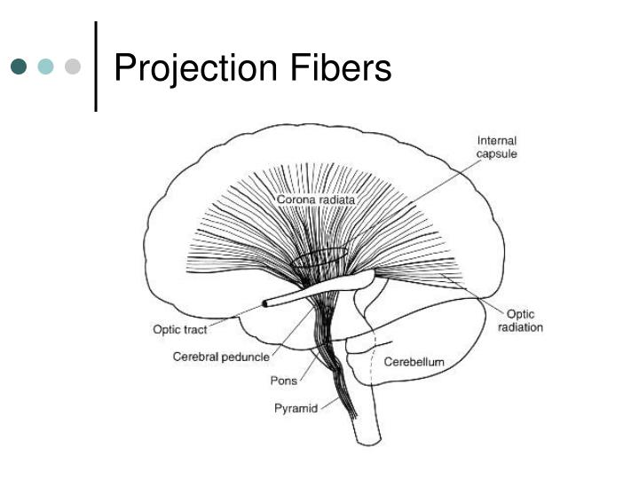
Projection Fibres
Descending tracts / Cortico fugal
Corticorubral fibres
Corticopontine fibres
Corticonuclear fibres
Corticospinal fibres
Cortico reticular

Slide 13
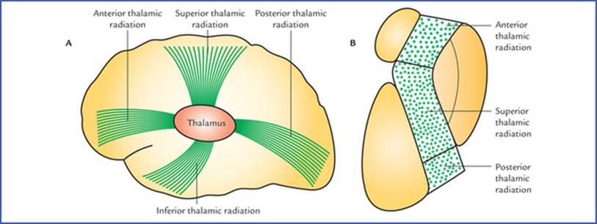
Projection Fibres
Ascending tracts/ cortico-petal :
Superior thalamic radiation
Inferior thalamic radiation
Anterior thalamic
Posterior thalamic radiation

Slide 14
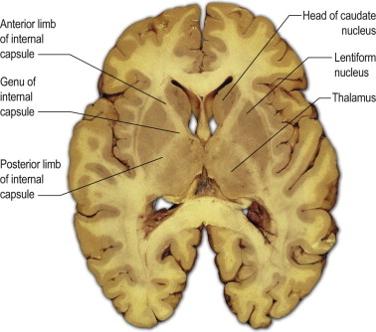
Internal Capsule
Introduction
Consists of a compact band of projection fibres
caudate nucleus & thalamus medially & lentiform nucleus laterally
Continuous with corona radiata above & crus cerebri below

Slide 15
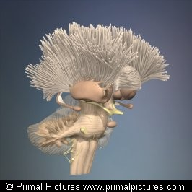
Corona radiata
Internal Capsule
Crus cerebri: Midbrain
Basilar part of Pons
Pyramid : Medulla Oblongata
PROJECTION FIBRES

Slide 16
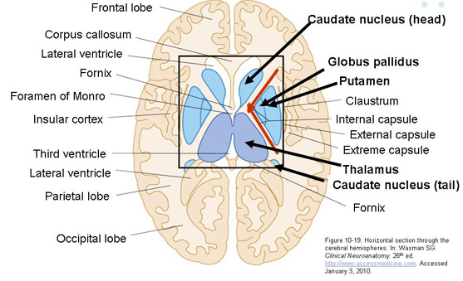
Internal Capsule

Slide 17
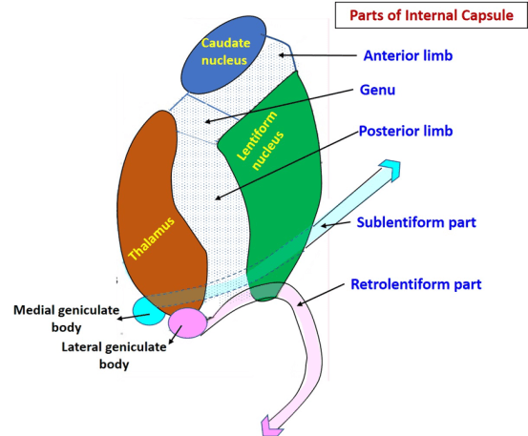
Parts
Anterior limb
Posterior limb
Genu
Retrolentiform part
Sublentiform part

Slide 18
Constituent Fibres
Anterior limb:
Frontopontine fibres
Anterior thalamic radiation
Genu
Corticonuclear fibres
Superior thalamic radiation
Posterior limb:
Corticospinal tract
Cortico pontine
Corticorubral tract
Superior thalamic radiation
Retrolentiform
Optic radiation
Parieto & occipitopontine fibres
Sublentiform
Parieto & temporopontine fibres
Auditory radiation

Slide 19
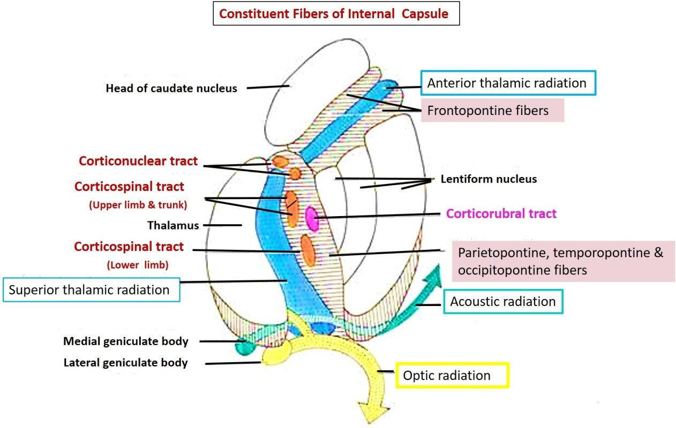

Slide 20
Blood supply
Arterial supply
Recurrent artery of Heubner (Medial striate branch of ACA )
Charcot’s artery of cerebral haemorrhage (Lenticulostriate branch of MCA )
Anterior choroid artery
Venous drainage
Striate veins -Basal veins -great cerebral and Internal cerebral veins

Slide 21
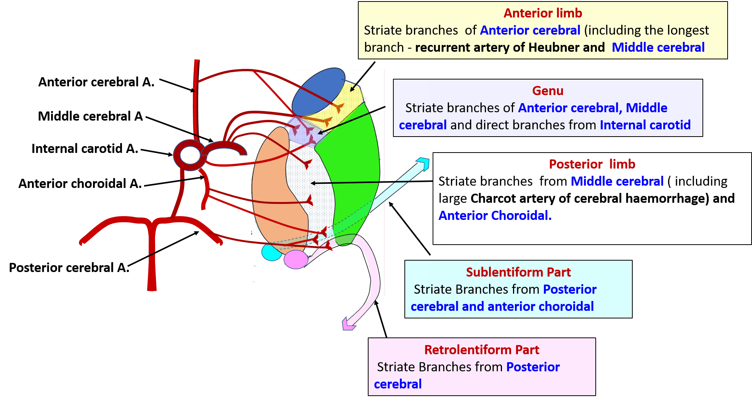

Slide 22
Clinical Aspects
Cerebrovascular accidents ( CVA ) : Result in lesions of Internal capsule
Artery most commonly involved : Lenticulostriate branch of MCA
The above artery supplies Genu & anterior 2/3rds of posterior limb of internal capsule
Corticonuclear & corticospinal tracts involved with superior thalamic radiation
Results in contralateral hemiplegia, contralateral lower Facial palsy ( sometimes paralysis of muscles of tongue ), contralateral hemianaesthesia

Slide 23
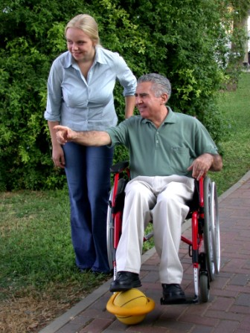
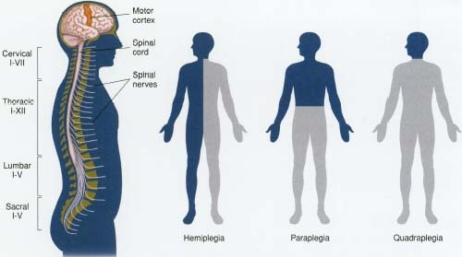

Slide 24
THANK YOU

