Slide 1
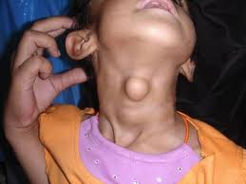
A 10 year old child comes with a swelling in the midline of neck which moves up deglutition & with protrusion of tongue.
What is your diagnosis?

Slide 2
Development of thyroid gland
Objectives
At the end of this session, you will be able to:
Mention the germ layer which gives rise to thyroid gland
Describe the origin of follicular cells and parafollicular cells
Enumerate the congenital anomalies associated with thyroid gland and explain the embryological basis of the anomalies

Slide 3
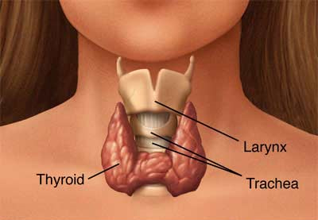
Development of thyroid gland
Introduction
Thyroid gland is present in the lower part of the neck in front of the larynx & upper part of trachea

Slide 4
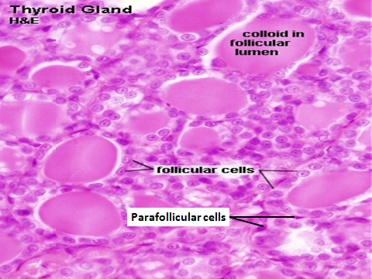

Slide 5
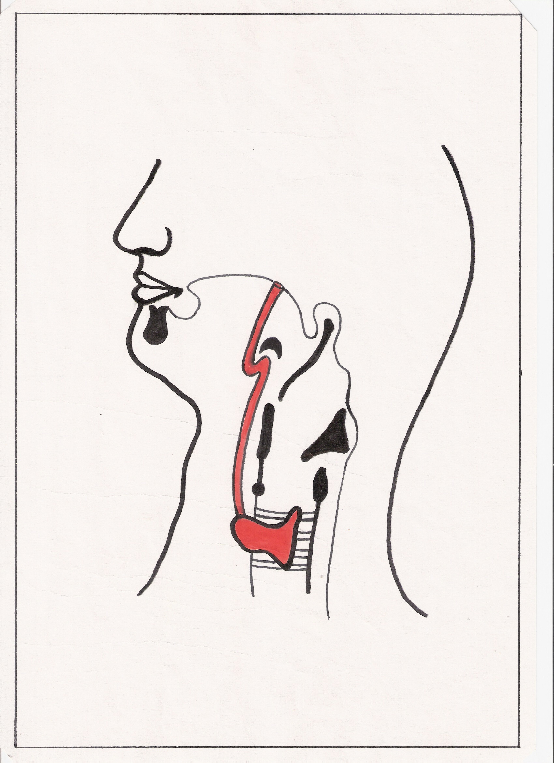
Development of thyroid gland
Develops from a median endodermal thyroid diverticulum
Also called thyroglossal duct
Extends from foramen caecum b/w anterior 2/3 rd and posterior 1/3 rd of tongue from the centre of sulcus terminalis
Foramen caecum
Median Endodermal
Thyroid Diverticulum

Slide 6
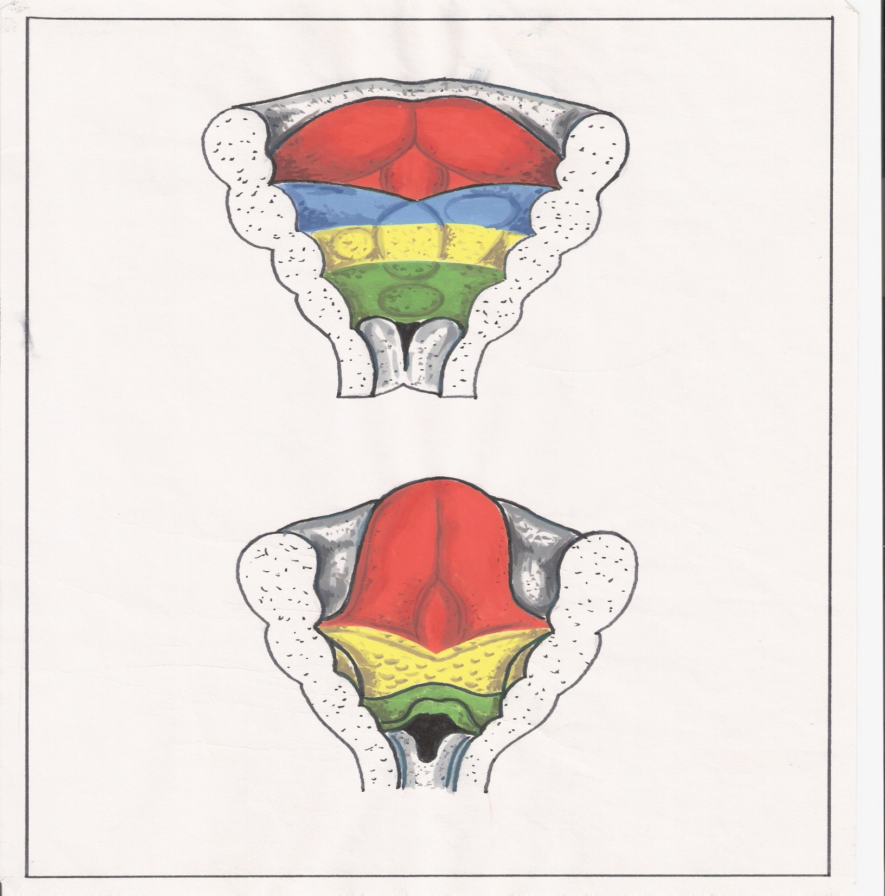
Lingual swelling
Tuberculum impar
Foramen caecum
Sulcus terminalis

Slide 7
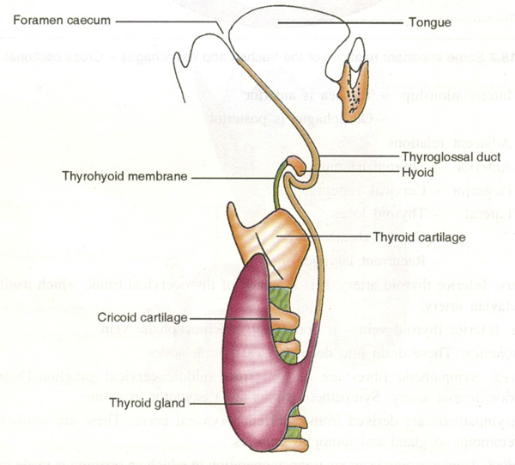
Development of thyroid gland
The diverticulum extends through developing tongue into the neck, initially in front of hyoid bone, then behind the bone & finally below the hyoid bone

Slide 8
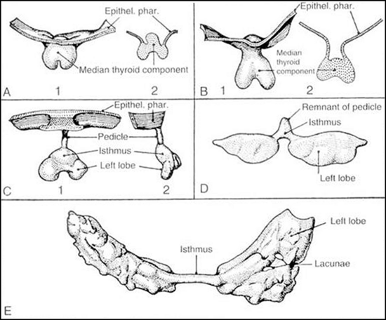

Slide 9
Development of thyroid gland
Lower end of diverticulum proliferates and becomes bilobed
Lobes move away from each other to form an isthmus
Once lobes & isthmus are formed the rest of diverticulum disintegrates & disappears
Development of FOLLICULAR CELLS of thyroid gland

Slide 10
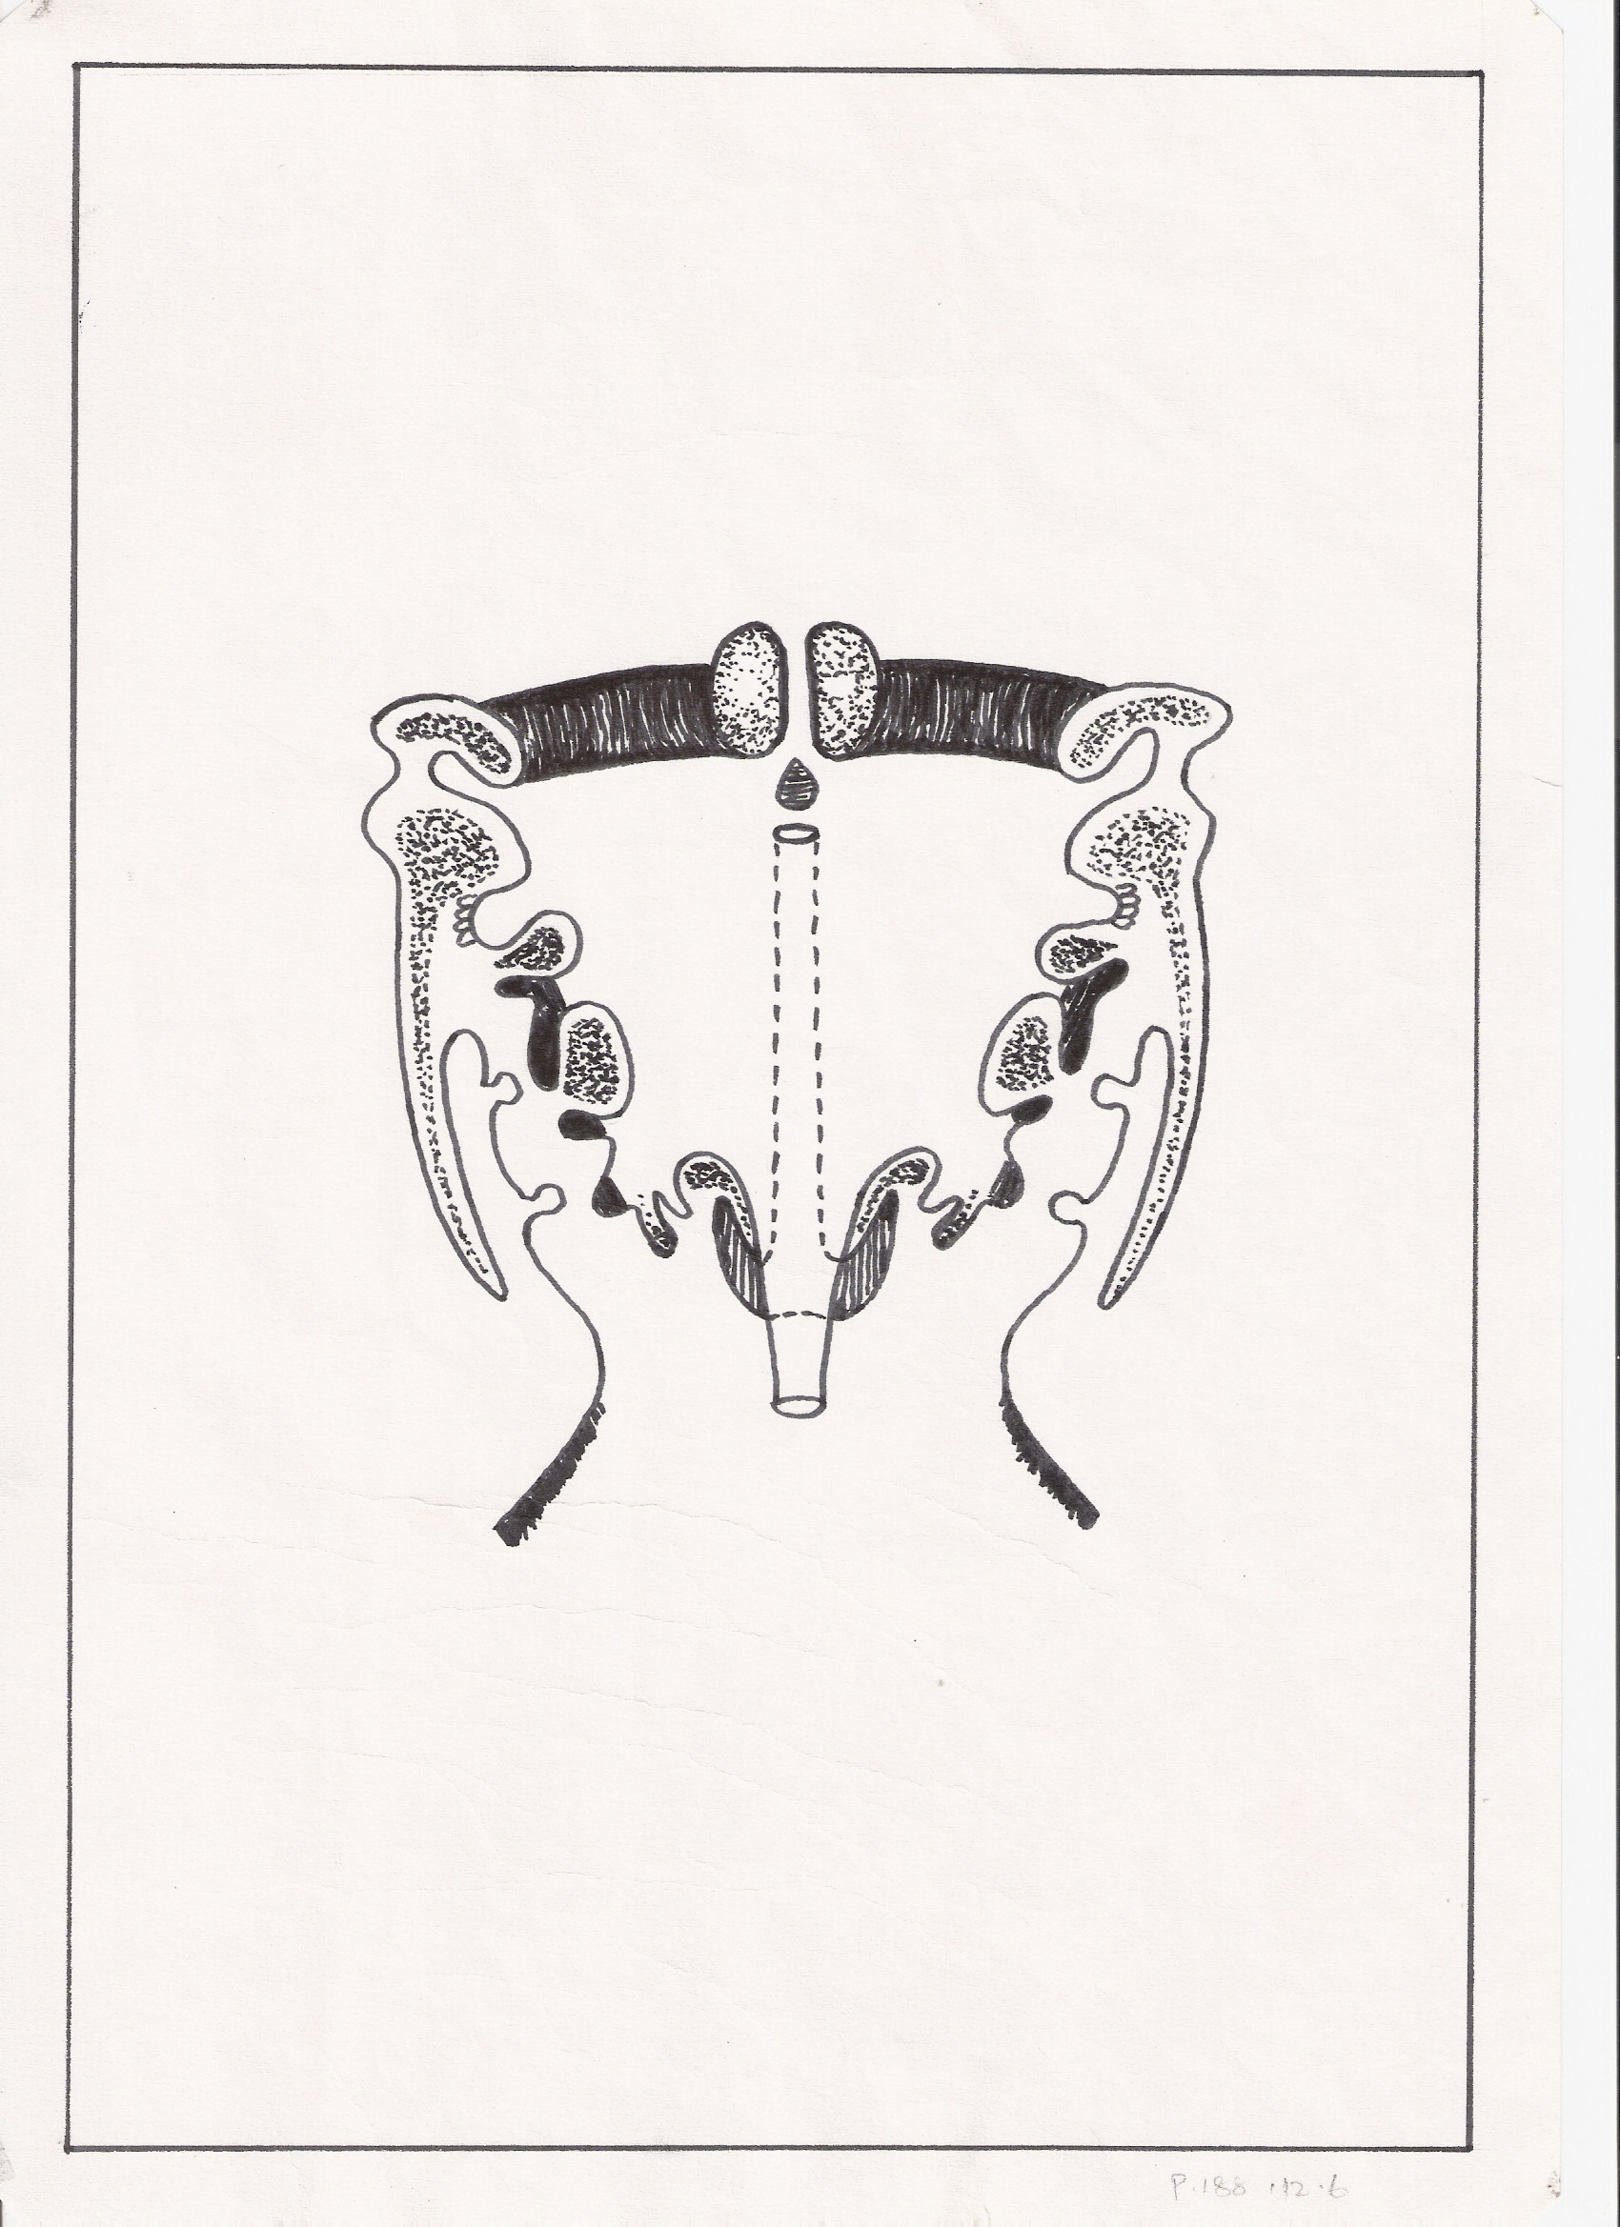
Development of thyroid gland
Parafollicular cells develop from ultimobranchial body from 5th pharyngeal pouch before it disappears
( fuses with 4th pouch to form caudal pharyngeal complex)

Slide 11
Development of thyroid gland
Congenital anomalies
Agenesis
Absence of isthmus thyroid gland
Ectopic thyroids:
Intralingual thyroid
Suprahyoid thyroid
Retrohyoid thyroid
Infrahyoid thyroid
Ectopic thyroid tissue in posterior triangle of neck
Retrosternal thyroid
Anomalies of thyroglossal duct*:
Thyroglossal cyst
Thyroglossal sinus
Thyroglossal fistula
* Connected to tongue
Variations:
Pyramidal lobe
Levator glandulae thyroidea

Slide 12
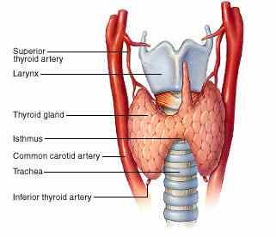

Slide 13
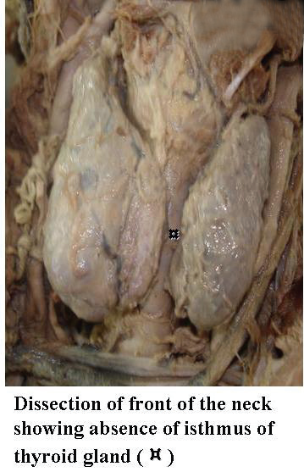

Slide 14
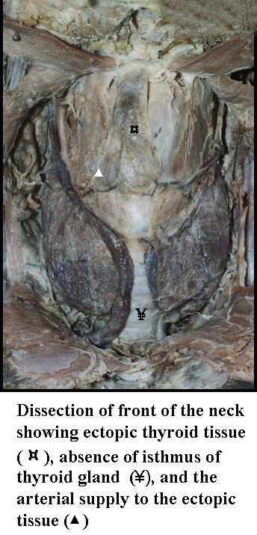

Slide 15
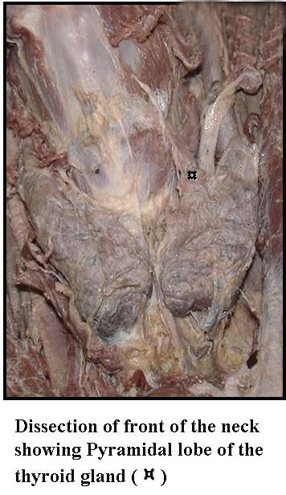

Slide 16
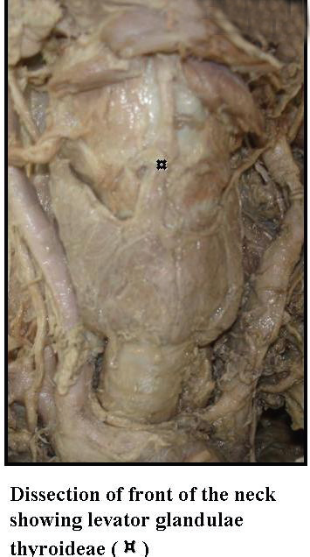

Slide 17
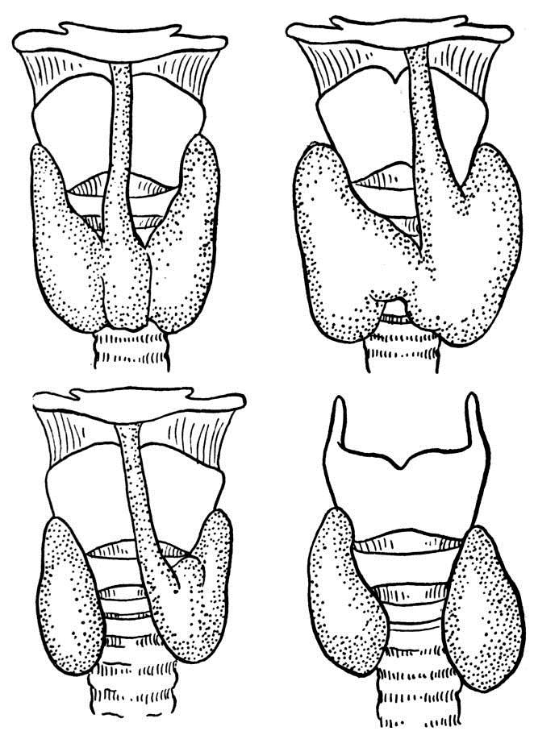

Slide 18
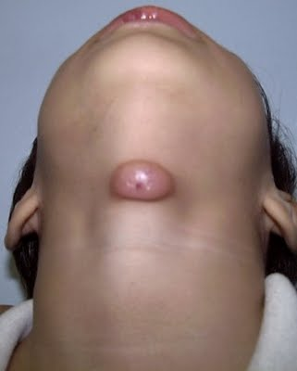
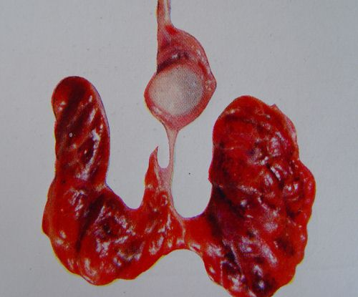
Thyroglossal cyst
( Moves up with protrusion of tongue)

Slide 19
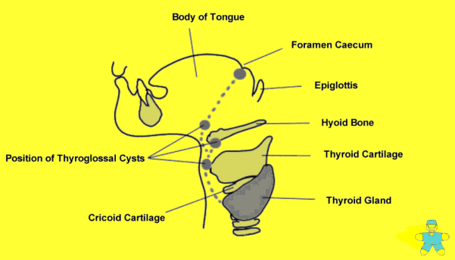

Slide 20
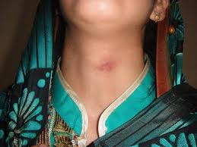
Thyroglossal fistula

Slide 21
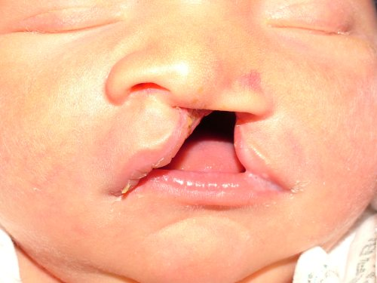
Cleft lip and
Cleft palate
A new born baby of a mother on antiepileptic drugs is diagnosed with cleft lip and cleft palate and is posted for surgery as she is unable to suckle and swallow milk.
With your knowledge of embryology mention the development of palate and the various types of cleft palate
What is the process by which congenital anomalies develop due to effect of drugs ingested by the mother called?

Slide 22
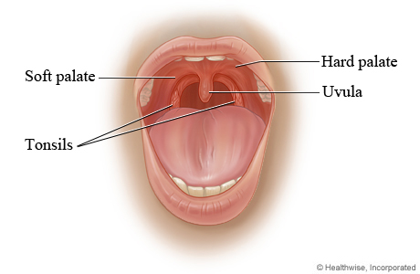
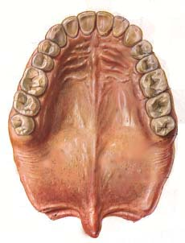

Slide 23
Development of palate
OBJECTIVES
At the end of this session, you will be able to:
Mention the development of primary and secondary palate
Mention the different types of cleft palate

Slide 24
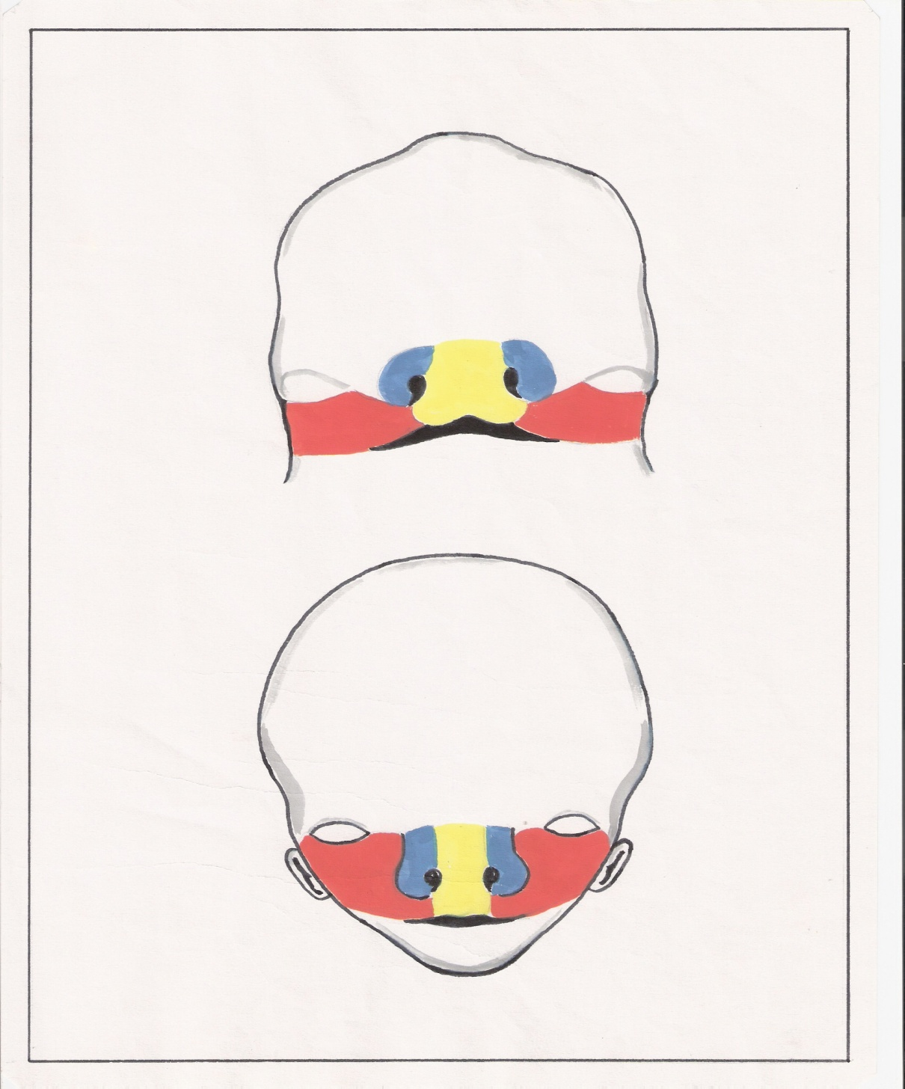
Development of face
Frontonasal process
Maxillary process
Mandibular arch
Median nasal process
Lateral nasal process
Stomatodaeum

Slide 25
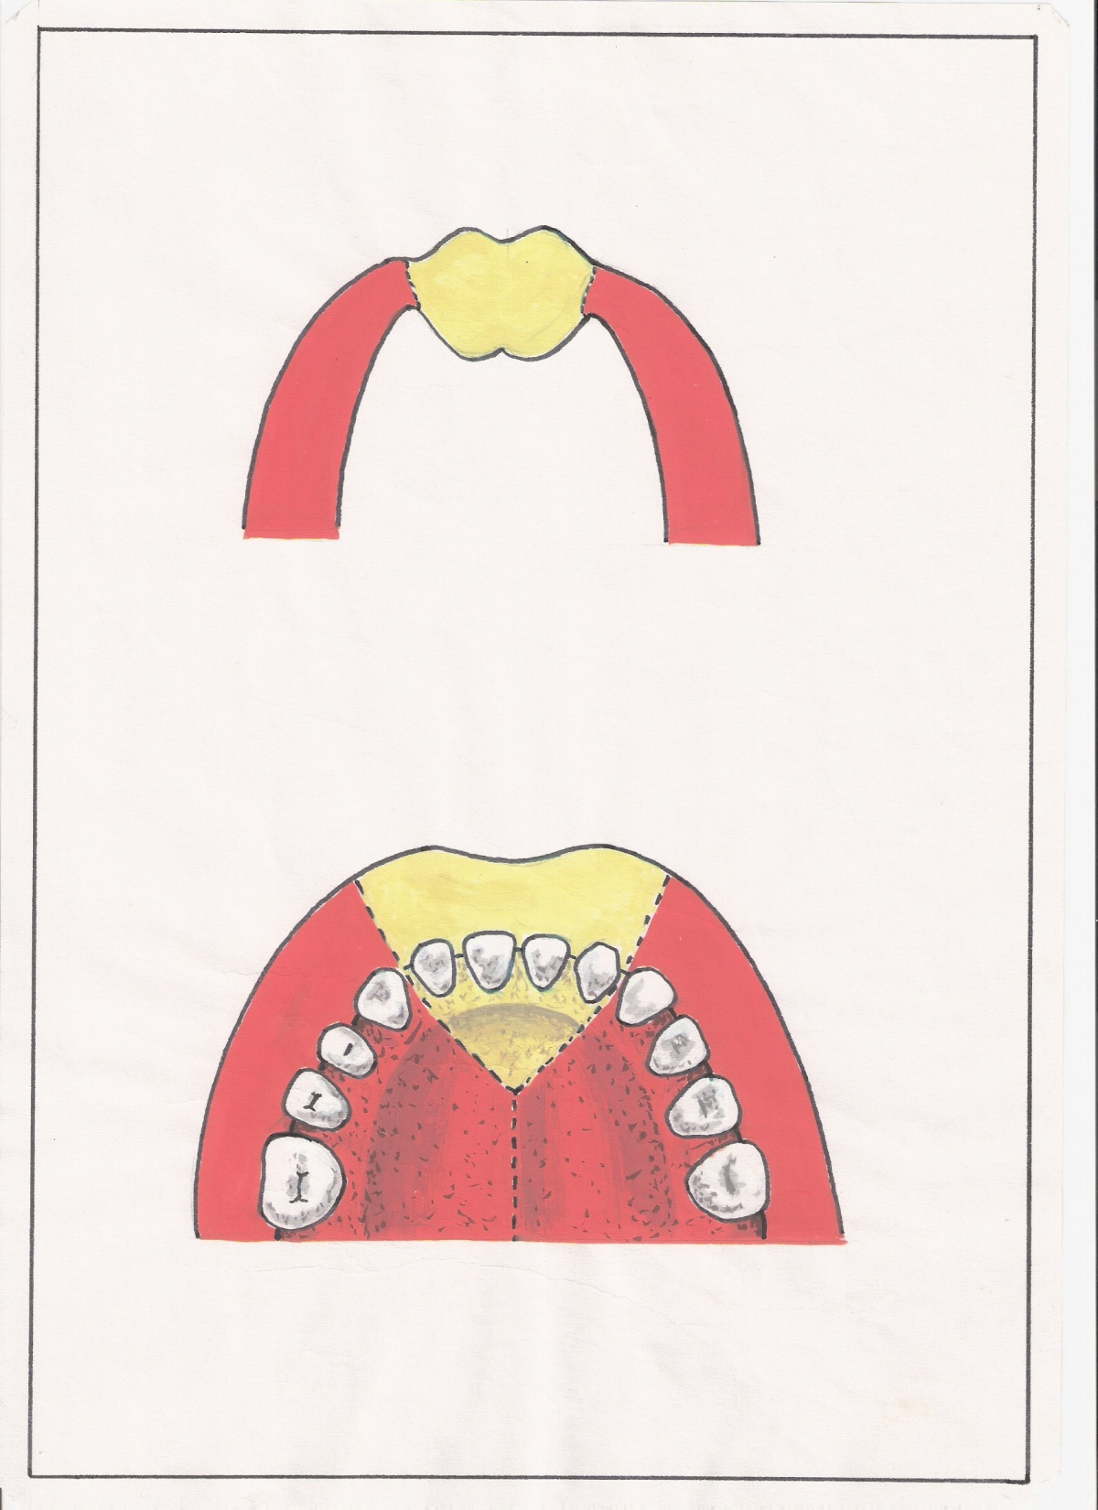
Development of palate
Median nasal process
Maxillary Process
Premaxilla/ Primary palate/ Primitive palate
Secondary palate

Slide 26
Development of palate
Palate develops between 5th to 10th week of IUL
Primary palate/premaxilla/primitive palate – develops from median nasal process
Secondary palate develops from palatine shelves from maxillary processes
They fuse with each other & undergo ossification
Anterior 3/4th becomes ossified to form Hard palate
Posterior 1/4th remains unossified to form Soft palate

Slide 27
Development of palate
Congenital anomalies
Cleft palate
Types
Cleft lip & cleft palate
Unilateral cleft palate
Bilateral cleft palate
Complete cleft palate
Incomplete cleft palate

Slide 28
a.
b.
a. Bilateral complete cleft palate
b. Unilateral complete cleft palate
c.
INCOMPLETE CLEFT PALATE
c. Median incomplete
d. Bilateral incomplete
e. Unilateral incomplete
d.
e.

Slide 29
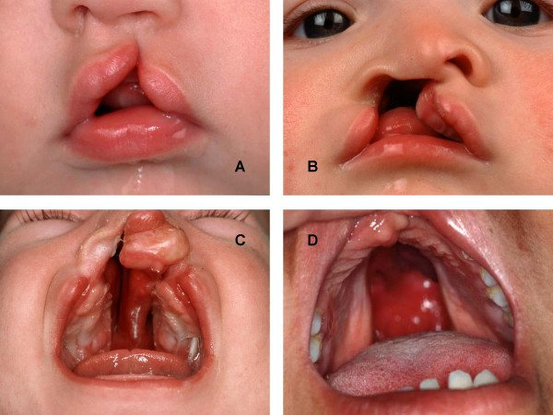
Development of palate

Slide 30
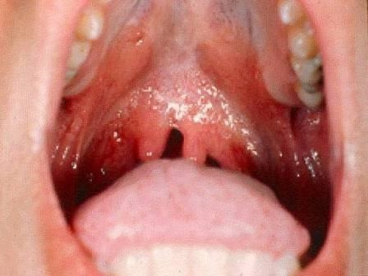
Development of palate
BIFID UVULA

Slide 31
DEVELOPMENT OF PALATE
Palate has two sources of origin:
Premaxilla from median nasal process
Palatine shelves of maxilla
Anterior 3/4ths gets ossified to form hard palate
Posterior 1/4th remains unossified as soft palate
Congenital anomalies
Unilateral complete cleft palate
Bilateral complete cleft palate
Unilateral incomplete cleft palate
Bilateral incomplete cleft palate
Bifid uvula
PREMAXILLA ( Median nasal process )
Secondary palate (PALATINE SHELVES FROM MAXILLARY PROCESSES)

Slide 32
Unilateral Cleft lip and
Cleft palate
What is the process by which congenital anomalies develop due to effect of drugs ingested by the mother called?

Slide 33
Thank you

