Slide 1
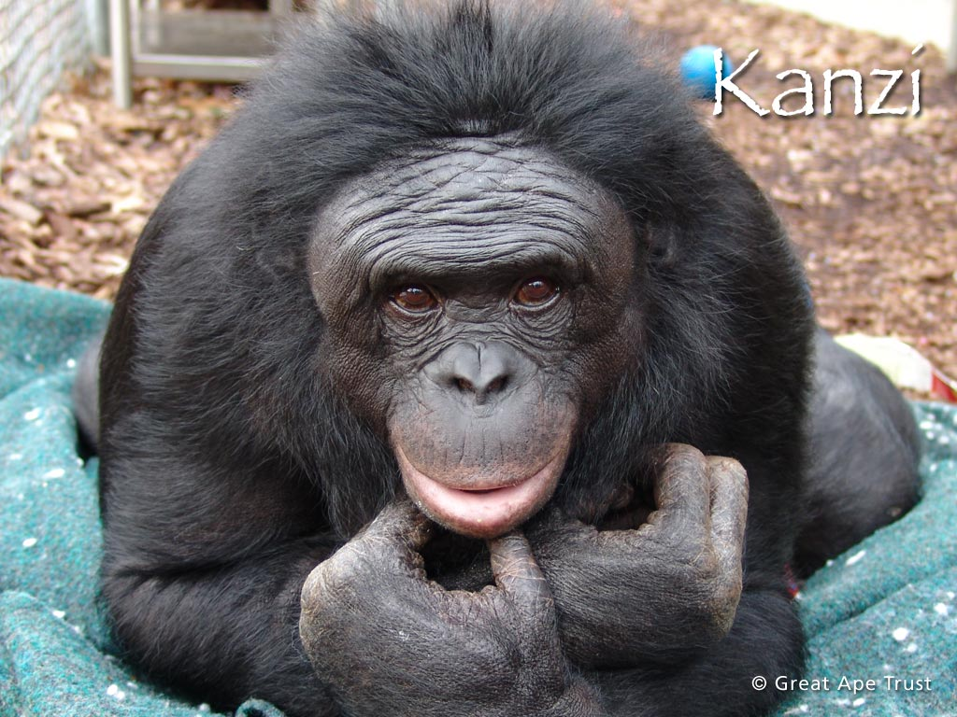

Slide 2
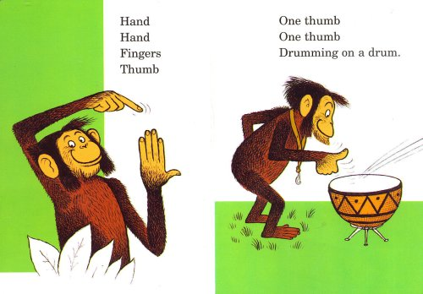
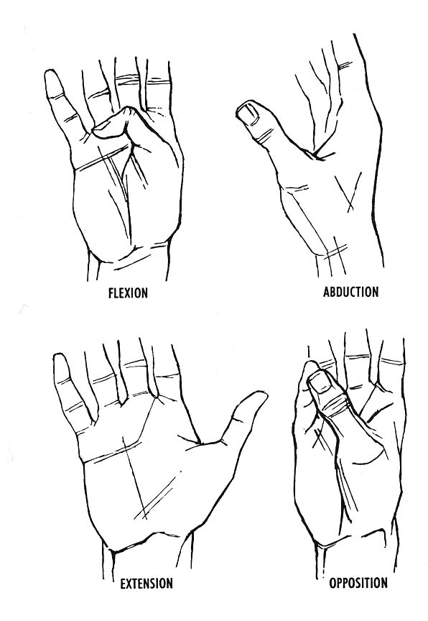

Slide 3
MEDIAN NERVE

Slide 4
LEARNING OBJECTIVES
At the end of this session, you will be able to:
Identify the median nerve
Mention the root value of nerve
Describe the formation; course & relations; branches & distribution of the nerve
Explain the anatomical basis of deformities occuring due to lesion of the nerve

Slide 5
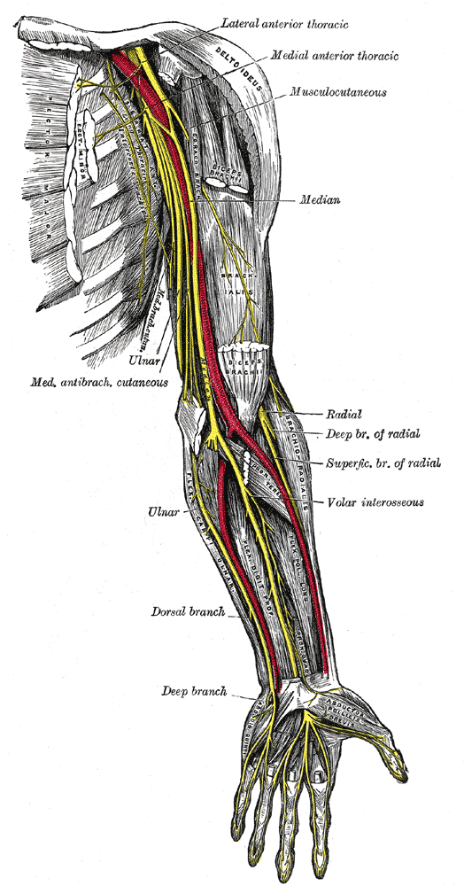

Slide 6
C7
C6
C8
Axilla
C5
T1
MEDIAN NERVE
Brachial artery
Arm
Tendon of Biceps Brachii
Pronator teres
Forearm
PT
FCR
PL
FDS
Anterior interosseous nerve
FPL
PQ
Lateral ½ FDP
Flexor retinaculum
Palmar cutaneous branch
Hand
AbPB
FPB
OP
1st & 2nd lumbricals
Digital branches to lateral 3 ½ fingers

Slide 7
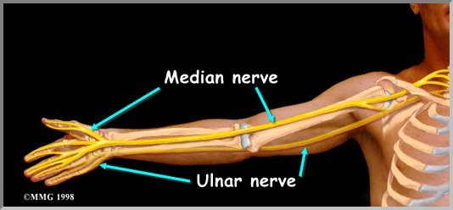
MEDIAN NERVE
Introduction
Nerve of flexor compartment of forearm
Called as ‘Laborer’s Nerve’
Branch from both lateral & medial cords of Brachial Plexus

Slide 8
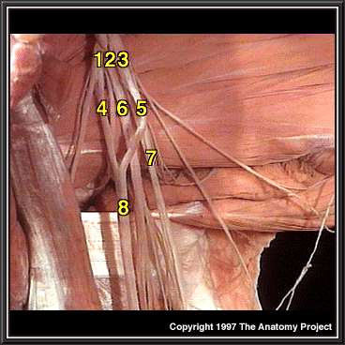

Slide 9
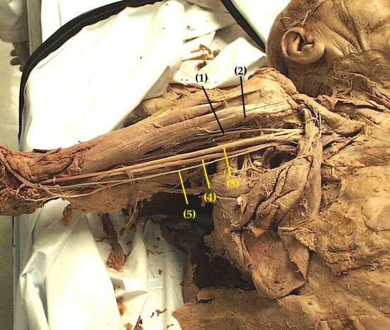
MEDIAN NERVE
Formation
Lateral root from lateral cord
Medial root from medial cord
Root Value
C₅, C₆, C₇, C₈, T₁

Slide 10
MEDIAN NERVE
Course & Relations
IN AXILLA
Medial root crosses III part of Axillary artery & joins lateral root
Formed lateral to III part of Axillary artery
Enters arm as it passes below lower border of Teres Major muscle

Slide 11
MEDIAN NERVE
IN THE ARM
In the upper part of arm, lateral to Brachial artery
At the level of insertion of Coracobrachialis, crosses Brachial artery from lateral to medial side
In the lower part of arm, medial to Brachial artery

Slide 12
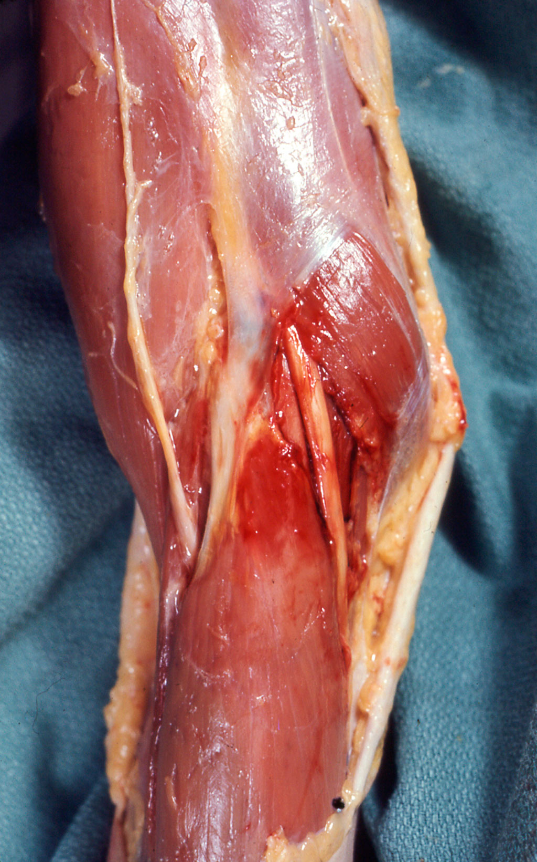
CUBITAL FOSSA
Biceps Brachii
Brachial artery
Median Nerve

Slide 13
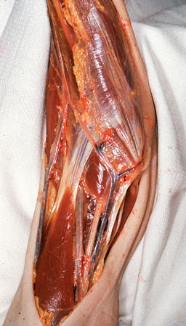
Median Nerve
Pronator Teres
Bicipital aponeurosis

Slide 14
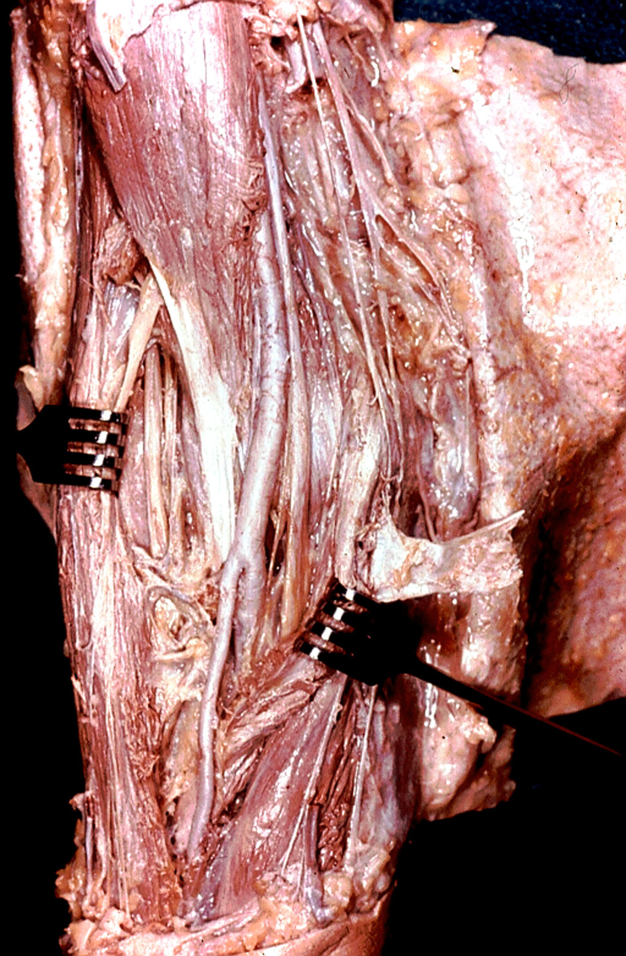

Slide 15
MEDIAN NERVE
AT THE CUBITAL FOSSA
Lies medial to tendon of Biceps Brachii & Brachial artery
Gives branches to superficial muscles of front of forearm from its medial side
Enters forearm by passing between 2 heads of Pronator Teres

Slide 16
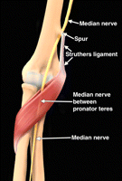

Slide 17
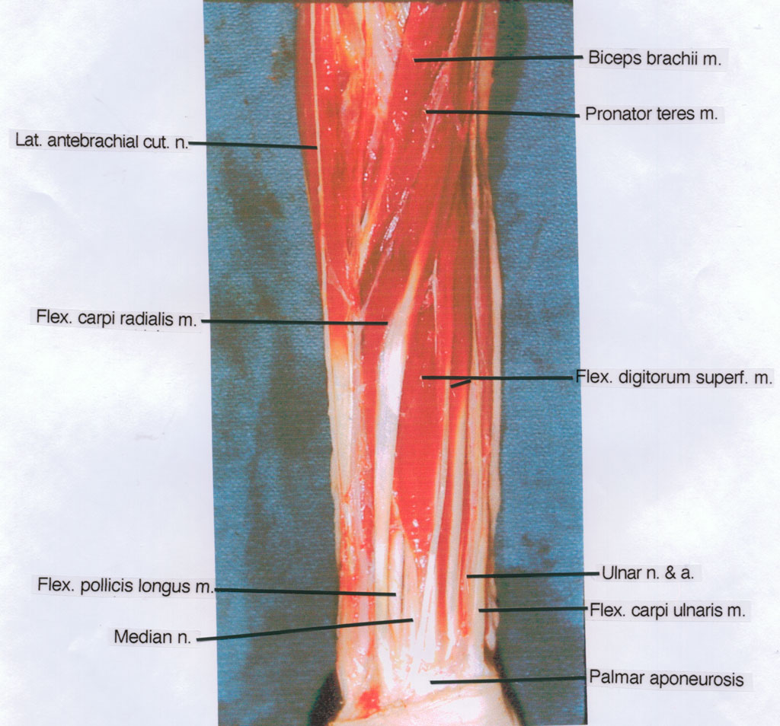

Slide 18
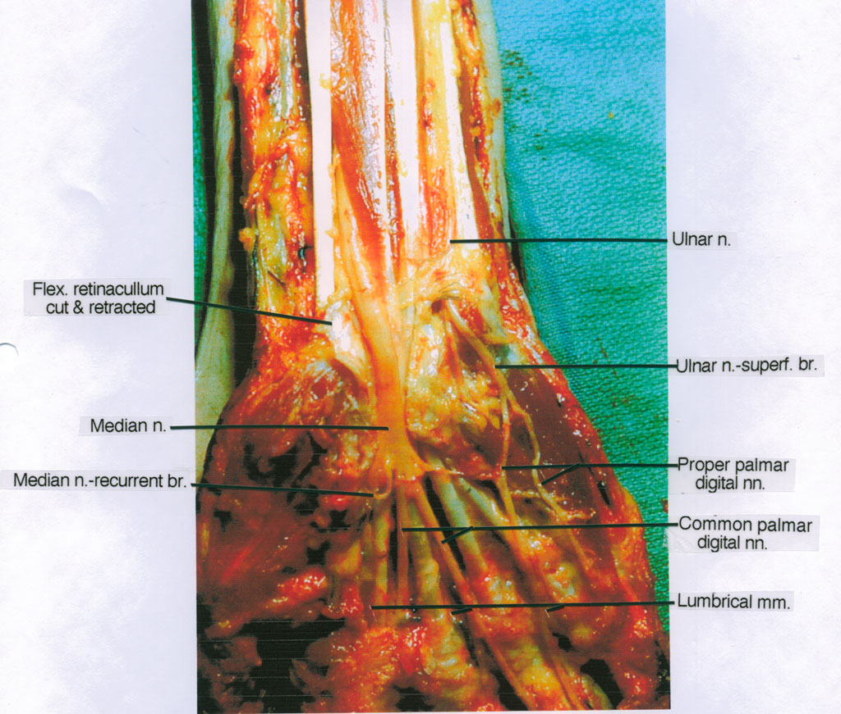

Slide 19
MEDIAN NERVE
IN THE FOREARM
Passes deep to arch formed by origin of FDS
Lies between superficial & deep flexors of forearm
Gives a deep branch – Anterior interosseous Nerve (AIN)
AIN supplies deep muscles in front of forearm
Becomes superficial in lower part of forearm
Gives palmar cutaneous branch
Lies between tendons of FDS & FCR & deep to PL
Enters hand by passing through Carpal Tunnel deep to Flexor retinaculum

Slide 20
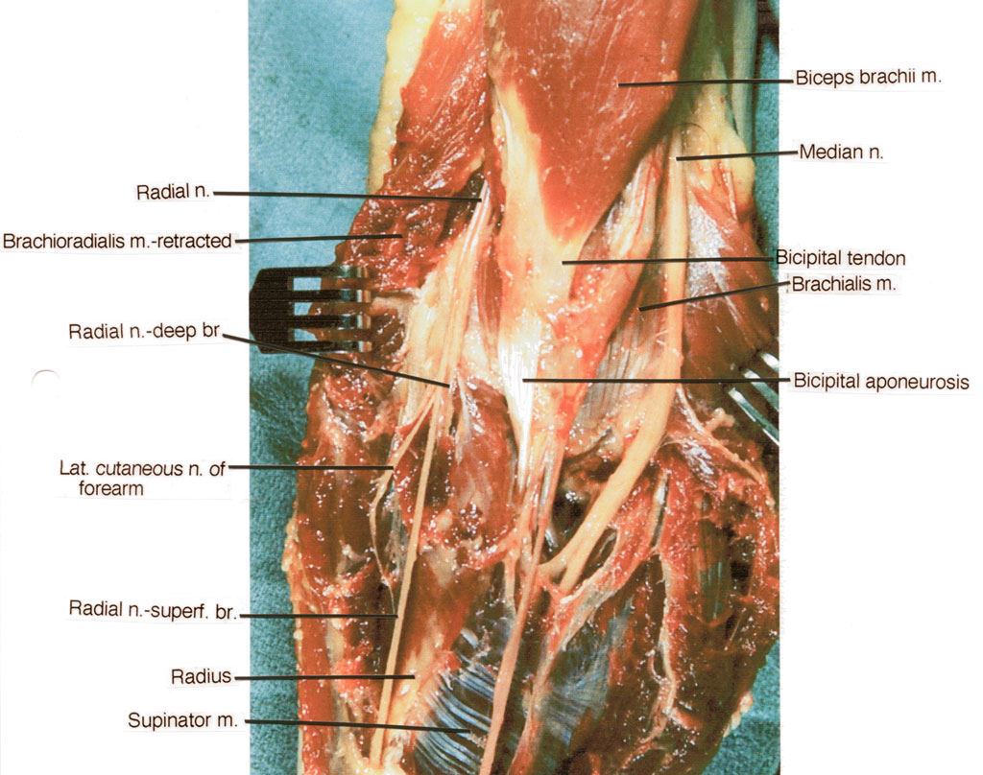
Anterior interosseous nerve

Slide 22
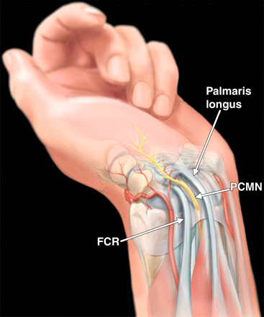

Slide 23
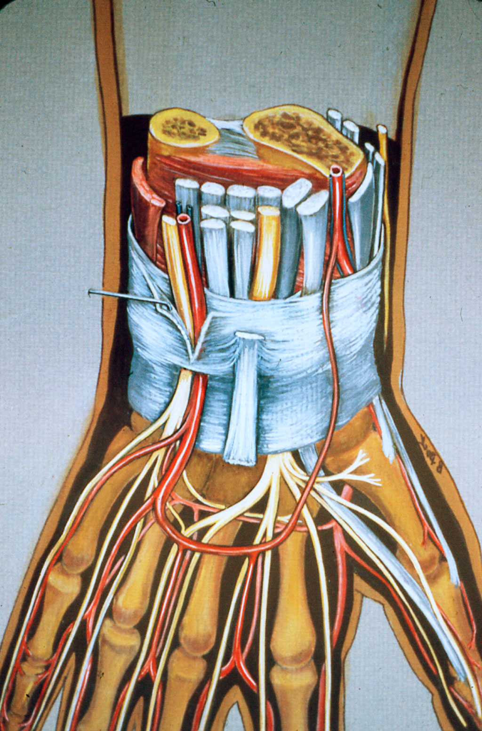
AT THE WRIST
Flexor retinaculum
MEDIAN NERVE

Slide 24
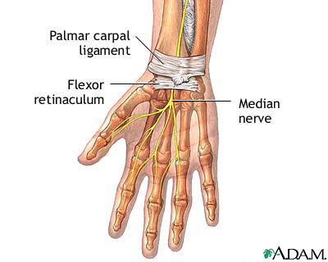

Slide 25
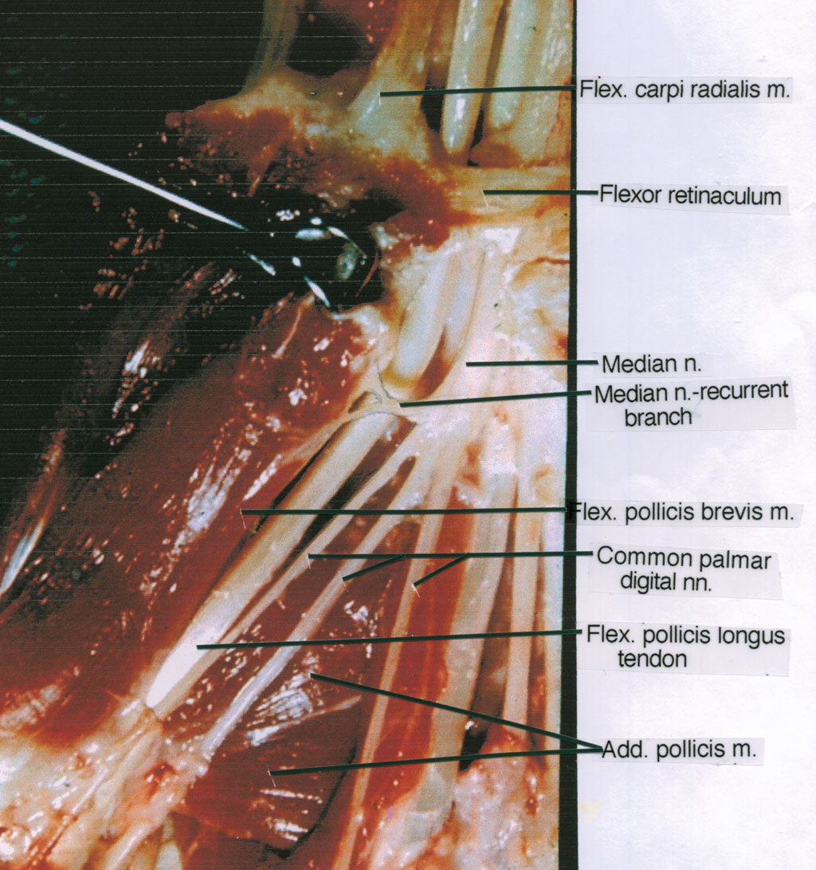

Slide 26
MEDIAN NERVE
IN THE HAND
Divides into medial & lateral branches
Lateral branch gives a reccurent branch which supplies Thenar muscles
Medial branch supplies lateral 2 lumbricals & ends by giving digital branches to skin of lateral 3 ½ fingers (palmar surface)

Slide 27
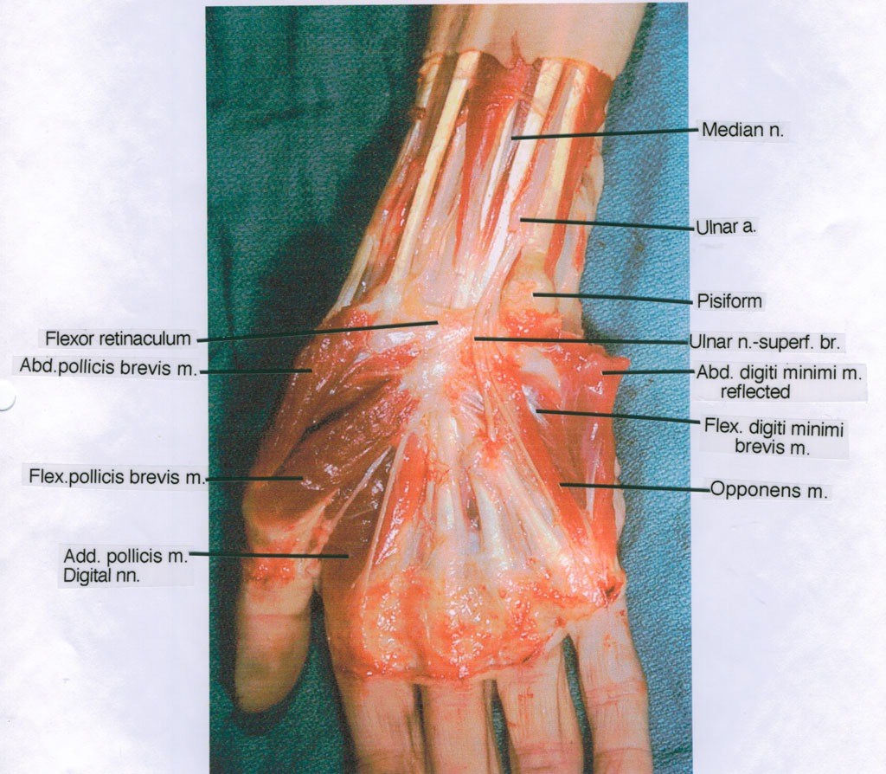
Opponens pollicis

Slide 28
MEDIAN NERVE
Branches & Distribution
In the Axilla – Nil
In the Arm – Nil
In the Forearm
– Motor : Superficial muscles : PT
FCR
PL
FDS
: Deep muscles : FPL
Lateral ½ FDP
PQ
- Cutaneous : Palmar cutaneous branch : Lateral ½ of palm including
thenar eminence

Slide 29
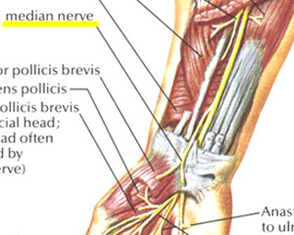

Slide 30
MEDIAN NERVE
Branches & Distribution
In the hand
Motor : Thenar muscles : AbPB
FPB
OP
Lumbricals : 1st & 2nd lumbricals
- Sensory : Skin of lateral 3 ½ fingers including nail beds & skin of dorsal surface of distal phalanx

Slide 31
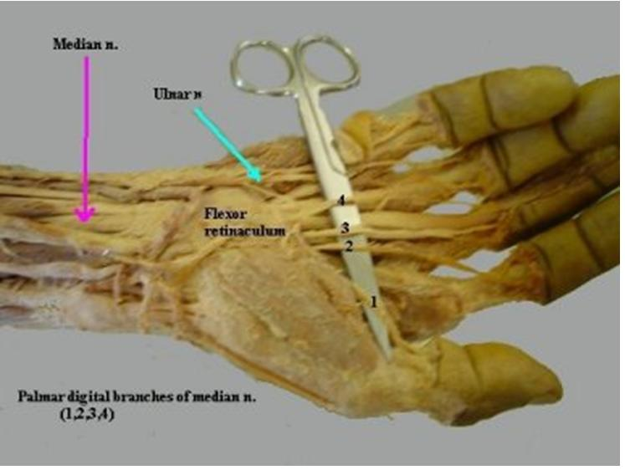

Slide 32
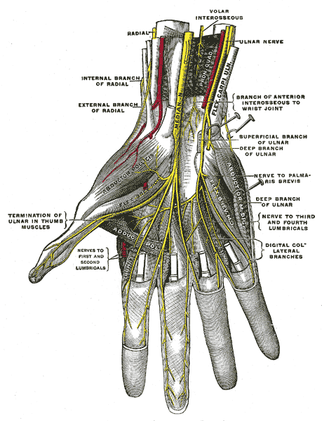

Slide 33
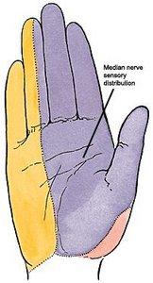

Slide 34
MEDIAN NERVE
Applied Anatomy
Lesions of Median nerve
CAUSES
In the arm : Supracondylar fracture of Humerus
At the cubital fossa : Entrapment Syndrome – Compression of nerve by Pronator Teres
In the forearm : Carpal Tunnel Syndrome

Slide 35
MEDIAN NERVE
Signs & Symptoms of lesions of Median Nerve
Paralysis of flexors of forearm results in Benediction Attitude
Pointing index finger
Paralysis of thenar muscles results in
Ape Thumb Deformity
Sensory defect : Loss of sensations on lateral 3 ½ fingers ( palmar surface)

Slide 36
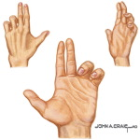

Pointing Index finger
Benediction attitude

Slide 37
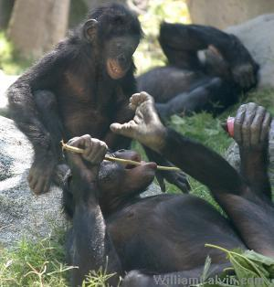
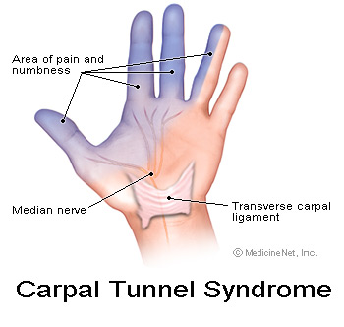
Ape thumb deformity

Slide 38
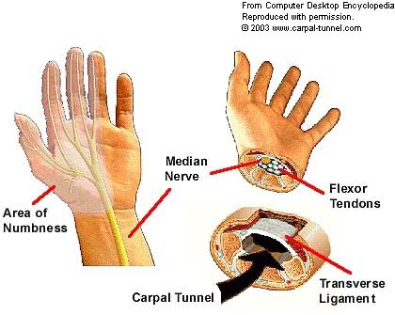

Slide 39
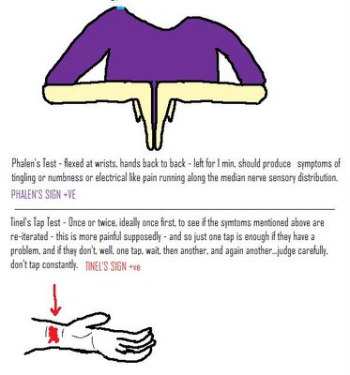

Slide 40
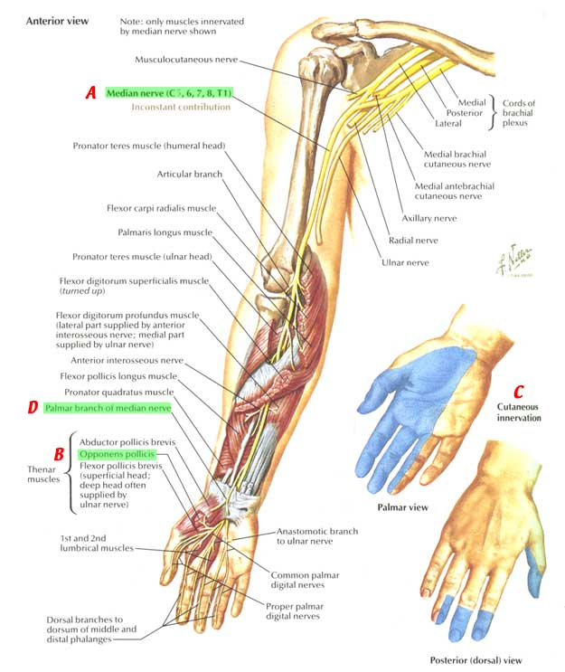

Slide 41
Thank You

