Slide 1
Gluteal muscles Gluteus maximus and structure under cover of it

Slide 2
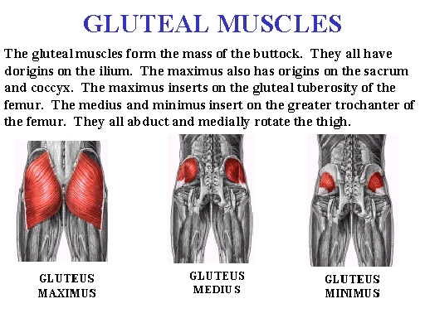

Slide 3
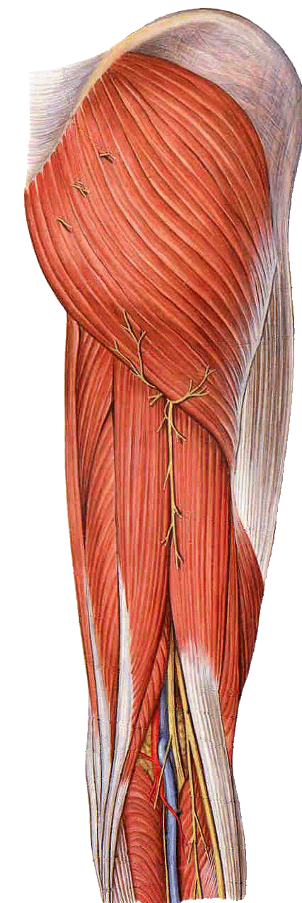
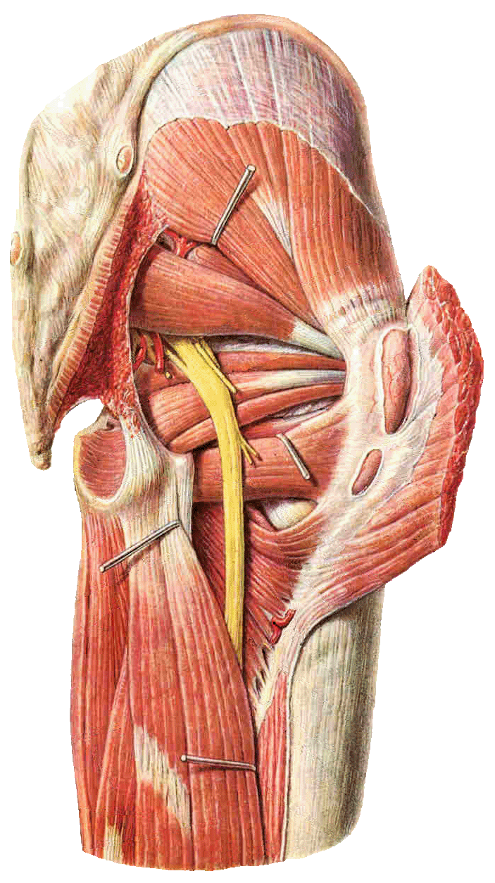
Muscles of hip
Posterior group
Gluteus maximus
Gluteus medius
Gluteus minimus
Piriformis
Obturator internus
Obturator externus
Quadratus femoris

Slide 4
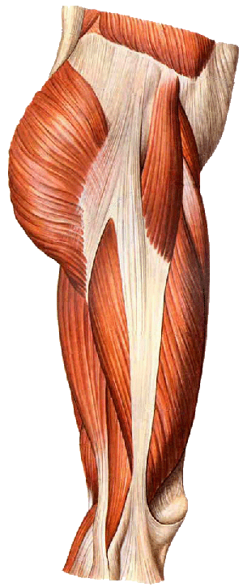
Muscles of the gluteal region
Gluteus medius
Gluteus maximus
Gluteus minimus
Piriformis
Obturator internus
Obturator externus
Quadratus femoris

Slide 5
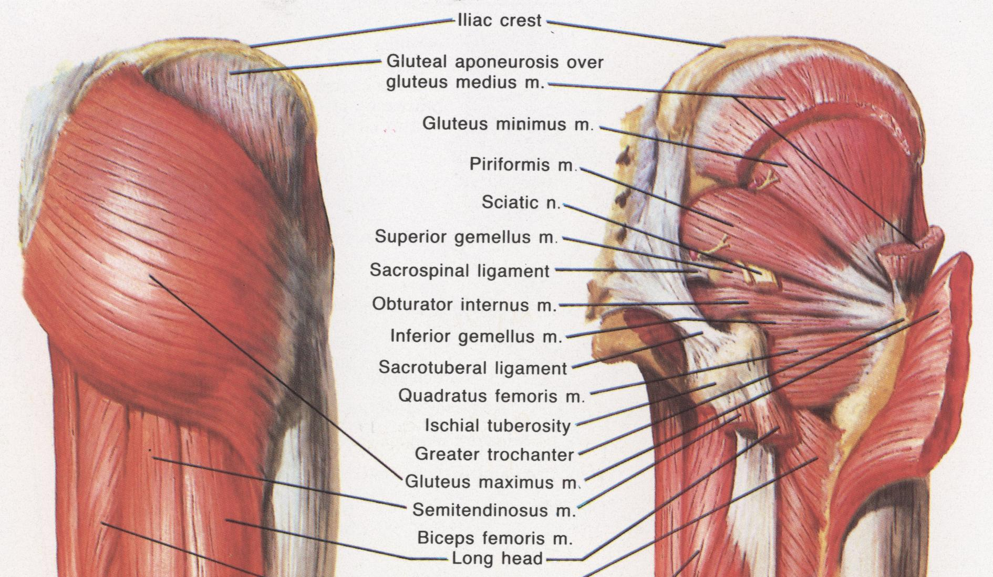
Gluteal muscles

Slide 6
Gluteus maximus
largest and most superficial muscle in the gluteal region.
It is a broad, thick quadrilateral mass, which forms the familiar prominence of the buttock.
Gluteus maximus is thicker and more extensive in man than in any non-human primate, developments that are associated with the evolutionary transition to bipedality and a permanently upright posture

Slide 7
origin
posterior gluteal line of the ilium, and the rough area of bone, including the crest, immediately above and behind it
from the aponeurosis of erector spinae
the dorsal surface of the lower part of the sacrum
side of the coccyx
sacrotuberous ligament;
fascia (gluteal aponeurosis) which covers gluteus medius. There may be additional slips from the lumbar aponeurosis or ischial tuberosity.

Slide 8
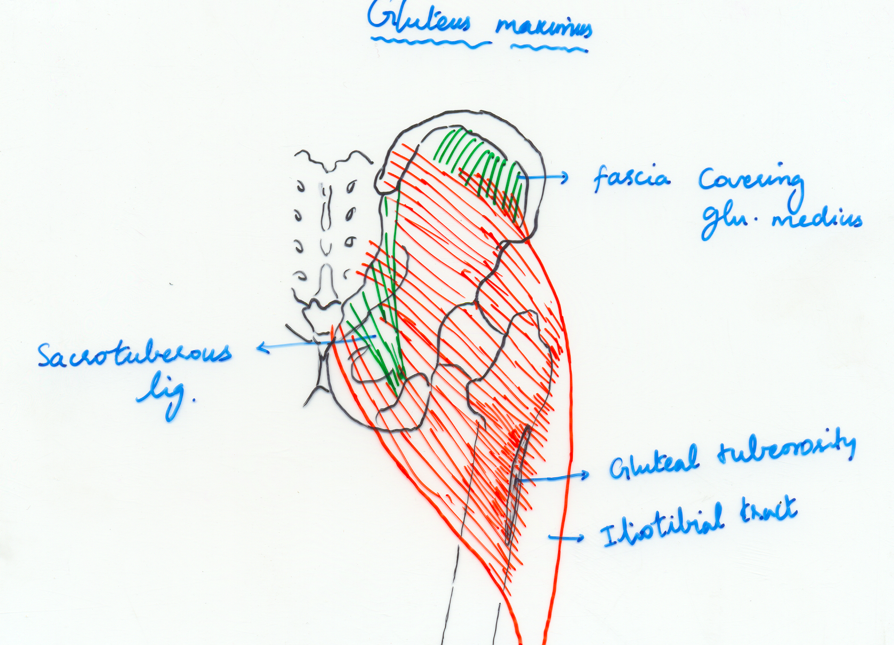

Slide 9
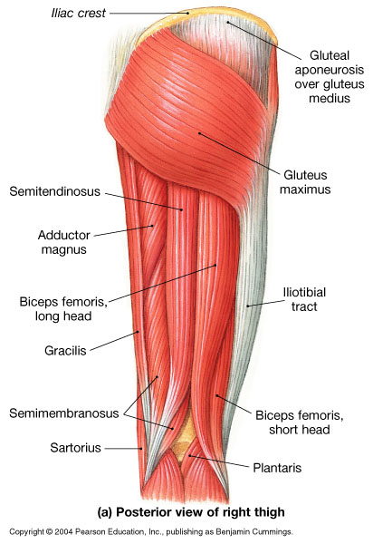
Figure 11.20a

Slide 10
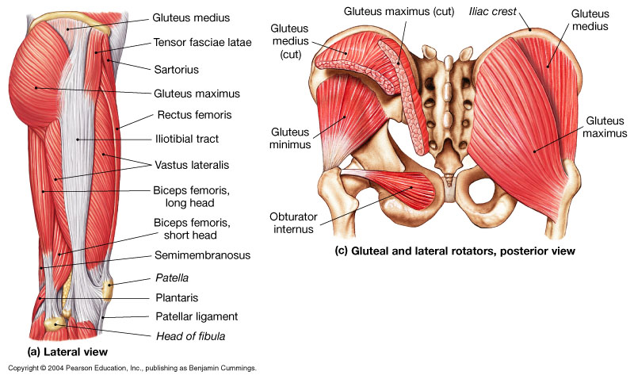
Figure 11.19a, c

Slide 11
Insertion
The fibres descend laterally;
iliotibial tract of the fascia lata.
The deeper fibres of the lower part of the muscle are attached to the gluteal tuberosity.

Slide 12
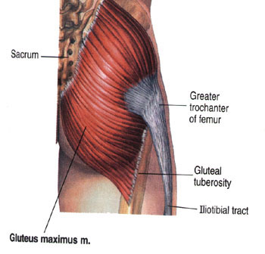

Slide 13
Structures deep to it
Its deep surface is related to the ilium, sacrum, coccyx, the ischial tuberosity, greater trochanter
sacrotuberous ligament,
part of gluteus medius, piriformis, the gemelli, obturator internus, quadratus femoris,, and the attachments of biceps femoris, semitendinosus, semimembranosus and adductor magnus.

Slide 14
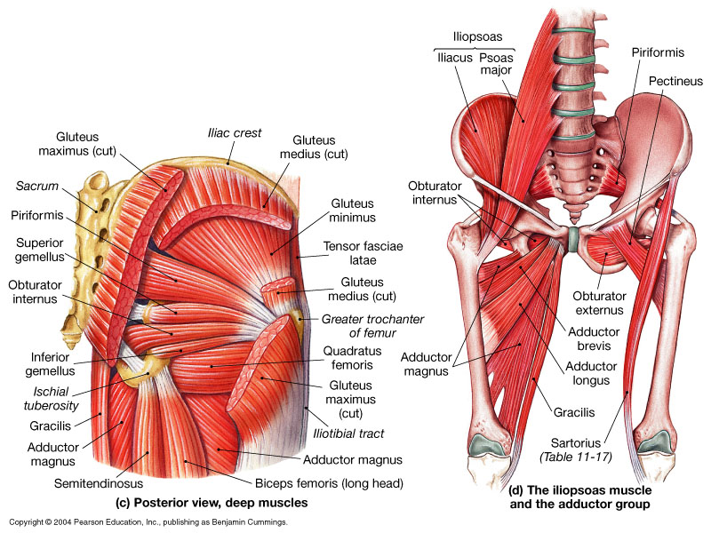
Figure 11.19c, d

Slide 15
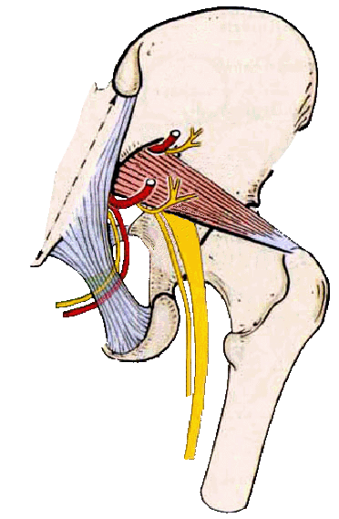
Structures passing through suprapiriform foramen
From lateral to medial side
Superior gluteal n.
Superior gluteal a.
Superior gluteal v.

Slide 16
The superficial division of the superior gluteal artery
The inferior gluteal and internal pudendal vessels,
The first perforating artery and the terminal branches of the medial circumflex femoral artery.

Slide 17
Structures passing through infrapiriform foramen
From lateral to medial side
Sciatic n.
Posterior femoral cutaneous n.
Inferior gluteal n.
Inferior gluteal a., v
Internal pudendal v., a.
Pudendal n.
They then curve forwards to enter the perineum through the lesser sciatic foramen

Slide 18
the sciatic,
Pudendal
posterior femoral cutaneous nerves,
muscular branches from the sacral femoral cutaneous nerves,
muscular branches from the sacral plexus all leave the pelvis below piriformis.

Slide 19
Blood supply
inferior gluteal artery, which supplies approximately two-thirds of the muscle.
The remainder is supplied mainly by the superior gluteal artery,
though this may sometimes receive a supply from the first profunda, perforator and from the medial circumflex femoral artery. Minor branches may be derived from the lateral circumflex femoral, lateral sacral and internal pudendal arteries

Slide 20
Nerve supply
innervated by the inferior gluteal nerve, L5 and S1 and 2.

Slide 21
extend the flexed thigh and bring it into line with the trunk.
may prevent the forward momentum of the trunk from producing flexion at the supporting hip during bipedal gait
intermittently active in the walking cycle and in climbing stairs,
strong lateral rotation of the thigh.
Its upper fibres are active in powerful abduction of the thigh.
It is a tensor of the fascia lata, and through the iliotibial tract it stabilizes the femur on the tibia when the knee extensor muscles are relaxed.

Slide 22
Testing
Extension of the hip against resistance, in the supine or prone position.

Slide 23
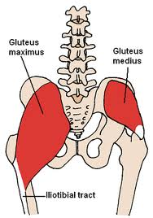
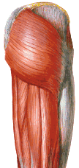
Gluteus maximus
Origin :
ilium & dorsal sacrum
Insertion
1. gluteal tuberosity
2. iliotibial band
Action
1. powerful extension
2. ER of hip
Innervation:
inferior gluteal N.

Slide 24
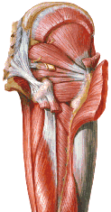
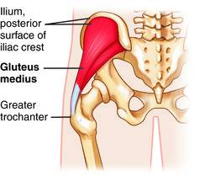
Gluteus medius
Origin:ilium between anterior & posterior gluteal lines
Insertion:
greater trochanter
Action:
1. powerful abduction
2. Medial rotation of thigh
3. Balancing during walking
Innervation:superior gluteal N.

Slide 25
Gluteus Medius Muscle
Most of this thick, fan-shaped or triangular muscle lies deep to the gluteus maximus on the external surface of the ilium.
Proximal attachments are: external surface of ilium between anterior and posterior gluteal lines.
Distal attachments are: lateral surface of greater trochanter of femur.
Innervation: superior gluteal nerve (L5 and S1)
This muscle is an abductor of the hip joint and plays an essential role during locomotion; it is largely responsible for the tilt of the pelvis. When the left muscle pulls the left side of the pelvis down, the right side is prevented from sagging as the right limb is raised during walking. Conversely, the right gluteus muscle permits the left foot to clear the ground during walking.
It also helps to rotate the thigh medially.
Summary: abduct and medially rotate thigh; steady pelvis

Slide 26
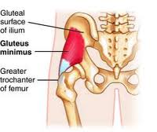
Gluteus minimus
Origin:
ilium between anterior & inferior gluteal lines
Insertion:
anterior greater trochanter
Action:
1. abduction & Medial Rotation of thigh
2. Assist gluteus medius during walking

Slide 27
The Gluteus Minimus Muscle
The fan-shaped or triangular muscle, the smallest of the gluteal muscles, lies deep to the gluteus medius.
Proximal attachments are: external surface of ilium between anterior and inferior gluteal lines.
Distal attachments are: anterior surface of greater trochanter of femur.
Innervation: superior gluteal nerve (L5 and S1)
During locomotion its actions are similar to those of the gluteus medius.
Its anterior fibres help to rotate the thigh medially, more strongly that do those of the gluteus medius.

Slide 28
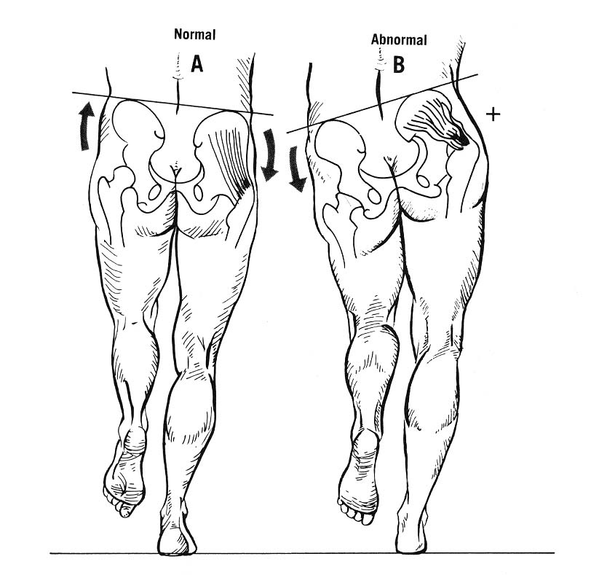
Trendelenburg sign

Slide 29
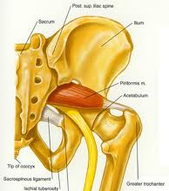
Piriformis
Origin:
anterior sacrum
Insertion: superior greater trochanter
Action:
1. hip ER
2. hip abduction during flexion

Slide 30
The Piriformis Muscle
It leaves the pelvis though the greater sciatic foramen to reach its distal attachment to the greater trochanter of the femur.
Because of its position, this narrow, pear-shaped (L. piriform) muscle is landmark of the gluteal region. It is the key to understanding relationships in this area because it determines the names of the blood vessels and nerves; e.g., the superior gluteal vessels and nerve emerge superior to it.
Proximal attachments are: anterior surface of sacrum and sacrotuberous ligament.
Distal attachments are: superior border of greater trochanter of femur.
Innervation: branches from ventral rami of S1 and S2
It laterally rotates extended thigh and abducts the flexed thigh; steadies femoral head in acetabulum.

Slide 31
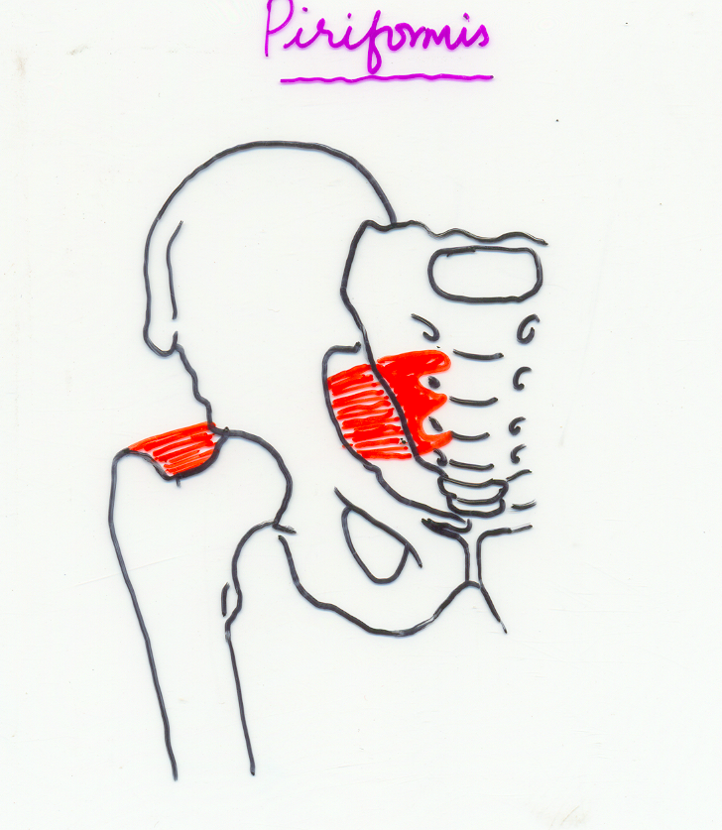

Slide 32
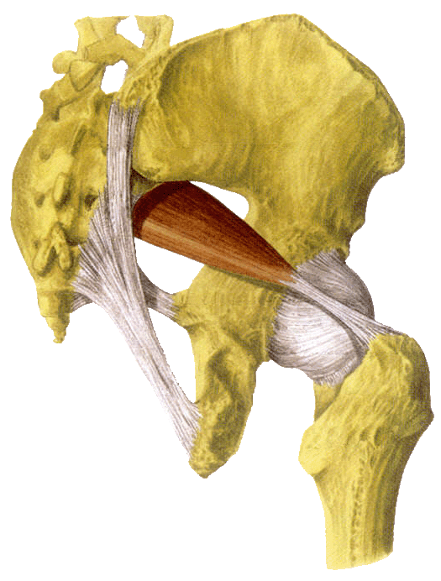
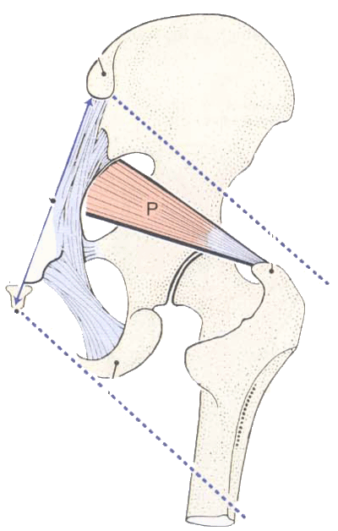
The gluteal region
suprapiriform foramen
infrapiriform foramen

Slide 33
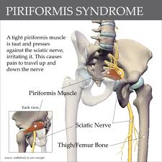
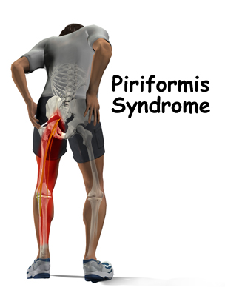

Slide 34
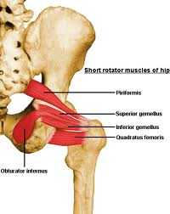
Obturator internus
Origin
1. ischiopubic rami 2.obturator membrane
Insertion: medial greater trochanter
Action:
1. hip ER
2. hip abduction during flexion

Slide 35
Figure 11.19a, c

Slide 36
The Obturator Internus Muscle
This thick fan-shaped muscle, like the piriformis, is located partly in the pelvis where it covers most of the lateral wall of the pelvis minor.
It leaves the pelvis through the lesser sciatic foramen to reach its attachment to the greater trochanter of the femur.
Proximal attachments are: pelvic surface of obturator membrane and surrounding bones.
Distal attachments are: medial surface of greater trochanter of femur.
Innervation: nerve to obturator internus (L5 and S1). Note: same as superior gemellus.

Slide 37
Superior & Inferior gemellus
Origin:
ischial spine(sup.)
ischial tuberosity(inf.)
Insertion: medial greater trochanter
Action:
1. hip ER
2. hip abduction during flexion

Slide 38
The Gamelli Muscles (Superior and Inferior)
The two gemelli muscles are narrow, triangular extrapelvic parts of the obturator internus.
The superior and inferior gemelli arise from the ischial spine and ischial tuberosity, respectively.
The obturator internus and gemelli muscles laterally rotate the extended thigh, abduct it when it is flexed and also help to hold the head of the femur in the acetabulum.
Innervation :Gemellus superior is innervated by the nerve to obturator internus, L5 and S1. Gemellus inferior is innervated by the nerve to quadratus femoris, L5 and S1.

Slide 39
Quadratus femoris
Origin:
ischial tuberosity
Insertion: intertrochanteric crest
Action: hip ER

Slide 40
The Quadratus Femoris Muscle
This is a short, flat, rectangular muscle.
Proximal attachments are: lateral border of ischial tuberosity.
Distal attachments are: quadrate tubercle on intertrochanteric crest of femur and inferior to it.
Nerve supply-nerve to quadratus femoris.

Slide 41
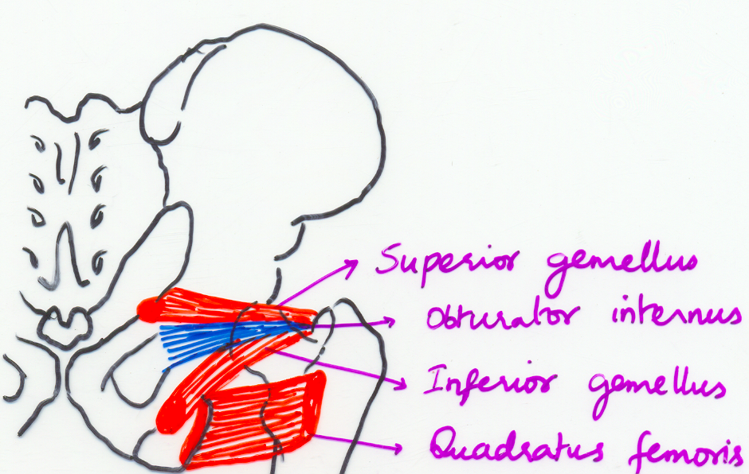

Slide 42
APPLIED ANATOMY
Gluteal intramuscular injections
Trendelenburg’s sign
Weaver’s bottom
Trochanteric bursitis
Pressure sores

Slide 43
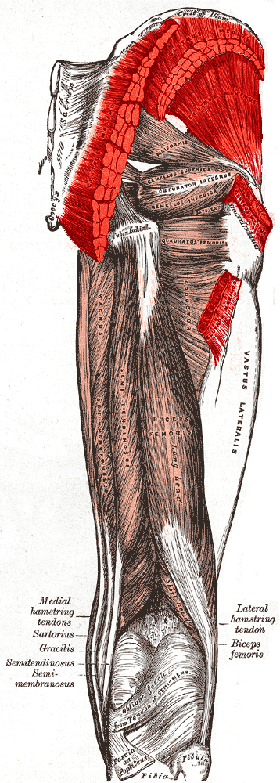

Slide 44
