Slide 1
Common peroneal nerve
By
Jose teena

Slide 2
ROOT VALUE:
ROOT VALUE:
is derived from the dorsal branches of ventral rami of L4,L5,S1,S2 spinal nerve.
L4,L5,S1,S2

Slide 3
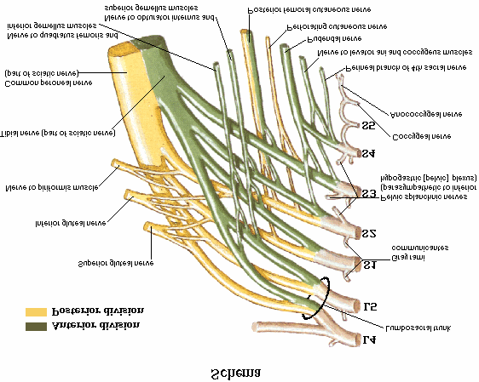

Slide 4
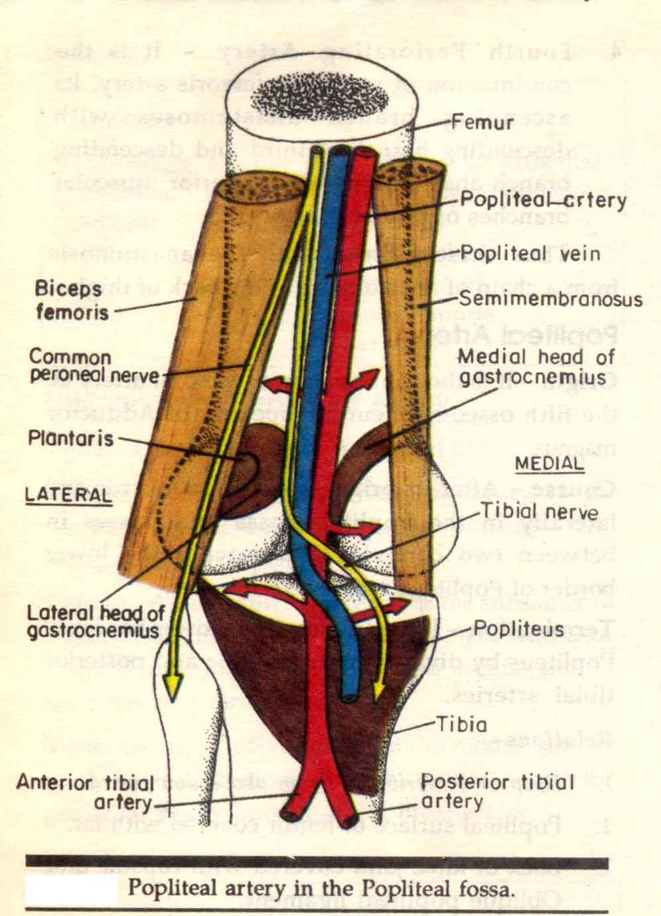

Slide 5
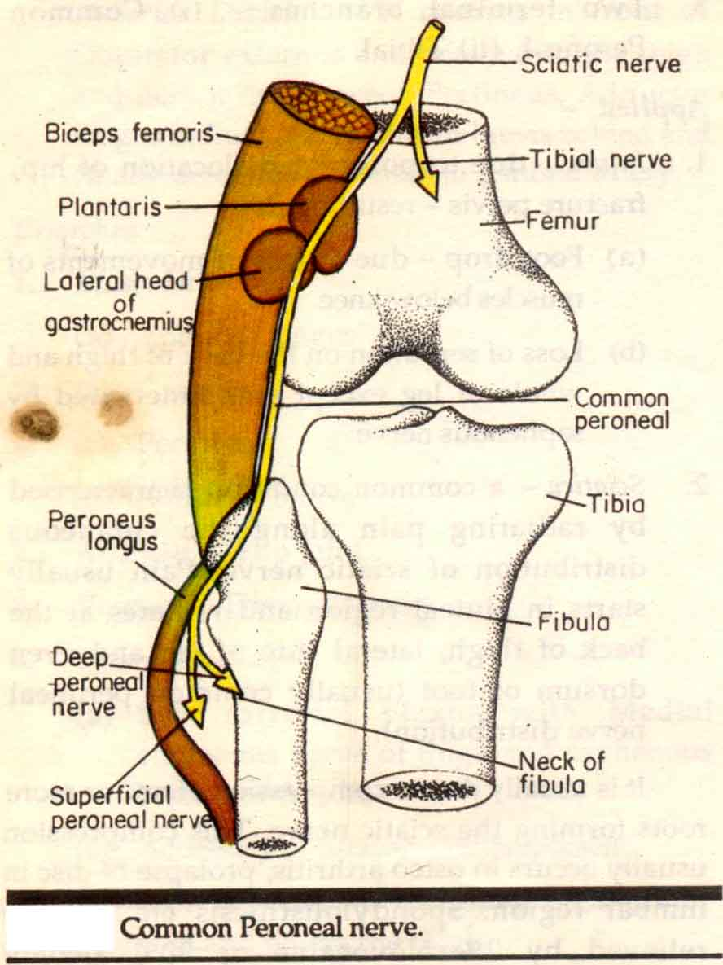

Slide 6
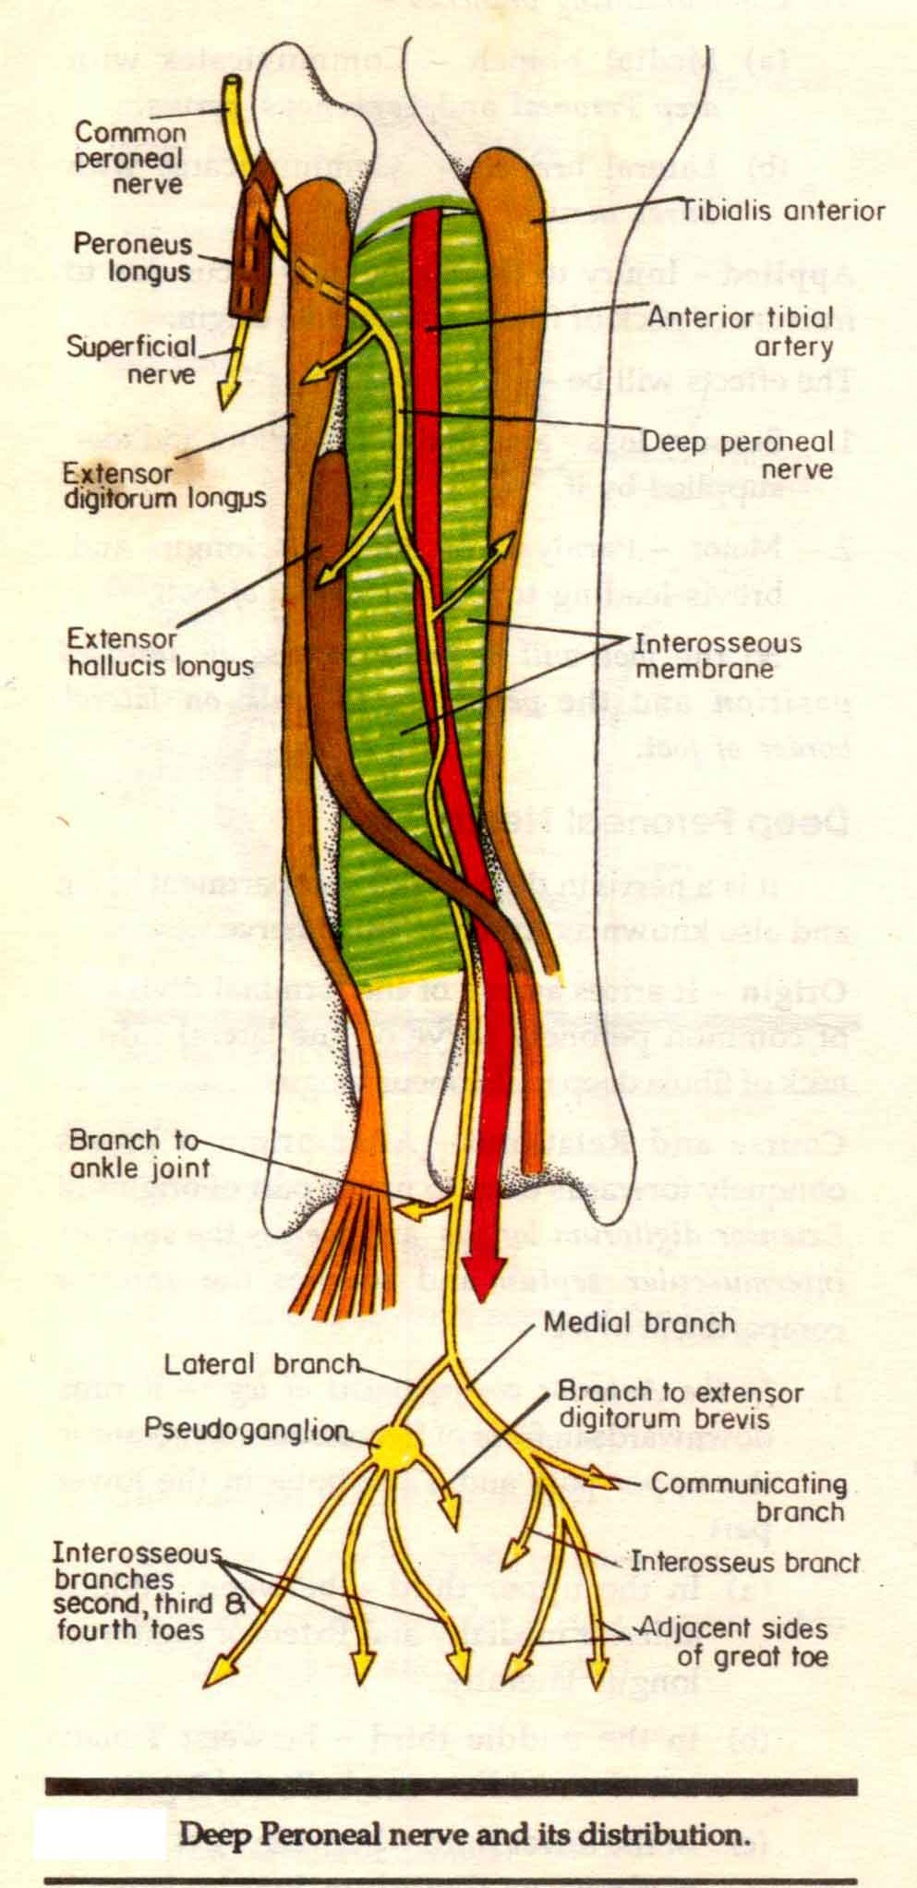

Slide 7
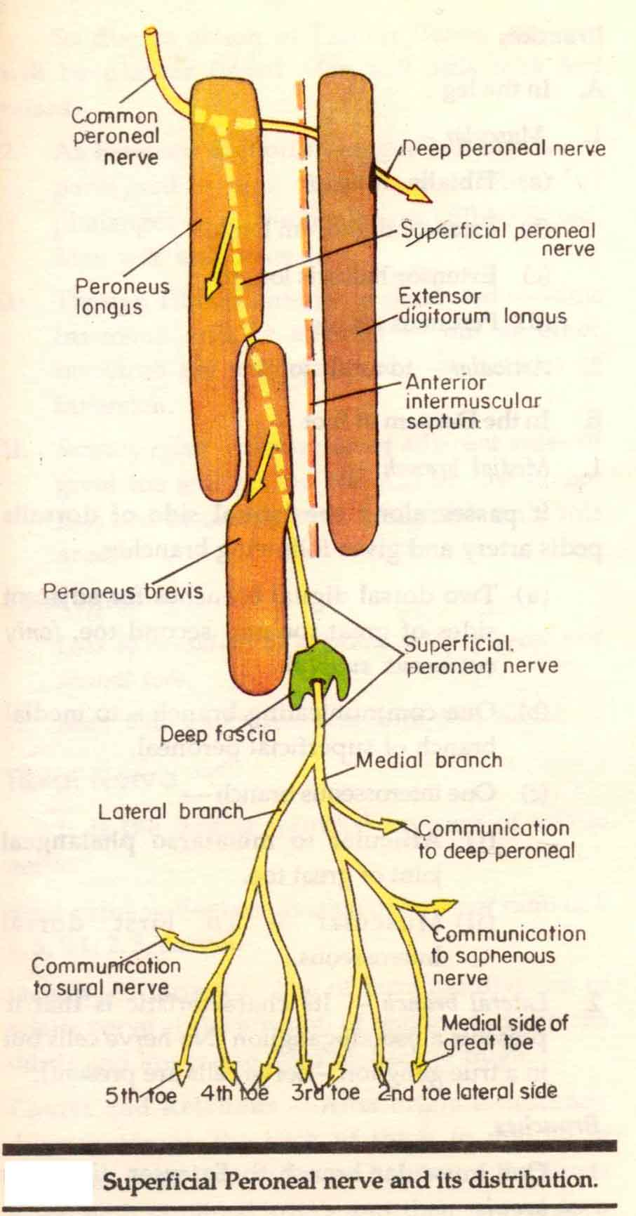

Slide 8
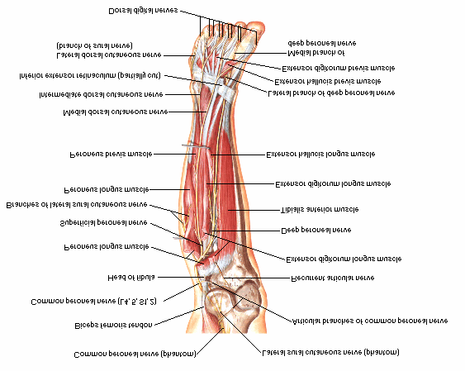

Slide 9
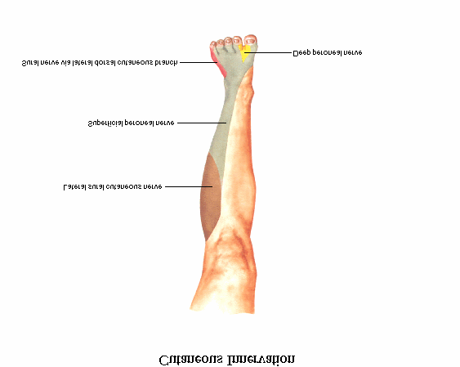

Slide 10
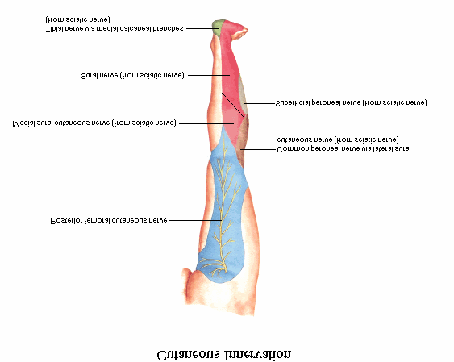

Slide 11
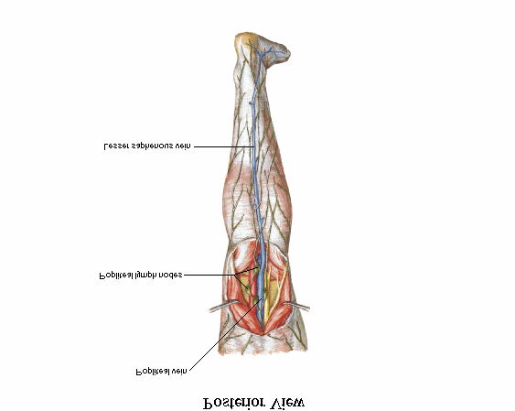

Slide 12
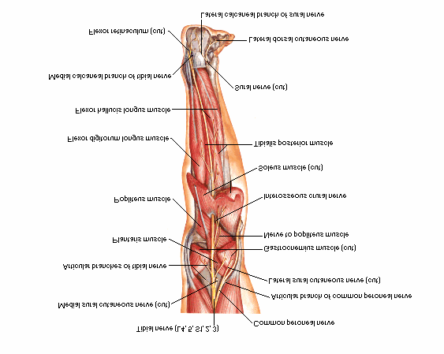

Slide 13
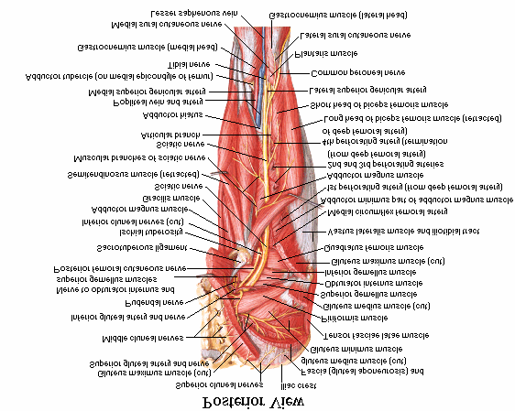

Slide 14
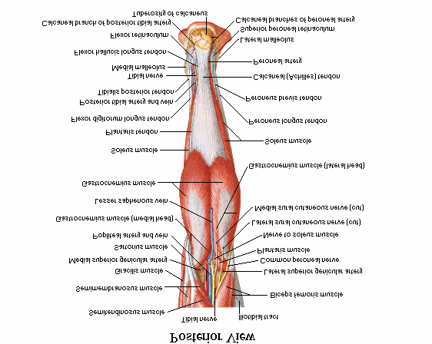

Slide 15
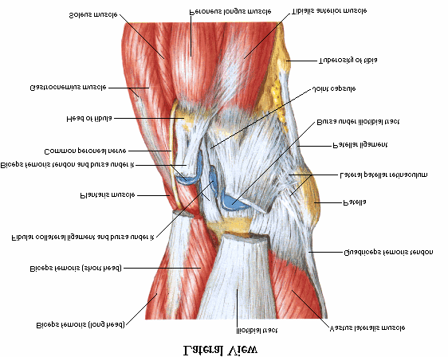

Slide 16
SURFACE MARKING :
FIRST POINT AT THE UPPER ANGLE OF POPLITEAL FOSSA
SECOND POINT ON THE BACK OF THE NECK OF THE FIBULA
at the lower end the nerve turns forwards and ends deep to the upper fibres of the peroneus longus.

Slide 17
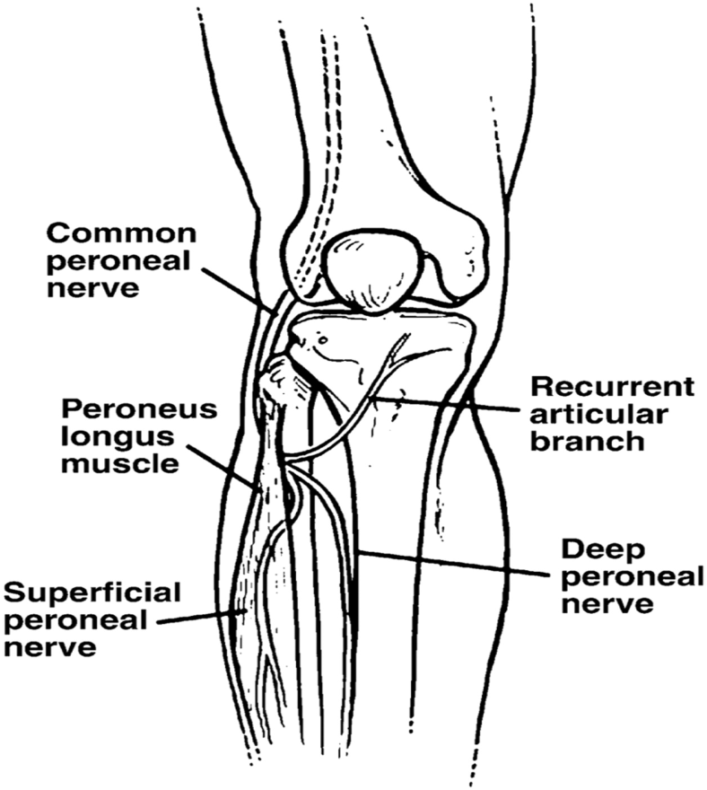
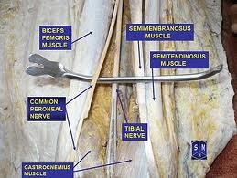

Slide 18
COURSE :
Smaller terminal branch of the sciatic nerve
Lies in the same superficial plane as the tibial nerve
Extends from the superior angle of the fossa to the lateral angle, along the medial border of biceps femoris
Moves down wards and forwards , winds around postero lateral aspect of neck of fibula
And divides as :
superficial
deep

Slide 19
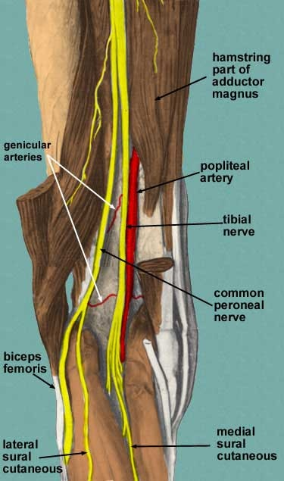

Slide 20
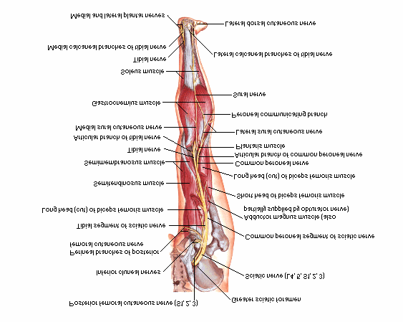

Slide 21
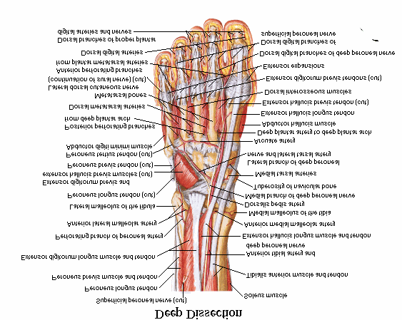

Slide 22
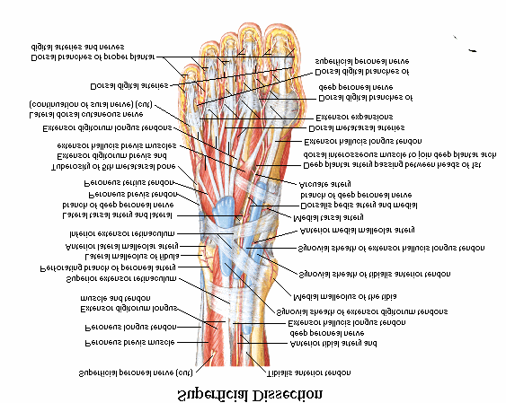

Slide 23
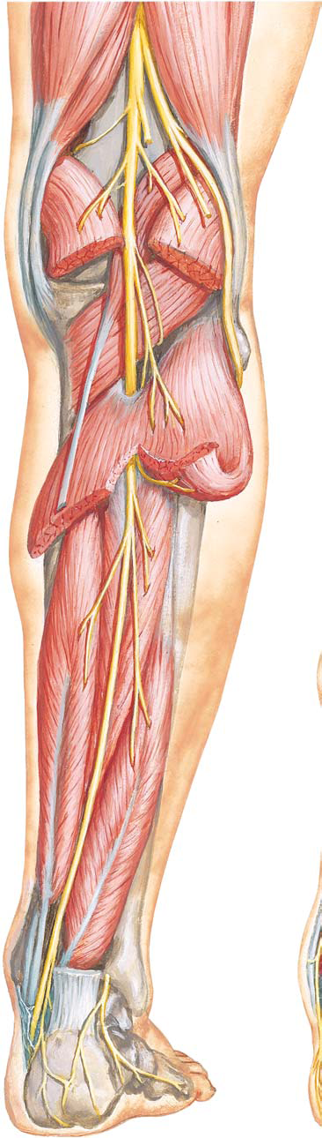
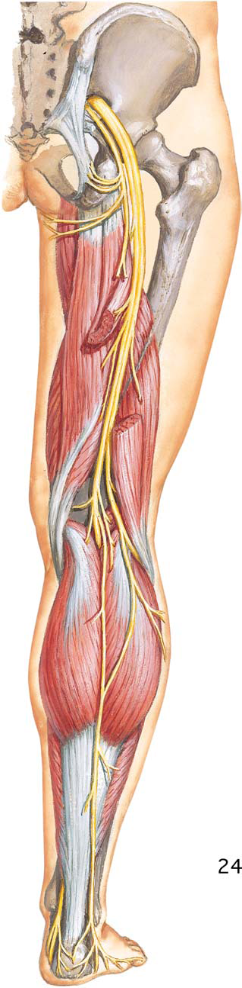

Slide 24
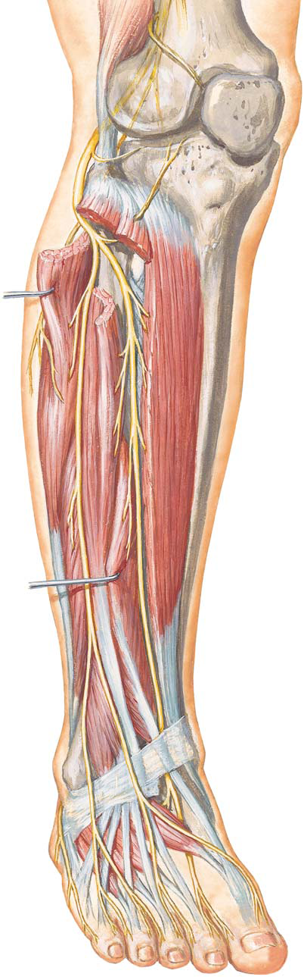
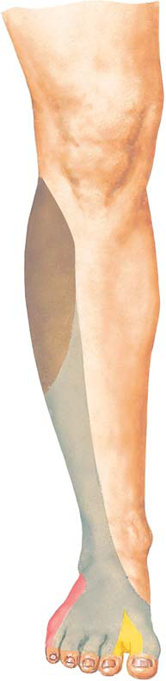

Slide 25
BRANCHES :
CUTANEOUS BRANCHES
a) LATERAL CUTANEOUS NERVE OF THE CALF :
DESCENDS TO SUPPLY THE SKIN OF THE UPPER TWO THIRDS OF THE LATERAL SIDE OF THE LEG
b) PERONEAL COMMUNICATING NERVE :
ARISES IN THE UPPER PART OF THE FOSSA
RUNS ON THE POSTERO LATERAL ASPECT OF CALF
AND FINALLY JOINS THE SURAL NERVE

Slide 26
ARTICULAR BRANCHES :
SUPERIOR LATERAL GENICULAR NERVE :
It accompanies lateral genicular artery and lies above the lateral femoral condyle.
INFERIOR LATERAL GENICULAR NERVE :
it runs with inferior lateral genicular nerve to the lateral aspect of the knee joint above the head of fibula.
RECURRENT GENICULAR NERVE :
arises where the common peroneal nerve divides in to superficial and deep peroneal nerves,
It ascends anterior to the knee joint
Also supplies tibialis anterior muscle

Slide 27
MUSCULAR BRANCHES :
Do not arise from this nerve
It may give rise to short head of biceps
femoris

Slide 28
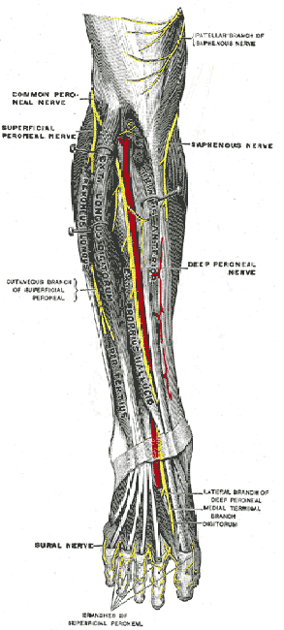

Slide 29
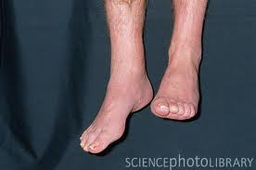
CLINICAL ANATOMY
INJURY TO THE COMMON PERONEAL NERVE CAUSES FOOT DROP. THIS IS THE MOST COMMONLY INJURED NERVE IN THE LOWER LIMB.

Slide 30
THE NERVE GET INJURED VERY EASILY BY A STICK BLOW ON THE POSTEROLATERAL ASPECT OF NECK OF THE FIBULA.
REASON : AS ITS TWO TERMINAL BRANCHES
SUPERFICIAL PERONEAL (SUPPLIES EVERTORS OF THE FOOT)
DEEP PERONEAL ( SUPPLIES DORSIFLEXORS)
ACTIONS ARE LOST.
THIS CONDITION IS CALLED FOOT DROP

Slide 31


