Slide 1
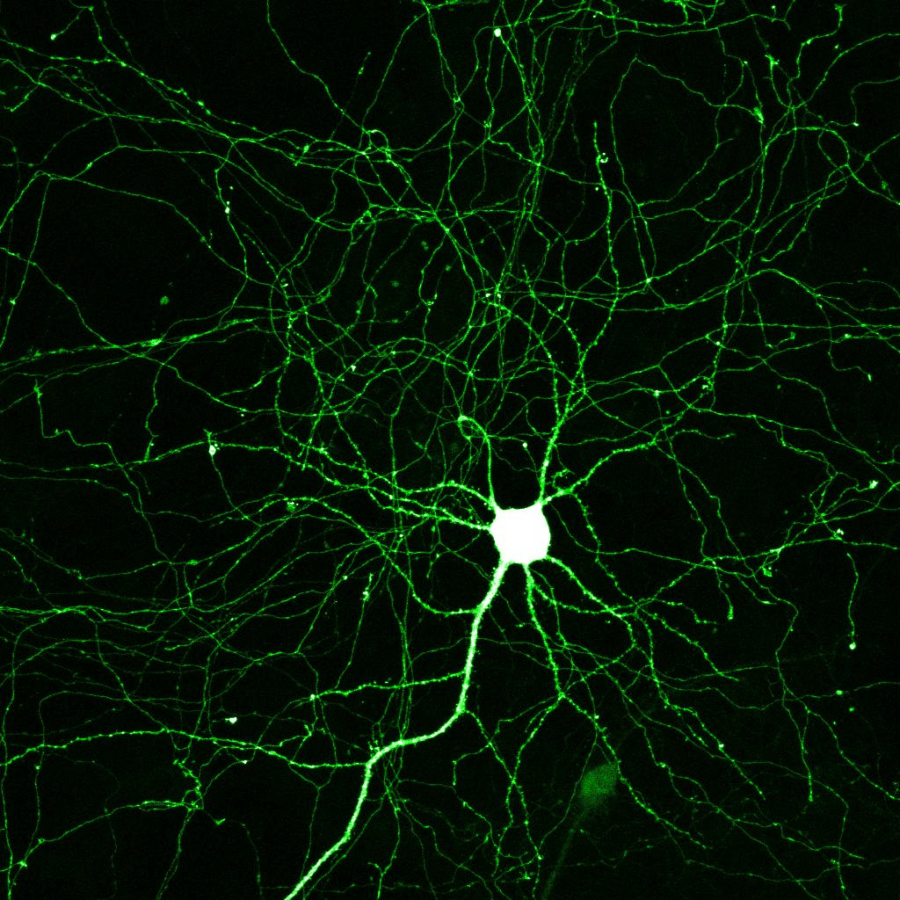
HUMAN NERVOUS SYSTEM – AN INTRODUCTION
A. PERUMAL,
ASSISTANT PROFESSOR,
DEPT. OF ANATOMY.

Slide 2
NERVOUS SYSTEM
CENTRAL
BRAIN
SPINAL CORD
PERIPHERAL
CEREBROSPINAL
AUTONOMIC

Slide 3
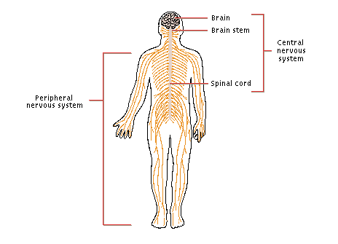

Slide 4
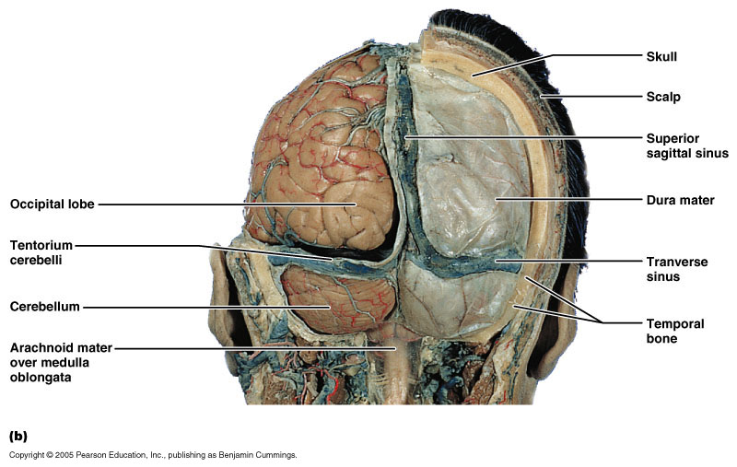
Brain
Lies in cranial cavity
Covered by meninges
Suspended in Cerebro
spinal fluid

Slide 5
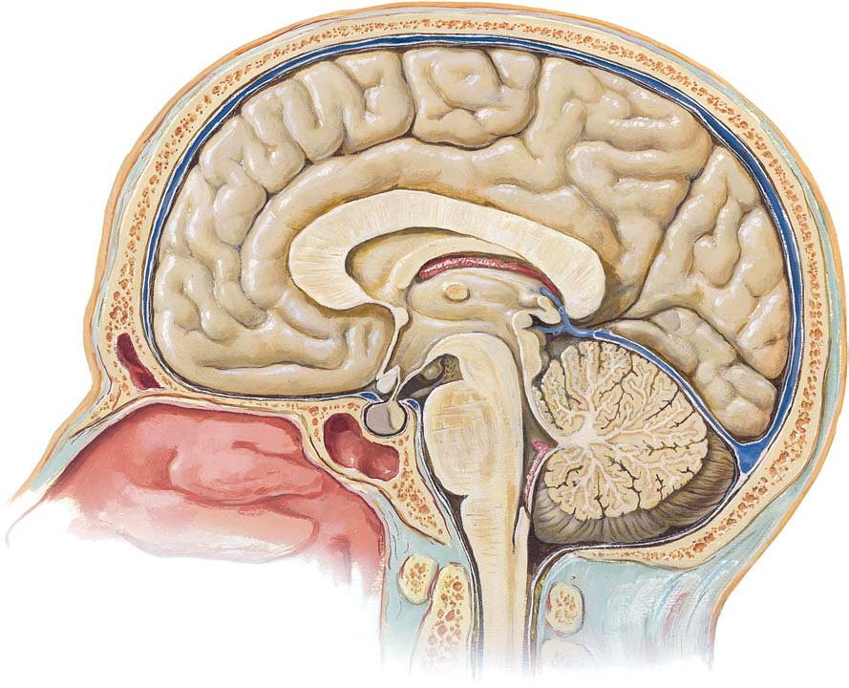

Slide 6
PARTS OF BRAIN
FORE BRAIN (PROSENCEPHALON)
-TELENCEPHALON - CEREBRUM
-DIENCEPHALON
- THALAMUS
- HYPOTHALAMUS
- METATHALAMUS
- EPITHALUMUS
MIDBRAIN (MESENCEPHALON)
- CRUS CEREBRI
- SUBSTANTIA NIGRA
- TEGMENTUM
- TECTUM
HIND BRAIN (RHOMBENCEPHALON)
- METENCEPHALON (PONS, CEREBELLUM)
- MYELENCEPHALON (Medulla oblongata)

Slide 7

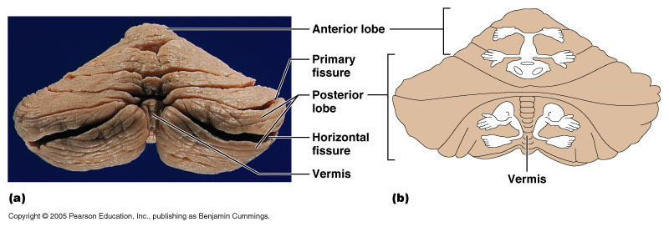
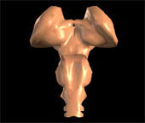
Picture of brain and its parts

Slide 8
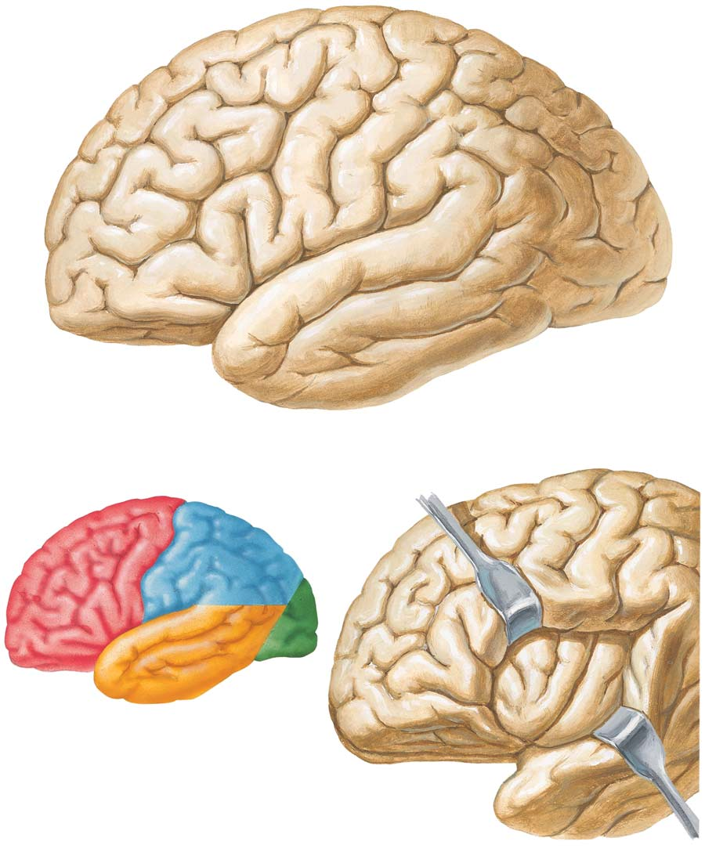
Cerebral lobes

Slide 9
Cerebrum
2 cerebral hemispheres
Connected by corpus callosum
Extends from frontal to occipital bone
Separated by longitudinal fissure and falx cerebri
Surface layer- cortex
Gyri and sulci

Slide 10
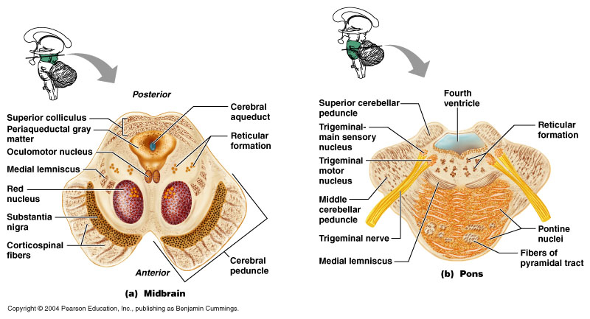
Midbrain
Connects forebrain to hind brain
Tectum , tegmentum , crus cerebri
Traversed by cerebral aqueduct

Slide 11
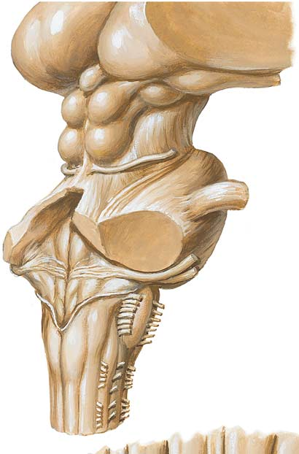

Slide 12
Hind brain
Medulla oblongata
Conical in shape
Connects pons and spinal cord
Consists of many nuclei
Pons
Anterior to cerebellum
Consist of transverse fibers connecting cerebellar hemispheres

Slide 13
Cerebellum has 2 hemispheres connected by vermis
Cerebellar peduncles connect it to brainstem
Controls posture and equillibrium
    Cerebellum

Slide 14
Structure of spinal cord
Inner grey matter and outer white matter
Gray matter- H shaped
United by a thin grey commissure the central canal
White matter – anterior , lateral , posterior white columns

Slide 15
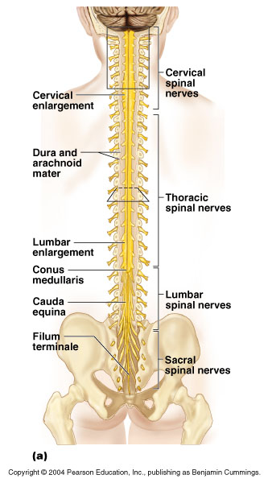

Slide 16
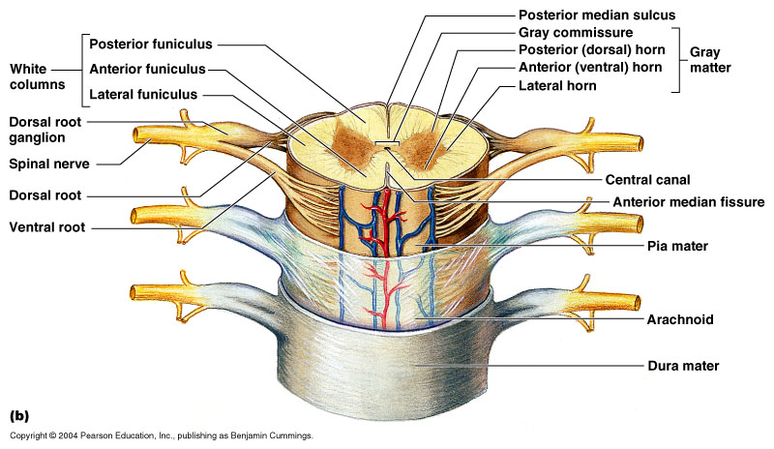

Slide 17
PERIPHERAL NERVOUS SYSTEM
Cerebrospinal nerves
12 pairs of cranial nerves
31 pairs of spinal nerves
Autonomic nervous system
Sympathetic system
Parasympathetic system

Slide 18
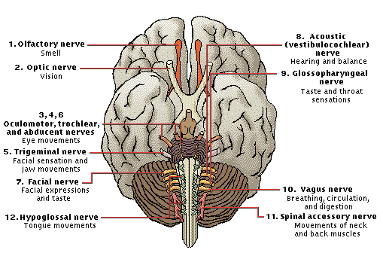
12 Pair of Cranial Nerves

Slide 19
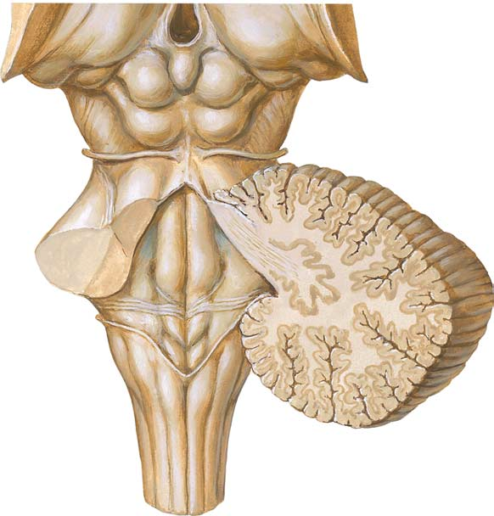

Slide 20
The Spinal Nerves
  31 Pairs of Spinal Nerves.
        8 Cervical
        12 Thoracic
        5 Lumbar
        5 Sacral
        1 Coccygeal

Slide 21
Origin Of The Spinal Nerves
  Spinal Nerves are attached by
      Ventral Root.
      Dorsal Root.
  The 2 roots unite to form a trunk.
  This short trunk divides in to
      Ventral Ramus.
      Dorsal Ramus.

Slide 22
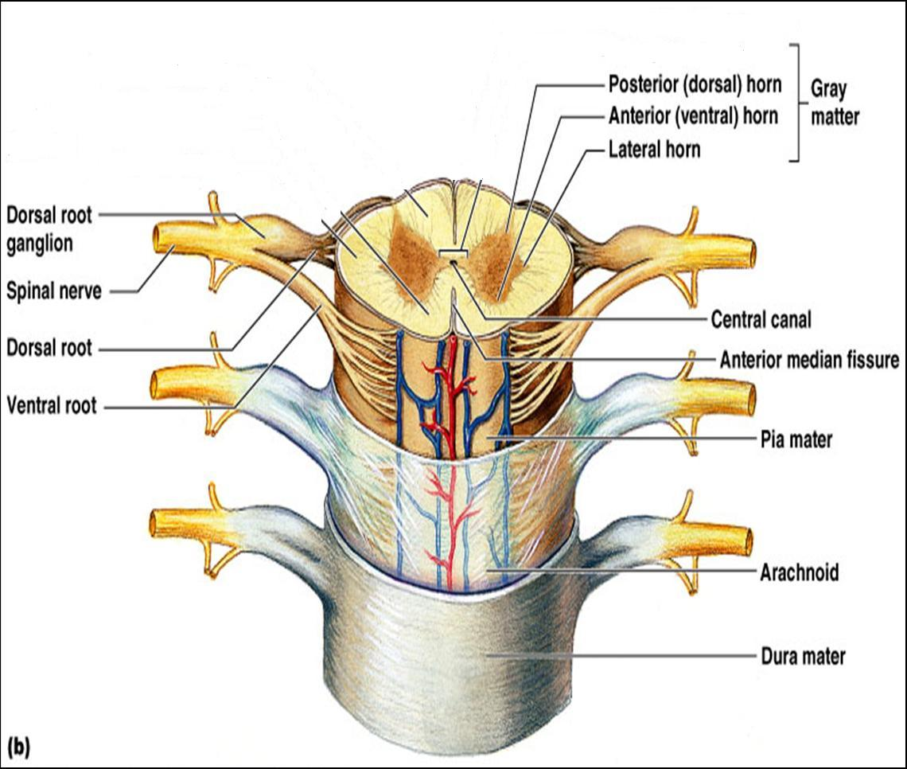
Picture1.jpg

Slide 23
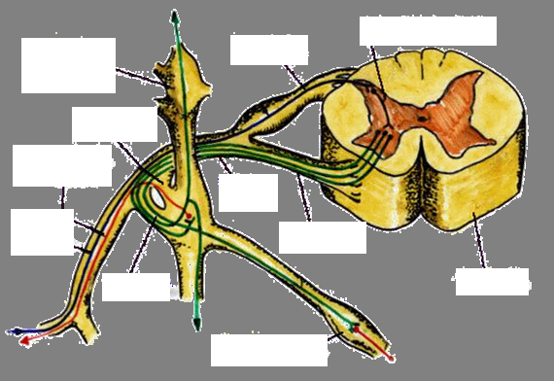

Slide 24
Dorsal ramus divides into the lateral and medial branches which supply the skin and muscles of the back
Ventral ramus supplies the muscles and skin of the front and the extremities by forming plexuses

Slide 25
AUTONOMIC NERVOUS SYSTEM
Controls involuntary activities of the body like sweating, salivation, peristalsis etc.
Divided into:
Sympathetic system (Thoracolumbar outflow)
Parasympathetic system (Craniosacral outflow)

Slide 26
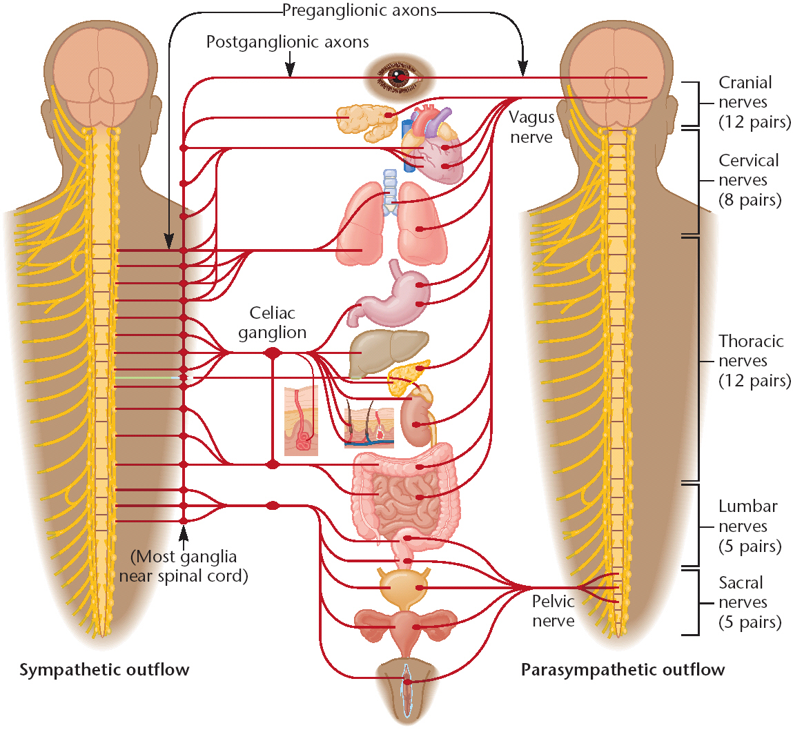

Slide 27
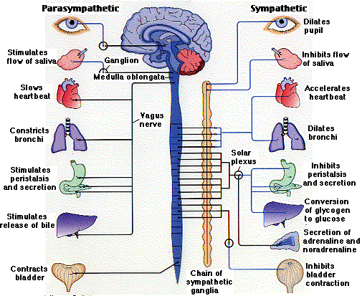

Slide 28
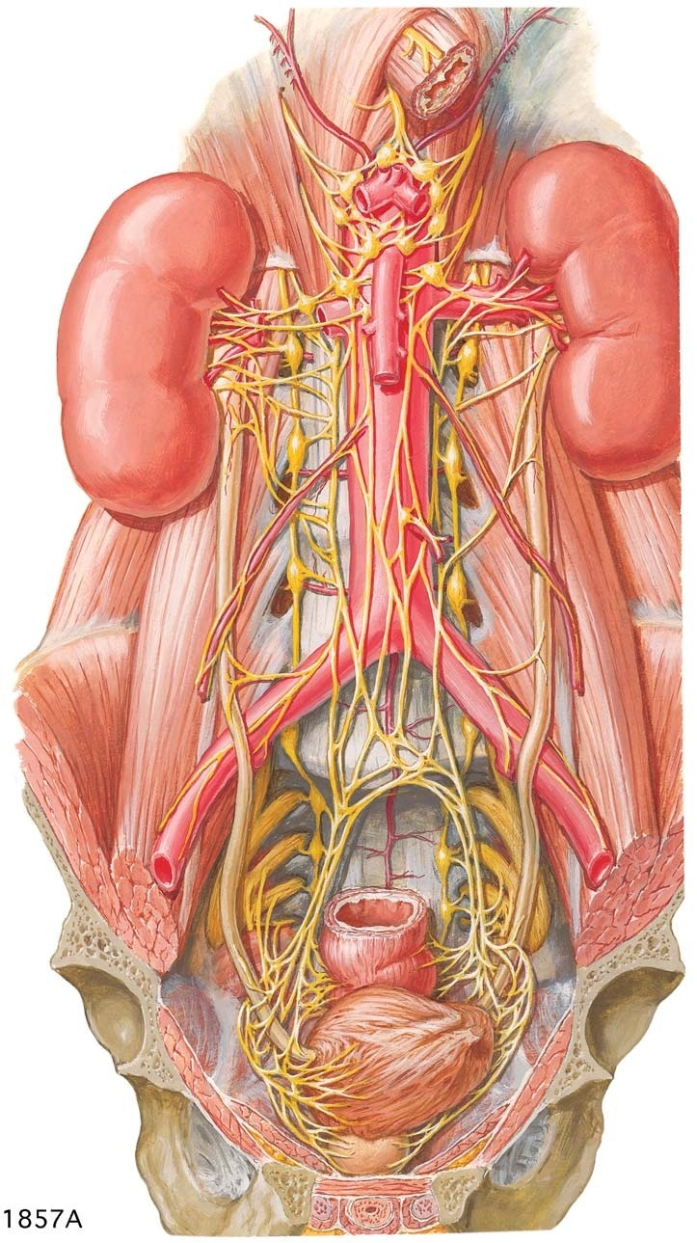
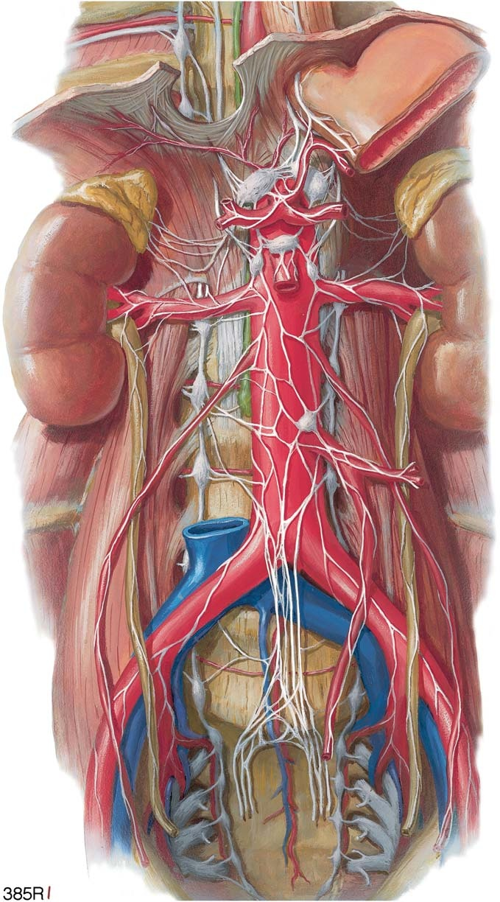
Nuclei and ganglia

Slide 29
Sympathetic system
Thoraco-lumbar outflow (T1 to L2)
Preganglionic fibres arise from lateral column emerge through ventral ramus enters ganglia relays in the sympathetic ganglia and post ganglionic fibres reaches the organ
Adrenergic
Fight or flight response

Slide 30
Parasympathetic system
Cranio sacral outflow (3, 7, 9 and 10th cranial nerves and S2,3,4 segments)
Preganglionic fibres are very long reaching upto the viscera of supply, ganglia situated close to the organ, post ganglionic fibres are short
Cholinergic

Slide 31
What is the difference between the somatic and autonomic nervous system?
(a) Preganglionic fibres from CNS
(b) Ganglia for relay
(c) Postganglionic fibres

Slide 32
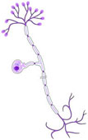
Cell types of nervous system
Neurons or Nerve cells (Excitable)
Supporting cells (Non Excitable)
  Neuroglia
  Schwann cells
  Capsular cells

Slide 33
NEURONS
Structural and functional units
10,000 million neurons in the cerebral cortex alone!!
No proliferation by cell division (mitosis)
Degenerates with age
Regeneration (possible) after injury

Slide 34
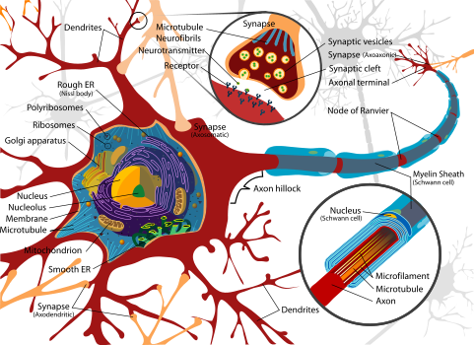
Structure
Cell body (Soma/Perikaryon)
Central nucleus
Nissl’s granules
Cell process (neurites)
Dendrites
Axons
Axon terminals
Node of Ranvier
Myelin sheath

Slide 35
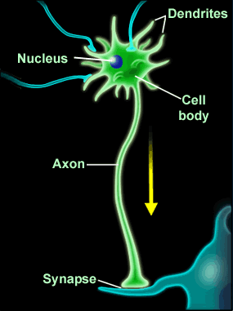

Slide 36
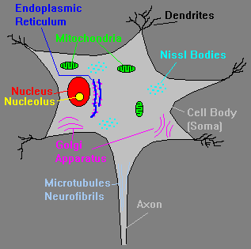
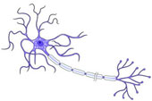

Slide 37
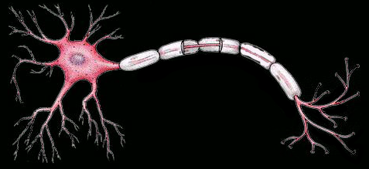
Axons
  Single Long process which conducts electrical changes away from soma.
  Near its origin from soma a specialized region called the axon hillock, which is free of Nissl bodies, this is the initial segment.
  An axon may give off side branches and terminal buotons, which contact the receptive surface of another cell.

Slide 38
Dendrites
Short and highly branched processes which conduct electrical changes towards the Soma.
DYNAMIC POLARITY

Slide 39
SUPPORTING CELLS
Non excitable
Mechanical support
Insulation
Phagocytosis
Repair of damaged tissue
Myelination

Slide 40
Supporting cells Contd.,
NEUROGLIA ( Glia)
  Macroglia – ectodermal origin
- Astrocyte
- Oligodendrocyte
- glioblast
  microglia – mesodermal origin
Ependymal cell
Satellite/ capsular cells – present in sensory and autonomic ganglia
Schwann cells – forming sheaths for axon of peripheral nerve

Slide 41
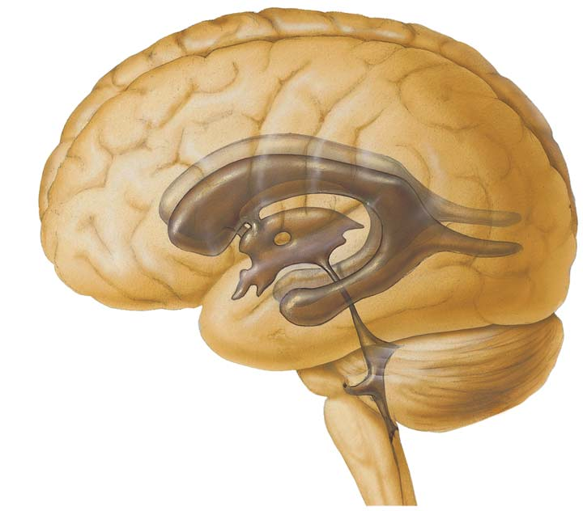
Ependymal Cells :
Line Ventricles and Central Canal – Ciliated.

Slide 42
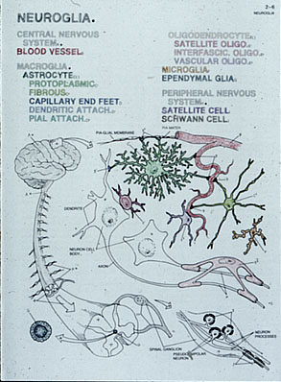
Neuroglia
-Supporting Cells of the Central Nervous System.
They are of Two Types.
MACROGLIA
- ASTROCYTES
- OLIGODENDROCYTES
- GLIOBLASTS
MICROGLIA

Slide 43
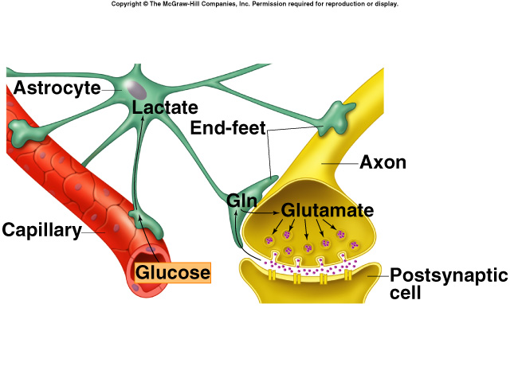
Astrocytes :
-Star Shaped Cells.
-Consisting Processes, whose end feet terminates at the blood vessels, which constitute Blood Brain Barrier.

Slide 44
Oligodendrocytes :
…Counterpart of Schwann Cells.
…Responsible for Myelination of Nerve Fibers within Central Nervous System.
…They enclose several axons in separate Myelin Sheath.

Slide 45
Microglia
  Small dendritic cells found in Central Nervous System and Retina.
  A form of resident macrophages.
  Provide defensive mechanism in the CNS.

Slide 46
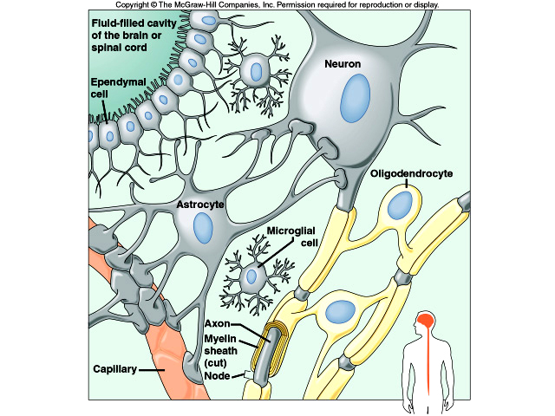

Slide 48
TYPES OF NEURONS
According to number of processes
  Unipolar – Mesencephalic nucleus
  Pseudounipolar – Sensory ganglia
  Bipolar – Spinal & Vestibular ganglia, bipolar neurons of retina
  Multipolar – neurons of cerebrum and cerebellum
According to Length of nerve fiber
  Golgi type I – Long
  Golgi type II - Short

Slide 49
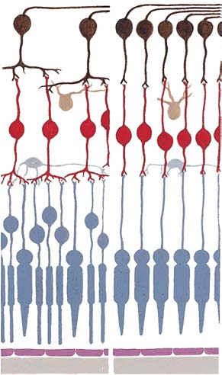



Slide 50
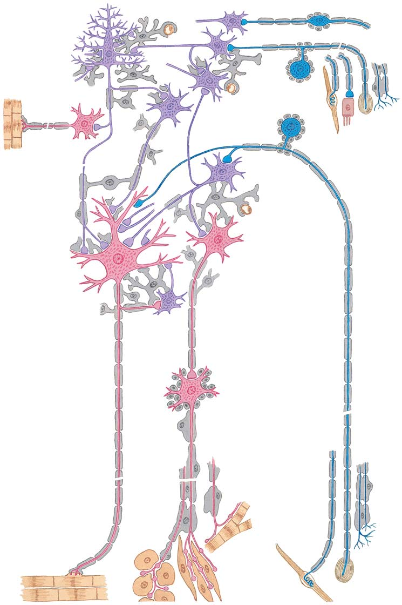

Slide 51
NERVES
NERVE IS A CONDENSE BUNDLES OF NERVE FIBRES
Nerve fibre – axon with its coverings
Endo, peri, epineurium
Vasa nervorum
Nervi nervorum
Dermatome – area of skin supplied by single segment of spinal cord
Resemble electric wires
Sensory (Afferent) nerves carry impulses from periphery to brain
Motor (Efferent) nerves carry impulses from brain to periphery

Slide 52
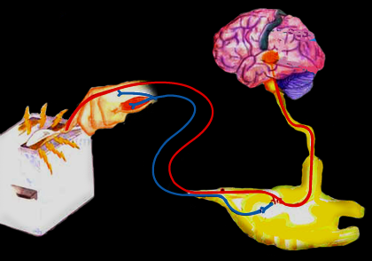
Brain
Sensory
Neuron
(Afferent)
Spinal
Cord
Motor
Neuron
(Efferent)

Slide 53
MYELINATION OF NERVE FIBRE
Myelinated – myelin sheath present
Non- myelinated – myelin sheath absent
Myelin → Lipids + Proteins
Schwann cells – peripheral nerves
Oligodendrocytes – nerves of CNS
Myelin increases speed of conduction (Saltatory conduction)

Slide 54
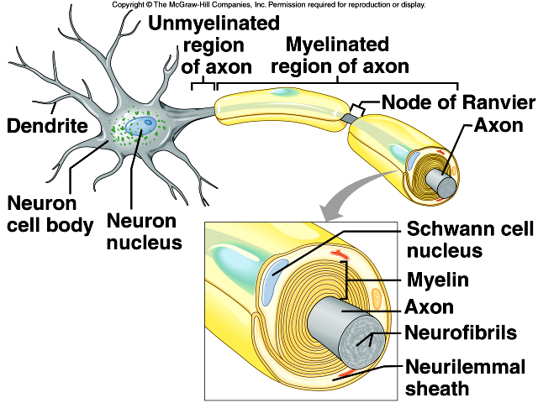

Slide 55
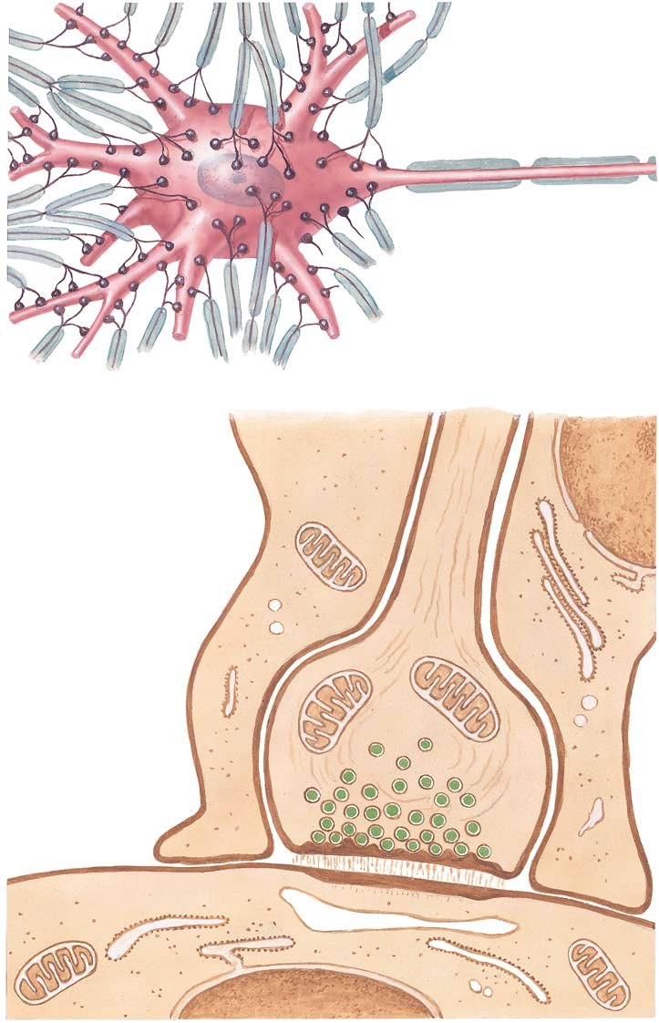
synapse

Slide 56
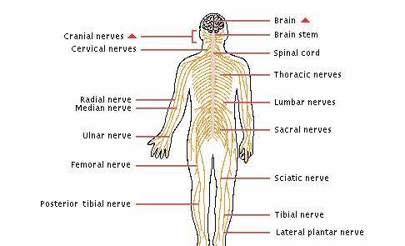
Names of some nerves
Axillary nerve
Radial nerve
Ulnar nerve
Femoral nerve
Peroneal nerve……

Slide 57
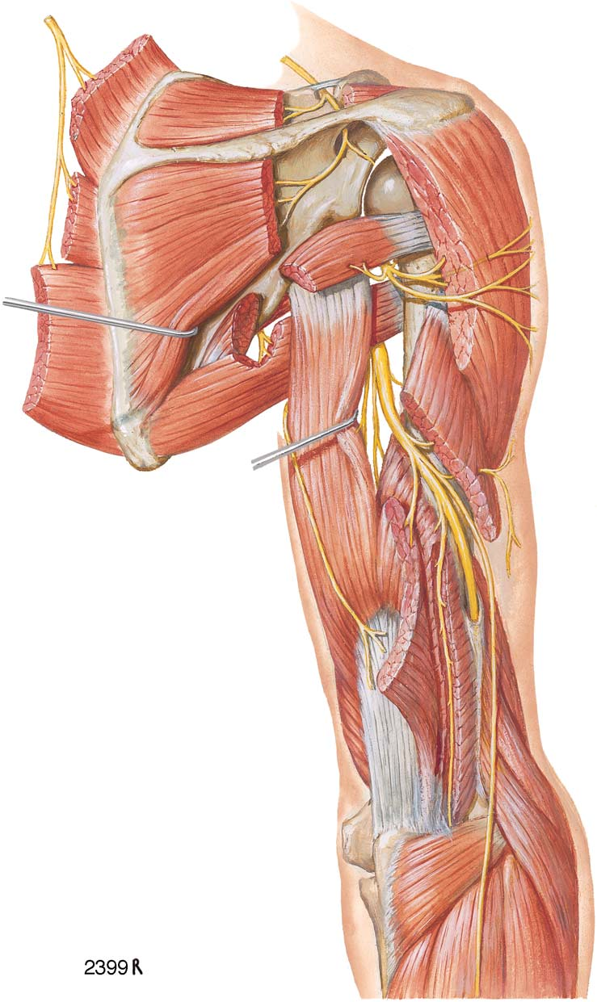
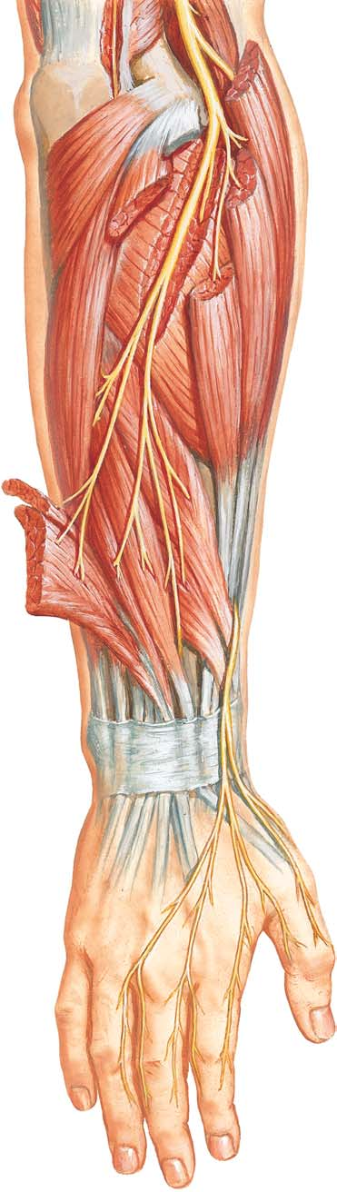
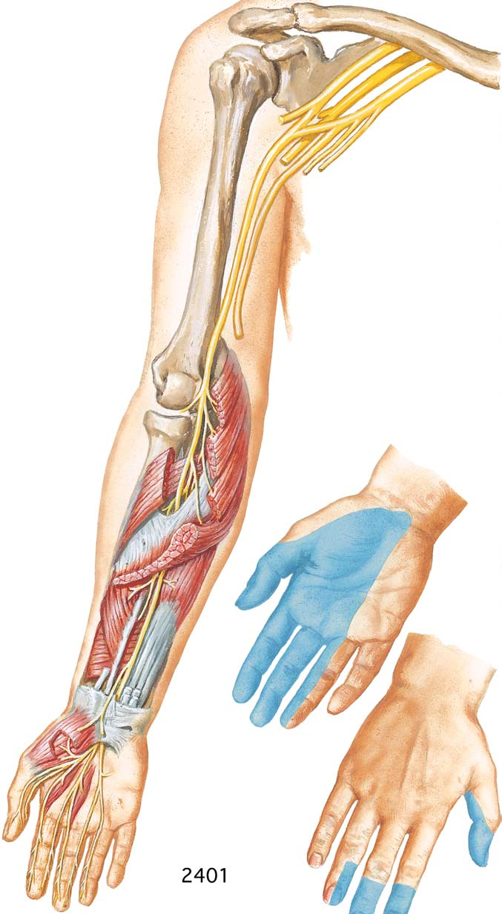

Slide 58
Names of some plexuses
Brachial plexus
Lumbar plexus…..

Slide 59
Applied anatomy
Irritation – motor nerve – muscular spasm
  Sensory nerve – tingling and numbness
  Mixed nerve – combined effect
Damage - motor nerve – paralysis of muscle
  Sensory nerve – localized anaesthesia analgesia
  Mixed nerve – both sensory and motor loss

Slide 60
Regeneration
------Of damaged nerve depends on degree of injury
  Degree of injury expressed by following 3 terms
  1. Neurapraxia
  – minimal lesion causing transient functional block without any degeneration
  -Recovery is spontaneous and complete

Slide 61
2. Axonotmesis
– is a lesion where, although continuity is preserved
- True wallerian degeneration occurs
- Regeneration takes place in due cource
3. Neurotmesis
– is complete division of nerve, for regeneration cut end must be sutured.

Slide 62
Neuralgia – severe pain along the distribution of nerve
Dementia – slow and progressive loss of memory, intellect, personalty.
Infections
Epilepsy – hyperexitable neurons by various types of stimuli
Leprosy – chronic inflammation of nerve sheaths by micobacterium leprey.
Notes:
Regeneration

Slide 63
APPLIED ANATOMY
Muscular spasm
Paralysis
Neuropraxia
Axonotmesis
Neurotmesis
Neuralgia
Neuropathy – any pathological change in nerve

Slide 64

Thank you

