Slide 1
Muscle Of Mastication

Slide 2
Introduction
Move the mandible during mastication and speech
The chief muscle of mastication are :
Masseter
Temporalis
Lateral pterygoid
Medial pterygoid
They develop from the mesoderm of first brachial arch
Supplied by mandibular nerve

Slide 3
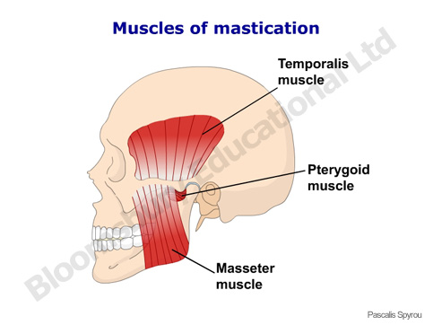

Slide 4
Temporal Fascia
A thick aponeurotic sheet that roofs over the temporal fossa
It covers the temporalis muscle
Superiorly:
Single layered
Attached to superior temporal line
Inferiorly:
Splits into 2 layers
Attached to the outer and inner lips of the upper border of zygomatic arch

Slide 5
Superficial surface of the temporal fascia receives an expansion from the epicranial aponeurosis
This surface gives origin to :
Auricularis anterior and superior
Superficial temporal vessels
Auriculotemporal nerve
Temporal branches of facial nerve
Deep surface gives origin to some fibres of temporalis muscle
Temporal fascia is replaced by bone in some species

Slide 6
Masseter
It is a quadrilateral muscle
Consist of 2 portions :
Superficial
Deep
Origin :
- Superficial layer : from anterior part 2/3rd of lower
border of zygomatic arch and
adjoining zygomatic process of
maxilla

Slide 7
Deep layer : from deep surface of zygomatic arch
Insertion :
- Superficial layer : into lower part of lateral surface
ramus of mandible
Deep layer : into rest of the ramus of mandible
Nerve supply :
- Masseteric nerve, a branch of anterior division of
mandibular nerve

Slide 8
Actions :
Elevates the mandible to close the mouth to bite
It raises the mandible against the maxilla with great force

Slide 9
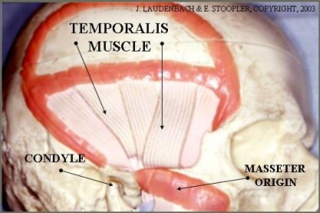

Slide 10
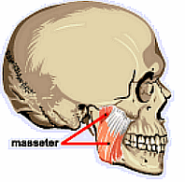

Slide 11
Temporalis
It is fan- shaped and fills with temporal fossa
It is broad, radiating muscle, situated at the side of the head
Origin :
Temporal fossa, excluding zygomatic bone
Temporal fascia
Insertion :
Margins and deep surface of coronoid process
Anterior border of ramus of mandible

Slide 12
Nerve supply :
Two deep temporal branches from anterior division of mandibular nerve
Actions :
Elevates mandible
Help in side to side grinding movement
Posterior fibres retract to protrude the mandible

Slide 13
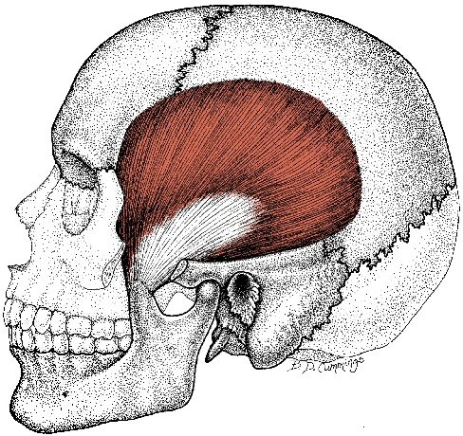

Slide 14
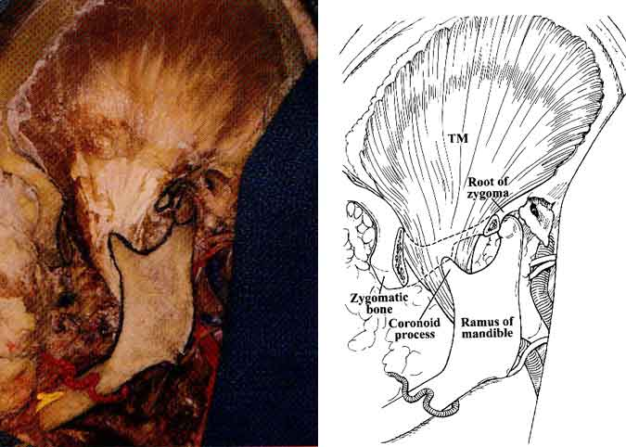

Slide 15
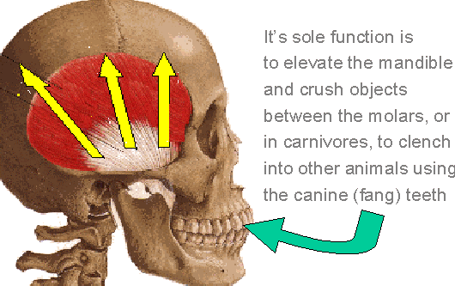

Slide 16
Lateral Pterygoid
short, thick muscle, somewhat conical in form
which extends almost horizontally between the infratemporal fossa and the condyle of the mandible
Has upper and lower heads
Origin :
Upper head : from infratemporal surface and crest
of greater wing of sphenoid bone
Lower head : from lateral surface of lateral
pterygoid plate
origin is medial to insertion

Slide 17
Insertion :
Upper head : pterygoid fovea on the anterior
surface of neck of mandible
Lower head : anterior margin of articular disc and
capsule of temporomandibular joint.
Insertion is posterolateral and at a slightly higher level than origin
Nerve supply :
- A branch from anterior division of mandibular nerve
Actions :
Depress mandible to open mouth
Lateral and medial pterygoids protrude mandible
Right lateral and medial pterygoid turn the chin to left side

Slide 18
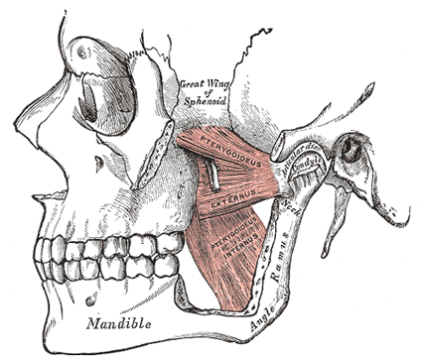

Slide 19
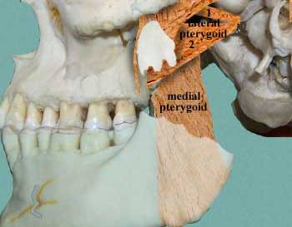

Slide 20
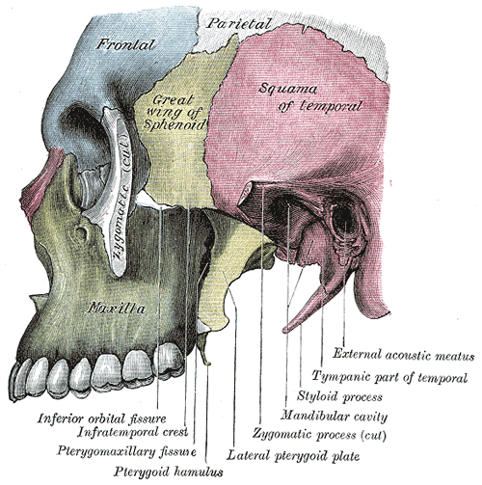

Slide 21
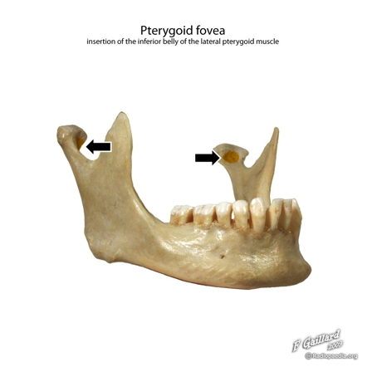

Slide 22
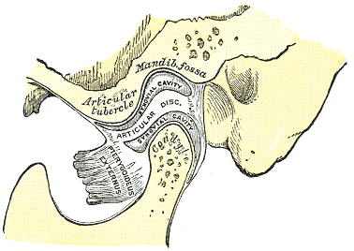

Slide 23
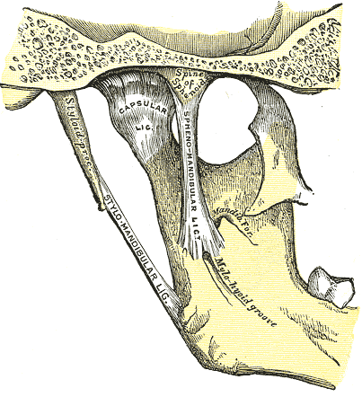

Slide 24
Medial Pterygoid
Is thick and quadrilateral muscle
Has superficial and large deep head
Origin :
Superficial head : from tuberosity of maxilla and
adjoining bone
Deep head : from medial surface of lateral
pterygoid plate and adjoining process
of palatine bone

Slide 25
Insertion :
Roughened area on the medial surface of angle and adjoining ramus of mandible, below and behind the mandibular foramen and mylohyoid groove
Nerve supply :
Nerve to medial pterygoid, branch of main trunk of mandibular nerve
Actions :
Elevates mandible
Helps protrude mandible
Right medial pterygoid with right lateral pterygoid turn the chin to left side

Slide 26
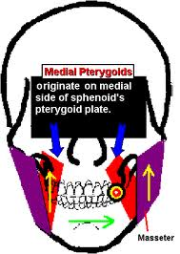

Slide 27
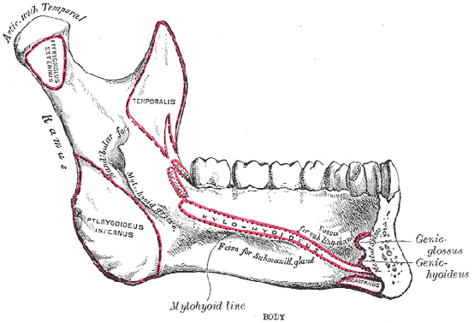

Slide 28
Relations of Lateral Pterygoid
Superficial :
Masseter
Ramus of mandible
Tendon of the temporalis
Maxillary artery
Deep :
Mandibular nerve
Middle meningeal artery
Sphenomandibular ligament
Deep head of medial pterygoid

Slide 29
Structures emerging at the upper border :
Deep temporal nerve
Masseteric nerve
Structures emerging at the lower border :
Lingual nerve
Inferior alveolar nerve
Middle meningeal artery passes upwards deep to it

Slide 30
Structures passing through the gap between the two heads :
Maxillary artery
Buccal branch of the mandibular nerve comes out through the gap
- The pterygoid plexus of veins surrounds the lateral
pterygoid

Slide 31
Relations of medial pterygoid
Superficial relations :
The upper part of the muscle is separated from the lateral pterygoid muscle by :
Lateral pterygoid plate
Lingual nerve
Inferior alveolar nerve
- Lower down the muscle is separated from the
ramus of mandible by :
Lingual and inferior alveolar nerve
Maxillary artery
Sphenomandibular ligament

Slide 32
Deep relations :
The relations are :
Tensor veli palatini
Superior constrictor of pharnyx
Styloglossus
Stylopharyngeus attached to styloid process

Slide 33


