Slide 1

TONGUE

Slide 2

What is the tongue?
Bone
Tissue
Muscle
Skin
C - MUSCLE

Slide 3

INTRODUCTION
Solid conical muscular organ
Covered by mucous membrane
Lies partly in oral cavity & partly in oropharynx

Slide 4

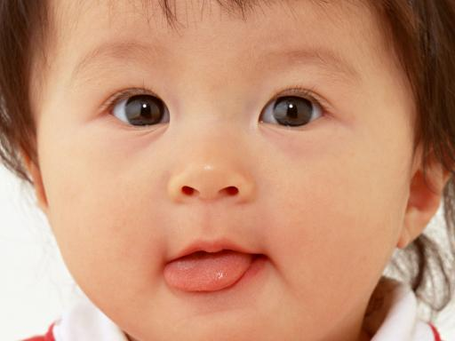

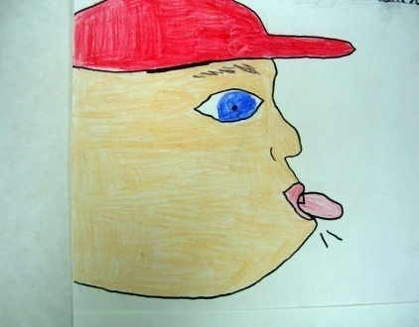


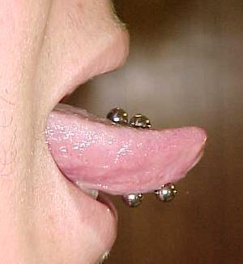
FUNCTIONS
Licking postage stamps
Facial expression
Speech
Taste
Taste
Mastication
Deglutition
Speech
Thermoregulation
Decoration/ Ornaments

Slide 5
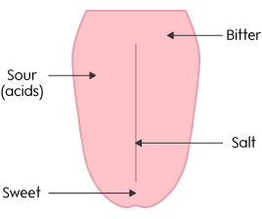
For Taste ….. And For Speech
Bitter and Sweet!

Slide 6
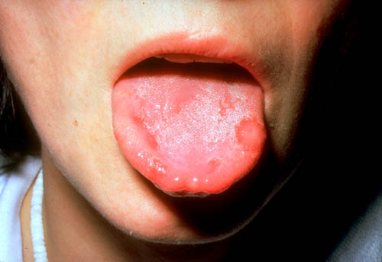
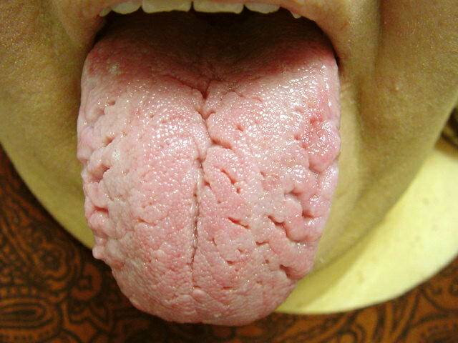
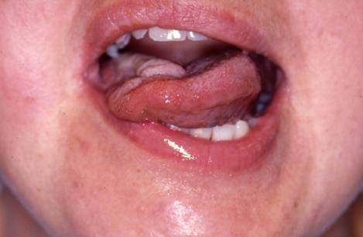
Indicator of diseases

Slide 7
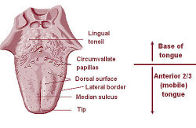
PRESENTING PARTS
Tip
Base
Dorsal surface
Inferior surface
Lateral border
Root

Slide 8
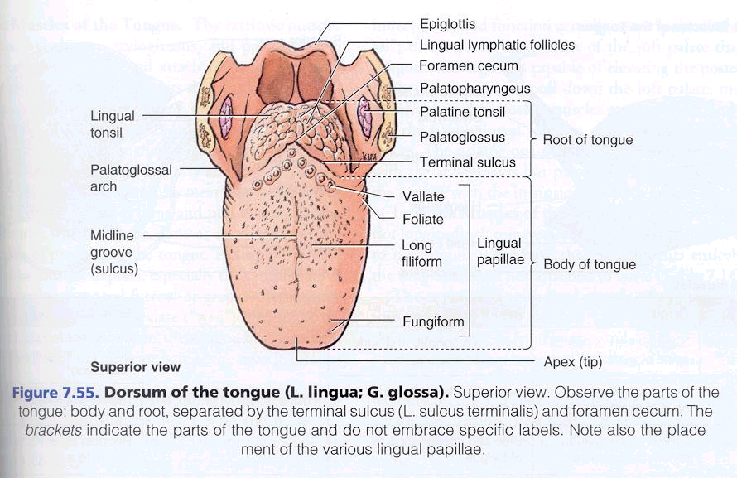
PRESENTING PARTS
Base- Connected to Epiglottis
Dorsal surface- Mucousmembrane
Non-keratinised stratified squamous epithelium
Sulcus terminalis
Foramen caecum
Anterior 2/3rd: Papillae
Circumvallate, fungiform, filliform
Posterior 1/3rd: Lingual tonsil

Slide 9
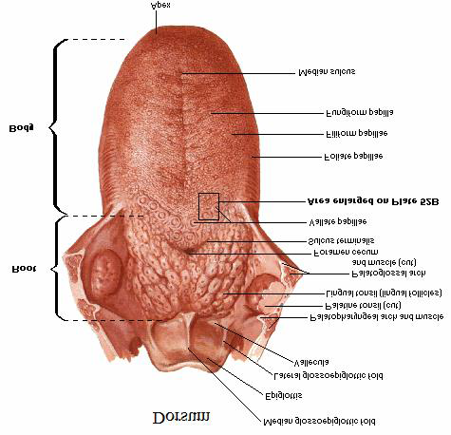

Slide 11
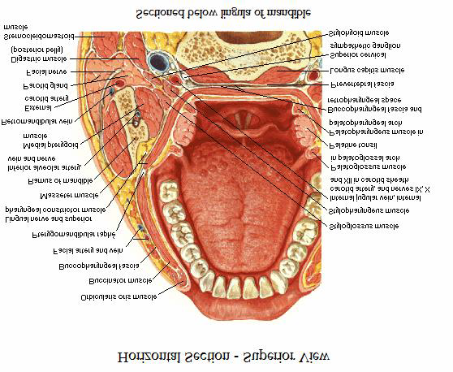

Slide 12
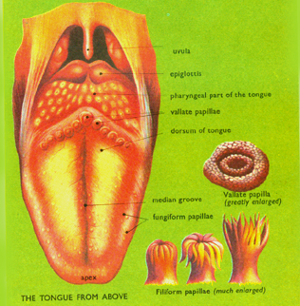

Slide 13
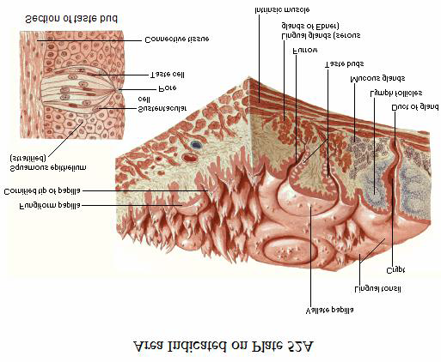
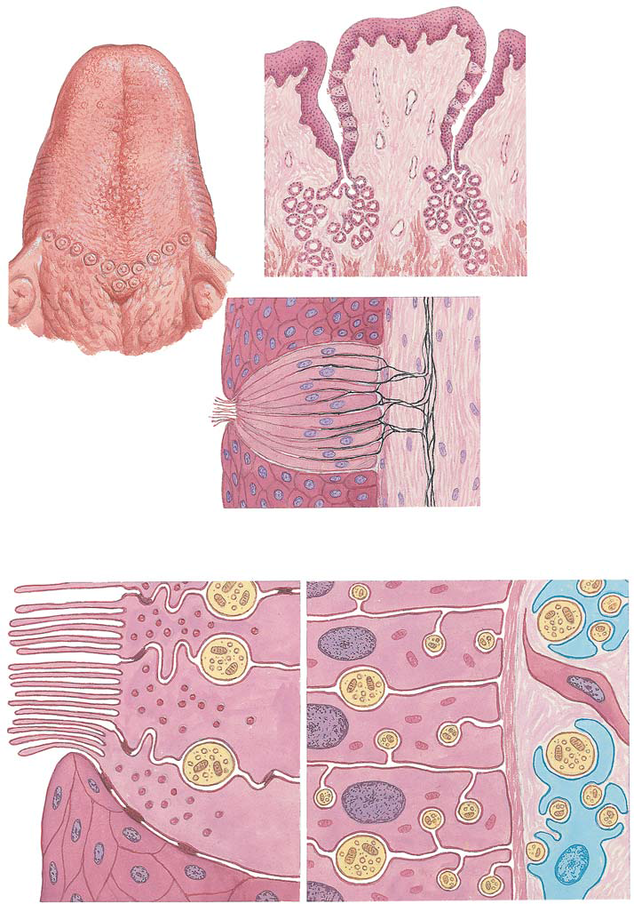

Slide 14
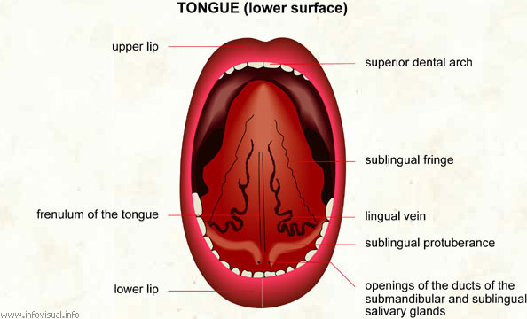
PRESENTING PARTS
Inferior surface:
Frenulum linguae
Sublingual papilla
Opening of submandibular duct
Deep lingual vein
Plica fimbriata
Root:
Attached to floor of mouth
Extends from symphysis menti to hyoid bone

Slide 15
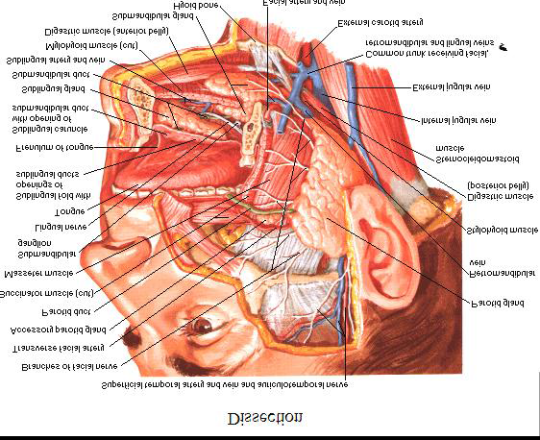

Slide 16
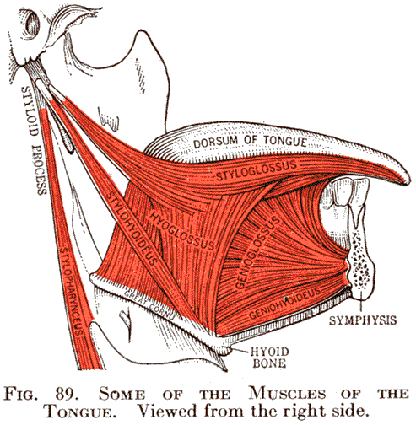
MUSCLES
EXTRINSIC:
Genioglossus
Hyoglossus & Chondroglossus
Styloglossus
Palatoglossus
INTRINSIC:
Superior longitudinal
Inferior longitudinal
Transversus linguae
Verticalis linguae

Slide 17
MUSCLES
ACTIONS
Extrinsic muscles alter position of tongue
Intrinsic muscles alter shape of the tongue
GENIOGLOSSUS:
Protrudes tongue & makes dorsum concave
SAFETY MUSCLE of tongue
HYOGLOSSUS & CHONDROGLOSSUS:
Depress sides of tongue & make dorsum convex

Slide 18
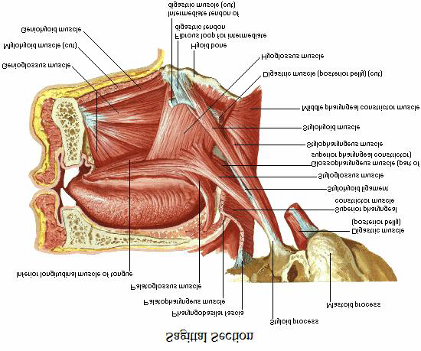

Slide 19
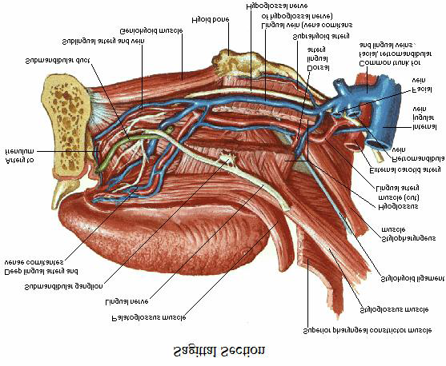

Slide 20
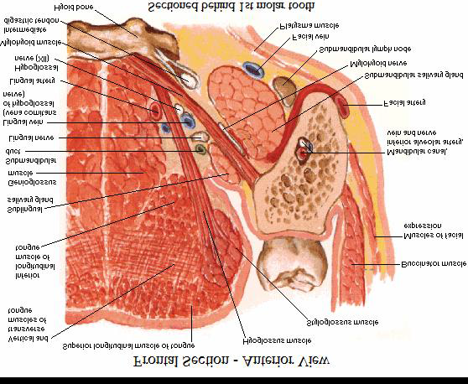

Slide 21

MUSCLES
SUPERIOR LONGITUDINAL:
Shortens tongue & makes dorsum concave
INFERIOR LONGITUDINAL:
Shortens tongue & makes dorsum convex
TRANSVERSUS LINGUAE:
Elongates tongue & makes it narrow
VERTICALIS LINGUAE:
Makes the tongue broad
ACTIONS
STYLOGLOSSUS:
Retracts the tongue backwards & upwards
PALATOGLOSSUS:
Elevates base of tongue

Slide 22
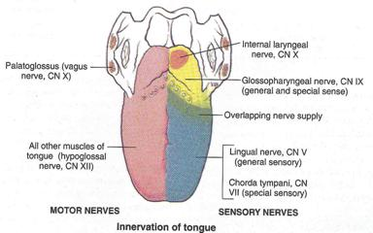

Slide 23
NERVE SUPPLY
SENSORY NERVE SUPPLY:
Anterior 2/3rds:
General: Lingual nerve
Taste: Chorda tympani
Posterior 1/3rd:
General & taste: IX nerve
Most posterior part:
General & taste: Superior laryngeal branch of X nerve
MOTOR NERVE SUPPLY:
All muscles are supplied by Hypoglossal nerve except Palatoglossus supplied by cranial part of XI through pharyngeal plexus

Slide 24
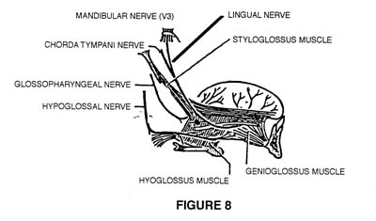

Slide 25
BLOOD SUPPLY
ARTERIAL SUPPLY
Lingual artery : Dorsal lingual artery
Deep lingual artery
Ascending palatine & tonsillar artery ( Facial artery)
Ascending pharyngeal artery
VENOUS DRAINAGE
Lingual vein drains into Internal jugular vein

Slide 26
LYMPHATIC DRAINAGE
Assumes importance due to spread of cancer of tongue via lymphatics
Tip: Submental lymph nodes ( richest lymphatics. Cancer affecting tip spreads to all cervical lymph nodes of both sides)
Margins: Submandibular lymph nodes ( unilateral)
Center: Bilaterally into Submandibular lymph nodes
Posterior 1/3rd: Jugulodigastric & jugulo omohyoid lymph nodes

Slide 27
CLINICAL IMPORTANCE
Diagnosis: Anemia/ jaundice/ Cyanosis
Carcinoma
Glossitis
Ulcers
Congenital anomalies: Aglossia
Hemiglossia
Ankyloglossia
Bifid tongue

Slide 28
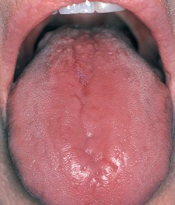
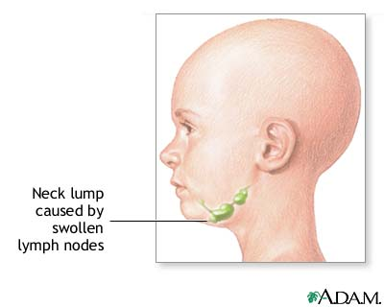
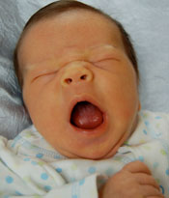

Slide 29
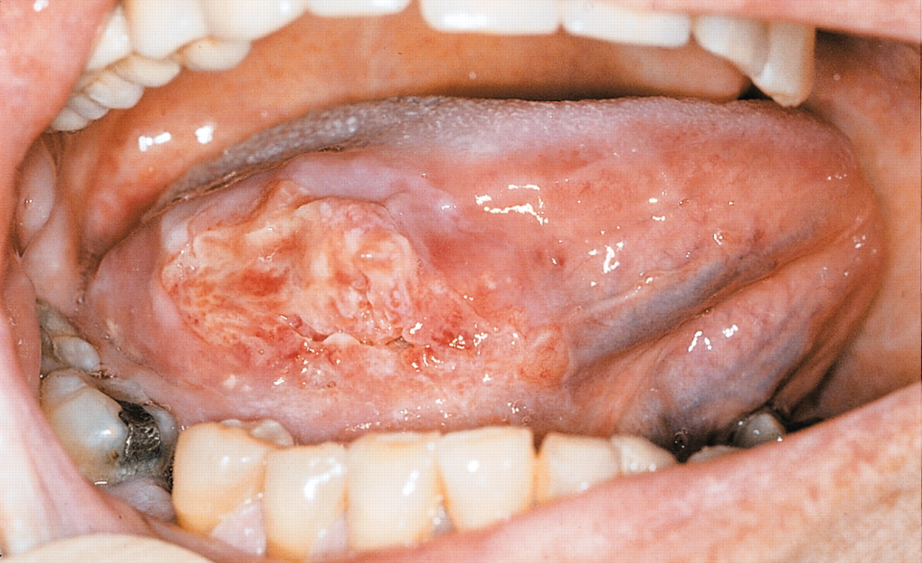

Slide 30
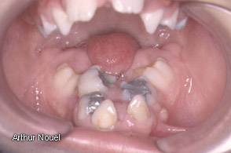
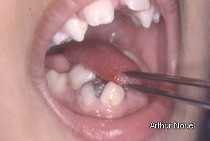
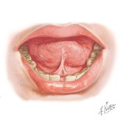
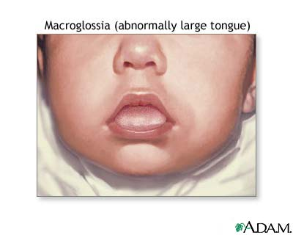


Slide 31
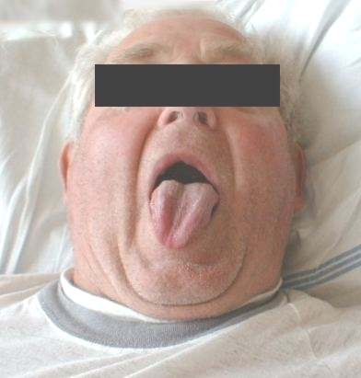
CLINICAL IMPORTANCE
Lesion of XII nerve: Deviation of tongue to side of lesion

Slide 32

See how far you can stick out your tongue.
Did you know that the average length of your tongue is 4 inches???

Slide 33

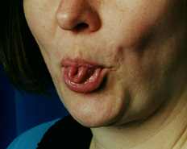
Can you do this?

Slide 34



THANK YOU

