Slide 1



LARYNX
DEPARMENT OF ANATOMY

Slide 2
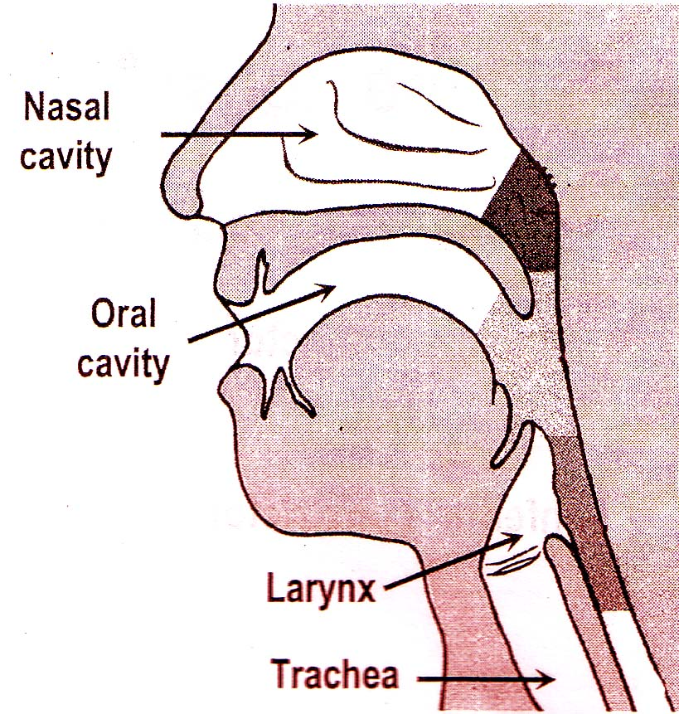

Slide 3
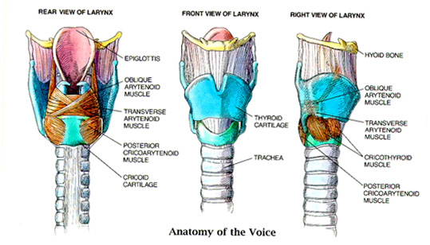

Slide 4
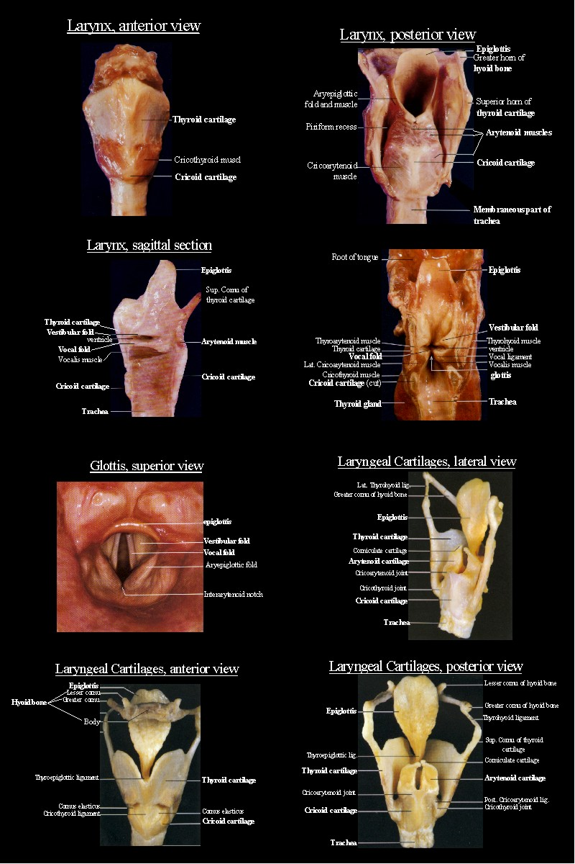

Slide 5
INTRODUCTION
VOICE BOX
PART OF RESPIRATORY SYSTEM
ORGAN FOR PRODUCTION OF VOICE
ACT AS SPHINCTER AT THE INLET OF LARYNX

Slide 6
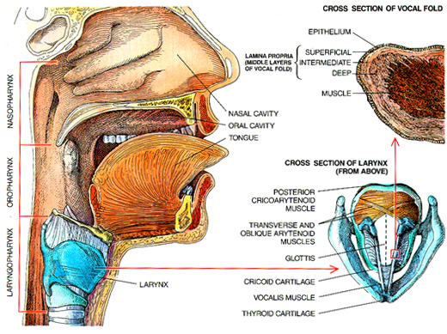

Slide 7
SITUATION
ANTERIOR MIDLINE OF THE NECK
ADULT – front of 3rd to 6th cervical vertebrae
CHILDREN AND FEMALE - LITTLE HIGHER LEVEL

Slide 8
EXTENT
ROOT OF THE TONGUE TO THE TRACHEA

Slide 9
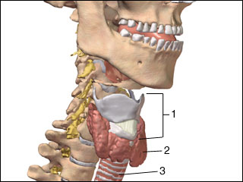
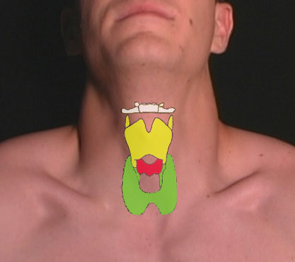

Slide 10
SIZE
LENGTH – 44mm IN MALE
36 mm IN FEMALE
At puberty – male larynx grows rapidly
Pubertal growth of female larynx is negligible

Slide 11
CONSTITUTION OF LARYNX
SKELETAL FRAMEWORK OF CARTILAGES
CARTILAGES ARE CONNECTED BY JOINTS, LIGAMENTS AND MEMBRANES
MUSCLES
CAVITY LINED BY MUCOUS MEMBRANE

Slide 12
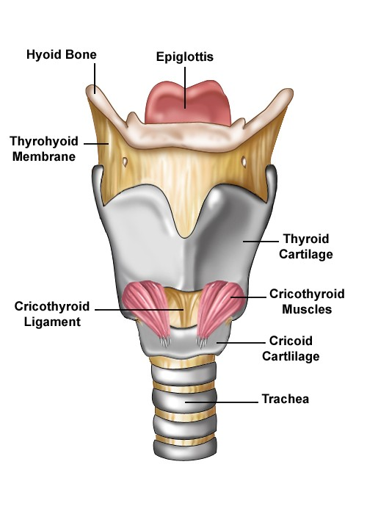

Slide 13
CARTILAGES OF LARYNX
3 unpaired and 3 paired
UNPAIRED – THYROID,
CRICOID, EPIGLOTTIC
PAIRED – ARYTENOID,
CORNICULATE, CUNEIFORM CARTILAGES

Slide 14
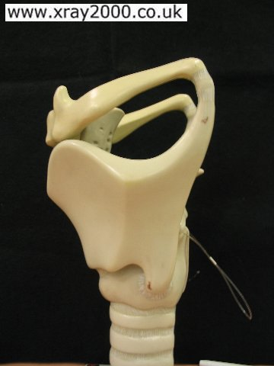

Slide 15
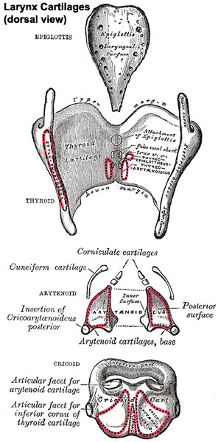

Slide 16
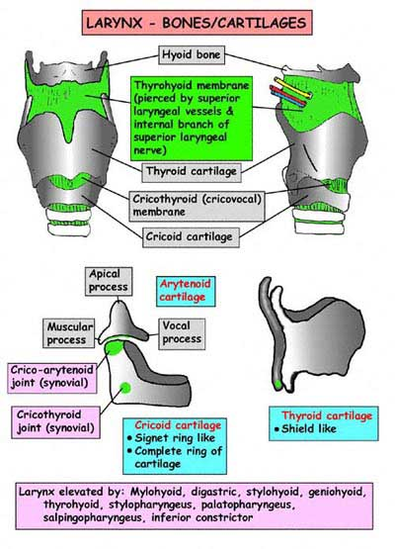

Slide 17
LARYNGEAL JOINTS
CRICOTHYROID JOINT
CRICOARYTENOID JOINT

Slide 18
LARYNGEAL LIGAMENTS
EXTRINSIC
THYROHYOID MEMBRANE
MEDIAL AND LATERAL THYROHYOID LIGAMENTS
HYOEPIGLOTTIC LIGAMENT
CRICOTRACHEAL LIGAMENT

Slide 19
INTRINSIC – PART OF BROAD SHEET OF FIBROELASTIC TISSUE – FIBROELASTIC MEMBRANE OF LARYNX
QUADRATE MEMBRANE - ABOVE SINUS
CONUS ELASTICUS – BELOW THE SINUS - ANTERIOR PART IS THICK – CRICOTHYROID LIGAMENT

Slide 20
CAVITY OF LARYNX
EXTENDS – FROM THE INLET OF LARYNX TO LOWER BORDER OF CRICOID CARTILAGE
BOUNDARIES OF INLET:
ANTERIORLY – EPIGLOTTIS
POSTERIORLY – INTERARYTENOID FOLD OF MUCOUS MEMBRANE
ON EACH SIDE – ARYEPIGLOTTIC FOLD

Slide 21
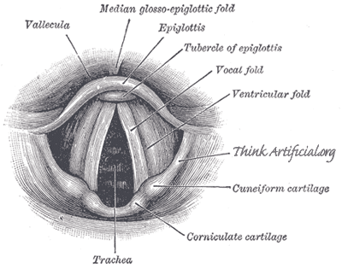
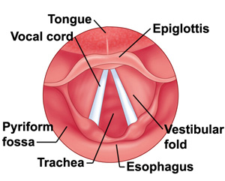

Slide 22
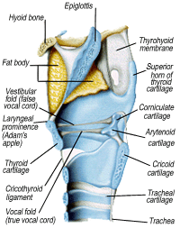

Slide 23
WITHIN THE CAVITY OF LARYNX –
TWO FOLDS OF MUCOUS MEMBRANE – VESTIBULAR FOLD – UPPER FOLD
- VOCAL FOLD – LOWER FOLD
Space b/w right and left vestibular fold – rima vestibuli
Space b/w right and left vocal fold – rima glottis

Slide 24
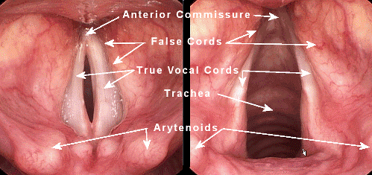

Slide 25
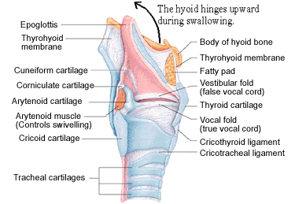

Slide 26
Vestibular and vocal folds divide the cavity into 3 parts
Above the vestibular fold is called vetibule of larynx
Part b/w vestibular and vocal fold is sinus or ventricle of larynx or sinus of Morgagni
Part below the vocal fold is called infraglottic part

Slide 27
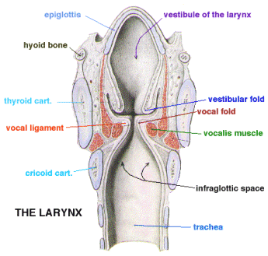
SACCULE OF LARYNX

Slide 28
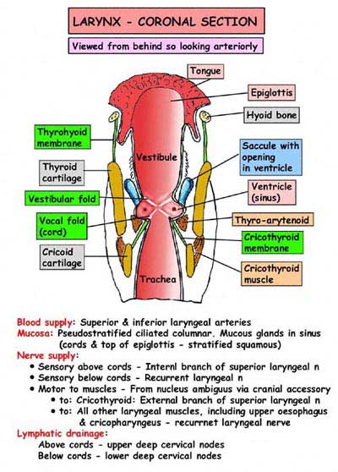

Slide 29
MUCOUS MEMBRANE OF LARYNX
Stratified squamous epithelium – ant surface, upper half of posterior surface of epiglottis, upper part of aryepiglottic fold, vocal fold
Rest of the laryngeal mucous membrane is covered with ciliated columnar epithelium

Slide 30
INTRINSIC MUSCLES OF LARYNX
Cricothyroid
Posterior cricoarytenoid
Lateral cricoarytenoid
Transvers arytenoid
Oblique arytenoid
Thyroarytenoid
Aryepiglotticus
Vocalis
Thyroepiglotticus

Slide 31
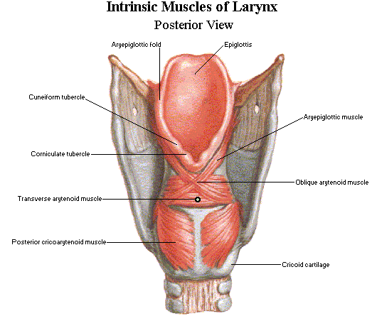

Slide 32
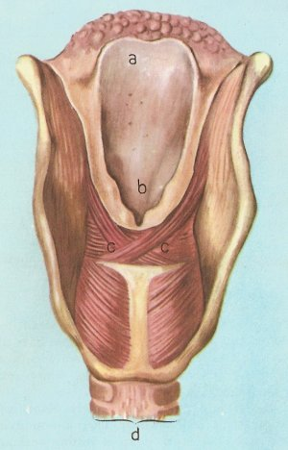

Slide 33
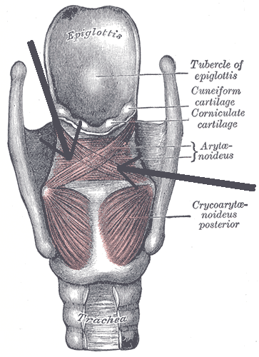

Slide 34
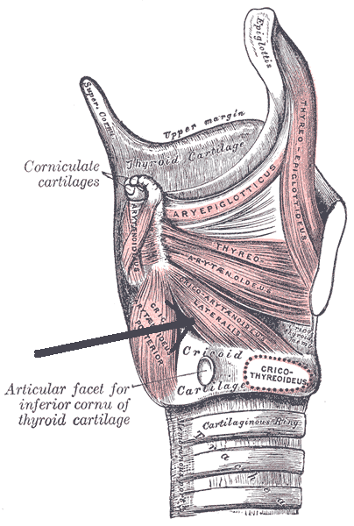

Slide 35
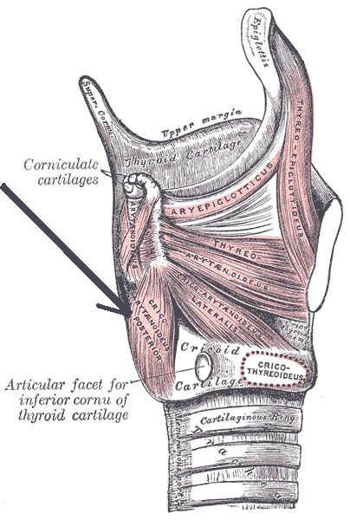

Slide 36
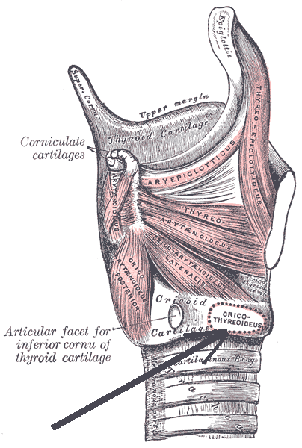

Slide 37
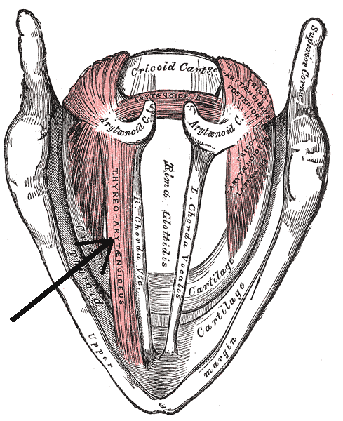

Slide 38
ACTION OF MUSCLES
MOVEMENTS
1. ELEVATION OF LARYNX
2. DEPRESSION OF LARYNX
3. OPENING INLET OF LARYNX
4. CLOSING INLET OF
LARYNX
5. ABDUCTOR OF VOCAL CORDS
6. ADDUCTOR OF VOCAL CORDS
7. TENSOR OF VOCAL CORDS
8. RELAXOR OF VOCAL CORDS
MUSCLES
THYROHYOID, MYLOHYOID
STERNOTHYROID, STERNOHYOID
THYROEPIGLOTTICUS
ARYEPIGLOTTICUS
POSTERIOR CRICOARYTENOID ONLY
LATERAL CRICOARYTENOID
TRANSVERSE, OBLIQUE ARYTENOIDS
CRICOTHYROID
THYROARYTENOID

Slide 39
ARTERIAL SUPPLY
UP TO THE VOCAL FOLD
SUPERIOR LARYNGEAL ARTERY
BRANCH OF THE SUPERIOR THYROID ARTERY
BELOW THE VOCAL FOLD
INFERIOR LARYNGEAL ARTERY
BRANCH OF THE INFERIOR THYROID ARTERY

Slide 40
VENOUS DRAINAGE
UP TO THE VOCAL FOLD
SUPERIOR LARYNGEAL VEIN DRAINS INTO THE SUPERIOR THYROID VEIN
BELOW THE VOCAL FOLD
INFERIOR LARYNGEAL VEIN DRAINS INTO THE INFERIOR THYROID VEIN

Slide 41
LYMPHATIC DRAINAGE
ABOVE THE VOCAL CORD – ANTERO- SUPERIOR GROUP OF DEEP CERVICAL NODES
BELOW THE VOCAL FOLD – POSTEROINFERIOR GROUP OF DEEP CERVICAL NODES

Slide 42
NERVE SUPPLY
SENSORY NERVE:
INTERNAL LARYNGEAL NERVE – SUPPLIES MUCOUS MEMBRANE UPTO THE LEVEL OF THE VOCAL FOLD
RECURRENTLARYNGEAL NERVE – SUPPLIES MUCOUS MEMBRANE BELOW THE LEVEL OF THE VOCAL FOLD
MOTOR NERVE
ALL INTRINSIC MUSCLES OF LARYNX SUPPLIED BY RECURRENT LARYNGEAL NERVE EXCEPT CRICOTHYROID – SUPPLIED BY EXTERNAL LARYNGEAL NERVE.

Slide 43
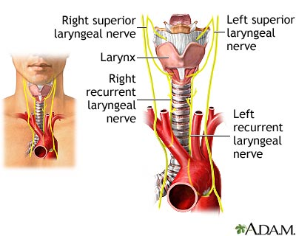

Slide 44
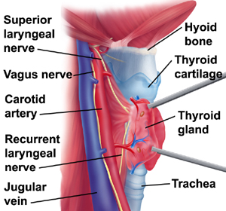

Slide 45
CLINICAL ANATOMY
WHEN ANY FOREIGN BODY ENTERS THE LARYNX IT PRODUCES SEVER PROTECTIVE COUGH AND THE FOREIGN BODY IS EXPELLED.
DAMAGE TO THE INTERNAL LARYNGEAL NERVE PRODUCES ANESTHESIA OF THE SUPRAGLOTTIC PART OF THE LARYNX. FOREIGN BODIES CAN READILY ENTER IT.

Slide 46
DAMAGE TO THE EXTERNAL LARYNGEAL NERVE - PRODUCES WEAKNESS OF SPEECH DUE TO LOSS OF TIGHTENING EFFECT OF CRICOTHYROID ON VOCAL CORDS
WHEN BOTH RECURRENT LARYNGEAL NERVE - VOCAL CORD LIE IN CADAVERIC POSITION INBETWEEN ABDUCTION AND ADDUCTION
PHONATION IS COMPLETELY LOST
BREATHING BECOME DIFICULT.

Slide 47
WHEN ONLY ONE RECURRENT LARYNGEAL NERVE - IS PARALYSED, THERE IS HOARSENESS OF VOICE, FAILURE OF FORCEFUL EXPLOSIVE PART OF VOLUNTARY AND REFLEX COUGHING
SEMON’S LAW:
IN PROGRESSIVE LESIONS OF RECURRENT LARYNGEAL NERVE , THE ONLY ABDUCTORS OF VOCAL CORDS ARE FIRST TO BE PARALYSED AND LAST TO RECOVER, AS COMPARED TO THE ADDUCTOR.

Slide 48
LARYNGOSCOPY - LARYNX CAN BE EXAMINED THROUGH A LARYNGOSCOPE
LARYNX OR GLOTTIS IS THE NARROWEST PART OF THE RESPIRATORY TRACT SO FOREIGN BODIES ARE USUALLY LODGED HERE.
LARYNGITIS – INFLAMATION OF LARYNX
LARYNGEAL OEDEMA MAY CAUSE DIFICULTY IN BREATHING.

Slide 49
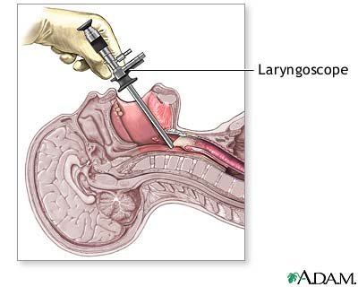

Slide 50
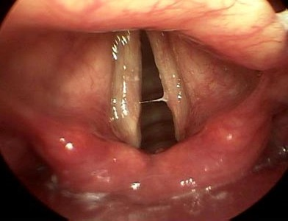

Slide 51
Presbylarynx is a condition in which age-related atrophy of the soft tissues of the larynx results in weak voice and restricted vocal range and stamina. Bowing of the anterior portion of the vocal cords is found on laryngoscopy.
Polyps and nodules are small bumps on the vocal cords caused by prolonged exposure to cigarette smoke and vocal overuse, respectively.

Slide 52
Vocal cord paresis is weakness of one or both vocal folds that can greatly impact daily life.
Laryngomalacia is a very common condition of infancy, in which the soft, immature cartilage of the upper larynx collapses inward during inhalation, causing airway obstruction.
The world's first successful larynx transplant took place in 1999 at the Cleveland Clinic.

Slide 53
Laryngeal cancer may also be called cancer of the larynx or laryngeal carcinoma.
Most laryngeal cancers are squamous cell carcinomas, reflecting their origin from the squamous cells which form the majority of the laryngeal epithelium.

Slide 54
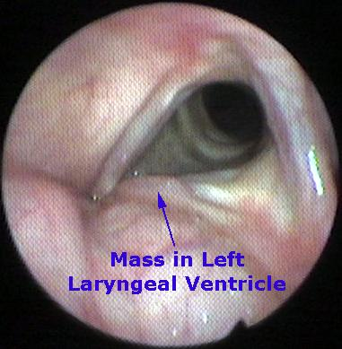

Slide 55
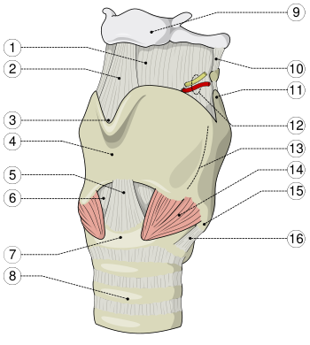

Slide 56

