Slide 1
Digestion and Absorption of carbohydrates
Dr.D.Ponnudhali

Slide 2
Complex carbohydrates
Oligosaccharides
Polysaccharides
Starch
Glycogen
Dietary fiber (Dr. Firkins)

Slide 3
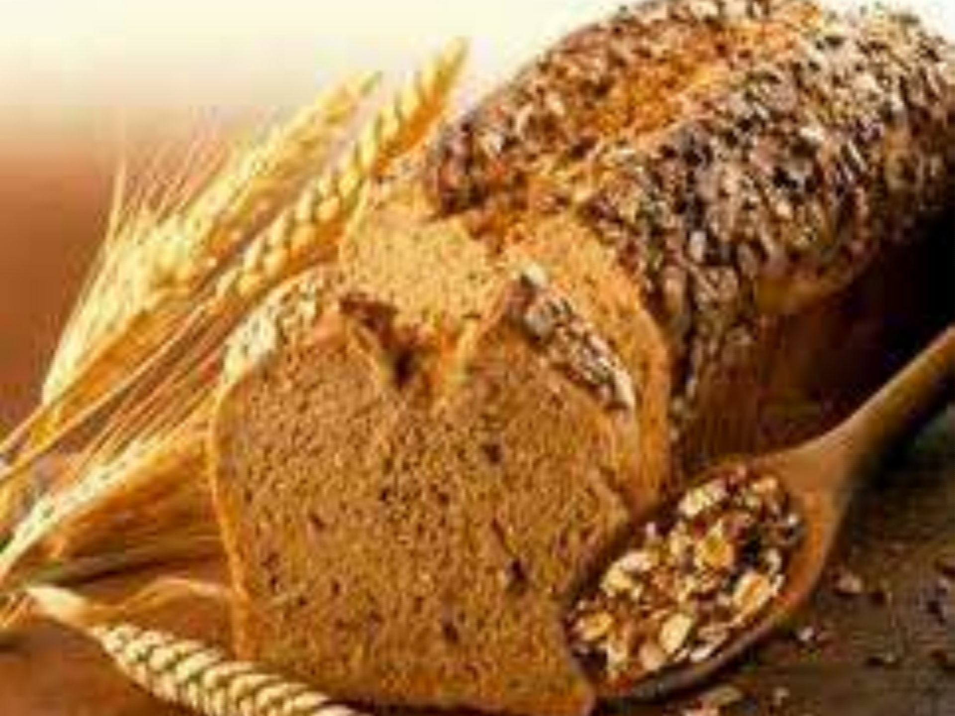
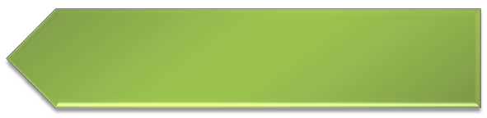

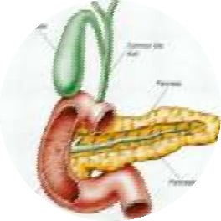


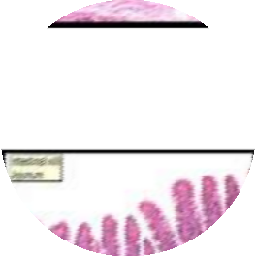

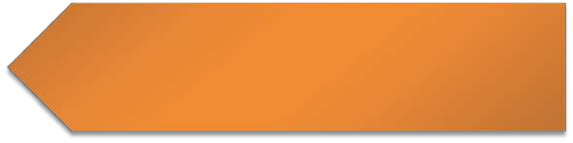
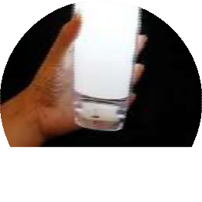
CONTENTS
Digestion of carbohydrates
Absorption of carbohydrates
Clinical significance

Slide 4

Carbohydrates
Carbohydrates are composed of carbon and water and have a composition of (CH₂O)_{n.}
The major nutritional role of carbohydrates is to provide energy and digestible carbohydrates provide 4 kilocalories per gram.
energy
Carbon dioxide
Water
Chlorophyll
GLUCOSE
6 CO2 + 6 H20 + energy (sun)
C6H12O6 + 6 O2

Slide 5







Carbohydrates present in the diet
Polysaccharides
Disaccharides
Monosaccharides
Lactose Maltose Sucrose
Glucose Fructose Pentose
Starch Glycogen
In GIT, all complex carbohydrates are converted to simpler monosaccharide form which is the absorbable form.

Slide 6
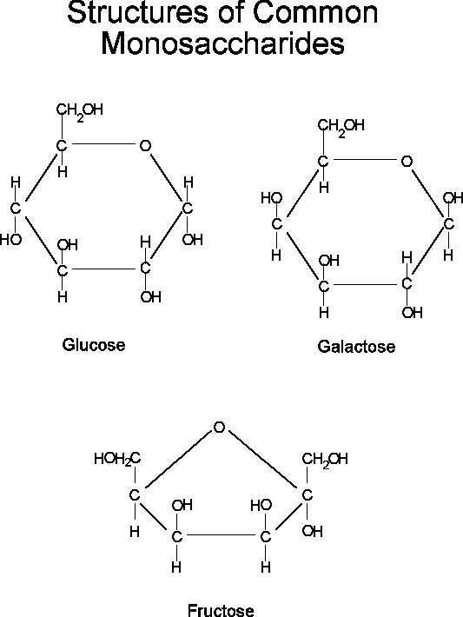
Simple Sugars -
Notes:
Glucose – basic unit of polysaccharides
Galactose – found as part of lactose in milk
Fructose – found in fruits, vegetables and honey (consumption on the rise….High fructose corn syrup)

Slide 7
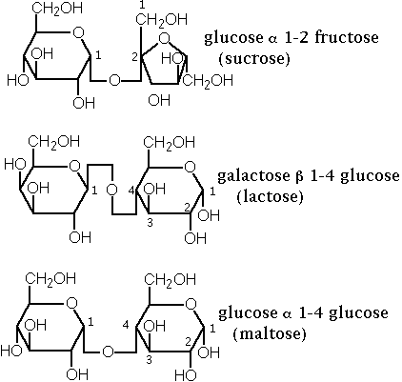
Disaccharides

Slide 8
Complex carbohydrates
Oligosaccharides
Polysaccharides
Starch
Glycogen
Dietary fiber (Dr. Firkins)

Slide 9
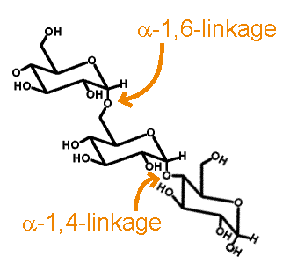
Starch
Major storage carbohydrate in higher plants
Amylose – long straight glucose chains (α1-4)
Amylopectin – branched every 24-30 glc residues (α 1-6)
Provides 80% of dietary calories in humans worldwide

Slide 10
Glycogen
Major storage carbohydrate in animals
Long straight glucose chains (α 1-4)
Branched every 4-8 glc residues (α 1-6)
More branched than starch
Less osmotic pressure
Easily mobilized
G
G
G
G
G
G
G
G
G
G
G
α 1-6 link
G
G
G
α 1-4 link
G
G
G
G
G

Slide 11
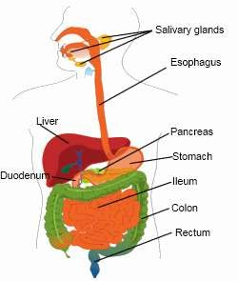


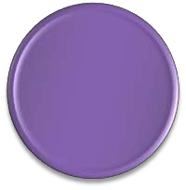
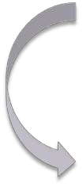

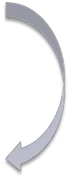

Digestion in mouth
Digestion in stomach
Digestion in small intestine

Slide 12
Digestion of Carbohydrates
Monosaccharides
Do not need hydrolysis before absorption
Very little (if any) in most feeds
Di- and poly-saccharides
Relatively large molecules
Must be hydrolyzed prior to absorption
Hydrolyzed to monosaccharides
Only monosaccharides can be absorbed

Slide 13

























Details of digestion of carbohydrates
2 Types of enzymes are important for the digestion of carbohydrates
Amylases
Disaccharidases
Convert disaccharides to monosaccharides which are finally absorbed
convert polysaccharides to disaccharides
Salivary Amylase
Maltase
Sucrase-Isomaltase
Pancreatic Amylase
Lactase
Trehalase

Slide 14
Digestion in the Mouth
Digestion of Carbohydrate starts in the mouth, upon contact with saliva during mastication. Saliva contains a carbohydrate splitting enzyme called salivary amylase , also known as ptylin.

Slide 15
Carbohydrate Digestion- Mouth
Salivary amylase breaks starches down to maltose.
It plays only a small role in breakdown because
- Shorter duration of food in mouth.
- Thus it is incomplete digestion of starch or glycogen in the mouth
Ruminants do not have this enzyme.

Slide 16
Digestion
Pre-stomach – Salivary amylase : α 1-4 endoglycosidase
G
G
G
G
G
α Limit dextrins
G
G
G
G
G
G
G
G
amylase
G
G
G
G
G
G
α 1-6 link
G
G
G
G
G
maltotriose
G
G
α 1-4 link
G
G
G
G
G
G
maltose
G
G
isomaltose
Notes:
Key- We must breakdown these very large oligosaccharides into monosaccharides in order to absorb them.
Alpha amylase. – Cannot attack a1-4 linkase close to 1-6 branch points.

Slide 17
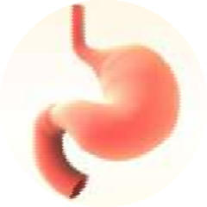
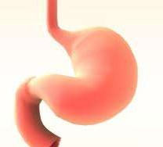
Digestion in the Stomach
There is no enzyme to break the glycosidic bonds in gastric juice.
However, HCl present in the stomach causes hydrolysis of sucrose to fructose and glucose
HCl
Sucrose ----------→ glucose + fructose

Slide 18
Stomach
Not much carbohydrate digestion
Acid and pepsin to unfold proteins
There is no enzyme to break the glycosidic bonds in gastric juice.
However, HCl present in the stomach causes hydrolysis of sucrose to fructose and glucose
Ruminants have forestomachs with extensive microbial populations to breakdown and
anaerobically ferment feed

Slide 19
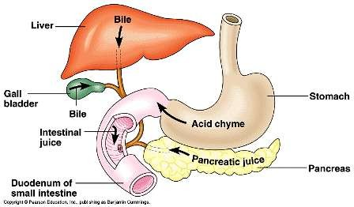
Digestion in Duodenum
Food bolus reaches the duodenum from the stomach where it meets pancreatic juice.
Pancreatic juice contains a carbohydrate splitting enzyme, pancreatic amylase (amylopsin) similar to salivary amylase.

Slide 20
Pancreatic amylase
It is an α- Amylase
Optimum pH=7.1
Like ptylin, it requires Cl− ion for its activity.
It hydrolyses α-1→ 4 glycosidic l inkages situated well inside polysaccharide molecules.
Note: Pancreatic amylase, an isoenzyme of salivary amylase,
differs only in the optimum pH of action.
Both the enzymes require Chloride ions for their actions
(Ion activated enzymes).

Slide 21
Carbohydrate Digestion- Pancreas
Pancreatic amylase
Hydrolyzes alpha 1-4 linkages
Produces monosaccharides, disaccharides,
and polysaccharides
Major importance in hydrolyzing starch and
glycogen to maltose.
Polysaccharides Disaccharides
Amylase

Slide 22



Reaction catalyzed by pancreatic amylase
Starch / Glycogen
Pancreatic
Amylase
Maltose/ Isomaltose
+
Dextrins and oligosaccharides

Slide 23
Digestion in Small Intestine
Main digestion takes place in the small intestine by pancreatic amylase
Digestion is completed by pancreatic amylase because food stays for a longer time in the intestine.

Slide 24
Small Intestine
Pancreatic enzymes
α-amylase
maltotriose
maltose
+
G
G
G
G
G
G
G
G
G
G
α amylase
amylose
G
G
G
G
G
G
G
G
G
G
G
G
G
G
G
G
G
amylopectin
α Limit dextrins

Slide 25
Digestion in Small Intestine
Digestion mediated by enzymes synthesized by cells lining the small intestine (brush border)
Brush Border Enzymes
Disaccharides
Monosaccharides
* Exception is β-1,4 bonds in cellulose

Slide 26
What are disaccharidases?
They are present in the brush border epithelium of intestinal mucosal cells where the resultant monosaccharides and others arising from the diet are absorbed.
The different disaccharidases are :
1. Maltase,
2. Sucrase-Isomaltase (a bifunctional enzyme catalyzing hydrolysis of sucrose and isomaltose)
3. Lactase

Slide 27
Digestion in Small Intestine
Sucrase
Glucose + Fructose
Sucrose
Maltase
Maltose
Glucose + Glucose
Lactase
Lactose
Glucose + Galactose
Sucrase Isomaltase
Sucrose Isomaltose 3 Glucose + fructose
Note: * Ruminants do not have sucrose
* Poultry do not have lactase

Slide 28
Oligosaccharide digestion..cont
α Limit dextrins
G
G
G
G
G
G
G
sucrase
G
G
maltase
G
G
Glucoamylase (maltase)
or
α-dextrinase
G
G
G
G
G
α-dextrinase
G
G
G
G
G
G
G
G
G
Notes:
Maltase – specifically removes a single glucose from the nonreducing end of a linear a1-4 glucose chain…breaking down maltose into glucose. (exosaccharidases)
Alpha dextinase – cleaves 1,6-alpha glucosidic linkages

Slide 29
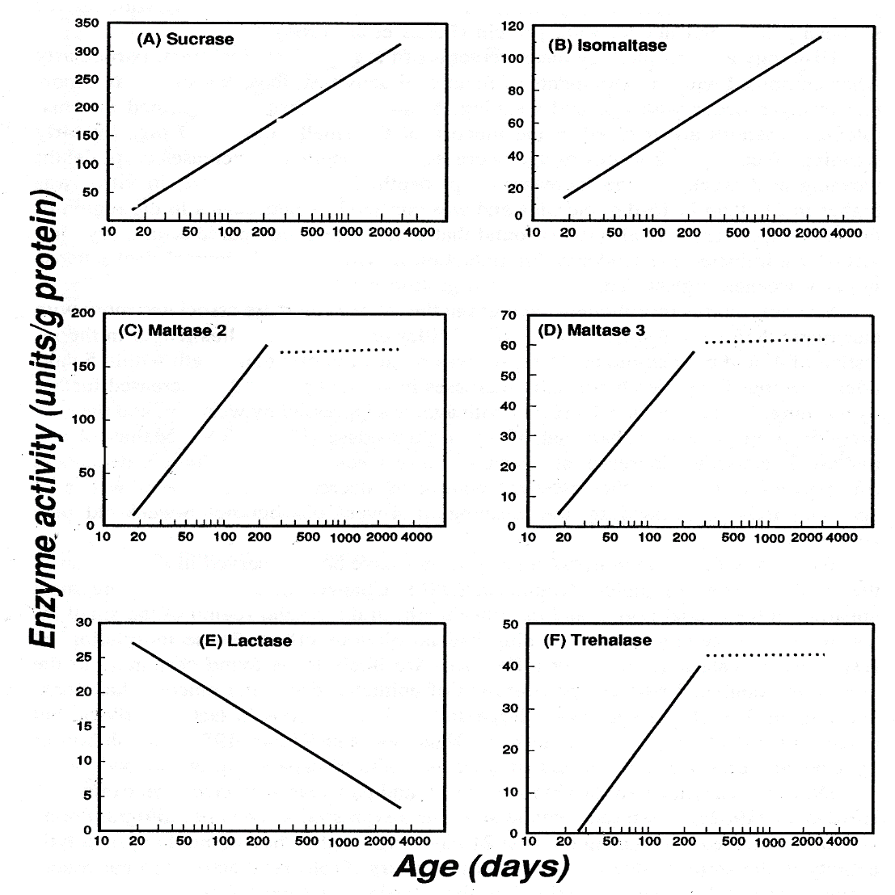
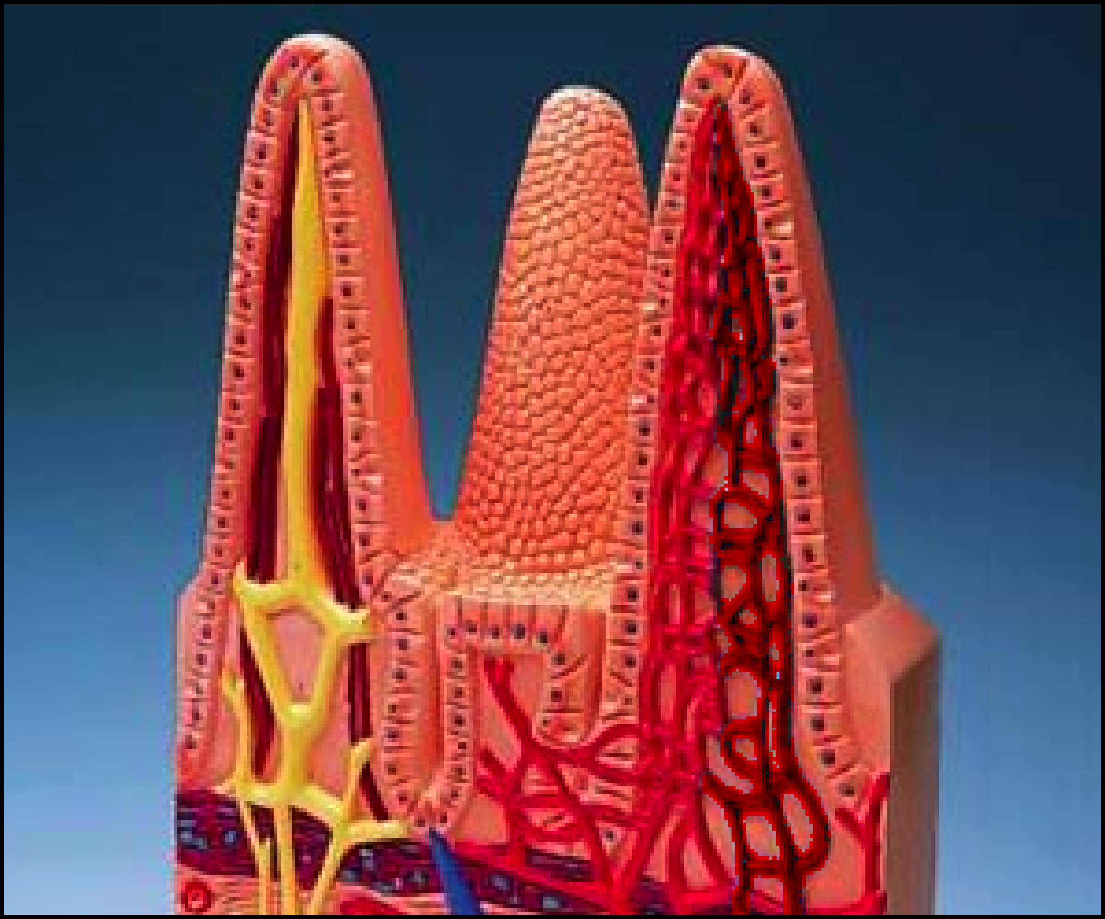
Digestion of Disaccharides
Newborns have a full complement of brush-border enzymes
Miller et al. (eds.), 1991

Slide 30

Clinical significance of Digestion
Lactose intolerance is the inability to digest lactose due to the deficiency of Lactase enzyme.
Causes
Congenital
Acquired during lifetime
Primary Secondary

Slide 31

Congenital Lactose intolerance
It is a congenital disorder
There is complete absence or deficiency of lactase enzyme.
The child develops intolerance to lactose immediately after birth.
It is diagnosed in early infancy.
Milk feed precipitates symptoms.

Slide 32

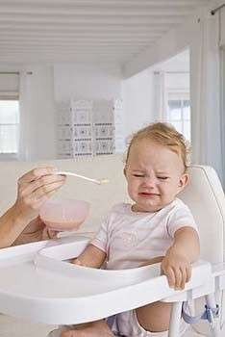
Baby with Lactose Intolerance

Slide 33
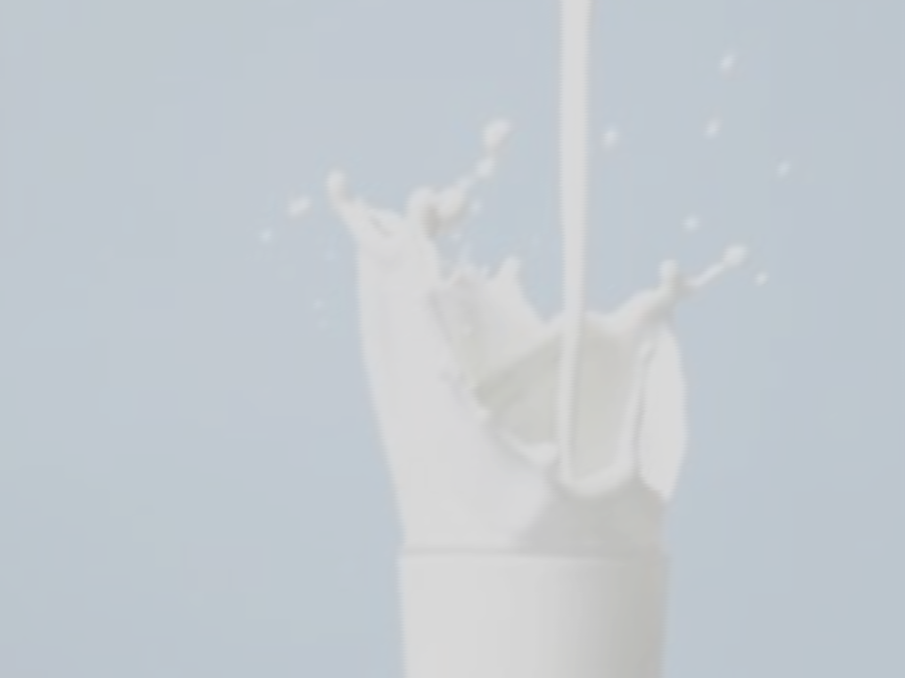




Primary Lactase deficiency
Primary lactase deficiency develops over time
There is no congenital absence of lactase but the deficiency is precipitated during adulthood.
The gene for lactose is normally expressed upto RNA level but it is not translated to form enzyme.
It is very common in Asian population.
There is intolerance to milk + dairy products.

Slide 34

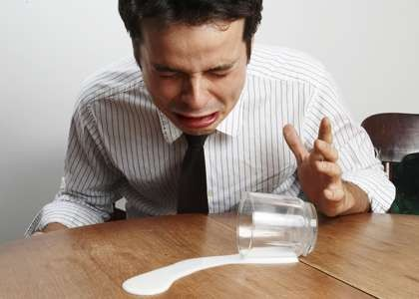
Adult with lactose intolerance

Slide 35
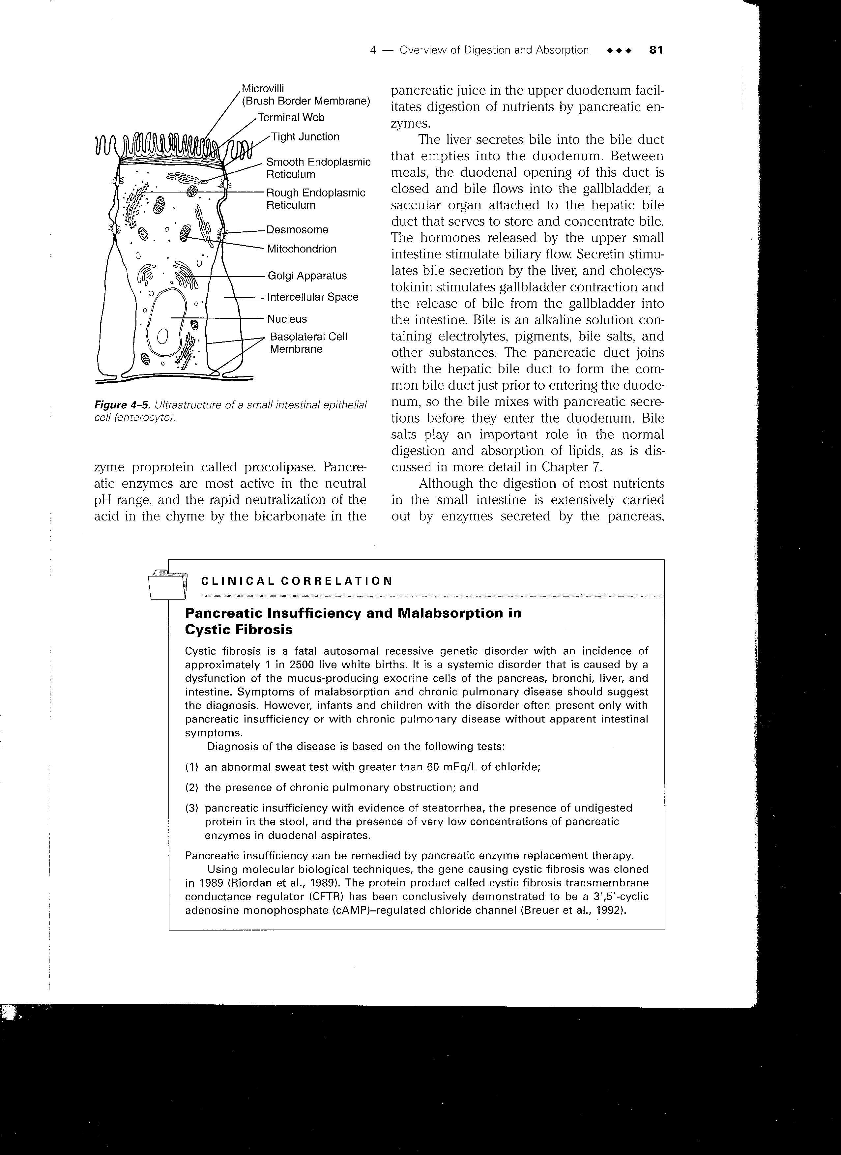
Small intestine
Portal for transport of virtually
all nutrients
Water and electrolyte balance
Enzymes associated with
intestinal surface membranes
Sucrase
α dextrinase
Glucoamylase (maltase)
Lactase
peptidases

Slide 36
Digestion in Large Intestine
Carnivores and omnivores
Limited anaerobic fermentation
Bacteria produce small quantities of cellulase
SOME volatile fatty acids (VFA) produced by microbial digestion of fibers
Propionate
Butyrate
Acetate

Slide 37
Overview Monogastric Carbohydrate Digestion
Location Enzymes Form of Dietary CHO
Mouth Salivary Amylase Starch Maltose Sucrose Lactose
Stomach (amylase from saliva) Dextrin→Maltose
Small Intestine Pancreatic Amylase Maltose
Brush Border Enzymes Glucose Fructose Galactose
+ + +
Glucose Glucose Glucose
Large Intestine None Bacterial Microflora Ferment Cellulose

Slide 38
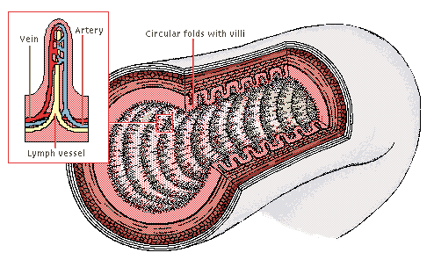
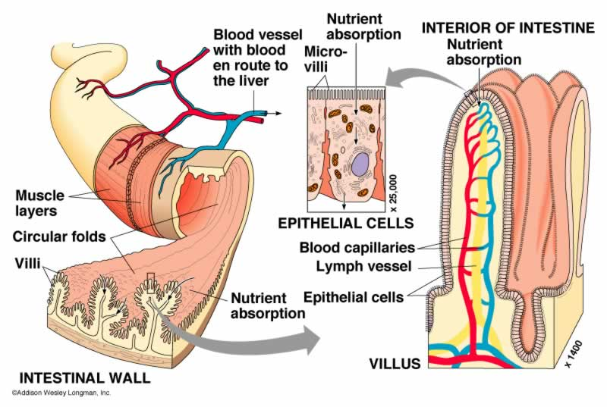
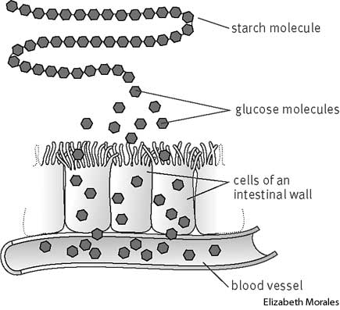
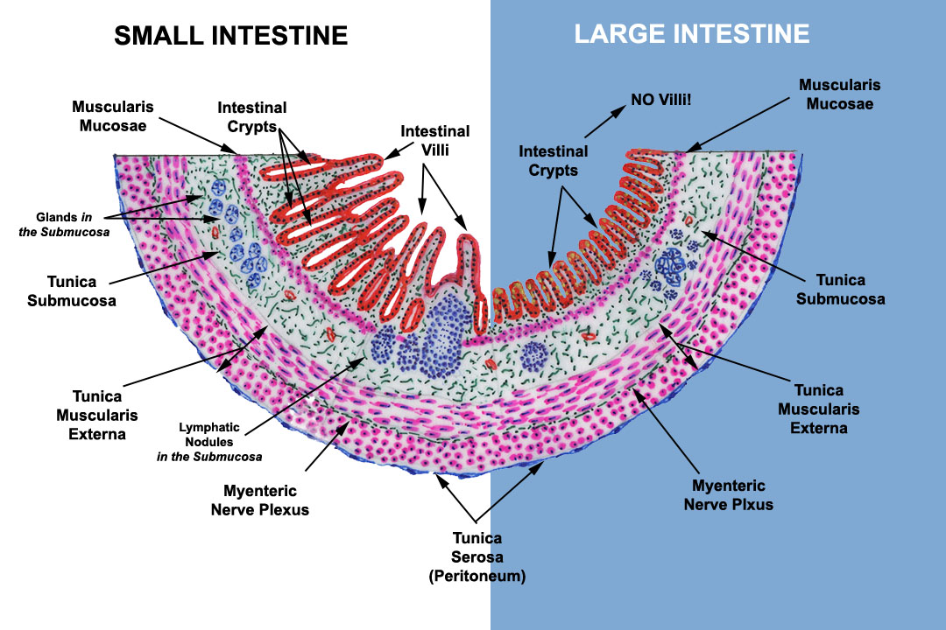

Slide 39
Small Intestine
Carbohydrates Monosaccharides
Portal Vein
Active Transport
Liver
Distributed to tissue through circulation

