Slide 1
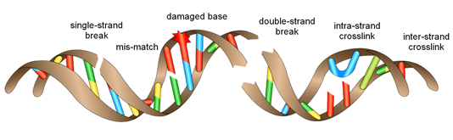

DNA REPAIR MECHANISM
Dr.Priya.K.Dhas
Assistant Professor
Department of Biochemistry
VMKV Medical College
Salem

Slide 2
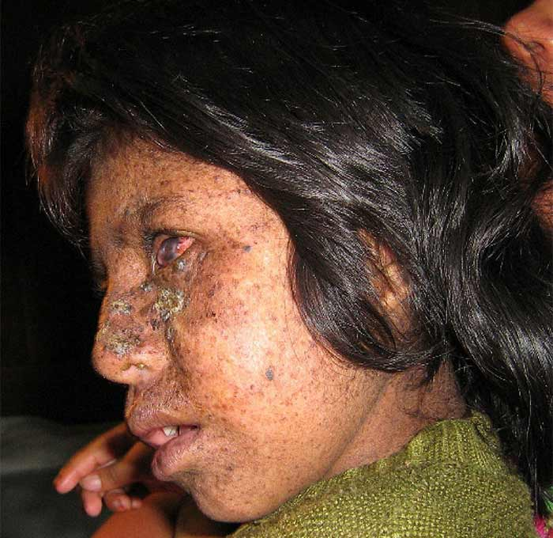
CASE STUDY
An 8 year-old girl was presented to the out-patient department of a hospital, concern regarding progressive ocular lesions.

Slide 3
CASE HISTORY
The history was unusual: since the age of 3 months the patient had suffered with persistent developmental delay as well as the appearance of multiple pigmented papular lesions on her face, neck, and forearms.
Over time these lesions had enlarged and become progressively more numerous and raised, although were confined to sun-exposed areas. Her mother had noted gradually enlarging corneal lesions bilaterally.

Slide 4
CASE HISTORY
Development –
social smiling, sufficient fine motor skills to feed herself,
infrequent speech of only single words, and an unsteady gait.
Though happy never been self-caring.
had 2 normal siblings
no family history
Non-consanguinity

Slide 5
On examination
The patient was smiling and playful, and appeared well-nourished.
Large hyperkeratotic lesions on the cheeks and nose with some induration suspicious of actinic keratosis and early squamous cell carcinoma.
Numerous hyper-pigmented lentigos and xerosis limited to sun-exposed sites.
Marked corneal scarring was evident bilaterally
No evidence of anaemia/vit def

Slide 6
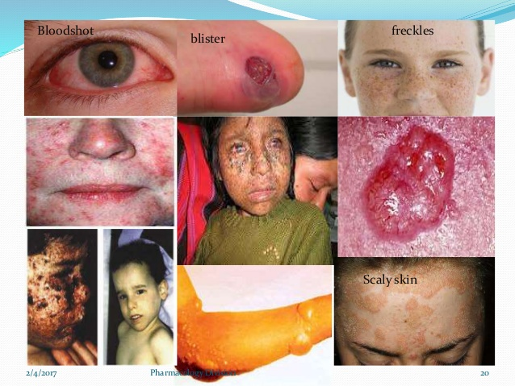
Features
Severe sunburn
Abnormal lentiginosis
Rough surfaced growth (solar keratoses) and skin cancer
Blistering or freckling on minimum sun exposure
Photophobia
Eyes painfully sensitive to sun,irritated, blood shot and clouded

Slide 7
Xeroderma pigmentosum (XP)
Greek - Xeres –dry , derma – skin
Autosomal recessive condition
Defect in Nucleotide Excision repair
???

Slide 8
DNA REPAIR MECHANISM

Slide 9
Objective
Introduction
Types of mutagens
Types of damages
Types of repair mechanism
Disorders associated

Slide 10
Learning outcome
At the end of this session the student should be able to
Discuss the type of DNA damages and its causes
Explain the types of DNA repair mechanisms with examples.
List the diseases and there biochemical defect

Slide 11
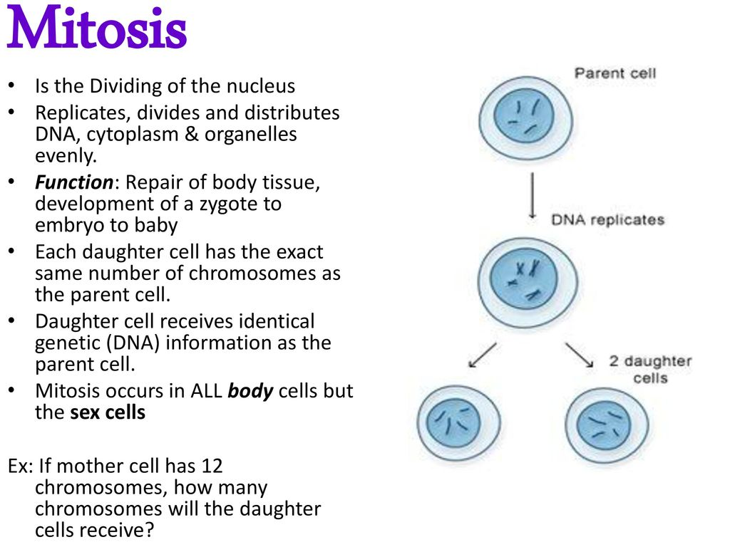
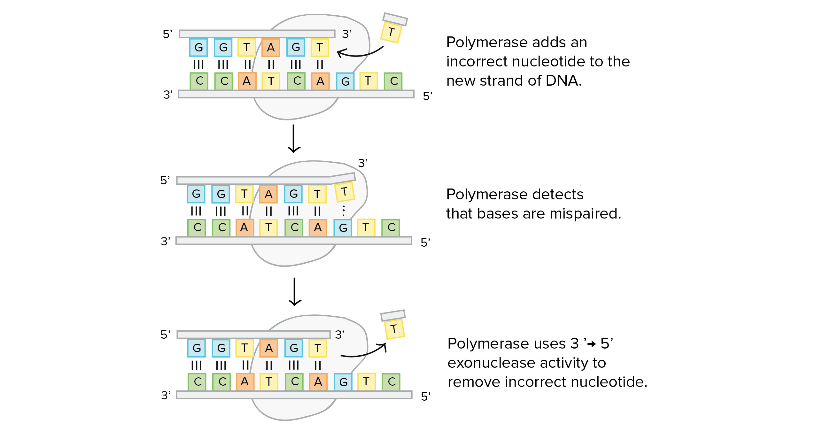
IntroductiON
PROOF READING
Replication- high fidelity
DNA polymerase
Each cycle Replication
∼ 1error/billion bp
Foolproof mechanisms to correct these errors

Slide 12
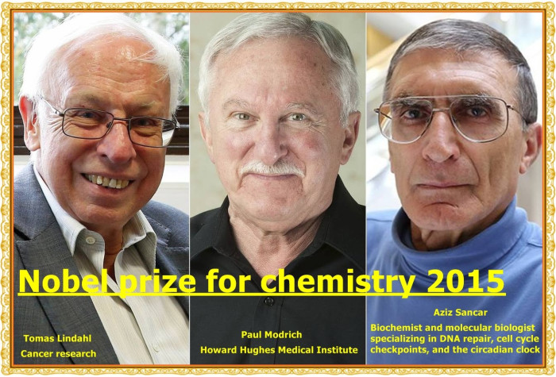
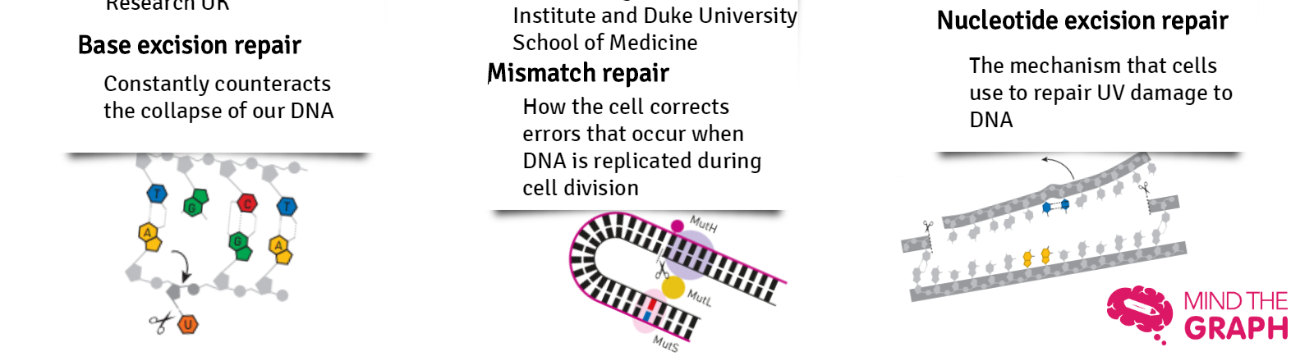
Studies in DNA repair mechanism

Slide 13
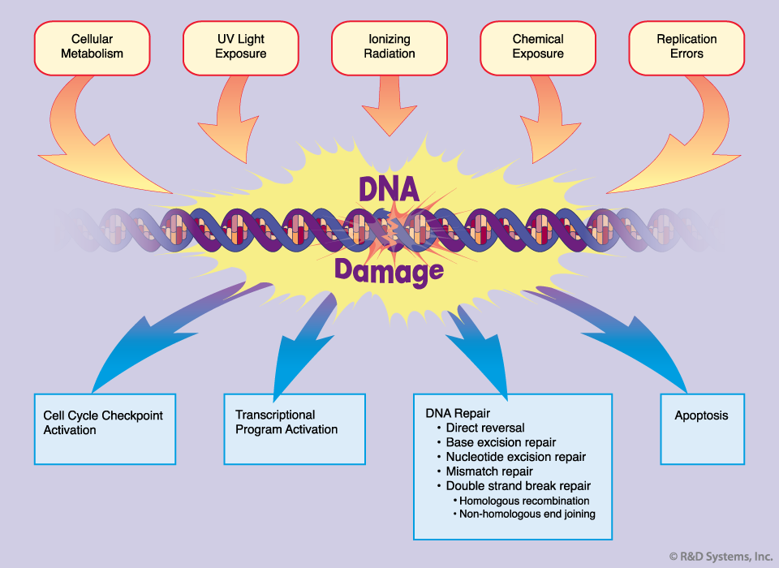
AGENTS - DNA damage
Despite an effective repair system errors do occur

Slide 14
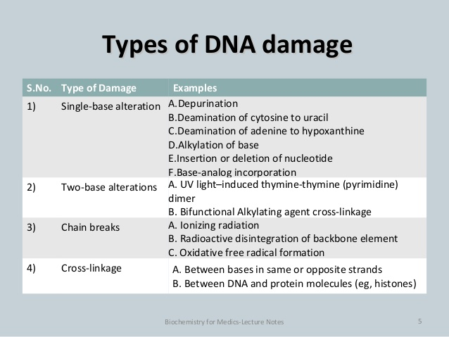
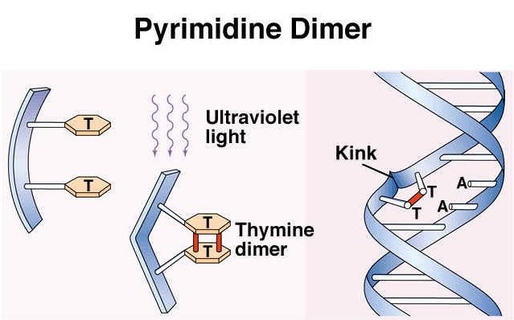
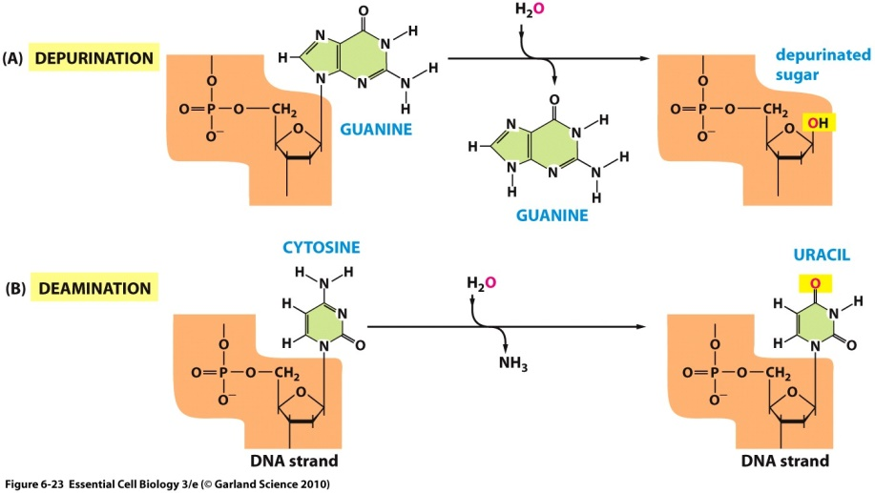
Types of DNA damage

Slide 15
Types of repair mechanism
Mismatch repair
Nucleotide Excision repair
Double strand break repair
Base Excision repair
Direct repair

Slide 16
Repair mechanism -4 steps
Recognition of distorted region of DNA
Removal/ Excision of the damaged region of DNA
Filling of gap DNA polymerase
Sealing the nick by DNA ligase

Slide 17
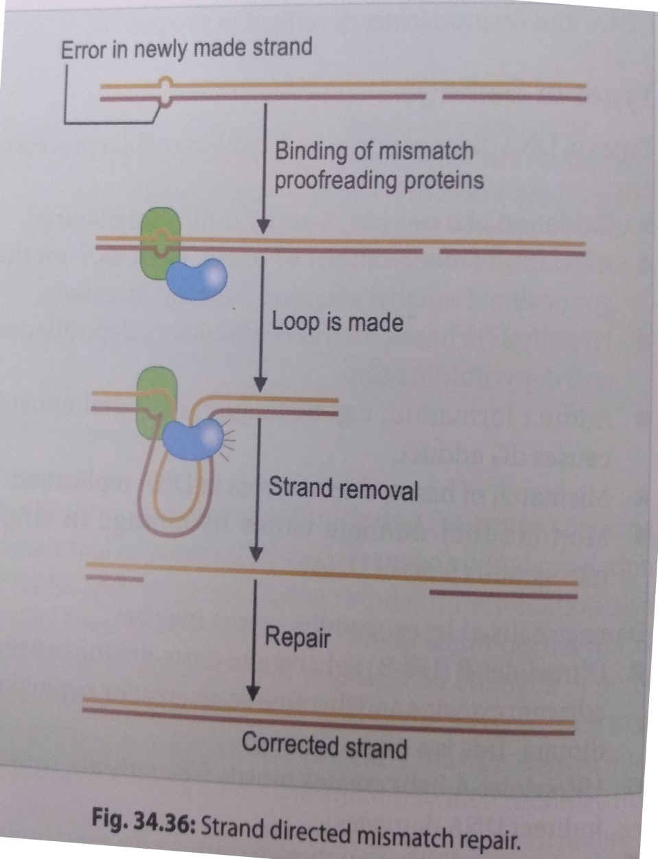
Mismatch repair
Specific proteins scan the newly synthesised strand .
Mismatch is identified and Loop is made.
Damaged segment is removed.
Action of DNA polymerase , SSBs and ligase.
E.Coli – MutS, MutH, MutC.

Slide 18
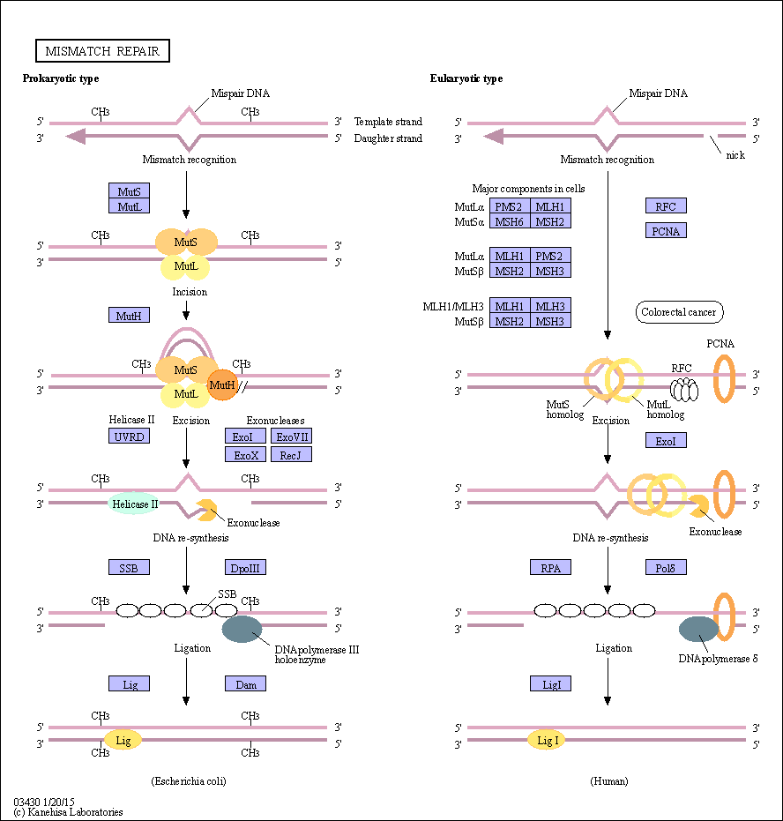
Mismatch repair

Slide 19
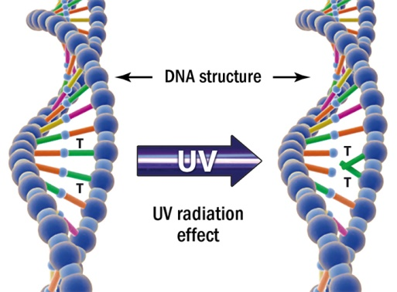
NUCLEOTIDE EXCISION repair
Prevent mutation caused UV induced damages
Thymine dimers
Proof reading
Mammalian cells 9 proteins – involved in NER
Xeroderma Pigmentosum - XPA, XPB, XPC, XPD, XPE, XPF, XPG
Cockyane syndrome – CSA and CSB
How do the cells recognise the newly synthesised strand?

Slide 20
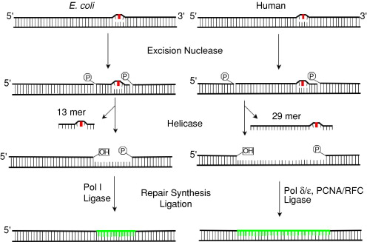
NUCLEOTIDE EXCISION repair
Mismatched base identified
Removed along with a few bases (30NTS)- endonuclease/ excinuclease
DNA polymerase beta- synthesise small segment of correct bases
DNA ligase – gap or nick sealed, energy required.

Slide 21
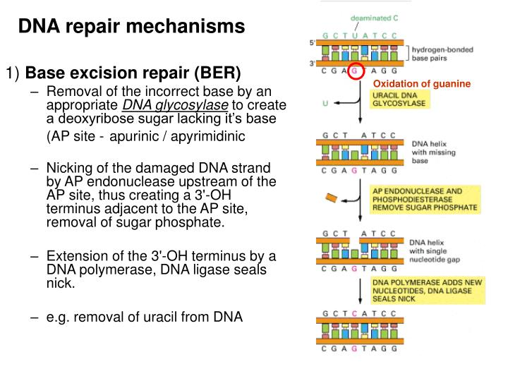
BASE EXCISION repair
Chemicals / radiation causes deamination
C-U, A-HX, G-X (donot exist in normal DNA)
DNA Glycosylase – deoxyribose sugar lacking its base thus forming AP site( apurinic /apyrimidinic)
AP endonuclease -Nick created by removal of sugar and phosphate(3’OH terminus adjacent to the AP site)
DNA polymerase – extension of 3’OH terminus. DNA ligase – seals the nick

Slide 22
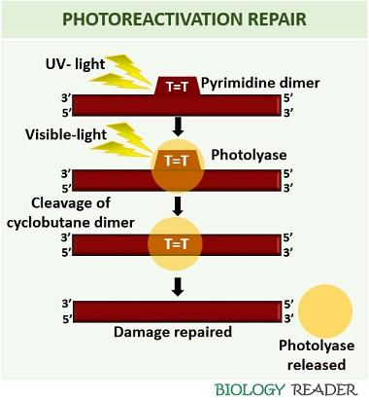
DIRECT REPAIR PATHWAY
Several damages are repaired without removing base or nucleotide.
Eg. Photochemical cleavage of pyrimidine dimers
All cells photoreactivating enzyme – DNA photoolyase (N5,N10, methyl THF, FAD)
Enzyme binds to damaged region of DNA
Enzyme get excited by light energy absorbed by MTHF.
Excited enzyme cleaves the dimer into the original bases.

Slide 23
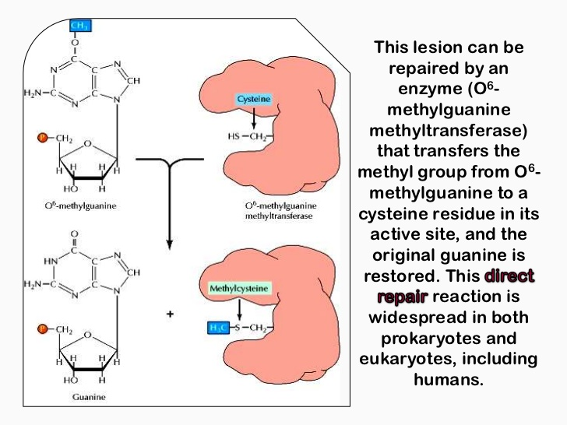
Repair of O⁶methyl guanine
Formed by alkylating agents
Highly mutagenic lesion
It tends pair with T rather than C during replication
Causes G≡C to A=T mutation.

Slide 24
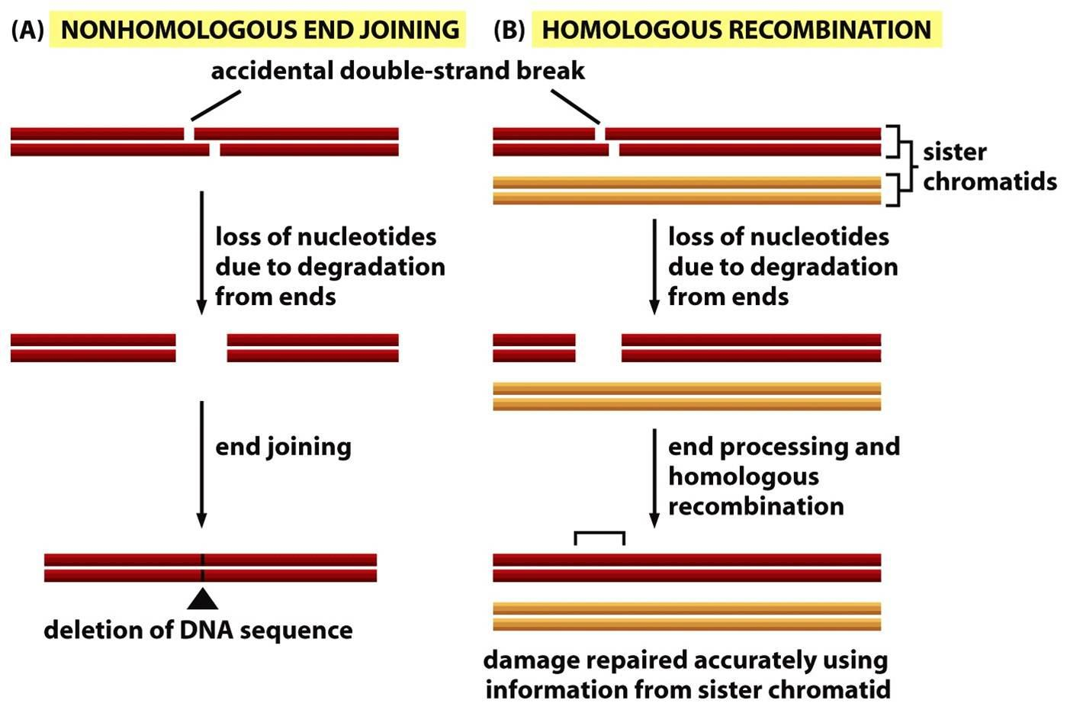
Double strand break repair

Slide 25
CLINICAL IMPORTANCE
Defect in DNA repair systems
Mutation
Cancer

Slide 26
Xeroderma pigmentosum (XP)
Greek - Xeres –dry , derma – skin
Autosomal recessive condition
Defect in Nucleotide Excision repair
???

Slide 27
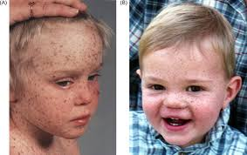
Xeroderma Pigmentosum
7 XP genes –products of these genes are involved in the repair of ultraviolet (UV)-induced damage in DNA (T=T).
Repair system not effective –mutation accumulate – cancer.
Sensitivity to UV rays
Sunlight causes blisters on the skin
Avoid sunlight, sunscreen ointment – beneficial
XP – more prone to skin cancer -1000fold
Death – second decade of life
Squamous cell carcinoma of skin.
Prenatal diagnosis is possible.

Slide 28
ATAXIA TELANGIECTASIA
Autosomal recessive disease
Occurrence : 1:40,000 persons
Features: Sensitivity to UV, cerebellar ataxia, telangiestica in eyes,
lymphoreticular neoplasms
Cause : mutated ATM gene in chromosome 11q (1% of population)

Slide 29
DISEASE - DNA REPAIR
Disease | Chromosome defective | Defective repair mechanism
Fanconi anemia | 20q and 9q | Cross- link repair | cancer
Bloom’s syndrome | 15q | DNA ligase or helicase | Lymphoreticular malignancies
Cockyane syndrome | Transcription factor II H | NER | Stunted growth , mental retardation
Hereditary polyposis colon cancer Lynch syndrome | 2, hMSH1 and 2 genes | Mismatch repair

Slide 30
THANK YOU
STAY SAFE
STAY AT HOME

