Slide 1
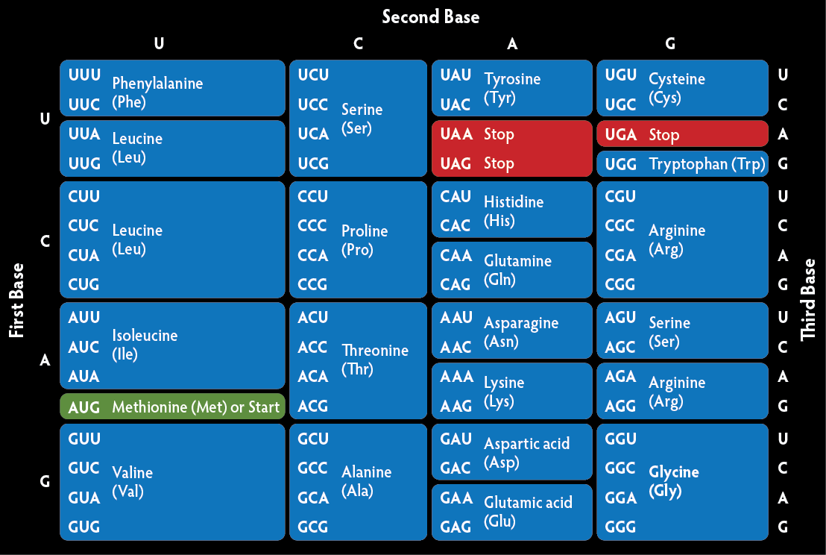

GENETIC CODE & MUTATION Dr. Evangeline Jones HOD& Professor of Biochemistry
& X

Slide 2
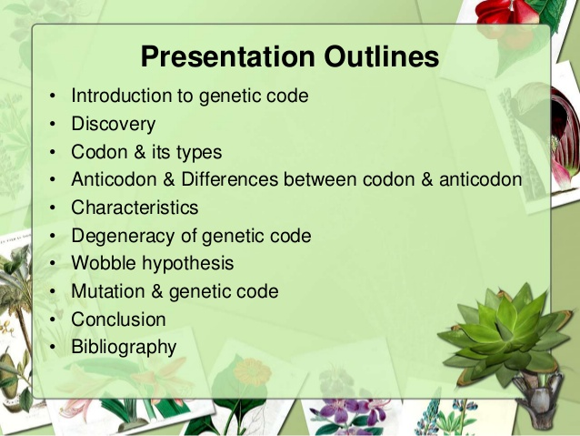

Slide 3
OBJECTIVES
To understand –
1. What is Genetic code?
2. What are its significance?
3. Salient features of Genetic code
4. What is Mutation & what are its types?
5. What are the causes?

Slide 4
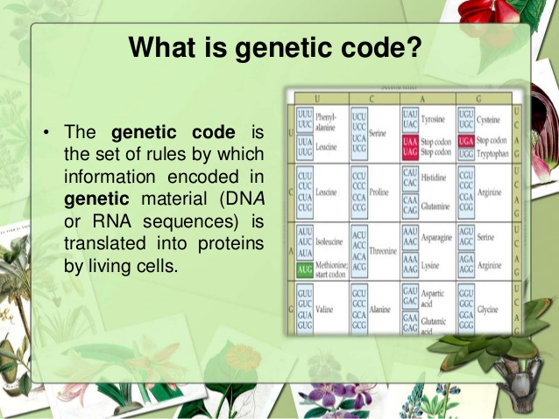

Slide 5
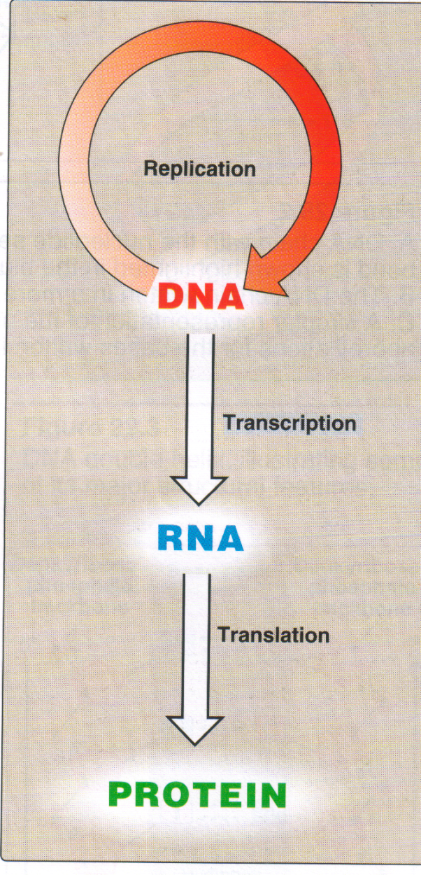
CENTRAL DOGMA OF LIFE
REVERSE
TRANSCRIPTION

Slide 6
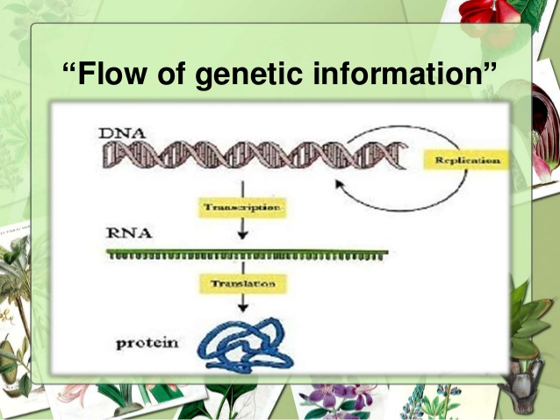

Slide 7
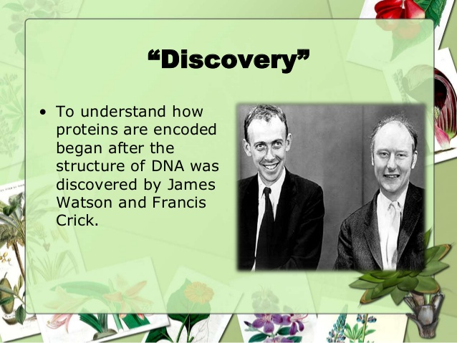

Slide 8
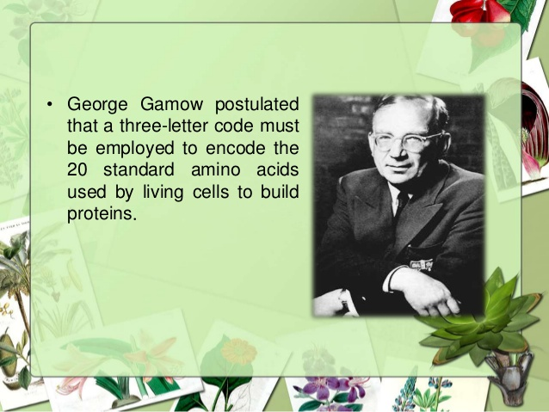

Slide 9
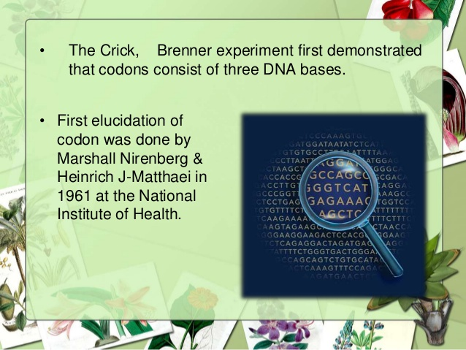

Slide 10
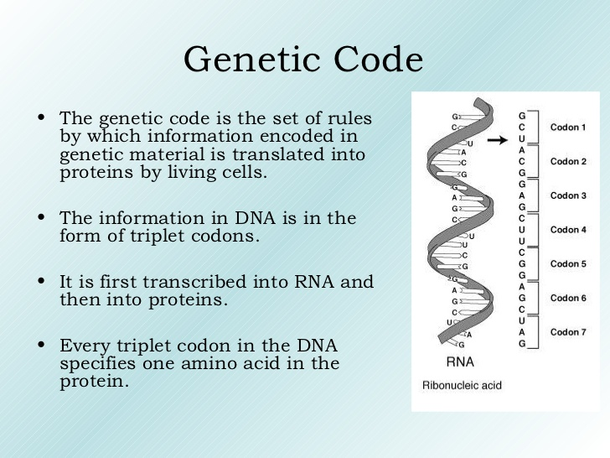

Slide 11
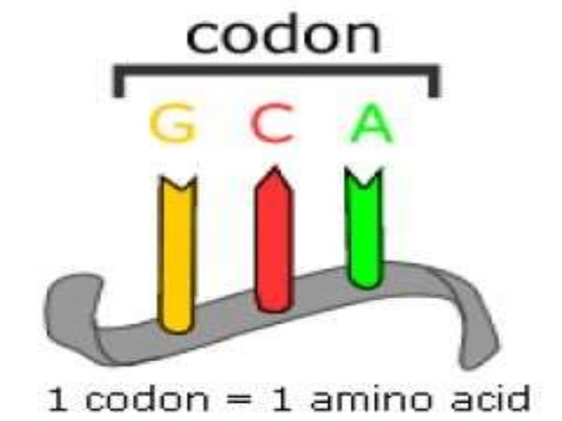
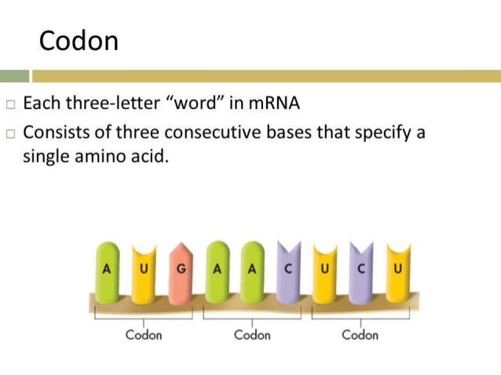
CODON - mRNA

Slide 12
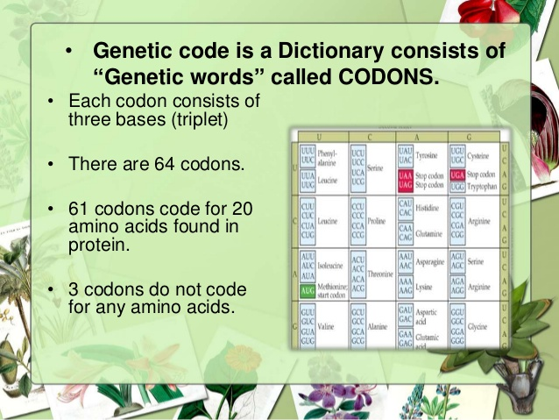
(4³)

Slide 13
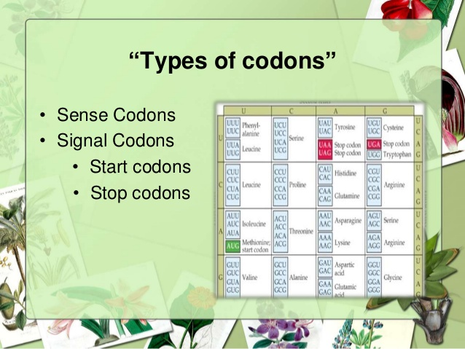
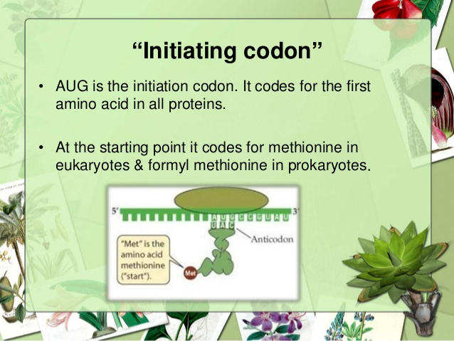

Slide 14
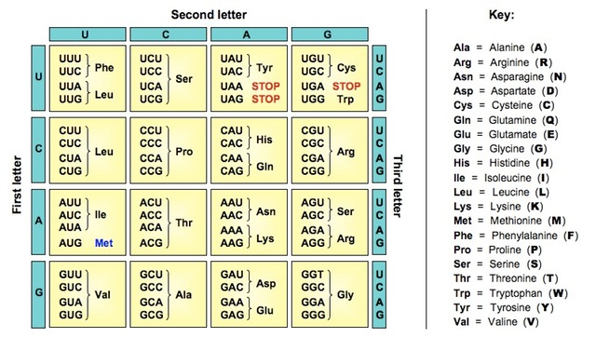
√
√
√
UAG – U – FIRST BASE (LETTER)
A - SECOND BASE (2ND LETTER) TERMINATOR
G – THIRD BASE – (3rd LETTER) (STOP) CODON

Slide 15
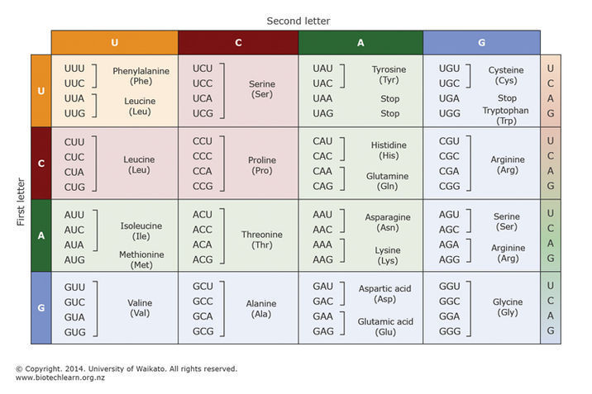
√
√
√
UAG – U – FIRST BASE (LETTER)
A - SECOND BASE (2ND LETTER) TERMINATOR
G – THIRD BASE – (3rd LETTER) (STOP) CODON

Slide 16
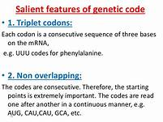
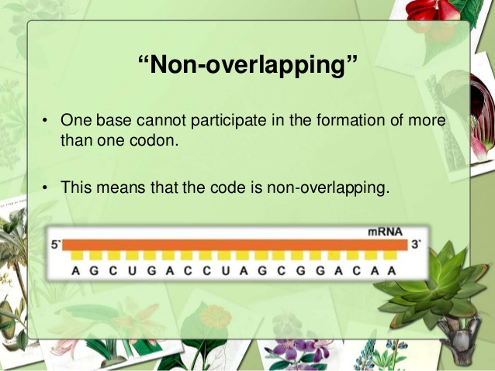
1
2
Non - punctuate

Slide 17
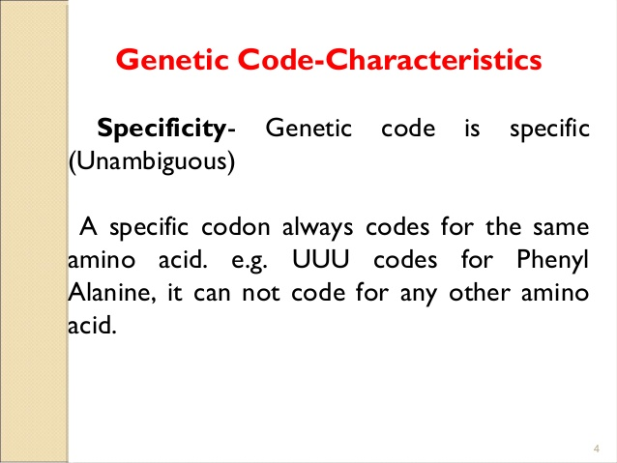
3

Slide 18
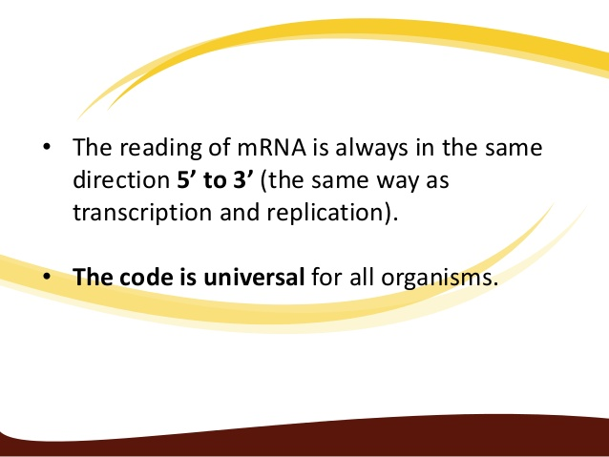
GENETIC CODE
4 & 5
UNIVERSAL & POLARITY

Slide 19
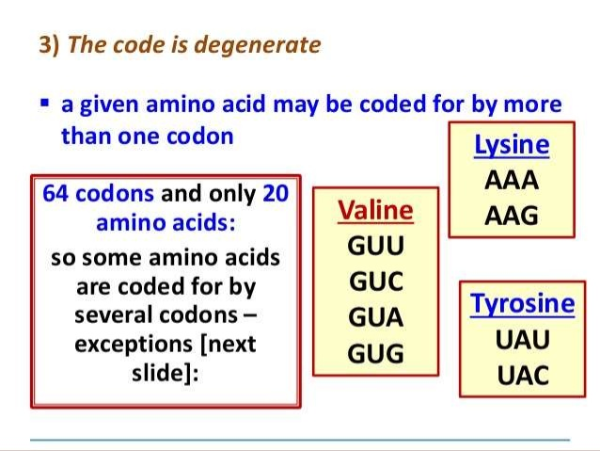
6

Slide 20
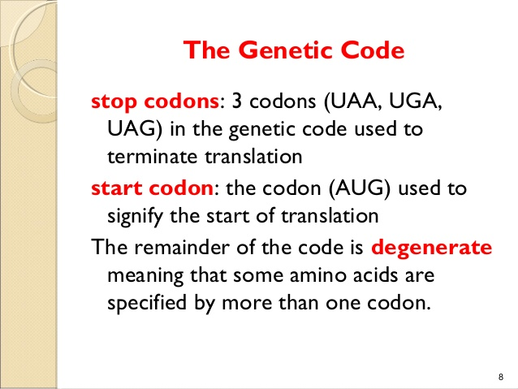
7
-TERMINATOR CODONS
-Initiation codons

Slide 21
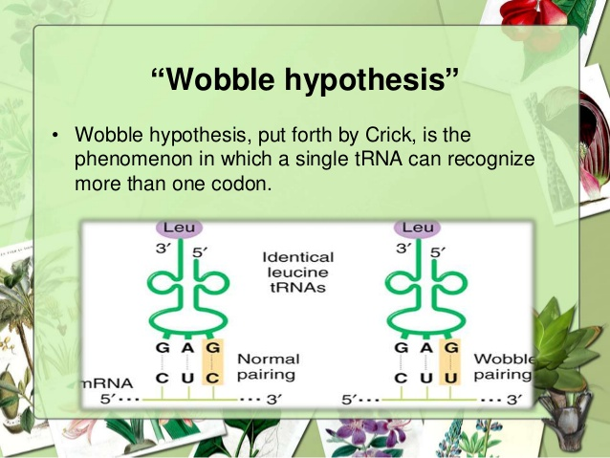
8.

Slide 22
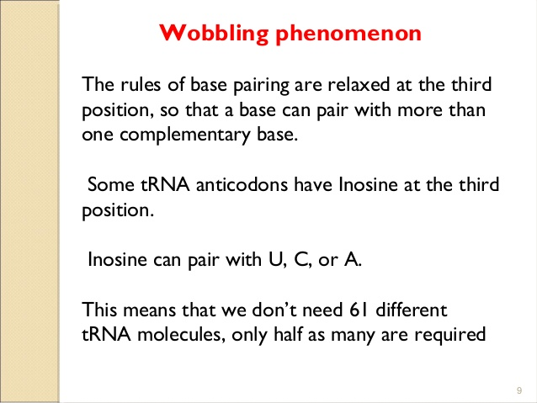
8.

Slide 23
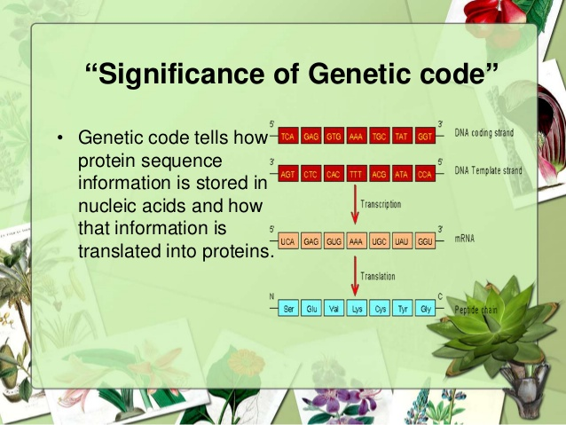

Slide 24
