Slide 1
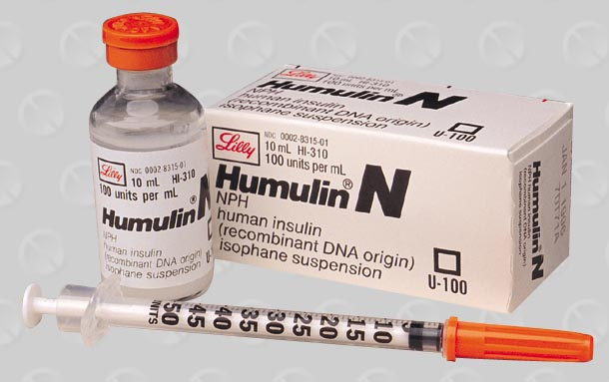
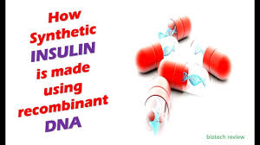


Slide 2
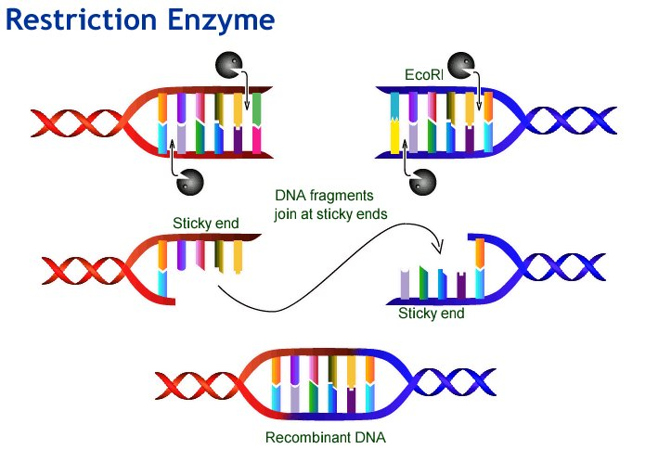
Recombinant DNA technology
Dr SUDHA

Slide 3
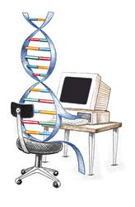
Objectives
Importance
Recombinant DNA technology
Applications

Slide 4
Importance
Molecular basis of diseases
Human proteins can be produced in abundance for therapy
Proteins for vaccines and diagnostic testing
Notes:
FH, sickle cell dis, thalassemias, CF, muscular dystrophy
2. Insulin, GH, Tpa
3. Hep B, ; Ebola, AIDS testing

Slide 5
Importance
Advances in forensic medicine
Gene therapy
Diagnose existing diseases, individual response to pharmacological therapeutics

Slide 6
The technology
Biotechnology Living organism or its parts are used to change or incorporate a particular character to another living organism
Bioremediation
Genetic engineering = rDNA technology
Notes:
Exchange of information between two DNA segments – Genetic recombination, Recombinant DNA technology is one of the recent advances in biotechnology, which was developed by two scientists named Boyer and Cohen in 1973.

Slide 7
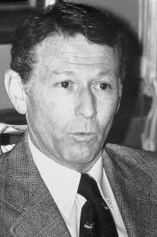
Milestones …..
1953
Discovery of DNA structure
1970
Isolation of Restriction Endonuclease
1972
rDNA technology (Paul Berg)
Notes:
Discovery of DNA structure Watson & Crick in 1953
Isolation of DNA ligase in 1967
Isolation of REase in 1970
Paul Berg generated rDNA technology in 1972
Cohen & Boyer in 1973 produced first plasmid vector capable of being replicated within a bacterial host

Slide 8

Definition
Production of a unique DNA molecule by joining together two or more DNA fragments not normally associated with each other
From different biological
sources
Notes:
Recombinant DNA technology involves isolation and manipulation of DNA from very different sources to make chimeric molecules
Involves several unique techniques and reagents

Slide 9
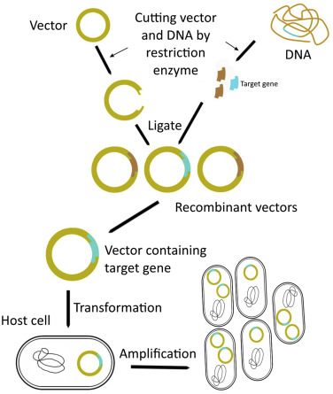
Overview of rDNA technology
1
2
5
Product
3
4
Notes:
1 2 3 4 5

Slide 10
Basic principles
1. Selection of desired DNA fragment
2.Insertion of the selected DNA into a cloning vector
3. Introduction of the recombinant vectors into host cells

Slide 11
Basic principles
4. Multiplication and selection of clones with recombinant molecules
5. Expression of the gene to produce the desired product

Slide 12
Molecular tools of Genetic Engineering
Restriction endonucleases
DNA ligase
DNA polymerase
Reverse transcriptase

