Slide 1
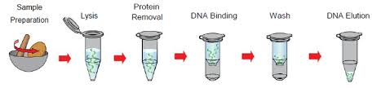

Isolation of DNA

Slide 2
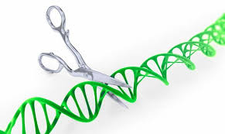
1. Cutting DNA at precise locations
Endonucleases – Enzymes that cut DNA at specific DNA sequences within the molecule
Restriction enzymes(RE) (“Molecular scissors”)
Notes:
Restriction enzymes – their presence in given bacterium restricted the growth of certain bacterial viruses called bacteriophages.
Others (physical, chemical) cut DNA randomly
They are present only in cells that also have a companion enzyme which methylates the host dna , unsuitable for digestion by restriction enzymes
These site specific dna methylases and restriction enzymes always exist in pairs in a bacterium

Slide 3
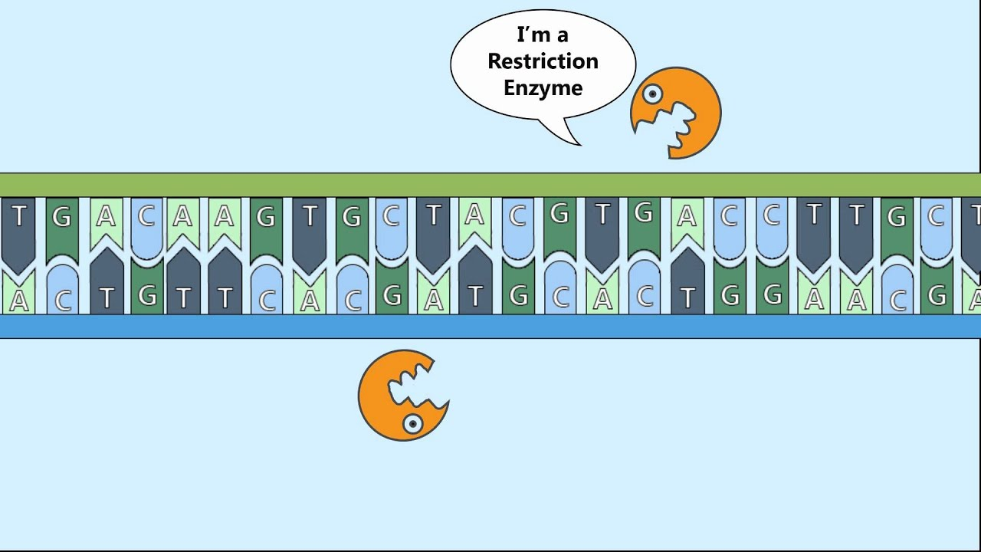
Restriction enzymes
Restrict the growth of certain bacterial viruses called bacteriophages
Cut DNA of any source into unique, short pieces in a sequence-specific manner
Notes:
Physical & chemical methods break DNA randomnly

Slide 4
Examples
Why the funny names?
Eco RI – Escherichia coli strain R, 1st enzyme
Bam HI – Bacillus amyloliquefaciens strain H, 1st
DpnI – Diplococcus pneumoniae, 1st enzyme
Hind III – Haemophilus influenzae, strain D,
3rd Enzyme
Notes:
BglII – Bacillus globigii, 2nd enzyme
PstI – Providencia stuartii 164, 1st enzyme
Sau3AI – Staphylococcus aureus strain 3A, 1st enzyme
KpnI – Klebsiella pneumoniae, 1st enzyme

Slide 5

Recognition/Cleavage Sites
Cuts usually occurs at a palindromic sequence
SmaI: Produces blunt ends
5´ CCCGGG 3´
3´ GGGCCC 5´
EcoRI: Produces sticky/ staggered ends
5´ GAATTC 3´
3´ CTTAAG 5´

Slide 6
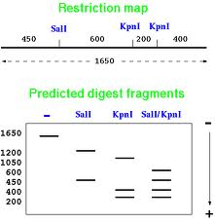
Restriction map
A characteristic array of cut pieces produced after the action of restriction enzyme on a piece of DNA
Isolated by electrophoresis
Finger print of the DNA

Slide 7
Basic principles
1. Selection of desired DNA fragment
2. Insertion of the selected DNA into a vector
3. Introduction of the recombinant vectors into host cells

Slide 8
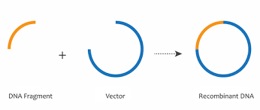
Vectors –The cloning vehicles
Carriers
Small molecule of DNA capable of self replication
Notes:
Plasmids – confer antibiotic resistance to host bacteria

Slide 9
VECTORS
Plasmids
Cosmids
Bacteriophage
BAC
YAC
Notes:
Choice of vector - Depends on nature of protocol or experiment
Type of host cell to accommodate rDNA
Prokaryotic
Eukaryotic

Slide 10
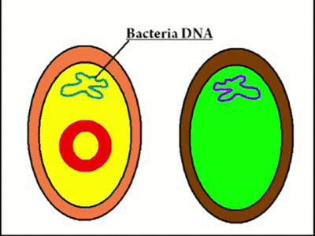
Plasmid vector
Small, circular, double stranded DNA molecules that occur naturally and replicate in bacteria
Many confer drug resistance to bacterial strains
Notes:
Plasmids are naturally occurring extrachromosomal DNA molecules.
Plasmids are circular, double-stranded DNA.
Plasmids are the means by which antibiotic resistance is often transferred from one bacteria to another.
Plasmids can be cleaved by restriction enzymes, leaving sticky or blunt ends.
Artificial plasmids can be constructed by linking new DNA fragments to the sticky ends of plasmid

Slide 11
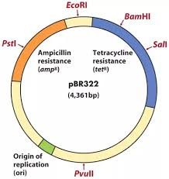
Plasmid vectors
Examples
pBR322
One of the original plasmids used
Two selectable markers (Amp and Tet resistance)
pUC18
Derivative of pBR322
Advantages over pBR322:
Smaller – so can accommodate larger DNA fragments during cloning (5-10kbp)

Slide 12
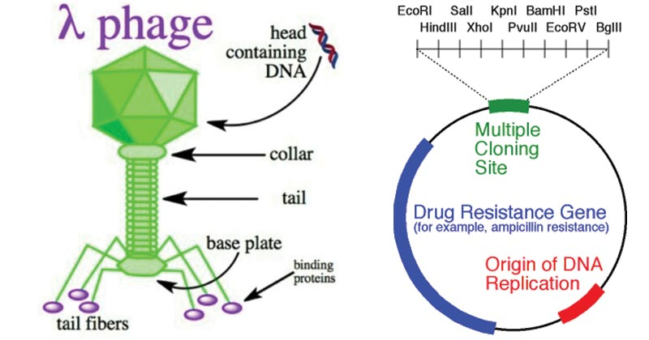
Bacteriophages
Viruses that replicate within the bacteria
Can take up larger DNA segments than plasmids
Preferred ones

Slide 13
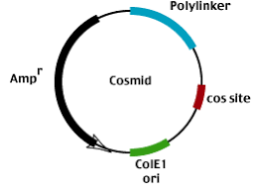
Cosmids
Vectors possessing the characteristics of both plasmid and bacteriophage λ

Slide 14
Artificial chromosome vectors
1. Human artificial chromosomes
2. Yeast artificial chromosomes
3. Bacterial artificial chromosomes

Slide 15
Cloning capacities
VECTOR | DNA insert size (kb)
Plasmid | 0.01 – 10
Lambda | 10 – 20
Cosmids | 35 – 50
BAC | 50 – 250
YAC | 500 -3000

Slide 16
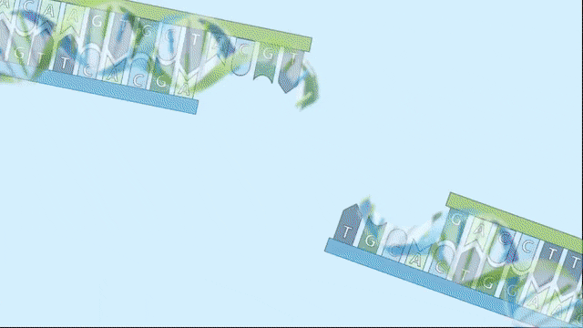
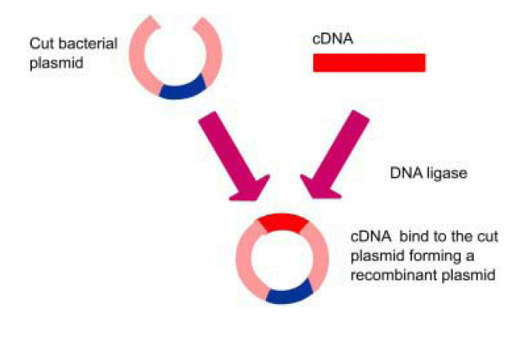
DNA Ligase joins DNA fragments together
Chimeric/ Hybrid/ Recombinant DNA molecules

Slide 17
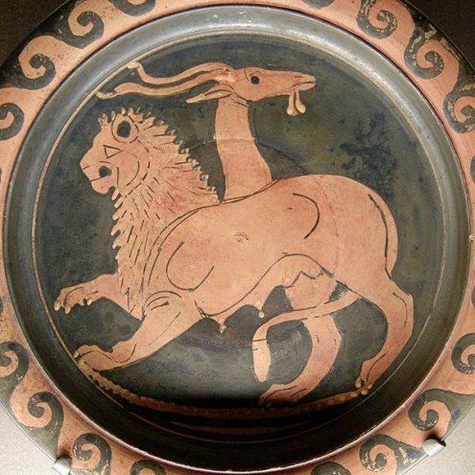
Chimeric Plasmids
CFTR
LacZ
MCS
pUC18-hCFTR
Ori
Amp^{r}
Notes:
After cleavage of a plasmid with a restriction enzyme, a foreign DNA fragment can be inserted.
Ends of the plasmid/fragment are closed to form a "recombinant plasmid”.
Plasmid can replicate when placed in a suitable bacterial host.

