Slide 1

Basic principles
1. Selection of desired DNA fragment
2.Insertion of the selected DNA into a cloning vector
3. Introduction of the recombinant vectors into host cells

Slide 2
Methods of Gene transfer
Introducing a foreign DNA (the gene) into the cells
Transformation
Conjugation
Electroporation
Liposome mediated gene transfer
Direct transfer of DNA

Slide 3
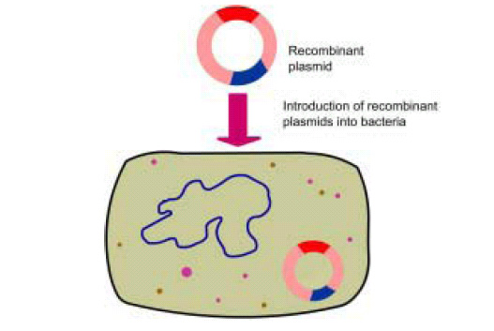
Transfection of vector into the host
Notes:
Process by which plasmid is introduced into the host is called transfection

Slide 4
Basic principles
4. Multiplication and selection of clones with recombinant molecules
5. Expression of the gene to produce the desired product

Slide 5
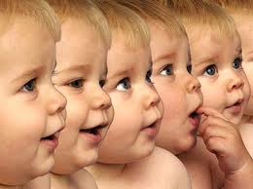
4. Cloning of chimeric DNA

Slide 6
What Does It Mean:“To Clone”?
Clone: A large population of molecules or cells, all identical to an original molecule or cell
Cloned gene can be a normal copy of a gene (= “wild type”).
Cloned gene can be an altered version of a gene (= “mutant”).
Notes:
A large population of identical bacteria or cells that arise from a common ancestor molecule

Slide 7
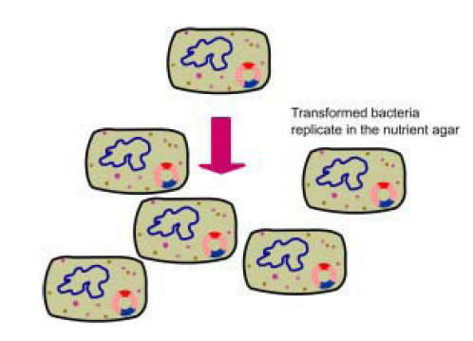
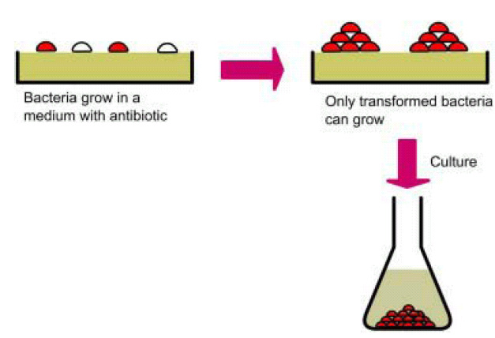
Selection of colony having desired gene
Notes:
The bacteria are spread onto nutrient agar. The agar also contains substances such as an antibiotic which allows growth of only the transformed bacteria.

Slide 8
Basic principles
4. Multiplication and selection of clones with recombinant molecules
5. Expression of the gene to produce the desired product

Slide 9
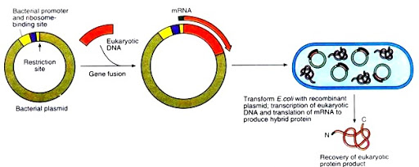
Expression vectors
A vector carrying the foreign gene, which is translated into a protein

Slide 10
Library
A collection of the different recombinant clones
Genomic library – From the total DNA of a cell line or tissue
cDNA library – Complementary DNA copies of the population of mRNAs

Slide 11
Applications
Quantitative preparation of biomolecules
Elimination of risk of contamination
Specific probes for diagnosis of diseases
Gene therapy

Slide 12
Diagnosis of diseases
Antenatal diagnosis of genetic diseases
Identify viral particles or bacterial DNA in suspected blood or tissue
Detect activation of oncogenes in cancer
To identify mutations in genes and for pedigree analysis

Slide 13
Proteins produced by rDNA
Recombinant human insulin
Recombinant Human Growth Hormone, FSH
Recombinant Blood clotting factor VIII, IX
Recombinant Hepatitis B vaccine, HPV vaccine
Cytokines, growth factors
Monoclonal antibodies
Recombinant enzymes(Acid alpha glucosidase)
Recombinant HIV protein(HIV ELISA)

Slide 14
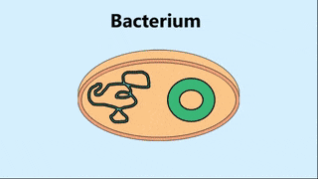
To summarize….

Slide 15
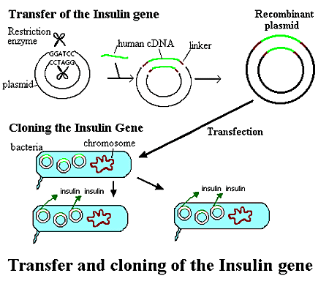

Slide 16
Possible questions…
Essay Describe in detail the rDNA technology and add a note on the applications of the technique.
Short notes/2 marks Restriction endonucleases with examples

Slide 17
Thank you…

