Slide 1
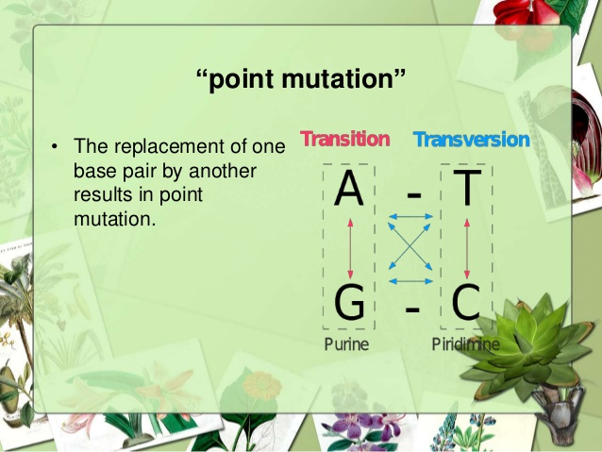

MUTATION
Alteration of nucleotide sequences in mRNA chain and also in daughter DNA
(1 mutation/ 10⁶ cell division)
SINGLE BASE CHANGE – POINT MUTATION

Slide 2
POINT MUTATION – SUBSTITUTION
TYPES:
1. TRANSITION :
Pyrimidine ↔ Pyrimidine T ↔ C
Purine ↔ Purine A ↔ G
2. TRANSVERSION
Purine → Pyrimidine & Purine → Purine
(U) T → A A → T (U)
C → G G → C

Slide 3
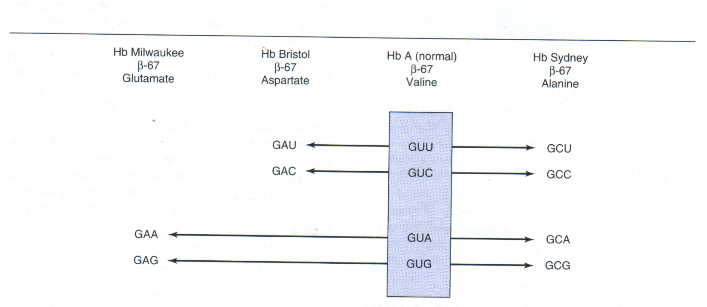
SINGLE STEP TRANSITION/ TRANSVERSION

Slide 4
POINT MUTATION
2. DELETION – REMOVAL OF 1 OR MORE BASES
- Large gene deletion - αThalassemia –
α chain
- one codon deletion – Cystic fibrosis – UUU
- one base - frame shift mutation
3. INSERTION – ADDING OF 1 OR MORE BASE
- one base - frame shift mutation
- Trinucleotide expansion - Huntington’s chorea
- (CAG)^{n}
- Duplication of same gene – Duchenne muscular
dystrophy – DMD gene

Slide 5
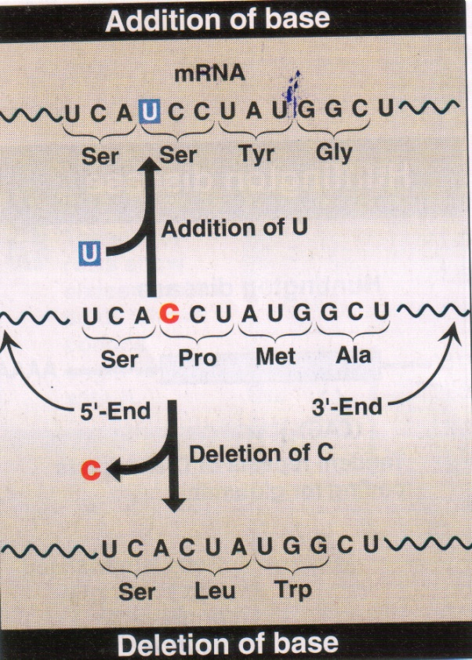
Addition of a
Single
Nucleotide
Deletion of a
Single
Nucleotide
NORMAL

Slide 6
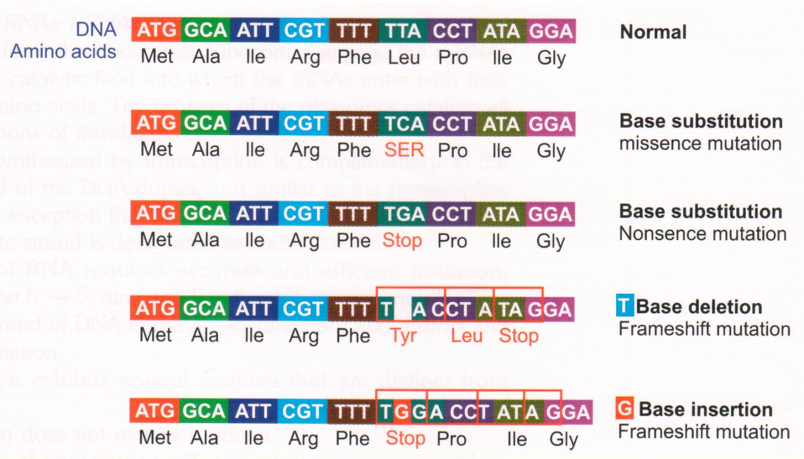

Slide 7
TYPES / RESULTS /EFFECTS OF
POINT MUTATION
SILENT MUTATION
MISSENSE MUTATION
NONSENSE MUTATION

Slide 8
SILENT MUTATION
Codon containing the changed base will code for the same amino acid
UCA
UCU SERINE
UCC
UCG
Change in 3rd nucleotide – no detectable effect

Slide 9
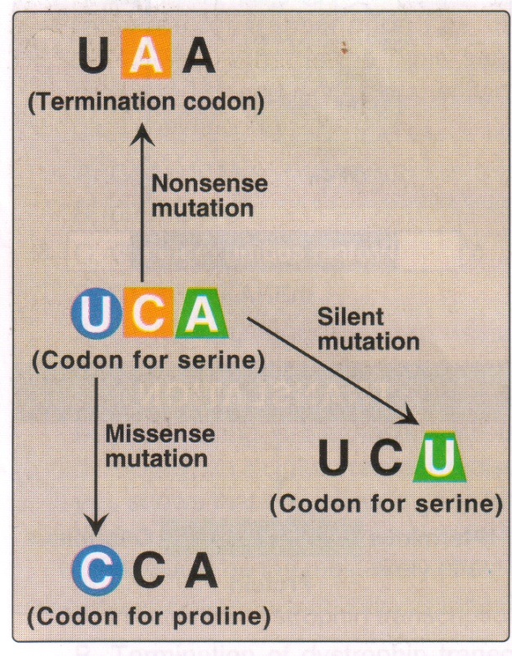

Slide 10
2. Missense Mutation
The codon containing the changed base may code for a different amino acid
Change in FIRST nucleotide
SERINE - UCA → CCA – PROLINE
UCA → ACA – THREONINE
UCA → GCA – ALANINE
3 TYPES – 1. ACCEPTABLE
- 2. PARTIALLY ACCEPTABLE
- 3. UNACCEPTABLE

Slide 11
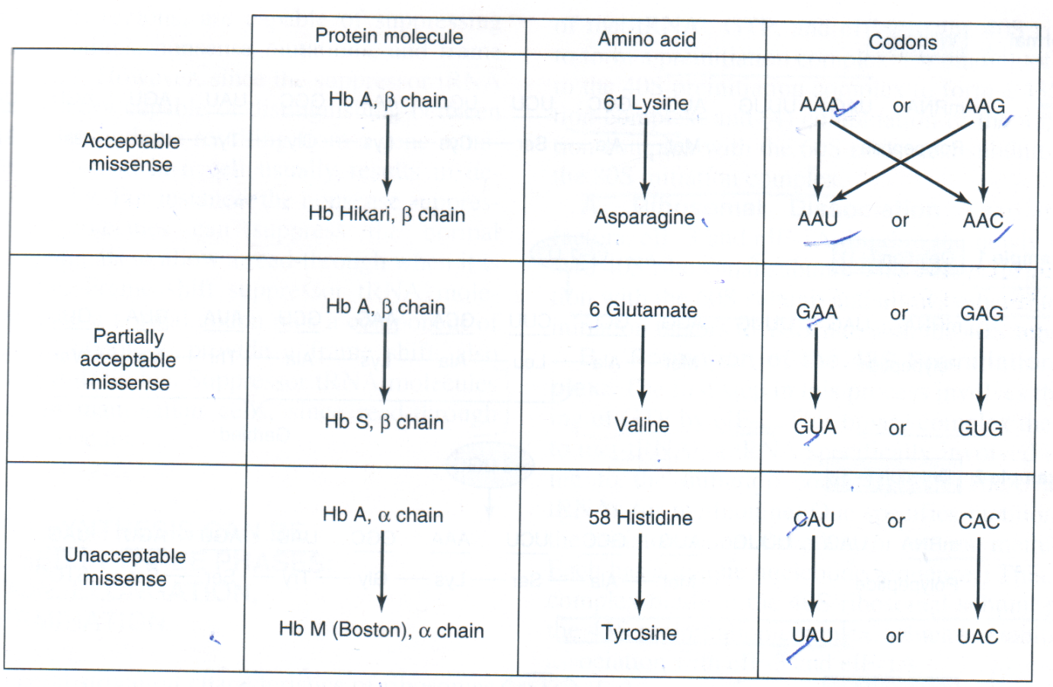
MISSENSE MUTATION

Slide 12
MISSENSE MUTATION – 3 TYPES
A. ACCEPTABLE - No change in Protein molecule – eg. Structural gene for
β chain of Hb A → Hb Hikari
61 Lysine → Asparagine
AAA → AAU ← AAG
↓
AAC

Slide 13
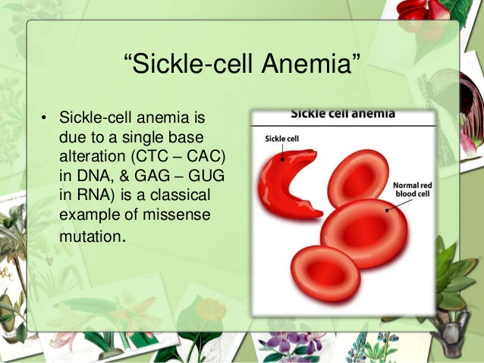
B. PARTIALLY ACCEPTED MISSENSE MUTATION
Example : Hb S
Glutamic acid β 6 →Valine
GAA → GUA
GAG → GUG
Hinders normal function
Results in sickle cell anaemia
Although abnormal, it
binds & release Oxygen abnormally

Slide 14
C. UNACCEPTABLE MISSENSE
NON FUNCTIONING PROTEIN
HAEMOGLOBIN M
Hb A α chain 58 Histidine → Tyrosine
CAU → UAU
CAC → UAC
Ferrous iron is oxidised to ferric iron
Met Hb cannot transport oxygen

Slide 15
3. NONSENSE MUTATION
The codon containing the changed base may become TERMINATOR CODON
Change in Second base of Serine
UCA → UAA -TERMINATOR CODON
Premature termination of protein synthesis
Termination in non-appropriate place – nonsense mutation

Slide 16
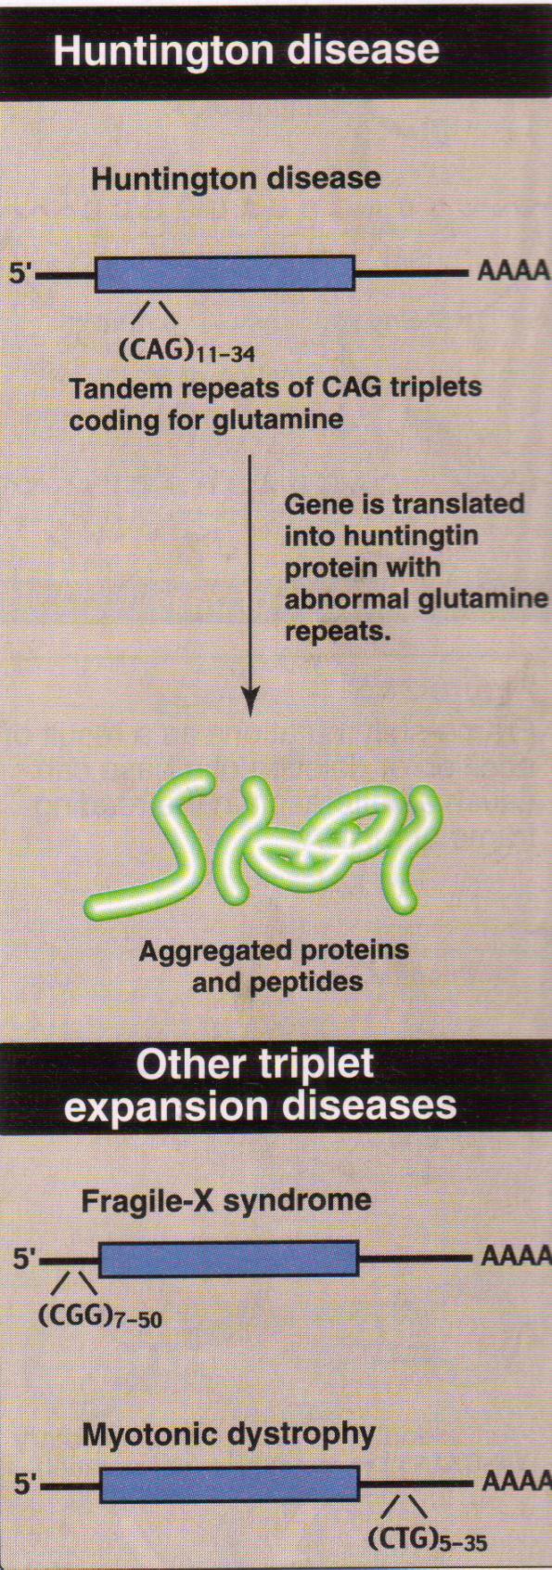
TANDEM TRIPLET REPEAT
Many copies of triplet
If in coding region –
many copies of aa
Amplification of CAG
- many Glutamine in
Huntington protein –
cause Huntington’s
disease – Neuro-
degenerative
disorder

Slide 17
TANDEM TRIPLET REPEAT
If trinucleotide repeat expansion occurs in untranslated –intron – portion of a gene – decrease in production of protein
Example – Fragile X syndrome (CGG)₇ ₋₅₀
- Myotonic dystrophy (CTG)₅ ₋₃₅
- HUNTINGTON’S CHOREA (CAG) ₃₀ ₋₃₀₀

Slide 18
Splice site mutation
Mutations at splice site –
↓
Alteration of removal of Introns
(from Pre mRNA molecule)
↓
Aberrant Proteins

Slide 19
FRAME SHIFT MUTATION
Addition or Deletion of one or two nucleotide sequence – Frame shift mutation
Alteration of Reading frame
Radically different amino acids resulted
If 3 nucleotides are added or deleted – a new amino acid may be added or deleted

Slide 20
Addition of a
Single
Nucleotide
Deletion of a
Single
Nucleotide

Slide 21
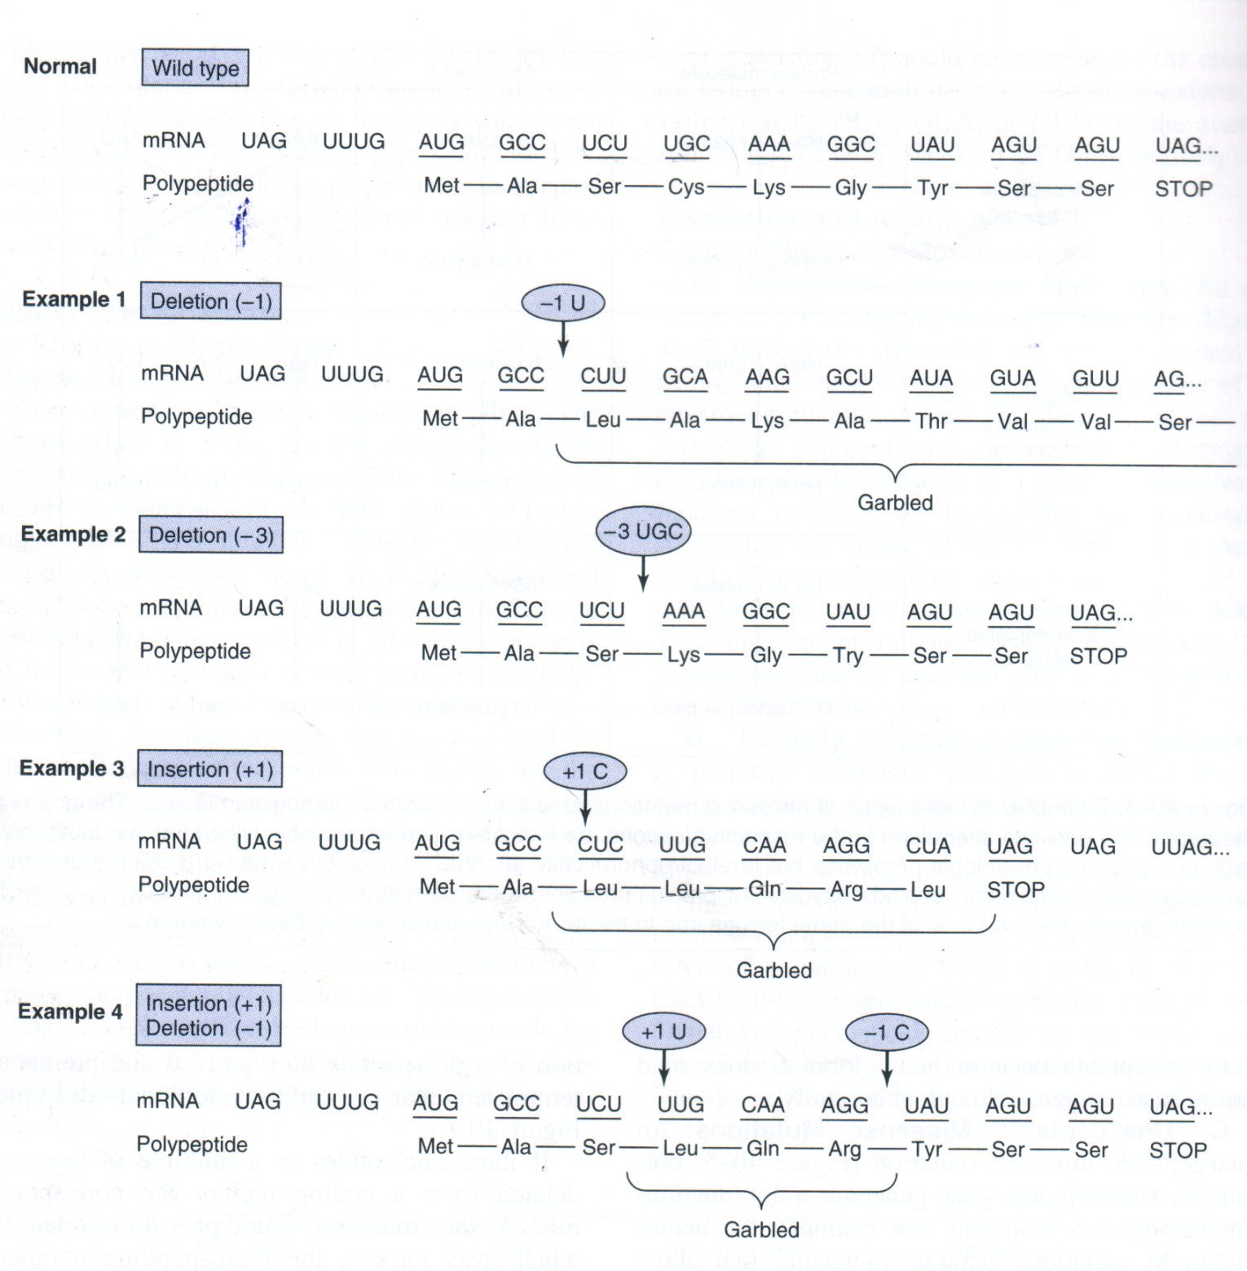
Frame shift mutation

Slide 22
RESULTS OF MUTATION
LETHAL - α4 Hb – Incompatiblity
SILENT – evolutionary respect
BENEFICIAL
– Evolution
- New variety in agriculture (Trpt + maize)
- Newer microorganism – New disease
- To resist antibiotics
CARCINOGENIC –alteration of regulatory control, Uncontrolled cell division

Slide 23
CAUSES OF MUTATION
1. ERRORS OF REPLICATION:
- Human – 10¹⁴ nucleated cells –
- 3 x 10⁹ bp/cell; 10¹⁶ cell division –life
- Mutation in 10⁻¹⁰ /bp/cell
- Rate – 1 mutation / 10⁶ bp in genome
- Occur in DNA – introns
- Mispairing – wrong compementary bp – corrected automatically – proof reading & repair

Slide 24
CAUSES OF MUTATION (cont)
2. ERRORS DUE TO RECOMBINATION EVENTS:
- Mobile DNA – Rearrangement,
Recombination – Ig gene
- Crossing over – meiosis
(Common – viral DNA)
- Un-repairable damage

Slide 25
CAUSES OF MUTATION (Contd)
3. MUTAGENS:
a) Chemical Mutagens:
- Aromatic hydrocarbons, amines
- Alkylating & Non alkylating agents –
ethyl methane sulfonate
- Intercalating agents – disrupts
replication
Alter base pairs / structure of DNA
May lead to carcinogenesis

Slide 26
CAUSES OF MUTATION (Contd)
3. b) PHYSICAL MUTAGENS:
- UV Rays, X rays, γ rays
- Free radicals
- Alter structure of DNA
- Carcinogenic
Thymine – thymine dimer
Apurinic / apyrimidinic sites
Single / double stranded breaks

Slide 27
CAUSES OF MUTATION (Contd)
3 .c) BASE ANALOGS :
- 5’ Bromouracil – Thymine analog
- Transition of AT → GC
- ↓ Replication
- Causes mutation
- 2 AMINO PURINE – Analog of adenine
- GC → AT

Slide 28
CAUSES OF MUTATION (Contd)
4. SPONTANEOUS CHANGES:
- Deamination of C to U
- Depurination
******************

Slide 29
PROBABLE QUESTIONS
GENETIC CODE :
I. SHORT NOTES
What is genetic code? Give its salient features.
II. Brief answers:
Degeneracy of code
Wobble hypothesis
Terminator codons

Slide 30
PROBABLE QUESTIONS
MUTATIONS:
SHORT NOTES
What is mutation? What are its types?
Explain each type of mutations with suitable examples.
What are the causes and effects of mutation?
BRIEF ANSWERS
Silent mutation
Point mutation with example
Transversion & Transition
Missense mutation

Slide 31
MCQ
  1. Example for unacceptable missense mutation is –
A) HbS B) Hb M C) Cystic fibrosis D) Alpha Thalassemi
2. Which of the following is NOT a terminator codon?
A) UAA B) UAG C) UAC D)UGA
3. Wobbling phenomenon can be observed by pairing of anticodon and codon at the level of -
A) First letter B) Second letter
C) Third letter D) None of the above
4. Initiator codon in Eukaryotes is –
A) UAG B) AUG C) AGU D) UGU
5. Trinucleotide expansion is seen in –
A) HbS B) Huntington’s Chorea C) HbM D) Hb Sydney

