Slide 1

BLOOD GLUCOSE REGUALTION
DR.D.PONNUDHALI

Slide 2


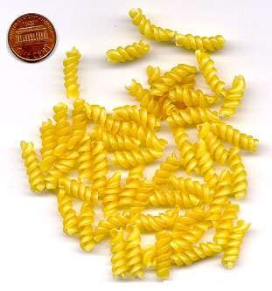



We eat food containing carbohydrates

Slide 3
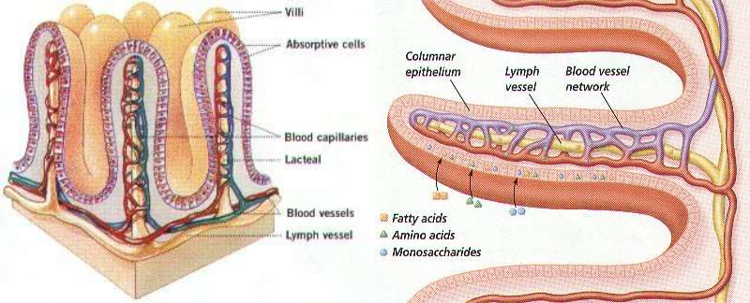
The carbohydrates are fully digested to glucose which is absorbed- in small intestine- duodenum, jejunum, ileum

Slide 4
Normal Blood glucose levels
Fasting levels: 70-110 mg/dL
Postprandial : up to 140 mg/dL
Maintained with in physiological limits by
Rate of Glucose entry into blood circulation
Rate of its removal from the blood stream.

Slide 5
Glucose homeostasis
It is the maintenance of blood glucose level within the normal range.
Normal blood glucose level (fasting) is 70-110mg/dl
Post-prandial blood glucose level is upto 140mg/dl.
Above and below the above level is considered abnormal.
Hyperglycemia - Levels above the normal range
Hypoglycemia - Levels below the normal range

Slide 6
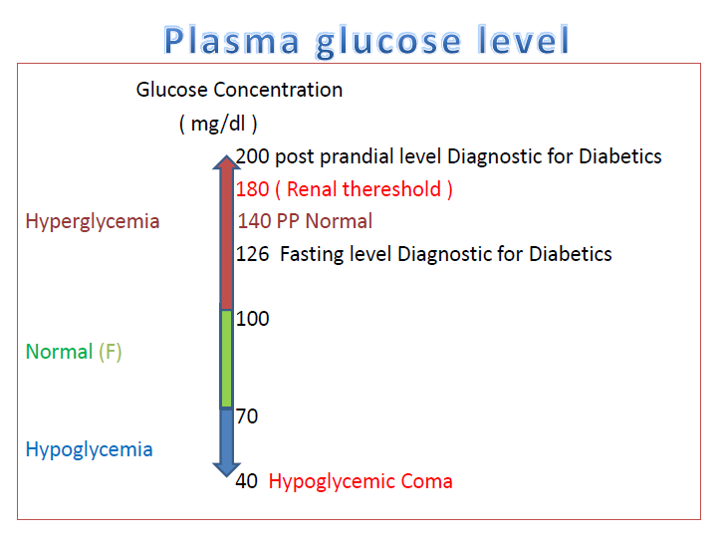

Slide 7
Why should blood glucose be regulated?
Regulation of blood glucose level is very essential because glucose is the only nutrient that is utilized for energy by many tissues like
Brain tissues
Retina
Germinal epithelium of gonads

Slide 8
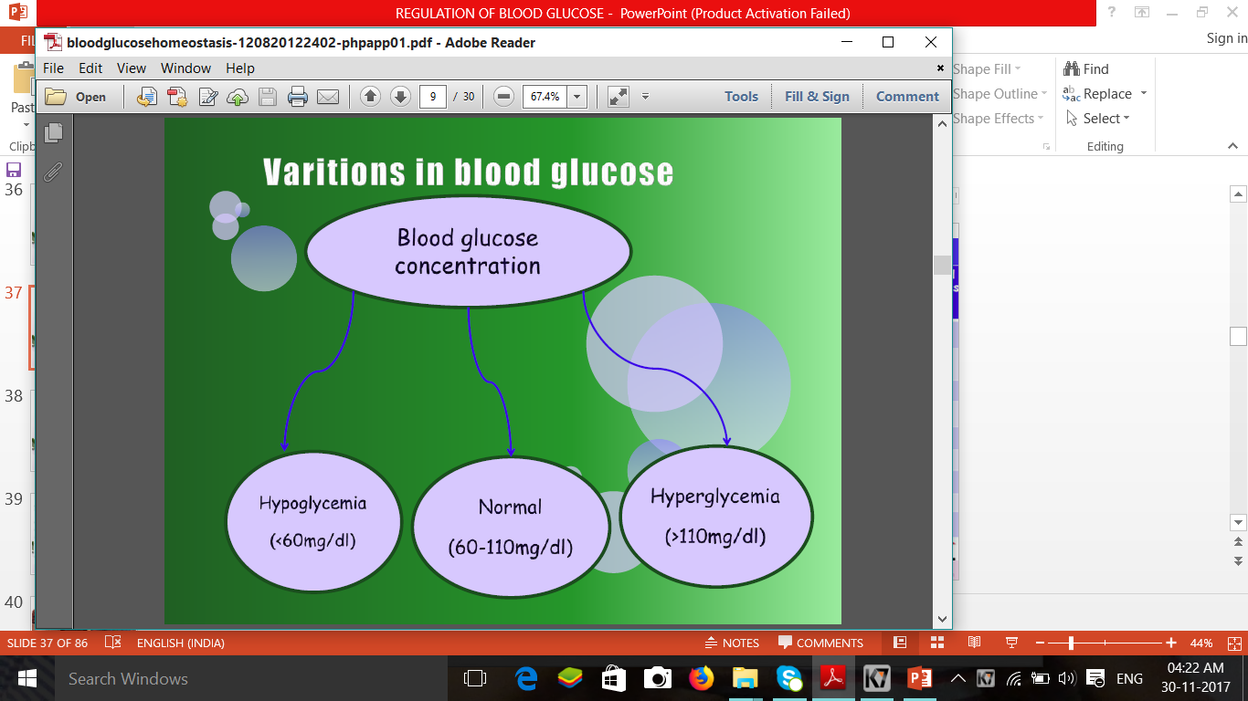
FBS
If there is no glucose regulation
If there is no glucose regulation

Slide 9
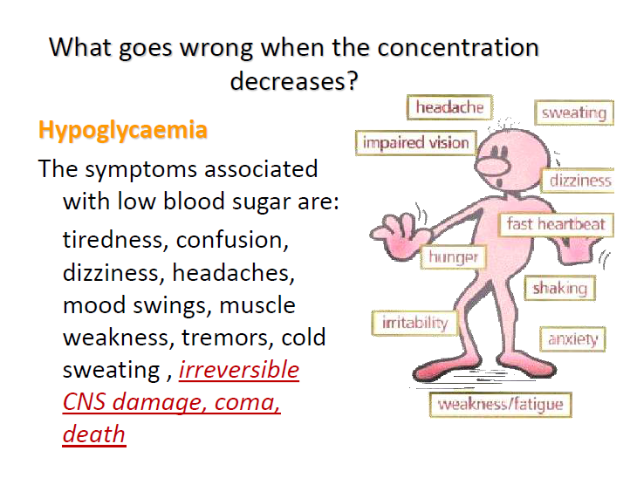

Slide 10
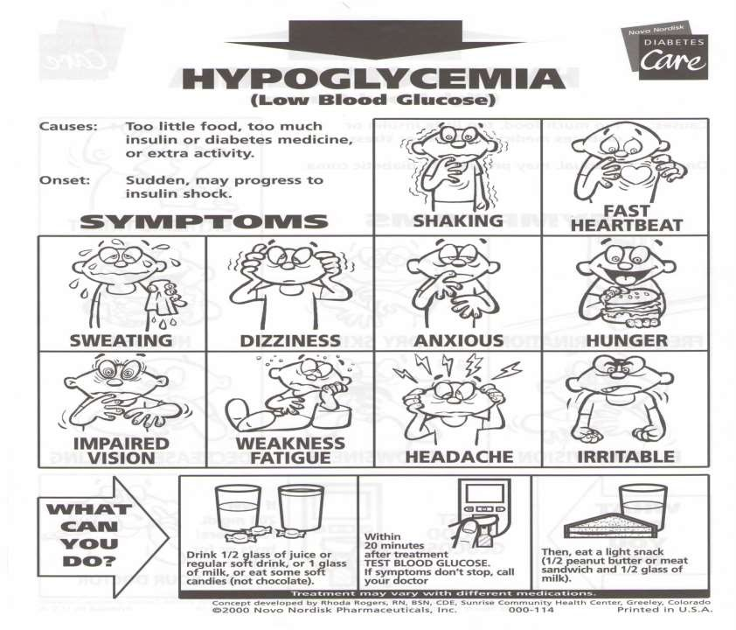
Blood glucose < 60 mg/dl

Slide 11
What goes wrong when the concentration increases too far? - Hyperglycaemia
Hyperglycaemia
The symptoms include:
Excessive thirst; frequent urination;
fatigue; weight loss; vision problems, such
as blurring; increased susceptibility to infections
- Diabetes mellitus

Slide 12
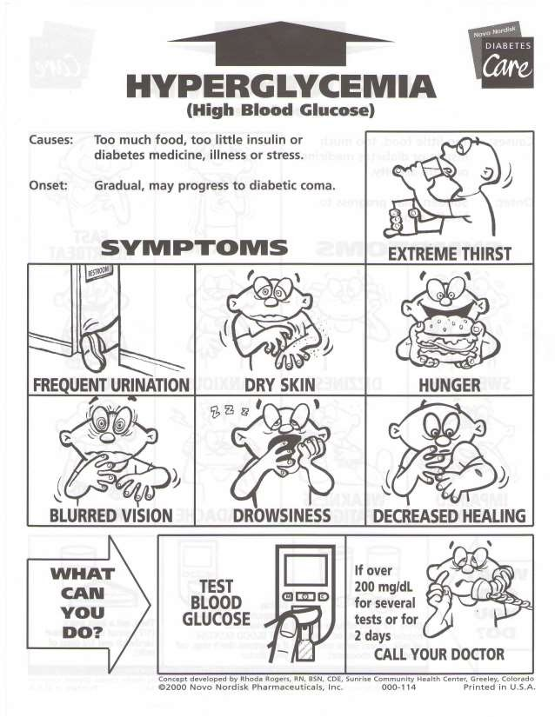

Slide 13
Blood glucose level is maintained by a balance between glucose entry into the plasma &
rate of removal from blood

Slide 14
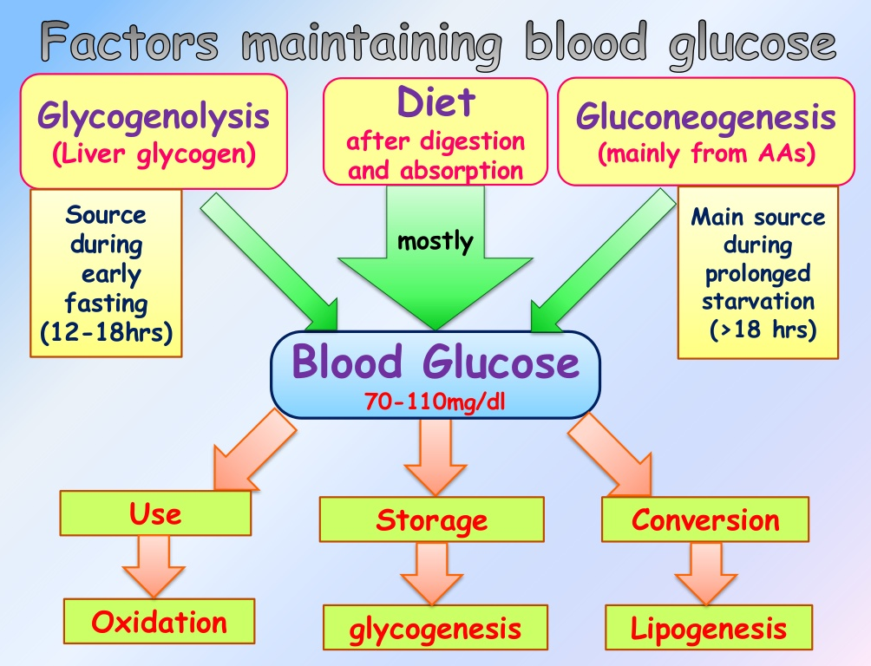

Slide 15
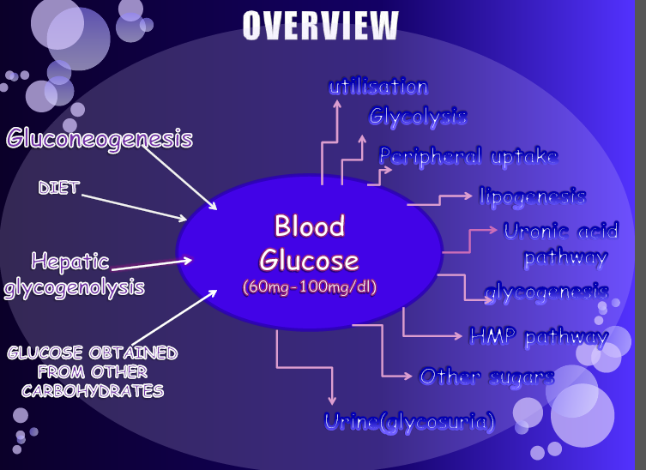

Slide 16
Rate of glucose entrance into the blood by:
  1. Absorption from intestine
  2. Hepatic glycogenolysis
  3. Gluconeogenesis
  4. Glucose obtained from other carbohydrates,
  eg: fructose, galactose etc

Slide 17
Rate of Removal of Glucose from blood depends on:
1. Oxidation of glucose by tissue to supply energy
2. Hepatic glycogenesis
3. Glycogen formation in muscles
4. Conversion of glucose to fats in adipose tissues
5. Synthesis/formation of fructose in seminal fluid,
lactose in mammary gland.
6. Formation of ribose sugars and nucleic acid synthesis.

Slide 18
Absorptive stage
(starts from feeding and lasts up to 3-4 hours after meal)
During this phase following activities takes place with regards to glucose.
Dietary glucose to liver and then to most tissues.
Glucose is used as a fuel by most tissues.
Excess of glucose is stored as glycogen in liver& muscles.

Slide 19
Post -Absorptive phase
Lasts for for 16-18 hrs after the absorption (3-4hours after meal) is completed.
Liver glycogenolysis becomes the major source of blood sugar.
Muscle use its glycogen stores for energy.
Glycogenolysis starts declining after 16-18 hours
and by about 24-30 hours is negligible.
4. Gluconeogenesis starts gradually and peaks about 24
hours after the last meal.

Slide 20
Starvation
After about 1- 1^{1/2} days of starvation, gluconeogenesis is the main source of glucose.
1. Fatty acids mobilized from adipose tissue become
an alternate fuel for energy for most tissues.
2. Lactate and glycerol are reutilized for gluconeogenesis
3. ATP produced in fatty acid oxidation is used in liver for
gluconeogenesis and other body functions.
4. High rate of hepatic gluconeogenesis continues
for few days in early starvation.

Slide 21
Prolonged Starvation
If starvation continues further beyond 2-3 days & extend into weeks, hepatic gluconeogenesis decrease and gluconeogenesis in kidney becomes more significant.
Proteins in muscles are broken down to provide gluconeogenic amino acids.
Fats are the energy source of most tissues.
If starvation continue beyond without any feeding, lipid stores are also depleted & several associated complications like ketoacidosis, dehydration, etc., occur
ultimately death follows.

Slide 22
HORMONES REGULATING BLOOD GLUCOSE LEVEL

Slide 23
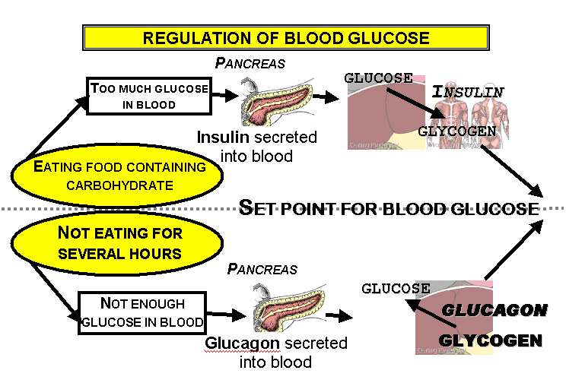

Slide 24
Hormonal Regulation of Blood glucose
There are two categories of endocrine influences.
Hormone that ↓ blood glucose levels : Insulin
Hormones that ↑ blood glucose levels: Glucagon, Epinephrine, Cortisol, Thyroid hormones.

Slide 25
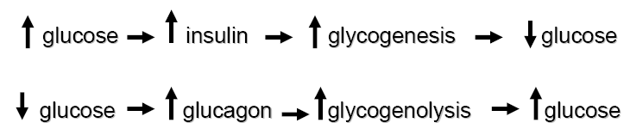
· There are two types of mutually antagonistic metabolic hormones affecting blood glucose levels:
Anabolic hormone (insulin), which decreases blood glucose.
Catabolic hormones (such as glucagon, growth hormone, cortisol and catecholamines) which increase blood glucose;

Slide 26
HORMONAL REGULATION
There are 2 mutually antagonistic metabolic hormones affecting blood glucose levels:
Anabolic hormone (insulin) → decreases blood glucose.
Catabolic hormones (such as glucagon, growth hormone, cortisol and catecholamines)
→ increase blood glucose;

Slide 27
Effect of insulin – on liver & muscles
  ↑ absorption of glucose from blood into cells.
  ↑ use of glucose in cellular respiration.
  ↑ rate of conversion to glycogen.

Slide 28
Insulin in Carbohydrate metabolism
↓ Blood glucose level by
↑ glucose to glycogen conversion- stored in liver &
muscle by - Activation of glycogen synthase.
↓ glycogen to glucose conversion by the liver –
Inhibition of glycogen phospharylase.
3. ↓ gluconeogenesis by Inhibiting
        pyruvate carboxylase
        PEP carboxykinases.
        Fructose 1,6 bisphosphatase.
        glucose 6 phosphatase.

Slide 29
Insulin in Carbohydrate metabolism
Increases the rate of utilization of glucose by tissues by
Facilitates transport of glucose into muscle & adipose cells via GLUT 4 receptors.
Activating glycolysis.
3. Increased glycogenesis – activating glycogen synthase

Slide 30
Insulin in Lipid metabolism
↑ lipogenesis - Activation of acetyl CoA carboxylase
↓ FFA mobilization from adipose tissue –
- suppression of lipolysis by ↓hormone sensitive lipase
↓ plasma FFA uptake & oxidation- by suppression of
lipolysis
↓ of hepatic VLDL synthesis
↓ fatty acid breakdown - ↓ circulating ketone body
concentrations
5. Activation of adipose tissue Hormone sensitive
lipoprotein lipase
Notes:
TAG(adipocytes) –-------Hormone sensitive lipase---→ Fatty acid + DAG

Slide 31
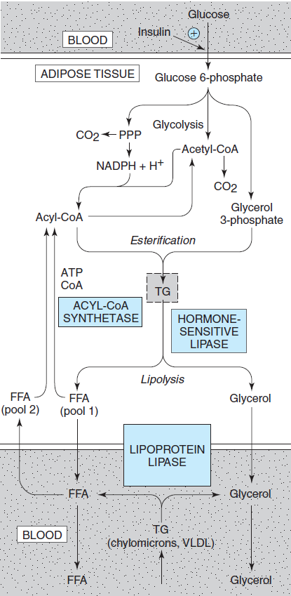
Notes:
The principle action of Insulin is to inhibit hormone sensitive lipase and inhibit/reduce the release of FFA.
In adipose tissue and skeletal muscle lipoprotein lipase is activated in response to insulin, the resulting FFA are taken up to form TAG stores. Glycerol remained in the blood is used for glycogen synthesis or lipogenesis.

Slide 32
Insulin in protein metabolism
Role of Insulin Protein Metabolism and Growth
  ↓ transport of amino acids
  ↑ mRNA translation and new Proteins synthesis
  - direct effect on ribosomes
  3. ↑ transcription of selected genes,
  - Especially enzymes for nutrient storage
  (glycogenesis, lipogenesis)
  4. ↓ protein catabolism
  5. Acts synergistically with growth hormone

Slide 33
Regulation of Insulin Secretion
Summary of feedback mechanism for regulation
↑ blood glucose
↓
↑ insulin
↓
↑ transport of glucose into cells,
↓ gluconeogenesis, ↓ glycogenolysis
↓
↓ blood glucose
↓
↓ insulin

Slide 34
Lack of insulin
  Occurs between meals, and in diabetes.
  Transport of glucose and amino acids into the cells decreases, leading to hyperglycemia.
  Hormone sensitive lipase is activated,
  Causing TG hydrolysis and FFA release.
  ↑ FFA conversion in liver →
  Phospholipids and cholesterol → lipoproteins -
  Lipoproteinemia,
  FFA breakdown leads to ketosis and acidosis.

Slide 35
COUNTER- REGULATORY HORMONES IN GLUCOSE REGULATION

Slide 36
GLUCAGON

Slide 37
Counter Regulatory Hormones -GLUCAGON
  Acts to increase blood glucose
  Secreted by alpha cells of the pancreas
  Chemical structure 29 amino acids
  Derived from 160 amino acid pro- glucagon precursor

Slide 38
Glucagon Secretion
Stimulation of Glucagon secretion
  Blood glucose < 70 mg/dL
  High levels of circulating amino acids
  Especially arginine and alanine
  Sympathetic and parasympathetic stimulation
  Catecholamines
  Cholecystokinin, Gastrin and GIP
  Glucocorticoids

Slide 39
Role of Glucagon
Metabolic Effects of Glucagon
  ↑ hepatic glycogenolysis
  ↑ gluconeogenesis
  ↑ amino acid transport
  ↑ Fatty acid metabolism (ketogenesis)
  ↓glycolysis

Slide 40
Effect of glucagon – on liver cells
  Stimulates break down of glycogen to glucose
  Use of fatty acids as fuel for cellular respiration instead of glucose
  Production of glucose from fats
  Release glucose into blood

Slide 41
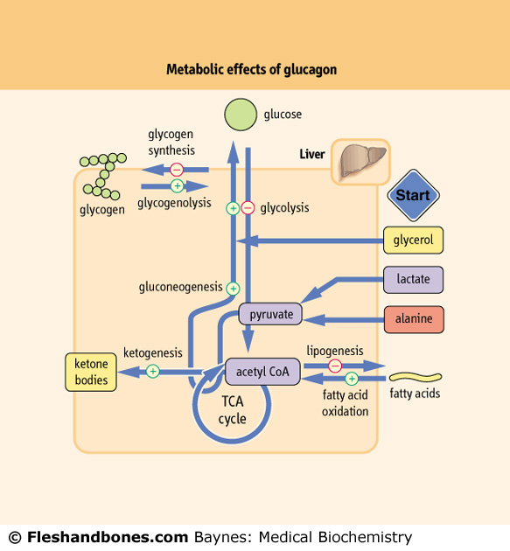
Metabolic Effects of Glucagon

Slide 42
Insulin – Anabolic and Glucagon - Catabolic
Metabolic Action | Insulin | Glucagon
Glycogen synthesis | ↑ | ↓
Glycolysis (energy release) | ↑ | ↓
Lipogenesis | ↑ | ↓
Protein synthesis | ↑ | ↓
Glycogenolysis | ↓ | ↑
Gluconeogenesis | ↓ | ↑
Lipolysis | ↓ | ↑
Ketogenesis | ↓ | ↑

Slide 43
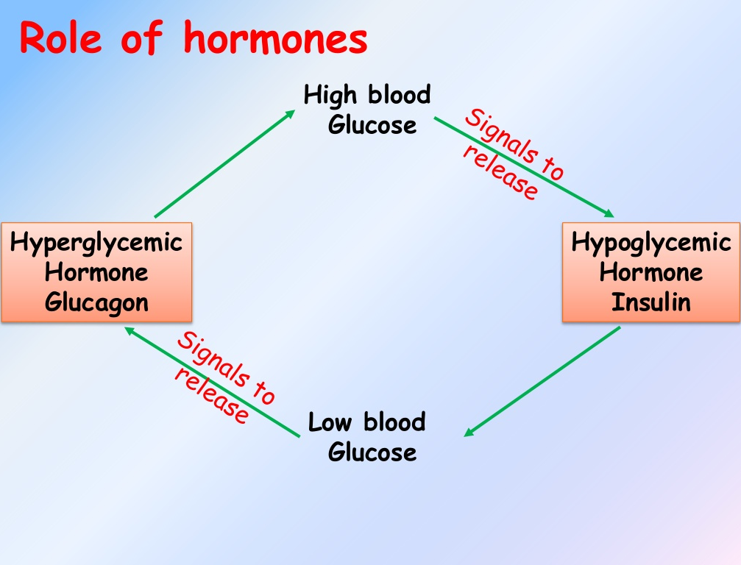

Slide 44
Role of Epinephrine
  The second early response hyperglycemic hormone.
  This effect- mediated through hypothalamus in response to low blood glucose
  Stimulation of sympathetic neurons - release of epinephrine from adrenal medulla .

Slide 45
Functions of Epinephrine
  Glycogen breakdown, gluconeogenesis, and glucose release from the liver.
  ↑ blood glucose
  ↑ glycogenolysis
  ↑ gluconeogenesis
  ↑ uptake of amino acids

Slide 46
Glucocorticoids- Cortisol
Cortisol is a steroid hormone
  It is synthesized in the adrenal cortex.
  Synthesis is regulated via the hypothalamus (CRF) and anterior pituitary (ACTH).
  Catabolic hormone
  ↑ fasting hyperglycemia, ↑ liver glycogen,
  decreases lean body mass and muscle mass and may increase energy expenditure.

Slide 47
Role of glucocorticoids
Secreted by adrenal cortex
  ↑ blood glucose
  ↑ gluconeogenesis
  ↑ release of amino acids from muscle

Slide 48
Role of Cortisol and GH
These are long term hyperglycemic hormones
Activation takes hours to days.
  Cortisol and GH act to decrease glucose utilization in most cells of the body.
  Effects of these hormones are mediated through the CNS.

Slide 49
Growth Hormone (GH)
GH is the major anabolic hormone during famine and stress, sparing glucose and protein at the expense of lipids.
GH is a single chain polypeptide hormone.
Source is the anterior pituitary somatotrophs.
It is regulated by the hypothalamus.
GHRH has a stimulatory effect.
Somatostatin (GHIF) has an inhibitory effect.
Clinical correlation: Gigantism and Acromegaly cause insulin resistance.

Slide 50
Growth Hormone (GH)
↓ glucose uptake
↑ liver gluconeogenesis
↑ fatty acid mobilization fro adipose tissue
↑ ATP & NADP - ↓ glycolysis

Slide 51
Growth Hormone (GH)
DIRECT EFFECTS:
↑ TGL breakdown in adipose tissue and ↑ oxidation of fatty acids
Increases protein anabolism in many tissues. This means increased amino acid uptake, increased protein synthesis and decreased oxidation of proteins.
Suppresses the glucose uptake in peripheral tissues
↑ glucose synthesis in liver
↑ insulin synthesis- hyperinsulinemia

Slide 52
Growth Hormone (GH)
INDIRECT EFFECTS:
Causes the release of IGF-1 – Insulin like growth factor-1 hormone.
Growth effects of the growth hormone are mostly related to the action of IGF-I.

Slide 53
EFFECT OF HORMONES
HORMONES | EFFECTS
Insulin | ↓ blood glucose ↓gluconeogenesis ↑glycolysis ↑glycogen synthesis
Glucagon | ↑ glycogenolysis ↑ gluconeogenesis ↓ glycogen synthesis ↓ glycolysis

Slide 54
Cortisol | ↑ gluconeogenesis ↑ release of amino acids by muscle Induces PEPCK , fructose 1,6 bisphosphatase, glucose -6- PO₄ ase & amino transferases
Epinephrine | ↑ glycogenolysis ↑ gluconeogenesis favours uptake of amino acids enhances release of glycerol by lipolysis

Slide 55
Growth hormone | ↓glycolysis Mobilises fatty acids from adipose tissue

Slide 56
Responses to decreasing Glucose levels
Response | Glycemic theshhold | Physiological effects | Role in counter regulation
↓ Insulin | 80 - 85 mg% | ↑ R_{a} (↓ R_{d}) | Primary First Defense
↑ Glucagon | 65 - 70 mg% | ↑ R_{a} | Primary Second Defense
↑ Epinephrine | 65 - 70 mg% | ↑ R_{a} ↓ R_{d} | Critical Third Defense
↑ Cortisol, GH | 65 - 70 mg% | ↑ R_{a} ↓ R_{d} | Not Critical
↑ Food ingestion | 50 - 55 mg% | ↑ Exogenous Glucose | < 50mg% no cognitive change
Notes:
Ra Rate of appearance, Rd – Rate of disappearance

Slide 57
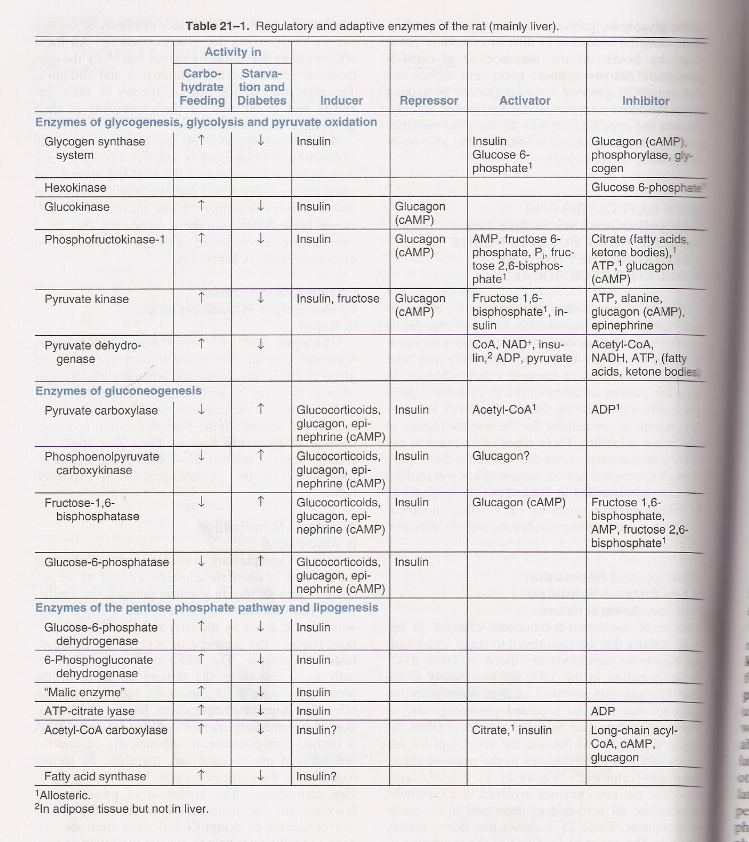

Slide 58
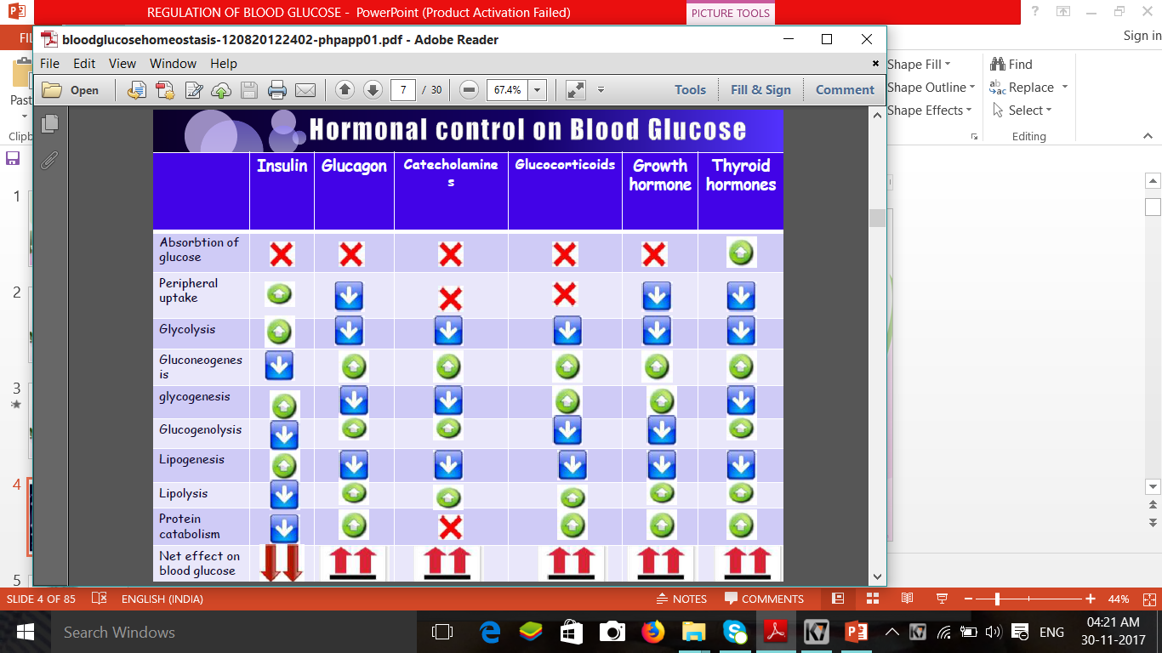

Slide 59
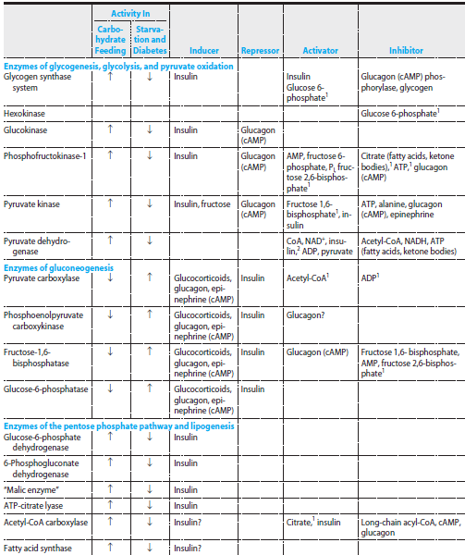

Slide 60
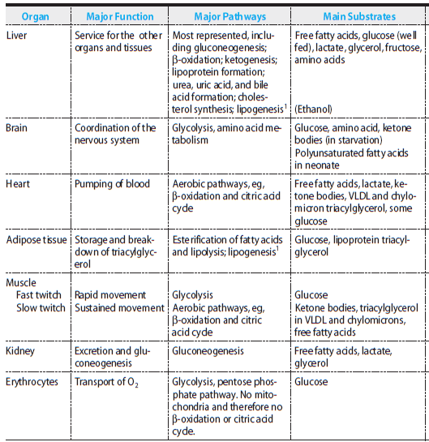
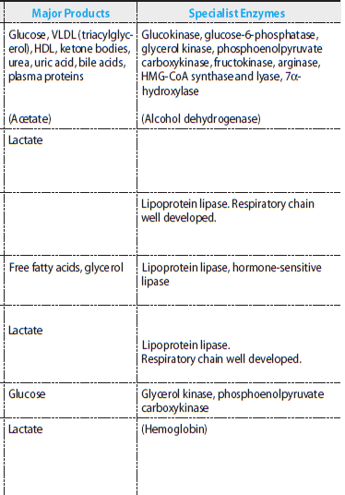
Metabolism of individual organs

Slide 61
What happens in starvation & well fed state?

Slide 62
FASTING STATE- EARLY FASTING
FASTING

Slide 63
FASTING STATE
Also called as post absorptive state.
Aprrox 12-14 hrs after the meal.
Only source of glucose – Liver glycogen
Muscle glycogen ??

Slide 64
NO FUEL ENTERS THE GUT & little glycogen is left in the liver
Hence major source of energy is GLUCONEOGENSIS.
Cori & alanine cycles also play an important role

Slide 65
Alanine & glutamine are the amino acids released from the muscle in large amounts.
Branched chain α- keto acids are released from the branched chain amino acids – TRANSAMINATION.
These ketoacids are released into blood- uptake by the liver – synthesis of glucose

Slide 66
Adipose tissue-
It is important in fasting state- ↑lipolysis due to ↓ insulin levels
Glycerol, byproduct of lipolysis in adipose tissue is an important substrate for glucose synthesis
Acetyl CoA produced by fatty acid oxidation can’t be converted into glucose, hence converted to ketone bodies- acteoacetate & β- hydroxy butyrate.
These ketones are utilised for energy by many tissues like brain.

Slide 67
WELL FED STATE
EARLY WELL FED STATE
WELL FED STATE

Slide 68
WELL FED STATE
GLUCONEOGENESIS provides glucose for GLYCOGENESIS
After gluconeogenesis declines GLYCOLYSIS predominates.

Slide 69
Thank you!

Slide 70
Glucose Equilibrium – A Wonder !!
Normal Blood Glucose
  Fasting state : 60 to 100 mg%
  Postprandial : 100 to 140 mg %
What keeps the blood glucose in such a narrow range?
Why are we not becoming hypoglycemic when we fast?
Why is our blood sugar not shooting up to very high levels after a rich meal ?
What are the regulatory and counter regulatory hormones ?
Let us grasp some of the fascinating answers !!

Slide 71
HYPERGLYCEMIA
Blood glucose levels > 140 mg/dl
HYPOGLYCEMIA
Blood glucose levels < 50 mg/dl

Slide 72
GLUCOSE ENTRY INTO BLOOD
Rate of glucose entrance in to the blood by:
Absorption from intestine
Hepatic glycogenolysis
Gluconeogenesis
Glucose obtained from other carbohydrates, eg: fructose, galactose etc

Slide 73
Glucose Entry in to the Cell
1. Insulin-dependent, GLUT 4 – mediated (40%)
  Cellular uptake of glucose into muscle & adipose tissue
2. Insulin-independent glucose disposal (60%)
GLUT 1 – 3 - in Brain, Placenta, Kidney
  SGLT 1 and 2 (sodium glucose symporter)
  - in Intestinal epithelium, Kidney

Slide 74
GLUCOSE REMOVAL FROM BLOOD
Rate of Removal of Glucose from blood depends on:
Oxidation of glucose by tissue to supply energy
Hepatic glycogenesis
Glycogen formation in muscles
Conversion of glucose to fats in adipose tissues
Synthesis/formation of fructose in seminal fluid, lactose in mammary gland, synthesis of glycoproteins.
Formation of ribose sugars and nucleic acid synthesis.

Slide 75
POSTPRANDIAL STATE
Condition following ingestion of food.
Absorbed monosaccharides are utilised for oxidation to provide energy.
Excess stored as glycogen in Liver and Muscle.
40% of the glucose absorbed is used for lipogenesis
Remaining glucose- for synthesis of glycoproteins & glycolipids.

Slide 76
Body Response to low Blood Glucose
Fasting state - Blood glucose levels ↓
Stimulates the secretion of Glucagon from pancreas.
Glucagon – will stimulate hepatic glycogenolysis and gluconeogenesis, hence↑ blood glucose levels.
When blood glucose levels becomes normal, the stimulus for the release of Glucagon will diminish.

Slide 77
Body Response to Elevated Blood Glucose
In the post prandial state (after a meal), there are two
separate signaling events
First signal is from ↑ Blood Glucose to pancreas
To stimulates insulin secretion in to the blood stream
The second signal from insulin to the target cells
Insulin signals to the muscle, adipose tissue and liver to permit to glucose in and to utilize glucose
This effectively lowers Blood Glucose

Slide 78
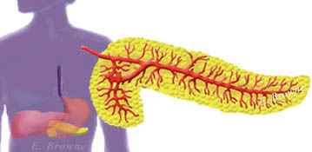
The pancreas detects the change in blood glucose concentration and releases the appropriate hormone

Slide 79
Glucose Homeostasis
Lower Blood Glucose
Between meals
α-cells release Glucagon
stimulate glycogen breakdown and gluconeogenesis
β-cells release insulin
stimulate glucose uptake by peripheral tissues
Higher Blood Glucose
Food
Notes:
Glucose Homeostasis
Here is a diagram of glucose homeostasis. When we eat food, our blood glucose concentration rises, which stimulates insulin secretion from β-cells and eventual glucose absorption by peripheral tissues. In between meals or in times of starvation, we are not taking in glucose and, therefore, experience a drop in blood glucose. During these times, the α-cells release glucagon, which stimulates the liver to make glucose by glycogenolysis and gluconeogenesis, and thereby raise blood glucose to normal levels.
References:
Langley, L.L. (Ed.). (1973). Homeostasis: Origins of the Concept. Langley, National Library of Medicine. Stroudsburg, PA:Dowden Hutchinson, and Ross Inc.
Sherwood, Lauralee. (1997). Human Physiology: From Cells to Systems (3rd ed.). West Publishing Co.

Slide 80
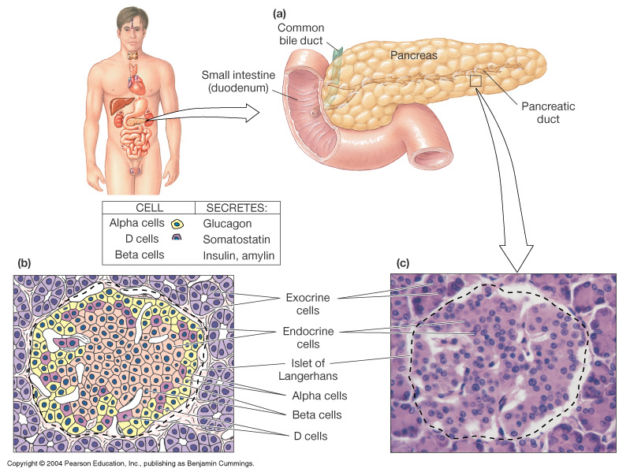
High blood glucose affects size of beta cells

Slide 81
Handling of glucose by liver
GLYCOGENESIS – glycogen synthesis
GLYCOLYSIS- pyruvate & lactate production
PENTOSE PO4 PATHWAY – NADPH production

Slide 82
The control of blood glucose
Glucose in blood
Stored in liver and muscles as glycogen
Normal blood glucose level 80-120 mg/ml
Increase in blood glucose
  Alpha - cells stop secreting glucagon
  Beta - cells secrete insulin

Slide 83
Effect of insulin – on liver & muscles
  increases absorption of glucose from blood into cells
  increase rate use of glucose in cellular respiration
  increase rate of conversion to glycogen

Slide 84
Effect of glucagon – on liver cells
  stimulates break down of glycogen to glucose
  use of fatty acids as fuel for cellular respiration instead of glucose
  production of glucose from fats
  release glucose into blood

Slide 85
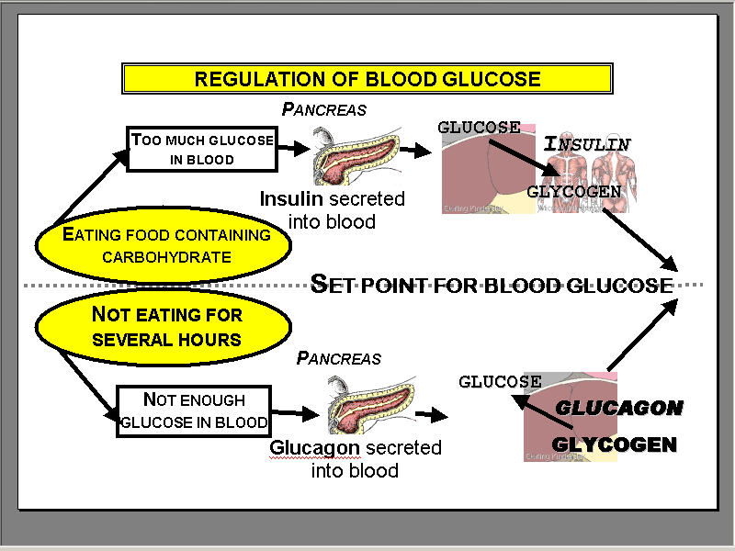

Slide 86
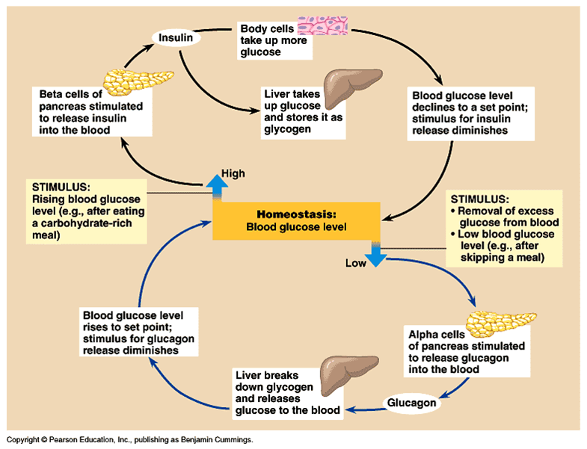
Blood glucose regulation

Slide 87
Thank you!

