Slide 1

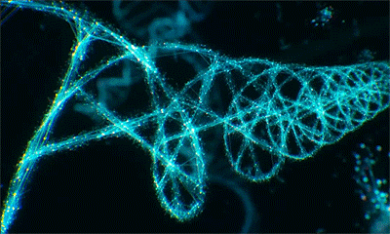
Ribonucleic acid (RNA)
Dr viji

Slide 2
Objectives
To learn - Structure, Functions, & Types of RNA

Slide 3
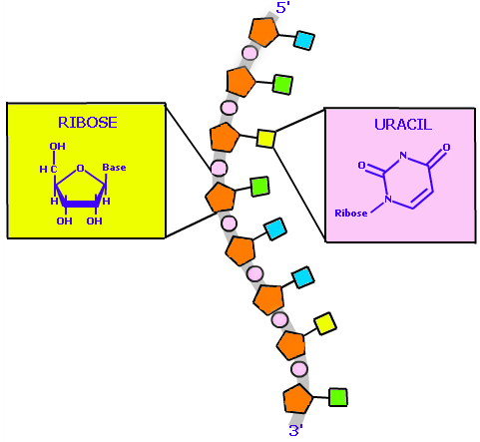
What’s this RNA?
Polymer of purine & pyrimidine nucleotides linked by 3’ 5’ phosphodiester bonds.
Adenine, Guanine, Cytosine & Uracil

Slide 4
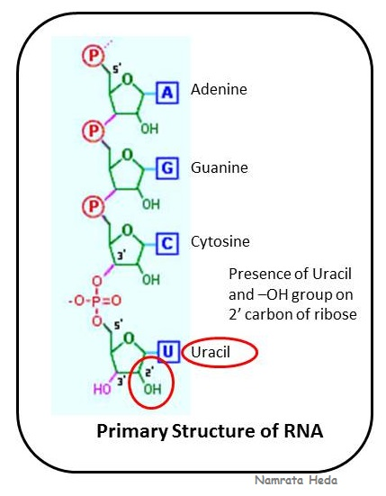
Notes:
Phosphodiesterbond binds with 5 prime hydroxyl group of pentose of one nucleotide to the 3 prime hyroxyl group of pentose of another nucleotide through phsphate group

Slide 5
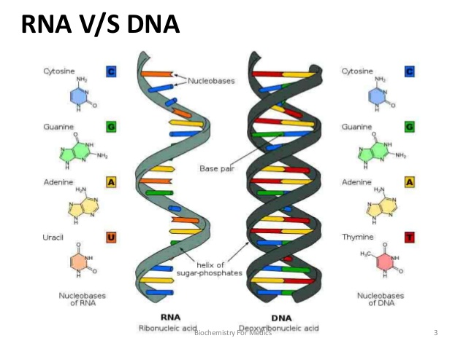

Slide 6
RNA Vs DNA
Single stranded
Ribose Sugar
Pyrimidine – Uracil
No Chargaff’s rule
Subjected to alkali hydrolysis
100 – 5000 bases
Double stranded
Deoxy ribose
Thymine
Obey Chargaff’s rule
Cannot be
Millions of base pairs
Notes:
Orcinol colour reaction - No color

Slide 7
The Location of RNA
RNA can be found in the Nucleus and the Cytoplasm.
RNA is made in the Nucleolus.
Notes:
Mainly in the cytoplasm

Slide 8
Distribution
50% → Ribosomes & Endoplasmic reticulum
25 % → Cytoplasm
15% → Mitochondria
10 % → Nucleus

Slide 9
Types of RNA
1. Messenger RNA (mRNA) → 5 – 10%
2. Ribosomal RNA (rRNA)→ 50 – 80%
3. Transfer RNA (tRNA) → 10 – 20%
4. Small RNA (SnRNA)
5. Micro RNA (MiRNA)

Slide 10
Small RNAs
Heterogenous nuclear RNA (hnRNA)
Small nuclear RNA (snRNA)
Small nucleolar RNA (snoRNA)
Small cytoplasmic RNA (scRNA)
Notes:
Small RNAs subtypes are above blue letters

Slide 11
Types of RNA
1. Messenger RNA (mRNA)
2. Ribosomal RNA (rRNA)
3. Transfer RNA (tRNA)
4. Small RNA (SnRNA)
5. Micro RNA (MiRNA)
Protein synthesis
mRNA processing &
Regulation of
gene expression
Notes:
Protein synthesis
Regulation of gene expression

Slide 12
Messenger RNA (mRNA)

Slide 13
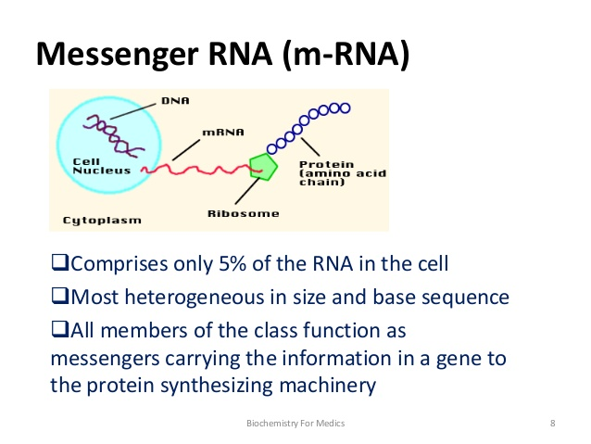
Notes:
Genetic information present in DNA is transcribed into mRNA
Shorthalflife so degrad quickly

Slide 14
Prok-polycistronic
In prok mRNA carries information from more than one gene
monocistronic
In eukar mRNA carries information from one gene

