Slide 1
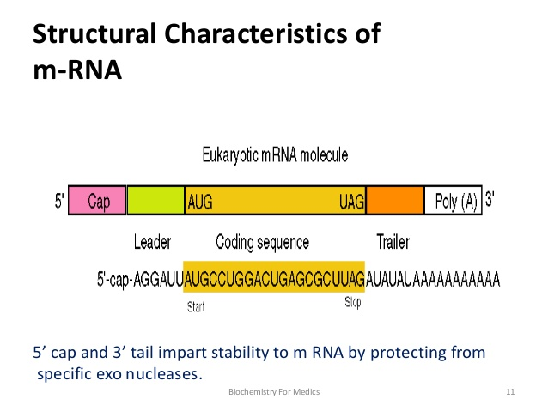

Cap on 5’ end consist of 7 methyl guanosine attached by unusual 5’ ------→ 5’ triphosphate linkage
Tail fascilitate exit from nucleus and aids in translation
Notes:
Cap on 5” end consist of 7 methyl guanosine attached by unusual 5’ ------→ 5’ triphosphate linkage
Tail fascilitate exit from nucleus and aids in translation
Tail fascilitate exit from nucleus and aids in translation

Slide 2
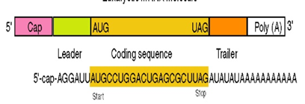
mRNA
On both 5’ and 3’ end there are noncoding sequence which are not translated
The intervening region between non coding sequence present between 5’ and 3’ end is called coding region
This region encodes for synthesis of proteins

Slide 3
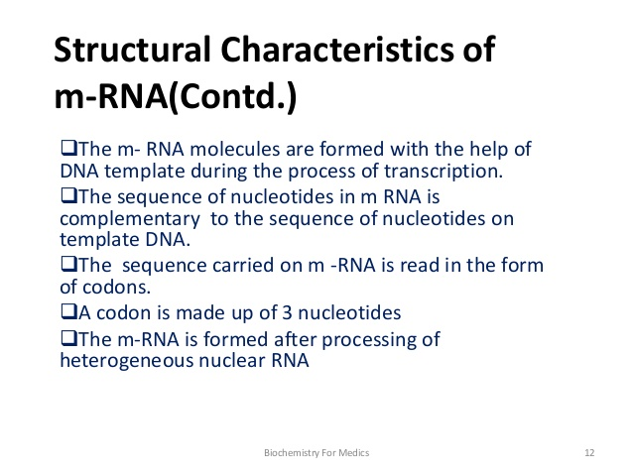

Slide 4
Heteronuclear RNA or primary transcript
mRNA formed and released from DNA template known as primarytranscript or Hetero nuclear RNA
It mammals it undergo extensive proessing to become mature mRNA . Modification are
Poly A TAILNG,methylation,capping,removal of interfering introns[that do not code for protein],
splicing [joining ]of exons [code for protein] occurs in nucleoplasm

Slide 5
removal of interfering introns[that do not code for protein],
splicing [joining ]of exons [code for protein] occurs in nucleoplasm
Splicesome do this work

Slide 6
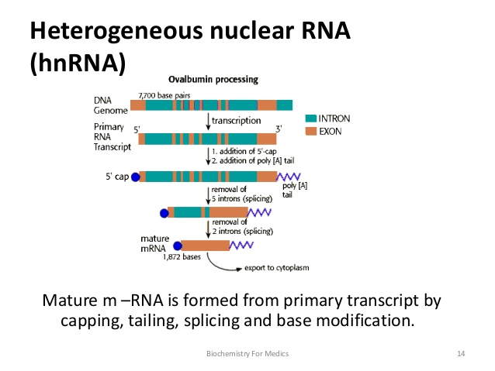

Slide 7
Small nuclear RNA[ uracil rich snRNA]
In association with multiple proteins,
uracil rich snRNA FORMS snRNPS or snurps
Which mediates splicing
snRNPS- small nuclear ribonuclear protein
SLE auto antibodies formed against snurps

Slide 8
Transfer RNA (tRNA)
Soluble RNA(sRNA); Stable
Present in the Cytoplasm
Transfers aminoacid from cytoplasm to the ribosomal protein synthesizing machinery

Slide 9
Clover leaf structure
Four arms
1. The acceptor arm
2. The anticodon arm
The DHU arm[DIHYDROURACIL]
The T Ψ C arm [Ψ –PSEUDOURIDINE] 5. The variable arm
Many bases methylated

Slide 10
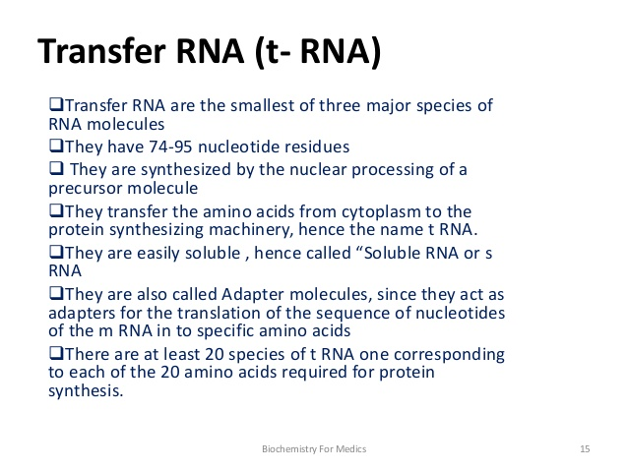
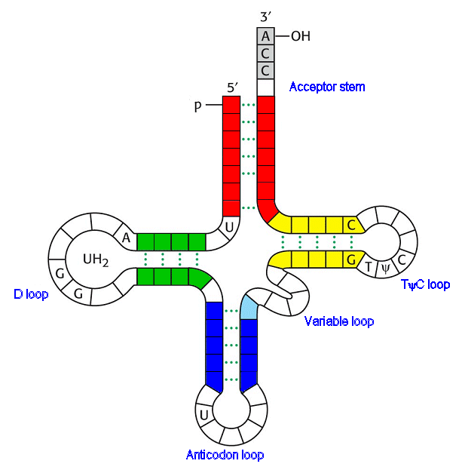

Slide 11
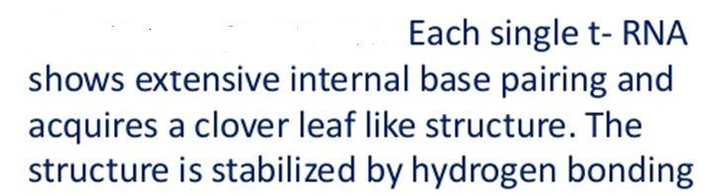
t- RNA

Slide 12
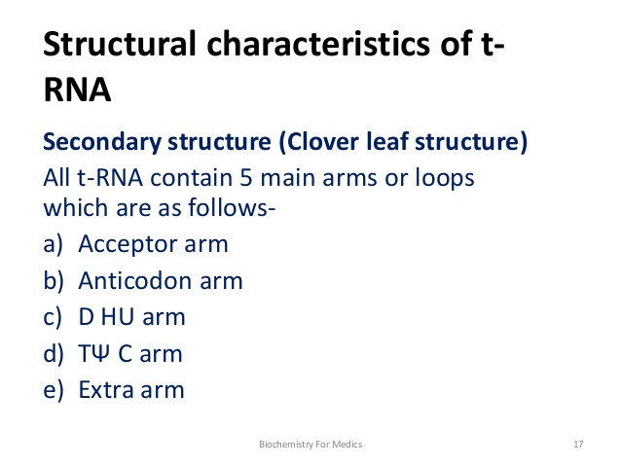

Slide 14
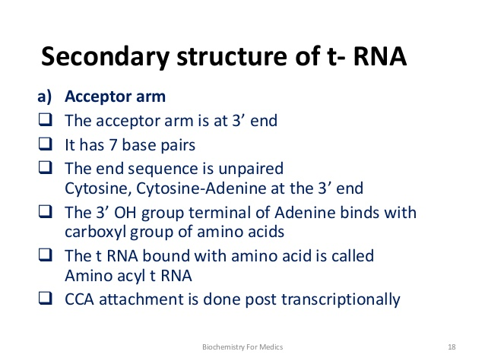

Slide 15
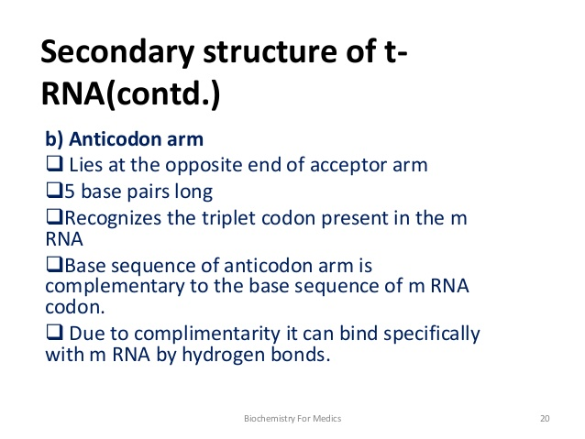

Slide 16
