Slide 1
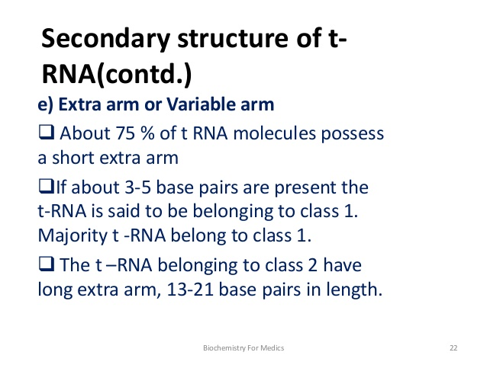
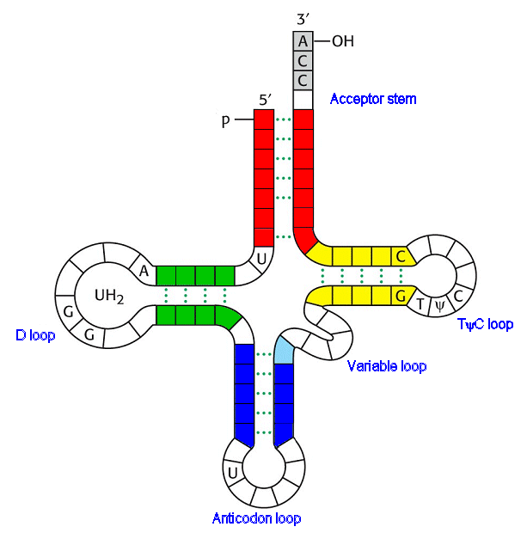


Slide 2
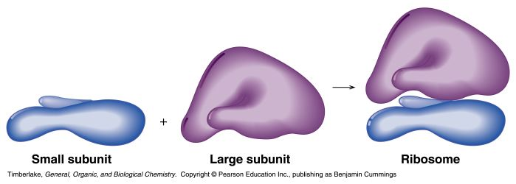

Slide 3
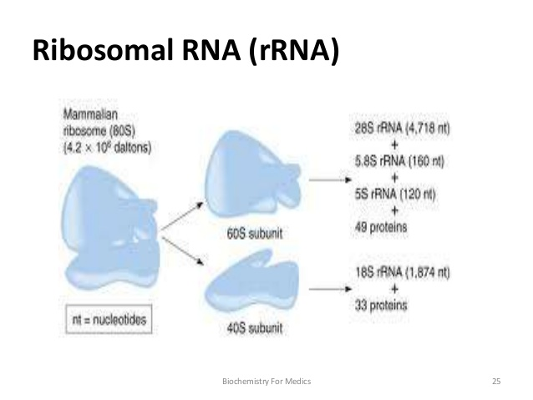

Slide 4
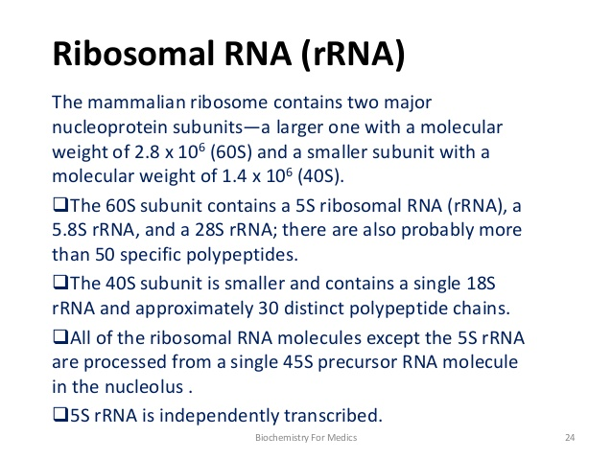

Slide 5
RNA functions
Storage/transfer of genetic information
Structural
Catalytic
Regulatory

Slide 6
Ribosomal RNA (rRNA)
Protein synthesizing machinery; Stable
Peptidyl transferase activity (28S RNA) – Ribozyme
- RNA with catalytic activity is ribozyme
S- svedberg unit for sedimentation rate[size ,shape of particle]
RNA polymerase I – syn rRNA)
Notes:
Binding of mRNA to ribosomes → Protein synthesis

Slide 7
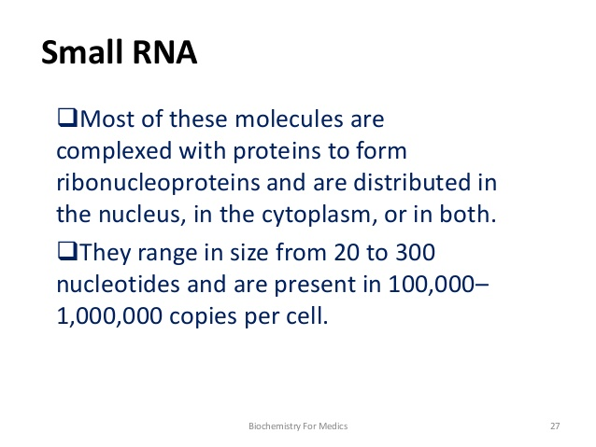

Slide 8
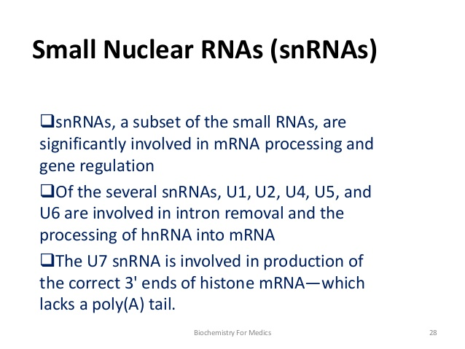
Notes:
U7 involved in histone mrna processing

Slide 9
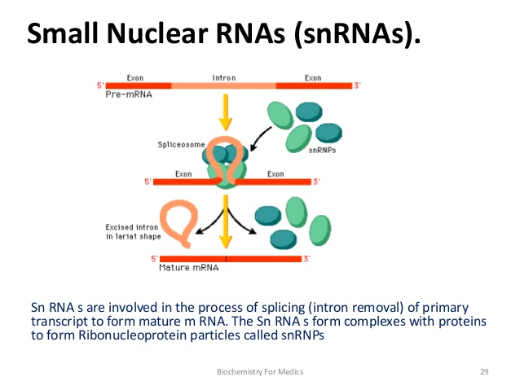

Slide 10
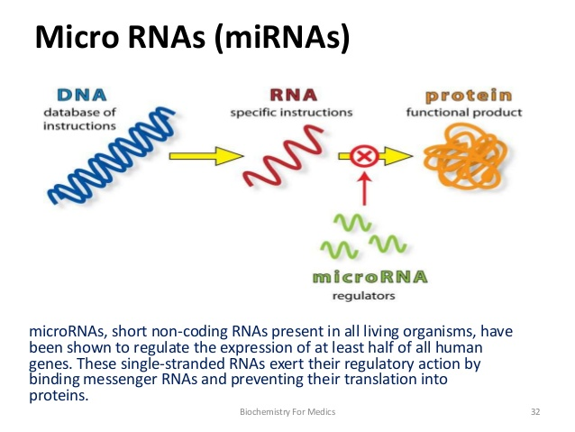

Slide 11
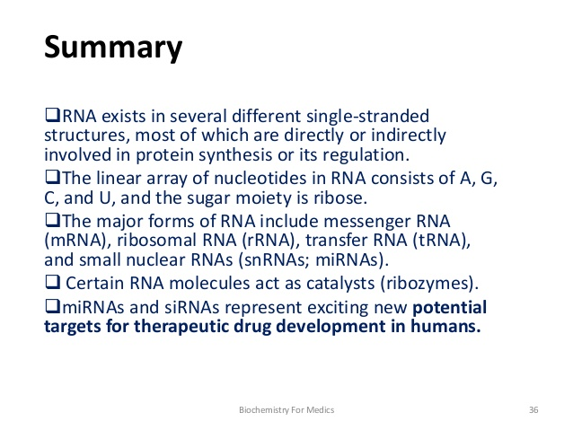

Slide 12
THANK U

