Slide 1

Replication of DNA
Dr. Sudha

Slide 2
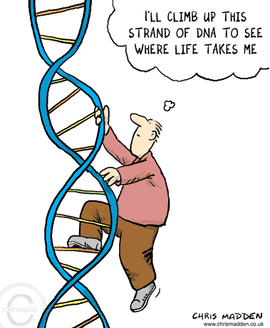
Objectives
To define Replication
Steps of Replication
Inhibitors of Replication

Slide 3
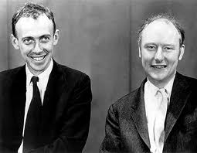
Watson & Crick Model
Right handed double helix
The base pairing rule
Hydrogen bonding
Antiparallel
Notes:
Others

Slide 4
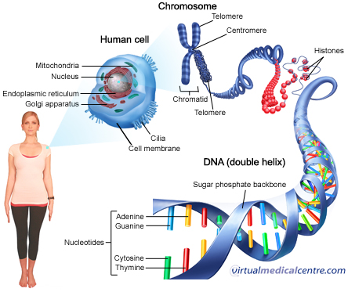

Slide 5
Central dogma of Molecular biology
Transcription Translation
DNA mRNA Protein
Replication
DNA
Maintenance and expression of genetic information

Slide 6
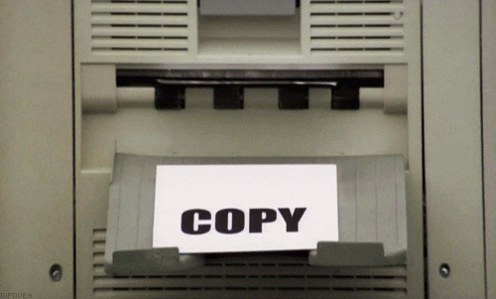
Replication
Process in which DNA copies itself to produce identical daughter molecules of DNA

Slide 7
Replication Facts
DNA has to be copied before a cell divides
DNA is copied during the S or synthesis phase of interphase
New cells will need identical DNA strands
Notes:
Growth, Repair, Replacement

Slide 8
Replication is Semiconservative
Idea presented by Watson & Crick
Half of the original DNA is conserved in the daughter DNA
DNA Template
Parental DNA
New DNA
Notes:
The two strands of the parental molecule separate, and each acts as a template for a new complementary strand

Slide 9
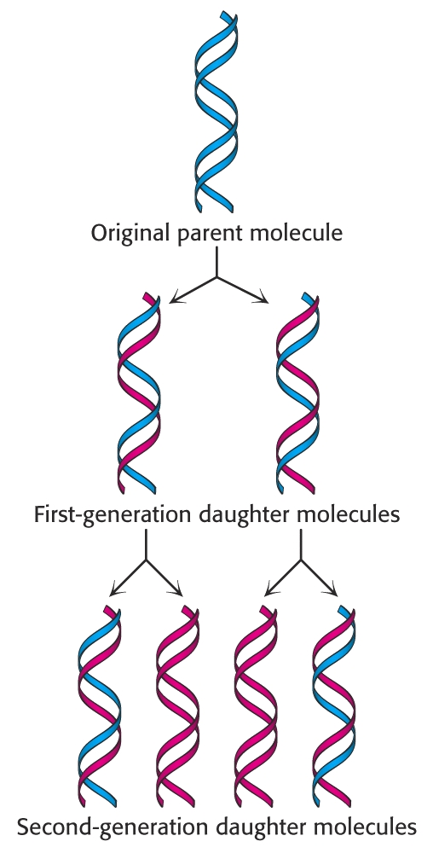
Semi-conservative
Replication of DNA
The Watson-Crick Model
Proved by the Meselson-Stahl Experiment

Slide 10

Replication - PHASES
Initiation
Elongation
Termination

Slide 11
Basic rules of replication
Semi-conservative
Starts at the ‘origin’
Can be uni or bidirectional
Semi-discontinuous
Synthesis always in the 5’-3’ direction
RNA primers required

Slide 12
DNA Replication
Large team of enzymes coordinates replication
1. DNA helicase
2. SSBs to prevent recoiling
3. Primase
4. DNA Polymerase
5. DNA Ligase
Notes:
Enzymes
more than a dozen enzymes & other proteins participate in DNA replication

Slide 13
1.Initiation
Begins at Origins of Replication (ori)
Two strands open forming Replication Forks (Y-shaped region)
3’
Parental DNA Molecule
5’
Replication
Fork
3’
5’
Notes:
Initiator proteins identify specific base sequences on DNA called sites of origin

Slide 14
Starts at origin
Prokaryotes – Single origin site E.g E.coli - oriC
Eukaryotes – Multiple sites of origin
- ARS (Autonomously replicating sequences)
Uni or bidirectional
Replication forks move in one or opposite directions

Slide 15
Replication Bubbles
2 DNA strands open at the origin, Replication Bubbles form
Prokaryotes → Single bubble
Eukaryotes → MANY bubbles
Bubbles
Bubbles

