Slide 1

Strand separation
Helicase unwinds and separates the 2 DNA strands by breaking the weak hydrogen bonds
Single-Strand Binding Proteins attach and keep the 2 DNA strands separated and untwisted

Slide 2
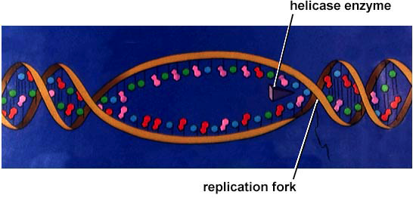
Helicase
    Unwinds part of DNA helix
    Stabilized by SSB(Single stranded DNA binding proteins)
helicase
single-stranded binding proteins
replication fork

Slide 3
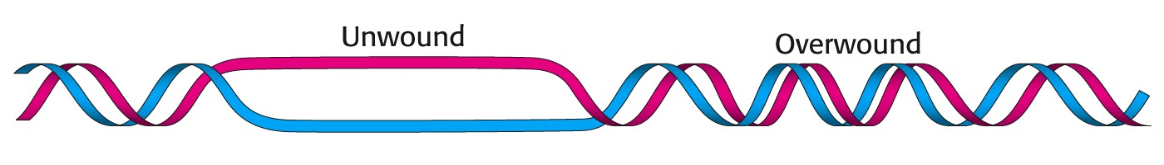
Super coiling
Ahead of the replication fork the DNA becomes supercoiled
Topoisomerase relieves stress on the DNA molecule as it separates
Enzyme
Enzyme
DNA

Slide 4
Supercoiling is relieved by the action of Topoisomerases.
Type I topoisomerases:
Make nicks in one DNA strands
Can relieve supercoiling
Type II topoisomersases
Make nicks in both DNA strands (double strand break)
Can relieve supercoiling and untangle linked DNA helices

Slide 5
Topoisomerases – Clinical significance
As drug targets
Because dividing cells require greater topoisomerase activity
due to increased DNA synthesis, topoisomerase inhibitors are
used as chemotherapeutic agents.
E.g. Camptothecin -- Topo I inhibitor
Doxorubicin -- Topo II inhibitor
Also, some antibiotics are inhibitors of the bacterial-specific
toposisomerase DNA gyrase e.g. ciprofloxacin

Slide 6
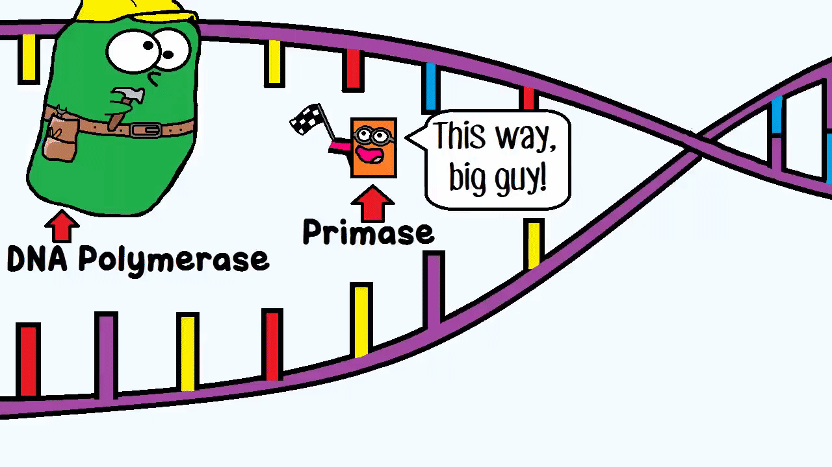
RNA primers
RNA primers (100-200 nucleotides)
Primase synthesizes the RNA Primer

Slide 7
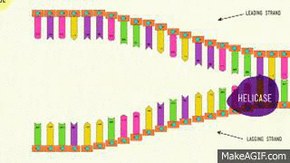
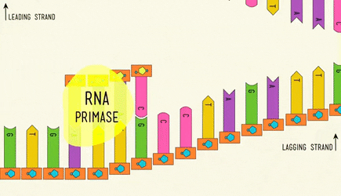

Slide 8
DNA Replication- Direction
DNA polymerase can only add nucleotides to the 3’ end of the DNA
Always 5’ to 3’ direction
5’
3’
5’
RNA
Primer
DNA Polymerase
Nucleotide

Slide 9
Remember the Strands are Antiparallel
5
O
3
3
O
P
5
P
5
O
G
C
1
2
3
4
4
2
1
3
5
P
O
P
T
A
3
5
O
O
5
P
P
3

Slide 10
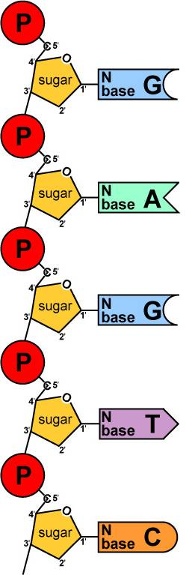
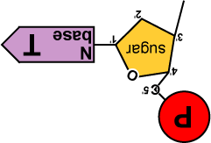
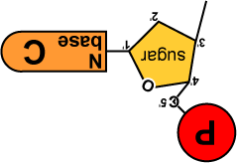
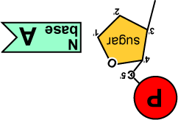
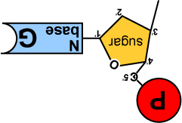
Replication: Elongation
Build daughter DNA strand
  add new complementary bases
DNA
Polymerase III

Slide 11
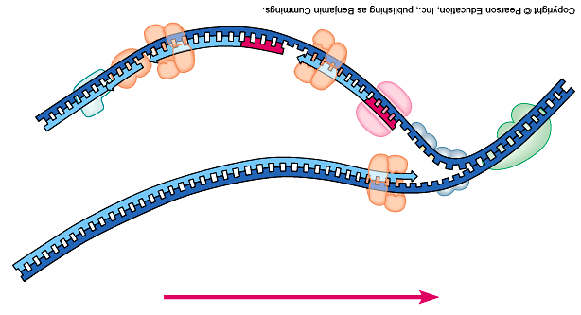
3’
5’
5’
3’
5’
3’
5’
3’
direction of replication

Slide 12
Replication fork
5′
3′
5′
3′
3′
5′
3′
5′
growing
replication fork
3′
primase
5′
DNA polymerase III
RNA
5′
3′

Slide 13
The Leading Strand
Synthesized as a single strand from the point of origin toward the opening replication fork
Continuous
5’
3’
5’
RNA
Primer
Nucleotides
DNA Polymerase

Slide 14
The Lagging strand
Synthesized discontinuously against overall direction of replication
Made in MANY short segments.
Replicated from the replication fork toward the origin

Slide 15
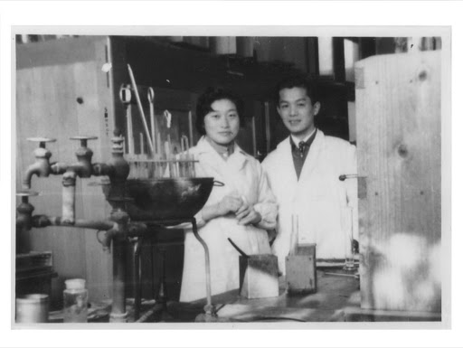
Lagging Strand Segments
Okazaki Fragments
Series of short segments on the lagging strand
DNA
Polymerase
Okazaki Fragment
RNA
Primer
5’
3’
3’
5’
Lagging Strand

