Slide 1

Joining of Okazaki Fragments
The enzyme Ligase joins the Okazaki fragments together to make one strand
DNA ligase
5’
Okazaki Fragment 1
Okazaki Fragment 2
3’
3’
5’
Lagging Strand

Slide 2
Replacing RNA primers with DNA
DNA polymerase I
5′
3′
3′
ligase
5′
growing
replication fork
3′
5′
RNA
5′
3′

Slide 3
Proof reading
DNA polymerase I & DNAP beta
Proof reads & corrects typos
(Repairs mismatched bases)
Reduces error rate

Slide 4
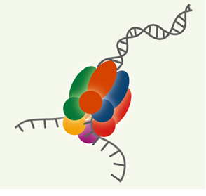
Origin of replication Replication bubbles DNA polymerases
Replication in Prokaryotes &
Eukaryotes

Slide 5
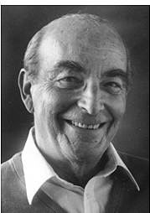
DNA polymerases
Mammalian
Bacterial
DNAPs – Alpha, beta, Gamma, Delta & Epsilon
Alpha – Primers
Beta – Repair
Gamma – mtDNA
Delta – Leading strand synthesis & Proof reading
Epsilon – Lagging strand synthesis
DNAPs I – III
I – repair enzyme (Kornberg enzyme)
DNAP III → Main replication enzyme
Arthur Kornberg
1959

Slide 6
Modification after replication
DNA methylation at C5 of cytosine
DNA methyl transferase
Aberrant methylation: - Reactive Oxygen Species - Cellular Senescence - Diabetes Mellitus

Slide 7
Inhibitors of Replication
Drug | Action
Antibacterial agents: 1. Ciprofloxacin 2. Nalidixic acid 3. Novobiocin | Bacterial topoisomerase (DNA gyrase)
Anticancer agents: 1. Etoposide 2. Adriamycin 3. Camptothecin | Human topoisomerase

Slide 8
To summarize….

Slide 9
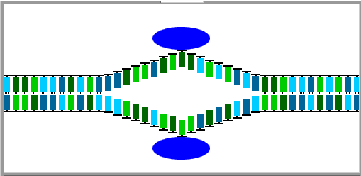
DNA Replication
Replication
fork
Replication
fork
Replication
bubble
Hydrogen
bond
Notes:
DNA replication is the process where an entire double-stranded DNA is copied to produce a second, identical DNA double helix.

Slide 10
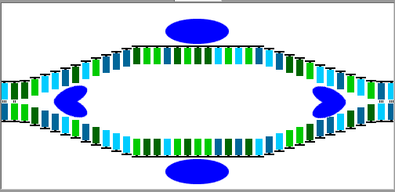
DNA Replication
DNA
helicase
Notes:
Helicase unwinds the double helix starting at a replication bubble.
The two strands separate as the hydrogen bonds between base pairs are broken.
Two replication forks form and the DNA is unwound in opposite directions.

Slide 11
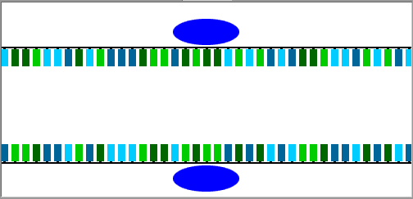
DNA Replication

Slide 12
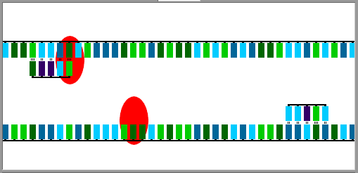
DNA Replication
Leading Strand
Primase
RNA Primer
Lagging Strand

Slide 13
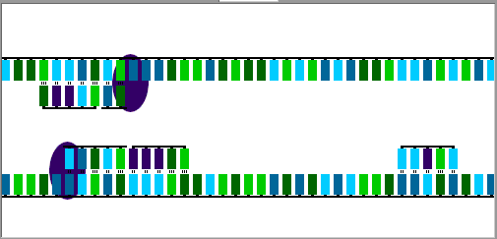
DNA Replication
Leading Strand
3’
5’
Direction of Replication
DNA Polymerase
5’
3’
Direction of Replication
Lagging Strand

Slide 14
Possible questions
Essay
Describe the process of DNA replication/ Synthesis of DNA with neat diagrams.
2 marks
Okazaki fragments
DNA polymerases
Inhibitors of replication

Slide 15
Next class …..
DNA repair

