Slide 1
MITOCHONDRIAL ELECTRON TRANSPORT CHAIN
By
Dr.D.Ponnudhali

Slide 2
Electron Transport:
Electrons carried by reduced coenzymes, NADH or FADH₂, are passed through a chain of proteins and coenzymes, finally reaching O₂, the terminal electron acceptor
and to drive the generation of a proton gradient across the inner mitochondrial membrane
Oxidative Phosphorylation:
Proton gradient runs downhill to drive the synthesis of ATP

Slide 3
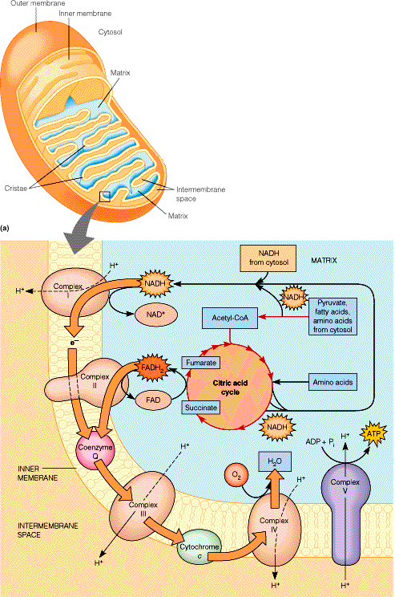
Intermembrane space
-- creatine kinase
-- adenylate kinase
Outer membrane
-- fatty acid elongation
-- fatty acid desaturation
-- phospholipid synthesis
-- monoamine oxidase
Inner membrane (cristae)
-- electron transport
-- oxidative phosphorylation
-- transport system
-- fatty acid transport
Matrix
-- pyruvate dehydrogenase
complex
-- citric acid cycle
-- glutathione dehydrogenase
-- fatty acid oxidation
-- urea cycle
-- replication
-- transcription
-- translation

Slide 4
Mitochondrial functions are localized in specific compartments
Outer membrane
Fatty acid elongation
Fatty acid desaturation
Phospholipid synthesis
Monoamine oxidase
Inner membrane
Electron transport
Oxidative phosphorylation
Transport system
Fatty acid transport
Intermembrane space
Creatine kinase
Adenylate kinase
Martix
Pyruvate dehydrogenase complex
TCA cycle
Glutathione dehydrogenase
Fatty acid oxidation
Urea cycle
DNA replication
Transcription
Translation

Slide 5
Reducing agent: The electron donating molecule in an oxidation reduction reaction is called a reducing agent/reductant.
Oxidizing agent: The electron accepting molecule in an oxidation reduction reaction is called a oxidizing agent/ oxidant.
H< C<S<N<O

Slide 6
Redox pairs
Oxidized and reduced forms of compounds operating in oxidation- reduction reactions are called as redox pairs.
Fe²⁺ and Fe³⁺ - conjugate redox pair
Fe²⁺ - electron donor and Fe³⁺ - electron acceptor
Reducing equivalent – it is a term used to
Designate a single electron equivalent participating
in an oxidation – reduction reaction
Reducing equivalent = Proton + electron= H⁺ + e⁻

Slide 7
Redox pairs
Oxidized and reduced forms of compounds operating in oxidation- reduction reactions are called as redox pairs.
Fe²⁺ and Fe³⁺ - conjugate redox pair
Fe²⁺ - electron donor and Fe³⁺ - electron acceptor
Reducing equivalent – it is a term used to
Designate a single electron equivalent participating
in an oxidation – reduction reaction
Reducing equivalent = Proton + electron= H⁺ + e⁻

Slide 8
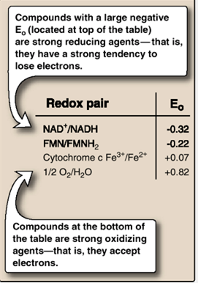

Slide 9
Reducing equivalents
In biochemistry, the term reducing equivalent refers to any of a number of chemical species which transfer the equivalent of one electron in redox reactions.
Examples of reducing equivalents are:
A lone electron (For Ex. in reactions involving metal ions)
A hydrogen atom (consisting of a proton and an electron)

Slide 10
Reducing equivalents in foodstuffs
Carbohydrates and proteins have a calorific value 3-4 kcal g⁻¹
Lipids have 3 times more calorific value
Carbon atoms in carbohydrates are in a more oxidized state compared to lipids
Hence sequential breakdown of lipids produce 3 times more reducing equivalents than that can be extracted from carbohydrates.

Slide 11
Reducing equivalents in foodstuffs
In fatty acid oxidation and TCA cycle, reducing equivalents are derived from sequential breakdown & oxidation of substrates.
These REQ are transferred to NADH & FADH2,
Oxidized in ELECTRON TRANSPORT CHAIN in inner mitochondrial membrane.
In presence of O2, this system converts REQ into utilizable energy, as ATP- by oxidative phosphorylation
NADH2- 2.5 ATPs, FADH2- 1.5 ATPs

Slide 12
Oxidation –reduction reactions
In some oxidation- reduction reactions only electrons are transferred from reductant to oxidant. Ex. e ⁻ transfer between cytochromes.
In some oxidation- reduction reactions both electrons and protons (H+) are transferred from reductant to oxidant. Ex. e ⁻ transfer between NADH& FAD.
Ex. NADH + H⁺ + FAD ↔ NAD⁺ + FADH2

Slide 13
Oxidation- reduction potential
Compounds with large negative potentials are considered will give up electrons easily than redox pairs with less negative / positive potential.
Compounds with large negative potentials are strong reducing agents (reductants).
Compounds with positive potentials are strong oxidizing agents (oxidants). They have a
high affinity for electrons.
Ex. NADH- -0.32V, O2 - +0.82V

Slide 14
Oxidation- reduction potential
This oxidation- reduction potential is measured in volts as an electromotive force (emf) of a half cell containing the redox pair compared to the standard reference half-cell (hydrogen electrode).

Slide 15
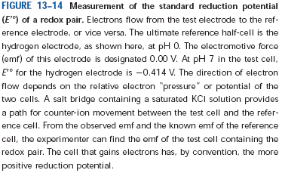
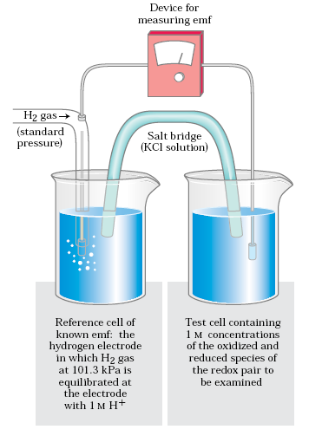

Slide 16
Free energy changes in redox reactions
This oxidation- reduction potential differences between two redox pairs are similar to free- energy changes in chemical reactions.

Slide 17
Oxidation- reduction potential
In a redox pair the electron donor (reductant) gives up its electrons to the electron acceptor (oxidant).
This depends on the affinity of the electron acceptor in the redox pair, for electrons.
This facility of giving up of electrons is expressed as oxidation- reduction potential.

Slide 18
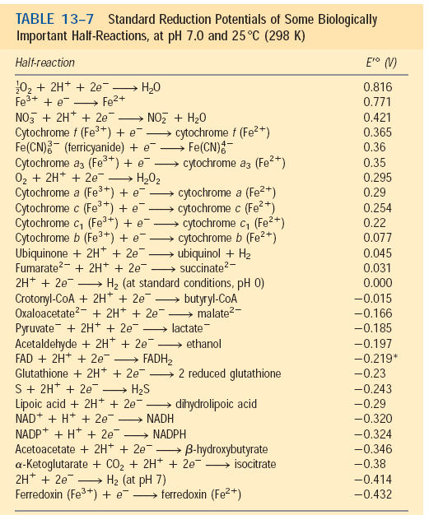

Slide 19
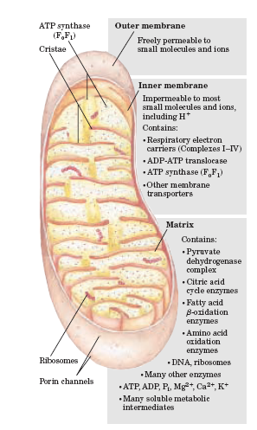

Slide 20
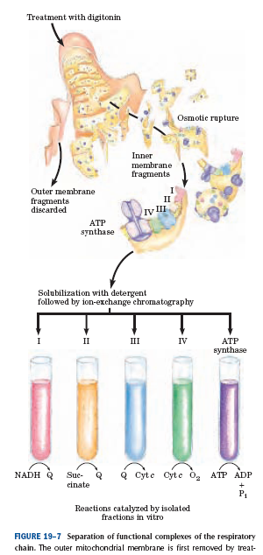

Slide 21
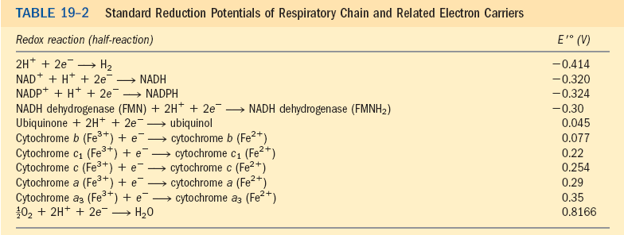
Mitochondrial electron transport system
→ 02
0.077V
0.22V
0.25V
0.29V
0.35V
0.8166V
-0.32V
0.045V

Slide 22
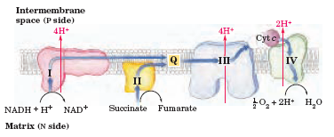
Mitochondrial electron transport chain
NADH dehydrogenase
Succinate dehydrogenase
Cytochrome reductase
Cytochrome oxidase
Ubiquinone

Slide 23
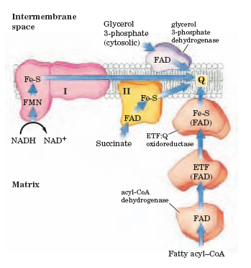
Mitochondrial electron transport chain

Slide 24
ELECTRON TRANSPORT CHAIN

Slide 25
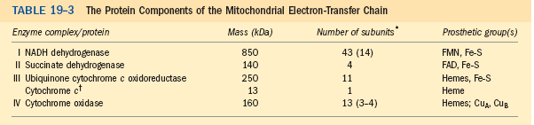

Slide 26
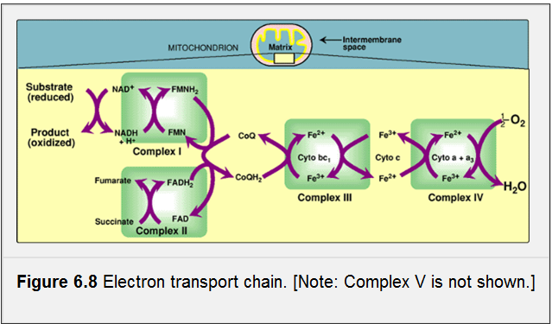

Slide 27
Transfer of e- to ubiquinone-Q

Slide 28
Nicotinamide nucleotide–linked dehydrogenases
NAD-linked dehydrogenases remove two hydrogen atoms from their substrates.
One of these is transferred as a hydride ion (:H-) to NAD;
the other is released as H+ in the medium
NADH and NADPH are water-soluble electron carriers that associate reversibly with dehydrogenases.

Slide 29
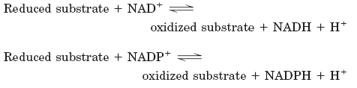
Nicotinamide nucleotide–linked dehydrogenases

Slide 30
Nicotinamide nucleotide–linked dehydrogenases
Glyceraldehyde – 3-PO4 dehydrogenase
Isocitrate dehydrogenase
Malate dehydrogenase
Glutamate dehydrogenase
Beta hydroxy acyl CoA dehydrogenase
Pyruvate dehydrogenase
Alpha ketoglutarate dehydrogenase

Slide 31
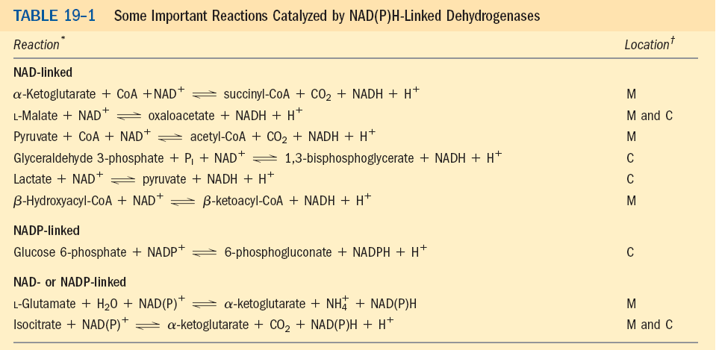

Slide 32
Complex I- NADH dehydrogenase
Transfer of electrons from NADH to ubiquinone(Q)
First the electrons are transferred to FMN
Then from FMN to Fe-S centres. There are 6 Fe-S centres present.
Then the electrons flow from the Fe-S centres to ubiquinone (Q).
The energy released is 12 kcal/mol
Here 4 H+ are pumped out.

Slide 33
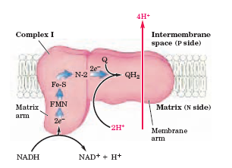

Slide 34
Complex II- Succinate dehydrogenase
Transfer of electrons from succinate to ubiquinone (Q)
First the electrons are transferred from succinate binding site to FAD.
It contains three 2Fe-2S centres present.
From FAD the electrons are transferred to 2Fe-2S centres.
Then the electrons flow from the Fe-S centres to ubiquinone (Q).
The energy released is not sufficient for flow of H+

Slide 35
Complex II- Succinate dehydrogenase
Succinate dehydrogenase
Fatty acyl CoA dehydrogenase
Glycerol-3-PO4 dehydrogenase

Slide 36
UBIQUINONE
Ubiquinone also called coenzyme Q, or simply Q)
It is a lipid-soluble benzoquinone with long isoprenoid side chain .
It is both small and hydrophobic, freely diffusible within the lipid bilayer of inner mitochondrial membrane
Accepts one electron to become the semiquinone
radical (QH) or two electrons to form ubiquinol (QH2)
Shuttles reducing equivalents between other, less mobile
electron carriers in the membrane.
It carries both electrons and protons, it plays a central role
in coupling electron flow to proton movement.

Slide 37
CYTOCHROMES
The cytochromes are proteins with characteristic strong absorption of visible light, due to their iron containing heme prosthetic groups
Mitochondria contain three classes of cytochromes, designated a, b, and c, which are distinguished by differences in their light-absorption spectra.
Each type of cytochrome in its reduced (Fe2) state has three absorption bands in the visible range
The longest wavelength band is near 600 nm in type a cytochromes,
near 560 nm in type b, and near 550 nm in type c.

Slide 38
CYTOCHROMES
The heme cofactors of a and b cytochromes are tightly, but not covalently, bound to their associated proteins;
the hemes of c-type cytochromes are covalently attached through Cys residues
Like flavoproteins, the standard reduction potential of the heme iron atom of a cytochrome depends on its interaction with protein side chains and is therefore different for each cytochrome.
The cytochromes of type a and b and some of type c are integral proteins of the inner mitochondrial membrane

Slide 39
Fe-S proteins
In Iron-sulfur proteins, iron is present not in heme but in association with inorganic sulfur atoms or with the sulfur atoms of Cys
residues in the protein, or both.
These iron-sulfur (Fe-S) centers range from simple structures with a single Fe atom coordinated to four Cys -OSH groups to more complex Fe-S centers with two or four Fe atoms

Slide 40
Fe-S proteins
Rieske iron-sulfur proteins (named after their discoverer, John S. Rieske) are a variation on this theme,
in which one Fe atom is coordinated to two His residues
rather than two Cys residues.
All iron-sulfur proteins participate in one-electron transfers in which one iron atom of the iron-sulfur cluster is oxidized or reduced.
At least eight Fe-S proteins function in mitochondrial
electron transfer. The reduction potential of Fe-S proteins varies from 0.65 V to 0.45 V, depending on the
microenvironment of the iron within the protein.

Slide 41
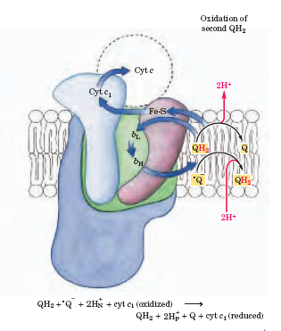
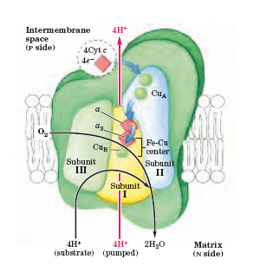
COMPLEX III, COMPLEX IV

Slide 42
Complex III- Ubiquinone cytochrome c oxidoreductase
Transfer of electrons from ubiquinone(Q) to cytochrome c.
Electrons are transferred to cytochrome b (2 hemes), to 2Fe2S centres & to cytochrome c1 .
Then the electrons flow to cytochrome c.
Free energy change is – 10 kcal/mol & 4 H+ are pumped out.

Slide 43
Cytochrome c
It is a mobile electron carrier from complex III to complex IV.
Like ubiquinone, it is a mobile electron carrier.

Slide 44
Complex IV- cytochrome c oxidase
Transfer of electrons from cytochrome c to oxygen.
It contains 2 cu ions- Cu_{A} , Cu_{B}(complexed with –SH groups of cysteine residues), cytochromes a & a3.
Electrons are transferred from cytochrome c - Cu_{A} - cytochrome a3- Cu_{B}.
Then the electrons flow to O2 which is bound to cyt a₃.
Here 2 H+ are pumped out.
4 H⁺ + O2 + 4 cytC Fe ⁺⁺ →2H2O + 4 cyt C ⁺⁺⁺

Slide 45
Complex IV- cytochrome c oxidase
Transfer of electrons from cytochrome c to oxygen.
It contains 2 cu ions- Cu_{A} , Cu_{B} (complexed with –SH groups of cysteine residues), cytochromes a & a3.
Electrons are transferred from cytochrome c - Cu_{A} - cytochrome a3- Cu_{B}.
Then the electrons flow to O2 which is bound to cyt a₃.
Here 2 H+ are pumped out.
4 H⁺ + O2 + 4 cytC Fe ⁺⁺ →2H2O + 4 cyt C ⁺⁺⁺

Slide 46
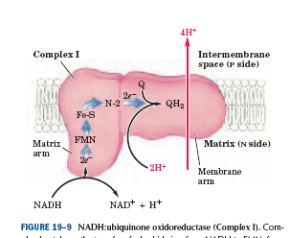
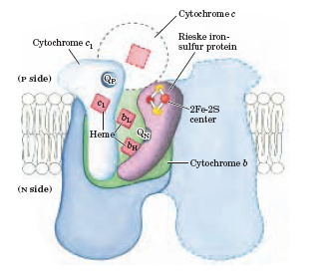
COMPLEX I, COMPLEX III

Slide 47
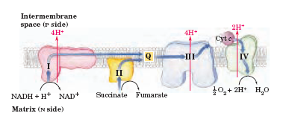
METC

Slide 48
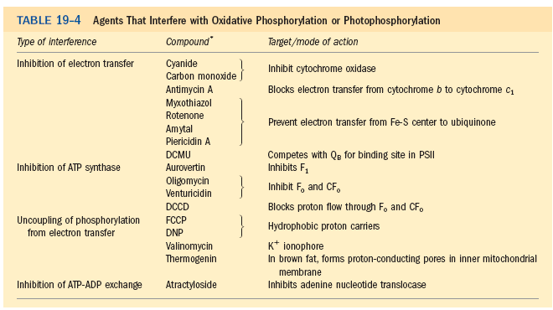

Slide 49
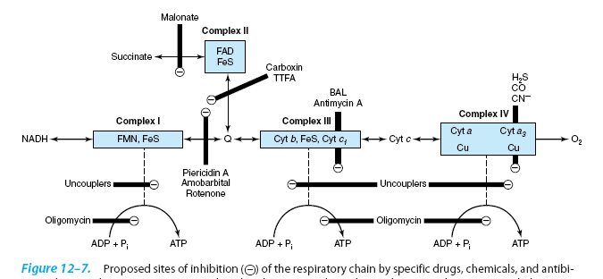
Inhibitors of METC
Inhibitors of Oxidative phosphorylation
Aractyloside 2. Oligomycin 3.ionophores
Cyanide, CO,azide
Dimercaprol
Rotenone ,
Barbiturates
2,4 DNP
2,4 DNC

Slide 50
Substrate level phosphorylation
Bisphosphoglycerate kinase
Pyruvate kinase
Succinate thiokinase

Slide 51
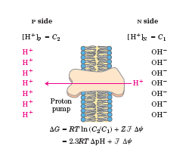
The electron transfer reactions are exergonic, and, the energy released is used for pumping of protons across the intermembrane space.

Slide 52
P/O RATIO or P/2e-
The no. of protons pumped out per pair of electrons are 10 H+→ NADH; 6 H+ for succinate
No. of H+ required for the synthesis of 1 ATP→ 4
1 H+ is used for transporting Pi
For 1 NADH, 10 H+ are pumped out – so 2.5 ATP are synthesized.
For FADH2(complex -II) – 6 H+ are pumped out – 1.5 ATP synthesized
1 NADH → 2.5 ATP (10 H+)
1 FADH2 → 1.5 ATP

Slide 53
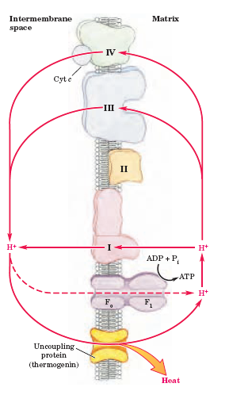
Brown adipose tissue
Uncoupling of oxidative phosphorylation

Slide 54
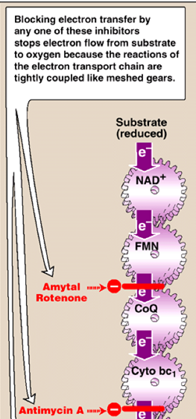
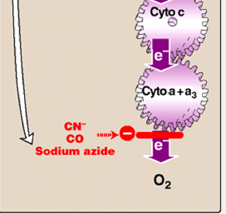

Slide 55
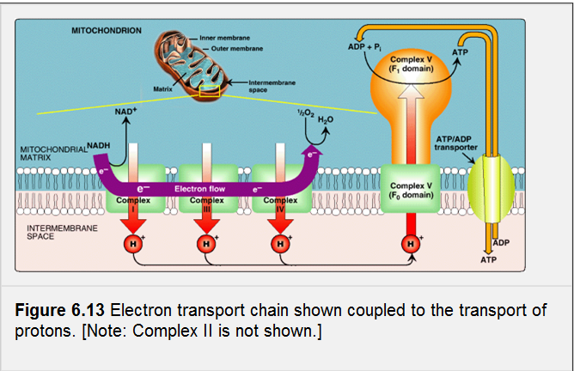

Slide 56
OXIDATIVE PHOSPHORYLATION

Slide 57
The flow of electrons results in the pumping of electrons out from the matrix to the intermembrane space- electrochemical gradient is created.
Due to this high conc. of H+ ions in the intermembrane space, these H+ ions flow passively back through the ATP synthase complex.
This proton influx causes ATP synthesis.

Slide 58
Three measurable processes occur in the
Mitochondria,
Oxidation of the substrate (Ex. succinate → fumarate)
O2 is consumed
ATP is synthesized.

Slide 59
Energetics
The H+ ions are pumped from the matrix to the intermembrane space during the electron transport.
This causes
A transmembrane potential difference= 0.15- 2.0 V
pH - of the matrix is 0.75-1 units more alkaline than the intermembrane space
The ∆G is 200kJ for transfer of 10 H+ across membrane, during transfer of e- from NADH to O2.
So the calculated free energy change for the pumping of one H+ is 20 kJ/mol (of H+)

Slide 60
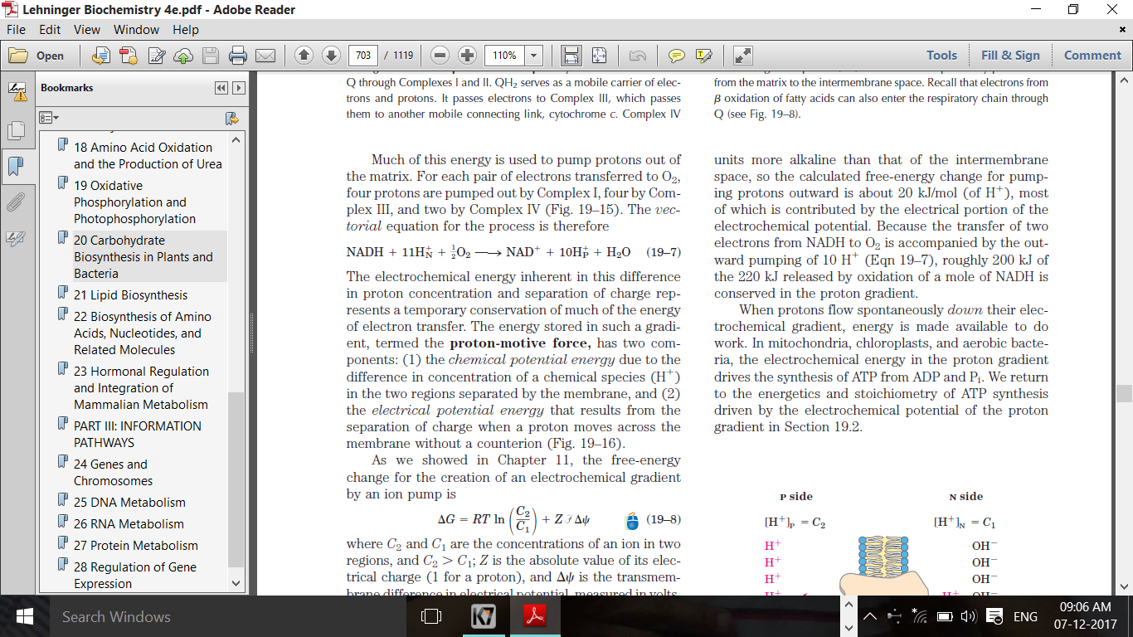

Slide 61
Energetics
Energy of the electron transfer reactions is captured in the electrochemical gradient- called the proton motive force.
This proton motive force - used to drive the synthesis of ATP , by the movement of protons down the electrochemical gradient.
This called chemiosmosis, proposed by Professor Peter Mitchell who won Nobel Prize in 1978.

Slide 62
Chemiosmotic theory- Peter Mitchell
These electrical & chemical gradients (difference in charge & proton concentration)- proton motive force between the matrix & intermembrane space, causes flow of protons back into the matrix.
This proton motive force drives the synthesis of ATP, as the protons flow passively back into the matrix through the proton pore in the ATP synthase complex

Slide 63
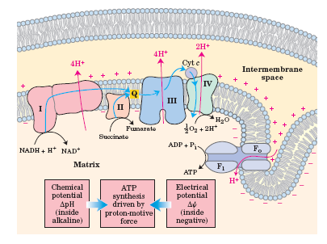

Slide 64
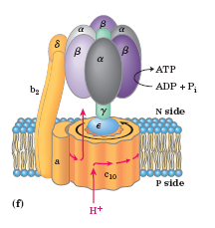
ATP synthase
F1 (peripheral membrane protein)
F0 (integral protein)- oligomycin sensitive

Slide 65
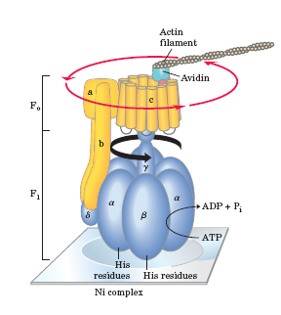
ATP synthesis

Slide 66
ATP synthase-F1 subunit
F1 has 9 subunits of 5 types- α ₃β₃γδƐ.
ATP synthesis takes place in the 3 β subunits
Each of the 3 β subunits has one catalytic site for ATP synthesis.
γ subunit forms the central shaft – which associates with 3 α & 3β subunits

Slide 67
ATP synthase- F0 subunit
Subunit c is small and very hydrophobic polypeptide
The a & b subunits of F0 and
δ subunit of F1 form the stator
to hold the α and β subunits in
position.
There are around 9-12 c subunits
Through the F₀ pore , the streaming
of protons occur ,causing the cylinder
of c sub units to rotate about the
long axis of γ subunit.

Slide 68
ATP synthase- F₀ subunit
With each rotation by 120⁰ ,γ subunit comes in contact
With a different β subunit
The 3 subunits interact in such a way
that when one β subunit is in β- empty
Configuration, the other must assume
β- ADP and the other β- ATP configurations
For each rotation 3 ATPs are synthesized
and released from the enzyme.

Slide 69
The binding sites for ADP & ATP are identified on both the α and β subunits
The catalytic sites are on the β subunits
The function of nucleotides bound to α subunits is unknown.

Slide 70
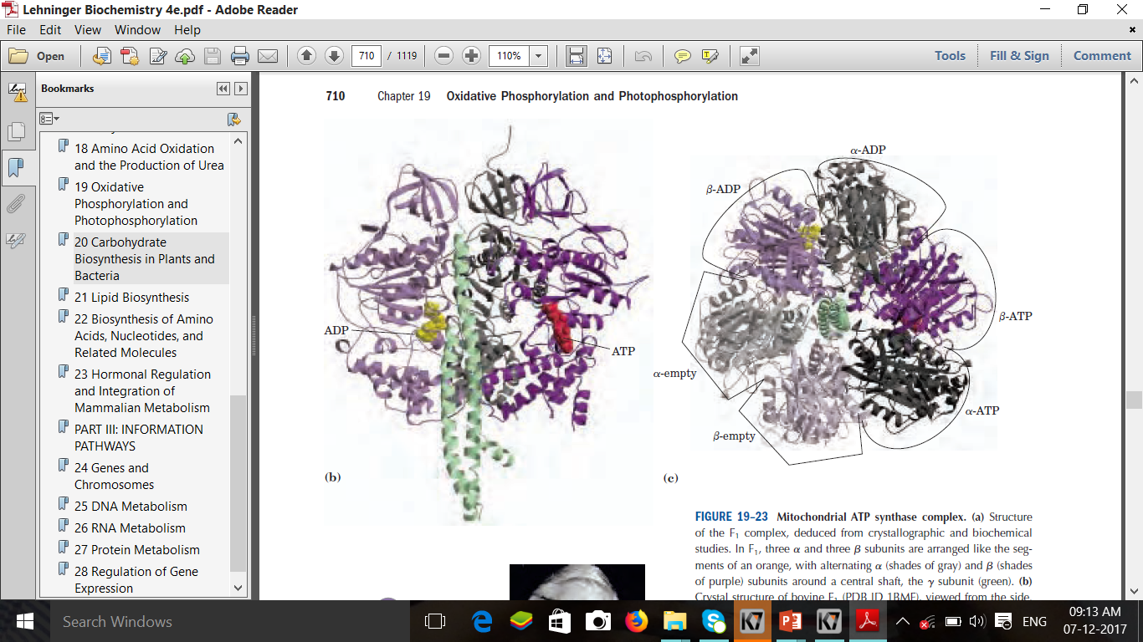

Slide 71
With each rotation of 120, comes into contact with a different subunit, and the contact forces that subunit into the -empty conformation.
The three subunits interact in such a way that when one assumes the -empty conformation, its neighbour to side must assume the -ADP form, and the other neighbor the -ATP form. Thus one complete rotation of the subunit causes each subunit to cycle through all three of its possible conformations, and
for each rotation, three ATP are synthesized and released from the enzyme surface.

Slide 72
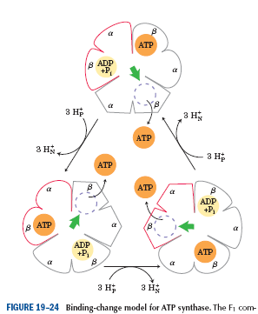
Binding change mechanism
L
T
O

Slide 73
P/O RATIO or P/2e-
The no. of protons pumped out per pair of electrons are 10 H+→ NADH; 6 H+for succinate
No. of H+ required for the synthesis of 1 ATP→ 4
1 H+ is used for transporting Pi
Hence per NADH 10 H+ are pumped out – so 2.5 ATP are synthesized.
For FADH2(complex -II) – 6 H+ are pumped out – 1.5 ATP synthesized
1 NADH → 2.5 ATP (10 H+)
1 FADH2 → 1.5 ATP

Slide 74
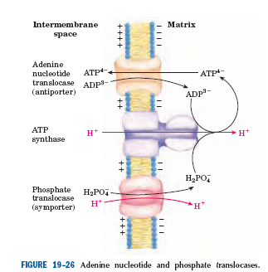
Transporters
The adenine nucleotide translocase is located on the inner mitochondrial membrane
Here there 1:1 exchange of ATP for ADP
It favours outward movement of ATP & inward movement of ADP
The proton motive force creates a more positive charge outside favouring movt of negative charged ATP outside
Phosphate tanslocase- transport of cytosolic PO4 into the matrix along with a proton.
Thus proton motive force provides energy for transport of 2 substrates as well.

Slide 75
Brown adipose tissue
Uncoupling of oxidative phosphorylation

Slide 76
Inhibitors of METC
Oxidative phosphorylation
Aractyloside
Oligomycin
ionophores
Rotenone ,
Barbiturates
Dimercaprol
Cyanide, CO,azide
2,4 DNP
2,4 DNC

Slide 77
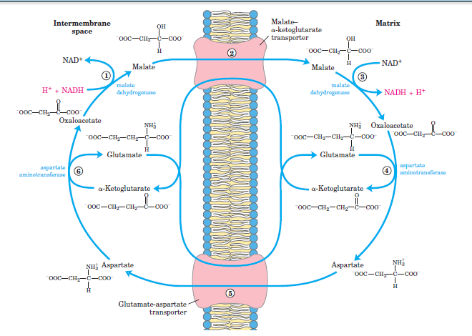
Malate aspartate shuttle
Occurs in liver, kidney & heart mitochondria
2.5 ATPS are produced

Slide 78
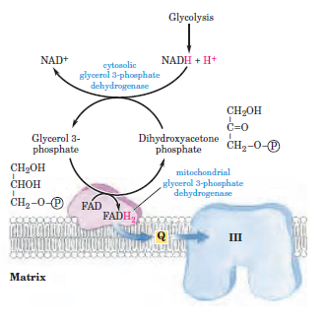
Glycerol 3-PO4 shuttle
Occurs in skeletal muscle and brain
1.5 ATPs are produced

Slide 79
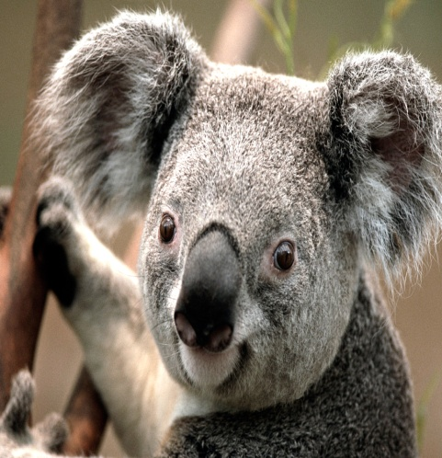
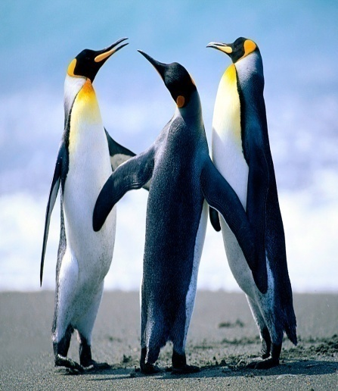
THANK YOU!

