Slide 1
ACID BASE BALANCE
DR.N.E.NANDHINI M.D

Slide 2
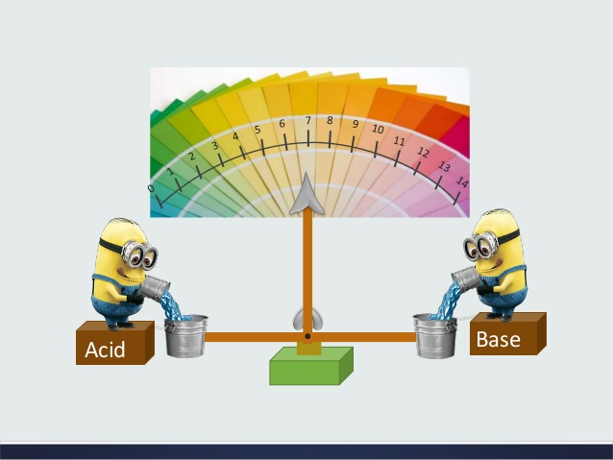

Slide 3
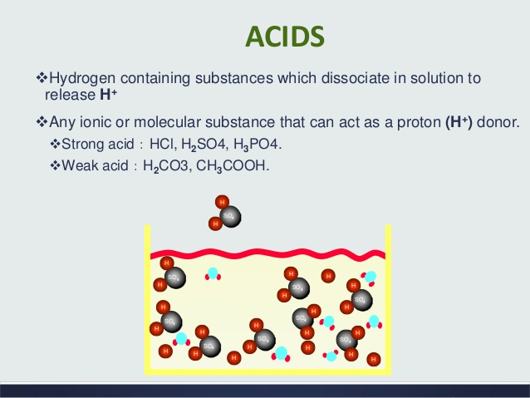
Acids
Hydrogen containing substances which dissociate in solution to release H+ ions.
Any ionic or molecular substance which acts as a hydrogen donor.
Eg – strong acids – HCl, H2SO4,H3PO4
weak acids – H2CO3, CH3COOH

Slide 4
Metabolic sources of acids
Volatile acids – produced during oxidative metabolism of carbohydrates, lipids, proteins.
Excreted through lungs as CO2.
Fixed acids – produced during catabolism of nucleotides, aminoacids, phospholipids.
Present in body fluids.
Excreted through kidneys.

Slide 5
Important acids
Includes ,
carbonic acid
phosphoric acid
pyruvic acid.
lactic acid

Slide 6
Bases
Any molecule or ion that acts as a proton (H+) acceptor.
Eg – strong alkalis – NaOH, KOH
weak alkalis – NaHCO3, CH3COONa

Slide 7
Important alkalis
Bicarbonate (HCO3)
Biphosphate (H2PO4)

Slide 8
Buffers
Buffers are solutions which can resist changes in pH when acid or alkali is added.
Composition
mixtures of weak acid with their salt with a strong base.
mixtures of weak base with their salt with a strong acid.

Slide 9
Buffers
Bicarbonate buffer – H2CO3/NaHCO3 (Carbonic acid and sodium bicarbonate).
Acetate buffer – CH3COOH/CH3COONa ( acetic acid and sodium acetate).
Phosphate buffer – Na2HPO4/NaH2PO4

Slide 10
pH
Defined as negative logarithm of hydrogen ion concentration.
pH = -log[H⁺] = log 1/ [H⁺]
Inversely proportional to acidity.
pH < 7 – acidosis , pH > 7 - alkalosis

Slide 11
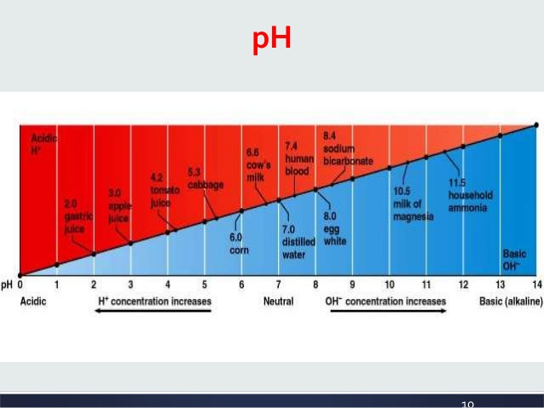

Slide 12
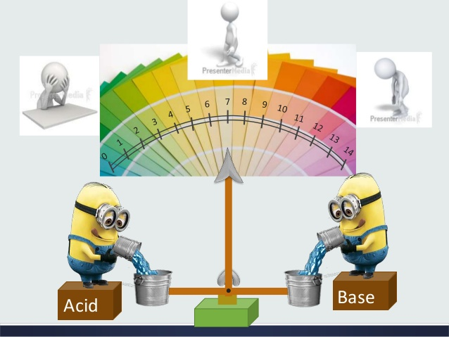

Slide 13
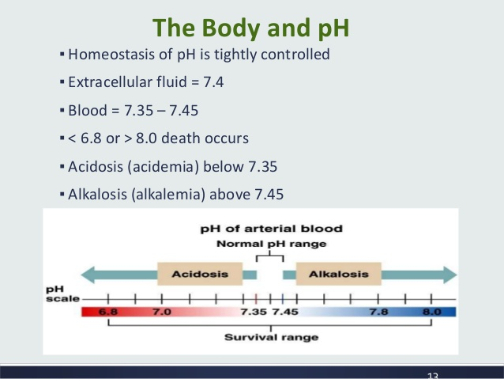
Homeostasis of pH is tightly regulated.
Normal blood pH = 7.35 – 7.45

Slide 14
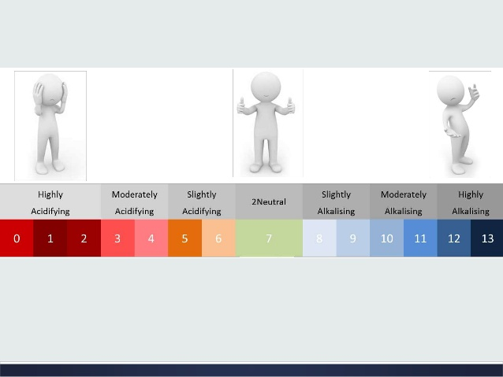

Slide 15
Significance of pH
Enzymes acts in a narrow range of pH.
Alteration of electrolyte activity.
Alteration of proteins and membrane functions.
Affects hormonal activity.

Slide 16
Buffers of body fluids.
Respiratory regulation.
Renal regulation.
Regulation of blood pH

Slide 17
BUFFER SYSTEM

Slide 18
Buffers of body fluids
First line defense mechanism.
Effective a long as the acid load is not excessive and the alkali reserve is not exhausted.
React very rapidly within seconds.
Immediately combine with excess acids or alkalis and restores the normal pH.
No elimination of hydrogen ions.

Slide 19
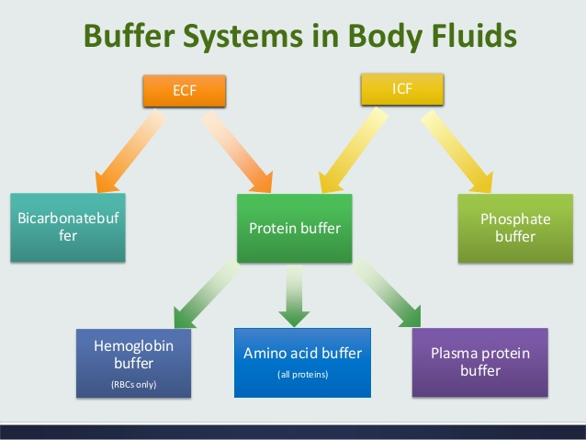

Slide 20
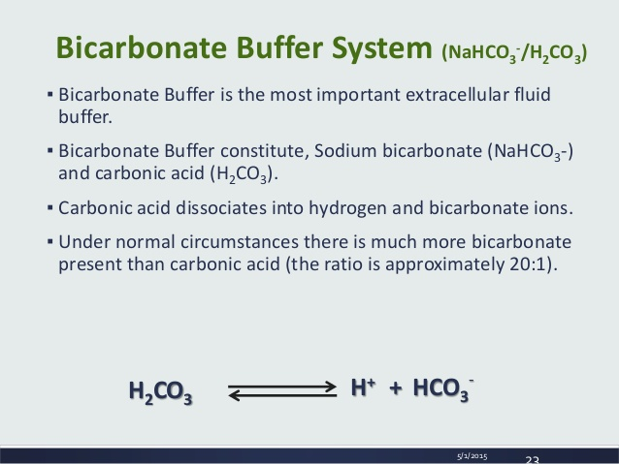

Slide 21
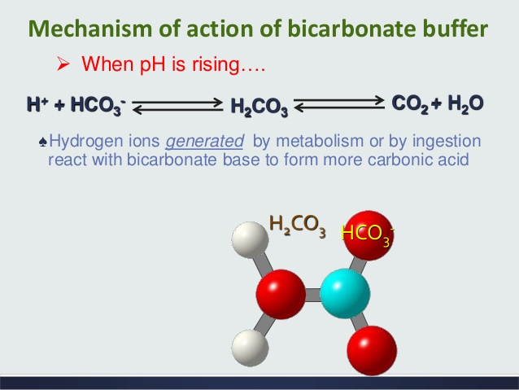

Slide 22
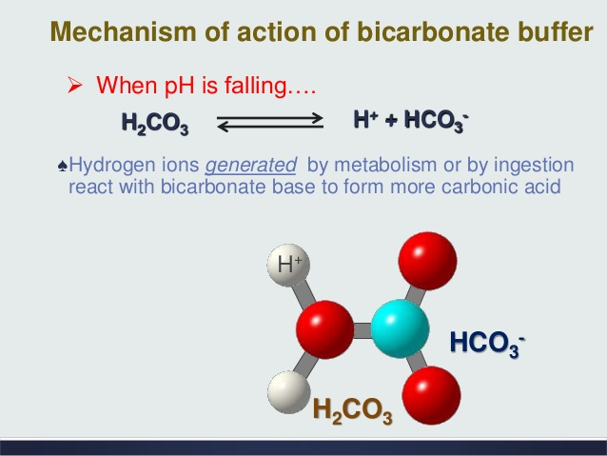

Slide 23
Importance of Bicarbonate buffer
Present in a higher concentration ( 40-50%).
Components are under physiological control.
CO2 by lungs.
bicarbonate by kidneys.

Slide 24
Alkali reserve
Bicarbonate represents the alkali reserve.
Always sufficiently high to meet acid load.
Ratio of HCO3 to H2CO3 – 20:1

Slide 25
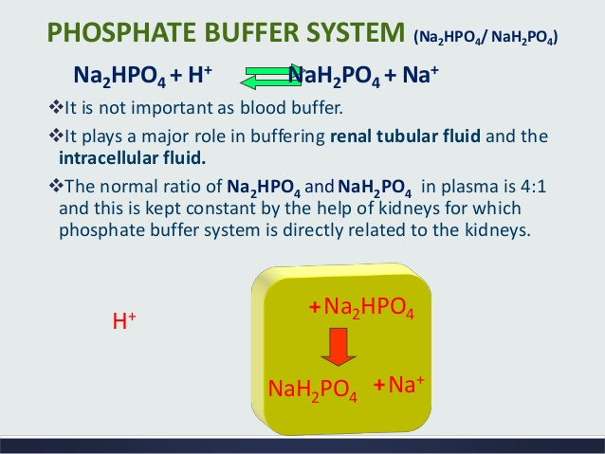

Slide 26
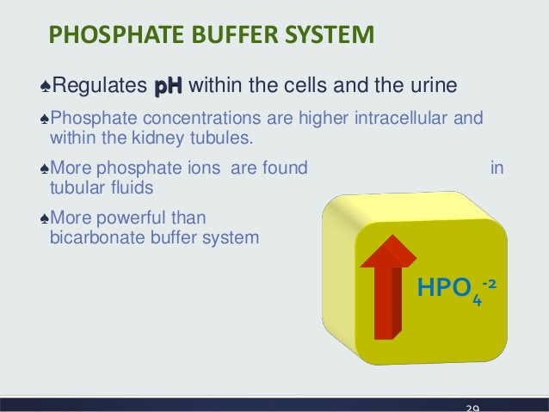

Slide 27
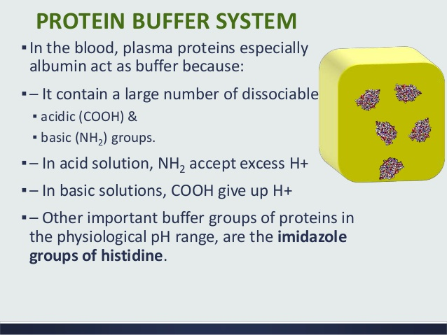

Slide 28
Buffers will act quickly to excess addition of acid or base but they do not eliminate acids from the body and they are unable to replenish the alkali reserve of the body.
So for final elimination of acids – respiratory and renal regulations are needed.

Slide 29
RESPIRATORY REGULATION

Slide 30
Second line defense mechanism.
Achieved by changing the pCO2 by controlling the rate of respiration.
Acidosis – increased respiratory rate – hyperventilation.
Respond to immediate change to pH but doesnot proceed to completion

Slide 31
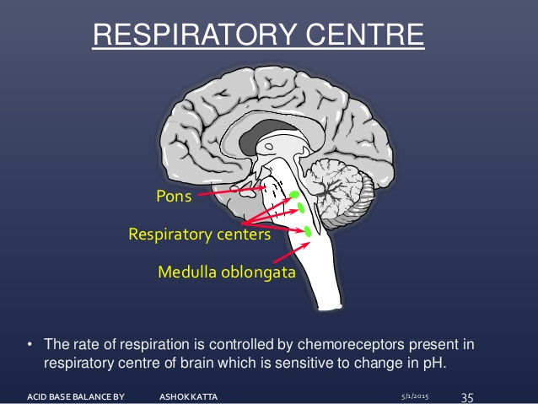

Slide 32
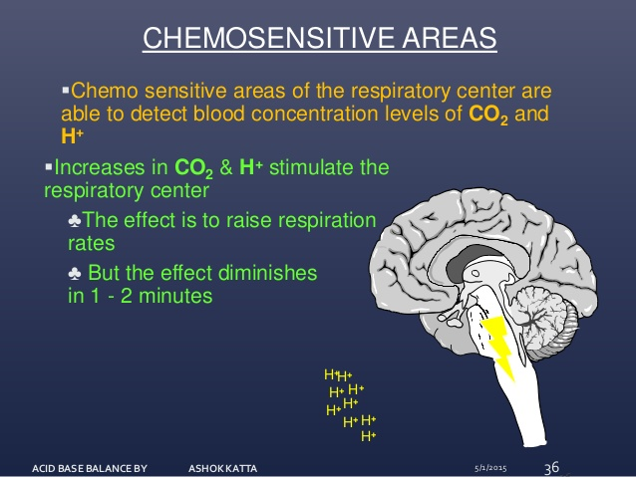

Slide 33
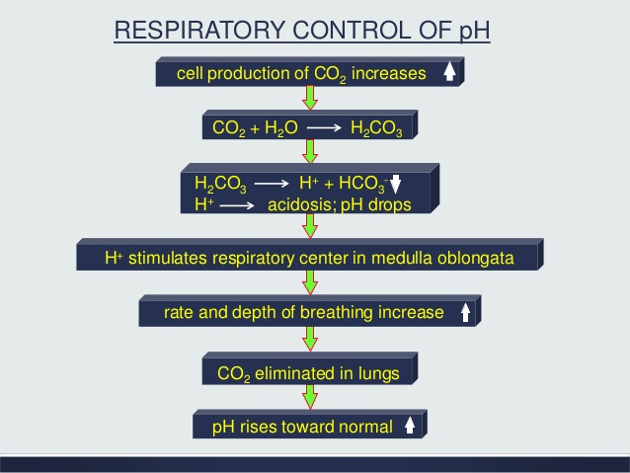

Slide 34
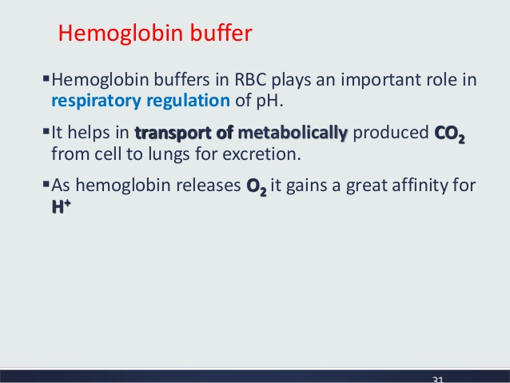

Slide 35
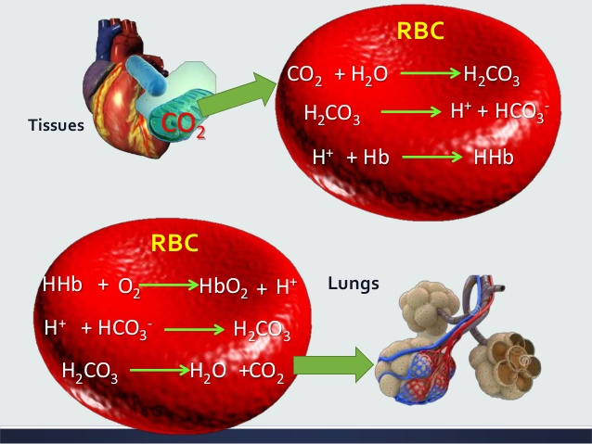

Slide 36
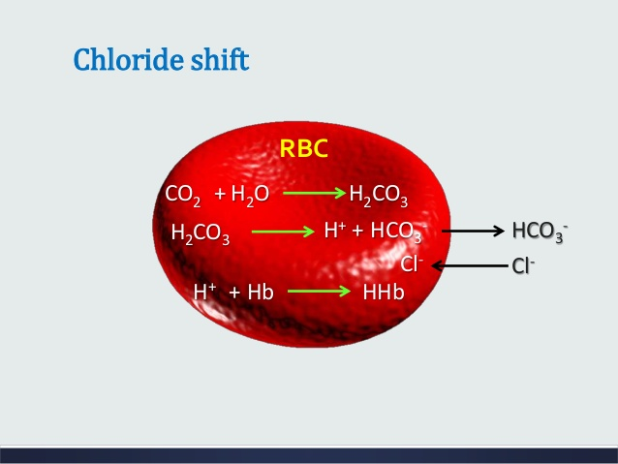

Slide 37
RENAL REGULATION

Slide 38
Kidneys plays a significant role in the regulation of acid base balance.
It maintains the alkali reserve.
Provides a complete solution to acid base disturbance

Slide 39
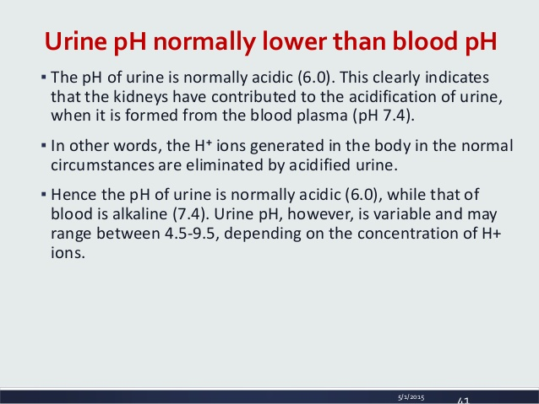

Slide 40
Renal Regulation
Only the kidneys can rid the body of acids generated by cellular metabolism (nonvolatile or fixed acids)
The kidney in response:
  To Acidosis
    Retains bicarbonate ions and eliminates hydrogen ions
  To Alkalosis
    Eliminates bicarbonate ions and retains hydrogen ions

Slide 41
Mechanism of Renal regulation
Excretion of H+ ions / generation of bicarbonate.
Reabsorption of bicarbonate.
Excretion of titratable acid (net acid excretion).
Excretion of ammonium ions.

Slide 42
Excretion of H+ ions
Occurs in proximal convoluted tubules.
There is a net excretion of hydrogen ions and net generation of bicarbonate ions.
So this process will increase the alkali reserve.

Slide 43
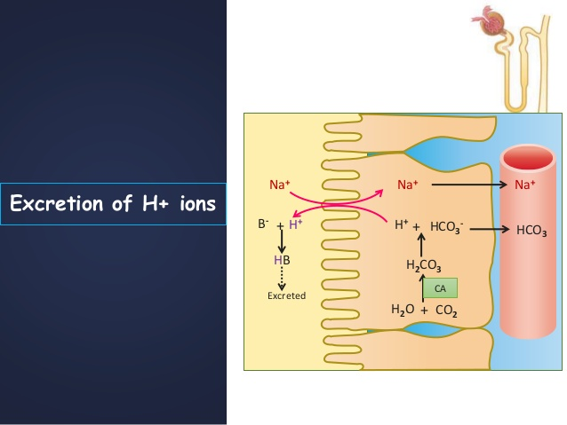
Excretion of H+ ions
Tubular lumen
Tubular cell
Plasma

Slide 44
Reabsorption of bicarbonate.
Mechanism to conserve the alkali reserve.
No excretion of H+ ions or generation of new bicarbonate.
Occurs in proximal convoluted tubules.

Slide 45
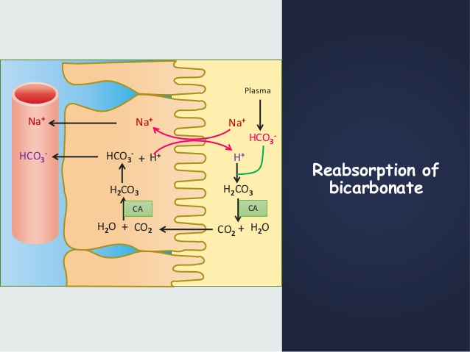
Plasma
Tubular cell
Tubular lumen

Slide 46
Excretion of titratable acid
Occurs in distal convoluted tubules.
Titratable acid – measure of net acid excretion by kidney.
Major titratable acid present in urine – sodium acid phosphate.
Process starts in PCT and continues till DCT.

Slide 47
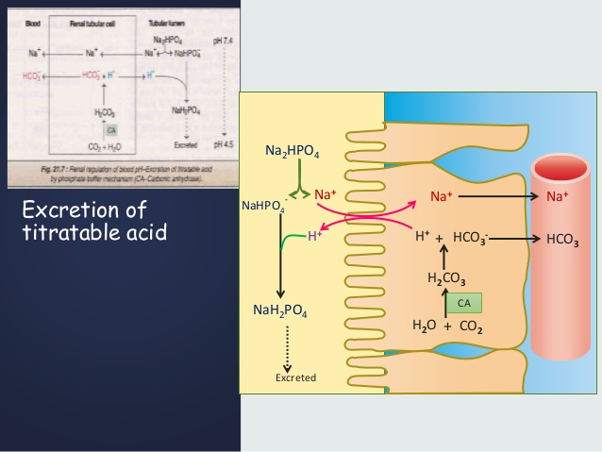
Tubular lumen
Tubular cell
Plasma

Slide 48
Excretion of ammonium ions
Process helps in excretion of hydrogen ions as ammonium ions.
Takes 3-4 days to start its action but has a high capacity to eliminate acids.

Slide 49
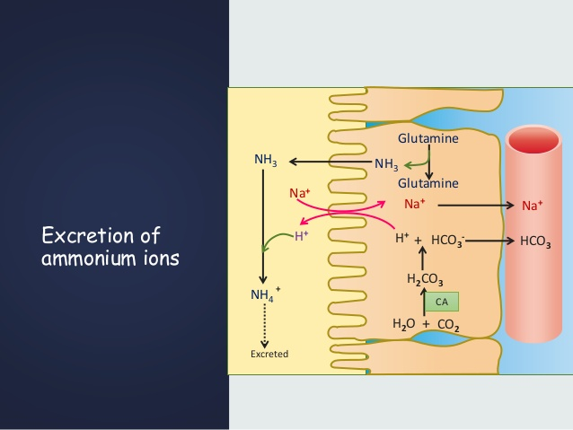
Tubular lumen
Tubular cell
Plasma
GLUTAMINASE
GLUTAMIC ACID

Slide 50
To summarise,
Normal blood pH – 7.35-7.45.
< 7.35 – acidosis, > 7.45 – alkalosis.
Defense mechanisms – blood buffers, respiratory regulation and renal regulation.
Blood buffer – bicarbonate buffer, first to act.
Respiratory regulation – chemoreceptor centre.
Renal regulation – complete regulation.

Slide 51


