Slide 1
Absorption & transport of glucose
Dr.D.Ponnudhali

Slide 2
There are 3 steps in the absorption of carbohydrates
Transport into the intestinal cell from the lumen - SGLT-1 & GLUT 5(fructose).
Transport from the intestinal cell into circulation - GLUT 2.
Transport from the circulation into the peripheral cells - all GLUT receptors.
Reabsorption into the proximal renal tubules- SGLT-2

Slide 3
SGLT RECEPTORS (co-transporter) - Secondary active transport.
GLUT RECEPTORS - FACILITATED DIFFUSION (ping pong mechanism)

Slide 4
Nutrient Absorption - Carbohydrate
Active transport for glucose and galactose
  Sodium-glucose transporter 1 (SGLT1)
  Dependent on Na/K ATPase pump
Facilitated transport for glucose ,fructose

Slide 5
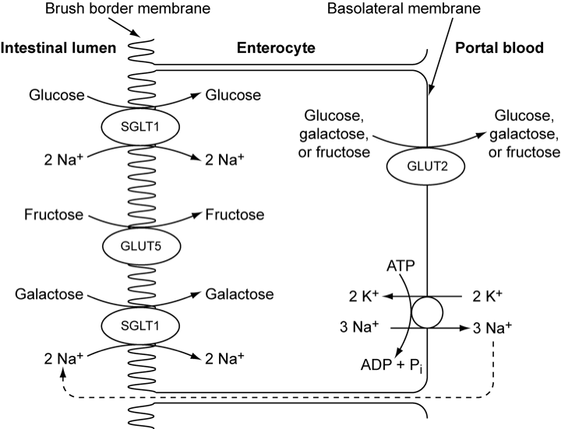

Slide 6
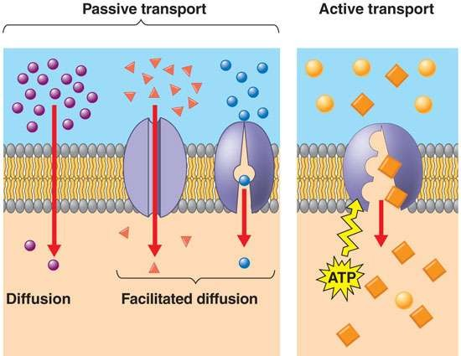
Absorption of carbohydrates
Passive diffusion
Facilitated diffusion/
Carrier mediated
Active transport

Slide 7
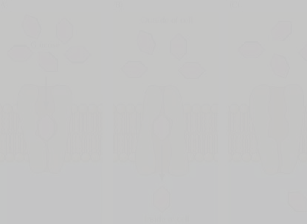

Passive diffusion
Features
Facilitated diffusion
Active transport
Concentration gradient
Down the concentration gradient from high to low.
Down the concentration gradient from high to low.
Against a concentration gradient from low to high
Energy expenditure
none
none
Energy expenditure is in the form of ATP
Carrier protein/ transporter
Not required
required
required
Speed
Slowest mode
Fast
Fastest mode
Note: Glucose is a polar molecule. It cannot pass through lipid bilayer of cell.

Slide 8
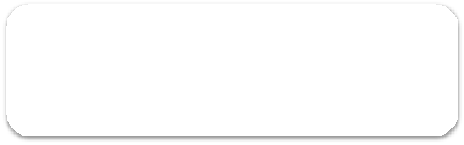




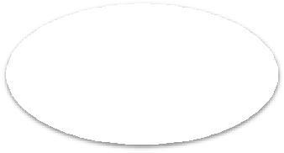
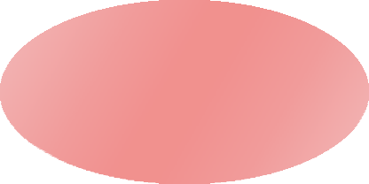
Glucose transporters
Glucose transporters
Na⁺ dependent transporter (Secondary active transport)
2 types
Na⁺ independent transporter
(facilitated diffusion)
Also called
Also called
SGLT
GLT

Slide 9
Na+ dependent transporter
Type of co-transport,
2 binding sites on the transporter, one for Na+ and other for glucose.
Na + binding is important because after Na + binding, conformational changes occurs so that glucose can bind.
Na + is transported across cell membrane, down the concentration gradient and glucose goes against a concentration gradient.
ATP is spent at the level of Na-K ATPase pump to expel Na out.
Both glucose and galactose are absorbed by a sodium- dependent process.
They are carried by the same transport protein (SGLT)

Slide 10
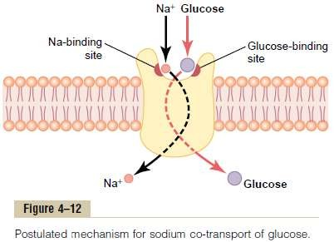

Slide 11
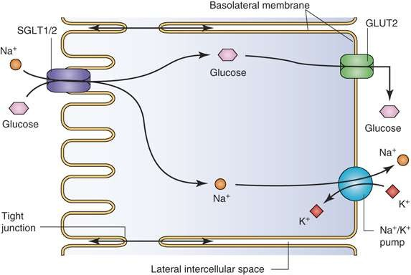

Slide 12
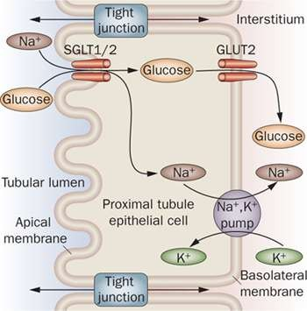
Figure- Showing the co transport of Glucose, mediated by SGLT- 1/2.
SGLT-1 - present on the intestinal cells
SGLT-2 - present on the proximal renal tubular cells.

Slide 13
3 reasons for expulsion of sodium
Na + is osmotically active, causes osmotic flow to cells, leading to osmolysis.
Na + concentration has to be kept minimal to maintain the downward gradient.
Na + is inhibitory to many enzyme actions.

Slide 14
Clinical significance
In deficiency of SGLT- 1, glucose is left unabsorbed and is excreted in faeces. Galactose is also malabsorbed.
In deficiency of SGLT- 2, the filtered glucose is not reabsorbed back, it is lost in urine, causing glycosuria.

Slide 15
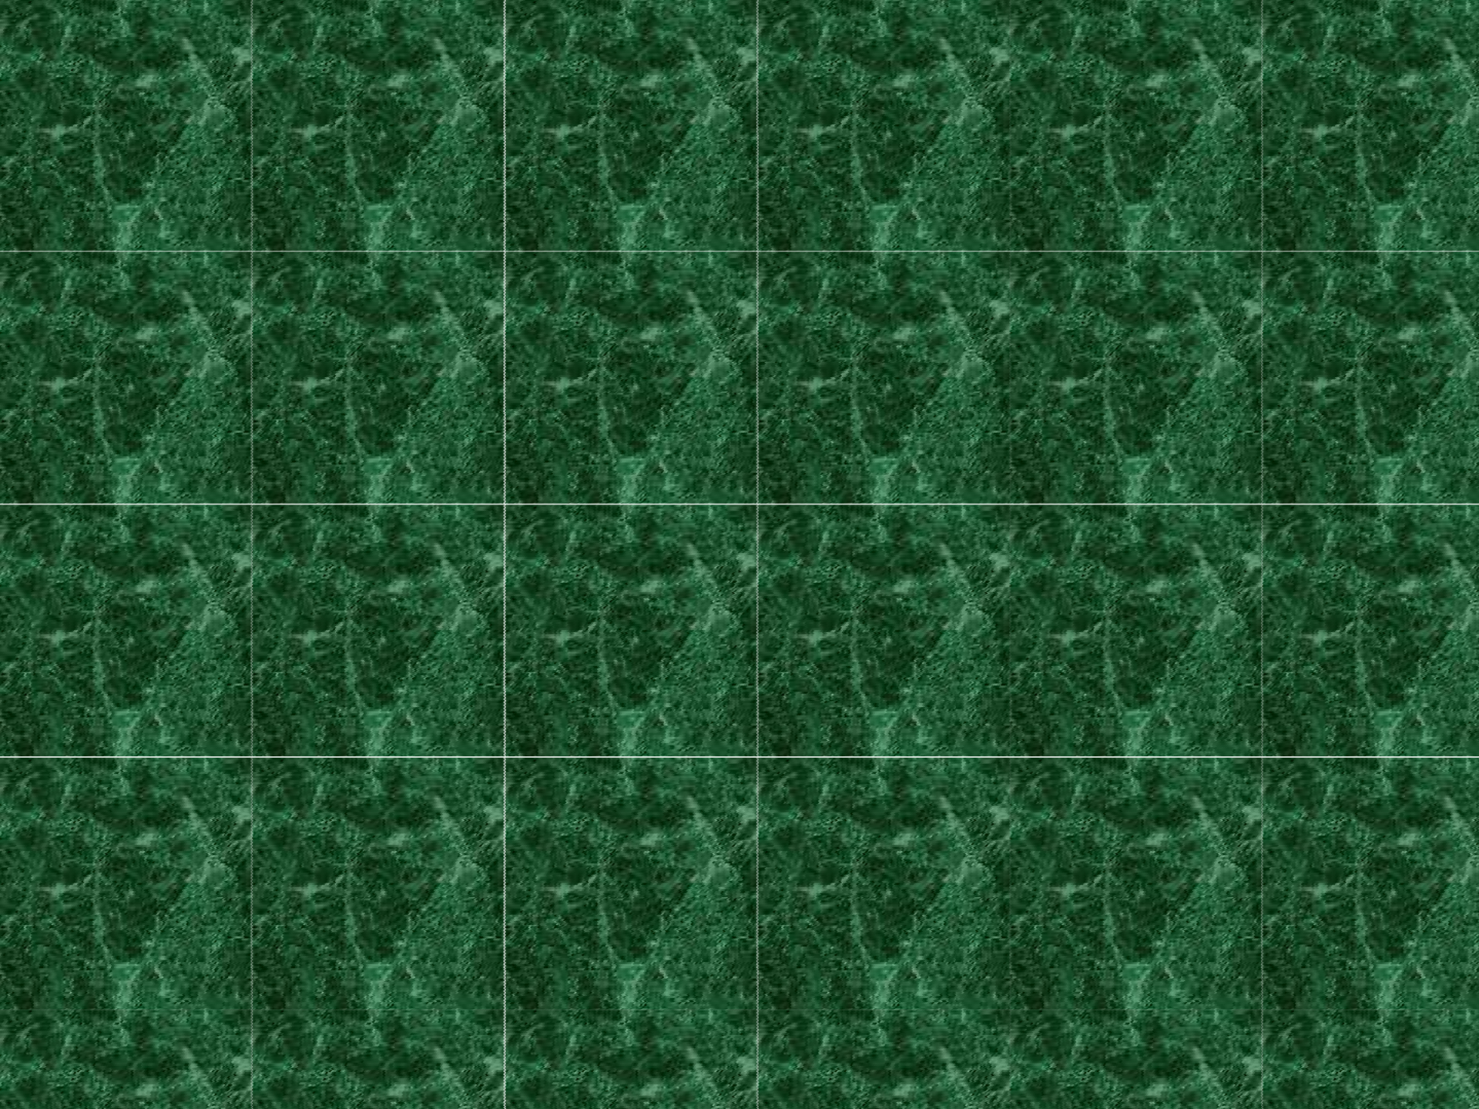

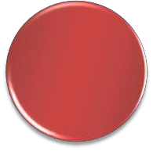


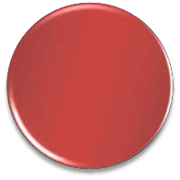


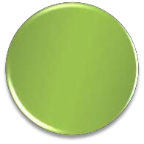


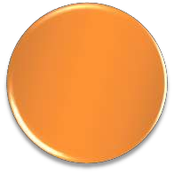
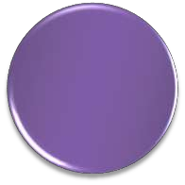

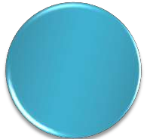

Solvent drag absorption
Downward gradient of Na⁺ releases energy
Energy released is captured for transport of glucose against a conc.
Gradient.
This type of absorption is called solvent drag
Na expelled out through Na-K
ATPase pump.
Energy is consumed at the level of ATP
Water carries dissolved glucose with it
3 sodium are expelled out and 2 K are internalised
The Na removed to paracellular spaces exerts osmotic pressure that causes flow of water to intracellular spaces

Slide 16














Solvent drag is not the main mechanism of glucose absorption but is important after a carbohydrate rich diet.
Absorption of galactose is faster than glucose.
In kidney, reabsorption of filtered glucose takes place by a similar mechanism, i.e, it is also a co-transport with Na. The transporter is SGLT- 2.
In intestine, it is SGLT- 1.

Slide 17
Glucose transport into peripheral tissues
- Facilitated diffusion

Slide 18
Na⁺ independent transporters
Used for facilitated transport.
These transporters are numbered from GLUT - 1 to 14
In the intestine, GLUT 2 are present towards the serosal surface of intestinal epithelial cells and GLUT 5 are present towards the luminal surface.

Slide 19
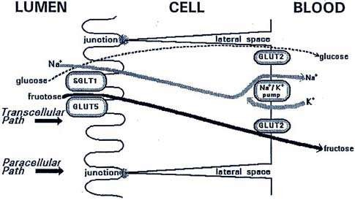
Location of GLUT 2 and GLUT 5 in intestine

Slide 20
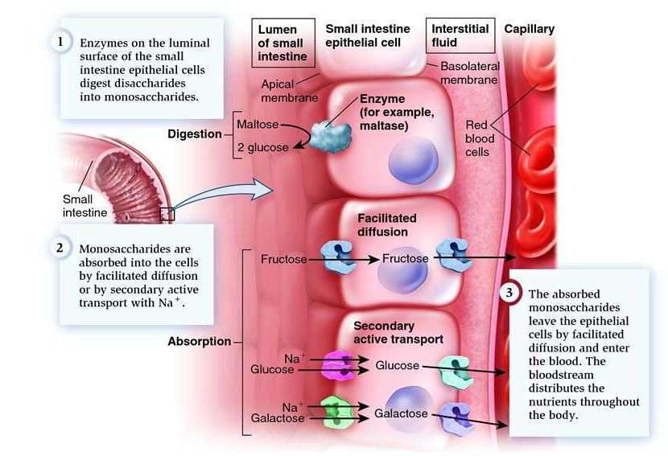
Diagram showing absorption of monosaccharides

Slide 21
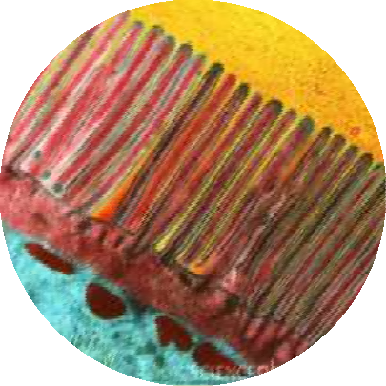
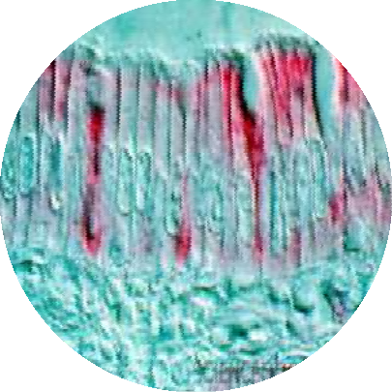
Purpose of GLUT 5 and GLUT 2
> For the transportation of fructose.(least affinity for glucose).
>Fructose is mainly transported by
facilitated diffusion.
>By GLUT 5, fructose moves down the gradient and the process is faster than passive diffusion.
>Energy is not consumed.
Mainly responsible for pouring all the absorbed glucose into blood.
GLUT 2 transporter transports all absorbed glucose to blood.
down aconcentration gradient.
Transporter is present but there is no energy expenditure.
Pentoses are absorbed by passive diffusion which is a very slow process.

Slide 22
Factors affecting rate of absorption of Monosaccharides
The absorption is faster through intact mucosa. The absorption is decreased if there is some inflammation or injury to the mucosa.
Thyroid hormones ↑ rate of absorption of glucose.
Mineralocorticoid,(i.e) Aldosterone ↑ rate of absorption.
Vitamin B6,B12, pantothenic acid, folic acid are required for absorption of glucose.
With advancing age, rate of absorption declines.
Note: Insulin has no role in the absorption of monosaccharide like glucose.

Slide 23
Glucose transporters
Concentration-driven transport
Five proteins with high degree of homology are involved: GLUT Family
Special physiological functions and tissue distribution.
Transport proteins mediate facilitated transport only, that is, they can only transport glucose (or fructose) from areas of high concentration to areas of lower concentration.

Slide 24
GLUCOSE TRASNPORTERS
Concentration-driven transport
Five proteins with a high degree of homology are involved: GLUT Family
Special physiological functions and tissue distribution.
Transport proteins mediate facilitated transport only, that is, they can only transport glucose (or fructose) from areas of high concentration to areas of lower concentration.

Slide 25
Sugar is bound by the
protein
A ping-pong mechanism reverses the membrane direction of the
sugar- protein complex
Sugar is released and the protein flips around once more to initiate a new cycle

Slide 26
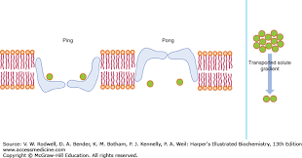

Slide 27
In most tissues the internal glucose concentration is quite low; transport can only proceed from the extracellular area into the cell.
In gluconeogenetic tissues (liver and kidney), intracellular glucose concentration can exceed blood glucose concentration in the post-absorptive or fasting states.

Slide 28
Glucose Transporters- facilitated diffusion
Glucose transporters are integral membrane glycoproteins
Molecular masses - 50,000 daltons, each has 12 membrane- spanning α-helical domains.
Transporter exposes a single substrate binding site toward either the outside/inside of the cell.
Binding of glucose to one site provokes a conformational change associated with transport, and releases glucose to the other side of the membrane.

Slide 29
Transporter | Tissue distribution | Special properties
GLUT 1 | Most cellS | Helps in basal glucose uptake
GLUT 2 | Liver, beta cells, hypothalamus, Baso-lateral membrane small intestine. | Carrier for glucose and fructose in liver and intestine
GLUT 3 | Neurons, placenta, testes, brain | Basal glucose uptake
GLUT 4 | Skeletal and cardiac muscle, fat | Activity ↑ by insulin
GLUT 5 | Mucosal surface in small intestine, sperm, kidneys | Involved in fructose transport

Slide 30
Regulation of Glucose Transport
Glucose enters cells by facilitated diffusion.
GLUT transporters - Na⁺-independent facilitated diffusion of glucose (co-transport system) into cells.
Insulin stimulates glucose transport by promoting translocation of intracellular vesicles that contain the GLUT4 and GLUT1 glucose transporters to the plasma membrane.
This effect is reversible.

Slide 31
Insulin interacts with the receptors
Glucose transporters stored in the vesicles move to the surface
Fuse with the Plasma membrane Increase in the no. of glucose
transporter in the Plasma Membrane
Inflow of glucose

Slide 32
Insulin level drops → glucose transporters are removed from the PM by endocytosis and stored in vesicles.
Faulty regulation: Type 2 Diabetes Mellitus

Slide 35
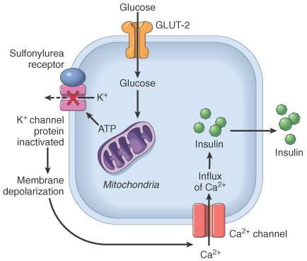
Metabolic actions of insulin in striated muscle, adipose tissue, and liver

Slide 36
Tissue specific glucose transporter | Tissue distribution | Functions | Clinical significance
GLUT-1 | Present in almost all | Na-independent | Cancer cells express
(great affinity for | cells with an |  | high level of GLUT-1,
glucose) | abundance in RBC. |  | so they can
 |  |  | internalize more of
 |  |  | glucose, which is
 |  |  | used as a source of
 |  |  | energy for rapidly
 |  |  | dividing cells.
GLUT-2 | Present in intestine, | Releases insulin by | Diabetes Mellitus.
(low affinity for | liver and pancreas. | movement of glucose
glucose, it can |  | into β-cells of
transport only when |  | pancreas.
there is glucose load |  | (Acts as a sensor for
in the body) |  | the release of insulin
 |  | by pancreas.)
 |  | Promotes uptake of
 |  | glucose in liver cells,
 |  | lowering down blood
 |  | glucose.

Slide 37
GLUT 3 | Brain cells, all other cells of body |  | Cancer cells express high level of GLUT- 3, so they can internalize more of glucose, which is used as a source of energy for rapidly dividing cells
GLUT 4 | Adipose tissue, | The only
 | skeletal muscles, | transporters which
 | cardiac muscles | are under the
 |  | influence of insulin.
 |  | Insulin promotes
 |  | uptake of glucose in
 |  | the tissues by
 |  | mobilizing the
 |  | transporters to the
 |  | cell surface
 |  | whenever there is
 |  | high glucose
 |  | concentration in the
 |  | blood.

Slide 38
Mainly for the transport of fructose
GLUT 5
(least affinity for
glucose)
Intestine at the luminal surface, testicles, seminal vesicles
GLUT 6
Non-functional transporter product of a pseudogene.
No role in absorption of glucose in peripheral cells.
Transportation of glucose across the membrane of endoplasmic reticulum.
GLUT 7
Surface of endoplasmic reticulum
SGLT 1
Kidney, intestine
For the absorption of glucose.
In cases where SGLT 1 is deficient, glucose is left unabsorbed and is excreted in faeces.
SGLT 2
Kidney
For the re-absorption of glucose.
If deficient, filtered glucose is not re- absorbed and is lost in urine.

