Slide 1
Hexose monophosphate pathway Dr Sudha

Slide 2
OBJECTIVES
To understand the functions of the pentose phosphate pathway
To examine the importance of products in HMP pathway
To relate defects in the pentose phosphate pathway to disease conditions.
Notes:
In cells against highly reactive oxygen species. production of NADPH and ribose precursors for nucleic acid synthesis.

Slide 3
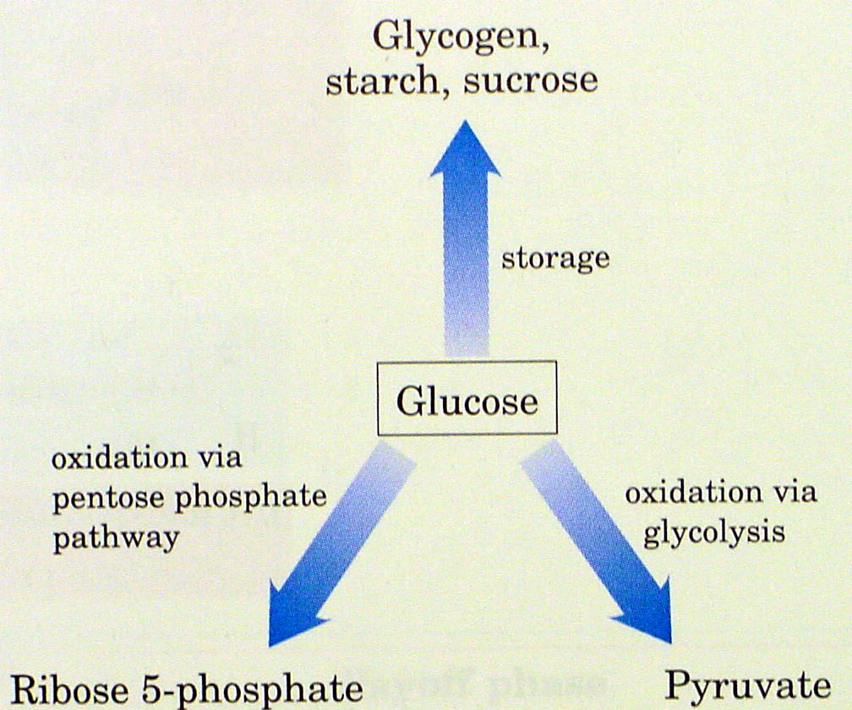
Fates of glucose
Notes:
The pentose phosphate pathway is an alternate route for the oxidation of glucose.

Slide 4
Also known as
Phosphogluconate Pathway
Pentose Cycle/ Shunt
Hexose Monophosphate Pathway or Shunt
Warburg-Dickens-Lipman Pathway
Direct oxidative pathway

Slide 5
Why?
Glucose shunted through this pathway – Shunt
Only monophosphates – HMP
Intermediate formation of Pentose phosphates – Pentose pathway

Slide 6

The pentose pathway is a shunt.
The pathway begins with the glycolytic intermediate glucose 6-Phosphate.
It reconnects with glycolysis because two of the end products of the pentose pathway are glyceraldehyde 3-P and fructose 6-P

Slide 7
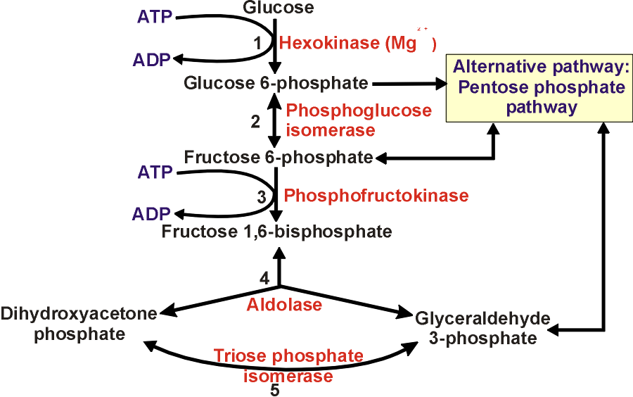
It’s a shunt

Slide 8
Unique pathway
10% of glucose molecules per day
Generation of - NADPH for synthesis of Fatty acids & Steroids - Pentoses For Nucleotide & Nucleic acids

Slide 9
What does the pentose phosphate pathway achieve?
Yields reducing potential in the form of NADPH to be used in anabolic reactions requiring electrons.
Yields ribose 5-phosphate.
Nucleotide biosynthesis leading to:
DNA
RNA
Various cofactors (CoA, FAD, SAM, NAD⁺/NADP⁺).

Slide 10
Location
Cytosol
Highly active tissues - Liver & Adipose tissue - Adrenal gland - Erythrocytes - Testes & - Lactating mammary gland
Low in nonlacting mammary gland, skeletal muscle

Slide 11
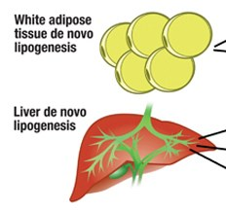
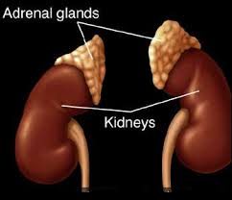
NADPH – Reductive biosynthesis
Fatty acids
Steroids
Amino acids via glutamate dehydrogenase
Reduced glutathione

Slide 12
Ribose – Virtually all tissues
For nucleotide and nucleic acid synthesis
Capable of synthesizing ribose 5-P by reversal of the nonoxidative phase

Slide 13
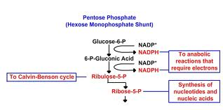

Slide 14
Overview of HMP shunt - Phases
Oxidative - Non reversible - Generates NADPH (2 mol.), Pentose(1), CO₂ (1)
Non oxidative - Reversible - Generates Ribose → Intermediates of Glycolysis

Slide 15
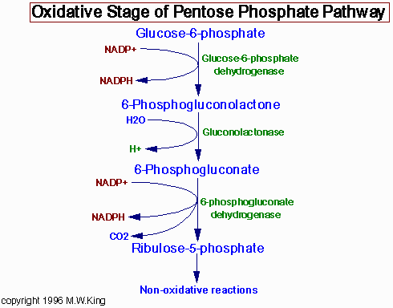
Oxidation
Regulatory enzyme
Hydrolysis
Oxidation
Decarboxylation
5 carbon atoms
Notes:
Hydrolysis
Oxidation
Decarboxylation

Slide 16
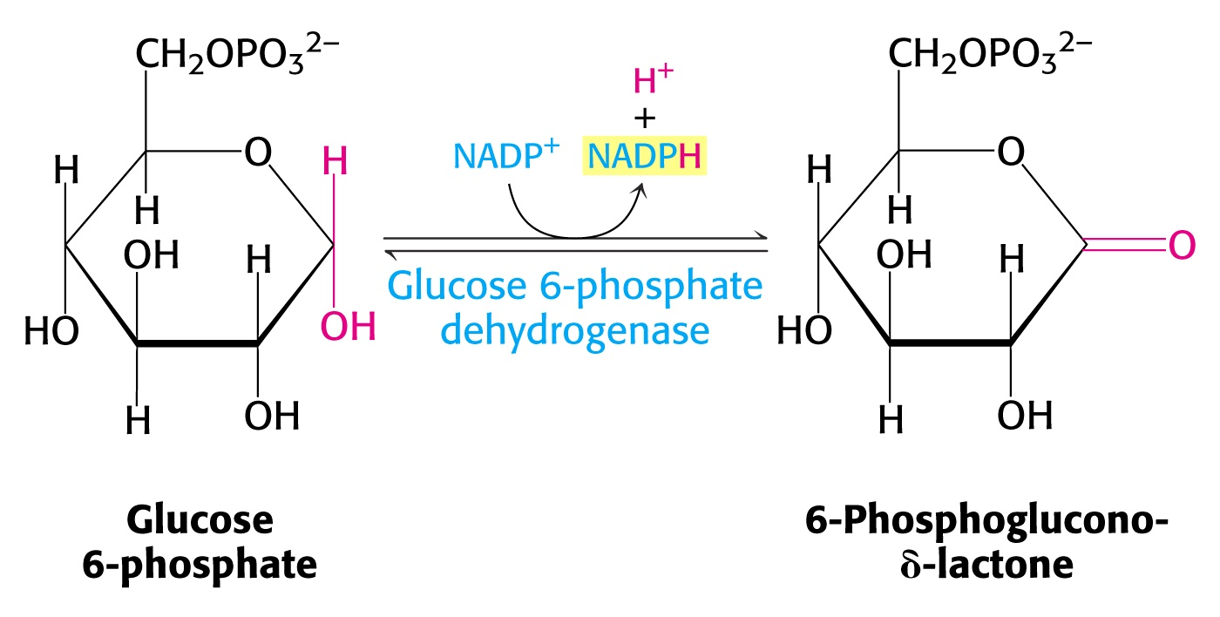
Regulatory enzyme
The enzyme is highly specific for NADP⁺; the K_{m} for NAD⁺ is 1000 greater than for NADP⁺.

Slide 17
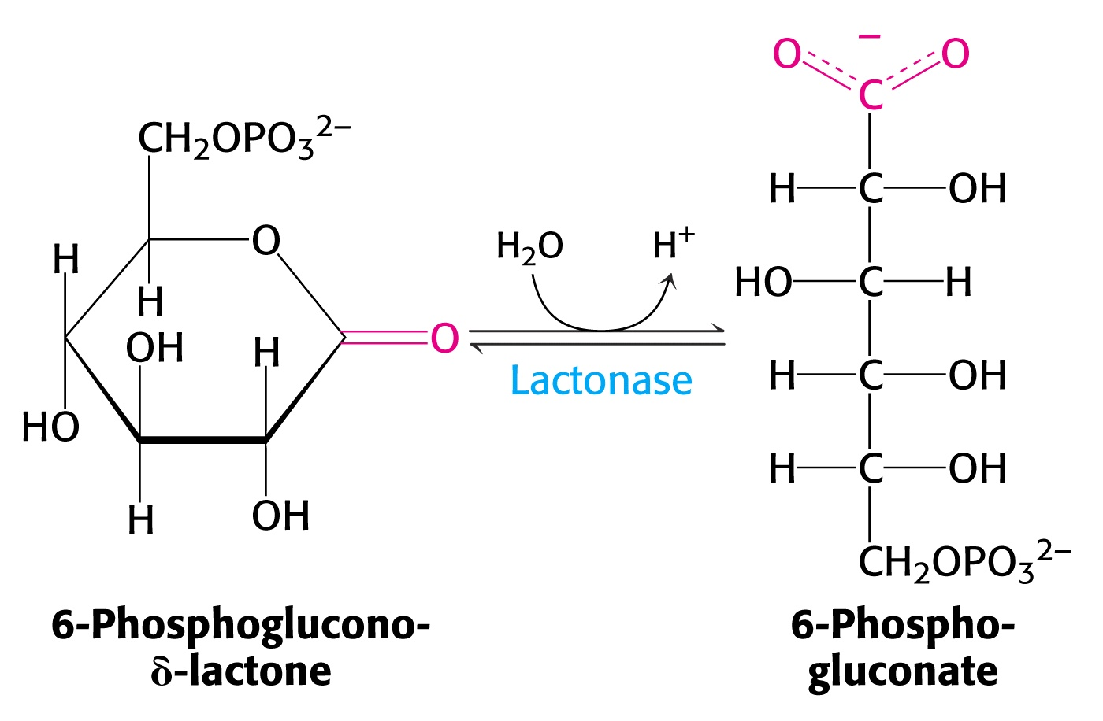

Slide 18
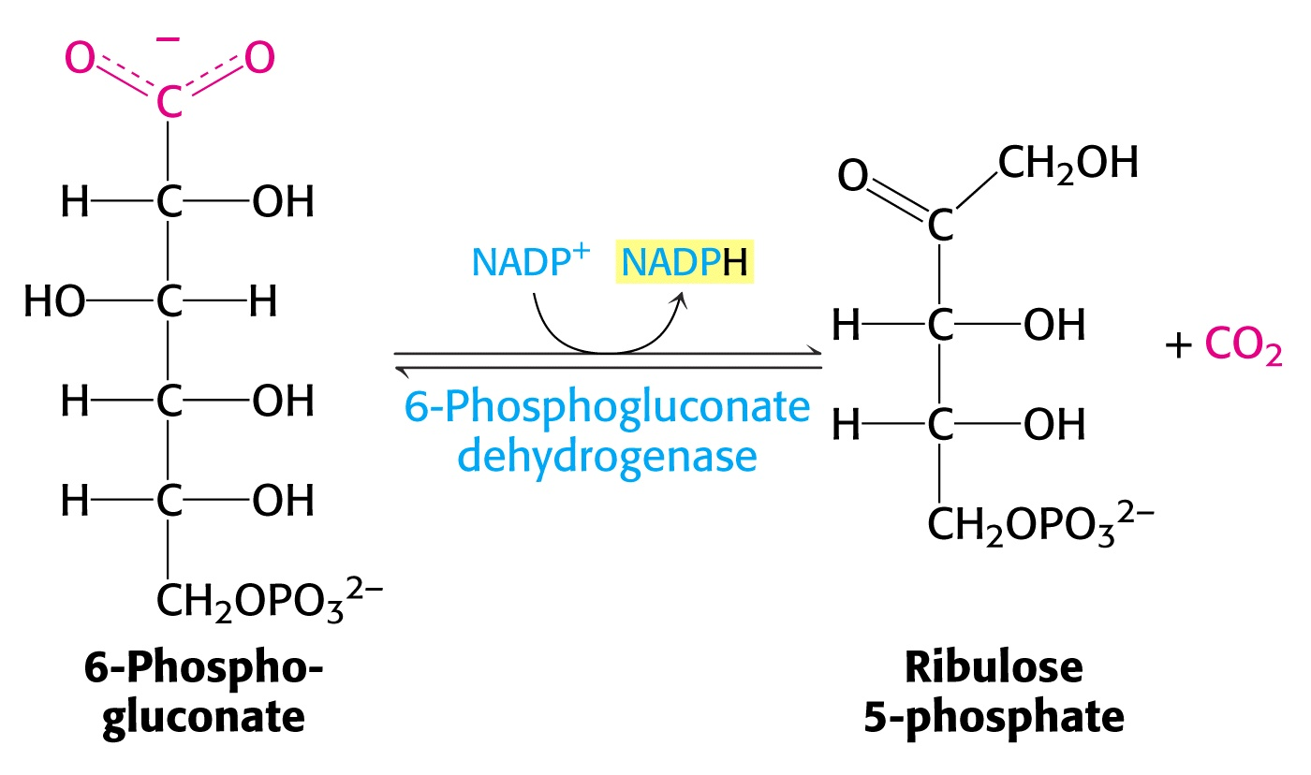

Slide 19
Non-oxidative phase
Interconversion of 3, 4, 5 & 7 carbon monosaccharides
Ribulose 5-phosphate – Substrate for 2 enzymes
Isomerization &
Epimerization

Slide 20
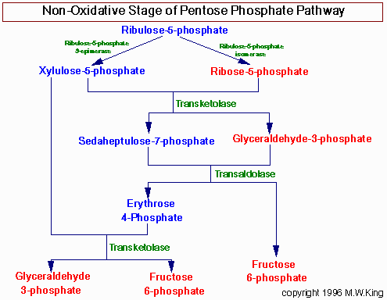

Slide 21
Transketolase
Transfers 2-carbon units from xylulose to ribose to form a 7 carbon sugar & a 3C sugar
Ketose (Donor) → Aldose (Acceptor)
Dependent on Mg++ & Thiamin
pyrophosphate (TPP)

Slide 22
Transaldolase
Transfer of a three carbon (Carbons 1,2,3) from sedoheptulose (ketose) to Glyceraldehyde 3-P (aldose) to form Fructose 6-P.
Ketose (Donor) → Aldose (Acceptor)

Slide 23
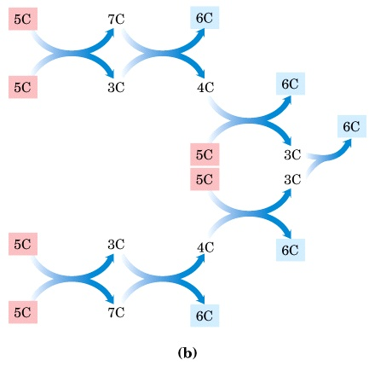

Slide 24
C₅ + C₅ → C₃ + C₇ (Transketolase)
C₃ + C₇ → C₆ + C₄ (Transaldolase)
C₅ + C₄ → C₆ + C₃ (Transketolase)
____________________________
3 C₅ → 2 C₆ + C₃ (Overall)

Slide 25
To summarize
6 molecules of glucose
→ 6 CO₂ eliminated
→ 5 Glucose are regenerated
→ 12 NADPH generated
→ 1 glucose is completely oxidized

Slide 26
Regulation
Glucose 6-phosphate DH is the regulatory enzyme.
Based on the requirement
Oxidative pathway
Ratio NADPH/NADP⁺ .
NADPH is a potent competitive inhibitor of the enzyme.

Slide 27
Non-oxidative portion:
Readily reversible.
Depending on the metabolic needs of a particular cell or tissue.

Slide 28
Catabolic pathways of Glucose have little in common
Oxidation utilizes NADP rather than NAD
CO2 – Characteristic product
No ATP generation

Slide 29
Different from Glycolysis
glycolysis
Hmp SHunt
Starts with Glucose
ATP
NAD+
Catabolic
No CO₂
Glucose-6- P
No ATP
NADP+
More anabolic
CO₂

Slide 30
Significance
Significance
PHYSIOLOGICAL
CLINICAL

Slide 31
Physiological significance
Reductive biosynthesis
Free radical scavenging
RBC membrane integrity
Prevention of formation of met-Hb

Slide 32
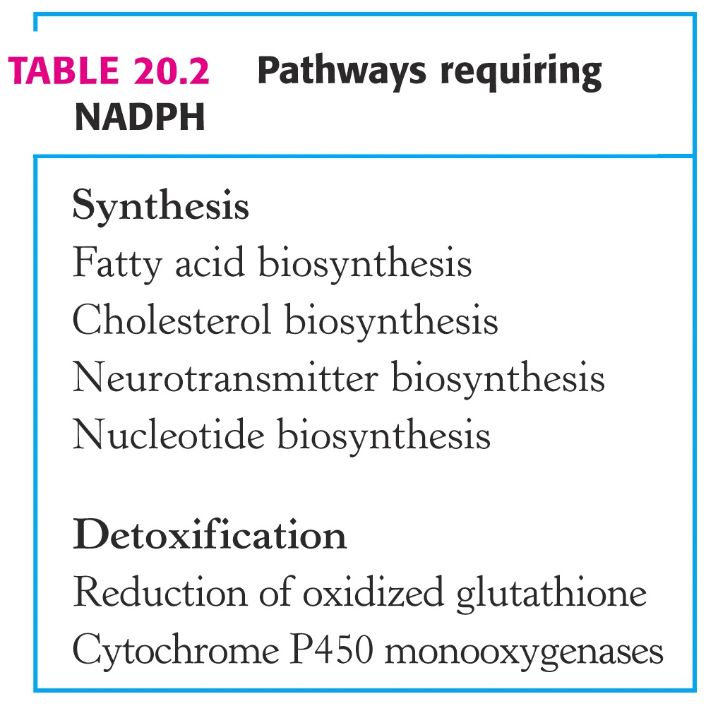
Notes:
In general, with some exceptions, NADH is used to drive the phosphorylation of ADP to ATP. NADPH is used where reducing potential is required for synthetic reactions.

Slide 33
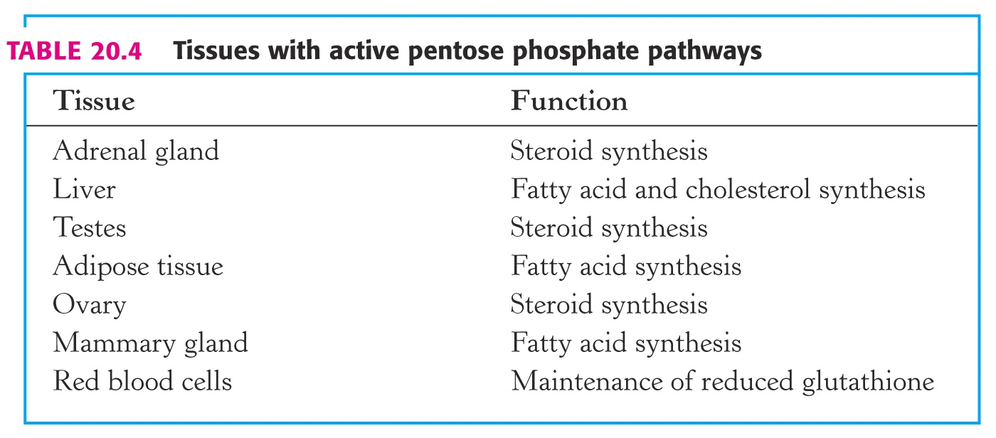

Slide 34
Physiological significance
Reductive biosynthesis
Free radical scavenging
RBC membrane integrity
Prevention of Met-Hemoglobinemia

Slide 35
Free radical scavenging
Super oxide, hydrogen peroxide – all cells
Destroys DNA, proteins, all biomolecules
Free radicals inactivated by - Superoxide dismutase (SOD) - Peroxidase (POD) - Glutathione reductase (GR)

Slide 36
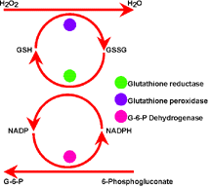
POD
GR
G6PD
Notes:
GR
POD
G6PD

Slide 37
Physiological significance
Reductive biosynthesis
Free radical scavenging
RBC membrane integrity
Prevention of Met-Hemoglobinemia

Slide 38
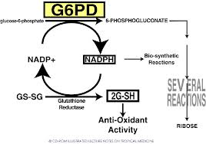
RBC membrane integrity
NADPH, Glutathione & Glutathione reductase together preserves RBC membrane

Slide 39
Significance
Detoxification - Liver microsomal p450 enzymes
Transparency of lens of eye - Maximum concentration in lens
Macrophage bactericidal activity - Production of ROS to kill bacteria
Availability of Ribose

Slide 40
Clinical significance
So, what happens if glucose 6-phosphate DH is defective?
Insufficient production of NADPH.
Which translates into insufficient glutathione.
Is this a medical problem?
YES
Notes:
GSH is extremely important particularly in the highly oxidizing environment of the red blood cell.
Mature RBCs have no mitochondria and are totally dependent on NADPH from the pentose phosphate pathway to regenerate GSH from GSSG via glutathione reductase.
In fact, as much as 10% of glucose consumption, by erythrocytes, is mediated by the pentose pathway.
The reduced form of glutathione serves as a sulfhydryl buffer.
It maintains cysteine residues in hemoglobin and other proteins in a reduced state.
GSH is essential for normal RBC structure and keeping hemoglobin in Fe⁺⁺ state.
Reduced glutathione also detoxifies peroxides.
2GSH + ROOH → GSSG + H₂O + ROH
Cells with low levels of GSH are susceptible hemolysis.
Individuals with reduced GSH are subject to hemolysis.
This is often clinically seen as black urine under certain conditions.

Slide 41
Clinical aspects
G6-PD deficiency
→ Drug induced hemolytic anemia
Met-hemoglobinemia
Thiamine deficiency → Reduced transketolase activity

Slide 42
Glucose-6-phosphate dehydrogenase deficiency causes hemolytic anemia
Deficiency of G6PD → Impairment of NADPH production.
Detoxification of H₂O₂ is inhibited, → Erythrocyte membrane breakdown and Hemolytic anemia.
Notes:
Mutations present in some populations causes a deficiency in glucose 6-phosphate dehydrogenase, with consequent impairment of NADPH production.
Detoxification of H₂O₂ is inhibited, and cellular damage results - lipid peroxidation leads to erythrocyte membrane breakdown and hemolytic anemia.
Most G6PD-deficient individuals are asymptomatic - only in combination with certain environmental factors (sulfa antibiotics, herbicides, antimalarials, *divicine) do clinical manifestations occur.
*toxic ingredient of fava beans

Slide 43
Oxidant drugs/ Toxins
Mostly asymptomatic - only in combination with certain environmental factors (sulfa antibiotics, herbicides, antimalarials, divicine) do clinical manifestations occur.
*toxic ingredient of fava beans

Slide 44
Wernicke-Korsakoff syndrome
Genetic disorder
Alteration in transketolase activity
→ Reduces affinity with thiamine pyrophosphate
Symptoms - Mental disorder - Loss of memory - Partial paralysis

Slide 45
Case Study
21 yr male medical student with malaria
Treated with primaquine
Four days later:
Black colored urine
Low RBC count
Elevated reticulocyte count
RBC with Heinz bodies
Low hemoglobin
Elevated serum bilirubin
Pt recovered in a few days

Slide 46


