Slide 1
Dr.Priya.K.Dhas
INSTRUMENTS
Colorimeter
Spectrophotometer

Slide 2
Objectives
Colorimetry
Principle
Application
Components and its uses
Laws
Steps to prepare a solution for measurement

Slide 3
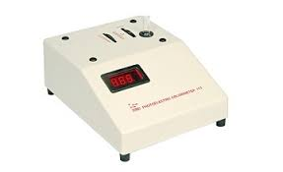
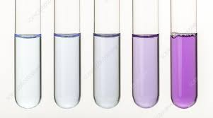
Colorimetry- Introduction
Techniques frequently used in biochemical investigations.
Quantitative estimation of coloured substances.

Slide 4
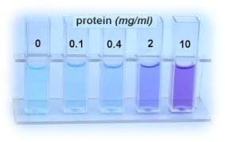
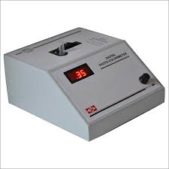
The difference in color results in the
difference in the absorption of light, which is
made use of here in this technique called
colorimetry.

Slide 5
Application
Estimation of biochemical compounds
In biological fliuds – plasma, serum CSF, blood , urine
Glucose, urea, creatinine

Slide 6
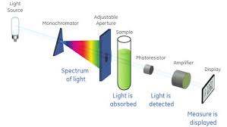
Principle
Light passes through coloured solution
Specific wavelength of light is absorbed
Based on colour intensity

Slide 7
Principle
passes through coloured solution
Specific wavelength of light is absorbed
Colour intensity
Colour intensity directly proportional to the concentration of the substance

Slide 8
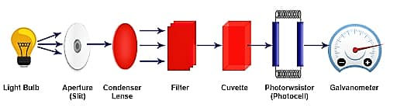
Components of colorimeter
A lamp(light source)
Adjustable slit
Condensing lense
Filter
Cuvette (sample holder)
Photodetector
Galvanometer

Slide 9
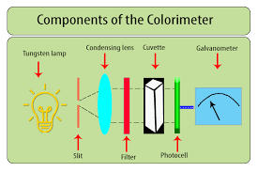

Slide 10
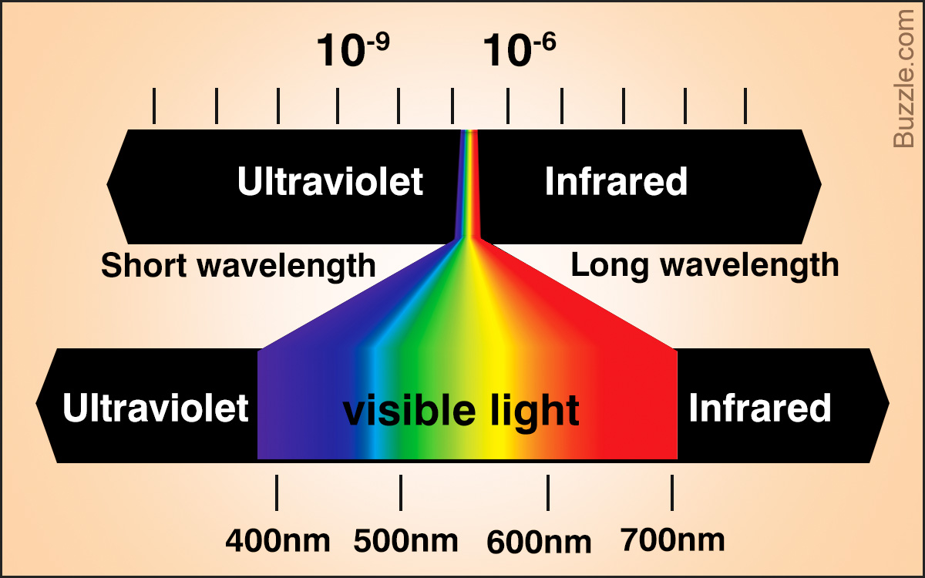

Slide 11
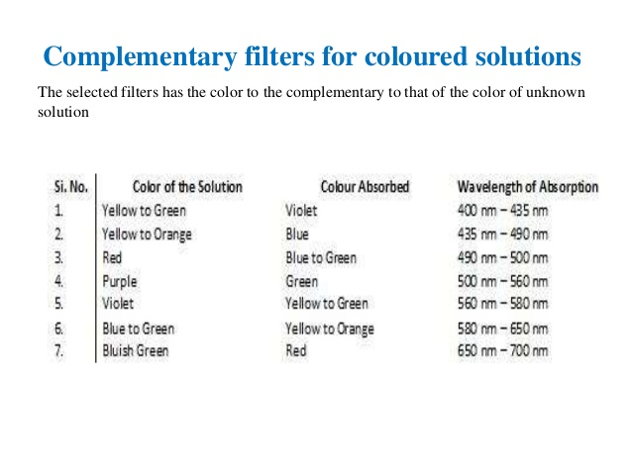

Slide 12
Beer Lamberts Law - Basis of colorimetric techniques
Beer’s law – the amount of light absorbed by a coloured solution is directly proportional to the concentration of the substance in the solution(light absorbing material)
A α C
Lambert’s law- the amount of light absorbed by a coloured solution is directly proportional to the depth//length through which the light passes.
A α L
Where A is light absorbed and C is concentration of the solution.
Where L = length of light path Lamberts law

Slide 13
By combining above equations, we get
A α Cx L
A= Kx Cx L
Where K= constant for colored solution

Slide 14
To find concentration of test / unknown substance
A1 –absorbance of test solution
C1 – concentration of test solution
A2 –absorbance of standard solution
C2 – concentration of standard solution

Slide 15
A1 = Kx C1x L
A2 = Kx C2x L
A1 = C1
A2 = C2
C1 = A1 xC2
A2
Concentration of test solution
= Absorbance of test x concentration of std
Absorbance of standard
Optical density (OD) = log incident light
transmitted light
O.D = 2- log % T

Slide 16
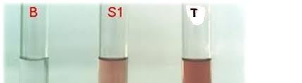
Preparation of solution for measurement
Three solutions
Blank (B) – all reagents but none of the
substance
Standard (S) – known quantity of substance
Test (T) - concentration to be analysed
Note :
avoid cloudiness, turbidity, bubbles
Solution –optically clear(photoelectric cell more sensitive for small changes in transmission)

Slide 17
Spectrophotometer
Differs from colorimeter
by covering the ultraviolet region (200-400nm) of the electromagnetic spectrum.
covers both uv and visible range (234nm- 610nm)
Sensitivity high
Light – prism or diffraction grating
Quartz cells

Slide 18
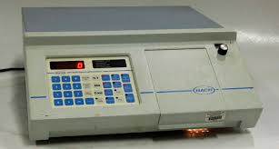
Spectrophotometer

Slide 19
Thank you

