Slide 1
Malignant Tumours of Larynx

Slide 2
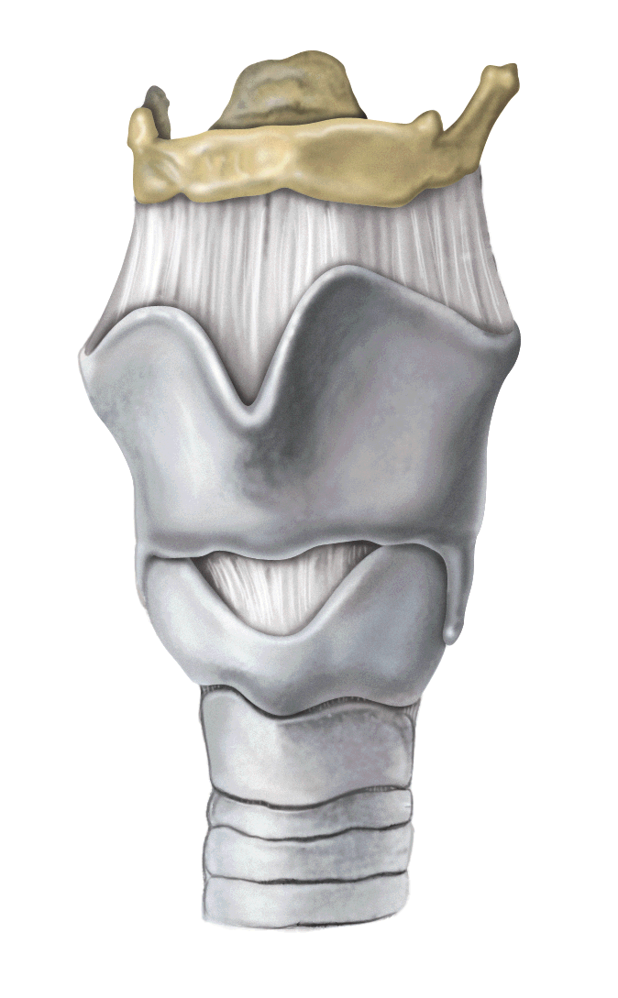
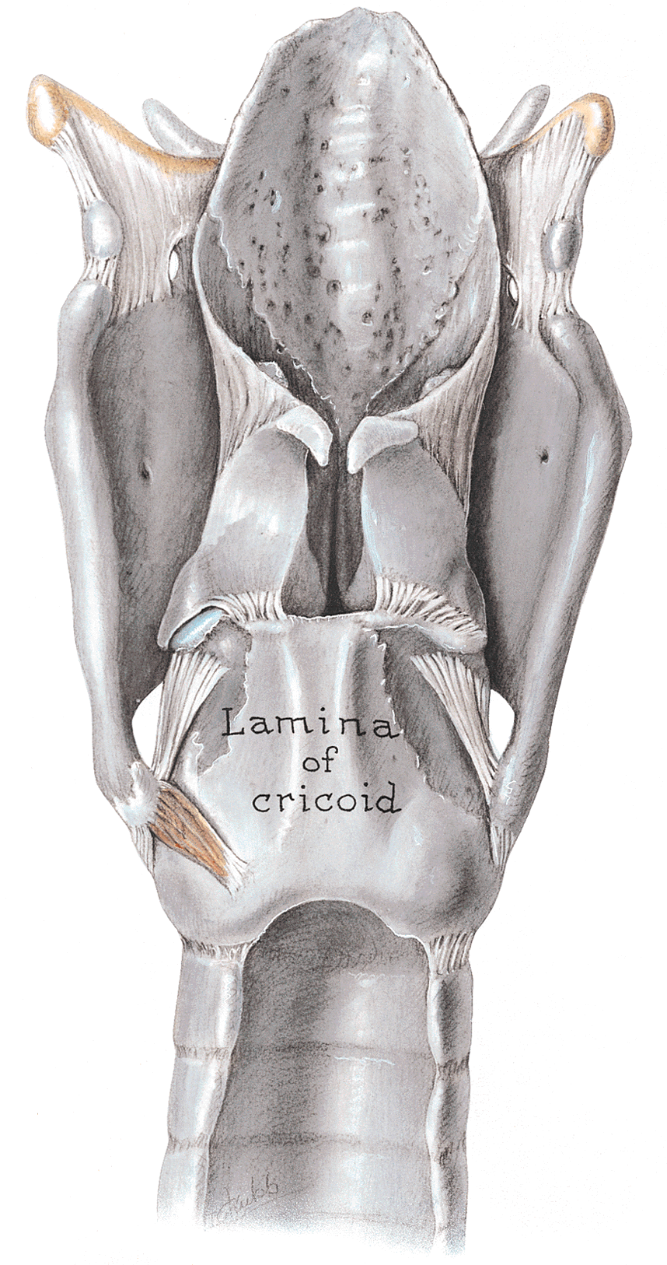
Anatomy

Slide 3
The Larynx
The larynx is a 5-7 cm long structure.
  Its upper boundary starts at the tip of the epiglottis, opposite the 3rd to 4th, cervical vertebra.
Its lower end is at the lower border of the cricoid cartilage.
  This lies opposite the 6th cervical vertebra.

Slide 4
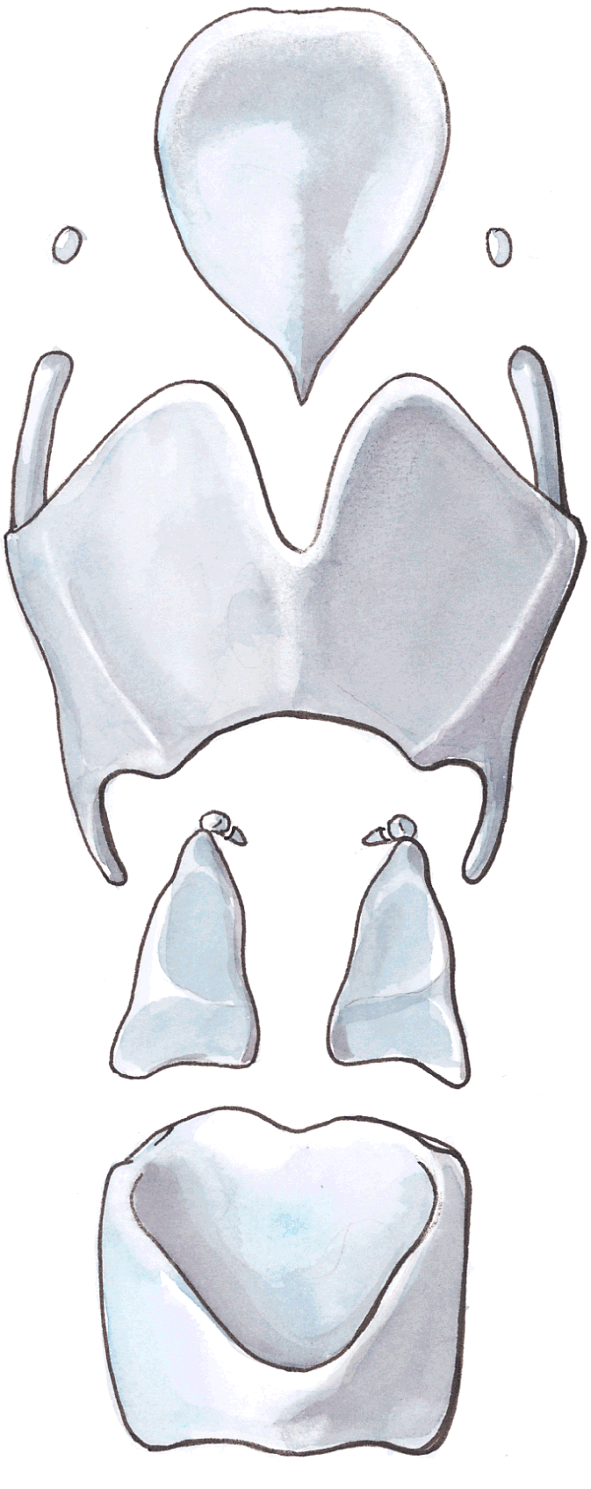
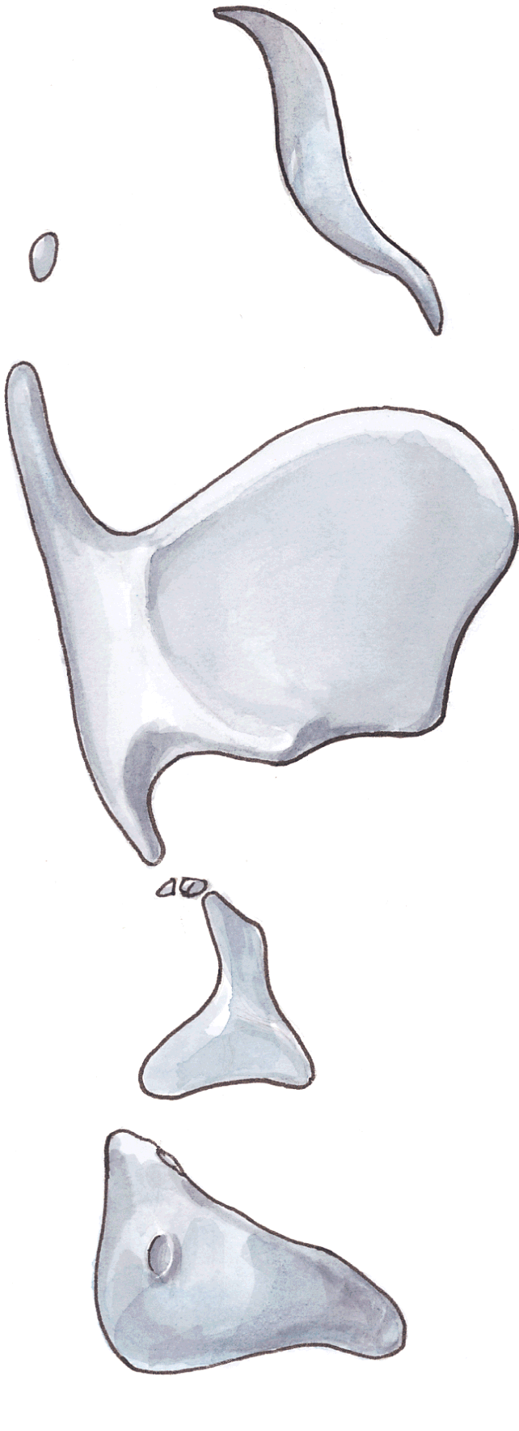
Anatomy

Slide 5
Anatomy

Slide 6
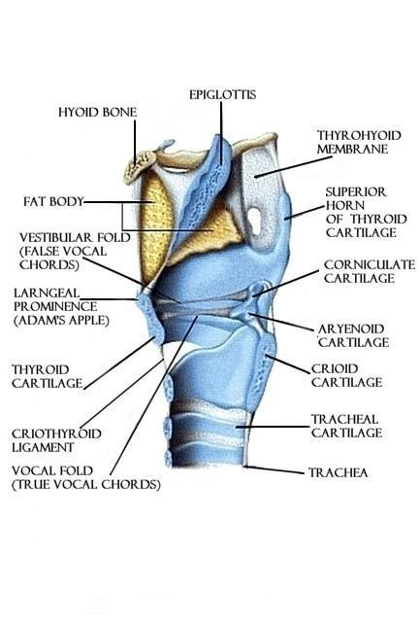
The Larynx: Anatomy
The six smaller cartilages of the larynx ( 3 pairs) are functionally involved with the movements of the vocal cords. These are:
  The arytenoids
  The corniculates
  The cuneiforms
The arytenoid cartilages are pyramid-shaped and articulate with the superior margin of the cricoid lamina. On their summit, are the corniculate cartilages; on their anterior aspect, the cuneiform cartilages

Slide 7
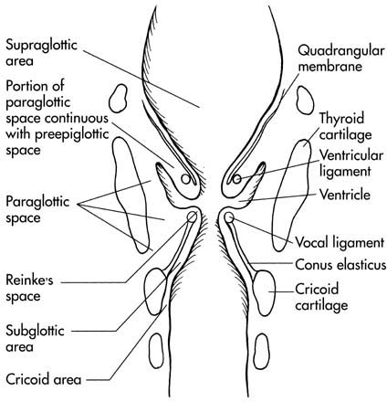
Anatomy
Fibroelastic membranes
  Barriers to carcinoma spread
    Quadrangular membrane
      Superior free edge= AE fold
      Inferior free edge= False cord
    Conus elasticus
      Supports vocal fold
      Lateral attachment at cricoid
      Medial attachment at anterior thyroid cartilage
      Free edge forms vocal ligament

Slide 8
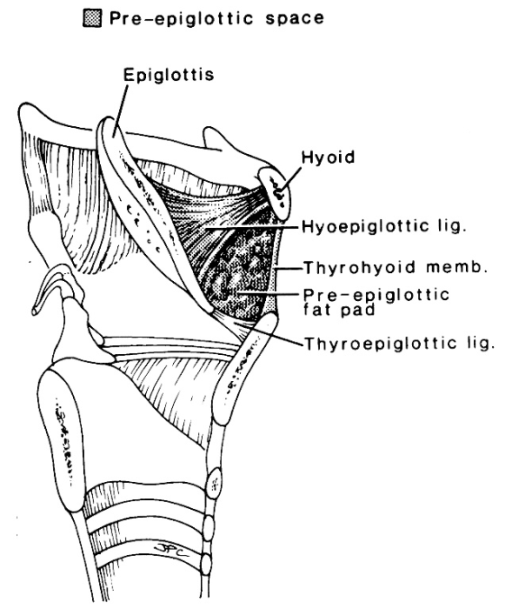
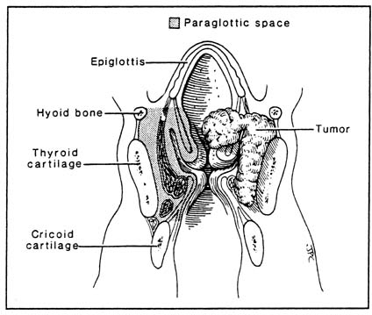
Pre-epiglottic space & Para-glottic space
Pre-epiglottic space
  Anterior: thyrohyoid membrane & thyroid cartilage
  Posterior: epiglottis elastic cartilage
  Inferior: Petiole attachment to thyroid cartilage
    Conduit :
      elastic epiglottic cartilage has perforations -→direct extension of infrahyoid supraglottic cancer into this fascia-bound space
    Bilateral neck drainage
Paraglottic space
  quadrangular membrane inferiorly
  conus elasticus anteriorly and medially
  thyroid cartilage laterally
Myers: Laryngoscope, Volume 106(5).May 1996.559-567
Cummings: otolaryngology, 4th ed- 2005 - Mosby, Inc.
Notes:
Expand to fill concept

Slide 9
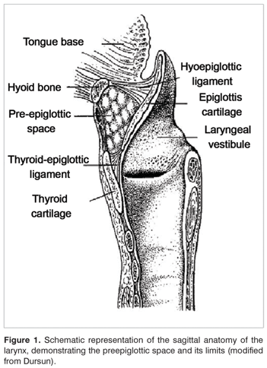
Pre-epiglottic fat space
The pre-epiglottic fat is located in the anterior and lateral aspects of the larynx and is often invaded by advanced cancers.

Slide 10
Introduction
Non neoplastic
Benign
Malignant
Neoplastic

Slide 11
Benign Tumours
Non-neoplastic lesions
  Solid lesions-
  Vocal nodules
  Vocal polyp
  Reinke’s oedema
  Contact ulcer
  Intubation granuloma
  Leukoplakia
  Amyloid tumours
  Cystic lesions-
  Ductal cyst
  Saccular cyst
  Laryngocele

Slide 12
  Neoplastic lesions
    Squamous papilloma
    Chondroma
    Haemangioma
    Granular cell tumour
    Glandular Tumour
    Rhabdomyoma
    Lipoma
    Fibroma

Slide 13
Solid lesions
Vocal nodules (Singer’s or screamer nodes)
  Appear symmetrically on free edge of vocal cord – jn ant 1/3 and post 2/3
  Area of maximum trauma
  Caused by vocal trauma – unnatural tones for prolonged periods or high intensities
  Seen in teachers, actors, vendors etc

Slide 14
Pathology
Trauma to vocal cord – misuse
Odema and haemorrhage in submucosal space
Hyalinisation and fibrosis
Epithelium --- hyperplasia forming a nodule

Slide 15
Complaints
Hoarseness
Vocal fatigue
Pain in neck on prolonged phonation
Treatment
- Conservative: proper use of voice
- Surgery – with precision using an operating microscope

Slide 16
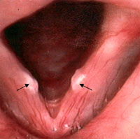

Slide 17
Vocal polyp
Unilateral
Soft, smooth or pedenculated
Moves up and down the glottis – respiration & phonation
Causes
Vocal abuse or misuse
Allergy and smoking → men (30-50 yrs)

Slide 18
Symptoms
Hoarseness
Diplophonia
Dyspnoea, Stridor and intermittent choking→ large polyp

Slide 19
Pathology
Sudden shouting haemorrhage submucosal edema
Treatment
Surgical excision + speech therapy

Slide 20
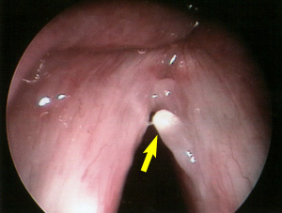

Slide 21
Reinke’s odema(Bilateral Diffuse Polyposis)
Collection of odema fluid in subepithelial space of Reinke
Vocal abuse and smoking
Diffuse symmetrical swellings
Treatment :
Vocal cord stripping , preserving enough mucosa for epithelialisation
Reeducation on voice production and quit smoking

Slide 22
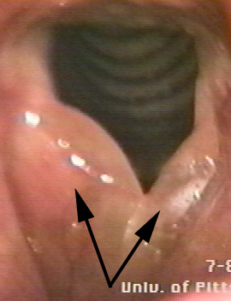

Slide 23
Contact ulcer
Faulty voice production
Vocal processes of arytenoids hammer against each other
Ulceration & granuloma
Hoarseness of voice and pain in the throat which worse on phonation

Slide 24
Intubation granuloma
Injury to vocal processes of arytenoids
Rough intubation – large tube & prolonged presence
Mucosal ulceration & granuloma → post of true cords
Treatment
Voice rest & endoscopic removal of granuloma

Slide 25
Leukoplakia or Keratosis
Localised epithelial hyperplasia on upper surface of one or both vocal cords
White plaque /warty growth on cord
Precancerous carcinoma in situ
Hoarseness
Treatment
Stripping of vocal cord → histology

Slide 26
Amyloid tumour
Men ( 50 – 70yrs)
Smooth plaque or pedunculated
Diagnosis: Histology
Treatment : endoscopic surgical excision

Slide 27
Cystic lesions
Ductal cysts
    Blockage of ducts of seromucinous glands of laryngeal mucosa
    Seen in vallecula,aryepiglottic fold, false cords, ventricles and pyriform fossa.
    Asymptomatic, if large- hoarseness, cough, throat pain

Slide 28
Saccular cysts
  Obstruction of orifice of saccule, retention of secretions,cyst in ventricle
  Anterior saccular cyst : anterior part of ventricle
  Lateral saccular cyst : false cord, aryeppiglottic fold, appear in the neck through thyrohyoid membrane

Slide 29
Laryngocoele: air filled cystic swelling due to dilatation of saccule
      Internal: confined within larynx, distention of false cords and aryepiglottic fold
      External : Distended saccule herniates through thyroid membrane
      Combined: both components seen.

Slide 30
Etiology:
Transglottic pressure
Symptoms
Hoarseness, cough, airway obstruction
external, presents as a reducible swelling in the neck which Valsalva manuevre
Diagnosis
Indirect laryngoscopy & CT Scan

Slide 31
Treatment
Surgical excision
Marsupialisation
Adult laryngocoele : can be associated with carcinoma

Slide 32
Neoplastic
Squamous Papilloma
  Juvenile pappilomas
    Viral origin ; multiple
    Often involve infants and young children
    Stridor & hoarseness
    Mostly seen in true &false cord &the epiglottis
    Glistening white irregular growths, sessile & friable, easily bleeds
    Disappear after puberty
    CO₂ laser precision & less bleeding

Slide 33
Adult onset
  Single & smaller
  Less aggressive and no recurrance after surgical removal
  Common in males(2:1) ;30-50yrs
  Arises from anterior half of vocal cord and anterior commisure
  Treatment same as benign

Slide 34
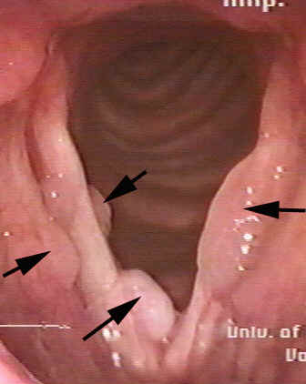

Slide 35
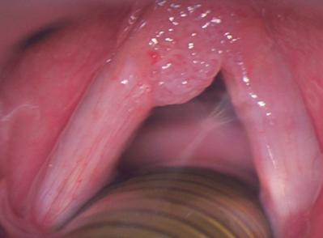
Adult laryngeal papilloma

Slide 36
Chondroma
  Arise from cricoid
  Causes dyspnoea, lump and dysphagia
  Mostly affect males,40 -60yrs
Hemangioma
  Infantile → subglottic region: presents with stridor in first 6 months
  50% have at other sites(head and neck area)
  Tracheostomy may be needed to relieve respiratory obstrution
  Most of them are capillary type &can be vaporised with CO2 laser

Slide 37
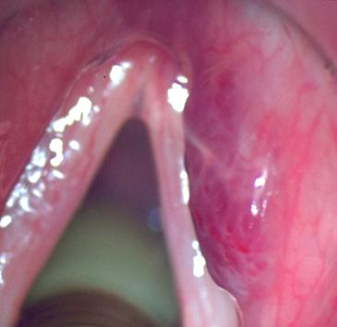
Hemangioma

Slide 38
Granular Cell Tumour
  Arise from Schawann cells
  Overlying epithelium shows pseudoepitheliomatous hyperplasia
Glandular tumour
  Rare
  Pleomorphic adenoma & oncocytoma

Slide 39
MALIGNANT TUMORS OF LARYNX
2.63% of all body cancer in India
10 times more common in males
Age : 40 – 70 yrs
Aetiology
Tobacco
Alcohol
Previous neck radiation
Occupational – asbestos , petroleum

Slide 40
Histopathology
90 – 95 % laryngeal malignancies are squamous cell carcinomas
Cordal lesions – well differentiated
Supraglottic - anaplastic

Slide 41
Site | Subsite
Supraglottis | Suprahyoid epiglottis Infrahyoid epiglottis Aryepiglottic fold Arytenoids Ventricular bands(false cords)
Glottis | True vocal cords including ant and post commisure
Subglottis | Subglottis upto lower border of cricoid cartilage

Slide 42
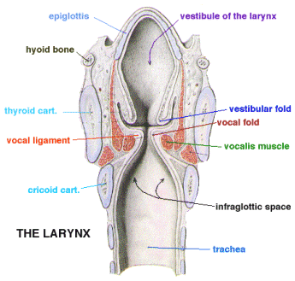

Slide 43
Supraglottic cancer
Majority in epiglottis and false cords
Spread: locally to vallecula, base of tongue and pyriform fossa
May extend to preepiglottic space.
Nodal metastases early – upper & middle jugular

Slide 44
Symptoms
Throat, pain, dysphagia,referred pain to ear & lymph nodes in neck
Hoarseness – late symptom
Respiratory obstruction & halitosis

Slide 45
Glottic cancer
Majority of laryngeal cancers
Free edge and upper surface of vocal cord in its ant and middle third.
Spread:
Ant: ant commisure & opposite cord
Post: vocal process & arytenoids
Upward: ventricle and false cord
Downward: subglottic region

Slide 46
Symptoms
Hoarseness –early sign can be detected early
Late: stridor & laryngeal obstruction
Fixation of vocal cord: bad prognosis
thyroarytenoid muscle

Slide 47
Subglottic cancer
Rare
Spread: ant wall to opposite side & to trachea
Upward spread to cords is late
Nodes – prelaryngeal , pretracheal, paratracheal & lower jugular

Slide 48
Symptoms
Stridor or laryngeal obstruction
Hoarseness – late
  Spread to vocal cords, thyroarytenoid & recurrent laryngeal nerve

Slide 49
Staging- Primary Tumor (T)
TX | Minimum requirements to assess primary tumor cannot be met
T0 | No evidence of primary tumor
Tis | Carcinoma in situ

Slide 50
Staging- Supraglottis
T1 | Tumor limited to one subsite of supraglottis with normal vocal cord mobility
T2 | Tumor involves mucosa of more than one adjacent subsite of supraglottis or glottis, or region outside the supraglottis (e.g. mucosa of base of the tongue, vallecula, medial wall of piriform sinus) without fixation
T3 | Tumor limited to larynx with vocal cord fixation and or invades any of the following: postcricoid area, preepiglottic tissue, paraglottic space, and/or minor thyroid cartilage erosion (e.g. inner cortex)
T4a | Tumor invades through the thyroid cartilage and/or invades tissue beyond the larynx (e.g. trachea, soft tissues of neck including deep extrinsic muscles of the tongue, strap muscles, thyroid, or esophagus)
T4b | Tumor invades prevertebral space, encases carotid artery, or invades mediastinal structures

Slide 51
Staging- Glottis
T1 | Tumor limited to the vocal cord (s) (may involve anterior or posterior commissure) with normal mobilty
T1a | Tumor limited to one vocal cord
T1b | Tumor involves both vocal cords
T2 | Tumor extends to supraglottis and/or subglottis, and/or with impaired vocal cord mobility
T3 | Tumor limited to the larynx with vocal cord fixation and/or invades paraglottic space, and/or minor thyroid cartilage erosion (e.g. inner cortex)
T4a | Tumor invades through the thyroid cartilage, and/or invades tissues beyond the larynx (e.g. trachea, soft tissues of the neck including deep extrinsic muscles of the tongue, strap muscles, thyroid, or esophagus
T4b | Tumor invades prevertebral space, encases carotid artery, or invades mediastinal structures

Slide 52
Staging- Subglottis
T1 | Tumor limited to the subglottis
T2 | Tumor extends to vocal cord (s) with normal or impaired mobility
T3 | Tumor limited the larynx with vocal cord fixation
T4a | Tumor invades cricoid or thyroid cartilage and/or invades tissues beyond larynx (e.g. trachea, soft tissues of the neck including deep extrinsic muscles of the tongue, strap muscles, thyroid, or esophagus)
T4b | Tumor invades prevertebral space, encases carotid artery, or invades mediastinal structures

Slide 53
Staging- Nodes
N0 | No cervical lymph nodes positive
N1 | Single ipsilateral lymph node ≤ 3cm
N2a | Single ipsilateral node > 3cm and ≤6cm
N2b | Multiple ipsilateral lymph nodes, each ≤ 6cm
N2c | Bilateral or contralateral lymph nodes, each ≤6cm
N3 | Single or multiple lymph nodes > 6cm

Slide 54
Staging- Metastasis
M0 | No distant metastases
M1 | Distant metastases present

Slide 55
Stage Groupings
0 | Tis | N0 | M0
I | T1 | N0 | M0
II | T2 | N0 | M0
III | T3 | N0 | M0
 | T1-3 | N1 | M0
IVA | T4a | N0-2 | M0
 | T1-4a | N2 | M0
IVB | T4b | Any N | M0
 | Any T | N3 | M0
IVC | Any T | Any N | M1

Slide 56
Diagnosis
1. History : any patient (40 – 70yrs) persistent or gradually increasing hoarseness of voice for 3 weeks laryngeal examination to exclude cancer.
2. Indirect laryngoscopy
  Appearance of lesion
  Vocal cord mobility
  Extent of disease

Slide 57
3. Examination of neck
4. Radiography
    Xray Chest – TB, pulmonary metastasis
    Soft tissue lateral view neck
    Contrast laryngograms – dionosil

Slide 58
5. CT Scan : extend of tumour, invasion of preepiglottic & paraepiglottic
6. Direct laryngoscopy
a) hidden areas b) extent of disease
7. Microlaryngoscopy
8. Supravital staining & biopsy

Slide 59
Treatment
Radiotherapy
Surgery
Combined therapy
Conservative
Total laryngectomy

Slide 60
Radiotherapy
Curative in early lesions ie intact cord mobility and nodal metastasis
90% cure rate & voice preserved
Do not give good results in fixed cords, subglottic extension, cartilage invasion and nodal metastases

Slide 61
Surgery
I. Conservative surgery
Conserve voice
Avoid permanent tracheal opening
Methods:
Cordectomy via laryngeal fissure
Partial frontolateral laryngectomy
Partial horizontal laryngectomy

Slide 62
Total laryngectomy:first performed by BILLROTH in the yr 1870
Incision: Gluck sorensen(U-shaped flap)or through midline horizontal incision.
Above the level of the hyoid superiorly and to the level of the sternum and clavicular heads inferiorly

Slide 63
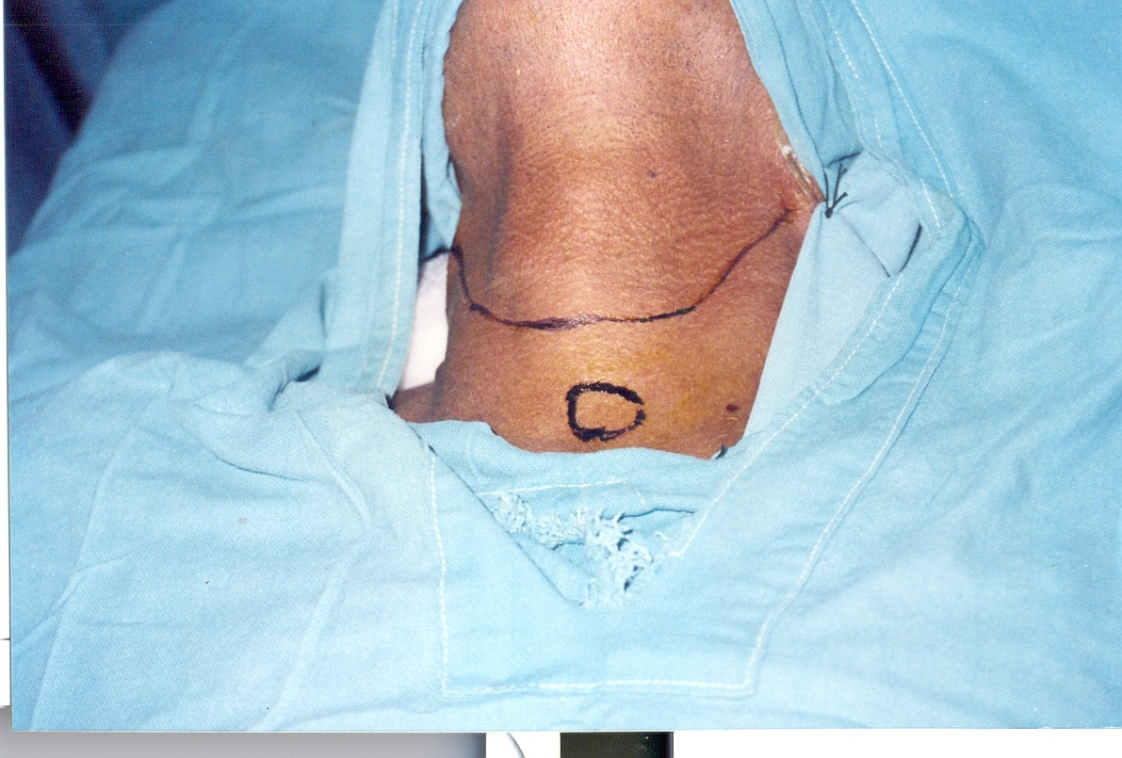

Slide 64
Entire larynx with hyoid, pre epiglottic space, strap muscles and one or more rings of trachea are removed
May be combined with block dissection for nodal metastasis

Slide 65
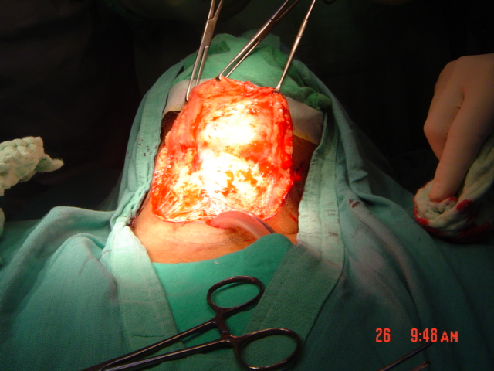

Slide 66
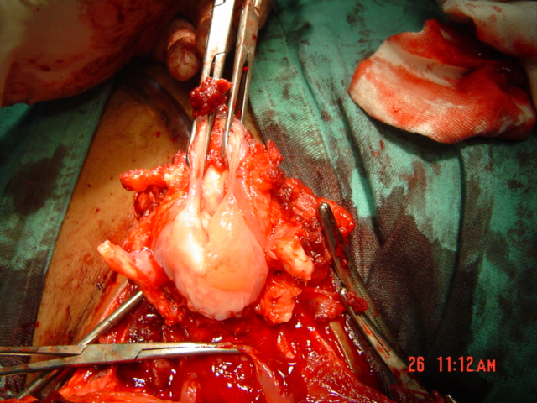

Slide 67
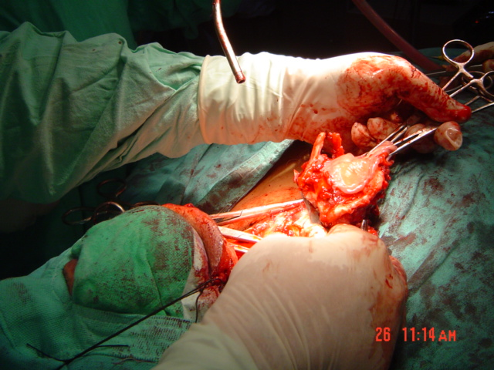

Slide 68
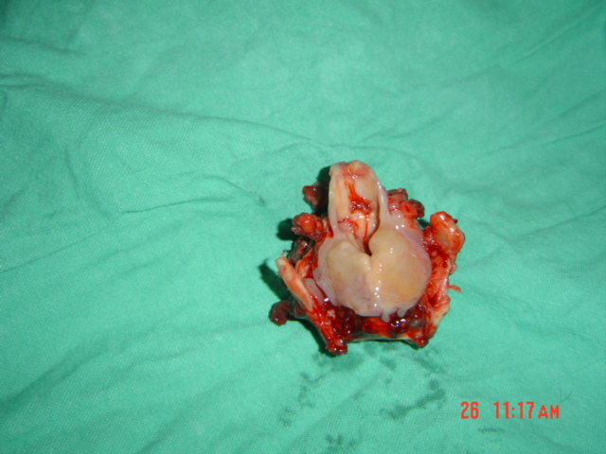

Slide 69
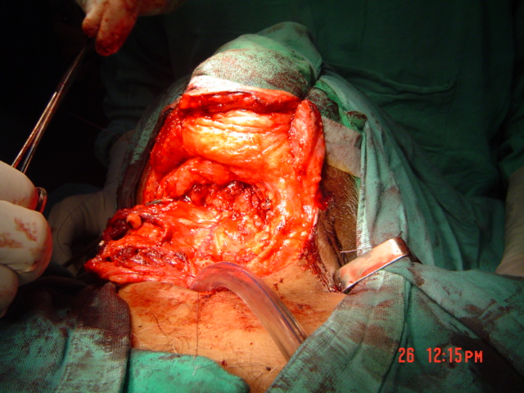

Slide 70
Indications
T₃ lesions (cord fixed)
All T₄ lesions
Invasion of thyroid or cricoid cartilage
Bilateral arytenoid cartilage involcement
Lesions of post commissure
Failure of radiotherapy or conservative method
Transglottic cancers

Slide 71
Combined therapy
Surgical removal + pre or post operative radiation to decrease incidence of recurrence

Slide 72
Glottic Carcinoma
Carcinoma in situ
  Trans oral endoscopic CO₂ laser
  If not available stripping of vocal cord under microscope
  Send for biopsy if in situ – regular follow up
  If invasive – radiotherapy
Invasive Carcinoma
  T1 – radiotherapy
  T1 extending to ant commissure – radiotherapy
  T1 with extension to arytenoid – surgery preferred

Slide 73
T2 N0 : algorithm
Cord mobility imp in outcome of T2 lesions.
T3 and T4 best treated by total laryngectomy

Slide 74
Subglottic cancer
T1 & T2 by radiotherapy
T3 & T4 total larygectomy & post operative radiation

Slide 75
Supraglottic cancer
T1 : radiation & also laser
T2 : supraglottic laryngectomy
T3 & T4 : total laryngectomy with neck dissection and post operative radiotherapy to neck.

Slide 76
Vocal rehabilitation after total laryngectomy
Oesophageal speech
Artificial larynx
  Electrolarynx
  Transoral pneumatic device
Tracheo – oesophageal speech
  Blom Singer or Panje

Slide 77
THANK YOU

