Slide 1
LARYNGEAL TRAUMA

Slide 2

 Larynx is a well protected structure in the neck
 Functions: airway ,tracheobronchial protection & phonation
 Skeletal framework : hyoid,thyroid,cricoid
 Divided into supraglottis.glottis,subglottis
 Supraglottis –soft tissue
 Glottis-relies on external support,cricoarytenoid jt mobility and neuromuscular coordinaton
 Subglottis - cricoid

Slide 3
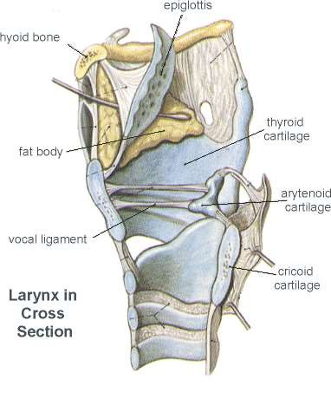

Slide 4
BLUNT INJURIES : CLOTHESLINE
CRUSHING HANGING
STRANGULATION PENETRATING INJURIES INHALATIONAL/INGESTION INJURIES IATROGENIC INJURIES

Slide 5

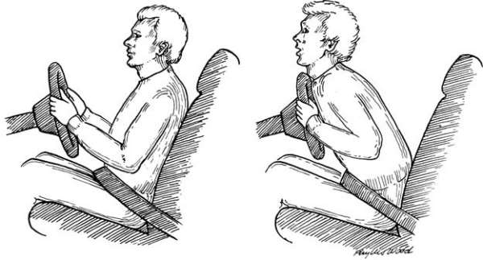


 ANTERIOR BLUNT INJURIES: Mc in
motor vehicle
accidents
 During deceleration driver is thrust forward with neck hyperextended: without the protection of mandible, larynx can strike wheel/ dashboard : compressed

Slide 6
 Clothesline injury : rider of vehicle : motorcycle or snowmobile: encounter a fixed horizontal object at neck, clotheline at neck, there is large amount of energy against small surface causing separation of cricoid from larynx or the trachea
 Strangulation : initially abrasion of skin
 12 - 24 hrs later edema of larynx leading to airway compromise

Slide 7
 Penetrating injuries : gunshot or knife injuries
 Gunshots at close range impart intense energy and are usually fatal
 Long range : damage may be minimal
 High velocity weapons : surrounding tissue damage is significant, wide debridement advisable

Slide 8
Hyoid bone :
 May be fractured
 Can cause mild discomfort or painful swallowing
 Rarely can lead to formation of bursa at the fractured ends which can be treated by excision

Slide 9
Thyroid cartilage & arytenoids
 Commonly fractured due to the prominence of the thyroid cartilage in the neck
 This injury depends on degree of calcification of the cartilage
 Minimal injury – no fracture
 If pushed backwards over cervical spine,thyroid ala is splayed apart to a more obtuse angle

Slide 10
 This can lead to pre-epiglottic space bleeding & posterior displacement of epiglottis
 Calcified thyroid cartilage gets shattered resulting in communited fracture

Slide 11
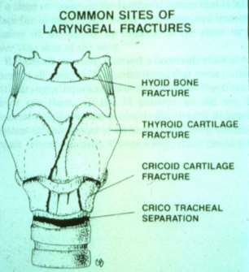
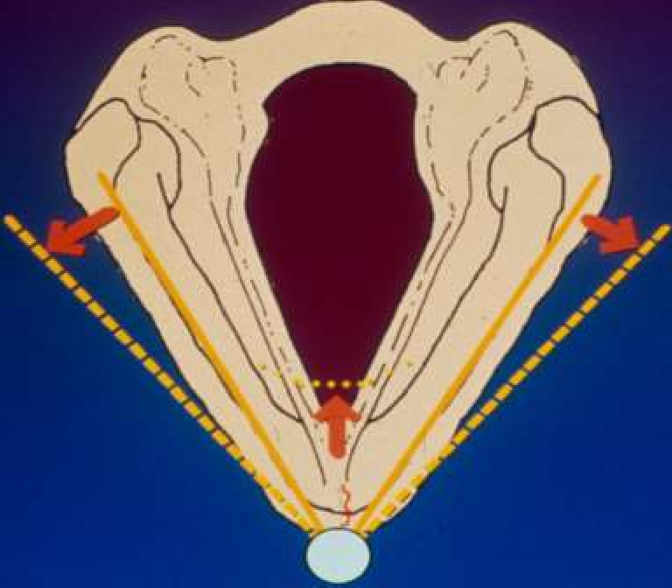
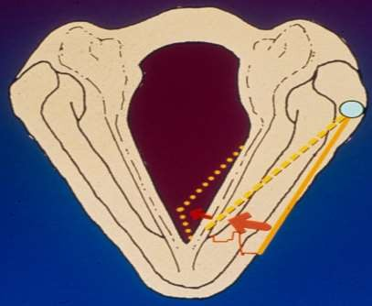

Slide 12
Cricoid cartilage
 Invariably associated with thyroid fractures
 Anterior part of the cricoid mostly fractured
Cricotracheal seperation
 Final soft tissue injury,usually results in death at the roadside
 Cricotracheal membrane is sheared off
 Several tracheal rings may be damaged
 Larynx pulled upwards & trachea is pushed to the retrosternal area

Slide 13
Inhalational injuries
 Hot air/smoke/steam: glottis reflexely closes: limits the amount of thermal injury by stopping inhalation : injury supraglottic larynx.
 As with burns in othr parts of the body
 Initial erythema & blackish sputum
 Marked oedema
 Early airway management : marked edema of injured mucosa with loss of airway : inability to intubate
Ingestion injuries
Mucosal burns
Direct damage due to ingestion / regurgitation
Alkali worse than acids

Slide 14
Iatrogenic injuries
 Intubation : Mucosal laceration / crico arytenoid dislocation / injury to lingual,hypoglossal , superior laryngeal , recurrent laryngeal nerve (neuropraxia)
 Prolonged intubation
 Tracheostomy : Injury to cricoid / recurrent laryngeal nerve

Slide 15
 Diagnosis
Symptoms : Change in voice ,Difficulty in breathing,Dysphonia,Dyspaghia,Pain,Cough
Hemoptysis
 Stridor : b/l vc palsy/ surpaglottic/ glottic / subglottic edema
 Skin : contusions, abrasions

open fractures

laryngocutaneous fistula
 Palpation : Crepitance

tenderness : significant injury
 Cervical spine should always be palpated

Slide 16
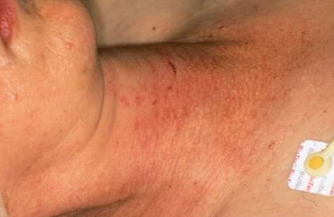
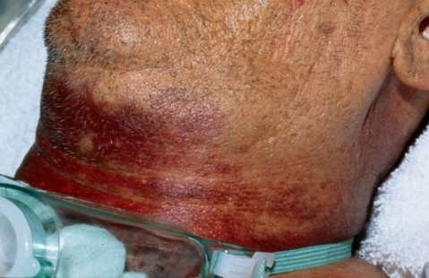

Slide 17
 EXAMINATION
 Incases of cricotracheal separation the airway may be maintained via a cutaneous laceration tat connects the trachea: no attempt should be made to cover or compress or manipulate the wound : until surgeon ready for airway establishment
 Subtle form of laryngeal dysfunction is aspiration: immobitly of vocal cords

Slide 18
 Any penetrating injury should be examined for entry and exit wounds
 Open wounds should not be explored with instruments, should not be probed
 Endolaryngeal anatomy examined : fibreoptic in
case of non intubated pts, very careful
 Look for hematomas, movement of arytenoids or presence of any exposed cartilage

Slide 19

Plain x-ray of cervical spine :
 To exclude hyoid bone fracture & concurrent cervical spine fracture
Chest x-ray
 To rule out mediastinal emphysema / puenomothorax

Slide 20
CT SCAN
 Mainly for pts who can do well without any surgical intervention
 Pts requiring a open surgical repair or with exposed cartilage : does give much input
 nonivasive
 Spiral ct scan- mainstay of post traumatic laryngeal injury
 Quick (< 20secs)
 Can produce two dimensional ,reconstructed images
 Detects mucosal oedema,fracture of thyroid,disruption of cricoaryteniod/cricothyroid joint,assessment of c-spine

Slide 21

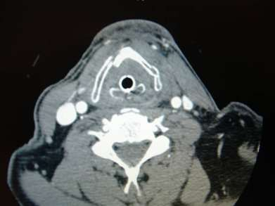
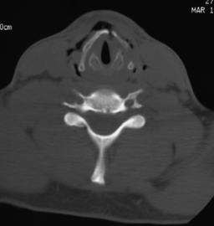
CT reserved for for patients in whom laryngeal injury is supected from either history or physical examination without any indications for surgery.
Noninvasive
confirmation of laryngeal injury without need for GA or laryngoscopy.
Presence of massive edema or hematoma : direct laryngoscopy not helpful: CT provides
input.

Slide 22
Direct laryngoscopy
 Done under GA
 Look for 1) large mucosal laceration 2) exposed cartilage 3)laceration on the free edge of the vocal cords 4)vocal cord immobility 5)dislocated arytenoids 6) displaced fractures 6) other neck injuries

Slide 23

Securing the airway-
 Tracheostomy
 Endotracheal intubation-indicated only when mucosa is intact,minimal laryngeal fracture
 Endotracheal intubation may further damage the larynx
 Paediatric pt –airway secured with rigid bronchoscopy,tracheostomy performed over bronchoscope
 Follwing intubation/ trach : direct laryngoscopy to assess the extent of damage: hematomas, exposed cartilage, lacerations, movement of vocal cords

Slide 24
Conservative management
 Clinical observation for 48hrs
 Head end elevation 30 degree
 Voice rest –minimize edema
 Humidified air-prevents crust formation & improves ciliary function
 Corticosteroids
 Antibiotics
 Antireflux medication

Slide 25
Surgical management
All injuries involving the anterior commisure
Exposed cartilage
Multiple or displaced fracture of thyroid cartilage
Multiple fractures of cricoid cartilage causing
Vocal fold paralysis
Airway compromise to require intubation
Injury to neck requiring exploration

Slide 26
 Open surgical exploration & repair
 Exploration within 24hrs –maximizes airway & phonation results
 Hemostasis
 Evacuation of hematoma
 Reconstruction of the laryngeal framework
 Coverage of de-epithelialized surfaces

Slide 27
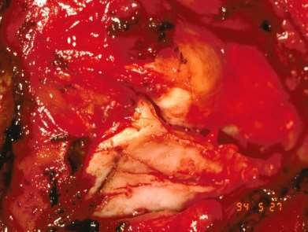
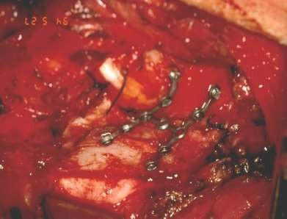
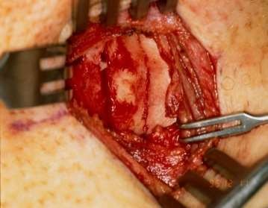
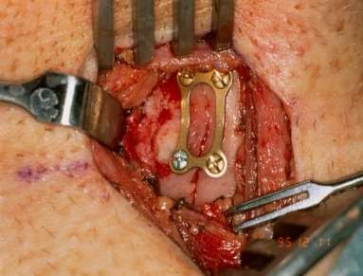

Slide 28
 Antireflux – proton pump inhibitors routinely used to prevent reflux which can cause mucosal damage & scarring.
 Avoid nasogastric tubes as it erodes the postcricoid mucosa
 Antibiotics – 5 to 7 days
 Head end elevation
 Early ambulation
 Tracheostomy care
 Removal of stents in 2 weeks followed by
decannulation
 Follow up-1yr for assessment of true vocal cord function & to monitor development of subglottic stenosis

Slide 29

 Formation of profuse granulation tissue ; can be debulked endoscopically
 Vocal cord immobility due to
RLN injury- unilateral paralysis wait & watch for 6 months.Medializtion procedure considered if no voice return is noted
Bilateral paralysis-arytenoidectomy / cordotomy
 Subglottic /Tracheal stenois

Slide 30
Thank you

