Slide 1
HYPERTENSION
Definition
Hypertension is sustained elevation of BP
– Systolic blood pressure >=140 mm Hg
– Diastolic blood pressure >= 90 mm Hg
Hypertension is poorly controlled, with less than 25% controlled in developed countries and less than 10% in developing countries.

Slide 2
Complications of Hypertension
1. Cardiac : | LVH LVF Systolic Diastolic IHD Arrhythmias
2. Vascular | Peripheral arterial disease Aortic dissection
3. Cerebral | Stroke TIA Encephalopathy
4. Renal | Nephropathy Renal failure
5. Eye | Retinopathy

Slide 3
Types of Hypertension
Primary HTN:
also known as essential HTN.
accounts for 95% cases of HTN.
no universally established cause known.
Secondary HTN:
less common cause of HTN ( 5%).
secondary to other potentially rectifiable causes.

Slide 4
Isolated Systolic Hypertension
Not distinguished as a separate entity as far as management is concerned.
SBP should be primarily considered during treatment and not just diastolic BP.
Systolic BP is more important cardiovascular risk factor after age 50.
Diastolic BP is more important before age 50.
Others
Malignant or accelerated Hypertension
Refractory/ Resistant hypertension

Slide 5
Aetiology of Systemic Hypertension
Essential or Primary HTN (95%)
A. ↑ Age
B. Genetic | Both parents (45%) Single (25%)
C. Environment | Diet | Fat Salt alcohol
 | Obesity
 | Physical inactivity
 | Stress
 | Smoking
D. Hormonal

Slide 6
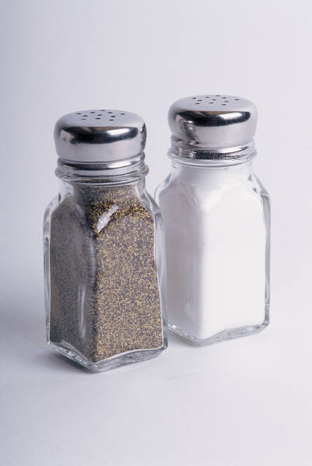
Primary Hypertension
Water and sodium retention
A high sodium intake may result in water retention
Some people are Na sensitive (about 20%) ; not everyone with high salt diet develops hypertension
Certain demographics are associated with “salt sensitivity”
Obesity
Increasing age
African American ethnicity
People with diabetes, renal disease

Slide 7
Stress
Produces increased vasoconstriction
↑ HR
↑ Renin release
Angiotensin II causes direct arteriolar constriction, promotes vascular hypertrophy and induces aldosterone secretion
Insulin resistance & hyperinsulinemia
High insulin concentration stimulates SNS activity and impairs nitric oxide–mediated vasodilation
Not present in secondary hypertension and don’t improve when hypertension is treated

Slide 8
Pathophysiology of Primary Hypertension
Altered renin–angiotensin mechanism
High plasma renin activity
Endothelial cell dysfunction
Source of many vasoactive substances
Role of endothelial cell dysfunction in cause and treatment of hypertension is ongoing

Slide 9
Hypertension Clinical Manifestations
Referred to as the “silent killer”
Frequently asymptomatic until target organ disease occurs
Or recognized on routine screening

Slide 10
Hypertension
Use auscultatory method with a properly calibrated instrument
Patient seated quietly for 5 min in a chair, feet on the floor, and arm supported at heart level
Appropriate-sized cuff is necessary to ensure accurate reading
At least three measurements should be obtained
Allow at least 1 minute between readings. If one arm higher than other; take BP in higher arm for subsequent measurements. BP highest in early morning, lowest at night

Slide 11

Hypertension Diagnostic Studies
Urinalysis, creatinine clearance
Serum electrolytes, glucose, Calcium
BUN and serum creatinine
Serum lipid profile
ECG
Echocardiogram
Urine Albumin
Lipid profile

Slide 12
B) Secondary HTN (05%)
A. Renal (80%) | AGN CGN, CPGN, Polycyst. K.D | Renal Artery stenosis
B. Endocrine | Adrenal | Primary aldosteronism Cushing’s syndrome Pheochromocytoma
 | Acromegaly
 | Exogenous hormone | Oral contraceptive) Glucosteroids
 | Hyperthyroidism & Hyperparathyroidism
Others | Coarctation of the aorta | ) Pregnancy Induced HTN (Pre-eclampsia

Slide 13
Causes of Secondary HTN
Common
Intrinsic renal disease
Renovascular disease
Mineralocorticoid excess
Sleep Breathing disorder
Uncommon
Pheochromocytoma
Glucocorticoid excess
Coarctation of Aorta
Hyper/hypothyroidism

Slide 14
Secondary HTN-Clues in Medical History
Onset: at age < 30 yrs ( Fibromuscular dysplasia) or > 55 (athelosclerotic renal artery stenosis), sudden onset (thrombus or cholesterol embolism).
Severity: Grade II, unresponsive to treatment.
Episodic, headache and chest pain/palpitation (pheochromocytoma, thyroid dysfunction).
Morbid obesity with history of snoring and daytime sleepiness (sleep disorders)

Slide 15
Secondary HTN-clues on Exam
Pallor, edema, other signs of renal disease.
Abdominal bruit especially with a diastolic component (renovascular)
Truncal obesity, purple striae, buffalo hump (hypercortisolism)

Slide 16
Secondary HTN-Clues on Routine Labs
Increased creatinine, abnormal urinalysis ( renovascular and renal parenchymal disease)
Unexplained hypokalemia (hyperaldosteronism)
Impaired blood glucose
( hypercortisolism)
Impaired TFT (Hypo-/hyper- thyroidism)

Slide 17
Secondary HTN-Screening Tests
www.nhlbi.nih.gov

Slide 18
Renal Parenchymal Disease
Common cause of secondary HTN (2-5%)
HTN is both cause and consequence of renal disease
Multifactorial cause for HTN including disturbances in Na/water balance, vasodepressors/ prostaglandins imbalance
Renal disease from multiple etiologies.

Slide 19
Renovascular HTN
Atherosclerosis 75-90% ( more common in older patients)
Fibromuscular dysplasia 10-25% (more common in young patients, especially females)
Other
Aortic/renal dissection
Takayasu’s arteritis
Thrombotic/cholesterol emboli
CVD
Post transplantation stenosis
Post radiation

Slide 20
Hypertensive Crises
Hypertensive Urgencies: No progressive target-organ dysfunction. (Accelerated Hypertension)
Hypertensive Emergencies: Progressive end-organ dysfunction. (Malignant Hypertension)
Resistant Hypertension is failure to achieve BP control to less than 140/90 despite using 3 class of drugs
Refractory Hypertension is failure after using 5 class of drugs including Spirinolactone

Slide 21
Hypertensive Urgencies
Severe elevated BP
Without progressive end-organ dysfunction.
Examples: Highly elevated BP without severe headache, shortness of breath or chest pain.
Usually due to under-controlled HTN.

Slide 22
Hypertensive Emergencies
Severely elevated BP (>180/120mmHg).
With progressive target organ dysfunction.
Require emergent lowering of BP.
Examples: Severely elevated BP with:
Hypertensive encephalopathy
Acute left ventricular failure with pulmonary edema
Acute MI or unstable angina pectoris
Dissecting aortic aneurysm

Slide 23
Resistant Hypertension
Not uncommon : 15-20%
Persistence of elevated systo-diastolic pressure in spite of at 3 anti-hypertensive drugs ( including diuretics)
Pre-requisites: Exclusion of pseudo-hypertension; white-coat hypertension,use of not-appropriate cuffs.

Slide 24
Resistant hypertension: Causes
Insufficient patient compliance
Inability to follow prescribed life-style modifications ( weight loss, increased alcohol consumption)
Use of offending drugs: steroids,NSAID
Obstructive Sleep apnoea syndrome
Volume overload

Slide 25
Resistant hypertension
Causes:
Volume overload & pseudotolerance
“White coat”
Pseudohypertension in the elderly
Excess sodium intake
Inadequate diuretic therapy
Volume retention
Drug related
Dosage too low
Inappropriate combination
Drug interaction
Associated conditions
Smoking
Obesity
Excess alcohol
Sleep apnea
Secondary hypertension
Braunwald’s Heart Disease, 2005

Slide 26
Therapeutic intervention
Exclude undiagnosed secondary hypertension
Compliance of drugs
Adherence to life style changes
Consider use of 3 or more anti-hypertensive drugs
Consider the use of drugs such as spironolactone

Slide 27

Hypertension Diagnostic Studies
“White coat” phenomenon may precipitate the need for ambulatory blood pressure monitoring (ABPM)
Noninvasive, fully automated system that measures BP at preset intervals over a 24-hour period

Slide 28
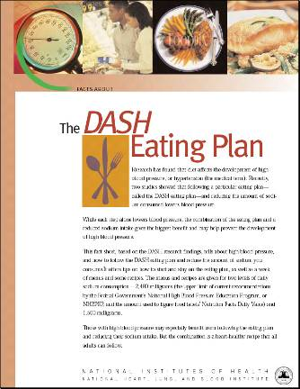
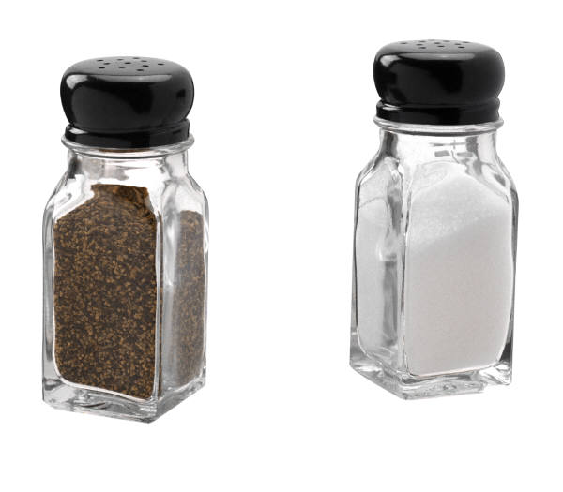
Collaborative Care Lifestyle Modifications
Wt. reduction
10 kg (22 lb) loss; SBP by 5-20 mm Hg
DASH eating plan (dietary approaches to stop hypertension)
Na reduction
<2.4 g of sodium/day
Moderate alcohol intake
Men: 2 drinks/day or less
Women: 1 drink/day or less

Slide 29

Collaborative Care Lifestyle Modifications
Physical activity:
Regular physical (aerobic) activity,
At least 30 min, most days of week
Avoidance of tobacco products
Stress management

Slide 30
Complications of Prolonged Uncontrolled HTN
Changes in the vessel wall leading to vessel trauma and arteriosclerosis throughout the vasculature
Complications arise due to the “target organ” dysfunction and ultimately failure.
Damage to the blood vessels can be seen on fundoscopy.

Slide 31
Target Organs
CVS (Heart and Blood Vessels)
The kidneys
Nervous system
The Eyes

Slide 32
Effects On CVS
Ventricular hypertrophy, dysfunction and failure.
Arrhithymias
Coronary artery disease, Acute MI
Arterial aneurysm, dissection, and rupture.

Slide 33
Effects on The Kidneys
Glomerular sclerosis leading to impaired kidney function and finally end stage kidney disease.
Ischemic kidney disease especially when renal artery stenosis is the cause of HTN

Slide 34
Nervous System
Stroke, intracerebral and subaracnoid hemorrhage.
Cerebral atrophy and dementia

Slide 35
The Eyes
Retinopathy, retinal hemorrhages and impaired vision.
Vitreous hemorrhage, retinal detachment
Neuropathy of the nerves leading to extraoccular muscle paralysis and dysfunction

Slide 36
Retina Normal and Hypertensive Retinopathy
A
B
C
Normal Retina
Hypertensive Retinopathy
A: Hemorrhages
B: Exudates (Fatty Deposits)
C: Cotton Wool Spots (Micro Strokes)
Notes:
B

Slide 37
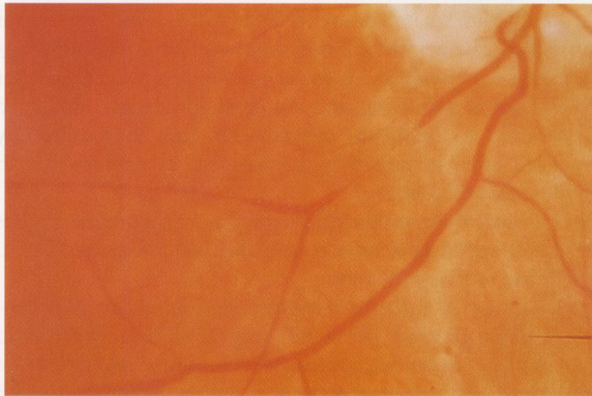
Stage I- Arteriolar Narrowing
Arteriolar Narrowing

Slide 38
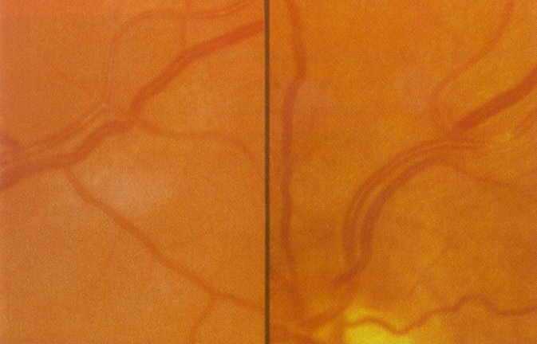
Stage II- AV Nicking
AV Nicking
AV Nicking
AV Nicking
Notes:
AV Nicking

Slide 39
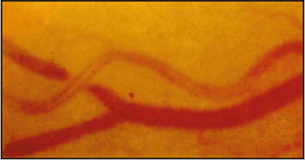
AV Nicking

Slide 40
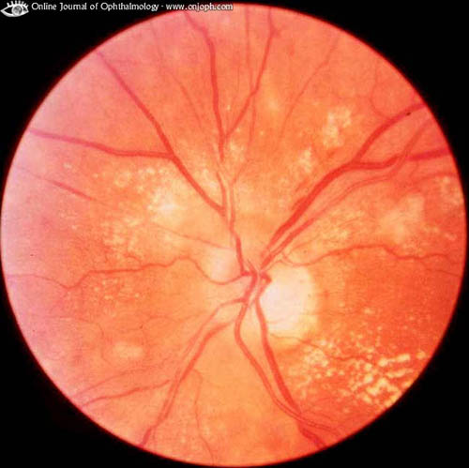
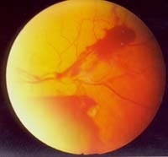
Stage III- Hemorrhages (H), Cotton Wool Spots and Exudats (E)
H
E

Slide 41
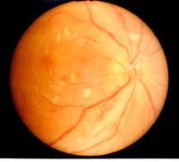
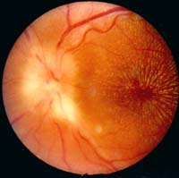
Stage IV- Stage III+Papilledema
Notes:
P

Slide 42
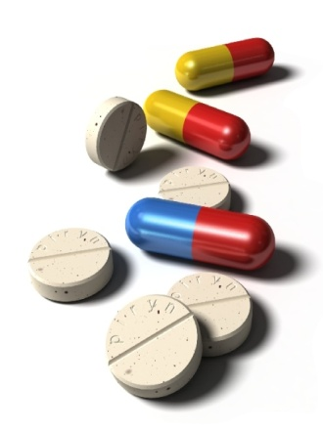
Collaborative Care HTN Drug Therapy
Primary actions
Reduce SVR
Reduce volume of circulating blood
Classifications
Diuretics
Adrenergic inhibitors
Direct vasodilators
Angiotensin inhibitors
Calcium channel blockers

Slide 43
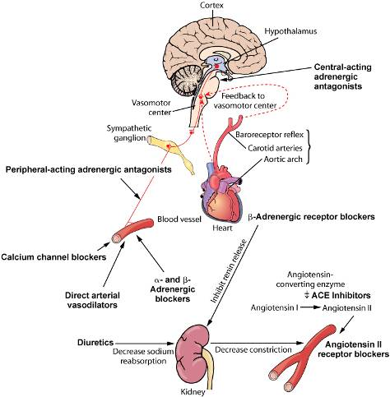
Collaborative Care
Fig. 33-5

Slide 44
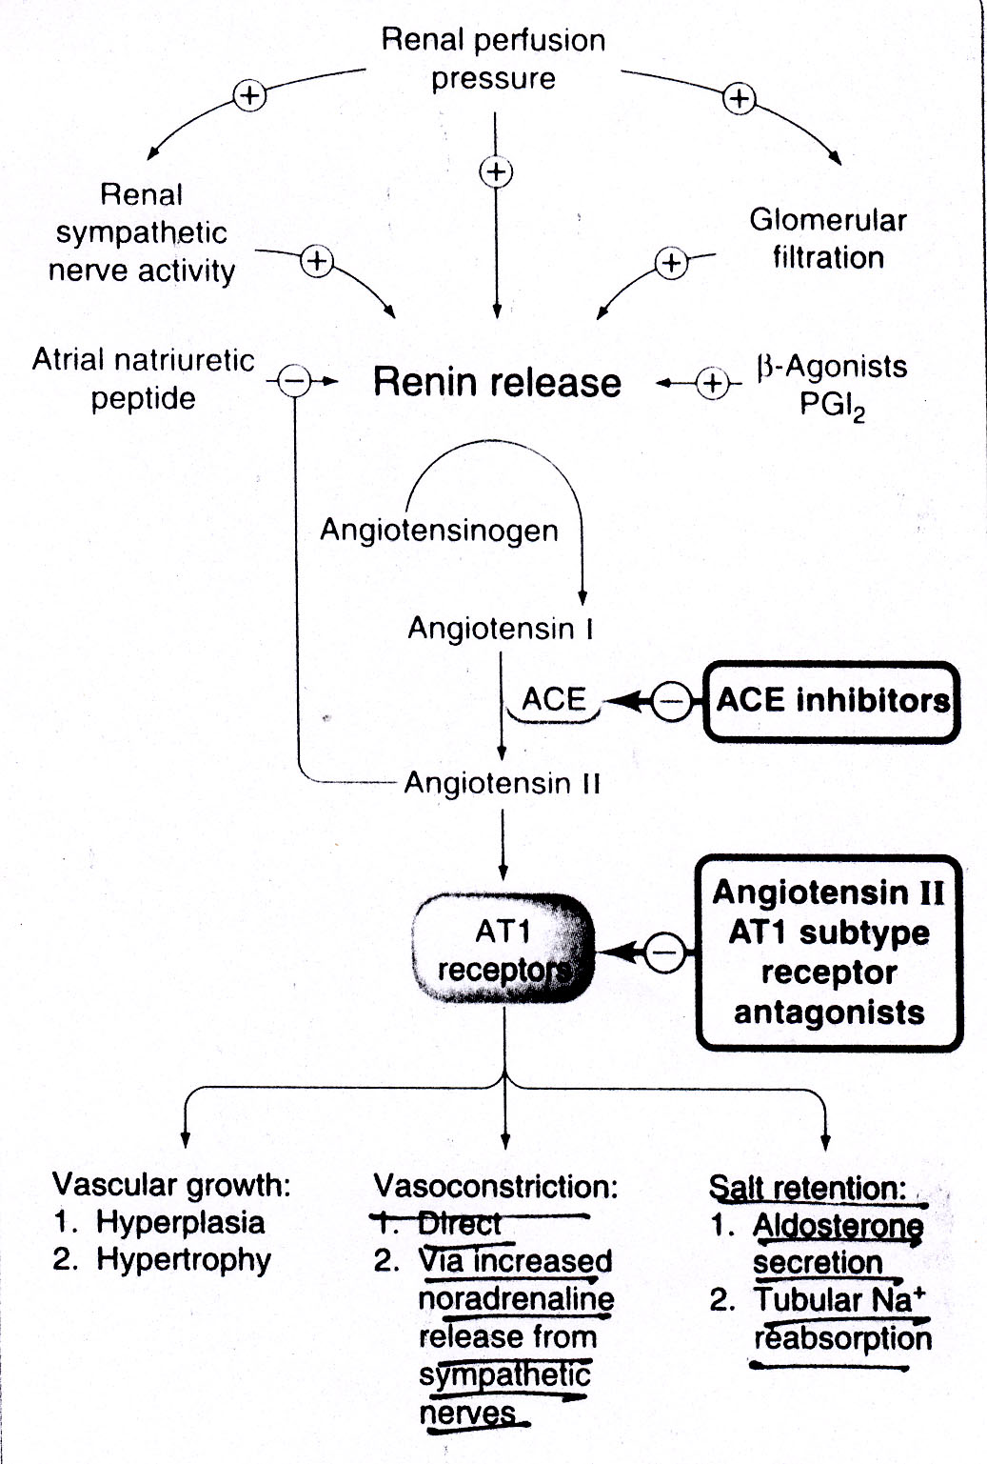
Antihypertensive Drugs

Slide 46
