Slide 1
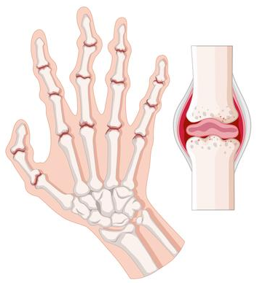
Rheumatoid Arthritis

Slide 2
Rheumatoid arthritis (RA) is a chronic inflammatory disease of unknown aetiology characterized by a symmetric polyarthritis.

Slide 3
Epidemiology
Females are affected more than males.
Onset – 4th or 5th decade of life.
Factors producing RA: Infectious trigger, genetic predisposition and autoimmune response.
  Genetic predisposition is associated with HLA-DR4 in 70% of patients.

Slide 4
CLINICAL FEATURES
Presenting symptoms: Early morning joint stiffness lasting >1 hour that eases with physical activity.
Most frequently involved joints: Wrists, MCP, and PIP joints (DIP is usually spared). Axial involvement is rare, if occurs most common site is cervical vertebrae.
Flexor tendon tenosynovitis – “Trigger” fingers.

Slide 5
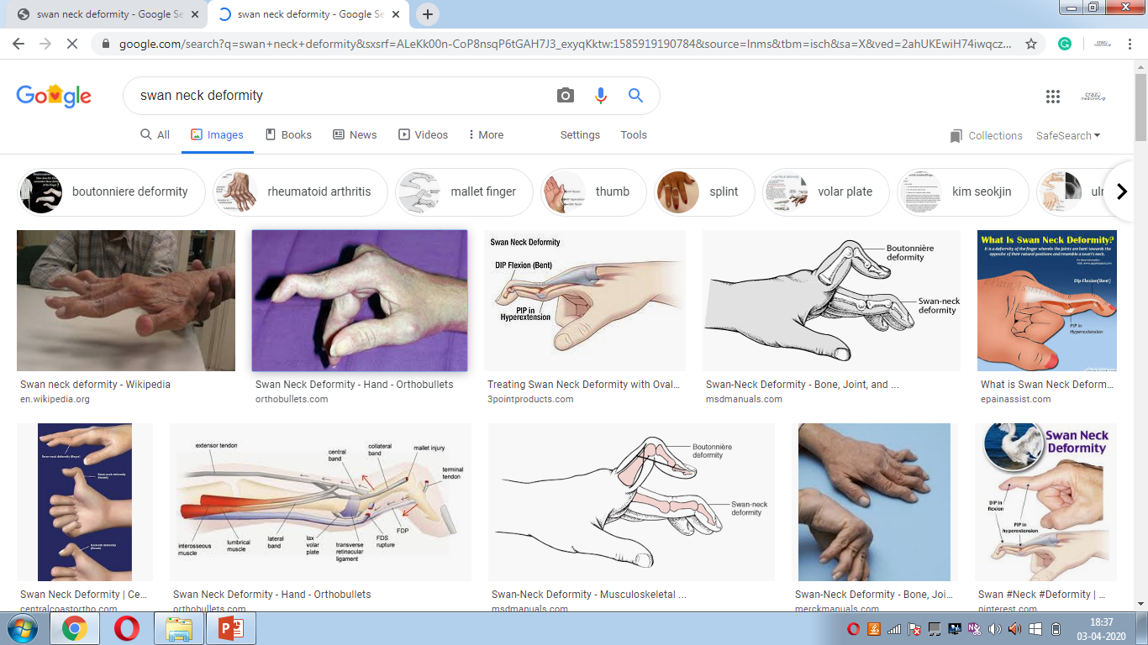
Swan-neck deformity: Hyperextension of the PIP joint with flexion of the DIP joint.

Slide 6
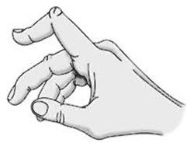
Boutonnière deformity: Flexion of the PIP joint with hyperextension of the DIP joint.

Slide 7
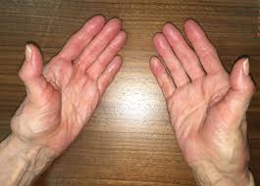
Z-line deformity: Subluxation of the first MCP joint with hyperextension of the first interphalangeal (IP) joint.

Slide 8
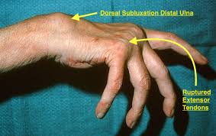
Piano-key movement of the ulnar styloid: due to Inflammation about the ulnar styloid and tenosynovitis of the extensor carpi ulnaris.

Slide 9
Extra Articular Manifestations:
Rheumatoid Nodules:
  In 25% of patients.
  Firm, round in subcutaneous tissues. (Visceral involvement can be there)
Rheumatoid vasculitis
  Polyneuropathy and mononeuritis multiplex
  Cutaneous ulcerations, palpable purpurae.
Pulmonary manifestations:
  Pleural involvement results in pleural effusion.
  Caplan’s syndrome: Multiple nodules and interstitial lung disease due to pneumoconiosis.
CVS manifestations:
  Pericarditis and chronic constrictive pericarditis.
  Premature atherosclerosis.
Neurological involvement:
  Nerve entrapment syndromes.
  Peripheral neuropathy.
Felty’s syndrome:
    Splenomegaly and neutropenia with RA.
Haematological:
  Normocytic Normochromic anaemia.
  Thrombocytosis.

Slide 10
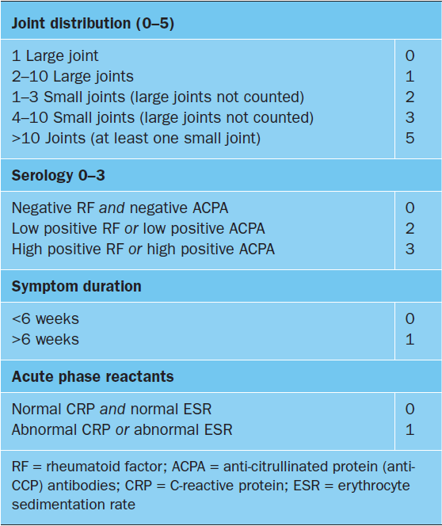
DIAGNOSIS
Classification criteria for RA:
RA is diagnosed if score is ≥ 6.

Slide 11
TREATMENT
Treatment may be divided into:
NSAIDs
Glucocorticoids
Conventional DMARDs
Biologic DMARDs

Slide 12
NSAIDS:
Considered to be adjunctive agents for management of symptoms uncontrolled by other measures. NSAIDs exhibit both analgesic and anti-inflammatory properties.
Glucocorticoids:
Can be given in several ways:
First, low to moderate doses to achieve rapid disease control before the onset of fully effective DMARD therapy.
Second, a 1 to 2 week burst of glucocorticoids for the management of acute disease flares, with dose and duration guided by the severity of the exacerbation.

Slide 13
Conventional DMARDs:
Includes: Methotrexate, Hydroxychloroquine, sulfasalazine and leflunomide.
Methotrexate is DMARD of choice for treatment of RA. It stimulates adenosine release from cells, producing an anti-inflammatory effect.
Biologic DMARDs:
IL-1 receptor antagonist: Anakinra
Anti TNF agents: Infliximab, Golimumab, Certolizumab, etanercept.
Anti CD-20: Rituximab.
Anti IL-6: Tocilizumab
Abatacept: Inhibits T cell stimulation
Tofacitinib: Inhibits JAK1 and JAK3. It is an oral agent.

Slide 14
THANK YOU

