Slide 1
VIRAL ENCEPHALITIS

Slide 2
Encephalitis: Infectious process & inflammatory response limited to brain parenchyma.
Meningoencephalitis: Meninges + brain
Encephalomyelitis: Brain + spinal cord

Slide 3
ENCEPHALITIS
• Encephalitis is the inflammation of the brain parenchyma, presents as diffuse and/ or focal neuropsychological dysfunction.
• From an epidemiologic and pathophysiologic perspective, encephalitis is distinct from meningitis though on clinical evaluation the two often coexist with the sign and symptoms of meningeal inflammation such as photophobia, headache or a stiff neck

Slide 4
Viral infection is the most common and important cause, with over 100 viruses implicated worldwide
Causes of acute viral encephalitis
Sporadic causes
• Herpes viruses – HSV-1, HSV-2, CMV, EBV, HHV6, HHV7 , VZV • Enteroviruses – Coxsackie, echoviruses, enteroviruses 70/71, poliovirus
• Paramyxoviruses – Measles, mumps
• Others (rarer causes) – Influenza viruses, Adenovirus, parvovirus, rubella virus, rabies , HIV
Geographically restricted causes
  Arboviruses — Japanese B, St Louis, West Nile, Eastern equine, Western equine, Venezuelan equine, tick borne encephalitis viruses, Dengue virus, Chikungunya v
  Bunyaviruses — La Crosse strain of California virus
  Reoviruses — Colorado tick fever virus

Slide 5
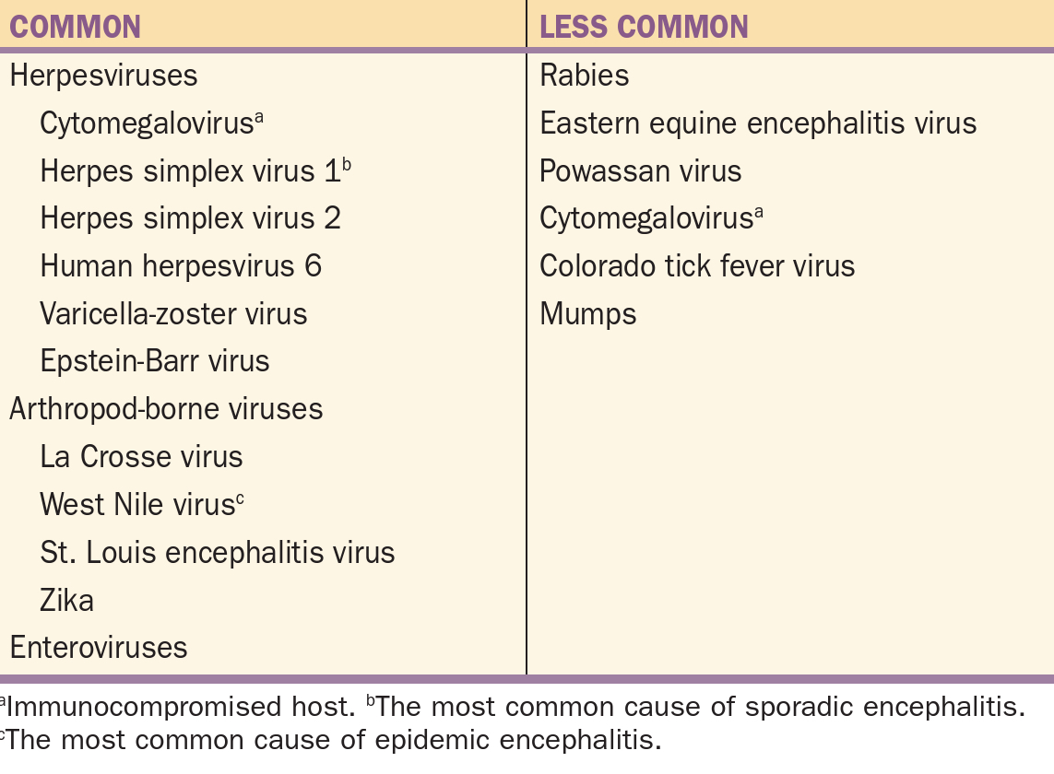

Slide 6
PATHOPHYSIOLOGY
Portal of Entry Mosquito- Transmit virus to the body
Hematogeneous Spread or neural and olfactory pathways.
Crosses BBB Enters neural cells
Disruption in cell functioning
Perivascular congestion, Haemorrhage Inflammatory response
Herpes simplex encephalitis- entry via olfactory nerve

Slide 7
In acute encephalitis, cerebral edema and petechial hemorrhages occur throughout the hemispheres, brain stem, cerebellum, and, occasionally, spinal cord.
• Direct viral invasion of the brain usually damages neurons, sometimes producing visible inclusion bodies.
• Severe infection, particularly untreated encephalitis, can cause brain hemorrhagic necrosis.

Slide 8
CLINICAL MANIFESTATIONS
Acute febrile illness with meningeal signs
Altered/depressed level of consciousness
Diffuse neurological signs – hallucinations, behavioural disturbances, personality change,, frank psychosis
Focal signs-aphasia, ataxia, UMN or LMN weakness, involuntary movements, cranial nerve defects

Slide 9
DIAGNOSIS-CSF EXAMINATION
Ideally 20 ml from all suspected patients
Lymphocytic pleocytosis,normal glucose,mildly elevated protein
Atypical lymphocytosis-EBV
Rarely polymorphonuclear lymphocytes-WNV
Red blood cells-20% of pts-due to hemorrhagic necrosis
CSF glucose normal

Slide 10
CSF PCR
Primary diagnostic test for CMV,EBV,HHV,Enteroviruses
HSV CSF PCR-sensitivity 96%,specificity 99% depends on
  Clinical likelihood of the disease
  Timing of the study
  Prior use of antiviral therapy
Enteroviral CSF PCR- 95%sensitivity and specificity
VZV CSF PCR-should be done always along with CSF antibody studies
WNV- CSF PCR less sensitive than antibody detection in CSF
EBV CSF PCR-false positives common

Slide 11
CSF CULTURE
Limited utility in diagnosis
Very insensitive
Takes too long to significantly effect immediate therapy

Slide 12
SEROLOGICAL STUDIES
Serum antibody determination is less useful for viruses with high seroprevalence rate in population-eg. HSV,EBV,VZV
Serological tests are useful mainly for retrospective diagnosis rather than helping in acute treatment
VZV-CSF antibody tests may be positive for varicella even when CSF VZV PCR is negative..so both tests should be done complementarily
WNV- CSF IgM antibodies are diagnostic of west nile virus encephalitis

Slide 13
IMAGING
MRI more sensitive than CT
CT-HSV shows focal areas of low absorption or contrast enhancement
MRI-
  HSV- areas of increased signal intensity in fronto temporal lobe(90%)
  WNV-2/3rd pts-abnormalities in thalamus,basal ganglia and brain stem
  VZV- multifocal areas of hemorrhagic and ischemic infarction
  CMV:immunocompromised adults-enlarged ventricles and subependymal enhancements

Slide 14
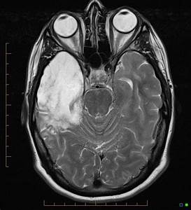
HSV encephalitis

Slide 15
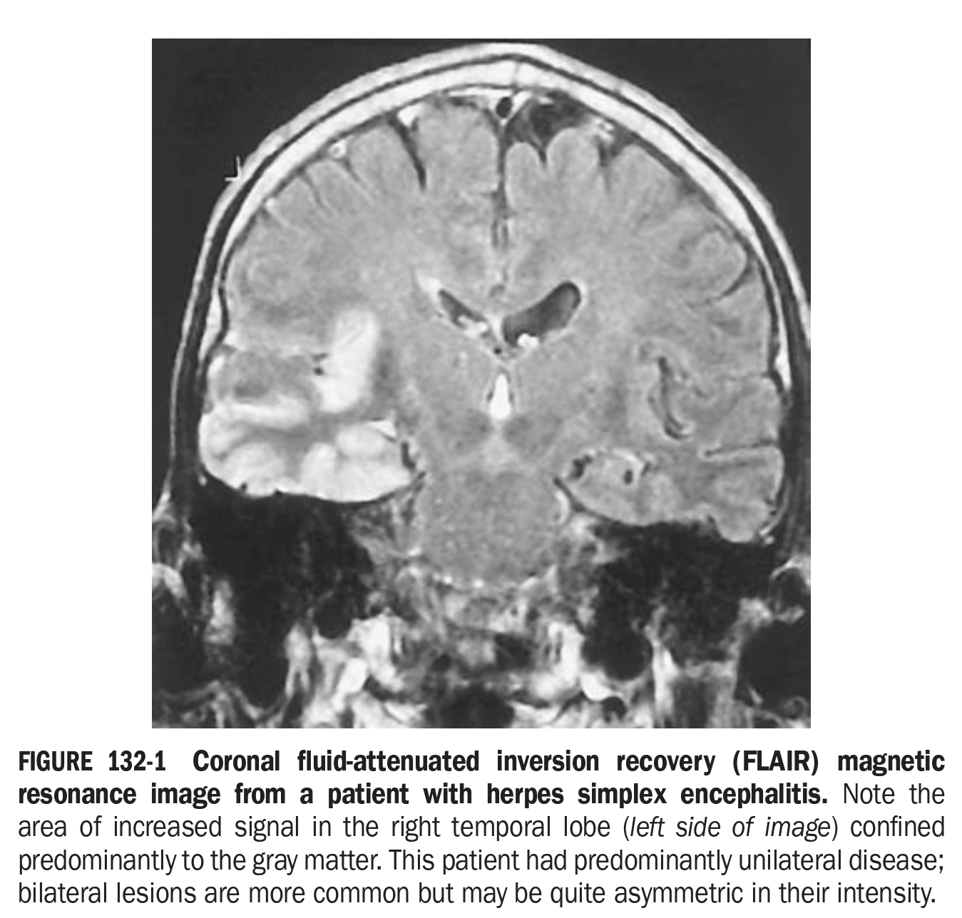

Slide 16
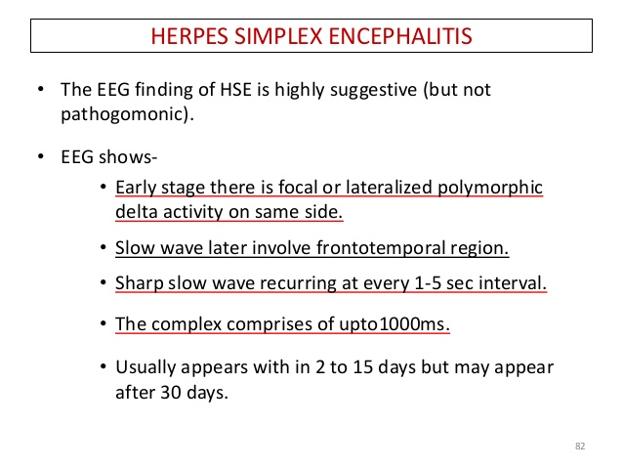
EEG

Slide 17
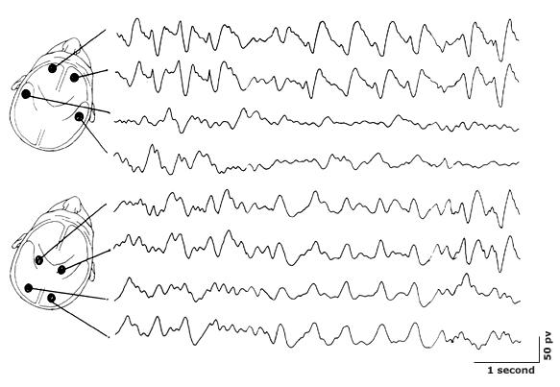
EEG HSV

Slide 18
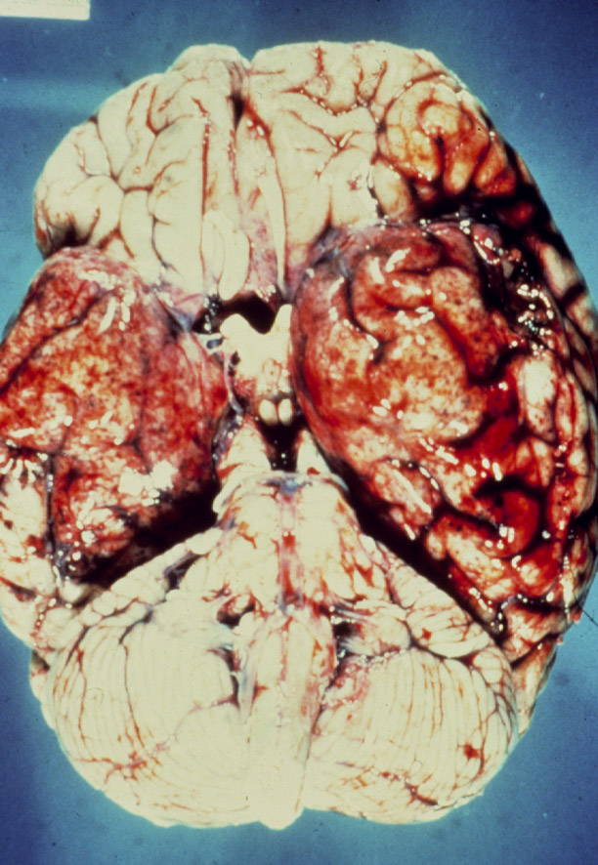

Slide 19
DIFFERENTIAL DIAGNOSIS
Infectious causes: mycobacteria,fungi,rickettsiae, listeria
Autoimmune encephalitis- diagnosis by detection of specific autoantibodies in CSF or serum
Paraneoplastic encephalitis
Hashimotos encephalopathy
Amoebic encephalitis- neutrophilic pleocytosis, low glucose, demonstration of motile trophozoites in wet mounts of CSF

Slide 20
How to distinguish HSV from the rest?
Why to distinguish?
When to suspect?
  Clinical findings suggesting inferomedial temporal lobe involvement
  Olfactory or gustatory hallucinations
  Anosmia
  Bizarre behaviour
  Focal findings in MRI
  Slow periodic spikes in EEG

Slide 21
TREATMENT
Evaluate and treat for shock or hypotension. Administer a crystalloid infusion until the patient is euvolemic.
Consider airway protection in patients with an altered mental status.
Consider seizure precautions. Treat seizures according to usual protocol (ie, lorazepam 0.1 mg/kg given intravenously [IV]).
Stabilize alert patients with normal vital signs by administering oxygen, securing IV access.
Expect complications of chronic immobilisation-DVT,aspiration pneumonia,decubitus ulcers

Slide 22
MEDICATIONS
Antivirals -The goal of the use of antivirals to shorten the clinical course, prevent complications, prevent the development of latency and/or subsequent recurrences, decrease transmission, and eliminate established latency
Acyclovir (Zovirax)
Adult • 10 mg/kg (infuse over 1 h) IV q8h for 14-21 d
Neonates-20 mg/kg i.v q8hourly
Administered as infusion
Can cause phlebitis and renal dysfunction
Other SE: thrombocytopenia,GI toxicity,neurotoxicity

Slide 23
2. Foscarnet (Foscavir)-CMV • Adult • 40 mg/kg IV q8h for 14-26 d
3.Ganciclovir-CMV infections 5mg/kg BD followed by 5mg/kg /day
4. Dexamethasone -10 mg IV q6h
5.Intravenous ribavirin-for severe rotaviral or adenoviral encephalitis
6.WNV-interferon ,ribavirin,IVIG

Slide 24
MANAGING COMPLICATIONS
Signs of hydrocephalus and increased ICP?
General measures: Manage fever and pain, control straining and coughing, and avoid seizures and systemic hypotension.
In otherwise stable patients, elevating the head and monitoring neurologic status usually are sufficient

Slide 25
When more aggressive maneuvers are indicated, some authorities favor the early use of diuresis (eg, furosemide 20 mg IV, mannitol 1 g/kg IV) provided circulatory volume is protected.
Dexamethasone 10 mg IV q6h helps in managing edema surrounding space-occupying lesions.
Hyperventilation (PaCO2 30 mm Hg) may cause a disproportional decrease in cerebral blood flow (CBF), but it is used to control increasing ICP on an emergency basis only.

Slide 26
PREVENTION
• Immunization against JE is recommended for those traveling into endemic areas during high-risk times of year and this must be explained to the patient

Slide 27
RABIES
Rhabdovirus transmitted by bite/saliva of dogs
Varying incubation period:9 days -8weeks
Encephalitic/furious rabies
  Fever, fluctuating consciousness and autonomic hyperactivity
  Phobic spasms of pharynx,larynx and diaphragm on attempts to drink water-hydrophobia
  Or by inspiration- aerophobia
Dumb rabies
  Presents as acute ascending paralysis

Slide 28
TREATMENT
Diagnosed by rapid immunofluorescent tests to detect antigen in corneal smears or skin biosies
Clean wound, excise debris,leave unsutured
HDC strain vaccine-1 ml i.m on days 0,3,7,14,30 and 90
HRIG(human rabies immunoglobulin)- 20 U/kg ,50% i.m and 50 % infiltrated in the wound
Only palliative treatment for established disease:
  Heavy sedation with diazepam and chlorpromazine
  Nutrition and fluids through i.v or gastrostomy

Slide 29
POLIOMYELITIS
Enterovirus causes lymphocytic meningitis and infects grey matter of the spinal cord,brainstem and cortex
Propensity to damage anterior horn cells especially in lumbar region
Incubation period 7-14 days
Weakness starts in one muscle group and spreads later.
Maximal weakness at the end of one week and recovery takes months
Respiratory paralysis- intercostal involvement

Slide 30
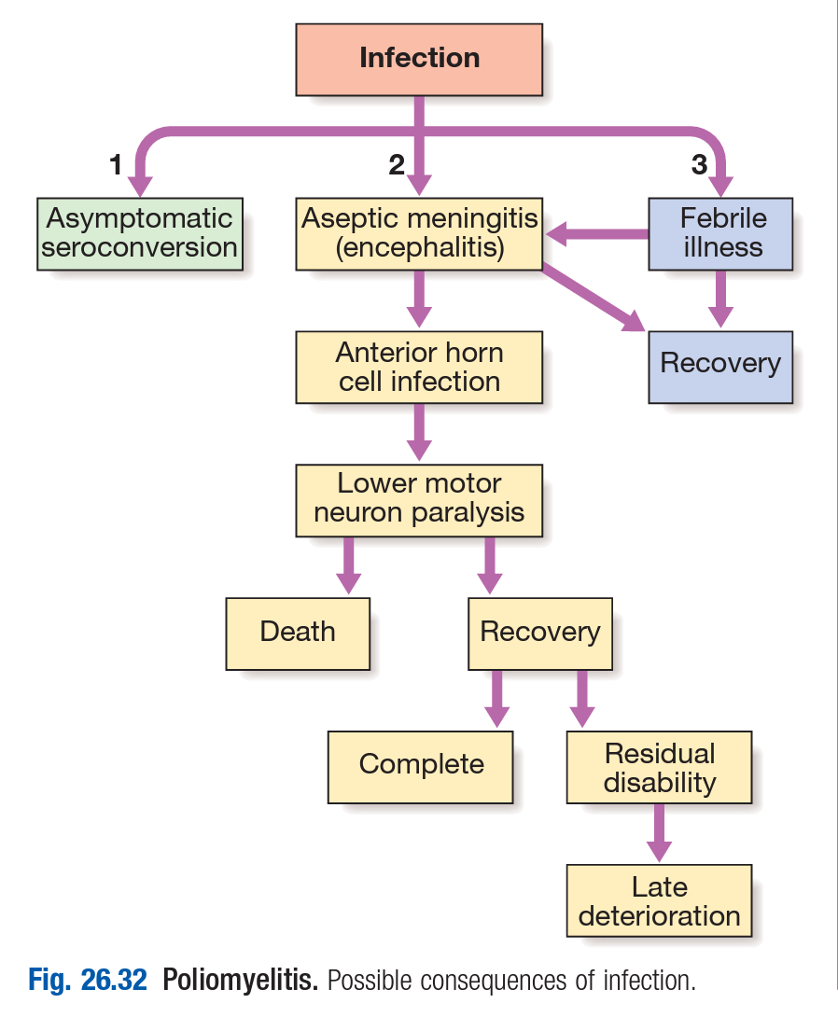

Slide 31
Investigations:
  CSF-lymphocytic pleocytosis,increased protein and normal sugar
  CSF and stool culture
Management:
  Bed rest,tracheostomy,ventilation.
  Physiotherapy and orthopedic measures
  prevention
  Universal polio vaccination

Slide 32
JAPANESE ENCEPHALITIS
Single stranded flavivirus transmitted by mosquito bite(culex tritaeniorhyncus)
Incubation period 6-16 days
Thalamus, basal ganglia, midbrain, cerebral cortex, cerebellum and anterior horn cells are affected
Clinical features:
  Fever, headache,seizures, altered sensorium,focal neurological deficits in the form of hemiplegia,quadrplegia or cerbellar signs
  Focal LMN signs may be present
  20-80% have movement disorders- parkinsonian features,dystonia.

Slide 33
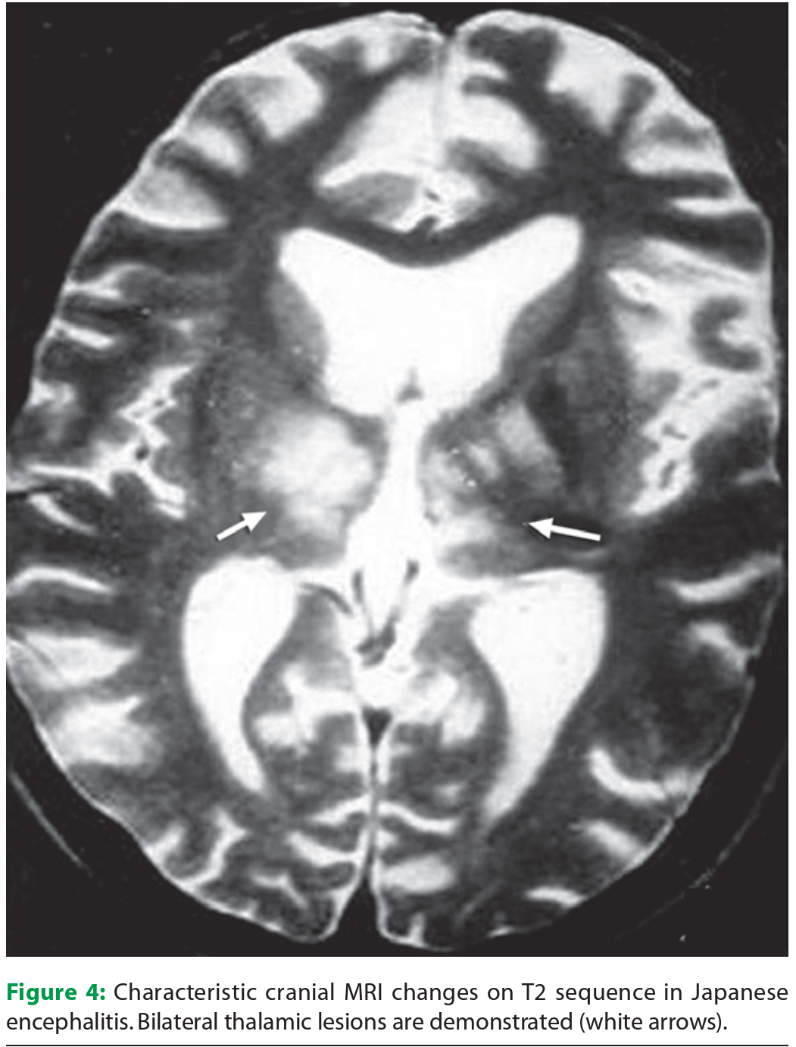

Slide 34
Diagnosis:
  CSF IgM capture ELISA-sensitivity and specificity of 90%
  CT/MRI-involvement of thalamus, basal ganglia and brain stem are characteristic.
Management:
  Symptomatic and supportive treatment
Prevention:
  Immunisation with formalin inactivated vaccine.

Slide 35
THANKYOU!!

