Slide 1
BACTERIAL MENINGITIS

Slide 2
Introduction
Bacterial meningitis is an inflammation of the leptomeninges, usually caused by bacterial infection.
CNS inflammatory reaction may result in decreased consciousness,seizures,raised ICP or stroke.
Bacterial meningitis may present acutely (symptoms evolving rapidly over 1-24 hours), sub acutely (symptoms evolving over 1-7days), or chronically (symptoms evolving over more than 1 week).

Slide 3
CAUSATIVE ORGANISMS
Streptococcus pneumoniae-m/c
Predisposing pneumonia,sinusitis,otitis media,splenectomy,complement deficiency
Neisseria meningitidis
H.influenza type b(unvaccinated children)
Listeria monocytogenes(<3mths,>60yrs age)
S.aureus and coagulase negative streptococci
Gram negative bacilli

Slide 4
PATHOGENESIS
Meningococci are transmitted by droplet aerosol or secretions from the nasopharynx of colonized persons.
The bacteria attach to and multiply on the mucosal cells of the nasopharynx. In a small proportion (less than 1%) of colonized persons, the organism penetrates the mucosal cells and enters the bloodstream

Slide 5
The pathogenic bacterium from blood invades the leptomeninges.
Bacterial toxins and Inflammatory mediators are released
The outer membrane is surrounded by a polysaccharide capsule that is necessary for pathogenicity because it helps the bacteria resist phagocytosis and complement-mediated lysis.

Slide 6
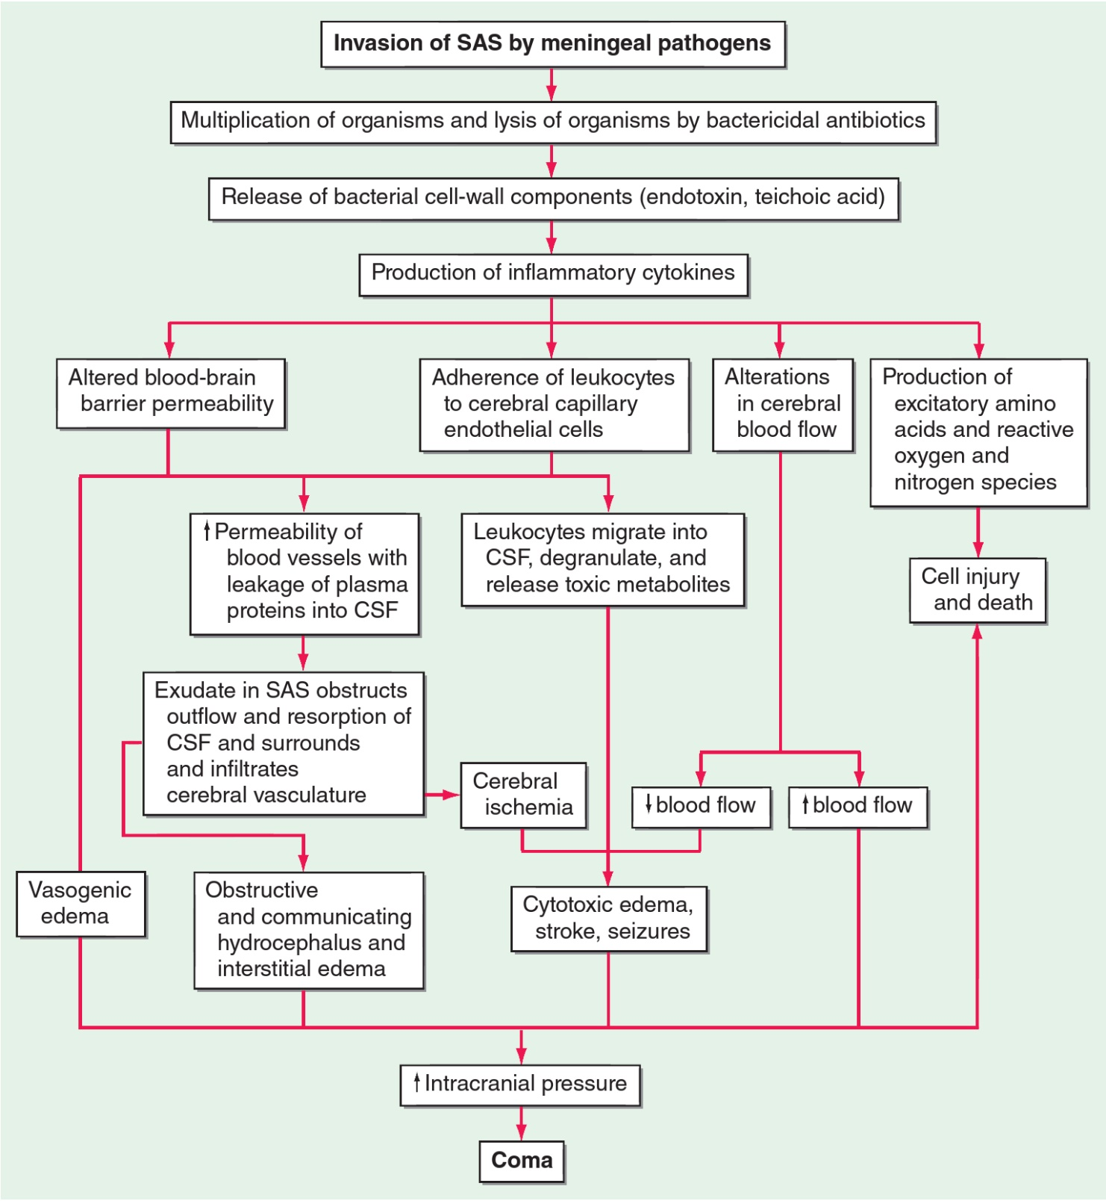

Slide 7
CLINICAL PRESENTATION
Meningitis can present as either an
acute fulminant illness that progresses rapidly in a few hrs
subacute infection that progressively worsens over several days
The classic clinical triad of meningitis is fever, headache, and nuchal rigidity
A decreased level of consciousness occurs in >75% of patients.
Coma. Nausea, vomiting, and photophobia are also common complaints
Seizures
Focal: focal ischemia/infarction, focal edema,cortical venous thrombosis
General: hyponatremia,anoxia

Slide 8
Raised ICP is an expected complication of bacterial meningitis and the major cause of obtundation and coma, with an opening pressure >180 mmH2O.
Signs of increased ICP :
deteriorating or reduced level of consciousness,
papilledema
dilated poorly reactive pupils
sixth nerve palsies
decerebrate posturing
Cushing reflex (bradycardia, hypertension, and irregular respirations).
The most disastrous complication of increased ICP is cerebral herniation.

Slide 9
Specific clinical features
The rash of meningococcemia, which begins as a diffuse erythematous maculopapular rash resembling a viral exanthem; however, the skin lesions of meningococcemia rapidly become petechial.
Petechiae are found on the trunk and lower extremities, in the mucous membranes and conjunctiva, and occasionally on the palms and soles.

Slide 10
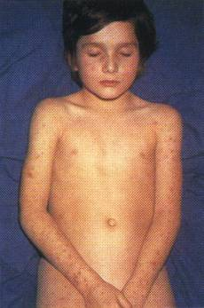
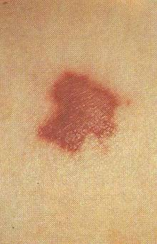
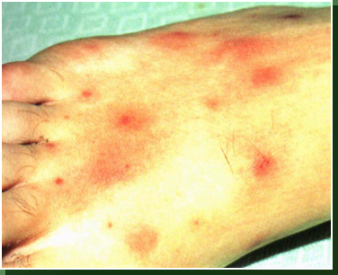
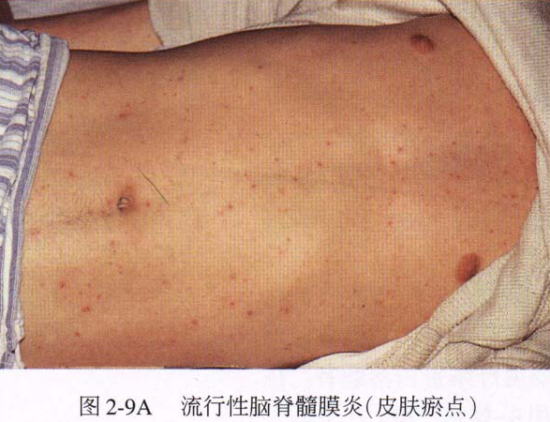

Slide 11
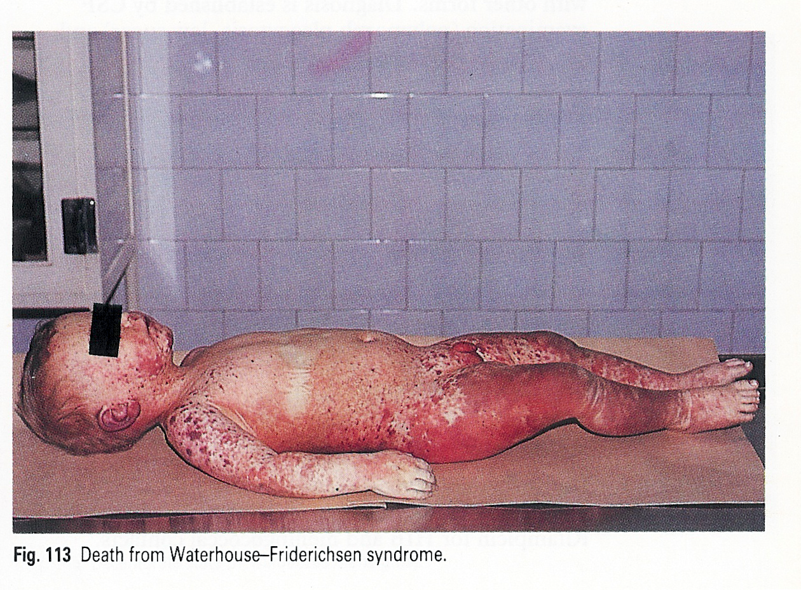
Adrenal hemorrhage (Waterhouse-Friderichsen syndrome) syndrome

Slide 12
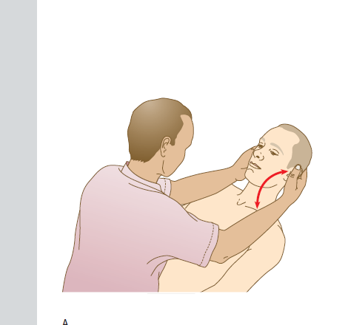
Neck stiffness/nuchal rigidity
Pathognomonic sign of meningeal irritation
Neck resists passive flexion
Cervical spine disease in elderly patients may result in false positive nuchal rigidity

Slide 13
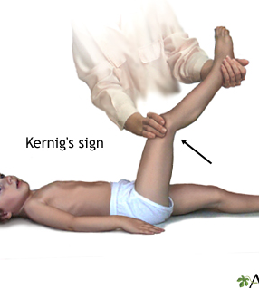
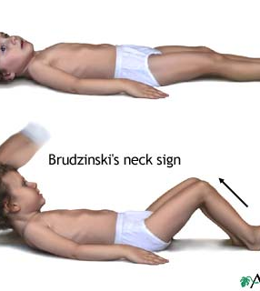
Clinical examination and Important Signs

Slide 14
Diagnosis
Blood cultures should be immediately obtained and empirical antimicrobial therapy initiated without delay
The diagnosis of bacterial meningitis is made by examination of the CSF.
Antibiotic therapy initiated a few hours prior to LP will not significantly alter the CSF WBC count or glucose concentration, nor is it likely to prevent visualization of organisms by Gram's stain.
Neuroimaging before lumbar puncture??yes or no??
Normal consciousness
No h/o trauma
No papilledema
No focal neurological deficits

Slide 15
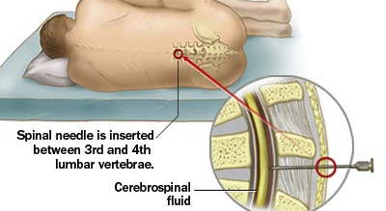
Lumbar puncture for CSF Examination

Slide 16
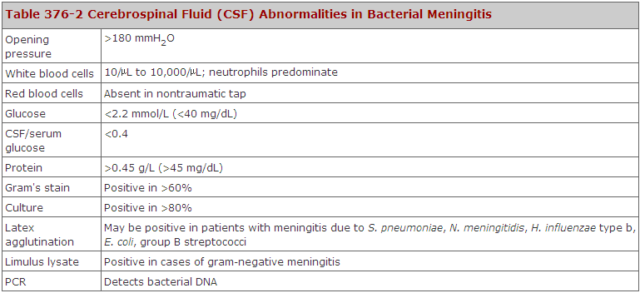

Slide 17
Imaging studies:
MRI superior to CT in demonstrating areas of cerebral edema and ischemia
Diffuse meningeal enhancement is seen
Biopsy of petechial lesions and gram stain

Slide 18
Differential Diagnosis
Viral meningoencephalitis
The typical CSF profile with viral CNS infections is a lymphocytic pleocytosis with a normal glucose concentration, in contrast to PMN pleocytosis and hypoglycorrhachia characteristic of bacterial meningitis.
HSV encephalitis: CSF HSV PCR, MRI- temporal lobe high signal intensity, distinctive periodic pattern in EEG

Slide 19
Differential Diagnosis
Focal suppurative CNS infections, including
subdural and epidural empyema and
brain abscess, when focal neurologic findings are present.
MRI should be performed promptly in all patients with suspected meningitis who have focal features, both to detect the intracranial infection and to search for associated areas of infection in the sinuses or mastoid bones.

Slide 20
Differential Diagnosis
noninfectious CNS disorders
Subarachnoid hemorrhage.
chemical meningitis due to rupture of tumor contents into the CSF (e.g., from a cystic glioma or craniopharyngioma epidermoid or dermoid cyst)
drug-induced hypersensitivity meningitis
carcinomatous or lymphomatous meningitis
meningitis associated with inflammatory disorders such as sarcoid, systemic lupus erythematosus (SLE), and Behçet's syndrome
subacutely evolving meningitis. The principal causes include Mycobacterium tuberculosis and Cryptococcus neoformans

Slide 21
Management
Bacterial meningitis is a medical emergency. The goal is to begin antibiotic therapy within 60 min.
Empirical antimicrobial therapy is initiated in patients with suspected bacterial meningitis before the results of CSF Gram's stain and culture are known. S. pneumoniae and N. meningitidis are the most common etiologic organisms of community-acquired bacterial meningitis.
a combination of dexamethasone, a third-generation cephalosporin (e.g., ceftriaxone or cefotaxime) and vancomycin, plus acyclovir, as HSV encephalitis is the leading disease in the differential diagnosis, and doxycycline during tick season to treat tick-borne bacterial infections.

Slide 22
Ceftriaxone or cefotaxime provide good coverage for susceptible S. pneumoniae, group B streptococci, and H. influenzae and adequate coverage for N. meningitidis.
Cefepime is a broad-spectrum fourth-generation cephalosporin with in vitro activity similar to that of cefotaxime or ceftriaxone against S. pneumoniae and N. meningitidis and greater activity against Enterobacter species and Pseudomonas aeruginosa.
Ampicillin should be added to the empirical regimen for coverage of L. monocytogenes in individuals <3 months of age, those >55, or those with suspected impaired cell-mediated immunity because of chronic illness, organ transplantation, pregnancy, malignancy, or immunosuppressive therapy.

Slide 23
Empirical Antimicrobial Therapy
In hospital-acquired meningitis, staphylococci and gram-negative organisms including P. aeruginosa are the most common etiologic organisms.
In these patients, empirical therapy should include a combination of vancomycin and ceftazidime, cefepime, or meropenem.
Ceftazidime, cefepime, or meropenem should be substituted for ceftriaxone or cefotaxime in neurosurgical patients and in neutropenic patients, as ceftriaxone and cefotaxime do not provide adequate activity against CNS infection with P. aeruginosa.

Slide 24
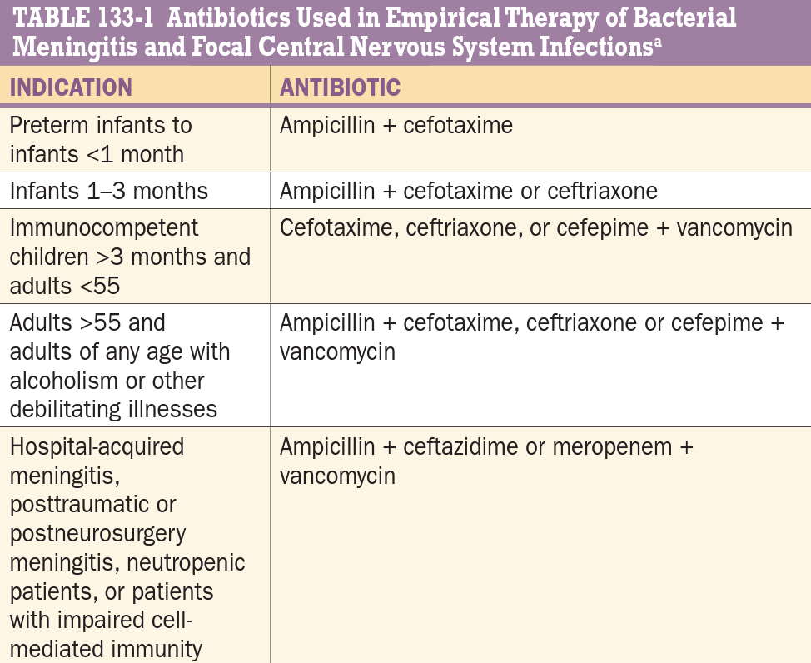

Slide 25
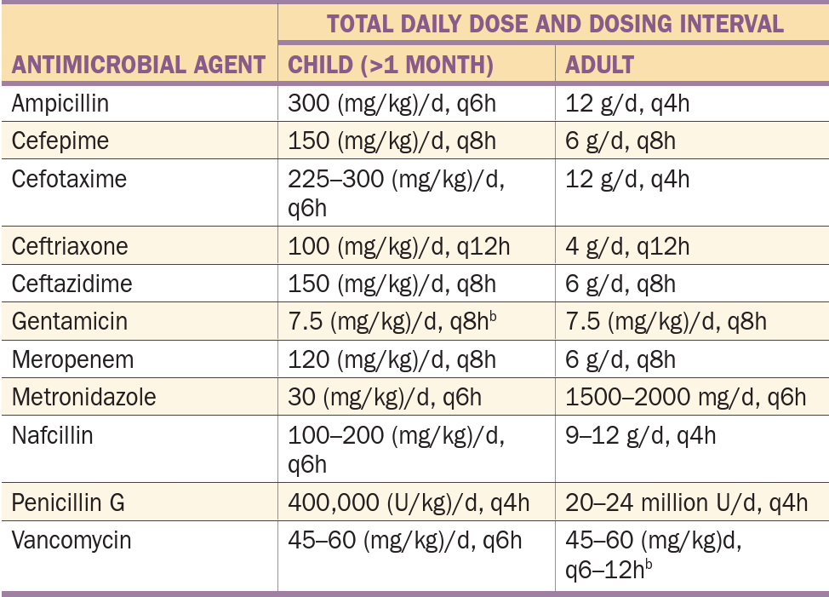

Slide 26
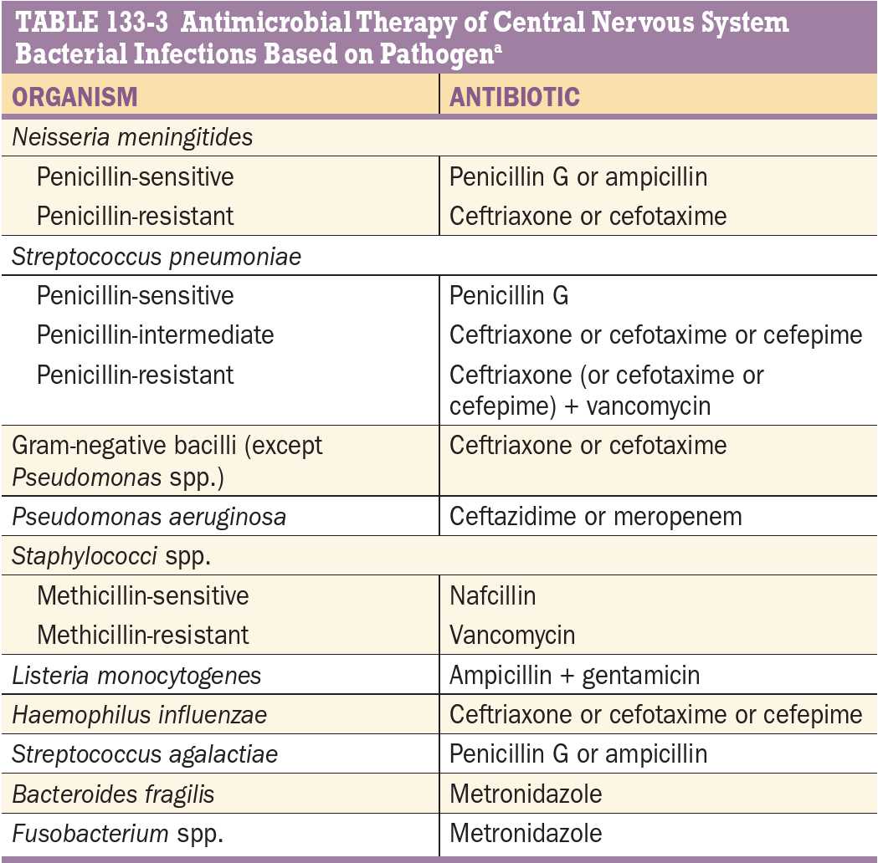
Specific antimicrobial therapy

Slide 27
Role of steroids
Dexamethasone – ideally given 20 mins before initiation of antibiotics
0.15mg/kg 4 times daily for 2-4 days
It inhibits the synthesis of cytokines
Decreases CSF outflow resistance
Stabilises the blood brain barrier
Decreases neurologic sequelae: decreased intellectual function,memory impairment,hearing loss,gait disturbances

Slide 28
Management of increased ICP
Elevation of patients head 30-45degrees
Intubation and hyperventilation
i.v mannitol

Slide 29
PROGNOSIS
Decreased level of consciousness at admission
Onset of seizures within 24 hours
Signs of raised ICP
Infancy and old age> 50
Comorbid conditions
Delay in treatment initiation
Markedly reduced glucose and elevated protein in CSF

Slide 30
PREVENTION
Close contacts of all patients of meningococcal meningitis-chemoprophylaxis with 2 day regimen of rifampin 600mg BD
Vaccination

Slide 31
THANKYOU

