Slide 1
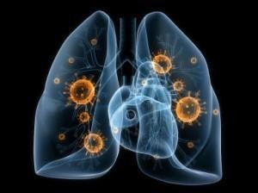
Health Care Associated Pneumonia

Slide 2
INTRODUCTION
Nosocomial pneumonia pneumonia acquired while in a hospital
From the Latin word nosocomium: “hospital”
Classically divided into:
  Hospital-acquired pneumonia (HAP)
  Ventilator-associated pneumonia (VAP)
  Recently has also been applied to health care–associated pneumonia (HCAP)

Slide 3
DEFINITIONS (CLINICAL)
Hospital-acquired (or nosocomial) pneumonia (HAP)
  Pneumonia that occurs 48 hours or more after admission
  Not incubating at the time of admission
Ventilator-associated pneumonia (VAP)
  Develops more than 48 to 72 hours after intubation.
  Healthcare-associated pneumonia (HCAP)
  Pneumonia in a nonhospitalized patient
  With extensive healthcare contact

Slide 4
Introduction
Nosocomial pneumonia is the 2nd most common hospital-acquired infections after UTI. Accounting for 31 % of all nosocomial infections
Nosocomial pneumonia is the leading cause of death from hospital-acquired infections.
The incidence of nosocomial pneumonia is highest in ICU (intensive care unit)

Slide 5
Introduction
The incidence of nosocomial pneumonia in ventilated patients was 10-fold higher than non-ventilated patients
The reported crude mortality for HAP is 30% to greater than 70%.
---

Slide 6
Pathogenesis
For pneumonia to occur, at least one of the following three conditions must occur:
1. Significant impairment of host defenses
2. Introduction of a sufficient-size inoculum to overwhelm the host's lower respiratory tract defenses
3. The introduction of highly virulent organisms into the lower respiratory tract
Most common is microaspiration of oropharyngeal secretions colonized with pathogenic bacteria.

Slide 7
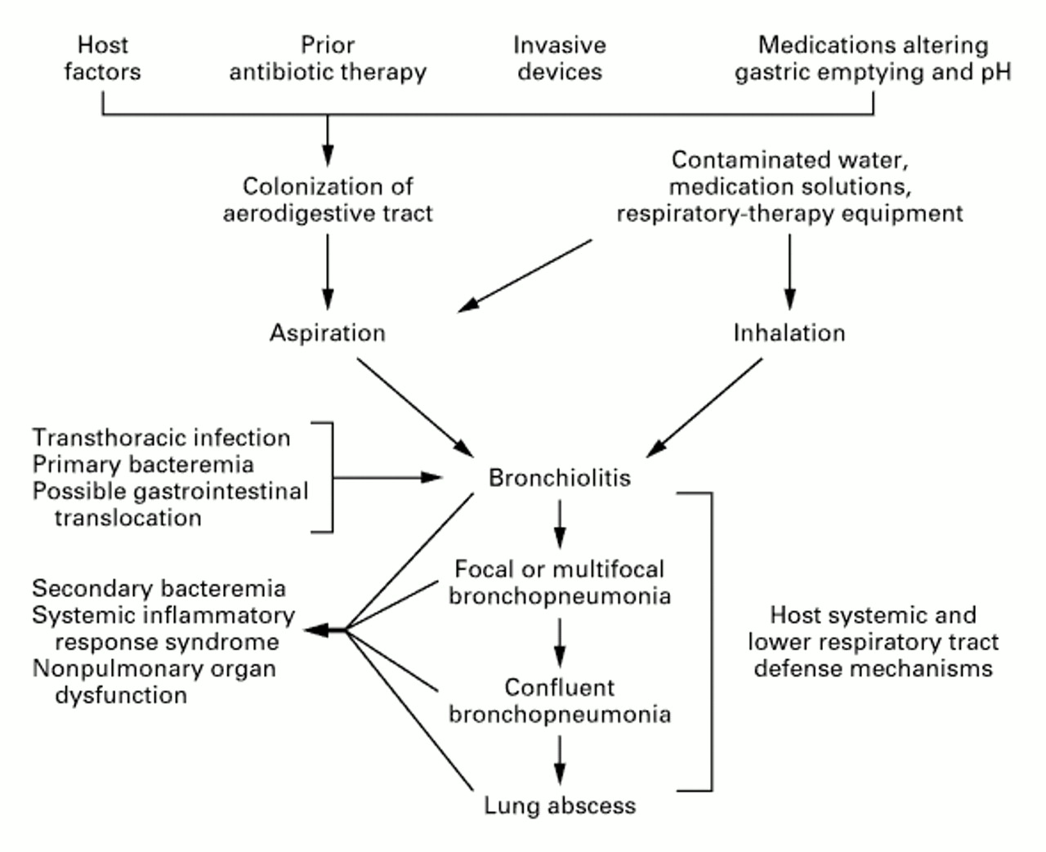
Pathogenesis

Slide 8
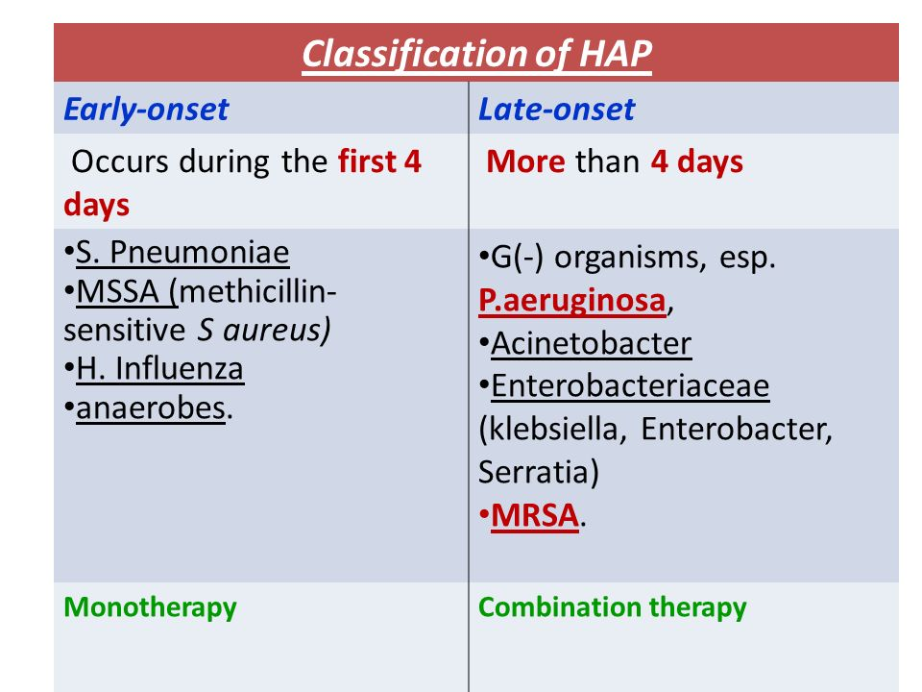
Classification
Early-onset nosocomial pneumonia:
Occurs during the first 4 days of admission.
Usually is due to S. pneumoniae, MSSA (Methicillin sensitive S.aureus ), H. Influenza, or anaerobes.
Late-onset nosocomial pneumonia:
occurs more than 4 days of admission.
More commonly by Gram negative organisms, especially: P. aeruginosa, Acinetobacter, Enterobacteriaceae (Klebsiella, Enterobacter, Serratia) or MRSA.

Slide 9
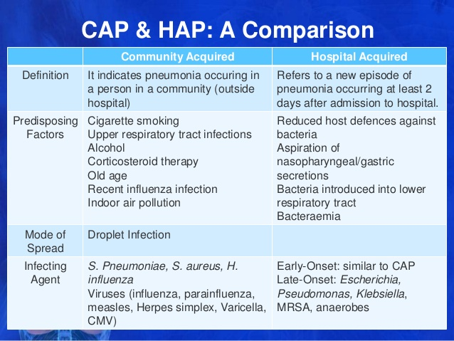

Slide 10
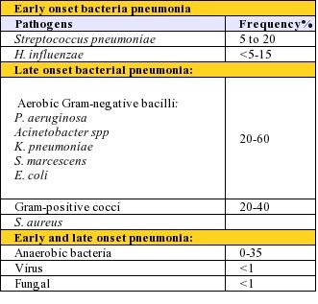
Causative Agents
P. aeruginosa and Acinetobacter are common causes of late-onset pneumonia, particularly in the ventilated patients.

Slide 11
Causative Agents
S. aureus is isolated in about 20~40% of cases and is particularly common in :
  1. Ventilated patients after head trauma, neurosurgery, and wound infection
  2. In patients who had received prior antibiotics or
  Prolonged care in ICU
MRSA(methicillin resistant S.aureus) is seen more commonly in patients who:
Received corticosteroids
Undergone mechanical ventilation >5 days
Presented with chronic lung disease
Had prior antibiotics therapy

Slide 12
Causative Agents
Anaerobes are common in patients predisposed to aspiration .
Ventilator associated pneumonia (VAP )with anaerobes occurred more often with oropharyngeal intubation than nasopharyngeal intubation.

Slide 13

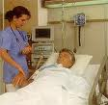
Ventilator-associated Pneumonia (VAP)

Slide 14
Ventilator-associated Pneumonia (VAP)
Definition:
Nosocomial pneumonia that has developed in patient who are receiving mechanical ventilation.
Classification:
Early-onset: 48-72 hours after tracheal intubation, which complicates the intubation process
Late-onset: after 72 hours

Slide 15
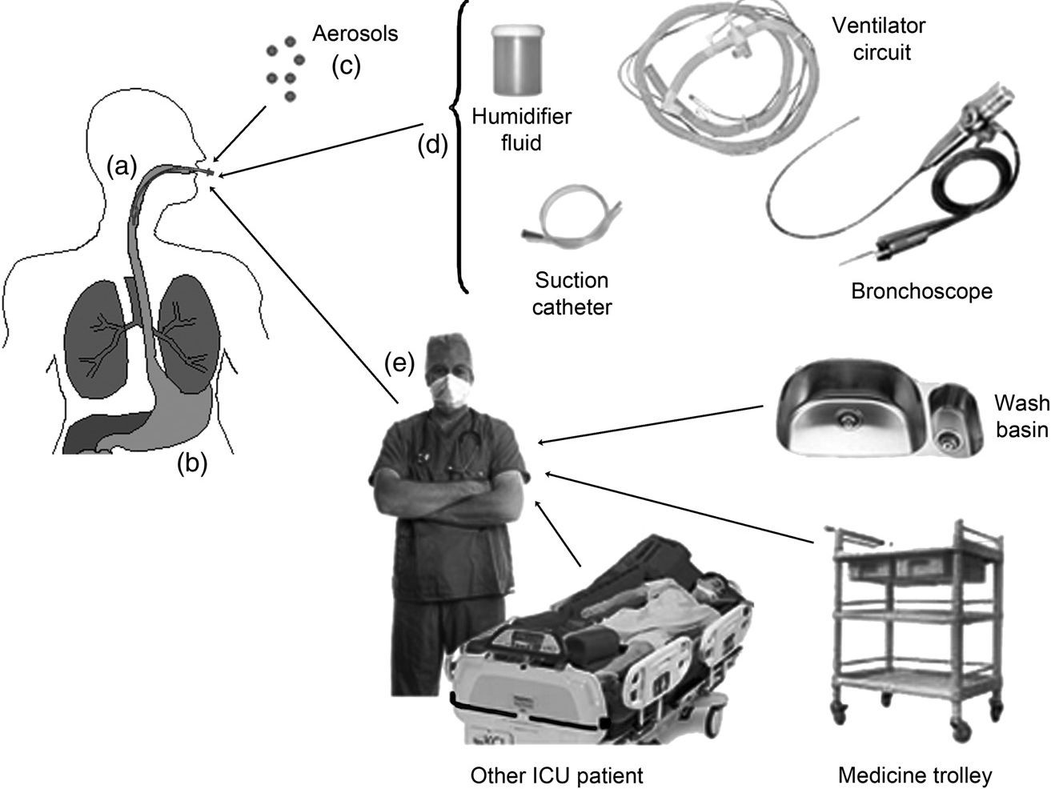

sources of pathogen
Oropharyn geal
colonizatio n
Gastric coloniza tion
Contaminated hands and Apparels of health
Care workers
Your Address, FILE: HAP presentation.odp / 03-1-24 / Page 8
Your Institute Your.Email@somewhere.com
European Journal of Internal Medicine 21 (2010) 360–368

Slide 16
Pathogenesis
Requires 2 important processes:
1. Bacterial colonization of the aerodigestive tract
2. Aspiration of contaminated secretion into the
Lower airway
Prevents mechanical clearance by cough and the mucociliary escalator.

Slide 17
VAP pathogenesis
Incidence of
VAP
Bacterial colonization of Aerodigestive tract
Aspiration of contaminated secretions past the cuff to the lower airways
Bacteria entered in to the Lower respiratory tract
● The magnitude of this response is dependent on the type of the inoculum and its size, the virulence of the pathogen, and the competence of the host's immune system
Aspiration is the most significant risk factor for VAP

Slide 18
Role of oropharyngeal & gastric colonization in VAP
Oropharyngeal colonization:
Aspiration of oropharyngeal pathogens around the endotracheal tube cuff is the primary routes of bacterial entry into the lower respiratory tract
ETT is commonly made of PVC & bacteria easily adhere to its internal surface and from Biofilm
Gastric colonization:
The stomach is potential reservoirs for MDR Gr -ve pathogens
The chief predisposing factors for gastric colonization, gastric pH, enteral nutrition
e

Slide 19
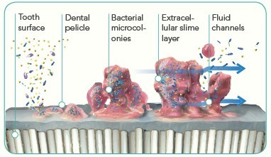

Slide 20
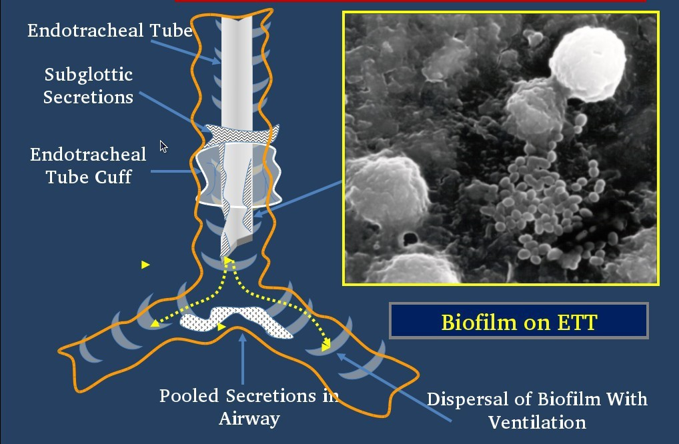

Slide 21
Diagnosis
The guidelines address two separate diagnostic strategies for HAP, VAP, and HCAP
Clinical strategy
And
Bacteriologic strategy
Your Address, FILE: HAP presentation.odp / 03-1-24 / Page 14
Your Instituteour.Email@somewhere.com

Slide 22
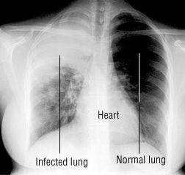
Clinical strategy
Clinical
  Fever (>380C)
  Cough with purulent sputum
Radiographic
  New or progressive infiltrates on Chest X-ray
Laboratorial
  Leukocytosis or leukopenia (Increase or decrease WBC)

Slide 23
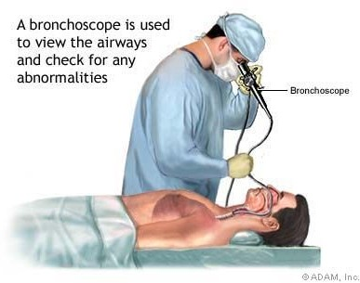
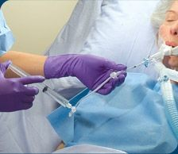
Microbiological Diagnosis of HAP
Suggestive Gram stain and positive cultures of
  Blood culture
  Samples of lower respiratory tract secretion should be obtained including:
  Endotracheal aspirate
  BAL, or Protected specimen brush sample
  If there a complicating empyema, a
pleural aspirate should be obtained
Bronchoalveolar lavage with bronchoscopy
Bronchial Aspirate Sampling
Your Address, FILE: HAP presentation.odp / 03-1-24 / Page 16
Your Institute Your.Email@somewhere.com

Slide 24
Treatment
Most initial therapy is empiric because no pathogen is identified or results are not available when antimicrobial decisions are made in most patients.

Slide 25
Treatment
Initially be treated with a broad-spectrum antibiotic regimen aimed at covering all likely bacterial pathogen
This regimen should subsequently be narrowed, according to the result of culture

Slide 26
Treatment
The mortality can be reduced with early appropriate empiric therapy.
  ----

Slide 27
Treatment
Guidelines by American Thoracic Society has separated patients into three groups, each with a set of probable pathogens.
Group 1: mild to moderate HAP with no risk factor
Group 2: mild to moderate HAP with risk factor
Group 3a: severe HAP, early-onset with no risk factor
Group 3b: severe HAP, late-onset or with risk factor

Slide 28
Treatment
For mild-to-moderate HAP, monotherapy has been shown to be effective.
For severe HAP in which infection with resistant organisms is likely, combination therapy probably should be instituted until culture result are available.

Slide 29
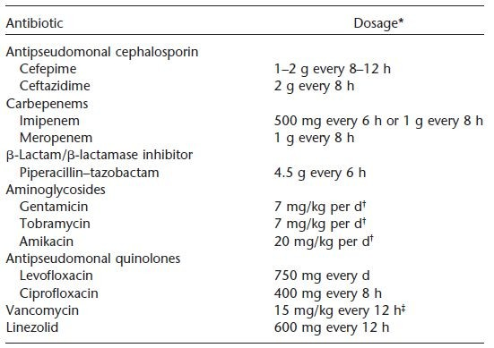
Your Address, FILE: HAP presentation.odp / 03-1-24 / Page 22
Your Institute Your.Email@somewhere.com

Slide 30
Response to Therapy
If no clinical response is noted or deterioration occurs, we need to consider:
1. Infectious causes:
Resistant pathogen
Superinfection
Unusual pathogens
Lung abscess
Extrapulmonary infection
2. Noninfectious events:
Heart: congestive heart failure (CHF)
Lung: fibroproliferative acute respiratory distress syndrome (ARDS), pulmonary emboli, Atelectesis.

Slide 31
The key components of a Ventilator Bundle are
Elevation of the head of the bed
Daily interruption of sedation and assessment of readiness to extubate
Peptic Ulcer Disease Prophylaxis
Deep Venous Thrombosis (DVT) Prophylaxis
Daily Oral Care with Chlorhexidine
Hand hyigene

Slide 32
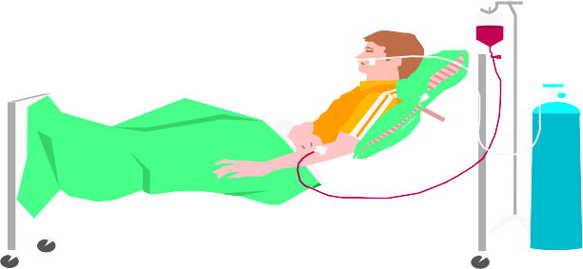
Elevation of the head of the bed

The recommended elevation is 30 to 45 degrees
 May decrease chances of aspiration of gastric contents
 Reduce the rate of VAP

Slide 33
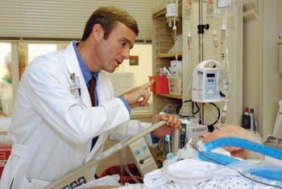
Daily interruption of sedation and assessment of readiness to extubate
 Lightening sedation decreases the time spent on MV
 In a study interruption of sedation leads to decreased MV from 7.3 days to 4.9 days
 But, may be an increased potential for pain and anxiety associated with lightening sedation

Slide 34
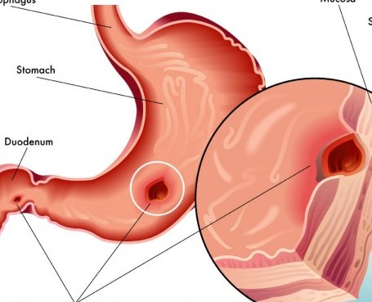
Peptic Ulcer Disease Prophylaxis
 Stress induced GI erosions and ulcer are common in ICU patients
 H2- receptor inhibitors are more preferred than sucralfate
 Raise gastric pH may promote the growth of bacteria in the stomach

Slide 35
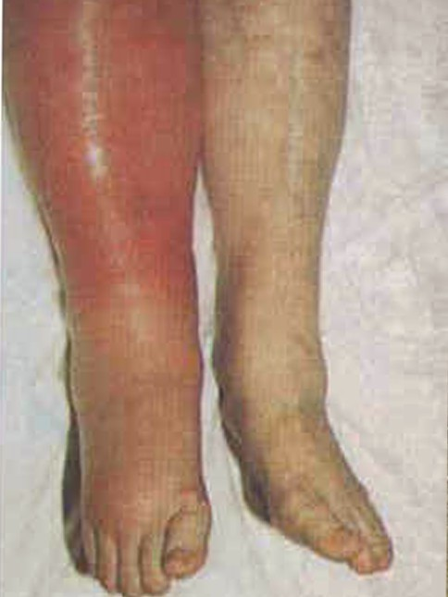
DVT prophylaxis
 Ventilated patients are at a high risk of developing DVT
 The risk of venous thromboembolism is reduced if prophylaxis is consistently applied
 But, Risk of bleeding may increase if anticoagulants are used to accomplish prophylaxis

Slide 36
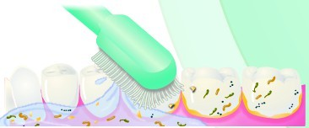
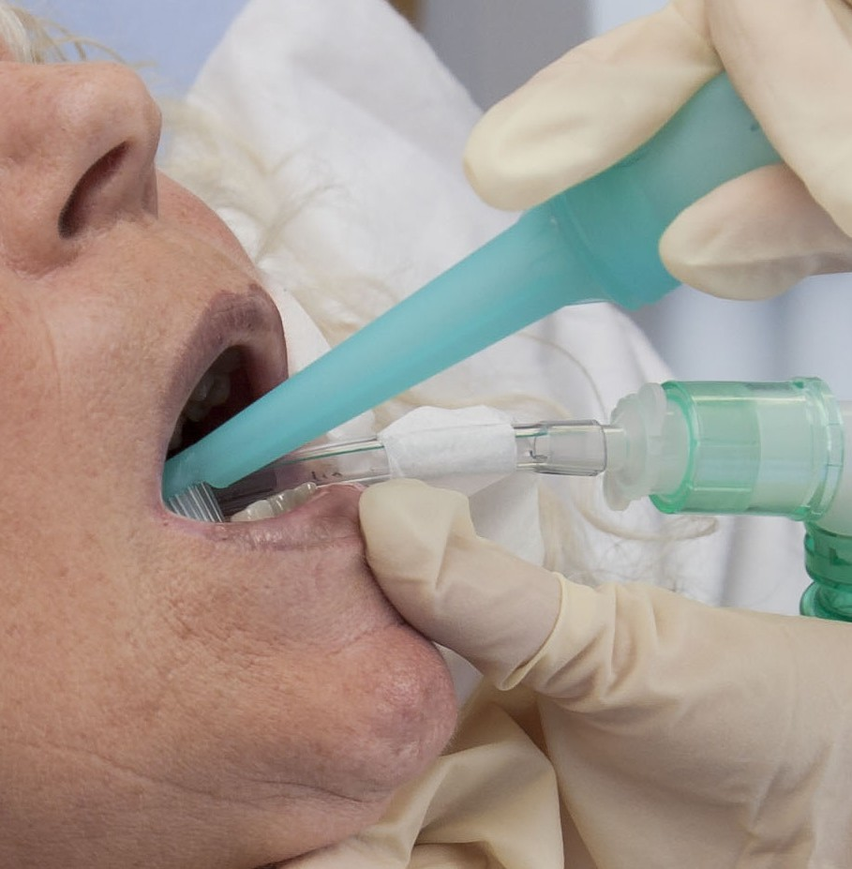
Daily Oral Care with Chlorhexidine
 Dental plaques are covered by a biofilm which are colonized by bacteria and leads to VAP
 The recommended chlorhexidine solution Recommended strength is 0.12%
 Nursing staff needs to be educated regarding use of chlorhexidine oral rinse

Slide 37


Appropriate hand hygiene
 Appropriate time for hand washing includes
Before and after touching a patient
Before and after an invasive procedure
After removing gloves
If contamination is suspected
 Washing hands or using an alcohol- based waterless hand cleaner can help to prevent contamination

Slide 38
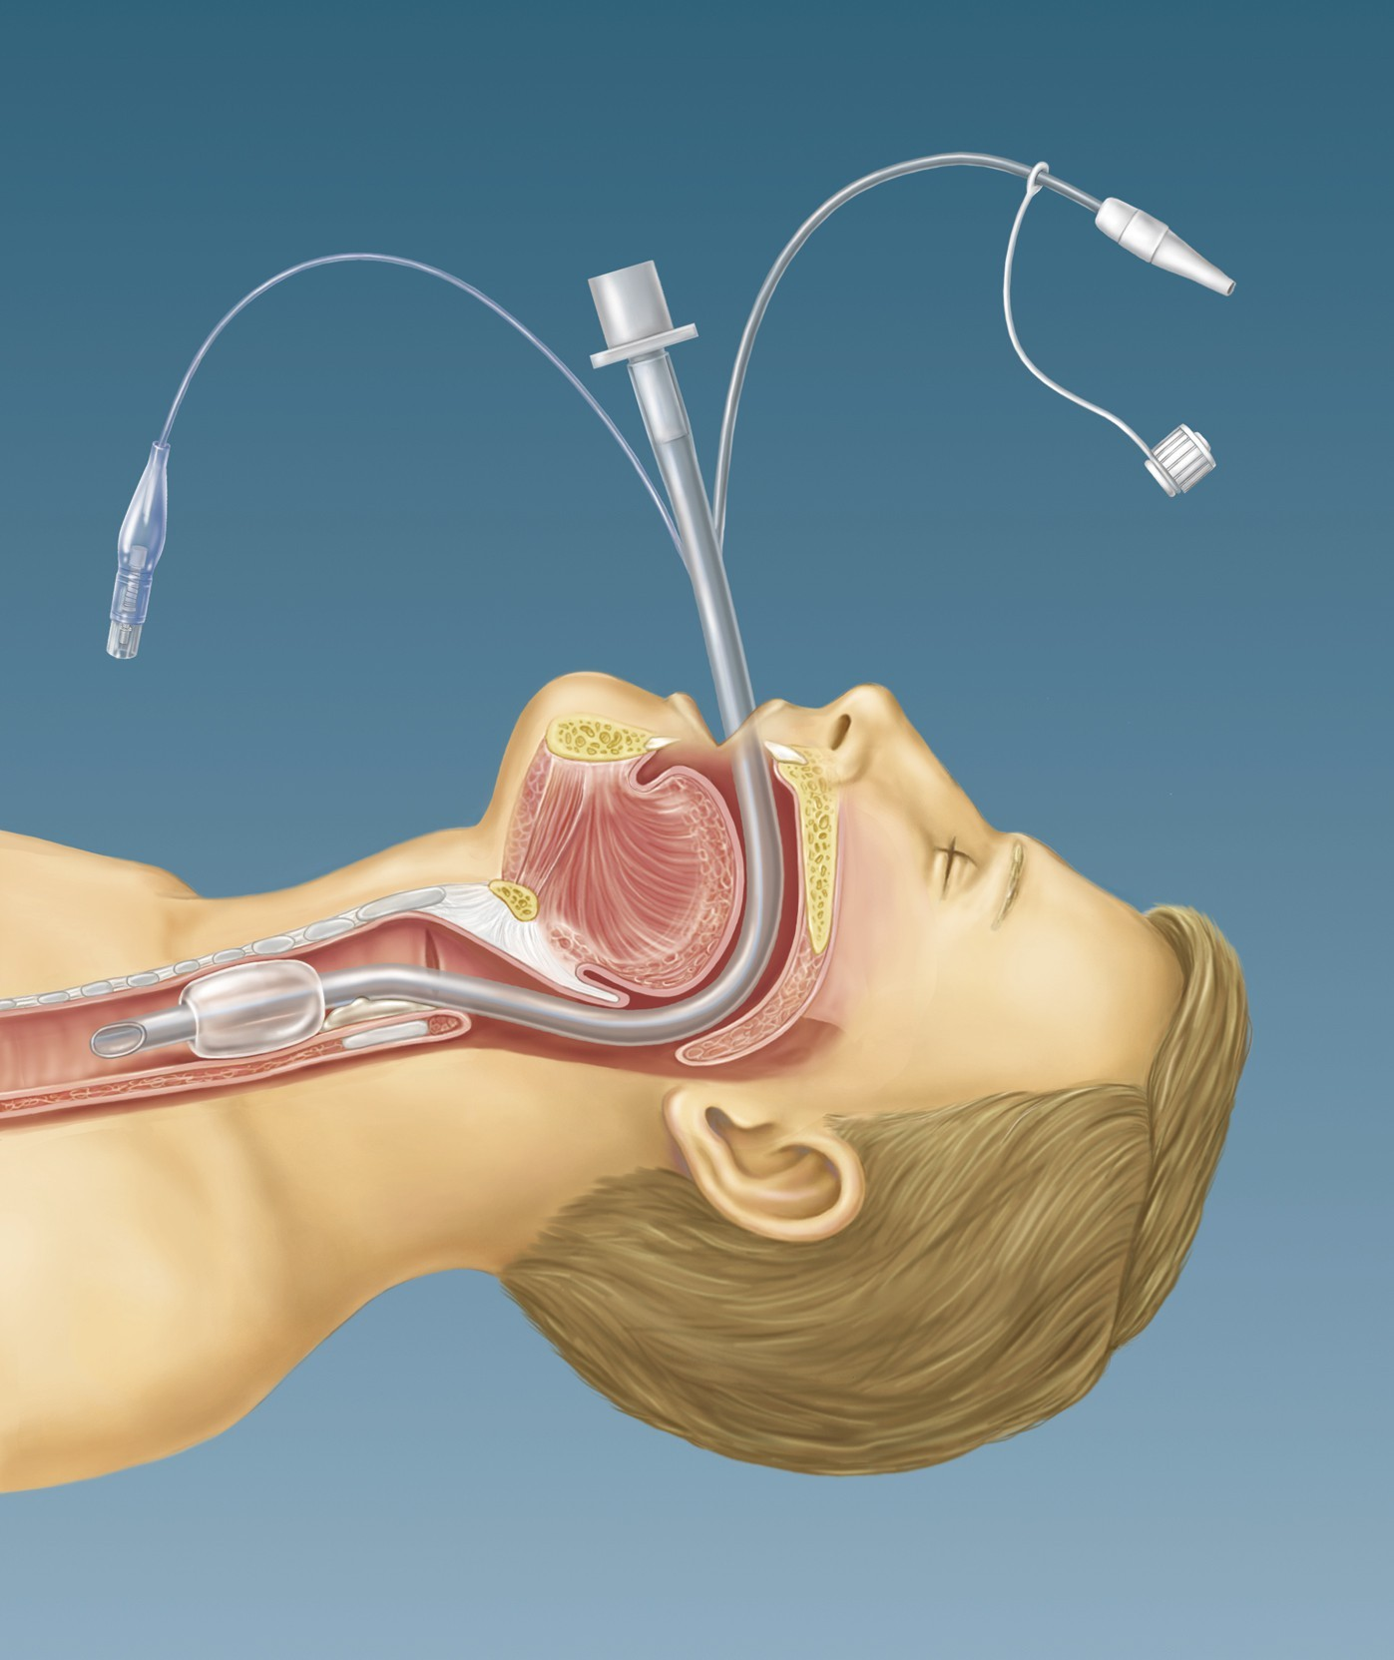
Continuous Removal of Subglottic Secretions
Use an ET tube with continuous suction through a dorsal lumen above the cuff to prevent drainage accumulation

Slide 39


