Slide 1
Myasthenia Gravis

Slide 2
Background
Acquired autoimmune disorder of neuromuscular junction.
Women>men
Clinically characterized by:
  Weakness of skeletal muscles
  Fatigability on exertion.
First clinical description in 1672 by Thomas Willis

Slide 3
Anatomy
Neuromuscular Junction (NMJ)
  Components:
    Presynaptic membrane
    Postsynaptic membrane
    Synaptic cleft
  Presynaptic membrane contains vesicles with Acetylcholine (ACh) which are released into synaptic cleft in a calcium dependent manner
  ACh attaches to ACh receptors (AChR) on postsynaptic membrane

Slide 4
Anatomy
Neuromuscular Junction (NMJ)
  The Acetylcholine receptor (AChR) is a sodium channel that opens when bound by ACh
    There is a partial depolarization of the postsynaptic membrane and this causes an excitatory postsynaptic potential (EPSP)
    If enough sodium channels open and a threshold potential is reached, a muscle action potential is generated in the postsynaptic membrane

Slide 5
Pathophysiology
In MG, antibodies are directed toward the acetylcholine receptor at the neuromuscular junction of skeletal muscles
Results in:
  Decreased number of nicotinic acetylcholine receptors at the motor end-plate
  Reduced postsynaptic membrane folds
  Widened synaptic cleft
Notes:
Induciton of a myasthenic-like syndrome in mice by injecting a large quantitiy of immunoglobulin G from MG patients

Slide 6
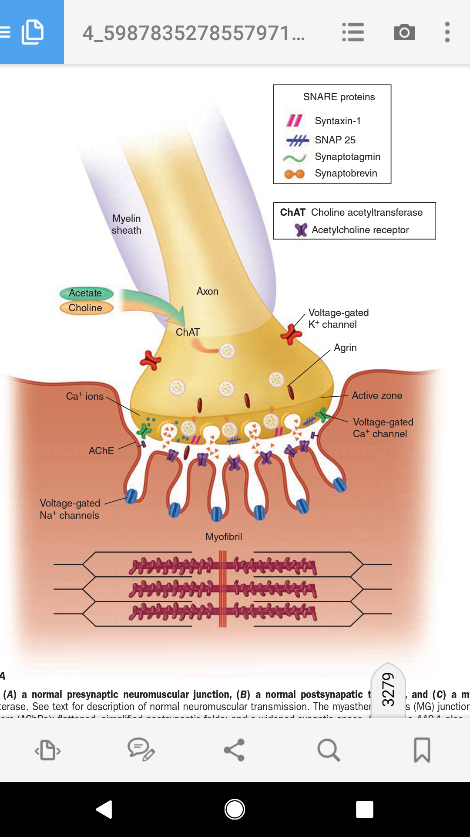

Slide 7
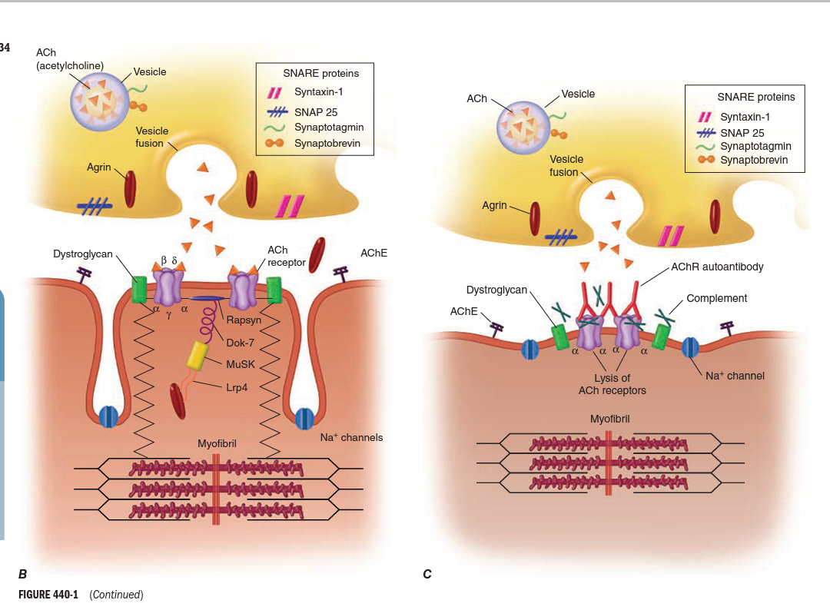

Slide 8
Pathophysiology
  Anti-AChR antibody is found in 80-90% of patients with MG
    Proven with passive transfer experiments
  MG may be considered a B cell-mediated disease
    Antibodies
Notes:
Induciton of a myasthenic-like syndrome in mice by injecting a large quantitiy of immunoglobulin G from MG patients
Top photo shows a rabbit with "floppy" ears after an injection of receptor antigens. Bottom shows the same rabbit after receiving edrophonium.
http://www.aneuroa.org/html/c20html/1970_1979.htm

Slide 9
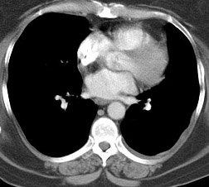
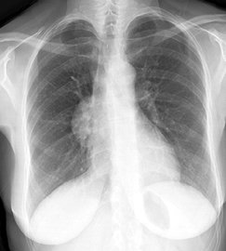
Pathophysiology
  T-cell mediated immunity has some influence
    Thymic hyperplasia and thymomas are recognized in myasthenic patients*
Notes:
Induciton of a myasthenic-like syndrome in mice by injecting a large quantitiy of immunoglobulin G from MG patients

Slide 10
Epidemiology
Frequency
  Annual incidence in US- 2/1,000,000 (E)
  Worldwide prevalence 1/10,000 (D)
Mortality/morbidity
  Recent decrease in mortality rate due to advances in treatment
    3-4% (as high as 30-40%)
  Risk factors
    Age > 40
    Thymoma
Sex
  F-M (6:4)
  Mean age of onset (M-42, F-28)
  Incidence peaks- M- 6-7th decade F- 3rd decade

Slide 11
Clinical Presentation
Fluctuating weakness increased by exertion
  Weakness increases during the day and improves with rest
Extraocular muscle weakness
  Ptosis is present initially in 50% of patients and during the course of disease in 90% of patients
Head extension and flexion weakness
  Weakness may be worse in proximal muscles

Slide 12
Clinical presentation
Progression of disease
  Mild to more severe over weeks to months
    Usually spreads from ocular to facial to bulbar to truncal and limb muscles
    Often, symptoms may remain limited to EOM and eyelid muscles for years
    The disease remains ocular in 16% of patients
Remissions
  Spontaneous remissions rare
  Most remissions with treatment occur within the first three years
Notes:
Onset from mild to maximal weakness is less than 36 months in 83% of patients

Slide 13
Clinical presentation
Basic physical exam findings
  Muscle strength testing
  Recognize patients who may develop respiratory failure (i.e. difficult breathing)
  Sensory examination and DTR’s are normal

Slide 14
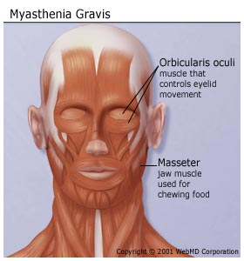
Clinical presentation
Muscle strength
  Facial muscle weakness
  Bulbar muscle weakness
  Limb muscle weakness
  Respiratory weakness
  Ocular muscle weakness

Slide 15

Clinical presentation
Facial muscle weakness is almost always present
  Ptosis and bilateral facial muscle weakness
  Sclera below limbus may be exposed due to weak lower lids

Slide 16
Clinical presentation
Bulbar muscle weakness
  Palatal muscles
    “Nasal voice”, nasal regurgitation
    Chewing may become difficult
    Severe jaw weakness may cause jaw to hang open
    Swallowing may be difficult and aspiration may occur with fluids—coughing and choking while drinking
  Neck muscles
    Neck flexors affected more than extensors

Slide 17
Clinical presentation
Limb muscle weakness
  Upper limbs more common than lower limbs
Upper Extremities
Deltoids
Wrist extensors
Finger extensors
Triceps > Biceps
Lower Extremities
Hip flexors (most common)
Quadriceps
Hamstrings
Foot dorsiflexors
Plantar flexors

Slide 18
Clinical presentation
Respiratory muscle weakness
  Weakness of the intercostal muscles and the diaphragm may result in CO2 retention due to hypoventilation
    May cause a neuromuscular emergency
  Weakness of pharyngeal muscles may collapse the upper airway
    Monitor negative inspiratory force, vital capacity and tidal volume
    Do NOT rely on pulse oximetry
      Arterial blood oxygenation may be normal while CO2 is retained

Slide 19
Clinical presentation
Occular muscle weakness
  Asymmetric
    Usually affects more than one extraocular muscle and is not limited to muscles innervated by one cranial nerve
    Weakness of lateral and medial recti may produce a pseudointernuclear opthalmoplegia
      Limited adduction of one eye with nystagmus of the abducting eye on attempted lateral gaze
  Ptosis caused by eyelid weakness
  Diplopia is very common

Slide 20
Clinical presentation
Co-existing autoimmune diseases
  Hyperthyroidism
    Occurs in 10-15% MG patients
      Exopthalamos and tachycardia point to hyperthyroidism
      Weakness may not improve with treatment of MG alone in patients with co-existing hyperthyroidism
  Rheumatoid arthritis
  Scleroderma
  Lupus

Slide 21
Causes
  Idiopathic
  Penicillamine
    AChR antibodies are found in 90% of patients developing MG secondary to penicillamine exposure
  Drugs

Slide 22
Causes
  Drugs
    Antibiotics (Aminoglycosides, ciprofloxacin, ampicillin, erythromycin)
    B-blocker (propranolol)
    Lithium
    Magnesium
    Procainamide
    Verapamil
    Quinidine
    Chloroquine
    Prednisone
    Timolol
    Anticholinergics

Slide 23
Differentials
Amyotropic Lateral Sclerosis
Basilar Artery Thrombosis
Brainstem gliomas
Cavernous sinus syndromes
Dermatomyositis
Lambert-Eaton Myasthenic Syndrome
Multiple Sclerosis
Sarcoidosis and Neuropathy
Thyroid disease
Botulism
Oculopharyngeal muscular dystrophy
Brainstem syndromes
Notes:
Lambert-Eaton myasthenic syndrome (LEMS) is a rare condition in which weakness results from an abnormality of acetylcholine (ACh) release at the neuromuscular junction. Recent work demonstrates that LEMS results from an autoimmune attack against voltage-gated calcium channels (VGCC) on the presynaptic motor nerve terminal.

Slide 24
Ice pack test
  Bedside test
  Application of a pack of ice over ptosis results in improvement of symptoms

Slide 25
Work-up
Lab studies
  Anti-acetylcholine receptor antibody
    Positive in 74%
    80% in generalized myasthenia
    50% of patients with pure ocular myasthenia
  Anti MuSK antibodies
    Positive in 40% of anti AchR negative patients
  Anti LRP4 antibodies
  Anti-striated muscle
    Present in 84% of patients with thymoma who are younger than 40 years

Slide 26
Work-up
TFT, associated auto immune disorders
TB, blood glucose
Pulmonary function tests
Imaging studies
  Chest x-ray
    Plain anteroposterior and lateral views may identify a thymoma as an anterior mediastinal mass
  Chest CT scan is mandatory to identify thymoma
  MRI of the brain and orbits may help to rule out other causes of cranial nerve deficits but should not be used routinely

Slide 27
Work-up
Electrodiagnostic studies
  Repetitive nerve stimulation
  Single fiber electromyography (SFEMG)
  SFEMG is more sensitive than RNS in MG

Slide 28

Electrodiagnostic studies:
Repetitive Nerve Stimulation
Low frequency RNS (1-5Hz)
  Anti AChE medication stopped 6-12 hours before
  Locally available Ach becomes depleted at all NMJs and less available for immediate release
    Results in smaller EPSP’s

Slide 29
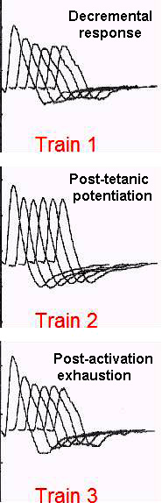
Electrodiagnostic studies:
Repetitive Nerve Stimulation
    Patients w/ MG
      AchR’s are reduced and during RNS EPSP’s may not reach threshold and no action potential is generated
        Results in a decremental decrease in the compound muscle action potential
        Any decrement over 10% is considered abnormal
        Should not test clincally normal muscle
        Proximal muscles are better tested than unaffected distal muscles
Notes:
Positive RNS test features
Decrement in CMAP amplitude
Size: More than 10% in reduction in CMAP amplitude
Measure from 1st to 4th or 5th potential in train
Smallest CMAP is often 2nd or 3rd potential in train
Post-exercise exhaustion
Exercising muscle briefly before testing exacerbates decremental response
Occurs rapidly after initial stimulation
Post-tetanic potentiation
Reduction in decrement in minutes after exercise
Occurs after post-exercise exhaustion

Slide 30
Repetitive nerve stimulation
Most common employed stimulation rate is 3Hz
Several factors can afect RNS results
  Lower temperature increases the amplitude of the compound muscle action potential
    Many patients report clinically significant improvement in cold temperatures
  AChE inhibitors prior to testing may mask the abnormalities and should be avoided

Slide 31


Electrodiagnostic studies:
Single-fiber electromyography
Concentric or monopolar needle electrodes that record single motor unit potentials
  Findings suggestive of NMF transmission defect
      Increased jitter and normal fiber density
      SFEMG can determine jitter
        Variability of the interpotential interval between two or more single muscle fibers of the same motor unit

Slide 32
Electrodiagnostic studies:
Single-fiber electromyography
  Generalized MG
    Abnormal extensor digiti minimi found in 87%
    Examination of a second abnormal muscle will increase sensitivity to 99%
  Occular MG
    Frontalis muscle is abnormal in almost 100%
    More sensitive than EDC (60%)

Slide 33
Workup
Pharmacological testing
Edrophonium (Tensilon test)
  Patients with MG have low numbers of AChR at the NMJ
  Ach released from the motor nerve terminal is metabolized by Acetylcholine esterase
  Edrophonium is a short acting Acetylcholine Esterase Inhibitor that improves muscle weakness
  Evaluate weakness (i.e. ptosis and opthalmoplegia) before and after administration

Slide 34
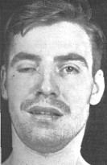
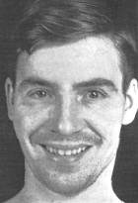
Workup
Pharmacological testing
Before After

Slide 35
Workup
Pharmacological testing
Edrophonium (Tensilon test)
  Steps
    0.1ml of a 10 mg/ml edrophonium solution is administered as a test
    If no unwanted effects are noted (i.e. sinus bradychardia), the remainder of the drug is injected
    Consider that Edrophonium can improve weakness in diseases other than MG such as ALS, poliomyelitis, and some peripheral neuropathies

Slide 36
Treatment
AChE inhibitors
Immunomodulating therapies
Plasmapheresis
Intravenous immunoglobin
Thymectomy
  Important in treatment, especially if thymoma is present

Slide 37
Treatment
AChE inhibitor
  Pyridostigmine bromide (Mestinon)
    Starts working in 15-30 minutes and lasts 3-4 hours
    Individualize dose
    Adult dose:
      60-600mg/d PO
    Caution
      Check for cholinergic crisis
    Others: Neostigmine Bromide

Slide 38
Treatment
Immunomodulating therapies
  Prednisone
    Most commonly used corticosteroid in US
    Significant improvement is often seen after a decreased antibody titer which is usually 1-4 months
    No single dose regimen is accepted
      Some start low and go high
      Others start high dose to achieve a quicker response

Slide 39
Cyclosporine and tacrolimus provide improvement in 1-3 months
MMF and azathioprine take years to act
Rituximab esp in anti MuSK positive patients

Slide 40
Thymectomy
Surgical removal of thymoma
Thymectomy as treatment for myasthenia
  Reduce anticholinesterase inhibitors dose
  Clinical improvement in power

Slide 41
IVIG and Plasmapheresis
Usually used in patients who require immediate improvement
As a bridge treatment to stabilise the patient before thymectomy
Plasmapheresis 3-4 l/cycle- 10 cycles
IVIG 2g/Kg iv

Slide 42
Treatment
Behavioral modifications
Diet
  Patients may experience difficulty chewing and swallowing due to oropharyngeal weakness
    If dysphagia develops, liquids should be thickened
      Thickened liquids decrease risk for aspiration
Activity
  Patients should be advised to be as active as possible but should rest frequently and avoid sustained activity
  Educate patients about fluctuating nature of weakness and exercise induced fatigability

Slide 43
Complications of MG
Respiratory failure
Dysphagia
Complications secondary to drug treatment
  Long term steroid use
    Osteoporosis, cataracts, hyperglycemia, HTN
    Gastritis, peptic ulcer disease
    Pneumocystis carinii

Slide 44
MYASTHENIC CRISIS
Sudden exacerbation of weakness sufficient enough to endanger life
Try stopping anti AChE inhibitors
m/c due to intercurrent infection
Rx
  Early and effective antibiotic therapy
  Ventilator assistance
  Pulmonary physiotherapy
  IVIG/plasmapheresis

Slide 45
Prognosis
20% may go for remission
Untreated MG carries a mortality rate of 25-31%
Treated MG has a 4% mortalitiy rate
40% have ONLY ocular symptoms
  Only 16% of those with ocular symptoms at onset remain exclusively ocular at the end of 2 years

