Slide 1
STROKE /CVD

Slide 2
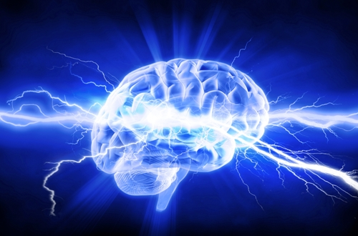
STROKE /CVD/APOPLEXY
Hippocrates (400 BC) described “Apoplexy”
DEFINITION:- Abrupt onset of neurological deficit
attributable to a focal vascular etiology
Stroke OR Cerebrovascular disease (CVD) - CEREBRO : referring to the brain - VASCULAR : referring to the blood vessels

Slide 3
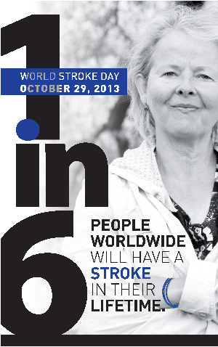
STROKE IS NO.1 CAUSE OF DISABILITY & 2ND LEADING CAUSE OF DEATH WORLD WIDE
In India Every half minute a person is struck by stroke !
Every 3 minutes someone dies of stroke!

Slide 4
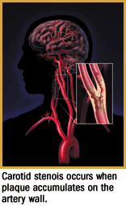
“STROKE IS A BRAIN ATTACK” Interruption of blood flow to the brain caused by 2 mechanisms - Clot blocking a blood vessel OR - Broken blood vessel Ishemic stroke - 85% Haemarrhageic stroke – 15%

Slide 5
TYPES OF STROKE Ischemic Stroke Haemarrhagic Stroke 85% 15%
Intracerebral haemarrhage(10%)
Subarachnoid haemarrhage(5%)
Thrombosis (Large vessel ds
small vessel ds)
Embolism (Cardio embolic,Art-art
embolism)
Global-Ischemic or Hypotensive Stroke

Slide 6
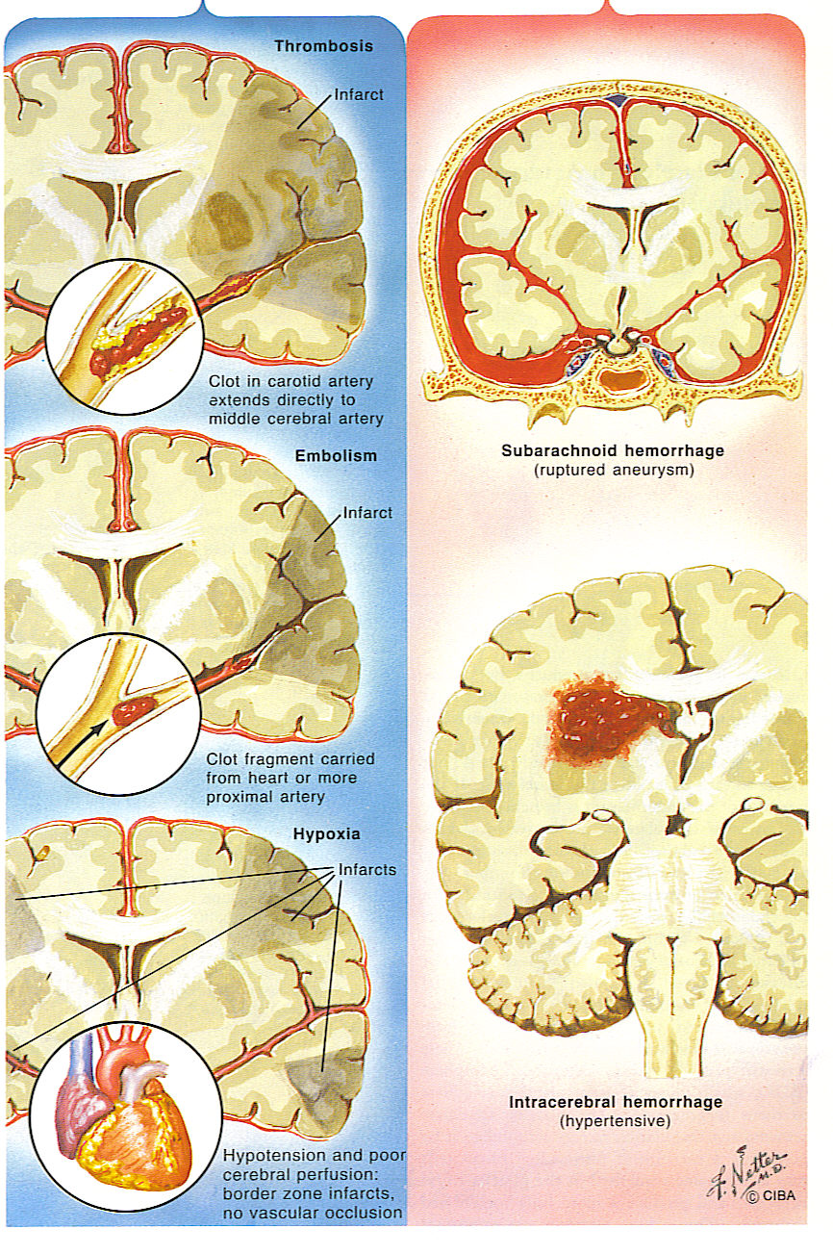

Slide 7
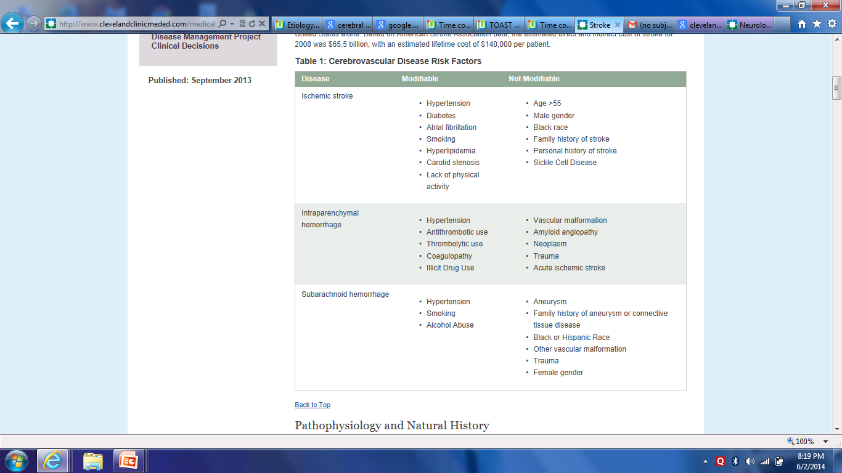
COCAIN AND AMPHETAMINES

Slide 8
Risk Factors and Predictors of Ischemic Stroke
Non-modifiable risk factors
Modifiable risk factors
Elevated blood pressure
Diabetes mellitus
Atrial fibrillation
Carotid artery disease
Heart diseases – dilated cardiomyopathy
Hyperlipidaemia
Cigarette smoking
Obesity
Older age
Male gender
Non-white ethnicity
Family history
Previous stroke is the single most important
risk factor for stroke

Slide 9
1. Hypertension
Most important modifiable risk factor
Responsible for 50% of all strokes
B.P > 140/90 needs treatment
Known as “Silent killer”

Slide 10
2. Diabetes
Diabetics are 3-4 times more likely to have Brain stroke and esp. diabetic women have 13 fold increase.
More mortality and morbidity from paralysis
In combination with MI CVD is the leading cause of death accounting for 2/3rd diabetes related deaths

Slide 11
3. Smoking
Commonest cause in young strokes
Contributes to 12 - 14% stroke deaths
Passive smoking also increases risks
After quitting, it takes 5 yrs to decrease the risk.

Slide 12
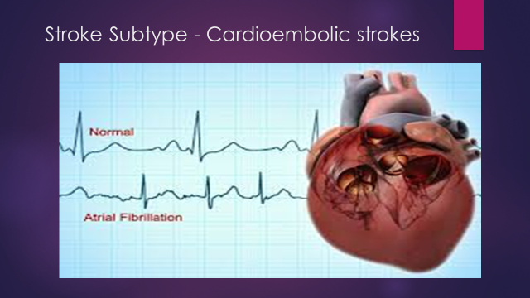
4. Atrial Fibrillation & Heart Diseases
Responsible for 25% of all strokes, esp. in older patients and also in young RHD patients.
Use of Anticoagulants can prevent.

Slide 13
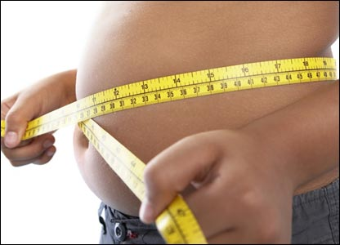
Obesity & Sedentary life

Slide 14
MECHANISMS of Ischemic Stroke
Thrombosis - Atherosclerosis
2. Embolism – Cardiac source
Artery to artery embolism from Carotid, Aorta
Pardoxical embolism due to DVT in PFO
3. Haemodynamic stroke – Global ischemia,
Critical artery stenosis with hypotension
4. Hypercoagulable states – Protein C & S deficiency , Factor v leiden mutation
5. Vessel wall abnormalities – ex. Dissection,
vasculitis – takayashu , giant cell arteritis
6. Rare causes – Vasoconstriction

Slide 15
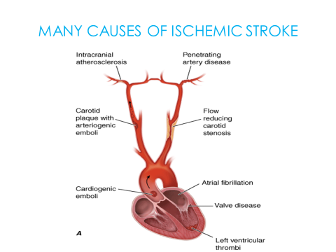

Slide 16
LARGE VESSEL DISEASE
Extra cranial – common in internal carotid and vertebral arteries
Intra cranial - includes circle of willis and proximal branches
THE MOST COMMON CAUSE OF LARGE VESSEL DS IS ATHEROSCLEROSIS

Slide 17
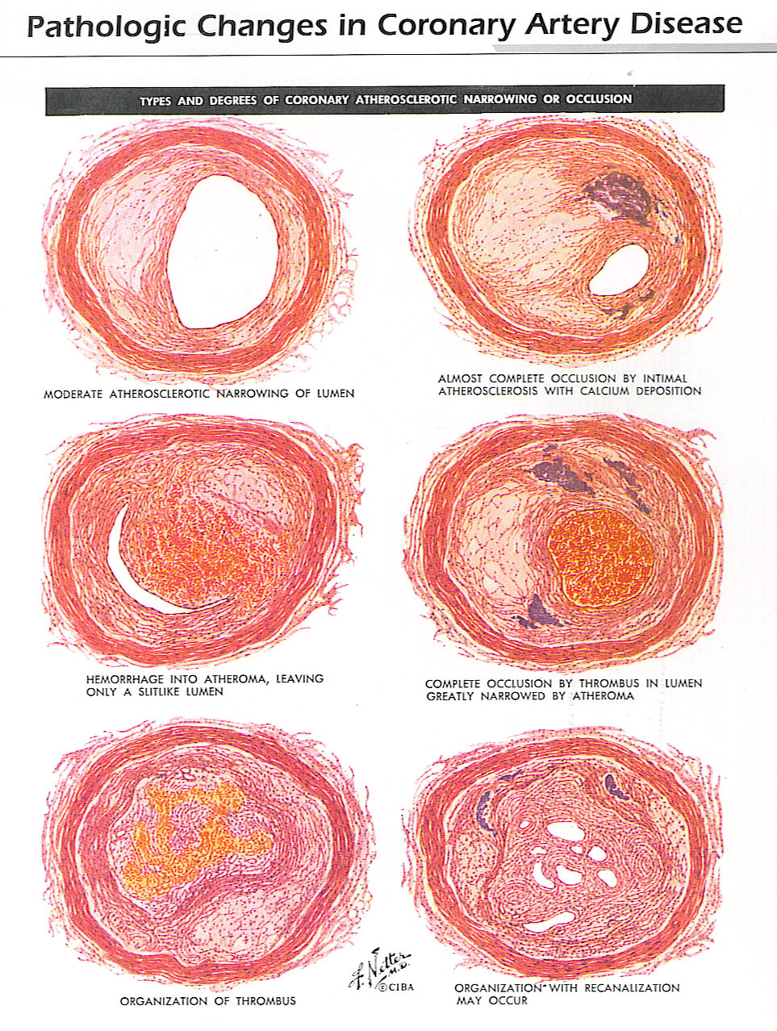
PATHOLOGY OF
ATHEROSCLEROSIS

Slide 18
SMALL VESSEL DISEASE
— Small vessel disease affects the intracerebral arterial system, specifically penetrating arteries
These arteries thrombose due to:
Lipohyalinosis (a lipid hyaline build-up distally secondary to hypertension) and fibrinoid degeneration
Atheroma formation at their origin or in the parent large artery

Slide 19
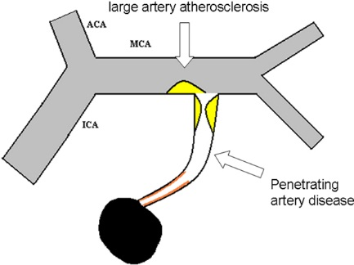

Slide 20
Pathogenesis of Stroke: Ischemia & Hemorrhage
Ischemia: lack of circulating blood deprives the neurons of oxygen and nourishment
Hemorrhage: Extravascular release of blood causes damage by cutting off connecting pathways, resulting in local or generalized pressure injury . Damage can occur quickly due to the pressure of increasing amounts of blood or because of the blood itself . Blood is irritating to the brain tissue, causing it to swell

Slide 21

Pathophysiology at Macro Tissue Level

Slide 22
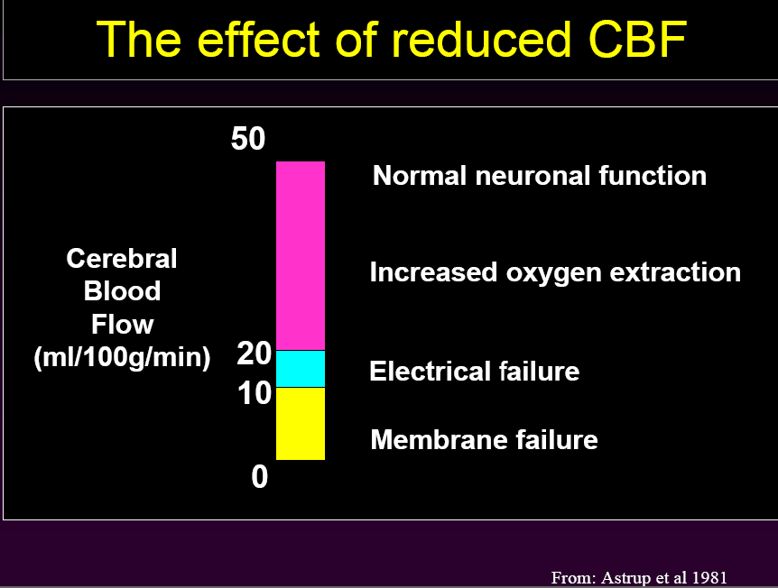
(NEURONAL DEATH)

Slide 23
Ischemic Penumbra & Window Of Opportunity
Ischemic zone that surrounds a central core of infarction with CBF of 25% to 50% of normal and loss of auto regulation
Viability of brain tissue is preserved if perfusion is restored within a critical time period (2 to 4 hours?)

Slide 24
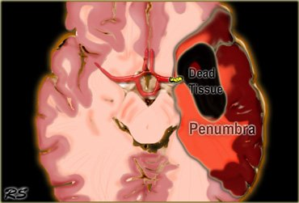
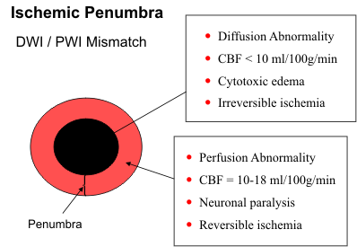
The Importance of penumbra

Slide 25
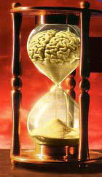
Time Is Brain
The typical patient loses 1.9 million neurons each minute in which stroke is untreated
120 million neurons, 830 billion synapses, and 714 km (447 miles) of myelinated fibers are lost each hour.
Ischemic brain ages 3.6 years each hour without treatment.

Slide 26
Microcellular mechanisms of Ischemic cascade
Lack of oxygen supply to ischemic neurones
ATP depletion
Membrane ions system stops functioning
Depolarisation of neurone
Influx of calcium
Release of neurotransmitters, including glutamate, activation
of N-metyl -D- aspartate and other excitatory receptors
at the membrane of neurones
(EXITOTOXICITY)
Further depolarisation of cells
Further calcium influx

Slide 27
Excitotoxicity
Ischemia depletes neuronal energy stores causing energy dependent membrane ion pumps to fail
This results in increased extracellular glutamate concentration
Release of excitotoxic Glutamate & Aspartate open up calcium channels resulting in influx of calcium, sodium and chloride and out flux of potassium causing irreversible neuronal damage

Slide 28
Cosequences of brain ischemia
Energy failure / depolarisation
Dysfunction of
receptors and
ion channels
Free radical
formation
Mitochondrial
dysfunction
Damage to membrane
structure and function
Inhibition of axonal transport, blebbing
Cell Death

Slide 29
Type of Neuronal Death in Ischemia
Coagulation necrosis – Which occurs rapidly due to energy failure.
Apoptotic pathway – programmed cell death ex. In ischemic penumbra, cells die days to weeks later.

Slide 30
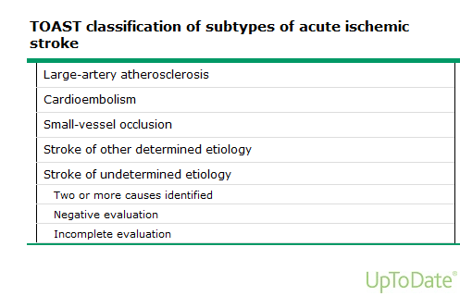

Slide 31
Stroke Begets Stroke
Stroke patients are most at risk of another stroke
16
Stroke
Myocardial Infarction
14%
14
13%
13%
12
10%
10
Percent of stroke patients with subsequent events
8
7%
6
4
3%
3%
2%
2
0
CATS
TASS
CAPRIE*
ESPS 2
Trials
*Stroke patient subgroup only (n = 6,431)
Albers G. Neurology. 2000; 14(5):1022-8.
Notes:
The relative efficacies of different antiplatelet agents for prevention of a second stroke are unknown because of differences in clinical trial design, a lack of direct comparisons between individual agents, and differences in the choice of primary endpoints. For patients with stroke or TIA, the single outcome of stroke is particularly important because these patients have a higher risk of recurrent stroke than any other vascular outcome during the initial years after a stroke.

Slide 32
TIA TRANSIENT ISCHEMIC ATTACK
Classical definition:- Epiosdes of temporary and focal cerebral dysfunction of vascular origion usually lasting 2-3 mins occassionaly upto 24hrs with no residual neurological deficit .
Tissue based definition (based on diffusion imaging):- Brief episodes of neurological dysfunction caused by focal brain or retinal ischemia, symptoms typically lasting <1hr without evidence of infarction on DWI( Diffusion weighted imaging)
In 37-64% of TIAs DWI abnormalities positive

Slide 33
TIA is a Stroke warning Attack
TIA means T = Take, I = Immediate, A= Action
Sometimes the symptoms like…..
Weakness, numbness of one hand or both hand and leg, slurring of speech, blurring of vision, vertigo, diplopia etc, can come for very short time(minutes) and disappear completely.
Don’t ignore, catastrophic stroke can come in next 2 days !!!!!!

Slide 34
RISK OF STROKE FOLLOWING A TIA ABCD2 score
SCORE 3 MONTH
TOTAL RATE OF STROKE %
0 0
1 2
2 3
3 3
4 8
5 12
6 17
7
SCORE
A AGE > 60YRS -- 1
B SBP > 140 OR -- 1
DBP> 90
C CLINICAL SYMP
UNILATERAL WEAKNESS -- 2
SPEECH DISTURBANCE
WITHOUT WEAKNESS – 1
D DURATIOIN
>60 MINS -- 2
10-59 MINS -- 1
DIABETIS( ORAL MEDICATION
OR INSULIN -- 1

Slide 35
Stroke can strike Anyone, Anytime, Anywhere !!!
THANK YOU

