Slide 1
Pyrexia of unknown origin
Dr. Sujeetha chandrababu M.D.

Slide 2
Original Definition (by Petersdorf and Beeson, 1961)
Temperatures ≥ 38.3ºC (101ºF) on several occasions
Fever ≥ 3 weeks
Failure to reach a diagnosis despite 1 week of inpatient investigations or 3 outpatient visits [1 IP / 3 OP]

Slide 3
Classification of PUO
Category | Definition | Aetiologies
Classic | Temperature >38.3°C (100.9°F) ; Duration of >3 weeks Evaluation of at least 3 outpatient visits or 3 days in hospital | Infection Malignancy collagen vascular disease
Nosocomial | Temperature >38.3°C Patient hospitalized ≥ 24 hours but no fever or incubating on admission Evaluation of at least 3 days | Clostridium difficile enterocolitis drug-induced pulmonary embolism septic thrombophlebitis, sinusitis
Immune deficient (neutropenic) | Temperature >38.3°C Neutrophil count ≤ 500 per mm3 Evaluation of at least 3 days | Opportunistic bacterial infections, aspergillosis, candidiasis, herpes virus
HIV-associated | Temperature >38.3°C Duration of >4 weeks for outpatients, >3 days for inpatients HIV infection confirmed | Cytomegalovirus, Mycobacterium avium-intracellulare complex, Pneumocystis carinii pneumonia, drug-induced, Kaposi’s sarcoma, lymphoma

Slide 4
COMMON CAUSES OF PUO

Slide 5
Causes of FUO (in India)
Infectious 53%
#1: TB (45%)
Neoplasm: 17%
#1: NHL (47%)
Collagen Vasc.: 11%
#1 SLE: 45%
Miscellaneous: 5%
Undiagnosed: 14%
Kejariwal D et al. J Postgrad Med. 2001 Apr-Jun; 47(2): 104-7.

Slide 6
Classic PUO
3 common etiologies which account for the
majority of classic PUO:
Infections
Malignancies
Collagen Vascular Disease
Others/Miscellaneous which includes drug-induced fever.

Slide 7
Infections
Bacterial: abscesses, TB, complicated UTI, endocarditis, osteomyelitis, sinusitis, Lyme disease, prostatitis, cholecystitis, empyema, bill-ary tract infection, brucellosis, typhoid, leptospirosis, Q fever, borreliosis, etc.
Parasite: Malaria, toxoplamosis, leishmaniasis, etc.
Fungal: histoplasmosis, etc.
Viral: CMV, infectious mononucleosis, HIV, etc.

Slide 8
Infections
As duration of fever increases, infectious etiology decreases
Malignancy and factitious fevers are more common in patients with prolonged FUO.

Slide 9
Malignancies
Haematological
Lymphoma
Chronic leukemia
Non-haematological
Renal cell cancer
Hepatocellular carcinoma
Pancreatic cancer
Colon cancer
Hepatoma
Myelodysplastic Syndrome
Sarcomas

Slide 10
Collagen vascular disease / Autoimmune disease
Adult Still's disease
Polymyalgia rheumatica
Temporal arteritis
Rheumatoid arthritis
Rheumatoid fever
Inflammatory bowel disease
Reiter's syndrome
Systemic lupus erythematosus
Vasculitides
Polyarteritis nodosa
Giant cell arteritis
Kawasaki disease
Still’s disease

Slide 11
Others/miscellaneous
Drugs: penicillin, phenytoin, captopril, allopurinol, erythromycin, cimetidine, etc.
Hyperthyroidism
Alcoholic hepatitis
Sarcoidosis
Inflammatory bowel disease
Deep Venous Thrombosis

Slide 12
Roth AR and Basello GM. Am Fam Physician. 2003 Dec 1;68(11):2223-8.

Slide 13
Nosocomial PUO
More than 50% of patients with nosocomial PUO are due to infection.
Focus on sites where occult infections may be sequestered, such as:
Sinusitis of patients with NG or oro-tracheal tubes.
Prostatic abscess in a man with a urinary catheter.
25% of non-infectious cause includes:
Acalculous cholecystitis,
Deep vein thrombophlebitis
Pulmonary embolism.

Slide 14
Neutropenic PUO
Patients on chemotherapy or immune deficiencies are susceptible to:
Opportunistic bacterial infection
Fungal infections such as candidiasis
Bacteremic infections
Infections involving catheters
Perianal infections.
Examples of aetiological agent:
aspergillus
Candida
CMV
Herpes simplex

Slide 15
HIV-associated PUO
HIV infection alone may be a cause of fever.
Common secondary causes include:
Tuberculosis
Toxoplasmosis
CMV infection
P. carinii infection
Salmonellosis
Cryptococcosis
Histoplasmosis
Non-Hodgkin's lymphoma
Drug-induced fever

Slide 16
Pyrexia of Unknown Origin
A Clinical Approach

Slide 17
History Taking
History of Presenting Illness (HOPI)
1。Onset
- acute: Malaria, pyogenic infection
- gradual: TB, thyphoid fever
2。Character
high grade fever: UTI, TB, malaria, drug
3。Pattern
sustained/persistent: Thyphoid fever, drugs

Slide 18
intermittent fever:
Daily spikes: Abscess, TB, Schistosomiasis
Twice-daily spikes: Leishmaniasis
Saddleback fever: Leptospirosis, dengue,borrelia
-relapsing/ recurrent fever: Non-falciparum malaria, Brucellosis, Hodgkin’s lymphoma
4。Antecedents
- prior to onset of fever:
dental extraction: Infective endocarditis
Urinary catherization: UTI, bacteremia.

Slide 19
5。Associated symptoms
Chills & rigors
bacterial, rickettsial and protozoal disease,
influenza, lymphoma, leukaemia, drug-induced
Night sweats
TB, Hodgkin’s lymphoma
Loss of weight
Malignancy, TB
Cough and Dyspnoea
Miliary TB, multiple pulmonary emboli, AIDS patient with PCP, CMV.
Headache
Giant cell arteritis, typhoid fever, sinusitis
Joint pain
RA, SLE, vasculitis

Slide 20
Abd. Pain
Cholangitis, biliary obstruction, perinephric abscess, Crohn’s disease, dissecting aneuryms, gynaecological infection
Bone pain
Osteomyelitis, lymphoma
Sorethroat
IM, retropharyngeal abscess, post-Streptococcal infection
Dysuria, rectal pain
Prostatic abscess, UTI
Altered bowel habit
IBD, thyphoid fever, schistosomiasis, amoebiasis
Skin rash
Gonococcal infection, PAN，NHL, dengue fever

Slide 21
Past Medical History
Malignancy = leukemia, lymphoma, hepatocellular ca
HIV infection
DM
IBD
collagen vascular disease-SLE, RA, giant cell arteritis
TB
Heart disease: valvular heart disease
Past Surgical History
Post splenectomy/ post- transplantation
Prosthetic heart valve
Catheter, AV fistula
Recent surgery/ operation

Slide 22
Drug History
Immunosuppressive drug/ corticosteroid
Anticoagulants: accumulation of old blood in closed space e.g. retroperitoneal, perisplenic
Before fever: drug fever →occur within 3 months after starting taking drugs
may cause hypersensitivity and low grade fever, usually associated with rash
Due to the allergic reaction, direct effect of drug which impair temperature regulation (e.g. phenothiazine)
E.g. Antiarrhythmic drug: procainamide, quinidine; Antimicrobacterial agent: penicillin, cephalosporin, hydralazine
After fever: may modify clinical pictures, mask certain infection e.g. SBE, antibiotic allergy
Family History
Anyone in family has similar problem: TB, familial Mediterranian fever

Slide 23
Social History
Travel
amoebiasis, typhoid fever, malaria, Schistosomiasis
Residental area
malaria, leptospirosis, brucellosis
Occupation
farmers, veterinarian, slaughter-house workers = Brucellosis
workers in the plastic industries = polymer-fume fever

Slide 24
Contact with domestic / wild animal / birds :
Brucellosis, psittacosis (pigeons), Leptospirosis, Q fever, Toxoplasmosis
Diet history
unpasteurized milk/cheese = Brucellosis
poorly cooked pork = Trichinosis
IVDU = HIV-AIDS related condition, endocarditis
Sexual orientation = HIV, STD, PID
Close contact with TB patients

Slide 25
Pyrexia of Unknown Origin
Physical Examination

Slide 26
Examination
General
Pattern of fever (continous, intermittent, relapsing)
Ill/not ill
Weight loss (chronic illness)
Skin rash

Slide 27
Hands
Stigmata of Infective Endocarditis
Vasculitis changes
Clubbing
Presence of arthropathy
Raynaud’s phenomenon

Slide 28
Arms
Drug injection sites (ivdu)
Epitrochlear and axillary nodes (lymphoma, sarcoidosis, focal infection)
Skin

Slide 29
Head & neck
Feel temporal arteries (tender & thicken)
Eyes – iritis/conjuctivitis (ct disease – reiter syndrome)
Jaundice (ascending cholangitis)
Fundi – choroidal tubercle (miliary tb), roth’s spot (ie) and retinal haemorrhage (leukaemia)
Lymphadenopathy

Slide 30
Face & mouth
Butterfly rash
Mucous membranes
Seborrhoic dermatitis (hiv)
Mouth ulcers (sle)
Buccal candidiasis
Teeth & tonsils infection (abscess)
Parotid enlargement
Ears – otitis media

Slide 31
Chest
Bony tenderness
Cvs – murmurs (ie, atrial myxoma), rubs (pericarditis)
Resp – signs of pneumonia, tb, empyema and lung ca

Slide 32
Abdomen
Rose coloured spot (typhoid fever)
Hepatomegaly (sbp, hepatic ca, met)
Splenomegaly (haemopoietic malignancy, ie, malaria)
Renal enlargement (renal cell ca)
Testicular enlargement (seminoma)
Penis & scrotum – discharge/rash
Inguinal ligament
Per rectal exam – mass/tenderness in rectum/pelvis (abscess, ca, prostatitis)
Vaginal Examination – collection of pelvic pus/ Pelvic Inflammatory Disease

Slide 33
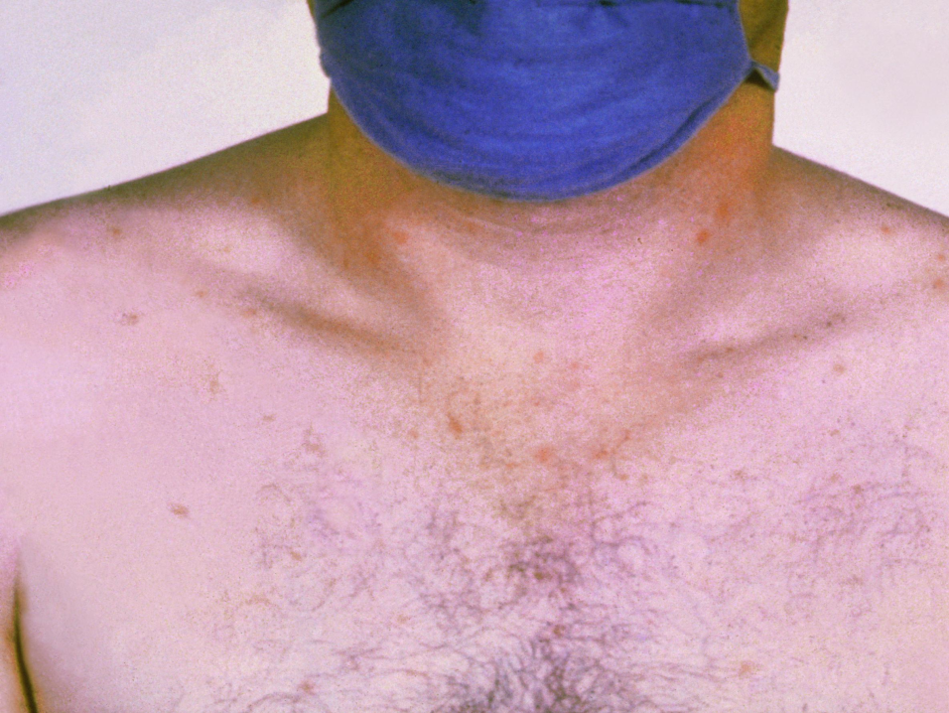

Slide 34
Central Nervous System
Signs of meningism (chronic tb meningitis)
Focal neurological signs (brain abscess, mononeuritis multiplex in polyarteritis nodosa)

Slide 35
Pyrexia of Unknown Origin
Investigation

Slide 36
Stage 1: Laboratory investigations
Stage 1: (screening tests)
Full blood count
ESR & CRP
BUN
LFTs
Blood culture
Serum virology
Urinalysis and culture
Sputum culture and sensitivity
Stool ME and occult blood
CXR
Mantoux test

Slide 37
Stage 2: Laboratory investigations
Stage 2:
Repeat history and examination
Protein electrophoresis
CT (chest, abdomen, pelvis)
Autoantibody screen (ANA, RF, ANCA, anti-dsDNA)
ECG
Bone marrow examination
Lumbar puncture
Consider PSA, CEA
Temporal artery biopsy
HIV test counselling

Slide 38
Stage 3: Laboratory investigations
Stage 3:
Echocardiography
Further Ix abdomen (Indium-labelled WC scan – IBD, abscesses, local sepsis)
Barium studies
IVU
Liver biopsy
Exploratory laparotomy
Bronchoscopy

Slide 39
Stage 4: Laboratory investigations
Treat TB,
endocarditis,
vasculitis,
trial of aspirin/ steroids

Slide 40
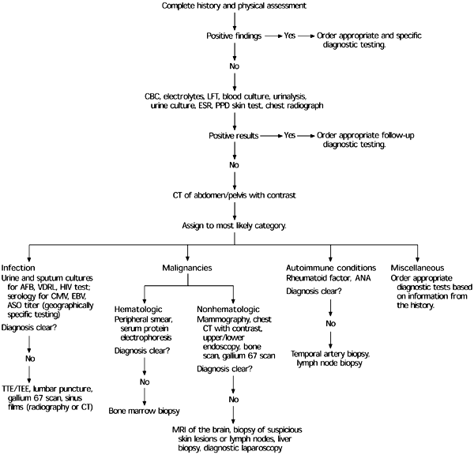
Diagnosing Pyrexia of Unknown Origin

Slide 41
Imaging Studies
Chest radiograph
Tuberculosis, malignancy, Pneumocystis carinii pneumonia
CT of abdomen or pelvis with contrast agent
Abscess, malignancy
Gallium 67 scan
Infection, malignancy
Indium-labeled leukocytes
Occult septicemia
Technetium Tc 99m
Acute infection and inflammation of bones and soft tissue
MRI of brain
Malignancy, autoimmune conditions
PET scan
Malignancy, inflammation
Transthoracic or transesophageal echocardiography
Bacterial endocarditis
Venous Doppler study
Venous thrombosis

Slide 42
Diagnosis
More invasive testing, such as LP or biopsy of bone marrow, liver, or lymph nodes, should be performed only when clinical suspicion shows that these tests are indicated or when the source of the fever remains unidentified after extensive evaluation.
When the definitive diagnosis remains elusive and the complexity of the case increases, an infectious disease, rheumatology, or oncology consultation may be helpful.

Slide 43
THANKYOU!!

