Slide 1
STROKE CLINICAL FEATURES AND MANAGEMENT

Slide 2
Acute Stroke
Ischemic (85%)
Hemorrhagic (15%)
Subarachnoid H.
Thrombotic (55%)
Intracerebral & Cerebellar H
Embolic (30%)
Subdural & Extradural H. and Hematoma
Lacunar (20%)
Large vessel (35%)
Artery-artery embolism
Cardioembolic
AF, IHD, VHD,

Slide 3
Ischemic: Thrombotic local origin of clot
Usually develops at night during sleep
Symptoms perceived in morning
Suspect in h/o hypercoaguable states, atherosclerosis and collagen vascular disorders

Slide 4
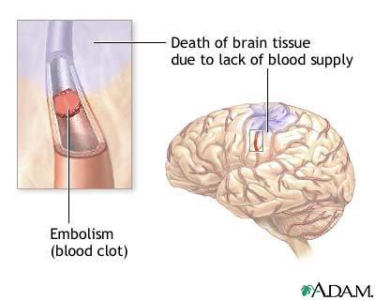
Ischemic: Embolic proximal origin of clot
Occurs at any time
Frequently during periods of vigorous activity
Hx of Atrial fibrillation, valvular vegetations, thromboembolism from MI, ulcerated plaques in carotid system
Seizures in 20% of cases

Slide 5
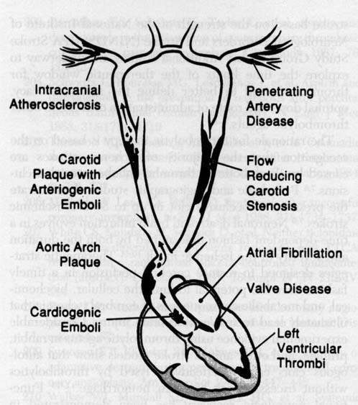
Causes

Slide 6
Hemorrhagic Stroke
Occur during stress or exertion
Focal deficits rapidly evolve
Signs of raised ICT
Confusion, coma or immediate death

Slide 7
Hemorrhagic or Ischemic
 | Ischemic | Hemorrhagic
Loss of Consciousness | -ve | +ve
Headache | -ve | +ve
Vomiting | -ve | +ve
Previous TIA | +ve | -ve
Gradual Onset | +ve | -ve (Sudden and maximal)
Relation with activity | -ve | +ve
BP | -ve/mild | Moderate/ Severe
Bloody CSF | -ve | +ve

Slide 8
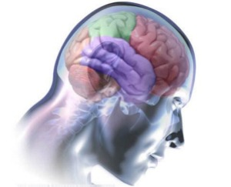
Localization of Stroke
.

Slide 9
Part of the brain affected
Left (Dominant) Hemisphere Stroke: Common Pattern
Aphasia , Difficulty reading, writing, or calculating
Majority of right handed and most left handed patients have dominance for speech and language located in the left hemisphere
Left hemisphere infarction is characterized by aphasia (both motor [Broca’s] and sensory [Wernicke’s]) and apraxia
Right Hemiparesis
Right-sided sensory loss
Right visual field defect
Poor right conjugate gaze

Slide 10
Right (Non-dominant) Hemisphere Stroke: Common Pattern
Less predictable syndromes
Left Hemiparesis
Left-sided sensory loss
Poor left conjugate gaze
Dysarthria
Attention defects: extinction and neglect
Spatial disorientation
Behavioral changes: acute confusion and delirium
Defect of left visual field

Slide 11
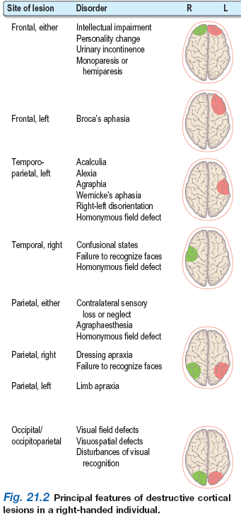

Slide 13
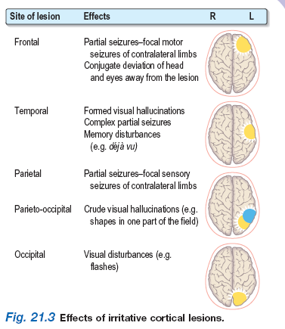

Slide 14
Stroke Syndromes: Classification
Stroke Syndromes
Large-vessel stroke
within
anterior ciculation
Internal carotid artery
and
Its branches
ACA
MCA
Large-vessel stroke
within
posterior ciculation
PCA
Basilar Artery
Vertebral and posterior
inferior cerebellar
arteries
Small-vessel disease
of
either vascular bed

Slide 15
Stroke – Signs and Symptoms
Ischemic
Carotid Circulation
Unilateral paralysis (opposite side)
Numbness (opposite side)
Language disturbance
Aphasia – difficult comprehension, nonsense, difficult reading/writing
Dysarthria – slurred speech, abnormal pronunciation.
Visual disturbance (opposite side)
Monocular blindness (same side)

Slide 16
Stroke – Signs and Symptoms
Ischemic
Vertebrobasilar Circulation
Vertigo
Visual disturbance
Both eyes simultaneously
Diplopia
Ocular palsy – inability to move to one side
Dysconjugate gaze – asynchronous movement
Paralysis
Numbness
Dysarthria
Ataxia

Slide 17
Stroke – Signs and Symptoms
Differential Diagnosis of Stroke
Head/Cervical trauma
Meningitis/encephalitis
Hypertensive encephalopathy
Intracranial mass
Tumor
Sub/epi dural hematoma
Todd’s paralysis
Migraine w/ neuro sx
Metabolic
Hyper/hypo glycemia
Post arrest ischemia
Drug OD

Slide 18
Stroke - Management
Airway
Potential problems
Paralysis of airway structures
Vomiting esp. w/ hemorrhagic stroke
Coma
Seizures
Cervical trauma due to pt. collapse
Manage Aggressively
ETT /High flow O₂

Slide 19
Stroke - Management
Breathing
Potential Problems
Irregular respiratory pattern
Cheyne-Stokes
Central Neurogenic hyperventilation
Paralysis of muscles of respiration
Manage Aggressively
High flow O₂

Slide 20
Stroke - Management
Circulation
Management is supportive
Other Treatment
EKG
Treat dysrhythmias
IV access
Balanced salt solution
Glucometer
Correct hypoglycemia
Prompt Transport
Alert receiving facility of potential Stroke patient

Slide 21
Stroke – Management In Review:
Prehospital Critical Actions
Assess and support cardiorespiratory function
Assess and support blood glucose
Assess and support oxygenation and ventilation
Assess neurologic function
Determine precise time of symptom onset
Determine essential medical information
Provide rapid emergent transport

Slide 22
Stroke - Management
ER Evaluation and Management
Assessment Goal: in first 10 minutes
Assess ABCs, vital signs
Provide oxygen by nasal cannula
Obtain IV access; obtain blood samples (CBC, electrolytes, coagulation studies)
Obtain 12-lead ECG, check rhythm, place on monitor
Check blood sugar; treat if indicated
Alert Stroke Team: neurologist, radiologist, CT technician
Perform general neurologic screening assessment

Slide 23
Stroke - Management
Assessment Goal: in first 25 minutes
Review patient history
Establish symptom onset (<3 hours required for fibrinolytics)
Perform physical examination
Perform neurologic exam
Determine level of consciousness (Glasgow Coma Scale)
Determine level of stroke severity (NIHSS or Hunt and Hess Scale)
Order urgent non-contrast CT scan/angiogram if non-hemorrhage (door-to–CT scan performed: goal <25 min from arrival)
Read CT scan (door-to–CT read: goal <45 min from arrival)
Perform lateral cervical spine x-ray (if patient comatose/trauma history)

Slide 24
Stroke - Management
ER Diagnostic Studies
CT scan – done w/in 25 mins, read w/in 45 mins
r/o hemorrhage
Often normal early in ischemic stroke
Lumbar puncture
EKG
Changes may be caused by or cause of stroke
MRA (Magnetic Resonance Angiography)
Cerebral Angiography

Slide 25
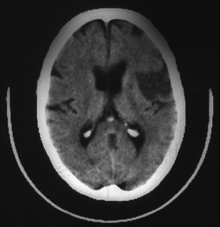
Hypodense area:
Ischemic area with edema, swelling
Indicates >3 hours old
No fibrinolytics!

Slide 26
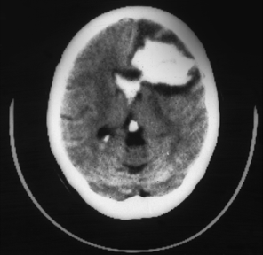
(White areas indicate
hyperdensity = blood)
Large left frontal
intracerebral hemorrhage.
Intraventricular bleeding
is also present
No fibrinolytics!

Slide 27
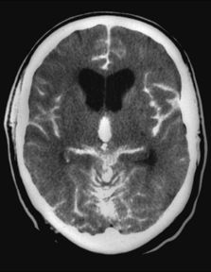
Acute subarachnoid hemorrhage
Diffuse areas of white (hyperdense) images
Blood visible in ventricles
and multiple areas on surface of brain

Slide 28
Stroke - Management
Decision: Specific Therapies
General Care
ABC’s, O₂
IV w/ BSS
Treat hypotension
Avoid over-hydration
Monitor input/output
Normalize Blood glucose
Manage Elevated BP?

Slide 29
Stroke - Management
Indications for Antihypertensive therapy
In general:
Consider: absolute level of BP?
If BP: >185/>110 mm Hg = fibrinolytic therapy contraindicated
Consider: other than BP, is patient candidate for fibrinolytics?
If patient is candidate for fibrinolytics: treat initial BP >185/>110 mm Hg
Consider: response to initial efforts to lower BP in ED?
If treatment brings BP down to <185/110 mm Hg: give fibrinolytics
Consider: ischemic vs hemorrhagic stroke?
Treat BP in the 220/120mm Hg range the same
The obvious: no fibrinolytics for hemorrhagic stroke

Slide 30
Stroke - Management
Decision: Specific Therapies (cont.)
Management of Seizures
Benzodiazepines
Long-acting anticonvulsants
Management of Increased ICP
Maintain PaCO₂ 30mm Hg
Mannitol/Diuretics
Barbiturates
Neurosurgical decompression

Slide 31
Stroke - Management
Drugs: Thrombolytic Therapy
Fibrinolytic Therapy Checklist Ischemic Stroke
Candidates for Neurointerventional Therapy
□ Age 18 years or older
□ Acute signs and symptoms of CVA <3 hours onset.
□ No contraindications.

Slide 32
Stroke - Management
Contraindications for Interventional Therapy
Absolute
□ Evidence of intracranial hemorrhage on non-contrast head CT
□ Patient with early infarct signs on CT scan.
Relative
□ Recent (w/in 2 mo’s) cranial or spinal surgery, trauma, or injury
□ Known bleeding disorder and/or risk of bleeding including:
- Current anticoagulant therapy, prothrombin time >15 sec.
- Heparin within 48 hrs of admission, PTT elevated
- Platelet count <100,000/mm
□ Active internal bleeding w/in the previous 10 days
□ Known or suspected pregnancy
□ History of stroke w/in past 6 weeks

Slide 33
Stroke - Management
Contraindications for Interventional Therapy (cont.)
Relative
□ Patient comatose
□ >85 years old
□ Diabetic hemorrhagic retinopathy or other opthalmic hemorrhagic disorder
□ Advanced liver or kidney disease
□ Other pathology with a propensity for bleeding
□ Infectiouse endocarditis
□ Severe EKG disturbance, uncontrolled angina or acute MI

Slide 34
Stroke - Management
Thrombolytic Agents
TPA
0.9mg/kg iv (max90mg)
10% bolus followed by 90% over 1hr
Streptokinase
Anticoagulant Therapy
Heparin
ASA/Warfarin/Ticlodipine

Slide 35
Stroke - Management
Management of Hemorrhagic Stroke
Subarachnoid
Neurosurgical intervention
Nimodipine
Intracerebral
Management of ICP
Neurosurgical decompression
Cerebellar
Surgical evacuation
Often associated with good outcome
Lobar
Surgical evacuation

Slide 36
Stroke rehabilitation
Avoid complications
Pressure sores
Muscle contractures
DVT and pulmonary embolism
Pneumonia
Rehabilitation
Physiotherapy
Speech therapy and occupational therapy
Patient attender education

Slide 37
THANK YOU

