Slide 1
AMOEBIASIS
Dr. Sujeetha chandrababu M.D.

Slide 2
Amoebiasis
Amoebiasis is an infection with the intestinal protozoa Entamoeba histolytica.
About 90% of infections are asymptomatic
Remaining 10% produce a spectrum of clinical syndromes
Ranging from -
asymptomatic to dysentery to abscesses of liver or other organs

Slide 3
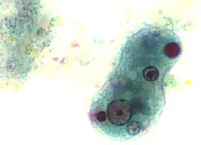
Agents
Entamoeba histolytica
Trophozoites
10 - 60 μm in D
Cytoplasm – # outer clear ectoplasm
# inner granular endoplasm
# food vacuoles with RBCs, leukocytes & tissue
debris
Motile by pseudopodial extensions
Nucleus with central karyosome, surrounded by delicate membrane lined with chromatin granules

Slide 4
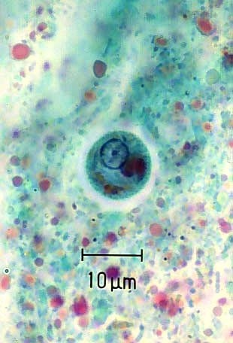
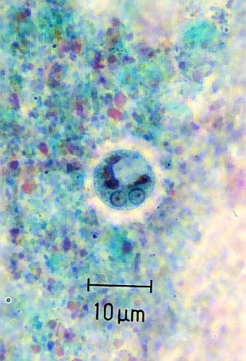
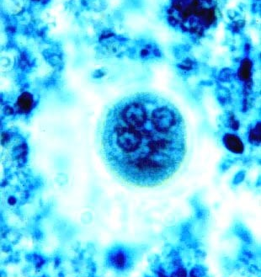
Agents (contd.)
Entamoeba histolytica
Precyst
Intermediate form
Oval with blunt pseudopodia
No food vacuoles
Cysts
Spherical, 10 - 15 μm in D
Uninucleate, later bi- or quadri- nucleate
Thick chitinous wall
Glycogen mass – not in quadrinucleate

Slide 5
Magnitude
World
worldwide in distribution
3rd most common parasitic death
India, China, Africa, South America
2-60% prevalence
100,000 deaths/yr
500 million infections
50 million cases
India
15% prevalence (3.6-47.4%)
variation according to sanitation

Slide 6
Important facts
Source of infection is a case or carrier
-1∙5 X 10⁷ cysts per day
Reservoir is only human – several years
Resistant to chlorine in normal conc.
Readily killed by freezing or heating(55°C)

Slide 7
Life Cycle

Slide 8
Host
All age groups affected
No gender or racial differences
Institutional, community living
Severe if children, old, pregnant, PEM
Develops antibodies in tissue invasion

Slide 9
Environment
Low socio-economic status
Poor sanitation, sewage contamination
Night soil for agriculture
Seasonal variation

Slide 10
Incubation period
1- 4 weeks
Modes of transmission
1- 4 weeks
Faeco -oral route
contaminated water and food
direct hand to mouth
Agency of flies, cockroaches, rats, etc.
Sexual contact via oro -rectal route

Slide 11
Clinical Spectrum
Most common type of amoebic infection is asymptomatic cyst passage
Intestinal amoebiasis – abdominal cramps with mild diarrhoea to colitis and dysentry
Extra-intestinal amoebiasis – Amoebic liver abcess, rarely lungs, skin, genitalia and CNS are affected
Amoeboma – inflammatory and edematous reaction around trophozoites

Slide 12
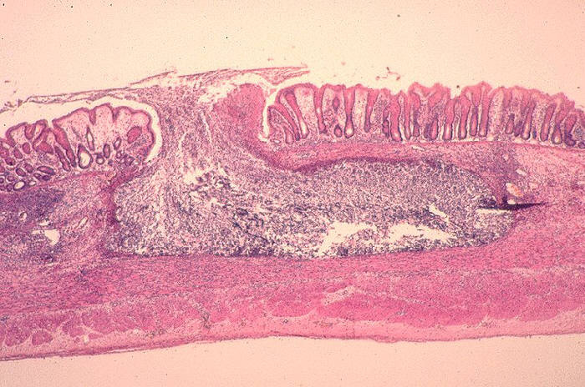
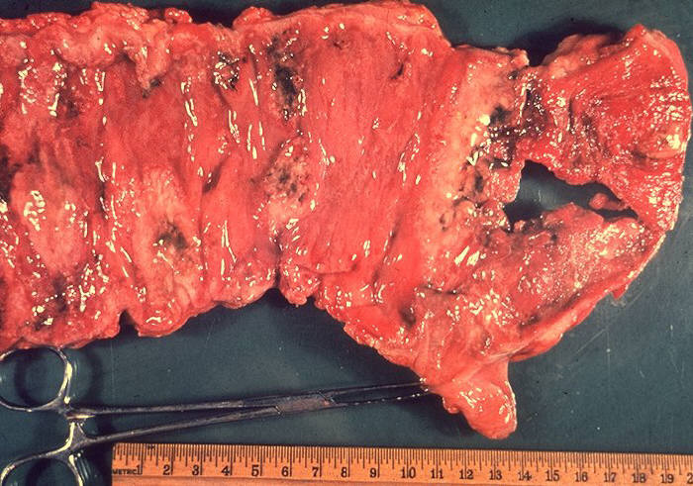
Asymptomatic carriers
90% without symptoms
does not damage lumen
Amoebic colitis
flask shaped ulcers superficial or deep
abd pain (tenesmus)
diarrhoea, dysentery, fever
peri-anal ulcers
Fulminant colitis
<0.5%
severely ill with high fever
intestinal bleeding, perforation
paralytic ileus
Uncommonly, a chronic form of amoebic colitis can be confused with inflammatory bowel disease

Slide 13
PATHOLOGY
the intestinal lesion
Gut
Minute crypt lesion
Extends through the muscularis mucosa and submucosa.
“Flask shaped” ulcer
Thrombosis of blood vessels
“Toxic megacolon”
Irreversible coagulation necrosis of bowel wall.

Slide 14
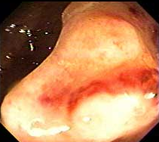
Amoeboma
Pseudotumoral lesion
Necrosis, edema and inflammatory thickening of mucosa and submucosa of intestinal wall
1% of cases
palpable mass with trophozoites
Always coexists with ulceration
Single, rarely multiple in different parts of colon, on skin at site of ALA aspiration

Slide 15

Difference between amoebic and bacillary dysentery
Macroscopy
Character | Amoebic dysentry | Bacillary dysentry
Number | 6-8 motions per day | > 10 motions per day
Amount | Copious | Small
Odour | Offensive | Odourless
Colour | Dark red | Bright red
Reaction | Acidic | Alkaline
Consistency | Non-adherent | Adherent

Slide 16
Difference between amoebic and bacillary dysentery (contd.)
Microscopy
Character | Amoebic dysentry | Bacillary dysentry
RBCs | In clumps | Discrete or in Rouleaux
Pus cells | Few | Numerous
Macrophages | Few | Numerous, many have RBCs and may mimic EH
Eosinophils | Present | Scarce
Charcot-Leyden crystals | Present | Absent
Pyknotic bodies | Present | Absent
Parasites | Trophozoites of EH | Absent
Bacteria | Few or absent | Many motile bacteria

Slide 17
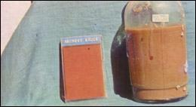
Amoebic Liver abscess
Most common extra-intestinal presentation
The parasite reaches liver via portal system
Occurs within 5 mths of dysentery in 95% of cases
But concomitant active diarrhea is seen in less than a third of cases
Pain and point tenderness over right hypochondrium and fever
Jaundice rare, pleural effusion is common
Older pt. from endemic areas usually have chronic disease
Right lobe is commonly affected, abscess of left lobe is more dangerous due to its proximity to heart –> rupture –> pericardial effusion
Necrotic cavitary lesion filled with cellular debris and parasite trophozoites – Anchovy sauce pus

Slide 18
PATHOGENESIS
Journey of E. Histolytica to the Liver
1. Direct Extension from the Gut to the Liver
2. Via the Lymphatics
3. Along the portal stream
Infarction – Enzymatic Dissolution

Slide 19
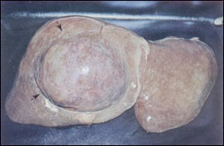
Bulge due to superficial abscess

Slide 20
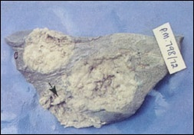
Shaggy appearance of the walls of the abscesses

Slide 21
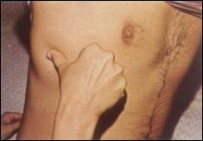
Intercostal tenderness

Slide 22
COMPLICATONS
Right chest
Peritoneum
Pericardium
Amoebic brain abscess - rare
Hemobilia – Rupture in to major bileduct
Portal hypertension

Slide 23
LABORATORY FINDINGS
Normocytic Normochromic anaemia
Leucocytosis -> more than 10× * 10 ⁹ / L
ESR
Stool Cyst or Vegetative form of E . Histolytica
LFT Bilirubin
Transaminases more than 50 %
Alkaline phosphatase more than 75 %

Slide 24
RADIOLOGY
CXR – Elevated Right Hemi diaphragm
Isotope liver scan
USG Abdomen – B mode , Hypoechoic
CT Scan
DD
Subphrenic Abscess
Cholecystitis
Liver Hydatid cyst
Primary and Secondary carcinoma of liver
Lesions of the right lung and right pleura

Slide 25
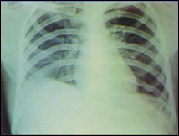
X-ray chest showing obliterated costophrenic angle and an elevated right dome of the diaphragm

Slide 26
INDICATIONS FOR ASPIRATION OF AMOEBIC LIVER ABSCESS
Formal Indications
To rule out a pyogenic abscess (, particularly with
multiple lesions )
As adjunct to medical therapy ( No response after 72 hours )
If rupture is believed to be imminent
Abscess in the left lobe where the risk of rupture is increased.
Possible Indications
To reduce the period of disability

Slide 27
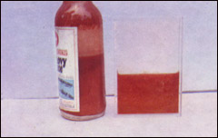
A bottle of anchovy sauce and amoebic pus.

Slide 28
SURGERY
ALA with Secondary infection
Left lobe Abscess
Bowel perforation
Rupture into pericordium

Slide 29
Pleuro-pulmonary involvement
Serous pleural effusion or contiguous spread from ALA
Rupture from ALA into pleural space
Hepato-bronchial fistula with necrotic material in sputum may mimic blood – trophozoites can be present
Other sites
CNS involvement – rare – hematogenous spread
Genital ulcer can occur – by contiguous spread or hematogenous route

Slide 30
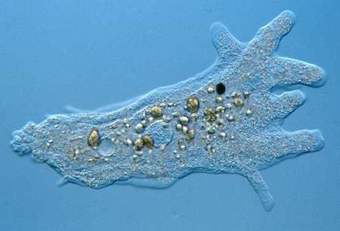
Virulence factors
Adhesion
Gal/GalNAc Lectin
Surface adhesins
Lipophosphoglycan like molecules
Invasion
ATPase
Neuraminidase
Phospholipase A₁, A₂, and L₁
Metallocollagenase
Cysteine protease
Lysis
Amoebopore –
insertion of protein ion channels – cytolytic and bactericidal

Slide 31
Laboratory diagnosis
Samples :
Stool ( 3 consecutive samples)
Biopsy material from the ulcers (colonoscopy or sigmoidoscopy)
Aspirate from liver abcess
Serum
Pleural fluid
Pericardial fluid
Sputum

Slide 32
Microscopy
Both saline and iodine wet mounts are prepared
Any motile trophozoite is better seen in saline mount
Iodine mount stains the internal structures and is used to identify cysts

Slide 33
Serology
Antibody detection
ELISA
IHA
IFA
Antigen detection
ELISA
Coagglutination
Copro-antigen detection by ELISA is another recent and very useful method

Slide 34
Treatment
Luminal amoebicide
Diloxanide furoate
Paromomycin
Diiodohydroxiquin
Liver, gut wall and other tissues
Emetine
Dehydroemetine
Hepatic amoebicide
Chloroquine
Both tissue and intestinal amoebicide (Nitroimidazoles)
Metronidazole [500-800 mg TDS X 5 (5-10) days]
Tinidazole [ 2 gm OD X 1-3 days]
Ornidazole [ 2 gm OD X 1-3 days]

Slide 35
Clinical presentation | Drugs of Choice | Adult Dosage
Asymptomahic Intestinal carrier Intestinal infection /amoebic liver abscess | 1st Choice Diloxanide Furoate 2nd Choice Paramomycin (or) Iodoquinol 1st Choice Metronidazole followed by diloxanide furoate ( or ) Tinidazole followed by diloxanide furoate 2nd Choice Paramomycin | 500 mg t.i.d × 10 days 25 – 30 mg kg⁻¹ day⁻¹ in 3 doses × 7-10 days. 650 mg t.i.d × 20 days 750 – 800 mg.t.i.d × 10 days 500 mg.t.i.d × 10 days 2 g/day 2 -3 days 500 mg .t.i.d × 10 days 25 – 30 mg kg⁻¹ day⁻¹ in 3 doses × 7 – 10 days

Slide 36
Thank You

