Slide 1
LEPROSY dr. sujeetha chandrababu M.D.

Slide 2
Epidemiology
Leprosy is a disease of developing countries but affects all races.
80% of the worldwide cases are found in five countries, namely India, Mynamar, Indonesia, Brazil and Nigeria.

Slide 3
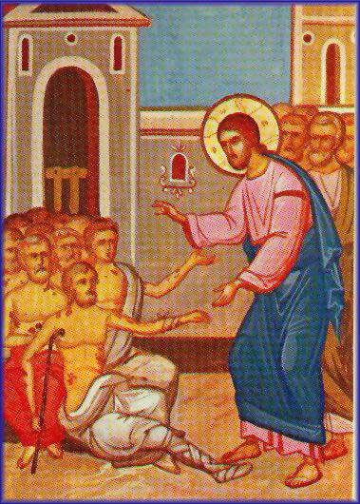
_{What is Leprosy?}
It is a chronic granulomatous disease
Characterized by lesions of the peripheral nerve, skin, and mucus
membrane of the URT (nasal mucosa).
World's oldest recorded disease
Every year January 27 is World Leprosy Day

Slide 4
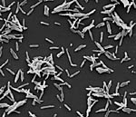
What causes it?
Mycobacterium leprae
Rod Shaped
First bacterium disease in humans

Slide 5
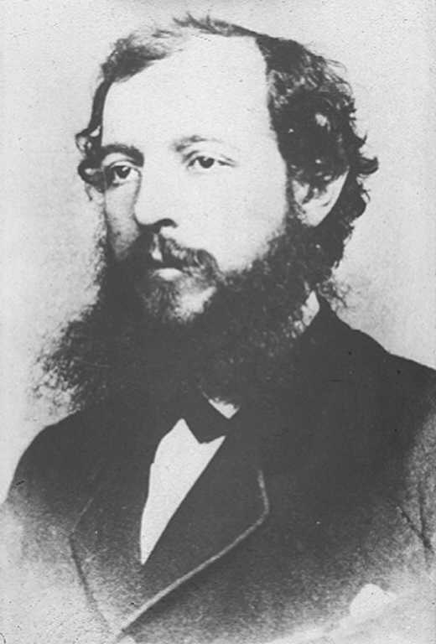
M. leprae is discovered by Hansen from Norway in 1873

Slide 6
Incubation period is 2-5 yrs to 8-12 years
M.leprae has predilection for schwann cells and skin macrophages.
Results in skin lesions and deformities, most often affecting the cooler places on the body ( for example: eyes, nose, earlobes, hands, feet, and testicles) that can be very disfiguring.

Slide 7
Mode of infection
Although human-to-human transmission is the primary source of infection, three other species can carry and (rarely) transfer M. leprae to humans: chimpanzees, mangabey monkeys, and nine-banded armadillos.

Slide 8
Mode of transmission The exact rout of transmission is not fully known .
The spread of leprosy is believed to be via nasal discharge (Droplets infection).
Every 1 cc of nasal secretion contains 1- 2millions lepra bacilli

Slide 9
Other modes of transmissions
Contact through the skin (rare).
Arthropod-born infection (rare).
Through placenta and milk.

Slide 10
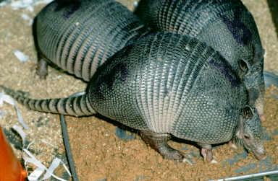
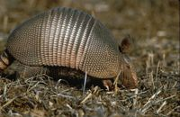
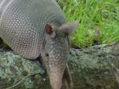

The nine - banded armadillo

Slide 11
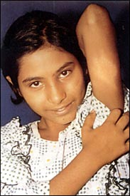
Signs and Symptoms
Early signs and symptoms of leprosy are very subtle and occur slowly (usually over years).
First symptoms :
Numbness and loss of temperature sensation (cannot sense very hot or cold temperatures)
As the disease progresses :
The sensations of touch, then pain, and eventually deep pressure are decreased or lost.

Slide 12
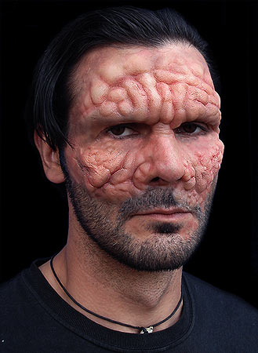
Long-term developing sequence of events :
Relatively painless ulcers, skin lesions of hypopigmented macules (flat, pale areas of skin), and eye damage (dryness, reduced blinking)
Late stage: large ulcerations, loss of digits, and facial disfigurement. (for example, hands, feet, face, and knees).

Slide 13
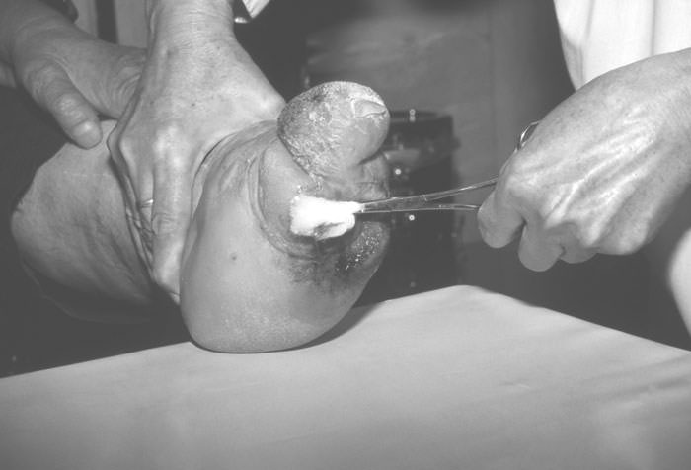
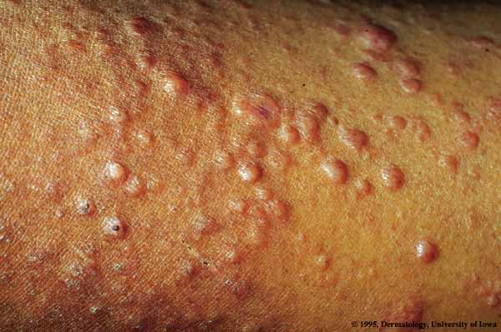
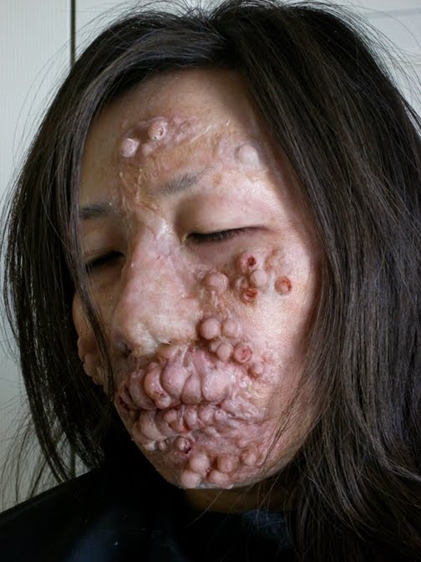
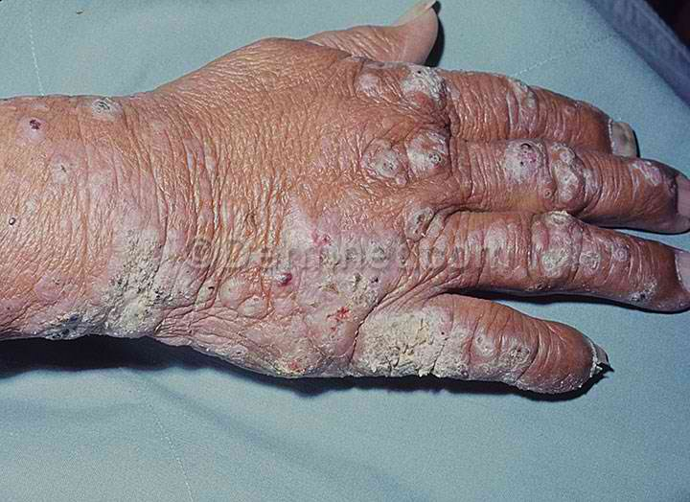
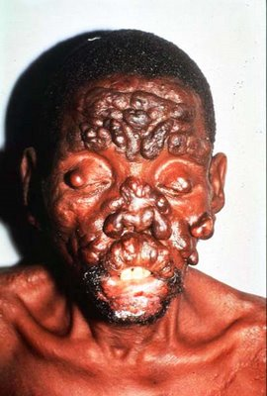

Slide 14
Predisposing or risk factors
Residence in an endemic area.
Poverty (malnutrition).
Contact with affected armadillo.
Immunity

Slide 15
(cont.)
Males appear to be twice common than females.
Bimodal age (10-14years & 35-44 years).
Children are more susceptible to disease.
Genetic factors, e.g. HLA markers may determine the type of leprosy which the patient develops .

Slide 16
Classification & Clinical Presentation
Ridley &Jopling Classification
Based on Host Immunity
TT
BL
LL
BT
BB
BL

Slide 17
Classification & Clinical Presentation
WHO Classification
Based on Bacterial Load
Slit Skin Smear
Negative
Positive
Paucibacillary
1-5 skin lesions
Multibacillary
>6 skin lesions

Slide 18
LEPROSY
Paucibacillary (PB)
Multibacillary (MB)
Indeterminate Leprosy (IL)
Tuberculoid Leprosy (TL)
Borderline Tuberculoid (BT)
Borderline Borderline (BB)
Borderline Lepromatous(BL)
Lepromatous Leprosy (LL)

Slide 19
Indeterminate Leprosy (IL)
Usually single (multiple) macule / patche.
Hypopigmented or faintly erythematous.
Sensation normal but sometimes imparied.
The peripheral nerves normal.
Slit skin smear negative.

Slide 20
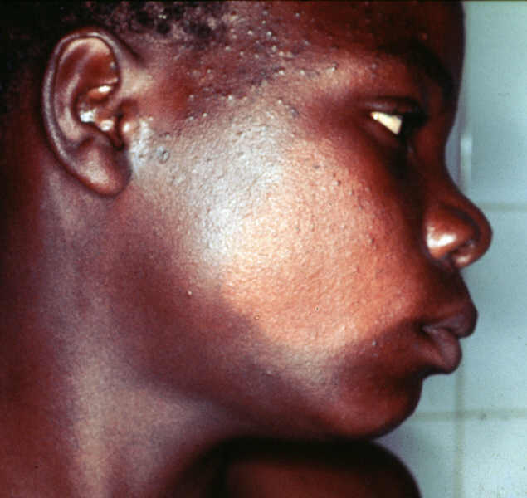
Indeterminate leprosy :Hypopigmented patch, sensation normal, no palpable peripheral nerve and slit skin smear negative.

Slide 21
Tuberculoid Leprosy (TL)
Usually single but may be few (<5).
Hypopigmented / erythematous plaque.
Varying in size from few mm to several cm.
Well defined borders.
Sensation markedly imparied.
Enlarged peripheral nerve.
Slit skin smear negative

Slide 22
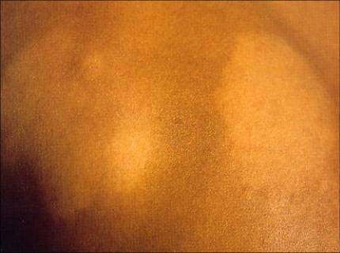
Tuberculoid leprosy: Two hypopigmented patches, hypoasthetic
well defined borders, palpable peripheral nerve and SSS negative.

Slide 23
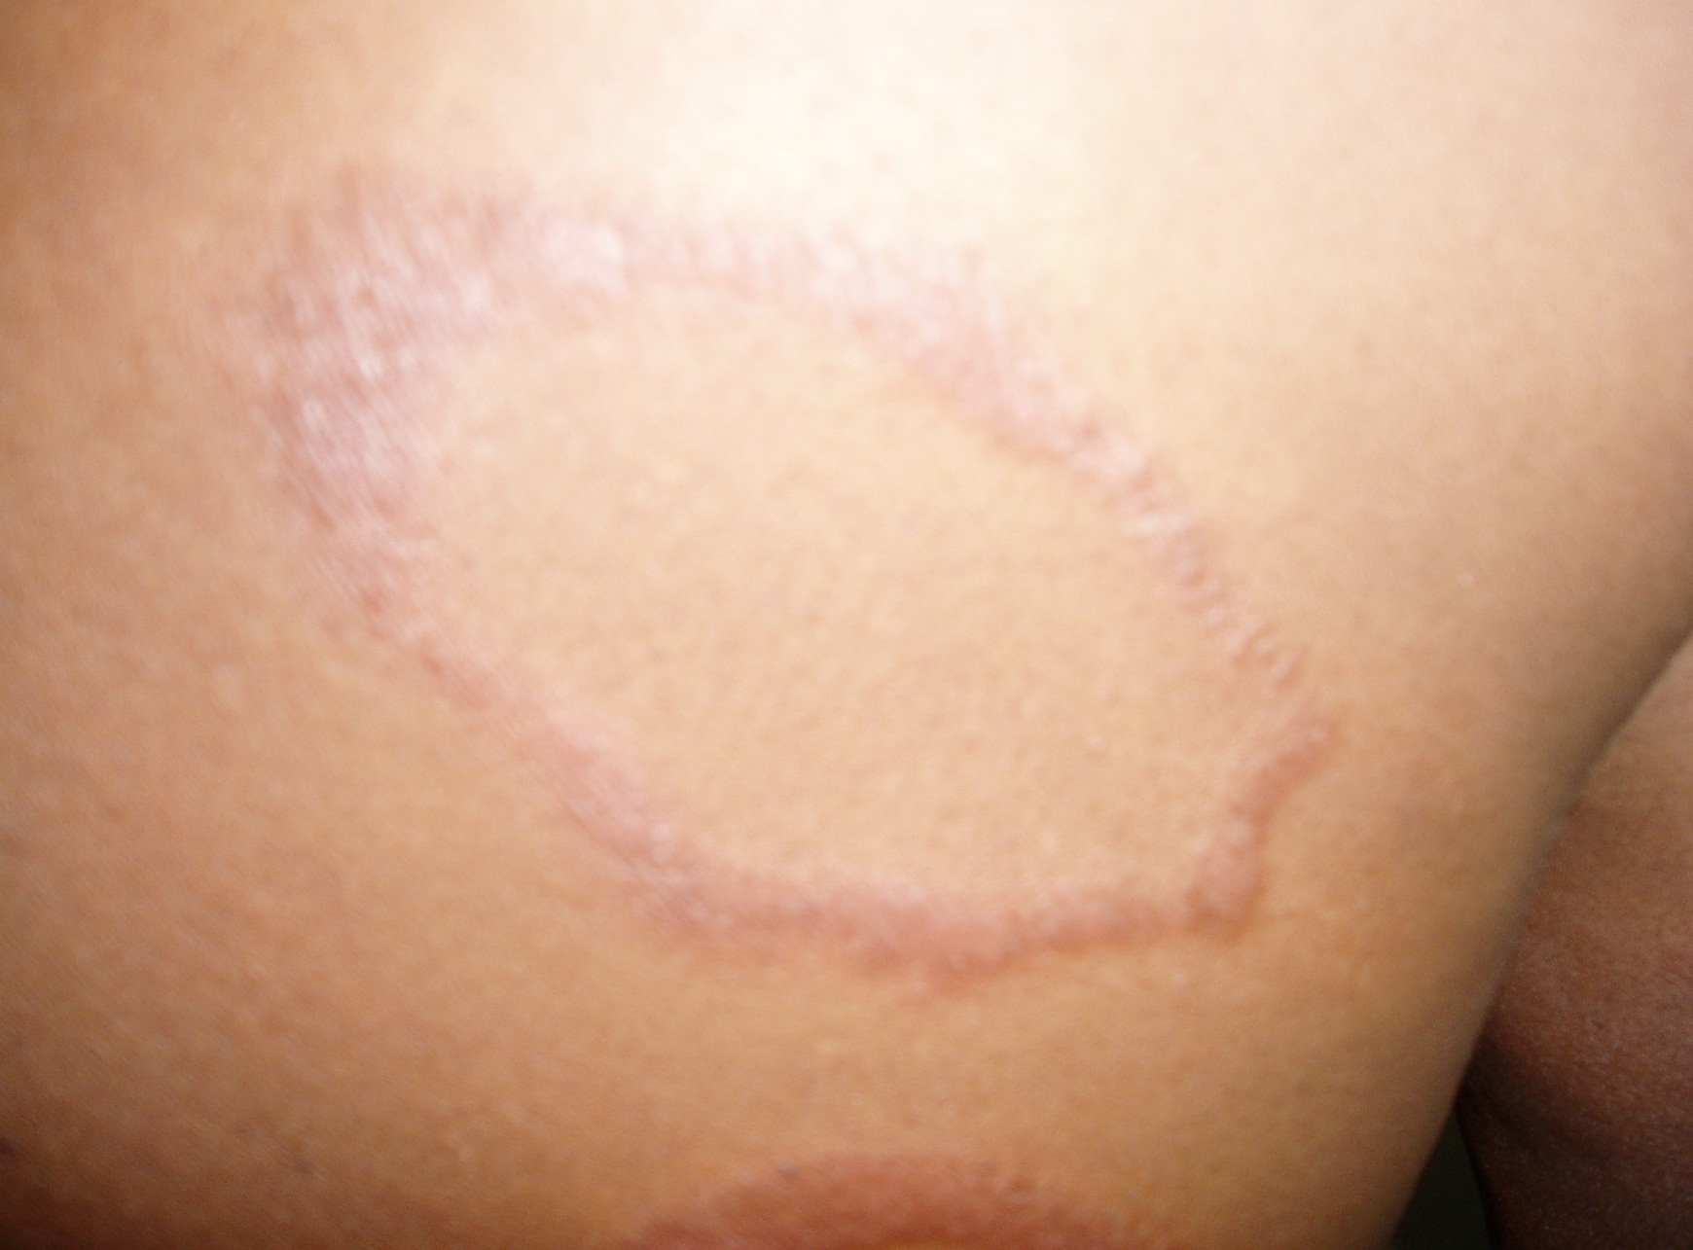
Tuberculoid Leprosy: Annular, erythematous, anasthetic patch with
well defined and raised borders and SSS Negative.

Slide 24
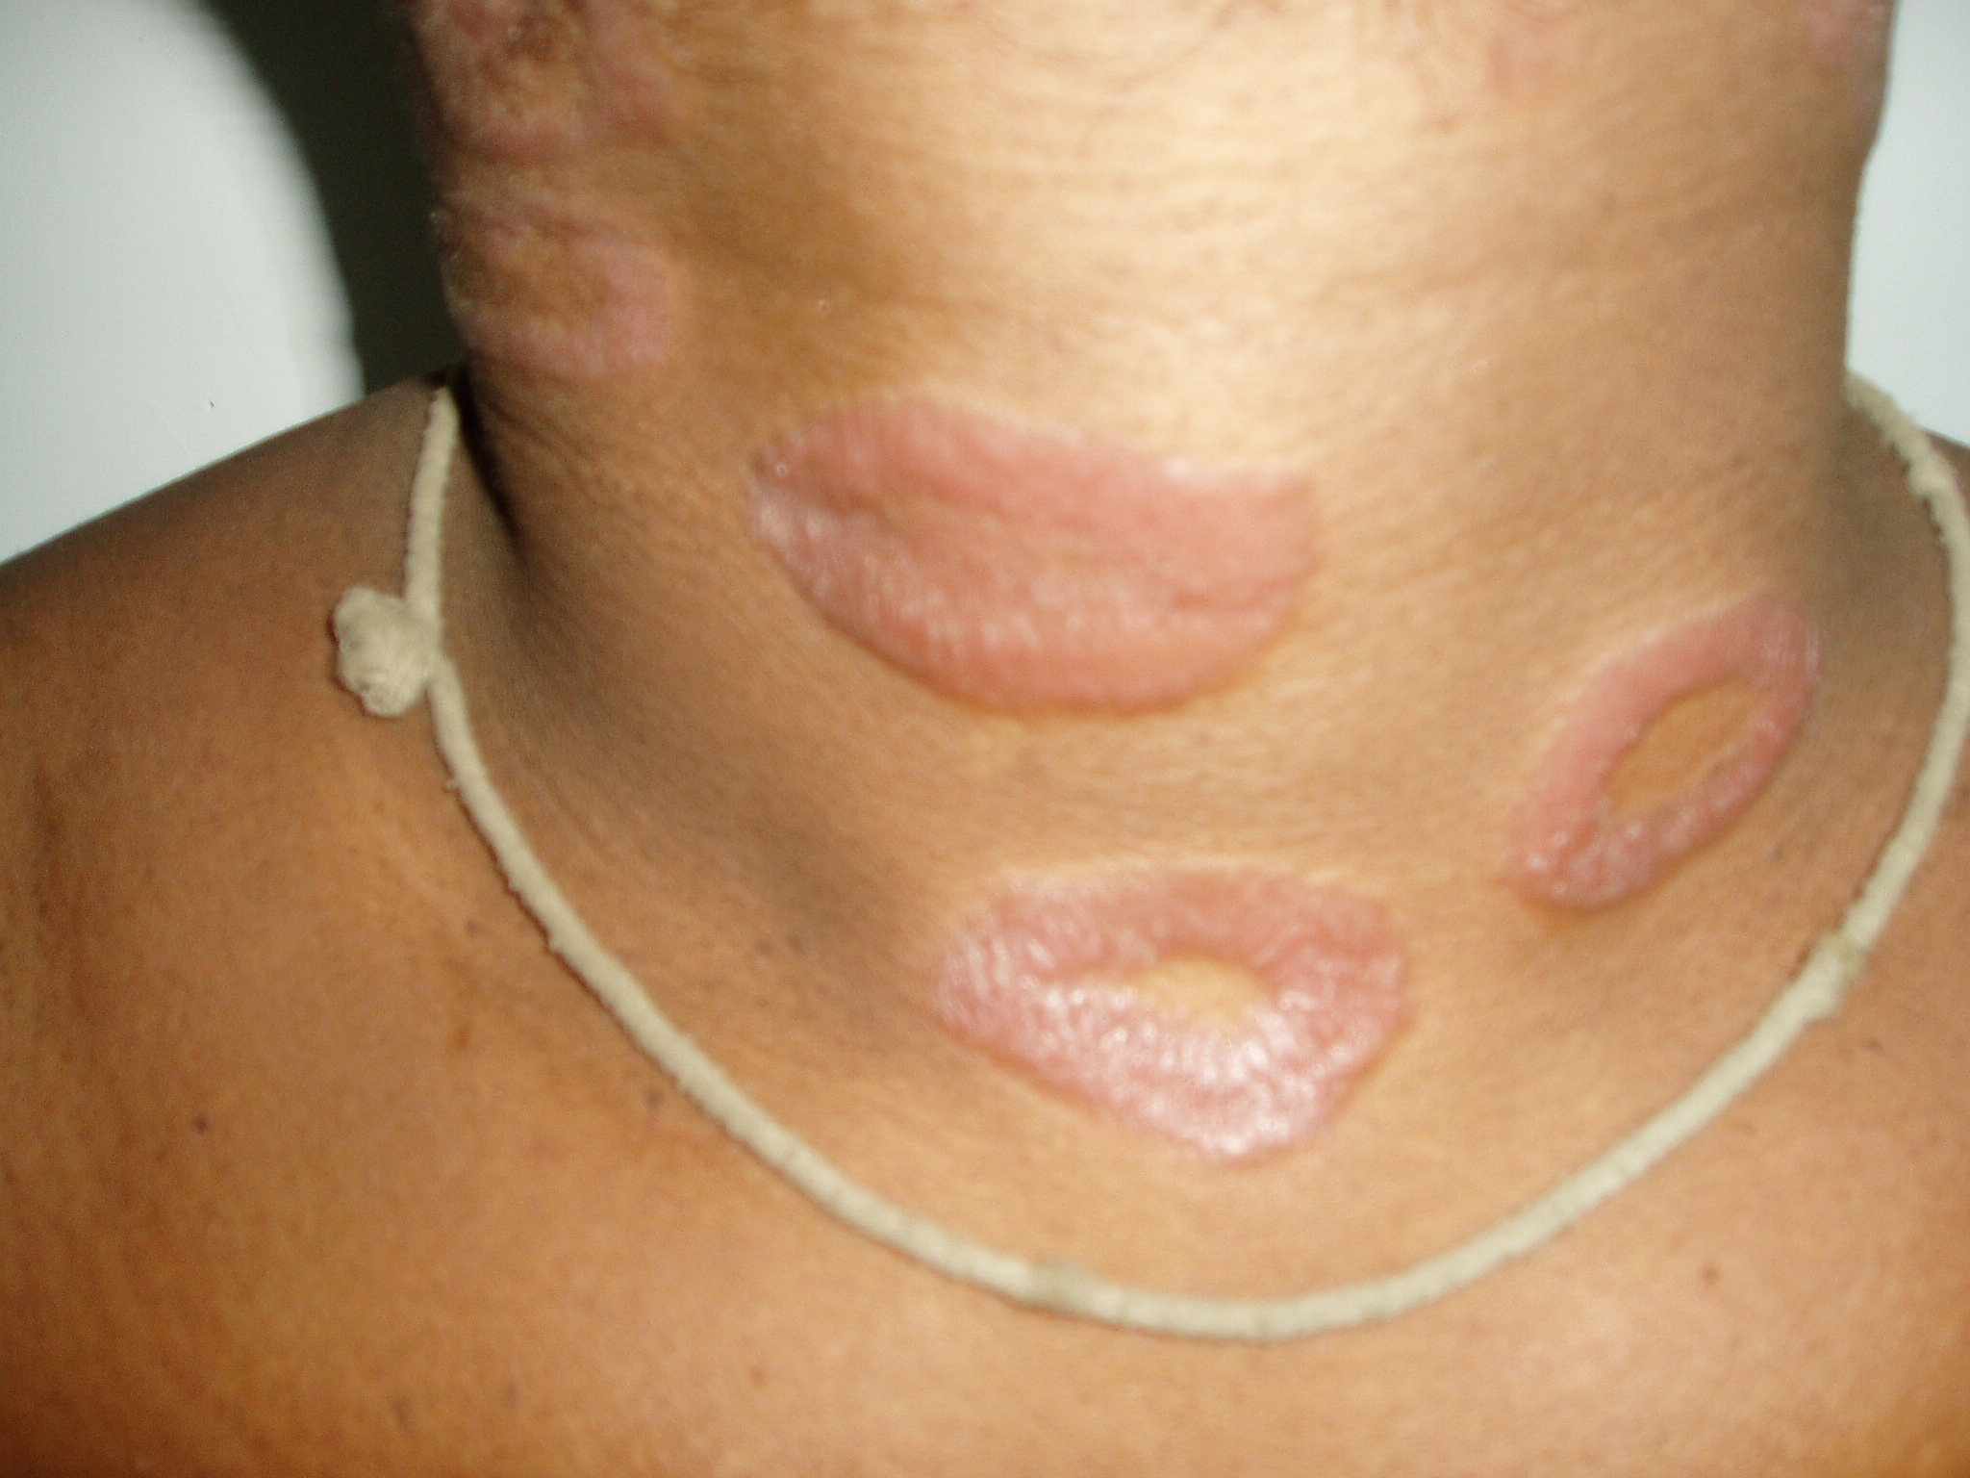

Slide 25
Borderline Leprosy (BT,BB,BL)
Few / many asymmetrical patches.
Partly well-defined borders.
Sensory impairments range from slight to marked.
Slit skin smear usually positive.
P. nerves asymmetrically enlarged.

Slide 26
BL | BB | BT
Many | Some | Few(<5) | Lesion no.
Roughly | Less | Well | Lesions borders
Slight | Moderate | Marked | Sensory impairment
Roughly symmetrical | Asymmetrical | Asymmetrical | Distribution of skin lesions
Less asymmetrical | Asymmetrical | Asymmetrical | Peripheral nerves
Multibacillary | Multibacillary | Paucibacillary | Type of leprosy
4+ | 2+ / 3+ | - / 1+ | Slit skin smear
Note: Sometimes patients may have BT/BB or BB/BL or BL/LL

Slide 27
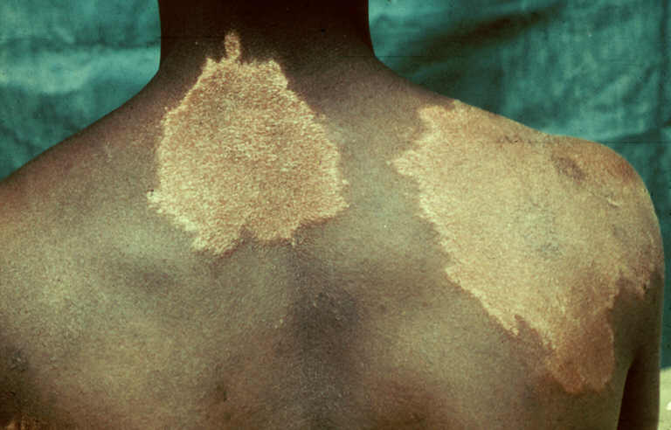
Borderline Tuberculoid Leprosy: Well-defined large anaesthetic patches
with satellite lesions. SSS Negative.

Slide 28
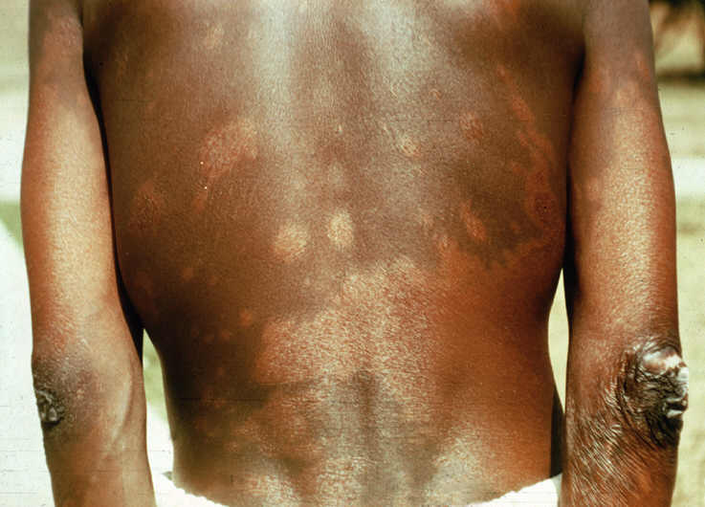
Borderline Borderline Leprosy: Less defined, asymmetrically distributed
hypoaesthetic patches. SSS positive.

Slide 29
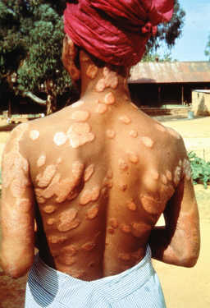
Borderline Lepromatous Leprosy: Numerous, hypoaesthetic almost
symmetrically distributed patches . SSS positive.

Slide 30
Lepromatous Leprosy (LL)
Very numerous ill defined lesions.
(macules, patches, papules,and nodules).
Symmetrically distributed allover the body
Loss of eyebrows and eyelashes.
No sensory impairments in lesions .
Peripheral nerves symmetrically enlarged.
Slit skin smear always positive.

Slide 31
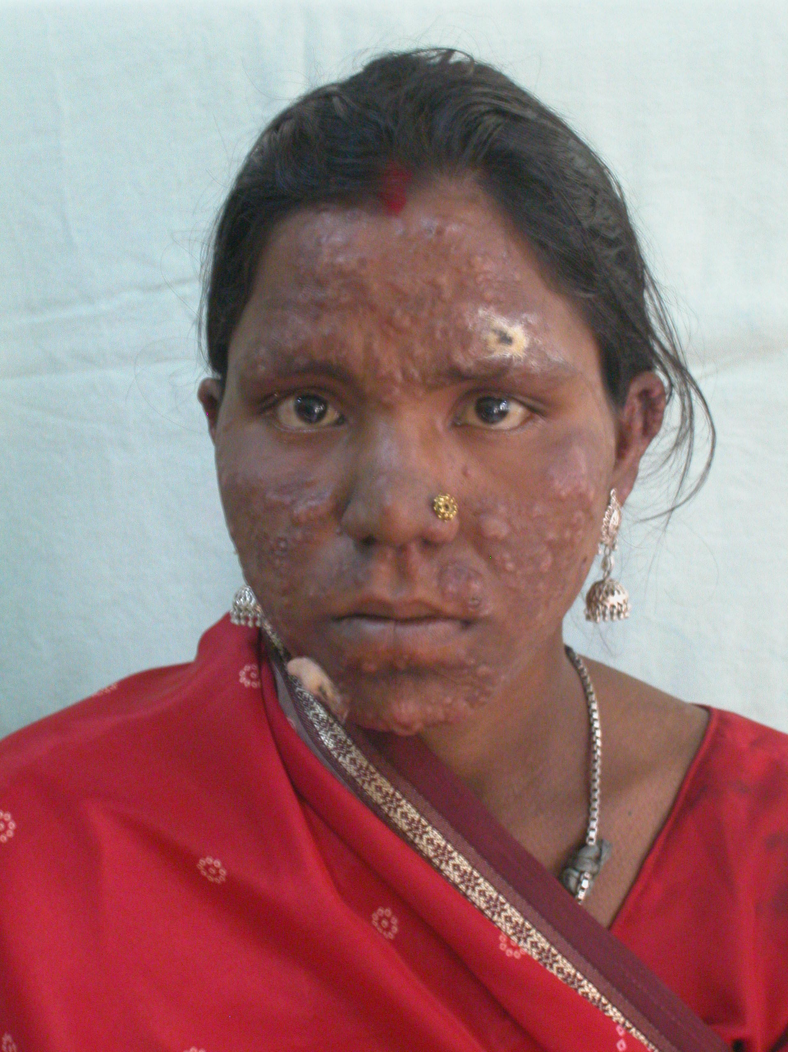

Slide 32
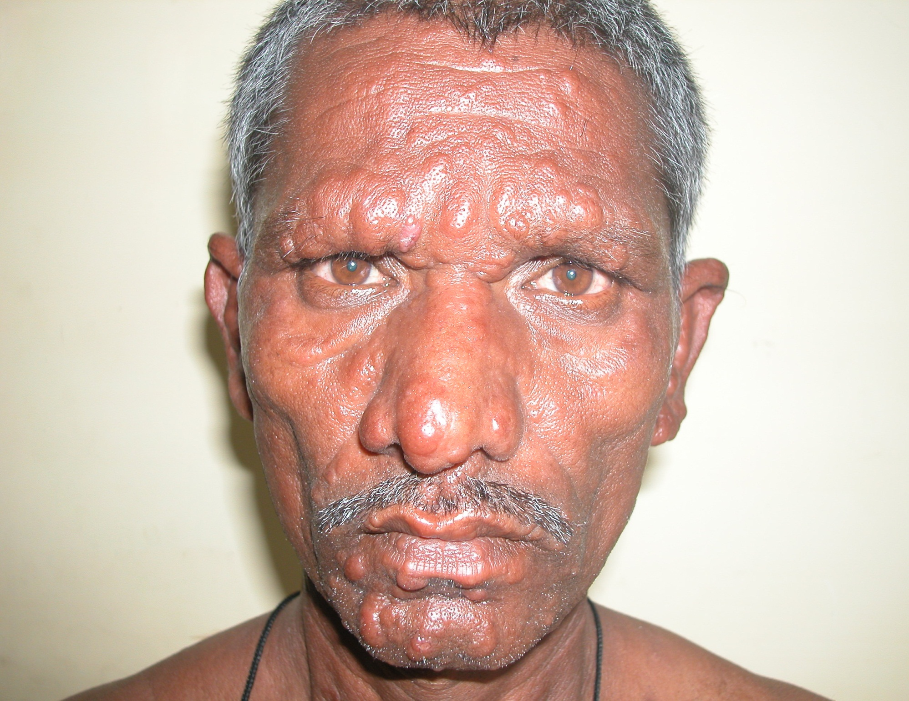

Slide 33
Lepromatous Leprosy: Leonine Face

Slide 34
Diagnosis of Leprosy
Clinical Examination.
Slit Skin Smear.
Skin Biopsy.

Slide 35
1.Clinical examination:
What are the cardinal skin signs of leprosy ?
Hypopigmented or erythematus patch / plaque
2. Complete / partial loss of sensation.
3. Thickening of peripheral nerves.

Slide 36
2.Slit Skin Smear
Simple and valuable test.
It is needed for diagnosis.
Monitor the progress of the treatment.

Slide 37
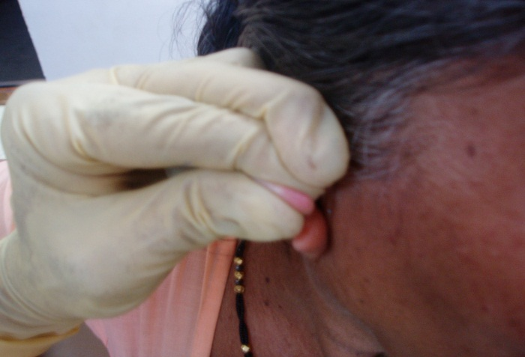
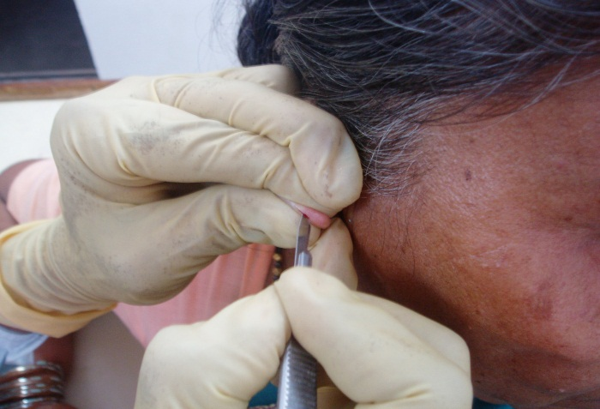
Slit Skin Smear (method).
Pinch the site tight.
Incise.
Scrape & collect material
Smear on a slide.
Air dry & fix.
Stain (Z-N method)

Slide 38
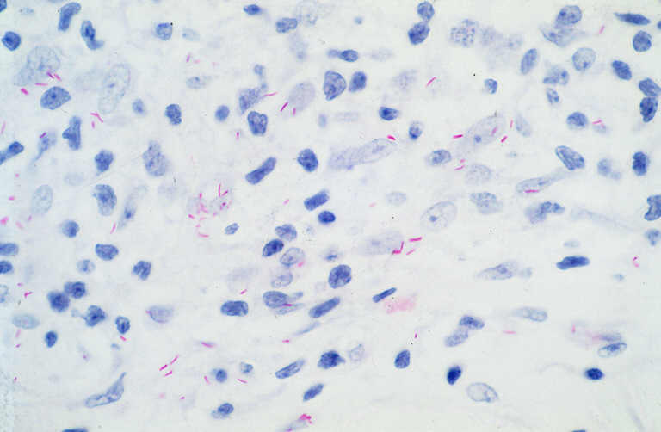
Slit Skin Smear (Reporting the smear).
(Ridley’s logarithmic
scale)Bacteriological index
0 – no bacilli in 100 fields
1+: 1-10 bacilli in 100 fields
2+: 1-10 bacilli in 10 fields
3+: 1-10 bacilli in 1 field
4+: 10-100 bacilli in 1 field
5+: 100-1000 in 1 field
6+: >1000 bacilli field (globi).

Slide 39
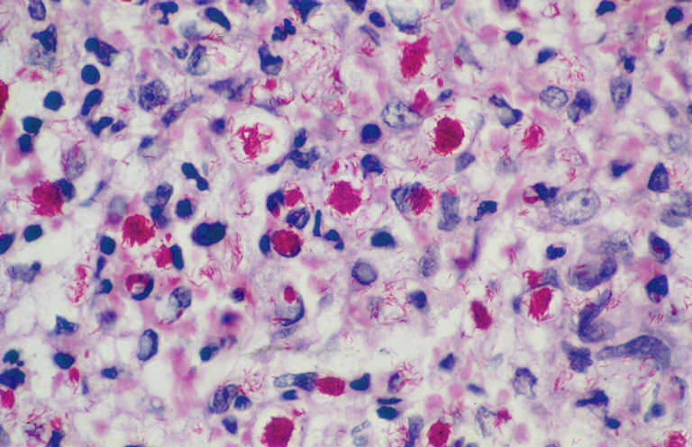
Morphological index
The percentage of living bacilli(solid staning bacilli) to the total number of bacilli in the smear.

Slide 40
Other smear techniques
Nasal smear
Nasal scrapings

Slide 41
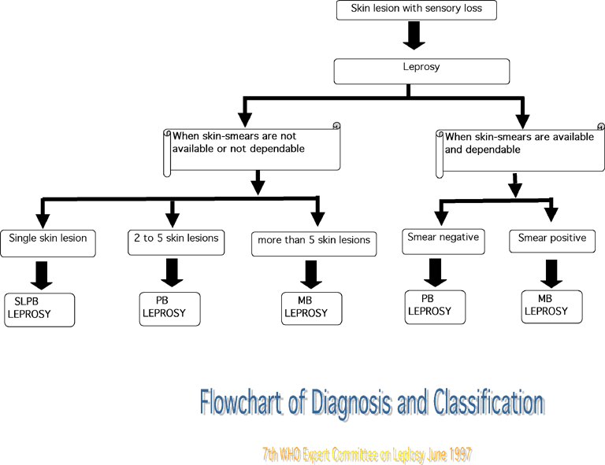

Slide 42
Clinical spectrum of leprosy
Immunity
Skin Lesions
No. of Bacilli
Slit skin test
TT
BT
BB
BL
LL

Slide 43
Skin Biopsy

Slide 44
Tuberculoid Leprosy (TT).
Histologically TT resemble tuberculosis.
Characterized by tuberculoid granuloma, made up of epitheloid cell in the center surrounded by abundant Langhans giant cells, lymphocytes and foci of caseating necrosis.
No acid-fast bacilli

Slide 45
Lepromatous Leprosy (LL)
Characterized by diffuse infiltration of foamy macrophages in the dermis.
Acid-fast bacill are present inside these foamy cells eighter singly or in globi.
Lymphocytes are scanty and giant cells typically absent.

Slide 46
Test for detecting CMI
Lepromin skin test :
To differentiate the two different forms of leprosy apart, but it is not used to diagnose the disease
Because:false negative and false positive

Slide 47
Lepromin Skin Test
Procedure to Lepromin Skin Test
A tiny sample of leprosy antigen is injected under the skin, usually in the forearm.
The skin gets pushed up, forming a small bump.
This is an indication that the antigen has been injected to the correct depth.
The site of the injection is marked, and is examined for reaction, first after 3 days(early reaction-Fernandez reaction:-redness and induration) and then again after 21 days(late reaction-Mitsuda reaction:-nodule>5mm).

Slide 48
Test for detecting antibobies
Fluorescent leprosy antibody absorption test(FLA-ABS test):-
Now widely used for identification of subclinical cases
92.3% Sensitive & 100% specific
Monoclonal antibodies
ELISA

Slide 49
TREATMENT

Slide 50
LEPROSY IS A CURABLE DISEASE Drugs used in Leprosy treatment
What are the three commonly used drugs?
Dapsone.
Rifampicin.
Clofazimine.
The combination of these three drugs is
known as Multi Drug Therapy (MDT)

Slide 51
MDT (Chemotherapy) renders Leprosy patients non-infectious. after three months of continuous treatment with dapsone or clofazimine, or after two to three weeks of treatment with rifampicin.
MDT, however, does not alter the damage done to an individual by M. leprae before MDT is started.

Slide 52
MDT for PB leprosy
6 months
Monthly dose
Rifampicin 600mg
Daily dose
Dapsone 100 mg

Slide 53
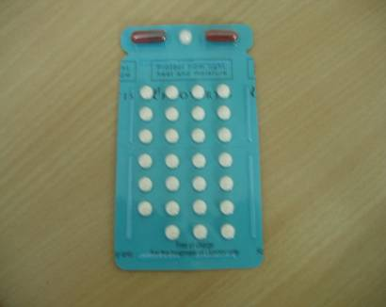
Multidrug Therapy (MDT) for Paucibacillary Leprosy (PB)

Slide 54
MDT for MB leprosy
12 months
Monthly dose
Rifampicin 600mg
Clofazimine 300mg
Daily dose
Dapson 100mg
Clofazimine 50 mg

Slide 55
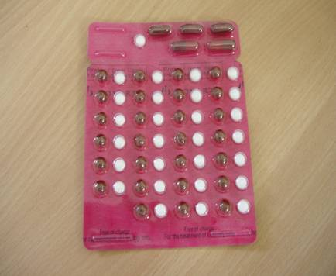
Multidrug Therapy (MDT) for Multibacillary Leprosy (MB)

Slide 56
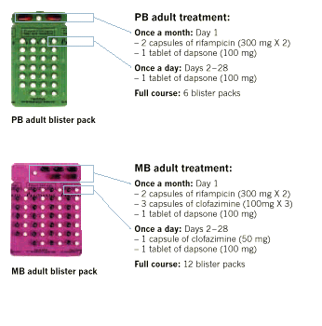
Multi Drug Therapy
6 months
24 months

Slide 57
OTHER DRUGS :-
Ethinamide and protionamide
Quinolones
Minocycline
Clarithromycin
ROM regimen-single lesion

Slide 58
COMPLICATIONS OF LEPROSY & ITS MANAGEMENT

Slide 59
COMPLICATION CAN BE CATEGORISED AS:
LEPRA REACTION
ADVERSE EFFECT OF ANTI-LEPROTIC DRUGS
DISABILITIES & DEFORMITIES
PSYCHO-SOCIAL PROBLEMS

Slide 60
LEPRA REACTION:
May occur before/during/after MDT.
Not caused by MDT.
Type1 (Reversal reaction)
Type2 (ENL)
Type I
Change in host CMI
Seen in borderlines
Skin and nerve lesions
Type II
Antigen antibody
Seen in LL & BL leprosy
Skin, nerve & systemic
involvement

Slide 61
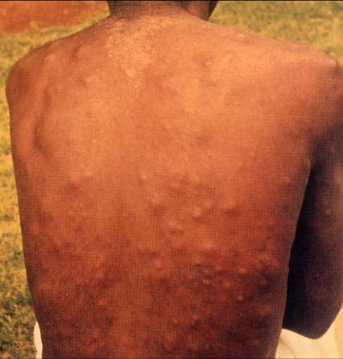
LEPRA REACTION
Treat ‘Reaction’ as a Medical Emergency:
Rest & Analgesics
DOC-Prednisolone(40-60 mg)
Taper gradually over 12-16 wks.
All need a detailed Neuromuscular assessment by a physiotherapist.
Erythema Nodosum Leprosum(ENL)
Erythematous.Tender .Subcutaneous.
Associated with fever & joint pains.
May be vesicular, pustular & may ulcerate
Treatment:with CLOFAZIMINE

Slide 62
ADVERsE EFFECT OF ANTI-LEPROTIC DRUGS:
DRUGS | MINOR | MAJOR
1. RIFAMPICIN | RED URINE | JAUNDICE
 | GIT UPSET | HEPATITIS
 | FLU LIKE SYNDROME | SHOCK
2. DAPSONE | GIT UPSET | DAPSONE SYNDROME
 | DRUG RASH | AGRANULOCYTOSIS
 | ANAEMIA | HEMOLYTIC ANAEMIA
3. CLOFAZIMINE | GIT UPSET | ACUTE PAIN ABDOMEN
 | DISCOLOURATION OF SKIN
 | ICHTHYOSIS

Slide 63
DISABILITIES
Disabilities such as loss of sensation and deformities of hands/feet/eyes occur because:
Late diagnosis and late treatment with MDT
Advanced disease (MB leprosy)
Leprosy reactions which involve nerves
Lack of information on how to protect insensitive parts
Only about 10-15% of leprosy affected person develop significant deformities and disabilities.

Slide 64
TYPES OF DEFORMITIES:
1) Specific deformities:
- b/c of local infection with M.Leprae
- seen most often in the face; facies leprosa(loss of eyebrow,nasal deformity), gynecomastia,less often in the hand and only occassionly in the feet.

Slide 65
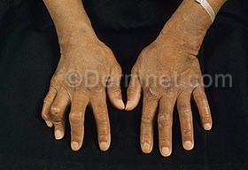
2) Paralytic deformities:
- result from damage to motor nerve.
-seen most often in the hand(claw finger),less often in the feet &occassionly in the face(lagopthalomos,facial palsy)

Slide 66
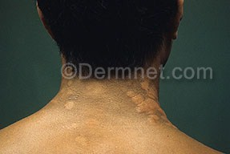
3)Anesthetic deformity :
Occur as a consequence of neglected injuries in part rendered insensitive b/c of damage to sensory nerve.
- Found most often on the feet and hand(ulceration,scar contrature,shortening of digits,&skeletal disorganization of foot)

Slide 67
Peripheral nerves
Sensory
Motor
Autonomic
Hypoaestesia / anaestesia
Muscle paralysis
Lack of sweating & sebum
Ulcers
Ulnar nerve Claw hand
Radial nerve Wrist drop
Lt. popliteal Foot drop
Post. tibial Claw toes
Facial lagophthalmous
Dry skin
Cracked skin
Ulcers

Slide 68
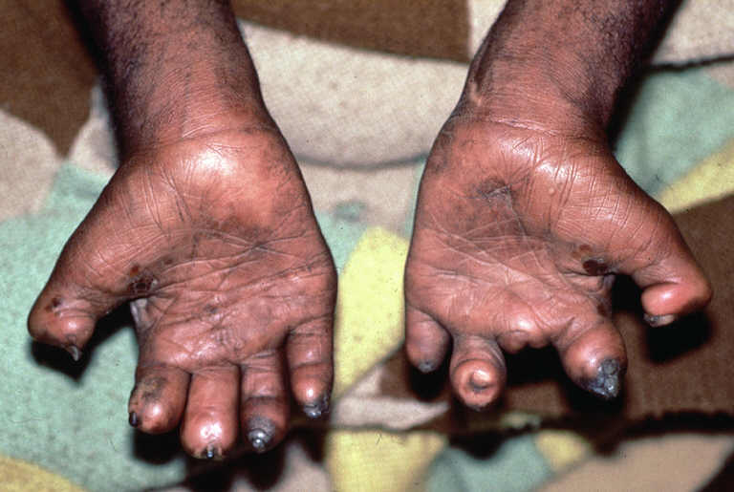
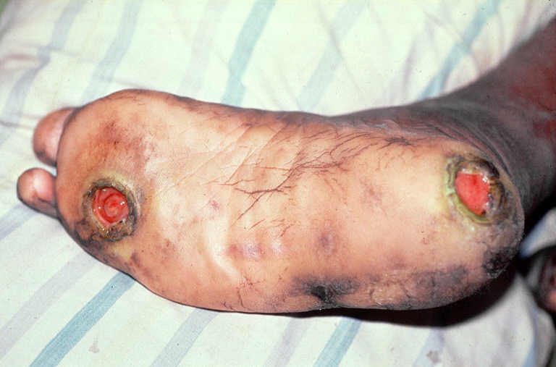
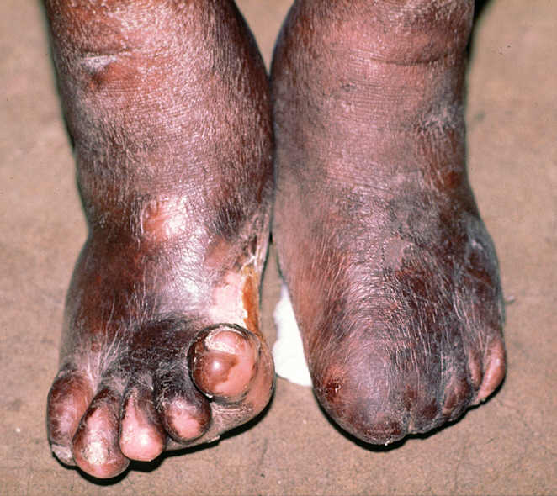
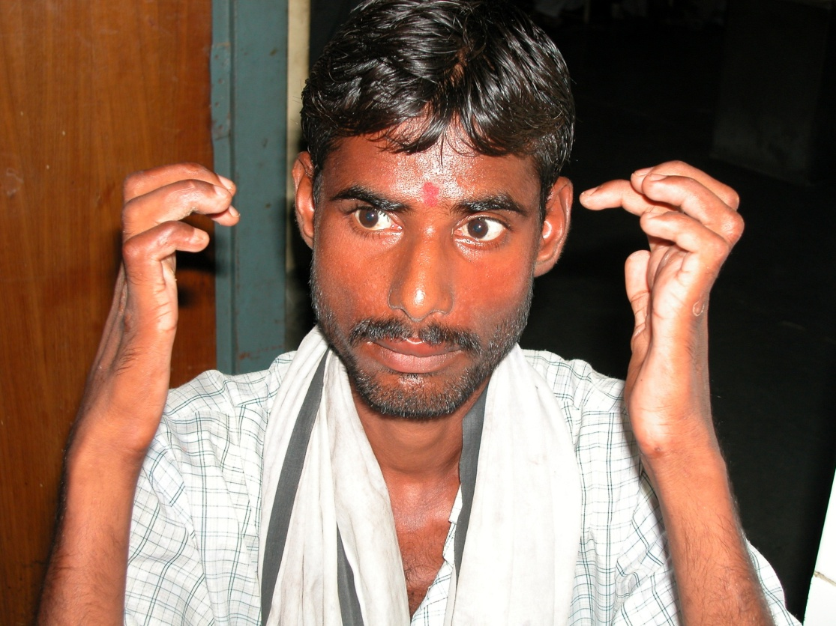

Slide 69
FOOT AND HAND CARE PRACTICE
Infected ulcer/Cracks
Wounds/injury
weakness/paralysis
Clean with soap & water
Rest & apply antiseptic dressing
Apply cooking oil/Vaseline
Soak in water
Clean and apply clean bandage
Protect when working/cooking
Oil massage
Exercises

Slide 70
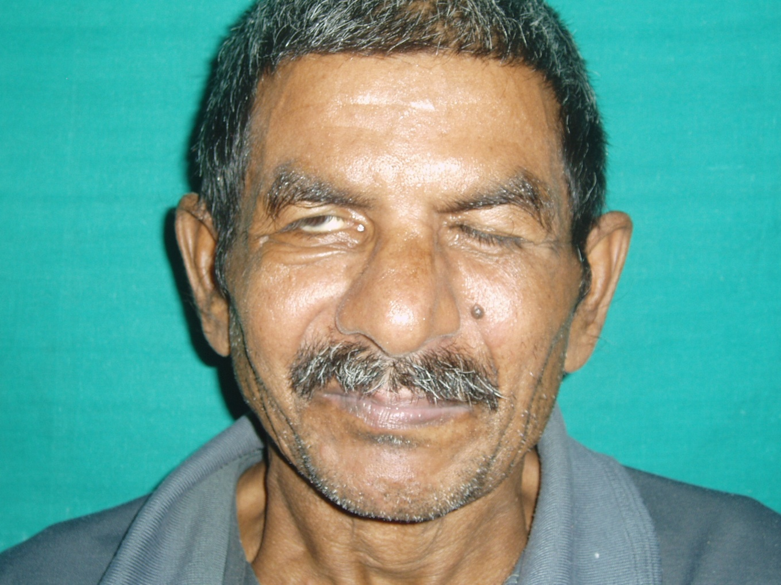
COMPLICATIONS OF EYE

Slide 71
Involvment of the ophthalmic division of the (5th.) trigeminal nerve
Corneal sensation imparment
Patients ignore injuries
keratitis, conjunctivitis and ulcers
Unable to close the eye (unbliking stare)
Lagophthalmos
Involvment of zygomatic & temporal braches of the (7th.) facial nerve.

Slide 72
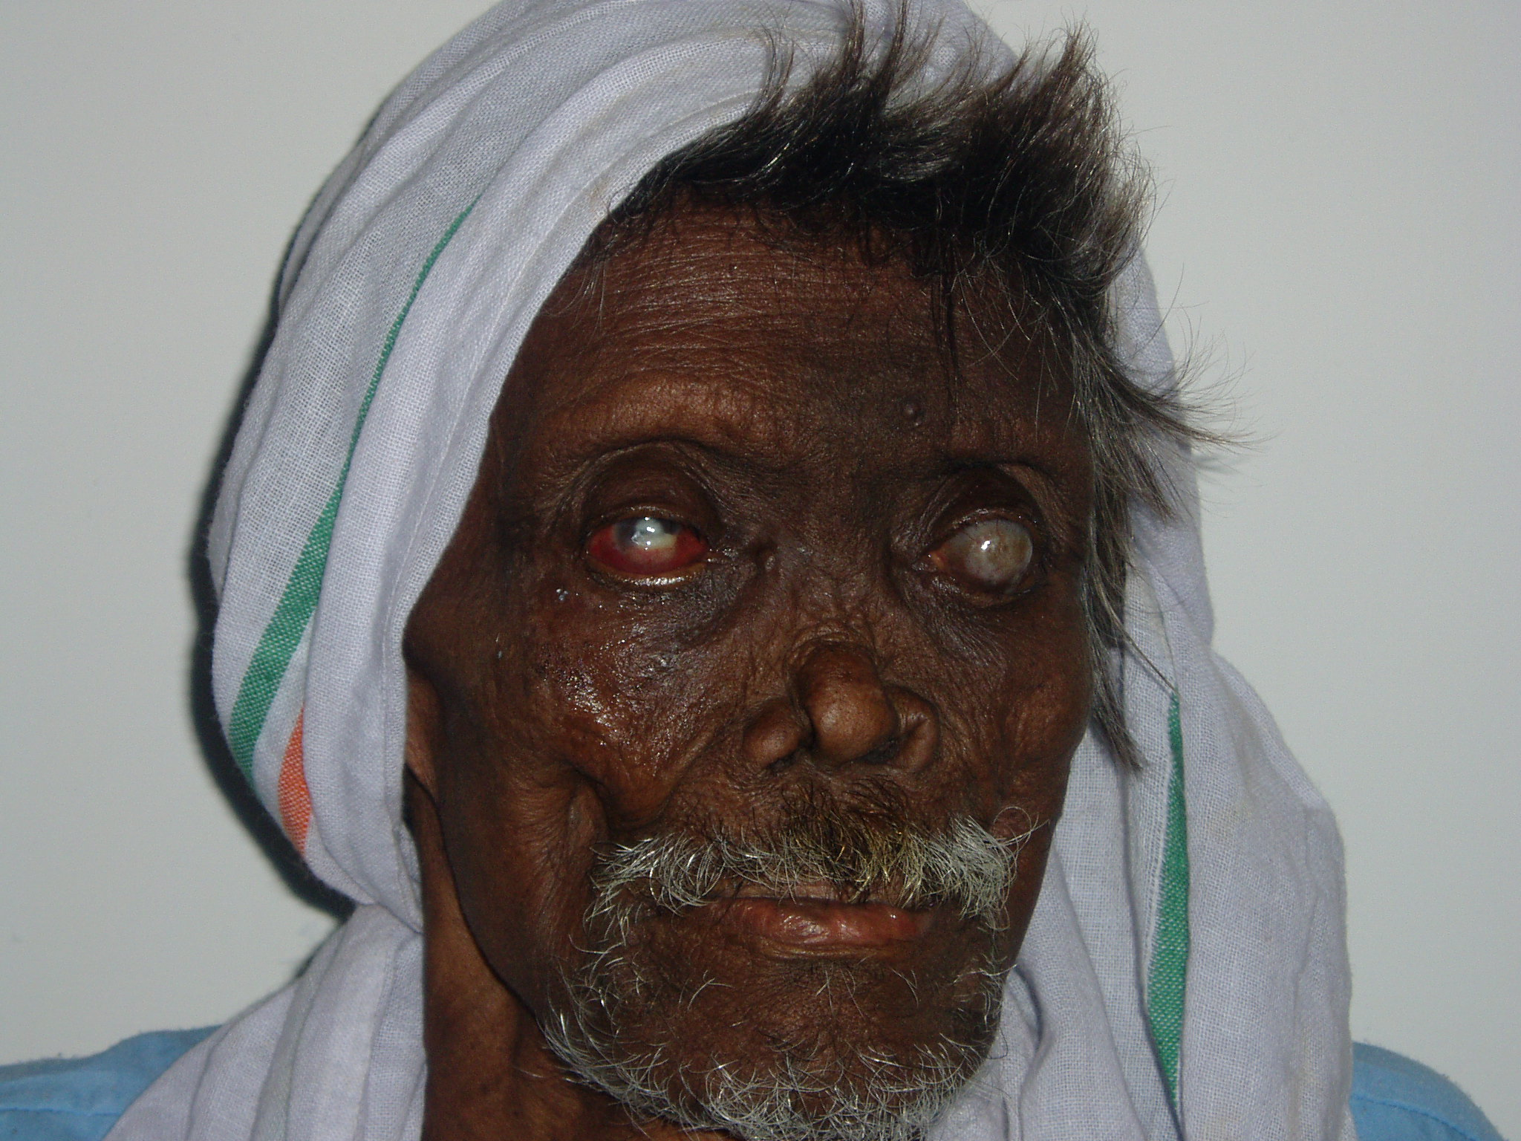

Slide 73
Care of eyes
Redness and pain
Injury to cornea
Difficulty in closing eye
Aspirin or paracetamol
Atropine and steroid ointment
Cover with eye pad
Apply antibiotic ointment
Refer
Tear substitute eye drops
Exercises
Dark glasses to protect
Refer

Slide 74
PSYCHO- SOCIAL PROBLEMS
-are related to widely held beliefs and prejudices concerning leprosy & its causes.
-they often develop self stigma,low self esteem & depression as a result of rejection and hostility,
-need to be referred for proper counselling.

Slide 75
Leprosy control

Slide 76
Methods of Control
Medical methods
Estimation of problem
Early detection
Multi drug therapy
Surveillance
Immunoprophylaxis
Chemoprophylaxis
Deformities
Rehabilitation
Health education
Social support
Programme management
Evaluation

Slide 77
Rehabilitation
Community based rehabilitation is recommended by WHO
Is a strategy within general community development for the rehabilitation, equalization of oppertunities and social inclusion of all people with disabilities.

Slide 78
Surveillance
For PB; clinically at least once a year for 2 years after treatment
For MB; at least once a year for 5 years after treatment

Slide 79
THANK YOU

